Slide 1
EPICS 2023 International Collaboration Meeting April 24th-28th
Erik Gottschalk - erik@fnal.gov
Denise Finstrom - finstrom@fnal.gov
Pierrick Hanlet - hanlet@fnal.gov
Lila Anderson - lila@fnal.gov

Slide 2
EPICS 2023 Local Organizing Committee
Erik Gottschalk
Denise Finstrom
Pierrick Hanlet
Lila Anderson
Bob Dalesio
Tech Support
Paul Bainbridge – PC Support
Josh O’Connell – Ramsey Auditorium AV
Gage Whittington – Presentation Logistics
Lynn Johnson – Ramsey Auditorium AV
Farha Bhimji – Zoom Support
Mike Souronis – One West AV
Blake Bittner – Curia II AV

Slide 3
Plenary Session Conveners
Eileen Crowley
Tia Miceli
John Diamond
Dennis Nicklaus
Anthony Tiradani
Beau Harrison
Site Access & Security
Joe Rogers
Beatriz Rodriguez
Melissa Huedem
Donna Iraci
Kim Pearson
Tim Wiley
Yesi Rubio
Griselda Lopez

Slide 4
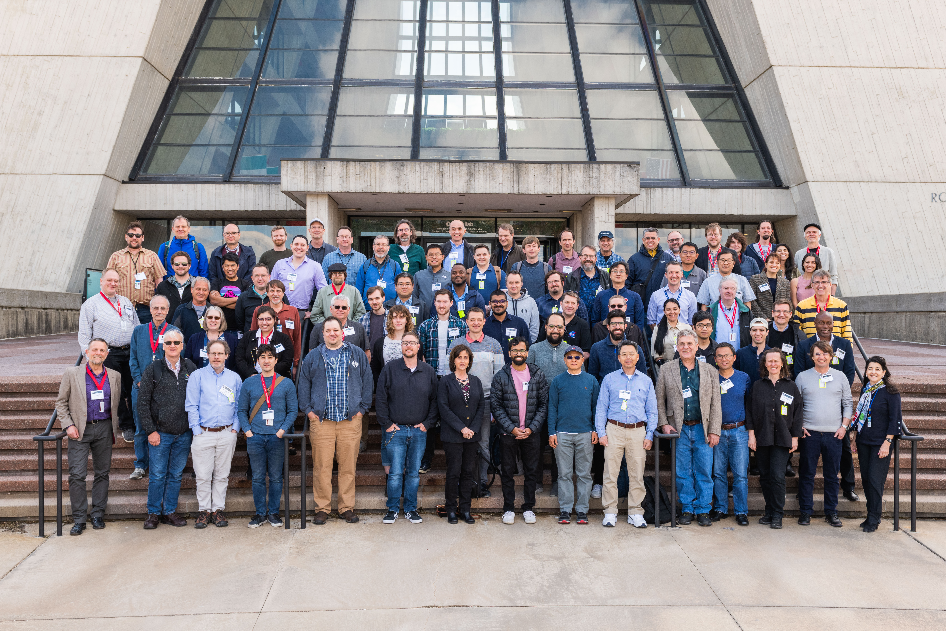
EPICS COLLABORATION MEETING 2023

Slide 5
Thank You
EPICS 2023 Planning Committee
Fermilab Site Security & Access Team

