Slide 1
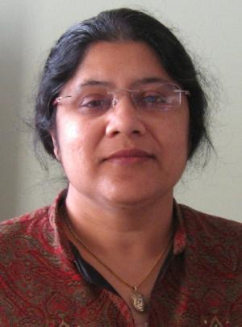
Meena in Run II
Robert Kehoe (SMU) **
Meenakshi Narain memorial symposium - march 3, 2023
** S. Jabeen, J. Hobbs, I. Iashvili, J. Qian, B. Klima, D. Denisov, T. Bose, K. Black, A. Schwartzmann, S. Protopropescu, P. Grannis

Slide 2
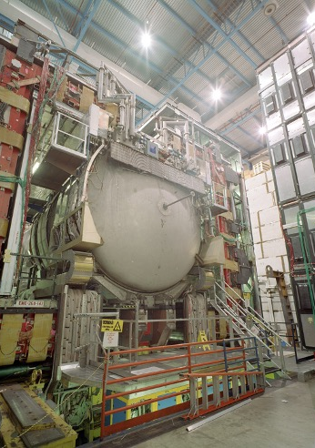
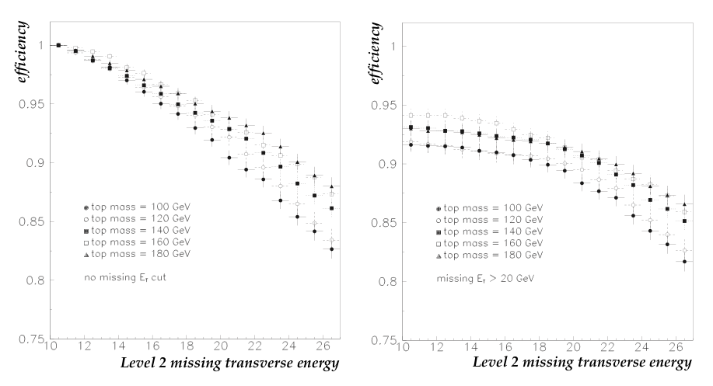
Trigger
Μεενα in d0 run II
Improve trigger rate while preserving efficiency
My first study with Meena in Top Group
What does a Meena project look like?
Well-informed
Thorough
Flexible enough for changing requirements
You know you accomplished something
It is used

Slide 3
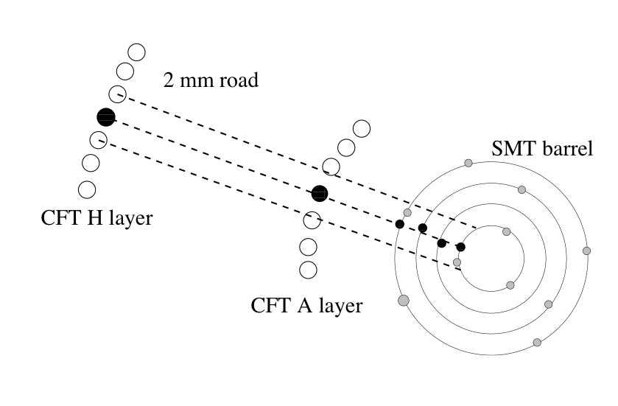
the silicon track trigger (STT)
Μεενα in d0 run II
Early work to identify science motivation of STT
Study in $Z→b\overline{b}$ simulation
Not an easy trigger to develop
Not originally part of upgrade plan
Cluster board became Meena’s responsibility
Wrote algorithms, integration, commissioning
Not a lot of hardware experience
Big change
Redefined self as person to deliver
Wonderful job getting hands dirty
Force of nature
Xilinx donated a large # of FPGAs for free/reduced price as she just kept calling
“Extremely strong contribution”
“Important role in everything”
Notes:
Trigger on inclusive bbbar final states
Seek unprescaled trigger with jet Pt > 15 GeV
Zbbbar:Should be able to reduce total top mass uncertainty by 35%
From reduction JES uncertainty

Slide 4
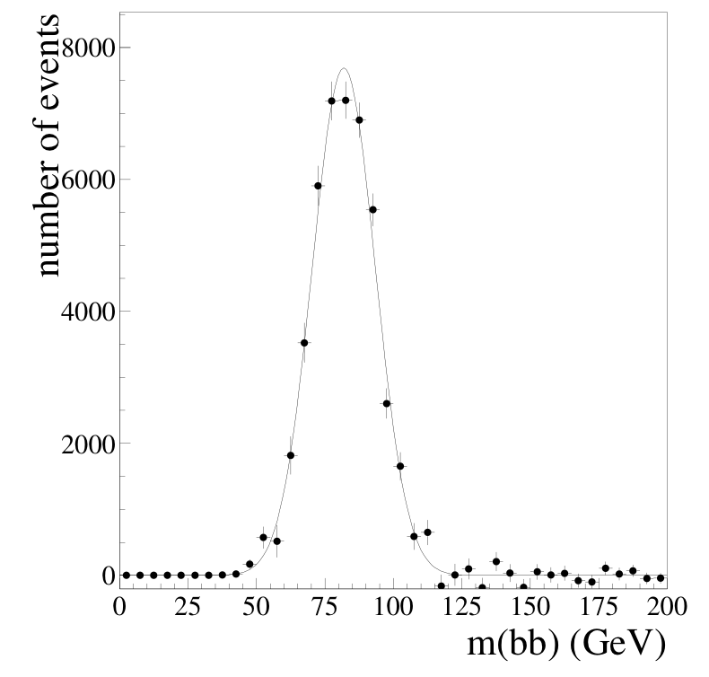
Role in Run 2
Μεενα in d0 run II
Early commissioning
Organized shifts to help test offline code from SUNY
Involved On 9/11 first integration tests @ BU
Intense period
Not a lot of testing before
Run parasitically
Biggest overall contribution
Make sure on time
The person putting pressure
2006 shutdown Work on trigger boards
Involved in trigger till end of Run 2
Fly in, work to late night every day, fly out
Important for understanding background distributions
Used in many Higgs triggers
Supported final D0 analyses
B_s oscillations analysis
need cross checks, BG samples
Critical at analysis stage
Notes:
Worked with Kevin Black on integration and commissioning

Slide 5
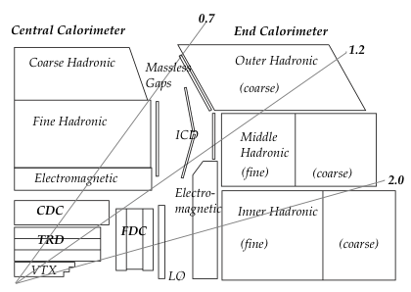
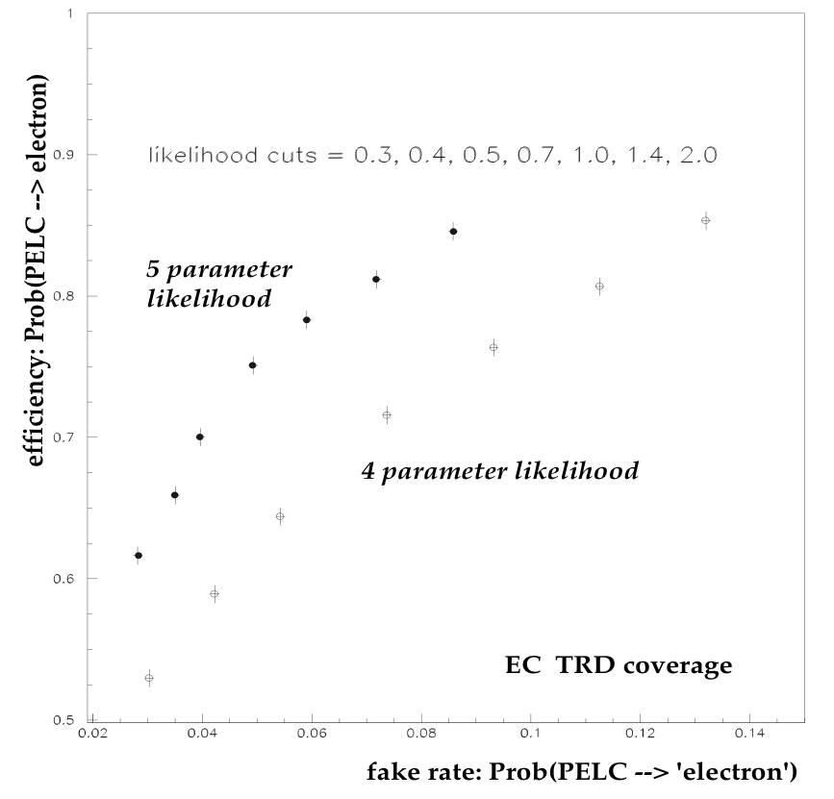
Particle ID and Reconstruction
Μεενα in d0 run II
Run 1 TRD in forward region
Possibly a bridge too far…
Not what designed for
How does Meena approach?
Pragmatic: TRD software may not be up to it
Very high standard of correctness, usefulness and usability
Very thorough

Slide 6
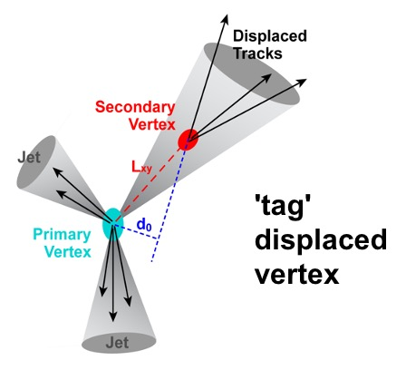
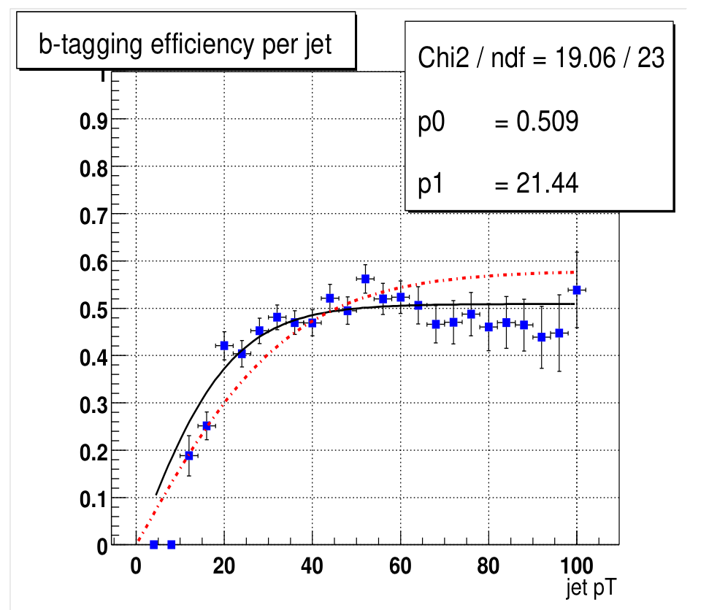
B-tagging in Run II
Μεενα in d0 run II
Convenor of Vertexing group prior to Run 2
Wrote new code for secondary vertex tagger (SVT)
2 years of software development and simulations
Day and night work
Focus was using b-tagging to ID top quarks
B ID convenor to 2005
“A driving force”
Notes:
Serban just covers preparation before Run II with MC
He will cover the framework
Worked with A. Schwartzmann 2001-2005

Slide 7
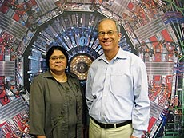
The HiT group - co-convenor
Μεενα in d0 run II
Start search for Higgs
Exploit similarities in top and Higgs characteristics
Use experience of what worked in Run 1
Build group, build structure, add more to plate
Recruit people, energetic
Motivated and challenged people
Would go around to figure how you are progressing
Eg. MC generation —> unstick it
We need it in 2 weeks
help you get thru physics bureaucracy
Get things moving
Story all thru her career
Set expectations high
Then keep with it — not absentee
Notes:
Meena as Gandalf
Everywhere
Able to do whatever needed

Slide 8
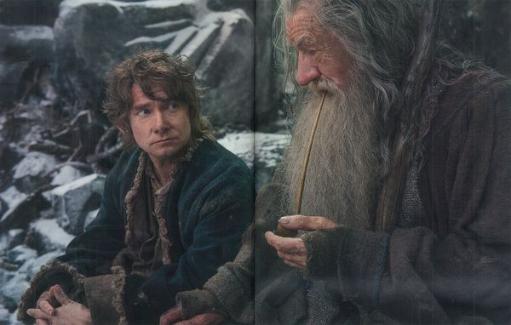
Μεενα in d0 run II
Notes:
Meena as Gandalf
Everywhere
Able to do whatever needed

Slide 9
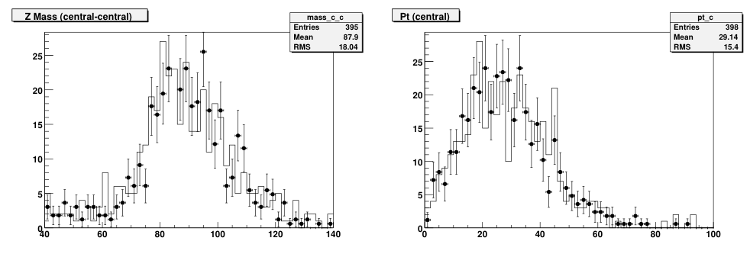
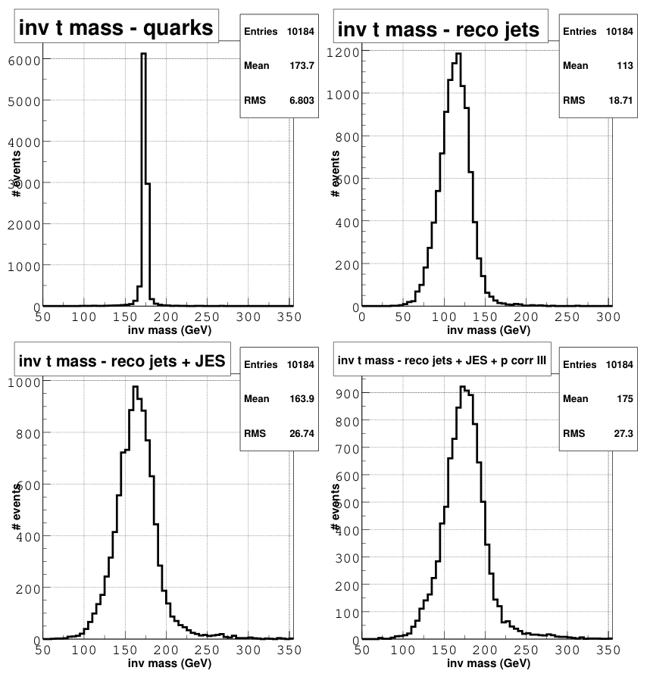
Top quark Mass early in Run II
Μεενα in d0 run II
lumi used 49.5 and 40.0 pb-1
Testing and quantifying the ingredients
muon, jets, electron, Etmiss performance
jet parton corrections
Matrix element analysis very popular
Pursue template approach instead
Resisted top group convenor
Simpler analysis: easier to understand while learning the new detector and data
Computationally fast
Better stat. Uncertainty lost due to large systematics (eg. JES)
Establish something that works first, then do more complex analysis

Slide 10
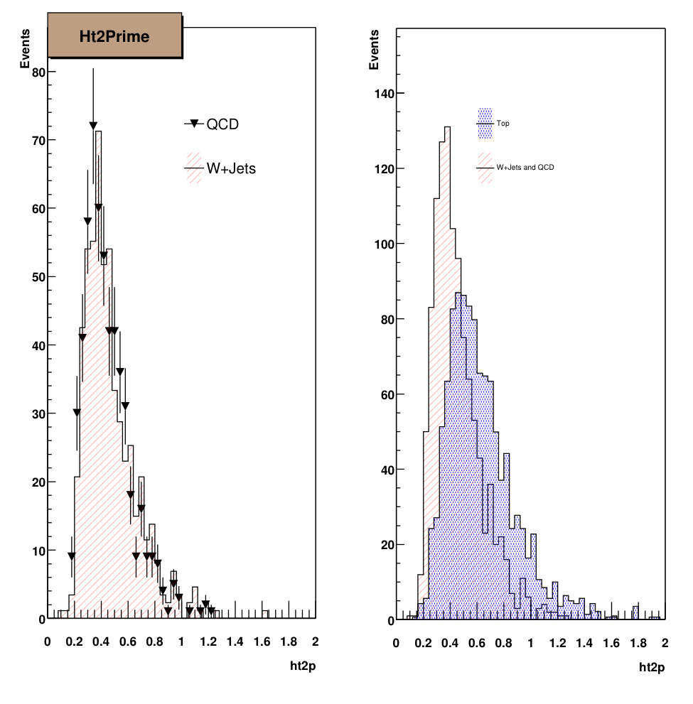
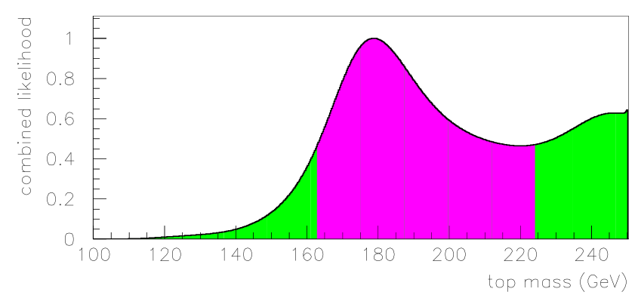
Top quark Mass
Μεενα in d0 run II
Two analyses
topological variables
Btag analysis
first D0 top mass effort with b-tagging
Made sure people worked on this got credit and it was presented adequately
Problem of stuck code
Anecdote: trouble with code that needed Fortran: stuck
Meena understood what to do, could look at the code and work out the problem
Pushed whole thing along
“Felt protected”
Notes:
2-3 years: too little data and difficulty understanding it
2004 finally enough data to make sense
Could see peak in btag sample
Template and ideogram methods first, ME later
Anecdote: trouble with code that needed Fortran: stuck
Meena understood what to do, could look at the code and work out the problem
Pushed whole thing along
2004 could see peak in btag sample
Felt protected

Slide 11
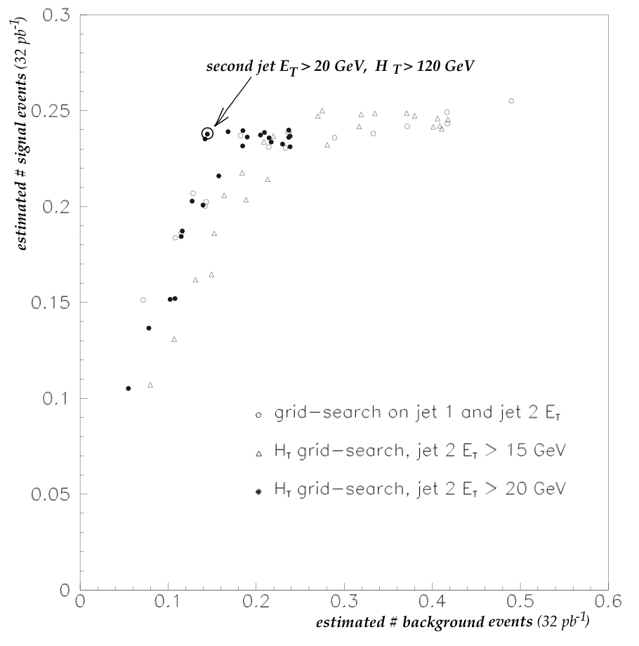
Searches for Top
Μεενα in d0 run II
Search for top-antitop
High mass top optimization
Very orderly development guided by Meena
Look at new variables
Event shapes, kinematic calculations
What works?
What can be modeled adequately
Some crazy ideas got shot down
Systematic scan thru cut space
Figure of merit at each operating point
Objective determination of optimal point
Once you pick it, stick with it!

Slide 12
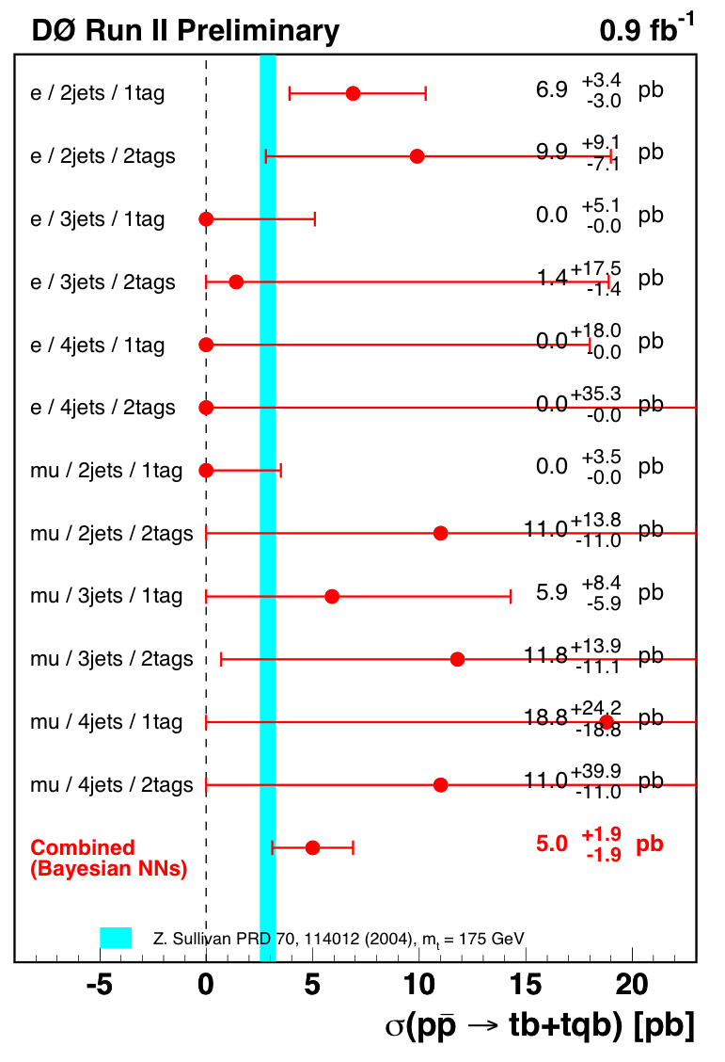
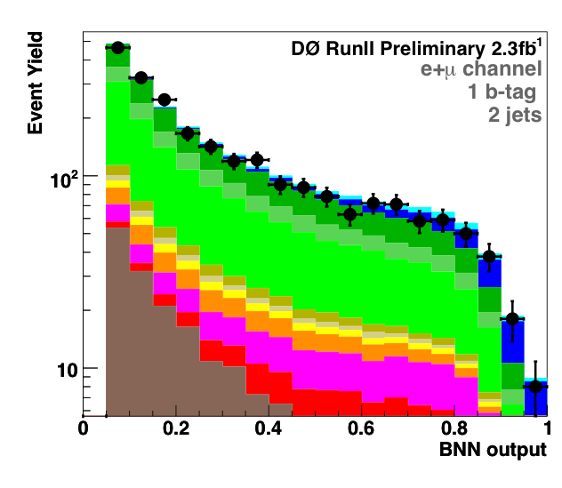
Search for single top
Μεενα in d0 run II
One of three methods: Bayesian NN
Others already going and well along
A very active role, technical details
Hands-on, running scripts, talking to others
Learned from Meena: vision for automation
Start from single thing, build up whole analysis
Thru Observation in 2.3 fb-1
“Never give up”
Notes:
Probe of Wtb vertex

Slide 13
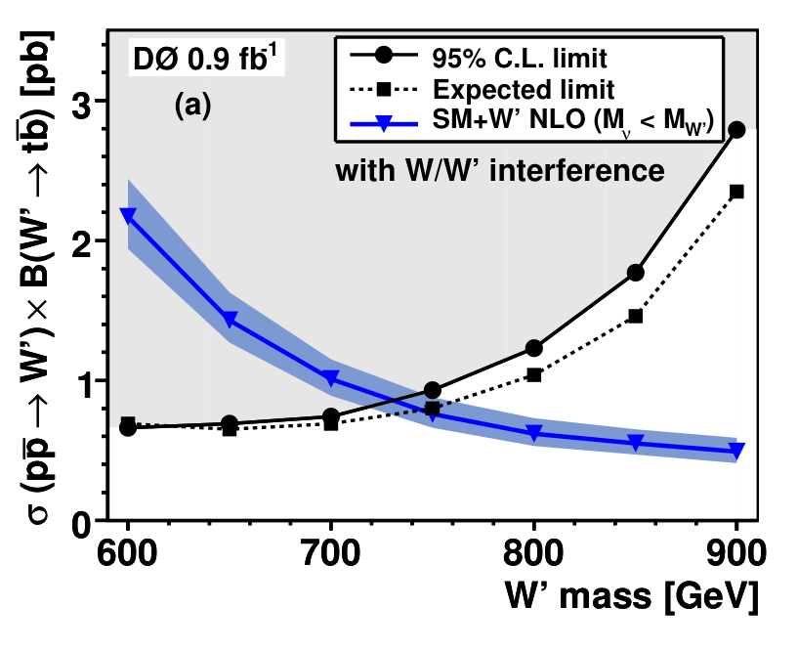
Search for W’
Μεενα in d0 run II
Straightforward evolution of single top
Effort to 2010
Interference between W and W’
Can yield lower rate
Few included interference (still rare)
Meena worked well with theorists
Moscow State produced signal modeling
Use BDT for analysis
First analysis with large data sample (2008)
“pretty hands on”
Notes:
W’ analysis
0.9fb-1, 5602 note
limits for W’>731 GeV (738/761) depending on MW’ compared to M_nu_R
constraints on coupling to fermions as function of W’ mass

Slide 14
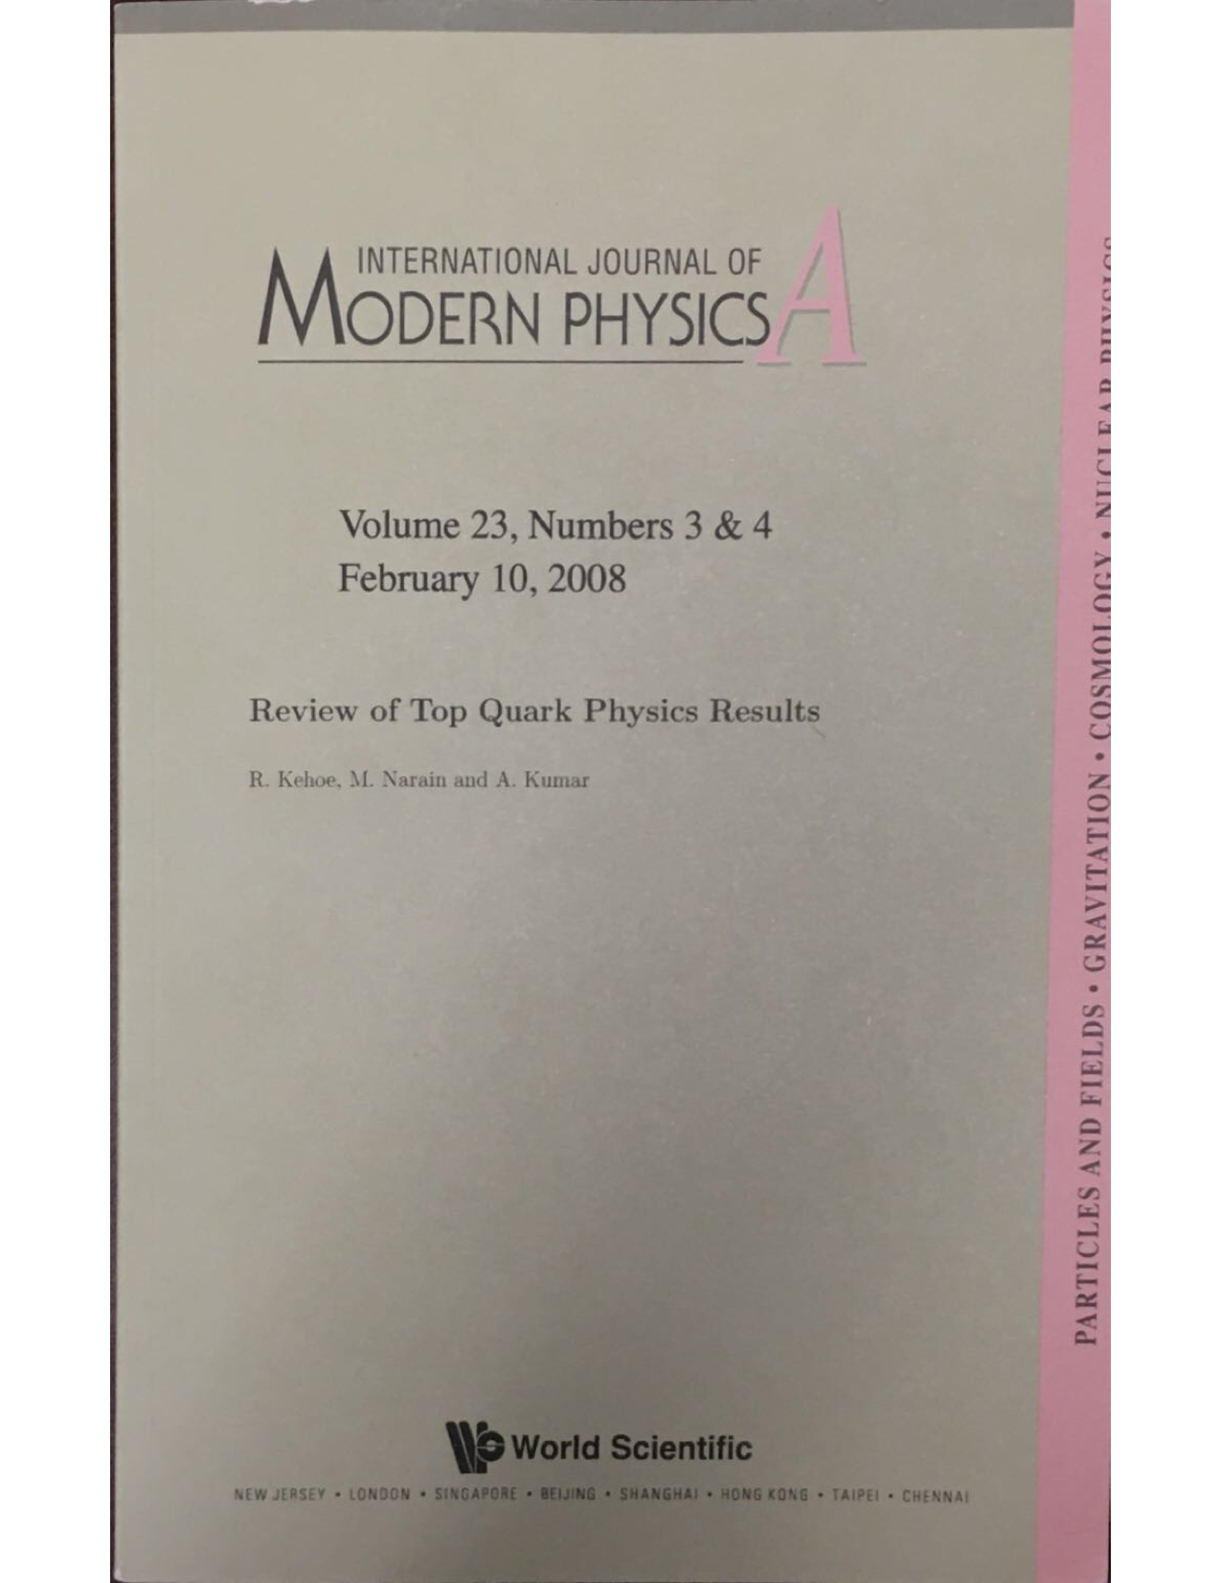
Review of Top Quark Physics
- preface with story on top quark review article
Μεενα in d0 run II
Wanted comprehensive review
Initially asked Meena, started in 2006
LHC results hoped for, but only Tevatron in end
Meena wanted to do single top
Excellent, concise review of very complex analysis
Includes ‘evidence’ results
Also did portions of rest, including parts of
top properties
nonstandard production and decay, incl. W’
Editing/proofing of whole
Very enjoyable collaboration
Focused on making it the best it could be
Intl. Journ. Of Modern Phys. A, 23:353 (2009)

Slide 15
Other contributions
Μεενα in d0 run II
Higgs associated production - WH
Technicolor search - $ρ_{T},ω_{T}→e^{-}e^{+}$
$t\overline{t}$ cross section - topological selection
$t\overline{t}$ cross section - b-tag selection
Top width measurement
$\left|V_{tb}\right|$ measurement
$t\overline{t}$ resonances
$t\overline{t}$ forward-backward asymmetry
And those she has taught:
Balamurali V. (Notre Dame)
Robert Kehoe (Notre Dame)
Sailesh Chopra
Ariel Schwartzmann (Buenos Aires)
Kevin Black (BU)
Lorenzo Feligioni (BU)
Monica Panglinan (Brown)

Slide 16
Farewell
Μεενα in d0 run II
“Work ethic 2nd to none”
“Great example for women, can have everything”
“An unstoppable force”
“Would not suffer a fool”
“Almost seemed invincible”
“Loved challenges”
“Very good at organizing people”
“She’s right!”
“Drives everyone to be more productive”
“You are not alone, we will help you”
“A brilliant physicist!”
“A great loss”

