Slide 1
DUNE Framework Requirements and Roadmaps
Andrew Norman & Paul Laycock
HEP-CCE Complex Workflows
December 2022

Slide 2
Background
DUNE is a combination of:
Massive LArTPC modules located at the far site (Sanford Underground Lab) in South Dakota
Combination of multiple technologies of high rate/granularity detectors at near site cavern (FNAL, Bativia IL)
And a mega-Watt+ neutrino beam (FNAL)

Slide 3
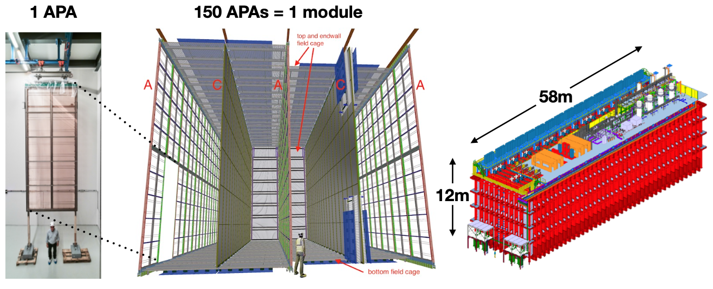
Data Structure
The DUNE data is different from prior large HEP detectors due to the readout technology and readout timing structure
A full detector module is sub-divided into 150 “Anode Plane Assembly” (APA) regions comprised of 2560 wires
Sampling frequency is 2 MHz (500ns) @ 12-bits
Readout duration is ~6ms (12000 samples)
Data volume ~40 MB/APA/readout, or 6 GB/readout uncompressed
Characteristic Event Stream: Slow (~.8 Hz), LARGE Events
Compression and zero suppression help but there are many caveats
4 Modules total for full DUNE concept

Slide 4
Different Frameworks for Different Jobs
There are currently 2 primary framework that DUNE uses for simulation, sensitivity studies and analysis of [ProtoDUNE] data.
Art/LArSoft
A combination of traditional ”event-loop” data processing framework (art) and highly integrated algorithms & customized data structures toolkit for liquid argon TPC data (LArSoft).
Process/thread level parallelism, modular components, scheduling based on data product dependency trees
In use across large array of experiments (DUNE, MicroBooNE, SBND, g-2 [art], mu2e [art], NOvA [art]
CAFAna
Traditional TTree based ensemble analysis framework
Carries spill-by-spill exposure information with the data
Include re-weighting and systematics toolkits (tuned to neutrino analysis)
Used by NOvA and DUNE
Both frameworks are C++ based

Slide 5
Framework Outlook
Already we have seen deficiencies with both Art/LArSoft and CAFAna
Memory scaling and footprints
Inflexible ”event” data model
Parallelism and access to accelerator hardware
Computational costs of systematic variations etc…
Disconnected from more industry standard Pythonic toolkits
We know that these frameworks will need to be either expanded or replaced prior to the start of Far Detector operations
Ques: What are the needs/requirements of the next generation of frameworks?

Slide 6
Framework Considerations
We generated from PHYSICS USE CASES, a set of realistic requirements that a data processing framework needs to be able to provide for DUNE.
Ref: DUNE-doc-21934. (available by request)
Incorporated into full DUNE Computing TDR (Chapter 5)
This report was reviewed by DUNE, by the LBNC and by the HSF Frameworks committees.
In particular we were trying to identify areas where DUNE needs did NOT overlap with existing technologies or were in some way novel and require R&D
Many novel requirements were identified, almost all were driven by the readout and data structure of the LArTPC technology (i.e. BIG readout trigger windows) and by “long readout” physics channels (i.e. supernova neutrino bursts)
Full report is available upon request

Slide 7
Major Novel Requirements
Memory Footprints
Full module readout windows are too big to be effectively treated as monolith analysis objects on most platforms (i.e. 6 GB data objects getting manipulated through multiple levels of transforms exhausts common compute node memory quickly)
But the data is naturally divisible along APA boundaries
Gives a natural 150-way parallelism to compute intensive DSP and Reco tasks
Need framework that can “subset” data and contextually switch the primary “data-atom”
Implies a more complex single node scheduler OR a multi-node scheduling capability
Need more advanced memory management than current frameworks provide
Need to be able to re-assemble events back into a full trigger record after DSP and partial Reco
i.e. classic reduction operation

Slide 8
Major Novel Requirements
Contextual switching also brings with it more complex accounting infrastructure
Neutrino analysis uses ”spill-by-spill” exposure accounting (i.e. not averaged lumi)
For near detector data (with significant interaction pileup) this requires careful accounting to avoid double counting and ensure proper normalizations
Multi-layer accounting and accounting w/ each data atom
Due to the TPC drift structure there is a need to ”stitch” sidebands onto events and across 6ms drift windows in the readout for longer readout events
This makes the trigger records non-independent and forces sequential processing in certain cases
This is a big deal. Essentially this breaks the “embarrassingly parallel” event model
Can be relieved w/ data duplication @ DAQ level**
**Huge can of worms

Slide 9
Major Novel Requirements
Advanced memory management and data product propagation and paging
Data views and transforms effectively need to be “page-able” to fit within realistic computing hardware.
Many workflows where views of the data need to be generated, passed to additional downstream modules, operated on, but then these intermediate views need NOT be persisted
Need facilities to “drop” the data products, but still retain provenance information for other products which were derived from the expunged view
Advanced management of accelerator hardware and/or external functionality
DUNE data naturally lends itself to matrix like operations and transforms. These are highly accelerable using GPU hardware. Similarly AI/ML operations are highly accelerable or can be externally hosted and called out to.
Concurrent (parallel) operation and scheduling need to be natively integrated in the framework to allow this to work without major blocking/fencing costs.
Parallel I/O (specifically write operations) for APA subsetting and data reduction operations

Slide 10
Major Novel Requirements
Full event level physics reproductivity in simulation and data analysis
This implies
deterministic parallelism safe random number generators
Execution order “commutation” of non-dependent modules. (i.e. AB |data> = BA |data> if A and B have no dependencies)
Configuration language level coherence
Ability to specify/override execution ordering in the scheduler
Thread-safety
“The framework must be able to schedule thread-safe and non-thread-safe task modules, while ensuring coherence of the data, memory and I/O systems”
This actually implies needing mechanisms to tag work as non-parallel and to set fences within the framework. It also implies restrictions regarding combining different parallelism toolkits.

Slide 11
And many more requirements….
There are 43 separate (non-trivial) requirements that were identified by the framework taskforce
These were all distilled into the Computing CDR and have been refined by the HSF report and by internal discussions
We need to develop a realistic plan for how we accomplish this
Most likely path is to build off of an existing framework or toolkit
Retro-fit path (i.e. retro-fit art/LArSoft with different scheduling components)
Design and reuse path (i.e. Design a new framework, but reuse module components from art/LArSoft which already satisfy the requirements and are compatible with the new design)
This is where we are in the timeline

Slide 12
But…..
We do have a number of different prototypes and projects underway
FNAL-LDRD (Lead by Kyle K.) looks at developing new scheduling techniques
HDF5 I/O support for dunesoft (art/LArSoft) output and for DAQ data
Pythonic parallel analysis tools framework (SciDAC and DoE SCGSR supported) to speed up analysis (and make it more compatible with analysis facilities and HPC environments)

Slide 13
Neutrino Data Filtering & Histogramming
 | Grid Computing (current) | HPC (Future)
Language | C++ | Python
Data Format | Nested Tuples/ROOT [across O(100k) files] | Multi-Index Tables HDF5
Data Processing | Event Loop | Columnar
Scalability | Limited by # of discrete files | Strong Scaling (demonstrated to O(10⁶) ranks)

Slide 14
HDF5 File Format Support
ROOT serialization is the default in our current frameworks, but has limitations in both scalability and access speed.
DUNE and NOvA have both added support for HDF5 data formats (and this looks to be the future)
Advantage is organizational & parallel I/O access
Effectively allows columnar analysis patterns w/ strong scaling behavior
Ideal for end stage datasets and dataset hosting

Slide 15
Pythonic Analysis
Move to HDF5 datasets also allow for pythonic analysis tool suites to be leveraged.
PandAna is a next-generation CAFAna prototype
Combines Pandas dataframes with data parallel HDF5 access and MPI compute/reduction distribution
Includes similar accounting and re-weighting/re-normal- ization functionality for neutrino analysis
Exhibits near perfect strong scaling on realistic neutrino cross section analysis

