Slide 1

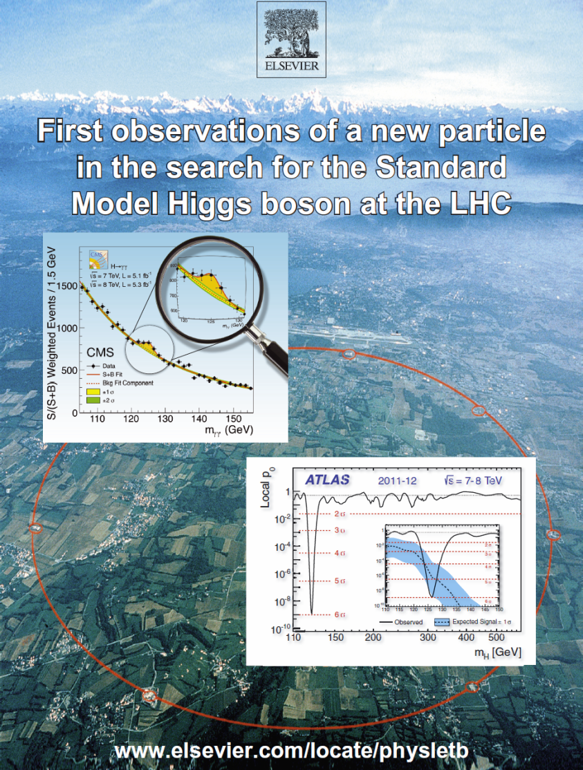
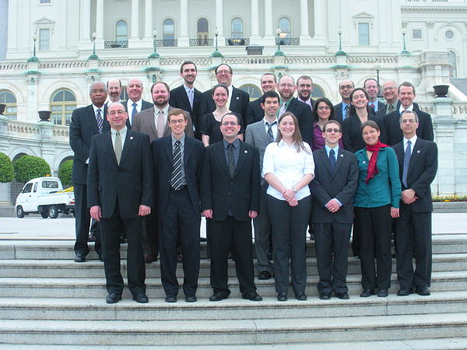
US LUEC Meeting
US LUO Annual
Meeting, Fermilab
October 18-20, 2012
Notes:
1

Slide 2
US LUO Executive Committee
2013 Membership (2 Year Terms)
Name Institution Collaboration Term Expires
Darin Acosta Florida CMS 2014
Ken Bloom Nebraska CMS 2014
Tom LeCompte Argonne ATLAS 2014
Usha Mallik Iowa ATLAS 2014
Sheldon Stone Syracuse LHCb 2014
Julia Thom Cornell CMS 2014
Daniela Bortoletto Purdue CMS 2013
Sridhara Dasu Wisconsin CMS 2013
Sarah Demers Yale ATLAS 2013
Sandor Feher Fermilab LARP 2013
Harvey Newman Caltech CMS 2013
Michael Tuts Columbia ATLAS 2013
Observers [Youth, Gender, Exp. Balance]: M. Hurwitz, Y. Maravin, J. Harris, J. Klay. Totals: CMS 6+1, ATLAS 4+1, LHCb 1, LARP 1, ALICE 0+1
+ Darin Acosta (ACCU), Jen Nahn (Webmaster through Nov. 2011)
Ex-Officio: US ATLAS and CMS PMs, Deputies, CB Chair, IB Chair
Thanks to: Joey Huston, Boaz Kilma, John Huth, Jane Nachtmann, Randy Ruchti
2
Notes:
2

Slide 3
US LUO Executive Committee
2012 Membership (2 Year Terms)
Name Institution Collaboration Term Expires
Daniela Bortoletto Purdue CMS 2013
Sridhara Dasu Wisconsin CMS 2013
Sarah Demers Yale ATLAS 2013
Sandor Feher Fermilab LARP 2013
Harvey Newman Caltech CMS 2013 (2012 Chair)
Michael Tuts Columbia ATLAS 2013
Joey Huston Michigan State ATLAS 2012
John Huth Harvard ATLAS 2012
Boaz Klima Fermilab CMS 2012
Jane Nachtman Iowa CMS 2012
Randy Ruchti Notre Dame CMS + NSF 2012
Sheldon Stone Syracuse LHCb 2012
Observers [Youth, Gender, Exp. Balance]: M. Hurwitz, Y. Maravin, J. Harris, J. Klay. Totals: CMS 6+1, ATLAS 4+1, LHCb 1, LARP 1, ALICE 0+1
+ Darin Acosta (ACCU), Jen Nahn (Webmaster through Nov. 2011)
With Thanks to: Kevin Burkett (Fermilab/CMS), Al Goshaw (Duke/ATLAS)
Ex-Officio: US ATLAS and CMS PMs, Deputies, CB Chair, IB Chair
3
Notes:
3

Slide 4
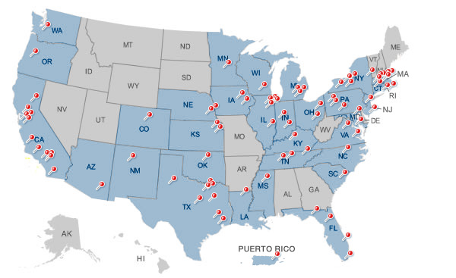
ACCU News
US LUEC
Issues for Discussion
Our 2012 Meeting: Participation and Finances
US LUA: Proposed to be Hosted by URA
  Uniform Nonprofit Assoc. Act
  US LUA Articles of Assoc.
  Bylaws
2012-13 Funding Campaign
  Review of Appeal Letter
Our “Agenda”: How to better
serve our community
  Preparing New Students/Postdocs
  for CERN; living in CH or France
  Well-being of our students
  at CERN
  Working conditions, burotels
US LUO Webmaster
2013 DC Trip
http://www.uslhc.us/The_US_and_the_LHC/
Collaborating_Institutions

Slide 5
CERN ACCU, US ATLAS and US CMS
and USLUO
http://cern.ch/ph-dep-ACCU/
“ACCU is the forum for discussion between the CERN Management and the representatives of CERN Users to review the practical means taken
by CERN for the work of Users of the Laboratory.”
 Our Representative is Darin Acosta
USLUO has “a focus on how best to enhance scientific participation in the discoveries expected from [LHC] research…”
US ATLAS and US CMS Managements also work to assist their users: the issues discussed by ACCU can be collaboration matters, or US LUO matters. Partly by agreement, partly because of who has the funding.
Pro-Active CERN DG
Recent Issues: Master Plan to 2030, to Accommodate more users
with better facilities and infrastructure
New Service Desk: 7777; http://cern.ch/service-portal
Housing: Online booking; evolution of occupancy and capacity
Day Care: http://www.lejardindecapucine.com/
Transportation: Bus and Tram; Car Sharing; Bike Sharing
Pending/Upcoming Issues: Students’ work environment and well-being;
Lack of office space and increased use of “burotel” common areas
5
Notes:
5

Slide 6
ACCU News
US LUO Host Organization
and Funding
US LUO does not have a host laboratory: unlike Fermilab UO, SLUO
Goodwill based funding served us well in the early years
but cannot sustain us
  We are grateful to Fermilab, LBNL and Argonne for supporting our Annual Meetings (in 2010-12 we also recovered a few $k in fees)
  Thanks to DPF and to the Lab Directors of Fermilab, Argonne, BNL, LBNL and SLAC for Supporting our 2009-12 DC Trips !
We need to be Self-Sustaining
  A home base, funding for operations, and staff help (~1/2 FTE)
  Need a Tax Free Host Organization to collect contributions
  We need to maintain our website; support add’l DC Trips (APS, NUFO),
  LUO in Nat’l Events, student travel to meetings, Outreach, Etc.
We finished exploring becoming an APS Unit: not a match
Working towards having URA Host US LUO
  A natural fit; initial responses (Bernthal; Cehelsky) Accommodating
  Major milestone this year to achieve this: establishing our legal existence by forming the US LHC Users Association

Slide 7
ACCU News
US LHC: 67 of 83 US Universities in URA
Alabama
Arizona
Caltech
UC Davis
UC Irvine
UCLA
UC Riverside
UCSD
UCSB
Colorado
Yale
Florida State
Florida
Chicago
UIC
UIUC
NIU
Northwestern
Indiana
Notre Dame
Purdue
Iowa
Iowa State
Johns Hopkins
UMd
BU
Harvard
MIT
Northeastern
Tufts
MSU
Michigan
Wayne State
Minnesota
Nebraska-Lincoln
Princeton
Rutgers
New Mexico
SUNY Buffalo
Columbia
Cornell
Rochester
Rockefeller
SUNY Stony Brook
Syracuse
Duke
Case Western
Ohio State
Oklahoma
Oregon
Carnegie Mellon
Pennsylvania
Pittsburgh
Brown
South Carolina
Tennessee-Knoxville
Vanderbilt
Rice
Southern Methodist
Texas A&M
Texas Tech
UT Arlington
UT Austin
UT Dallas
Virginia
Washington

Slide 8
US LUO Proposal to URA
We propose that URA be US LUO’s host organization, to help it carry out
its annual activities, including:
Annual trips to Washington, DC, to meet with policy makers in Congress and at OSTP, DOE Headquarters, OMB, the DOE Office of HEP and NSF. US LUO has established a strong tradition of coordinating with the Fermilab UEC and SLUO, starting with briefings and an organizational meeting at URA, oriented towards discussing and promoting support for the physical sciences in general. During this annual trip it has until now been difficult for US LUO to support more than a small handful of young members of our community. Hosting by URA, and gathering the resources needed would allow us to partially or fully support the needed complement of 10-15 young scientists and engineers.
There are also other occasions when visits to Washington take place, for example by the American Physical Society annually, and by the National User Facilities Organization which is currently planning its annual Exhibit on Capitol Hill. The proposed arrangement would help US LUO participate more actively in these initiatives. Due to lack of financial support, US LUO is unable to do this,until now.

Slide 9
US LUO Proposal to URA
Annual Meeting of US LUO. Until now our annual meeting has been graciously hosted by the US HEP Labs: Fermilab, LBNL, and most recently Argonne. But we have not been able to offer travel support for a sufficient number of young physicists to attend the meeting. We would hope to partially support up to ten young members to come and give a talk, and also contribute to the discussions during the meeting.
Participation in National Events highlighting science and technology. It is extremely important that members of the US physics community engage with the public, as part of helping to ensure that future support of basic research is kept high on the national agenda. The high visibility and public awareness in general of the LHC and its intriguing physics goals and possible discoveries offers a great opportunity in this regard, especially in hard economic times.
There are special events, such as the recent U.S. Science & Engineering Festival (http://www.usasciencefestival.org/) held in Washington, D.C and across the country last October, that offer a chance to engage with young people who are excited by science and who are just starting to consider their future careers, as well as teachers and people from all walks of life.

Slide 10
US LUO Proposal to URA
Attendance of Other Science Society Meetings. While particle physicists young and old take part in the APS April meeting, the March meeting is much larger and covers a broad range of disciplines. Under the proposed arrangement, support for young physicists to attend this meeting as well as the AAAS, AAS, MRS and ACS meetings where US LUO’s work has a significant impact would help let our colleagues in many fields of science and engineering know of the capabilities and developments of our community, both at the laboratories and at universities nationwide.
Coordinating Information about Large Scale Science in an International Context Science today is deeply and increasingly international. US LUO is at the cusp of this trend, with many members living and working overseas, and many others working closely with colleagues overseas through electronic means of collaboration while at their home institutions. Through its web site and by sharing information in real time as needed, US LUO has helped it members to deal with visa, taxation, health and medical issues, the rights and obligations of scientists working at an overseas laboratory, and the many aspects of acclimating to life and work abroad.

Slide 11
US LUO and URA in 2012
Forming the US LHC Users Association
Letter to the Lab Directors; Draft Budget
    Leadership by Marta Cehelsky (URA) and Pier Oddone (FRA)
  $ 30k from 5 Lab Directors agreed; During Feb. ICFA Meeting at Oxford:
  Fermilab, BNL, Argonne, LBNL, SLAC
US LUO must be its own organization if URA is to host it;
Forming the US LUA: An Unincorporated Nonprofit Association in DC
  Under the “Uniform Nonprofit Association Act”
  Formed with help of Tyler Przybylek, the General Counsel of URA
  Simple to form, but needs to be operated and managed with due care:
  Clear and precise Articles & Bylaws written with help of Counsel (Tyler)
To establish nonprofit tax free 501(c)(3) status: Will apply to the IRS
Once US LUA is formed and registered, will formulate and sign an agreement with URA; approval requires action by URA Executive Committee
Note: funding from the lab directors forms the core, but the rest will need to come from Institutional Donations (request to go out soon)
Notes:
11

Slide 12
US LUO Proposal to URA
Budget Outline
Expenses
Annual Trip to Washington (12 young members) $ 12k
Trips to participate in other events in Washington [e.g. APS, NUFO]: $ 7k
Funds to encourage participation by young members in the Annual US
LUO meeting, in the March APS or other science society meetings: $ 10k
Funds to allow US LUO to participate in national events, such as $ 11k
the Annual Science and Engineering festival
Part time URA staff person $ 30k
Total Annual Expenses (Estimated): $ 70k
Funding
HEP Lab directors’ discretionary funds $ 30k
Fees at Annual Meeting returned to US LUO $ 10k
Requested as donations from US LUO Universities $ 30k
Total Annual Funds (Estimated): $ 70k
+ Targeted NSF travel grants will be proposed, to support more young physicists

Slide 13

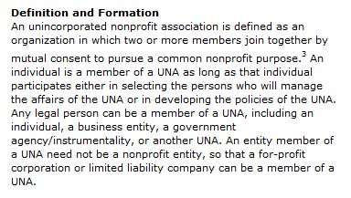
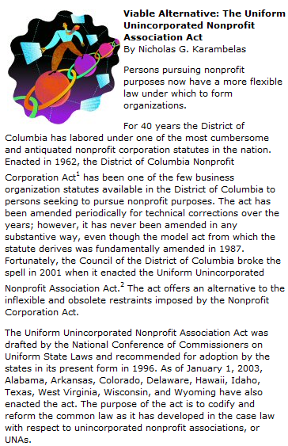
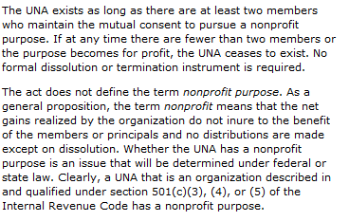
US LUA: The Uniform Nonprofit Association Act (dcbar.org)
http://www.dcbar.org/for_lawyers/resources/publications/washington_lawyer/august_2003/viable.cfm
Notes:
13

Slide 14
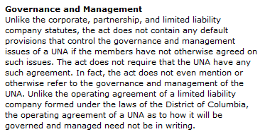
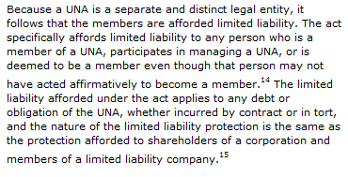
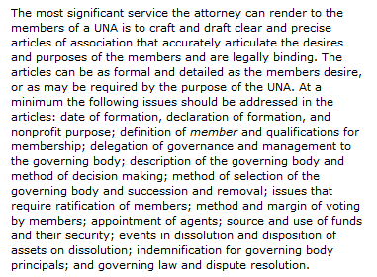
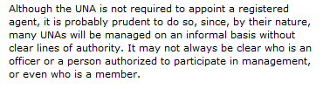
US LUA: The Uniform Nonprofit Association Act (dcbar.org)
http://www.dcbar.org/for_lawyers/resources/publications/washington_lawyer/august_2003/viable.cfm
Notes:
14

Slide 15
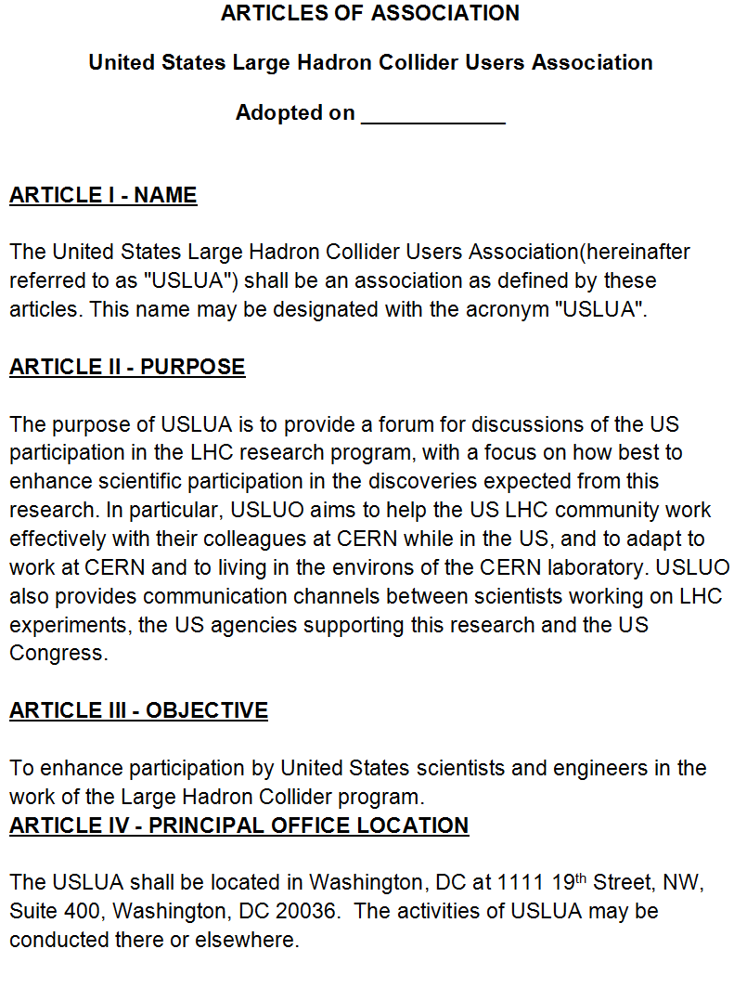
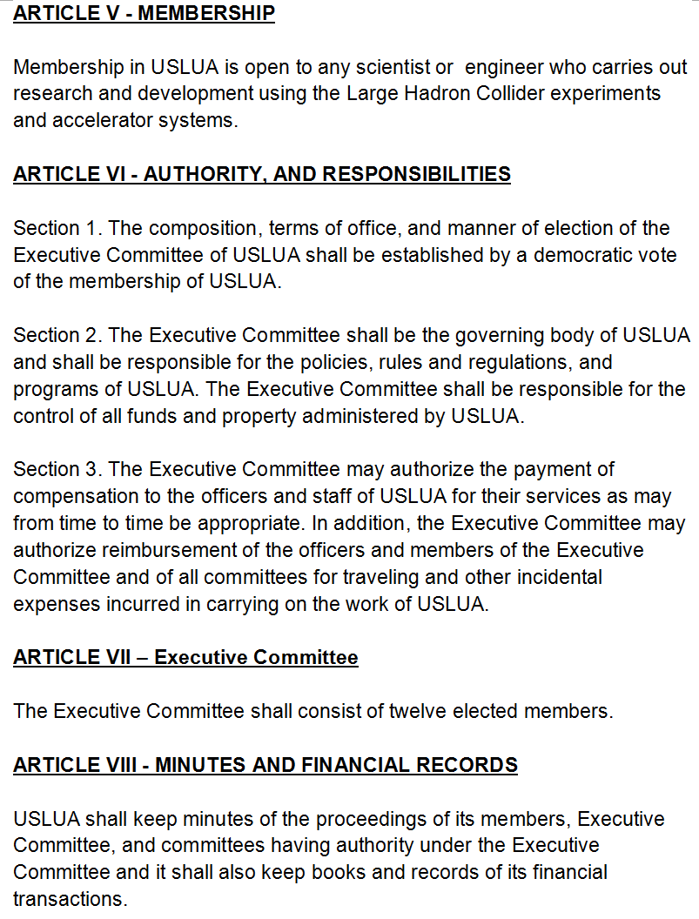
US LUA: Articles of Association
Notes:
15

Slide 16
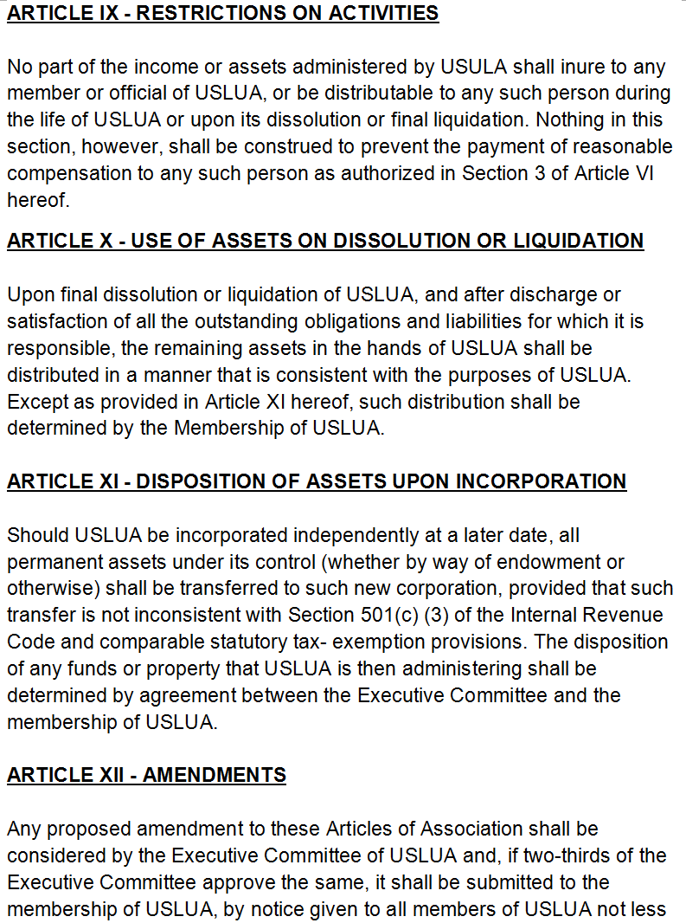
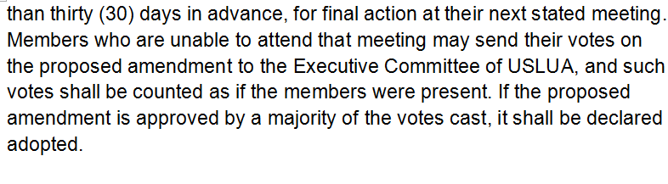
US LUA: Articles of Association
Notes:
16

Slide 17
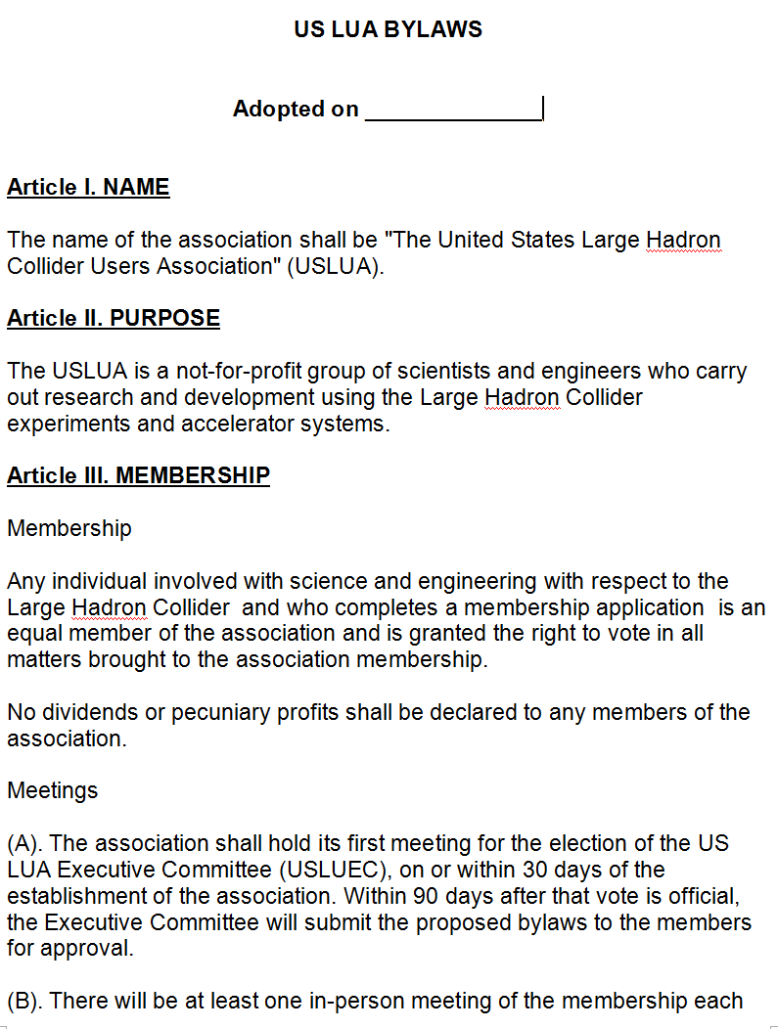
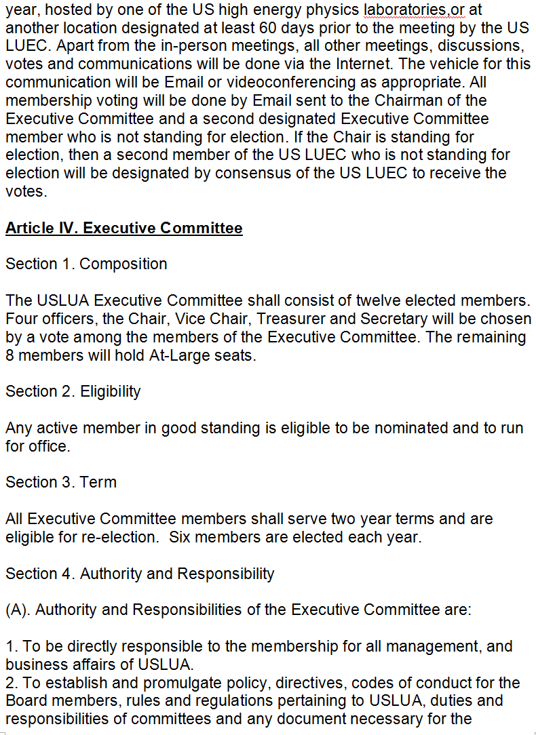
US LUA: Draft Bylaws
Notes:
17

Slide 18
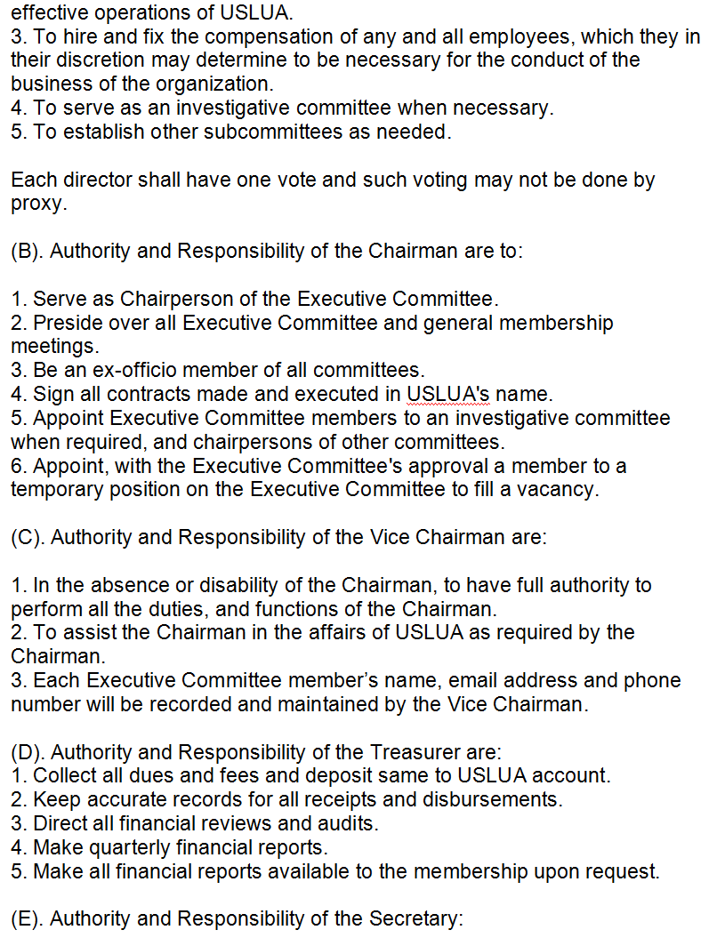
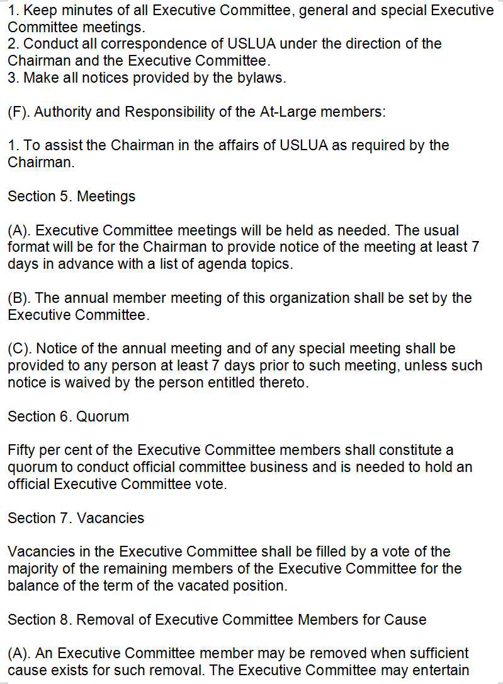
US LUA: Draft Bylaws
Notes:
18

Slide 19
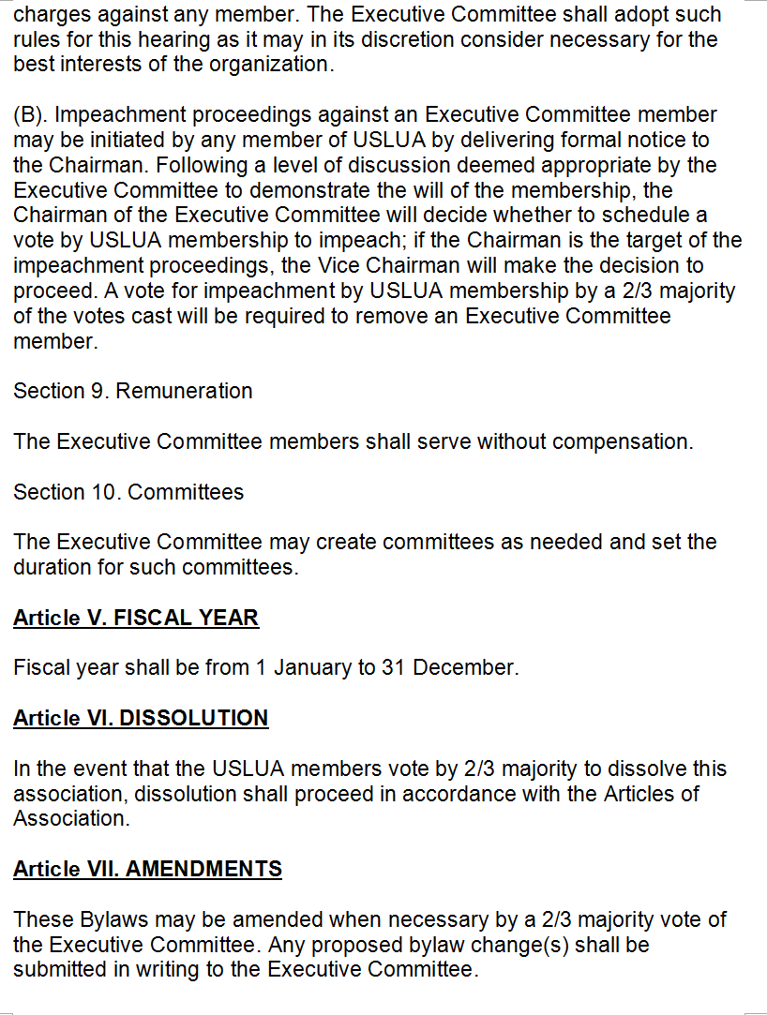
US LUA: Draft Bylaws
Notes:
19

Slide 20
US LUO: Visa Issues
Living and working abroad can be a Challenge
Especially for non-US citizens in the US LHC community who
work abroad for significant periods; even if they are US residents
Return visas can be long-delayed, and hard to obtain
  The delays can depend on geopolitical events, and the level
  of scrutiny being applied by the US DHS
  If delays do occur, it is hard to get feedback
  There is evidence that the rate of incidence is on the rise lately
What can you do if your visa case has been delayed > 21 days ?
Contact the National Academies’ International Visitors Office
  Before you Email them (visas@nas.edu) visit their website
  at www.nationacademies.org/visas and fill out the Questionnaire
  NAS staff review the questionnaires each week and report
  the visa applications pending for > 21 days to the State Dept.
  The State Dept. reports back to the NAS which cases are
  resolved each week.
  The process continues weekly, until each case is resolved
20
Notes:
20

Slide 21

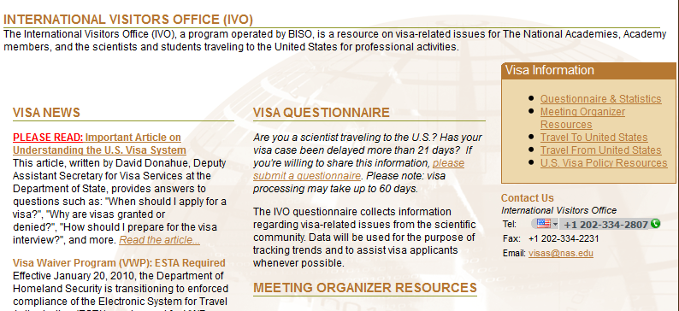
US LUO: Visa Issues
http://sites.nationalacademies.org/PGA/biso/visas/index.htm
21
With thanks to Amy Flatten, APS Director of the International Affairs Office
Notes:
21

Slide 22
I - Changes concerning
Schengen Visa type D requests
> 3 months, multiple entries
In the past, persons subject to visa requirements could ask for both Swiss and French visa before coming to CERN
Now only one visa is allowed by the Host States: Both host states refuse granting a visa if the person has already a visa from the other Host State for coming to CERN
Based on a Schengen Visa type D, residence rights will be granted in the country for which the visa was issued as well as the right to travel in the other Schengen countries
Users coming to CERN who are subject to visa restrictions will have to know in advance if they will live in France or in Switzerland and request the Visa at the corresponding Embassy

