Slide 1

US LHC Accelerator Research Program (LARP)
Eric Prebys, Fermilab
Director, LARP

Slide 2
LARP History
The US LHC Accelerator Research Program (LARP) was formed in 2003 to coordinate US R&D related to the LHC accelerator and injector chain at Fermilab, Brookhaven, and Berkeley
  SLAC joined shortly thereafter
  Has also had some involvement with Jefferson Lab, Old Dominion University and UT Austin
LARP has contributed to the initial operation of the LHC, but much of the program is focused on future upgrades.
The program is currently funded at a level of about
$12-13M/year, divided among.
  Accelerator research
  Magnet research (~half of program)
  Programmatic activities, including support for personnel at CERN

Slide 3
LARP Contributions to Current LHC Operation
Schottky detector
  Used for non-perturbative tune measurements (+chromaticities, momentum spread and transverse emmitances) – Operational (currently some issues)
Tune tracking
  Implement a PLL with pick-ups and quads to lock LHC tune – Fully integrated
  Investigating generalization to chromaticity tracking
AC dipole
  US AC dipole to drive beam
  Measure both linear and non-linear beam optics – Primary tool for high energy optics
Luminosity monitor
  High radiation ionization detector integrated with the LHC neutral beam
  absorber (TAN) at IP 1 and 5. – Functional, becoming primary fast system.
Synchrotron Light Monitor
  Used to passively measure transverse beam size and monitor abort gap
  Not a LARP project, but significantly improved by LARP – Operational (currently some issues)
Low level RF tools
  Leverage SLAC expertise for in situ characterization of RF cavities – Fully integrated
Personnel Programs…

Slide 4
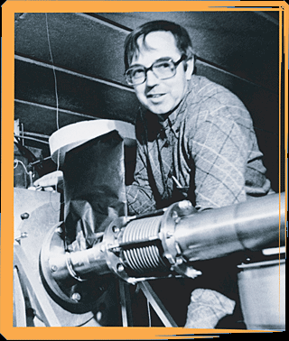
Toohig Fellowship
Named for Tim Toohig, one of the founders of Fermilab
Open to recent PhD’s in accelerator science or HEP.
Successful candidates divide their time between CERN and one of the four host labs.
Past
  Helene Felice, LBNL, now staff
  Rama Calaga, BNL, now CERN staff
  Ricdardo de Maria, BNL, now CERN Fellow
  Themis Mastoridis, SLAC, now CERN Fellow
  Ryoichi Miyamoto, BNL, now ESS Staff
  Dariusz Bocian, FNAL, now Ass. Prof. at
  The Henryk Niewodniczański Institute of Nuclear Physics
Present
  Simon White, BNL
  Valentina Previtali, FNAL
  John Cesaratto, SLAC
  Ian Pong, LBNL
If interested, visit:
  http://www.interactions.org/toohig/

Slide 5
Long Term Visitors Program
LARP Pays transportations and living expenses for US scientists working at CERN for extended periods (at least 4 months)
  Past:
    Jim Strait, FNAL – Machine protection/splice consolidation
    Steve Peggs , BNL – UA9
    Alan Fisher, SLAC – Synchrotron Light Monitor
    Rama Calaga, BNL – crab cavities and commissioning
    Eliana Gianfelice, FNAL – abort gap cleaning
    Uli Wienands, SLAC – UA9, PS2, PSB
  Present:
    Chandra Bhat, FNAL – flat bunches for Large Pewinski Angle solution,
    SPS lifetime issues
    Alexey Burov, FNAL – Instabilities in the injector chain.
Extremely successful at integrating people into CERN operations
  Big thanks to CERN for their support of this program
Interested parties coordinate with a CERN sponsor and apply to the program (contact me)

Slide 6
CERN Re: LARP Personnel Programs
Letter to Michael Procario, Acting Head, DOE
Office of High Energy Physics, 9-MARCH-2011

Slide 7
The Future: Baseline LHC Upgrade Path
Maximize current/brightness
Reach nominal energy
Time Line:
  LS1: “Nominal” (2013-2014)
    Complete repairs of the superconducting joint and pressure relief problems which cause “the incident” in 2008 and currently limit the energy to 4+4 TeV.
    “Lost memory” issues may limit the beam energy to somewhere between 6.5 and 7 TeV per beam.
    At least 1x10³⁴ cm⁻²s⁻¹ peak luminosity
  LS2: “Ultimate” (2017)
    injector and collimation upgrades
    Increase current and/or lowering emittance, increasing the luminosity further
    At least 2x10³⁴ cm⁻²s⁻¹ peak luminosity
  LS3: “HL-LHC” (~2022-2023)
    Lower β* and compensate for crossing angle to maximize luminosity
    5x10³⁴ cm⁻²s⁻¹ leveled luminosity

Slide 8
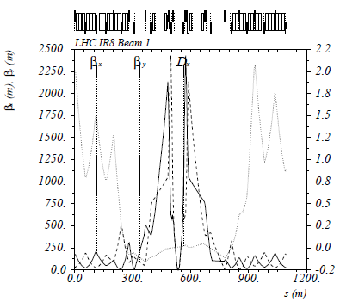
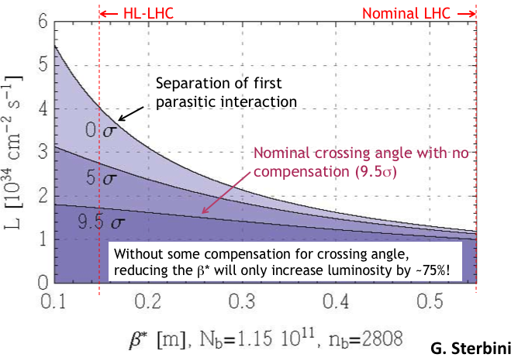
Key Components of HL-LHC
Reduce β* from 55 cm to 15 cm
  Requires large aperture final
  focus quads
  Beyond NbTi
  ➔Requires Nb₃Sn
    never before used in an accelerator!
    Nb3Sn R&D key component of LARP
BUT, reducing β* increases the
effect of crossing angle
“Piwinski Angle”

Slide 9
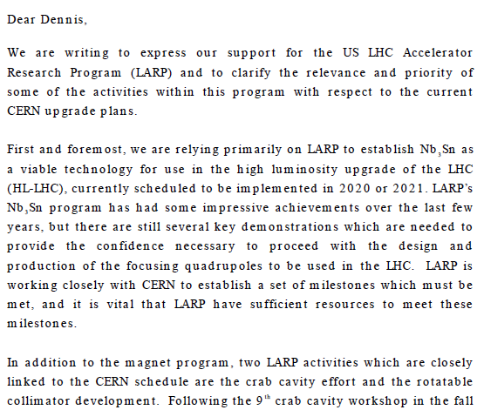

Relevance of LARP to CERN Upgrade*
Letter to Dennis Kovar, Head, DOE
Office of High Energy Physics, 17-August-2010
(…)
*letter suggested at review

Slide 10
HL-LHC Design Study
The Luminosity upgrade planning will be largely organized through EU,
  Centrally managed from CERN (Lucio Rossi and Oliver Bruning)
  Non-CERN funds provided by EU
  Non-EU partners (KEK, LARP, etc) will be coordinated by EuCARD, but receive no money.
Work Packages:
  WP1: Management
  WP2: Beam Physics and Layout
  WP3: Magnet Design
  WP4: Crab Cavity Design
  WP5: Collimation and Beam Losses
  WP6: Machine Protection
  WP7: Machine/Experiment Interface
  WP8: Environment & Safety
LARP is now integrating most of its activities into this framework
  Two LARP meetings/year ➔two joint meetings/year (spring in US, fall in Europe)
Goal
  CDR: 2014
  TDR: 2015
Significant LARP and other US Involvement

Slide 11
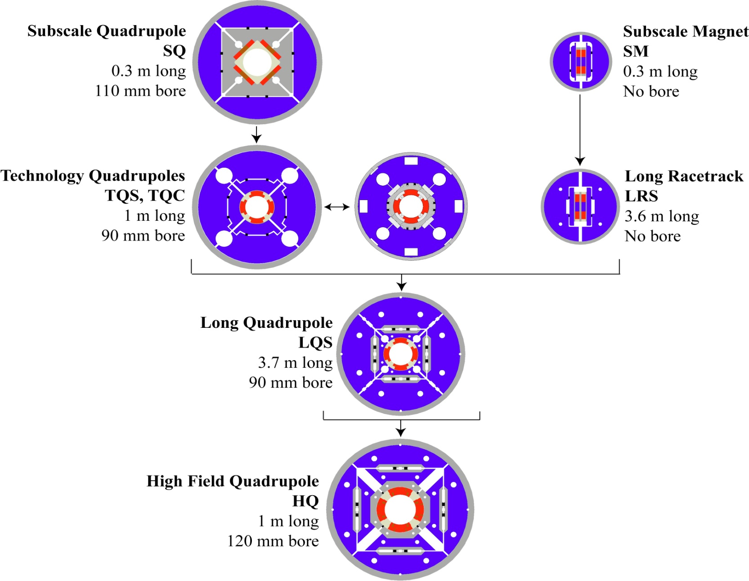
LARP Magnet Development Tree
Completed
Achieved
220 T/m
Length scale-up
High field
Accelerator features
Being
tested

Slide 12
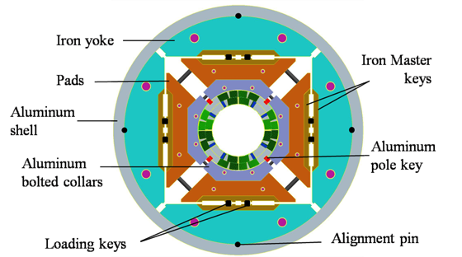
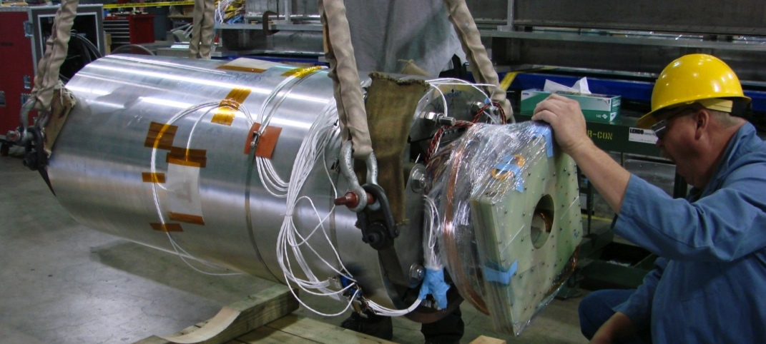
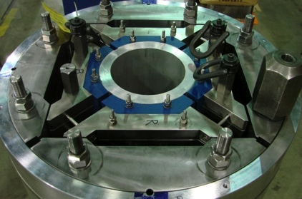
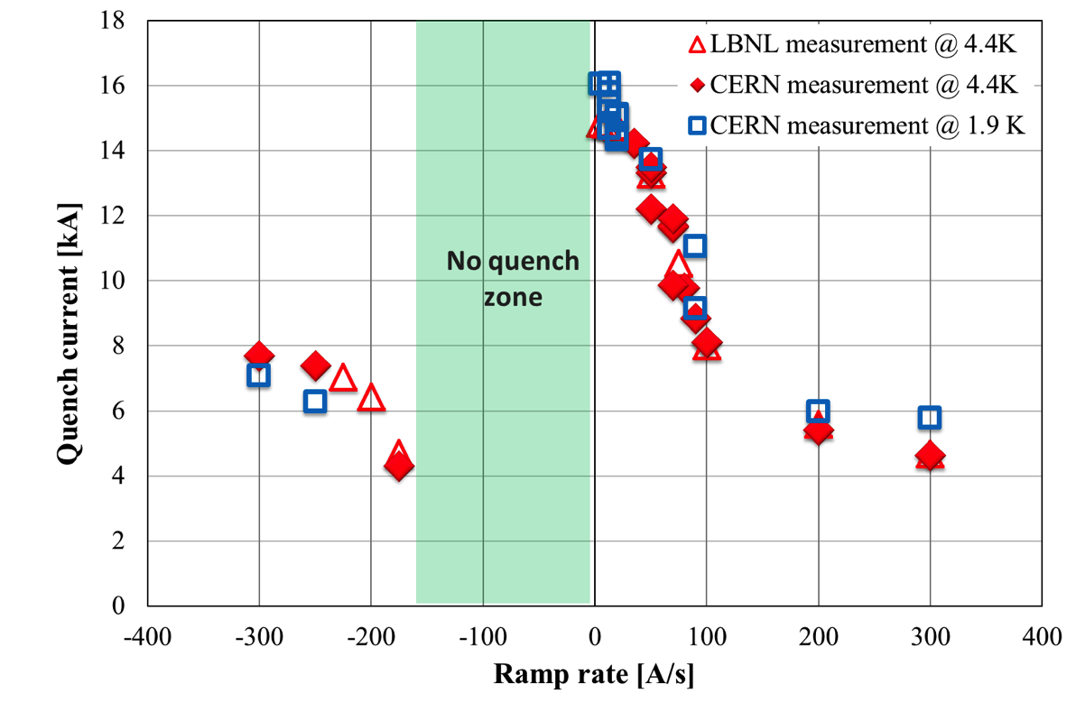
HQ Tests
Initial tests at LBNL
  Reached 14.6 kA @ 4.2K
Recent tests at CERN
  Good agreement with LBNL results
  Reached 16.2 kA @ 1.9K
    85% of short sample limit
    > nominal current of 14.9 kA!

Slide 13
Changes to Magnet Plans
Original plan
  Follow HQ with 4m x 120 mm LHQ
  Use this to demonstrate technology for 120 mm prototype as part of large scale construction project
Developments
  In June 2012, CERN chose 150 mm as the aperture for the HL-LHC
  July 2012 LARP review recommends abandoning LHQ to pursue 150 mm prototype
New plan
  Curtail 120 mm program to long ¼ magnet “mirror” tests
    We feel there are still important things to learn
  Begin working with CERN on 150 prototype as part of an integrated production plan for Nb₃Sn quads in LS3.

Slide 14
Approximate Magnet Schedule
This part being revised

Slide 15
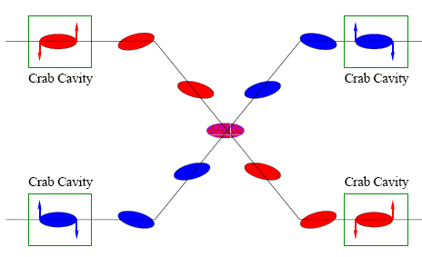
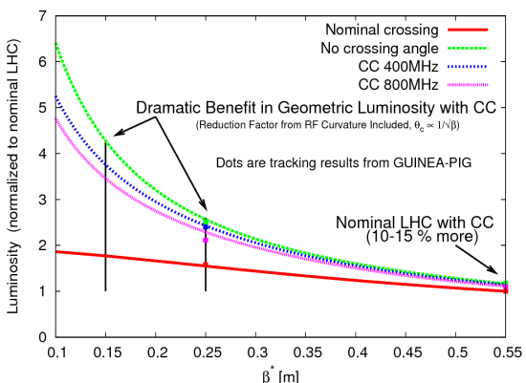
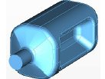
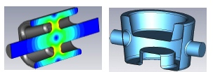
Crab Cavities
Technical Challenges
  Crab cavities have only barely been shown to work.
    Never in hadron machines
  LHC bunch length ➔ low frequency (400 MHz)
  19.4 cm beam separation ➔ “compact”
  (exotic) design
Additional benefit
  Crab cavities are an easy way to level luminosity!
Currently aiming for:
  Down-select ~next year
  SPS test in 2015
UK
LARP

Slide 16
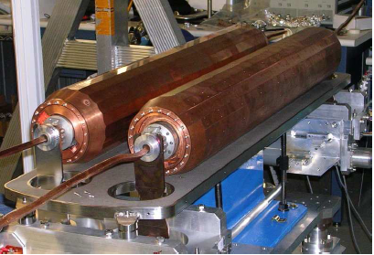
Other Important LARP Projects
High Bandwidth Feedback for SPS and/or LHC
  Leverage experience with LLRF to design feedback system to damp instabilities (particularly electron cloud)
Energy Deposition Studies
  In response to requests from CERN and review recommendations, we have engaged the Fermilab Energy Deposition Group (Mokhov and Co.), as well as expertise at SLAC, to simulate energy deposition in the final focusing magnets.
  Investigating high radiation studies at BNL and/or CERN HiRadMat facility
Rotatable Collimator
  A long time LARP project
  Completing prototype for tests
  at CERN
  Not certain what the future use
  may be

Slide 17
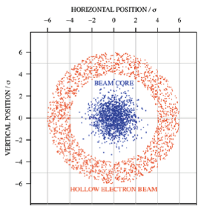
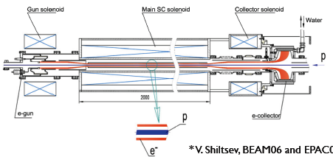
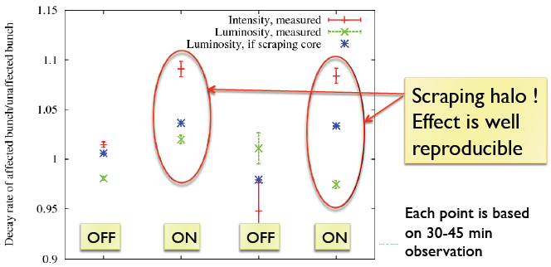
Important Projects (cont’d)
Hollow electron beam collimation
  Grew out of electron beam-beam compensation
  Tested at Tevatron
  Considering a test in the LHC

Slide 18
Evolving Priorities in Accelerator Systems
Top funded in FY12
  Crab cavities
  “Ecloud”, primarily in support of R&D into SPS feedback
* SUBSTANTIAL un-billed Labor from, especially, Fermilab NOT included

Slide 19
Future Planning: New Direction
At the DOE’s request, we are in the process of transforming LARP into a project to encompass all US contributions to the luminosity upgrade of the LHC.
Budget Guidance
  Flat-Flat LARP funding @ ~$12.3M/year through FY16
  A total of $200M (then year dollars) TPC, assuming CD-2 at approximately the beginning of FY17
  “Some amount” of General Accelerator Development (GAD) funds diverted in support of this program (still being negotiated).
First Deadline
  Submit a list of candidate deliverables and a plan for down-selection by September 4, 2012
    Done: LARP-DOC-1069 [http://tinyurl.com/LARP-Down-Selection]

Slide 20
Candidate Projects
Traditional LARP Scope
  150 mm aperture Nb₃Sn quadrupoles
    Likely just cold masses, divided between here and CERN
  Crab Cavities
    Prototypes? Production Units? Cryomodules?
  High Bandwidth Feedback System
    Pick-ups? Processing Systems? Response Kickers?
New Scope
  11 T Nb₃Sn dipoles
    Used to make room for collimation in dispersion suppression region
    Has been a bilateral CERN/FNAL effort
  Large Aperture NbTi D2 separator magnets
    First dual aperture magnets near Irs
    Has been bilateral CERN/BNL effort
Not included
  Collimation: No plan ➔ no scope

Slide 21
The Process
Currently working with Fermilab support to put all projects into consistent levels of budget and schedule
  Contingency, escalation, etc
  We know the total will be > $450M!
  Scheduled to finish by November 1, 2012
Next, we will work with a committee to prioritize, down select, and re-scope to fit with the budget guidance
  Representation from LARP, CERN, DOE, and the member labs
Submit proposal for project scope on December 21st, 2012
  Proposal will also include time line of Project Execution Plan (PEP) to mean CD-2 milestone at beginning of FY17.

Slide 22
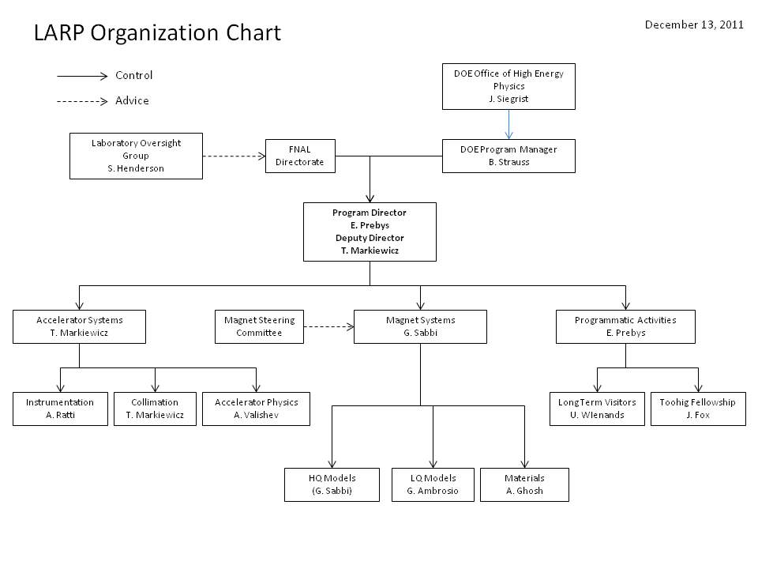
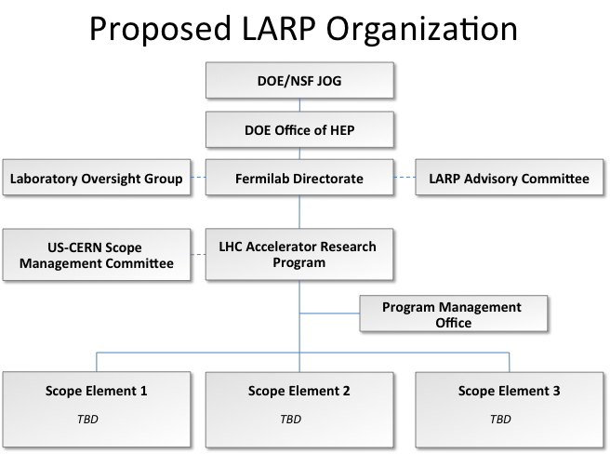
Restructuring of LARP
Will there be general R&D scope?
Stay tuned!

