Slide 1

Status and Outlook of the LHC
L. Bottura
CERN TE-MSC
US-LUO Meeting 2012
October 18-20, 2012, Fermilab

Slide 2
Outline
Where do we come from
The present production at the LHC
The foreseeable LHC future
Beyond the LHC
A final message
An insider view
And a special eye for technology

Slide 3
Outline
Where do we come from
The present production at the LHC
The foreseeable LHC future
Beyond the LHC
A final message

Slide 4
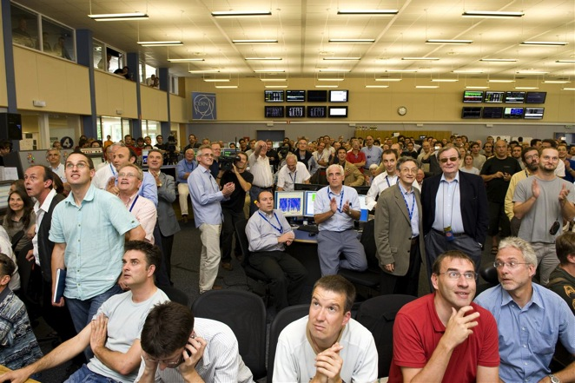
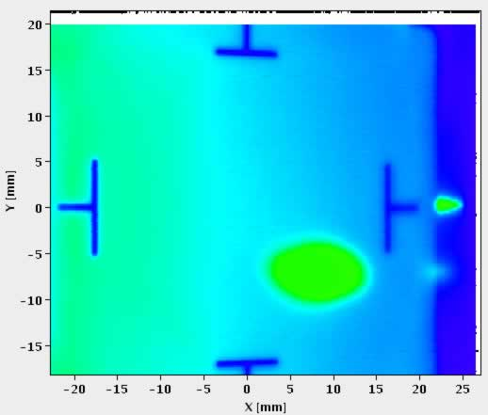
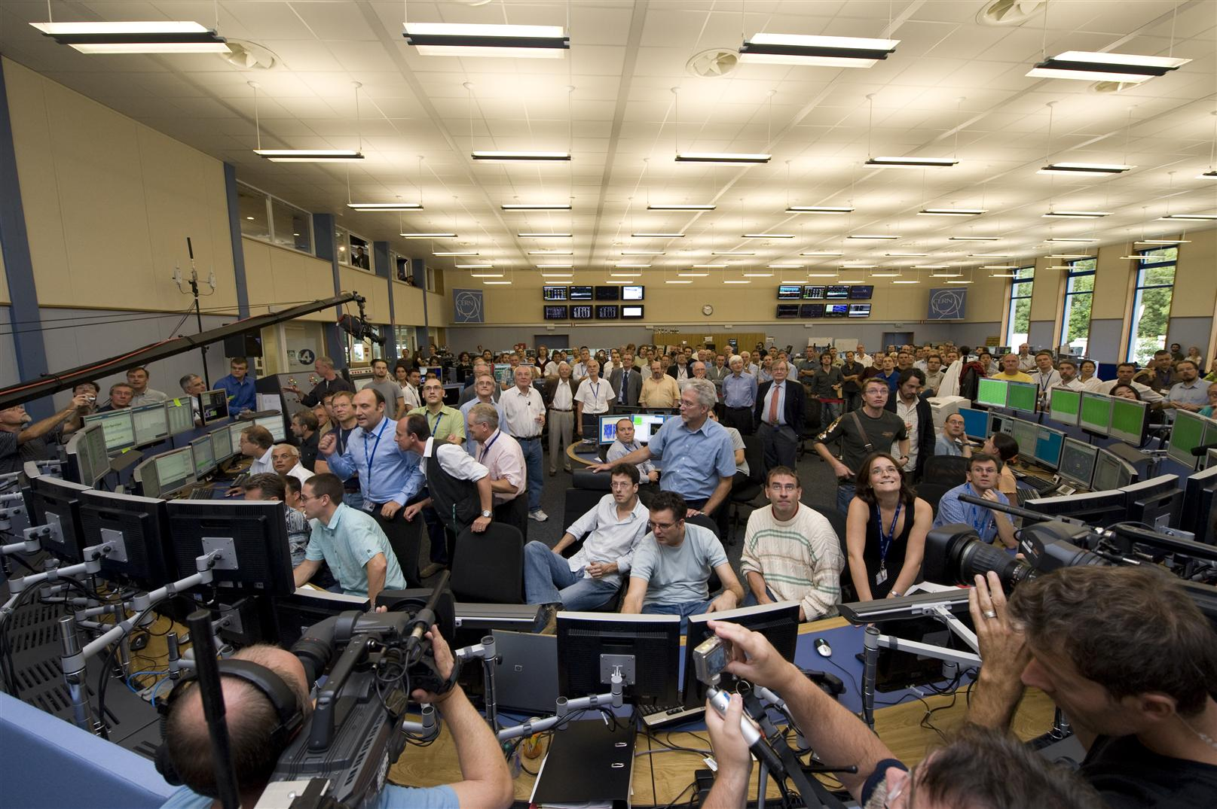
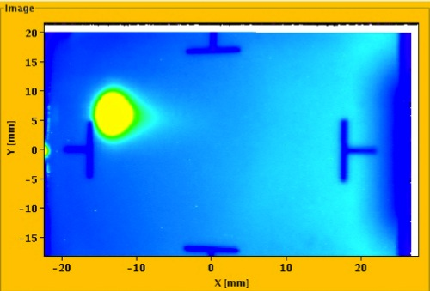
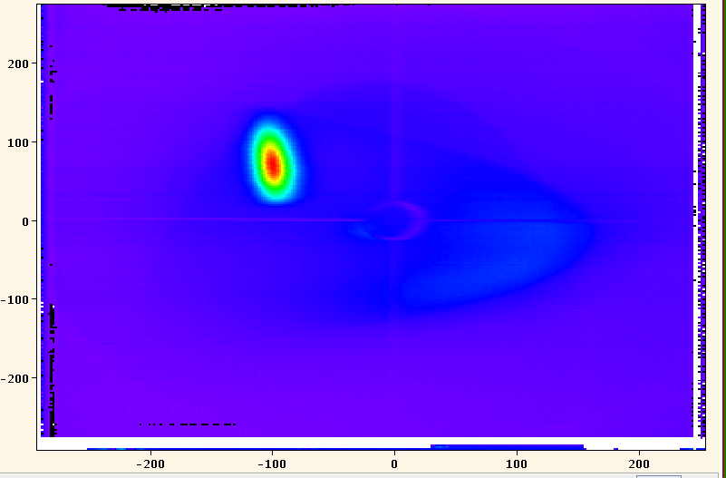
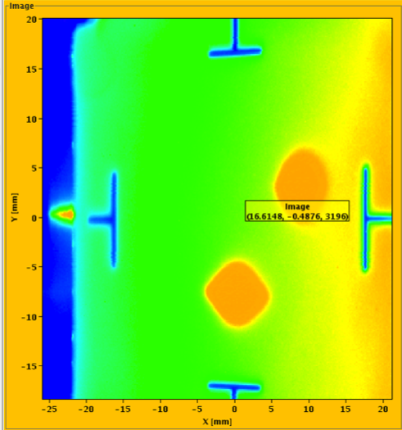
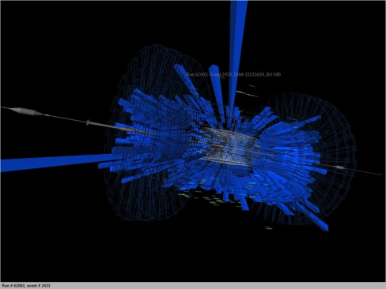
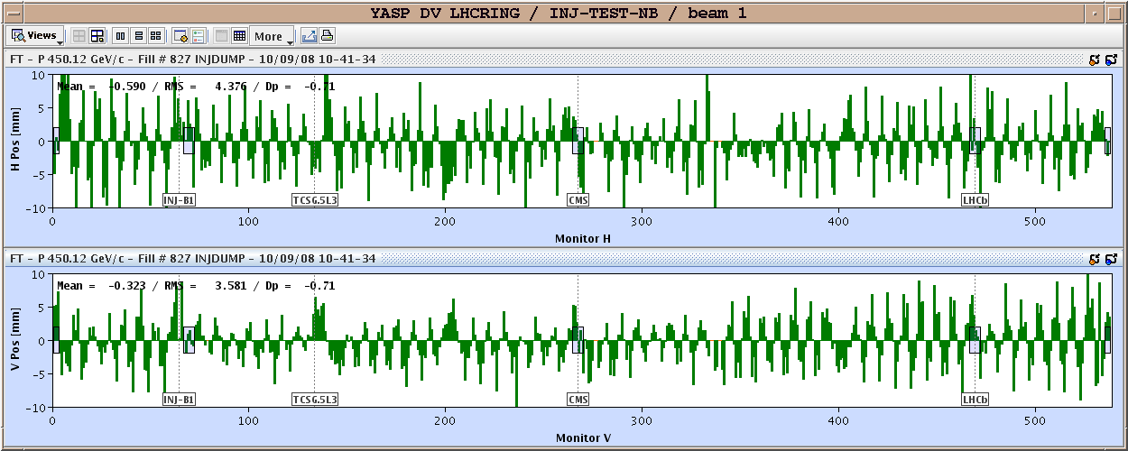
September 10th, 2008…
IR7
IR3
IR6
First turn !

Slide 5


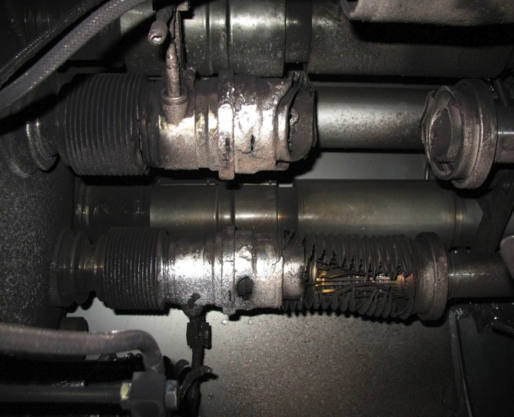
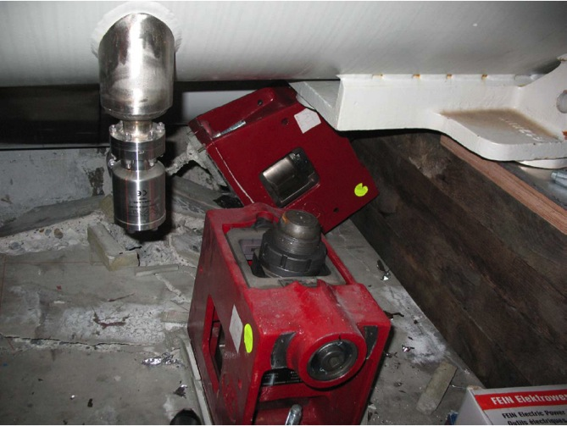
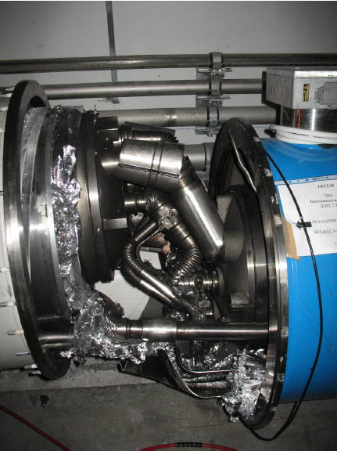
…September 19th, 2008…
Initiated by an unprotected quench of defective joint
NOTE: this is an intentional defect built for testing purposes
Arcing in an interconnection
Over-pressure
Magnet displacement

Slide 6
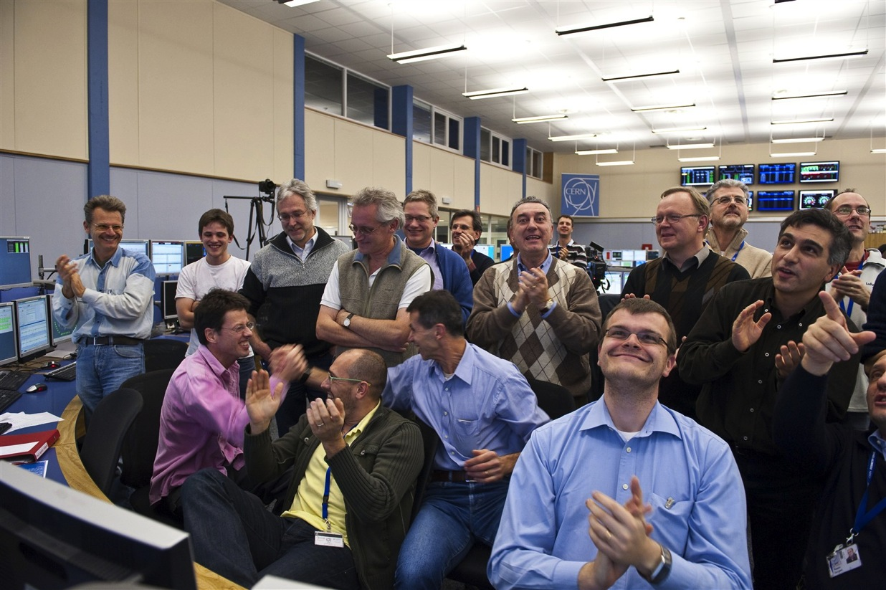
…November 30th, 2009…
LHC surpasses a proton beam energy of 1 TeV

Slide 7
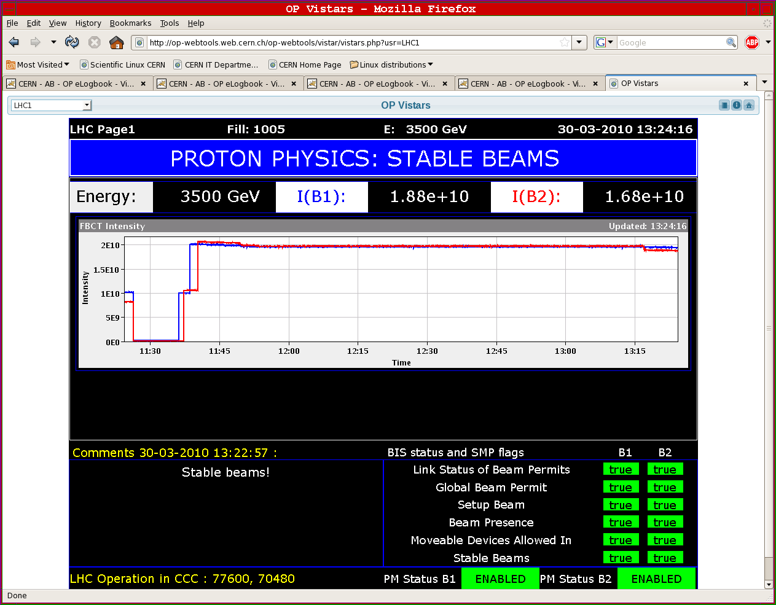
March 30th, 2010
3.5 TeV operation

Slide 8
Outline
Where do we come from
The present production at the LHC
The foreseeable LHC future
Beyond the LHC
A final message

Slide 9
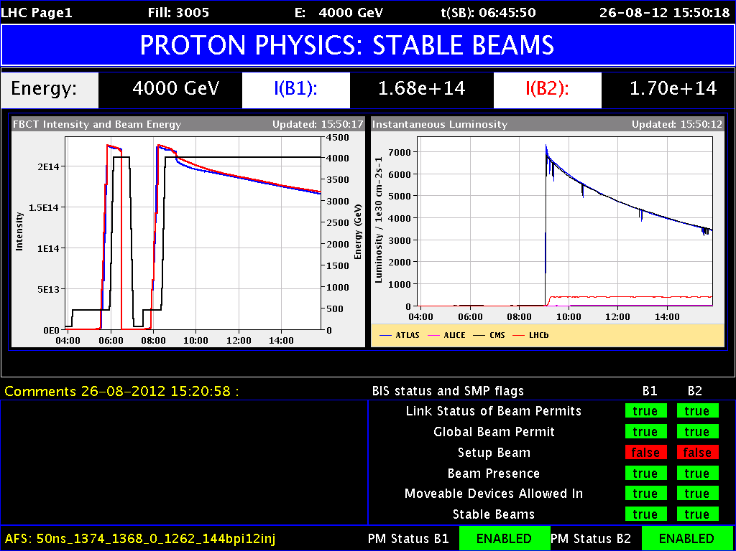
LHC operation “today”

Slide 10
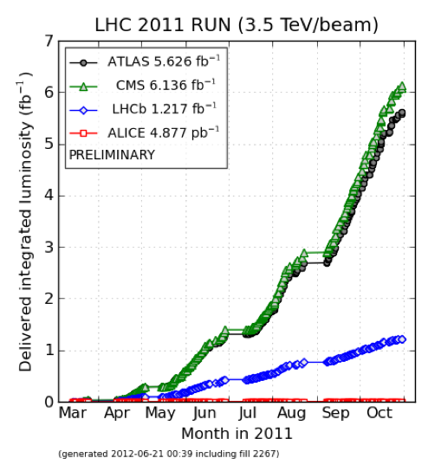
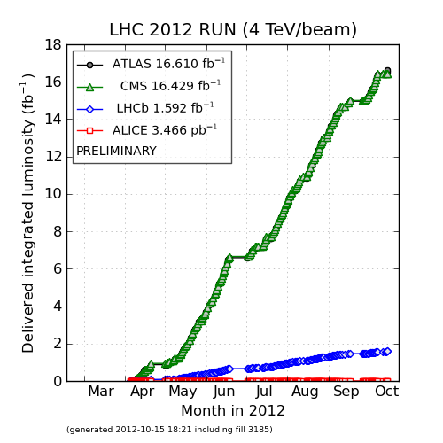
LHC luminosity production
Peak luminosity 7.7 10³³ 1/cm² s
LHC operation has reached good routine to deliver approximately 20 fb⁻¹ by the end of 2012

Slide 11
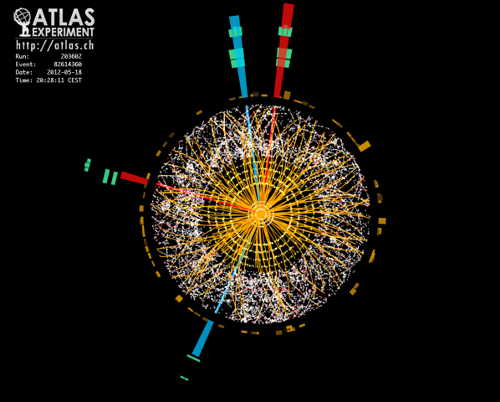
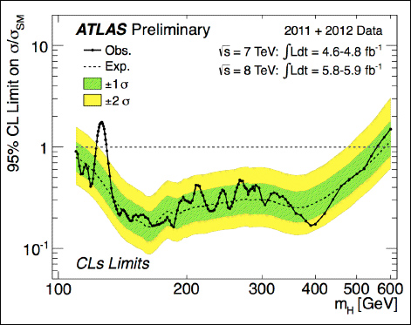
Results from ATLAS on H-Day
Candidate for a 4-e⁻decay of the Higgs boson
Exclusion limits for the existence of a new particle in the range of 100 to 600 GeV
Fabiola Giannotti, ATLAS, Status of the SM Higgs Boson Search, July 4th, 2012

Slide 12
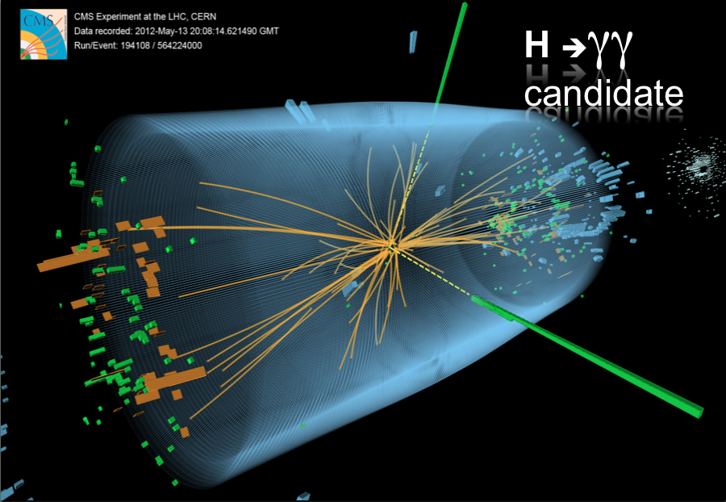
Results from CMS on H-Day
J. Incandela, CMS, Status of the SM Higgs Boson Search, July 4th, 2012

Slide 13
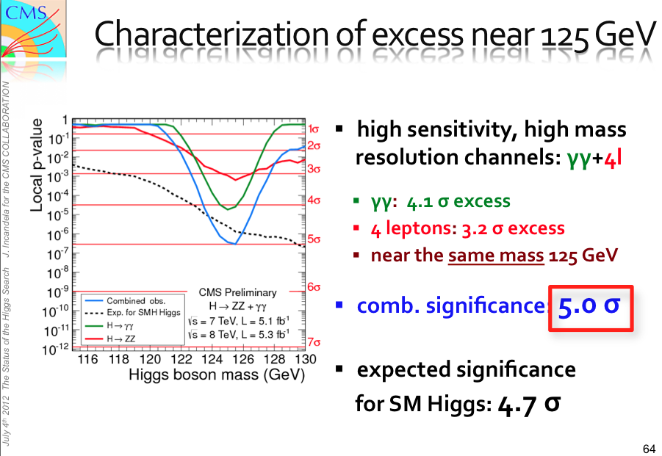
Results from CMS on H-Day
J. Incandela, CMS, Status of the SM Higgs Boson Search, July 4th, 2012

Slide 14
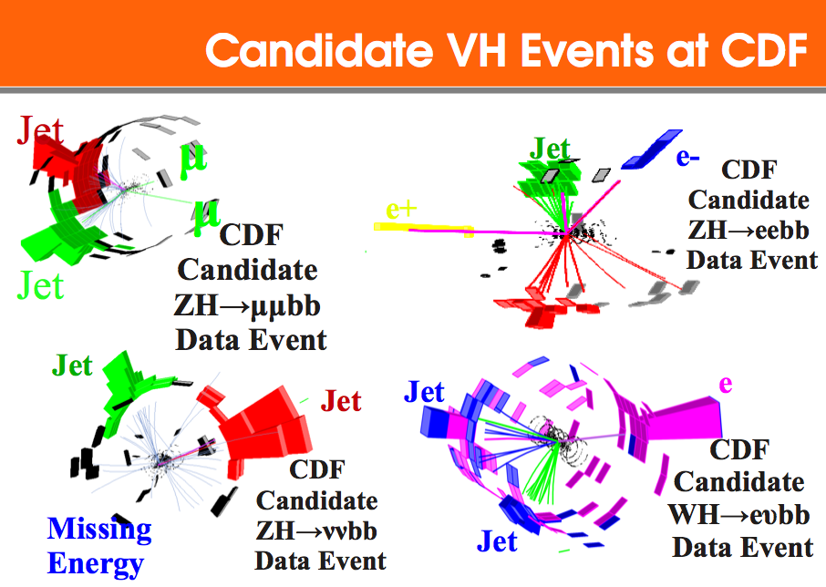
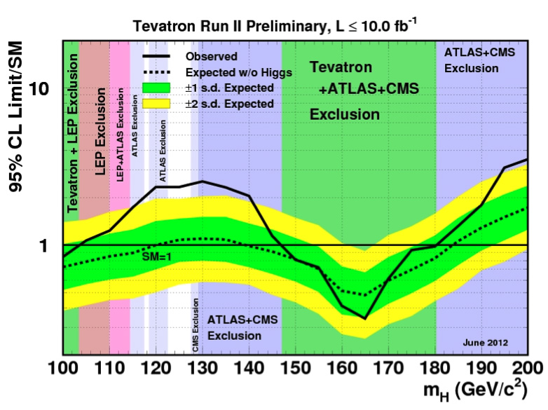
To be fair, results from Tevatron
Candidate events for Higgs boson decays at CDF
Exclusion limits for the existence of a new particle in the range of 100 to 200 GeV
Homer Wolfe, CDF, The Search For The Brout­Englert­Higgs Boson, March 7th, 2012

Slide 15
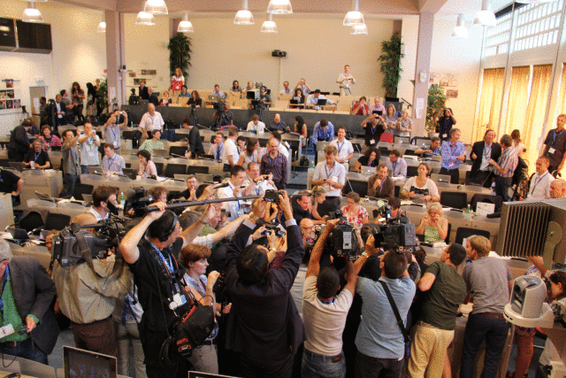
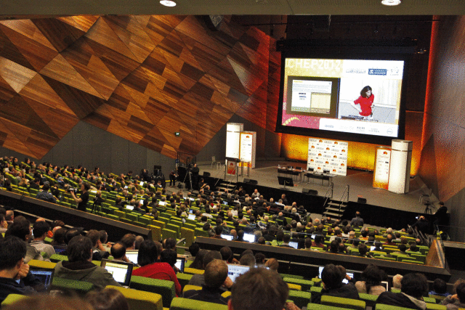
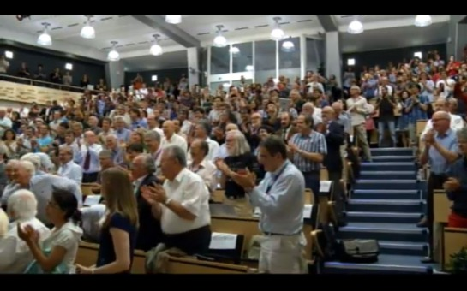
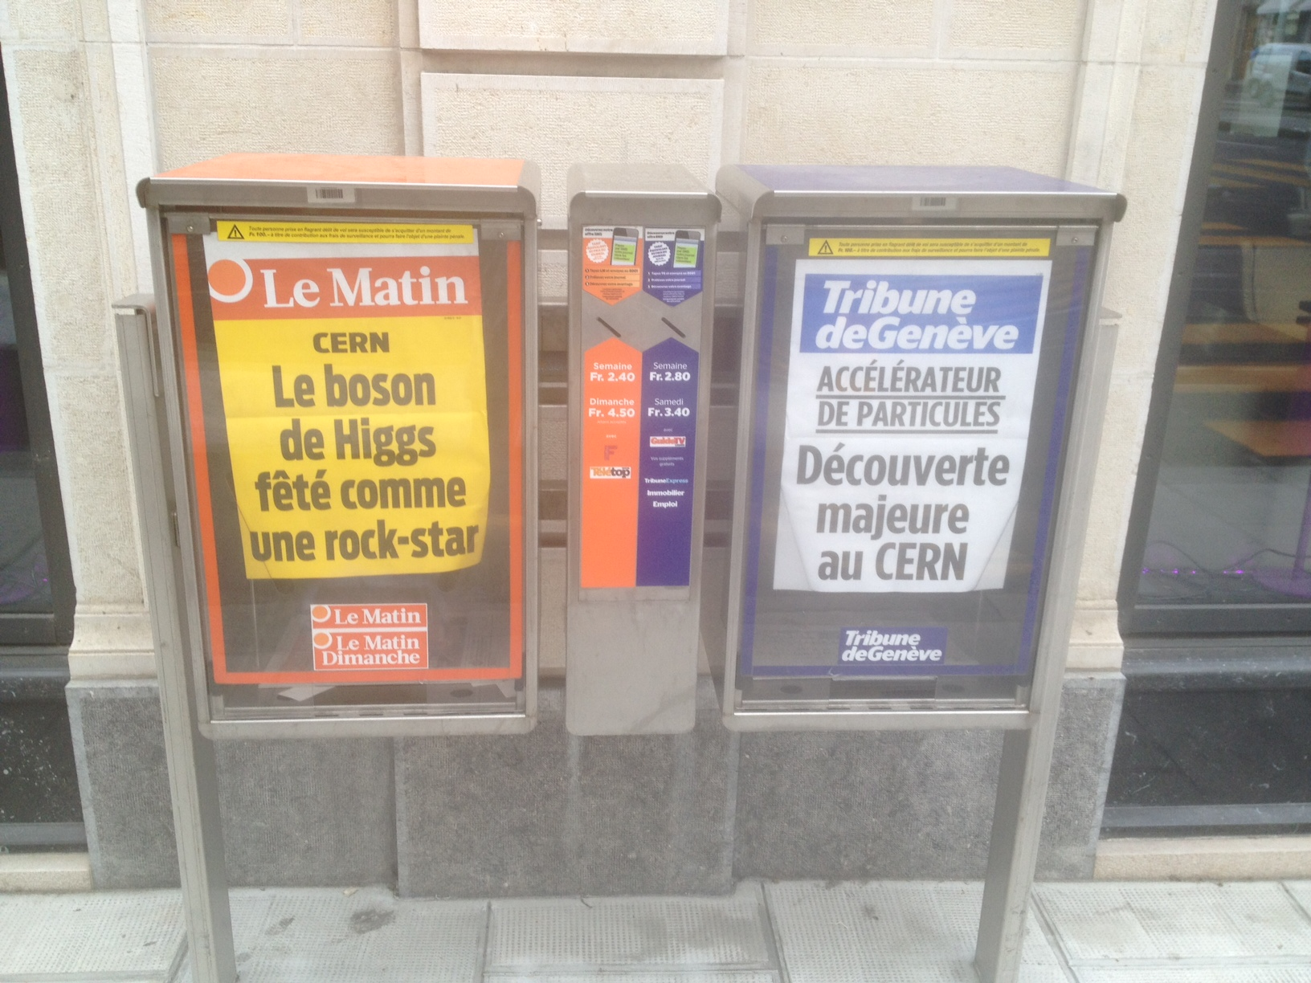
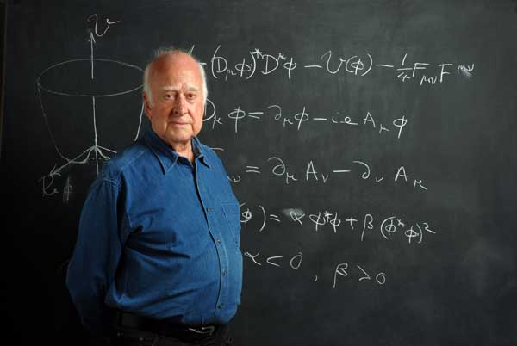
The “Higgs” is there !?!

Slide 16

Cuddle your Higgs

Slide 17
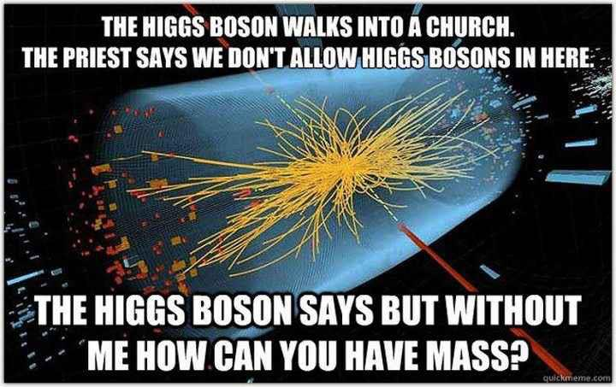
No Higgs in Catholic church ?

Slide 18

A Higgs event in CMS ?
No, a pack of spaghetti !

Slide 19
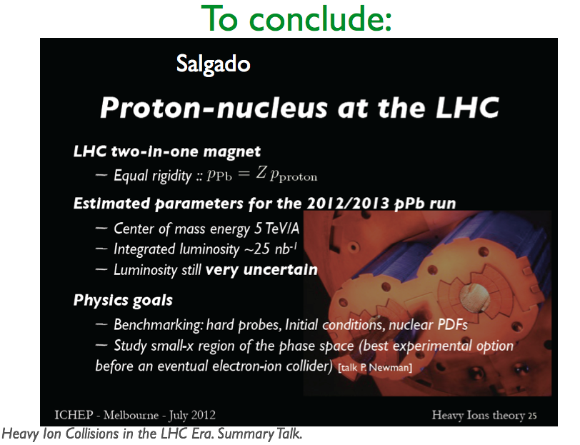
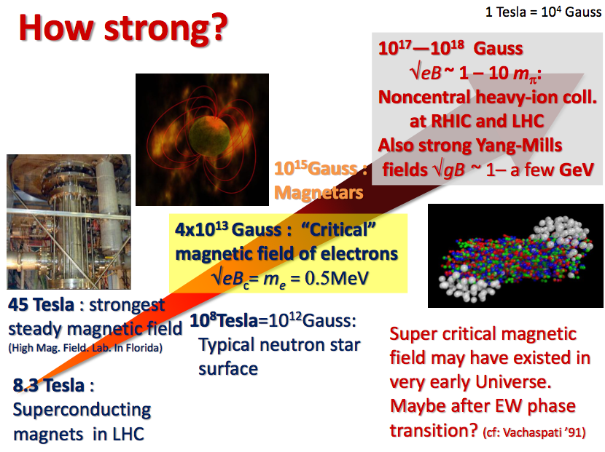
Do not forget heavy ions physics
p-Pb run coming up
Fascinating physics !

Slide 20
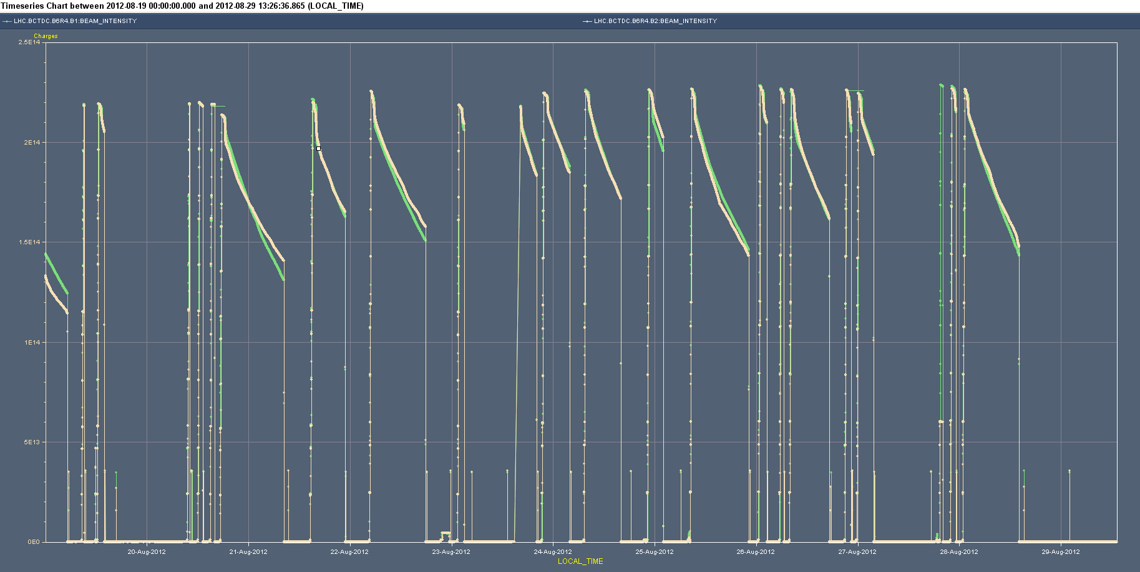
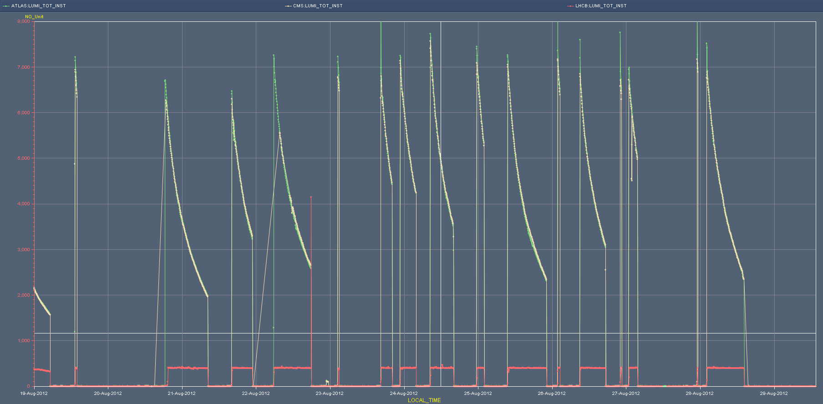
Not always plain sailing…
2e14
Mixed bag
Injectors
BSRT
CRYO
Beam intensity from weeks 34 and 35 (20th to 29th August 2012)
7e33
Luminosity logs from weeks 34 and 35 (20th to 29th August 2012)

Slide 21
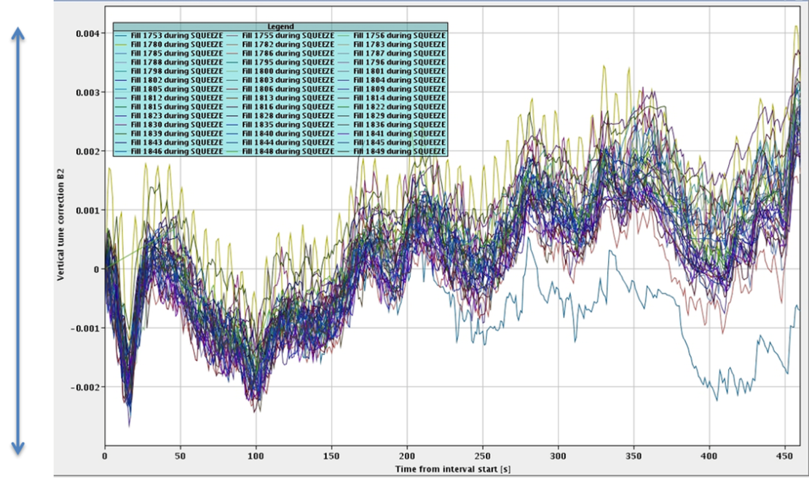
What did we learn?
LHC is magnetically very reproducible on a month to month time scale
High precision of the powering system
  (8 independent sectors !)
High availability of the cryogenics and hardware system
Head on beam-beam limit higher than foreseen
Aperture better than foreseen
Not a single magnet quenched due to beam , with 150 MJ per beam and more than 3 GJ stored in the magnets
Tune feedback during squeeze
δQ=0.007
June 2012, best so far

Slide 22
Concerns of intensity and energy
Single event upsets (SEU) that depend on beam intensity and luminosity (Radiation to Electronics)
Localized short losses, commonly referred to as UFOs (Unidentified Falling Objects : dust ?)
Beam induced heating of injection kickers, collimators, beam screens, beam instrumentation, RF fingers, …
Electron cloud and dynamic pressure rise at very high bunch intensities

Slide 23
Outline
Where do we come from
The present production at the LHC
The foreseeable LHC future
Beyond the LHC
A final message

Slide 24
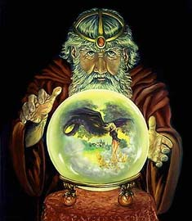
The predictable future: LHC time-line
2009
Start of LHC
Run 1: 7 TeV centre of mass energy, luminosity ramping up to few 10³³ cm⁻² s⁻¹, few fb⁻¹ delivered
LHC shut-down to prepare machine for design energy and luminosity
2013/14
Run 2: Ramp up luminosity to design (10³⁴ cm⁻² s⁻¹), ~50 to 100 fb⁻¹
2017 or 18
Injector and LHC Phase-I upgrades to go to ultimate luminosity
Run 3: Ramp up luminosity to 2.2 x design, reaching ~100 fb⁻¹ / year accumulate few hundred fb⁻¹
Phase-II: High-luminosity LHC. New focussing magnets and CRAB cavities for very high luminosity with luminosity levelling
~2021/22
Run 4: Collect data until > 3000 fb⁻¹
By courtesy of R. Heuer
CERN DG
2030
End of the LHC Era ? a Big Party !

Slide 25
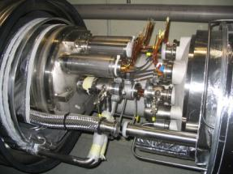
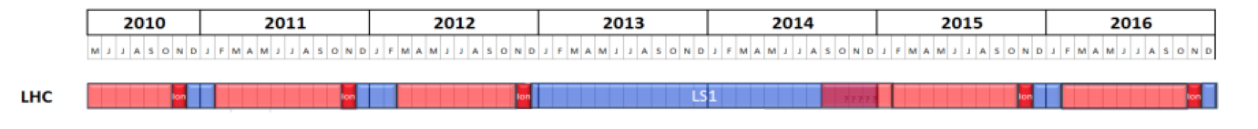
LS1 scope and schedule
  Repair defective interconnects
  Consolidate all interconnects with new design
  Finish off pressure release valves (DN200)
  Exchange magnets with non-conformities
  Repair He leaks (sectors 3-4 and 4-5)
  Maintenance of all the systems after 3 years operation
  Bring all necessary equipment up to the level needed for 7TeV/beam
10-15 % of interconnections to be opened and to be re-welded
100% (10’000) to be consolidated
Schedule is now consolidated, the countdown runs !

Slide 26


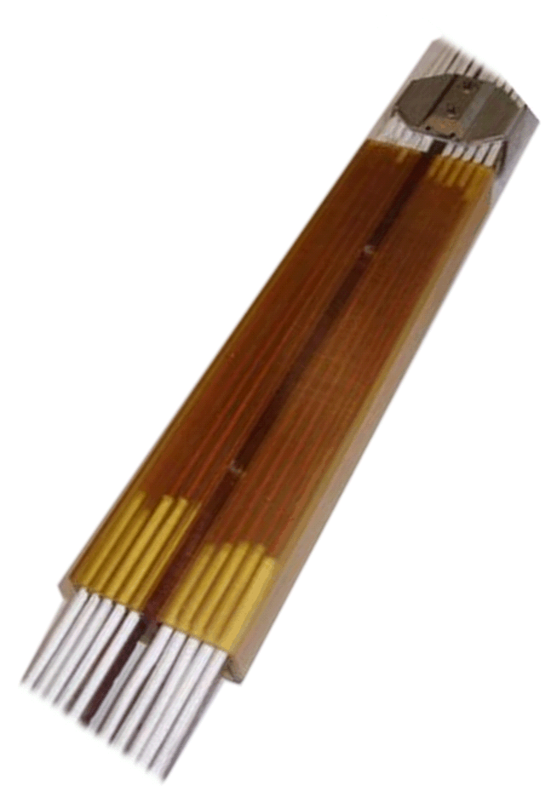


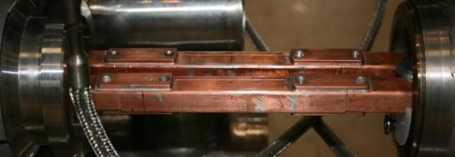
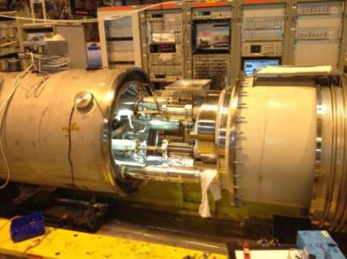
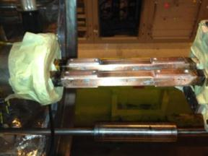
13 kA splice consolidation
Consolidated dipole magnets bus splice
Consolidated electrical insulation
Final validation test on a laboratory interconnect:
- 13 KA quench
- 20 kCycles
- Thermal cycles

Slide 27
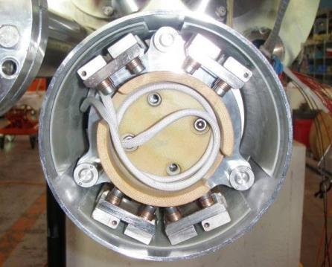
The diode stacks
R_{HS-bus}
R_{Diode-HS}
R_{bus-bus}
August 2011 – anomalous resistance observed in diode circuits during provoked quenches (20…40 μΩ)
September 2011 – diode task-force activities launched
Q4-2011, Q1-2012 – extensive testing of dipole diode stacks
February 2012 – report at Chamonix 2012 that the behaviour observed in the LHC can be reproduced in most cases in the laboratory and is not critical: the dipole diode stack and interconnects appear sound for operation at 7 TeV.
Q2-2012 – extensive testing of quadrupole diode stacks
Q3-2012 – bus-bus interconnects in quadrupole diode stacks found under-designed
October 2012 – recommend consolidation in the whole LHC

Slide 28
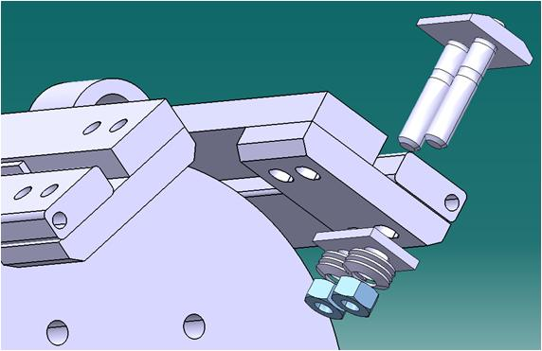
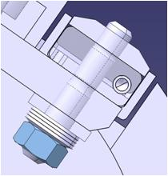
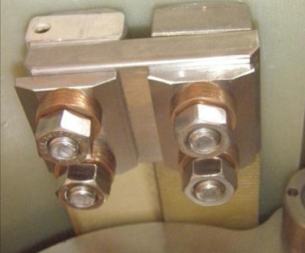
Proposed consolidation
R _{BB SSS/Plate}
R _{BB Diode/Plate}
Room temperature test
  R_{BBdiode-plate} ≈ 0.4 μΩ
  R_{BBSSS-plate} ≤ 0.1 μΩ

Slide 29
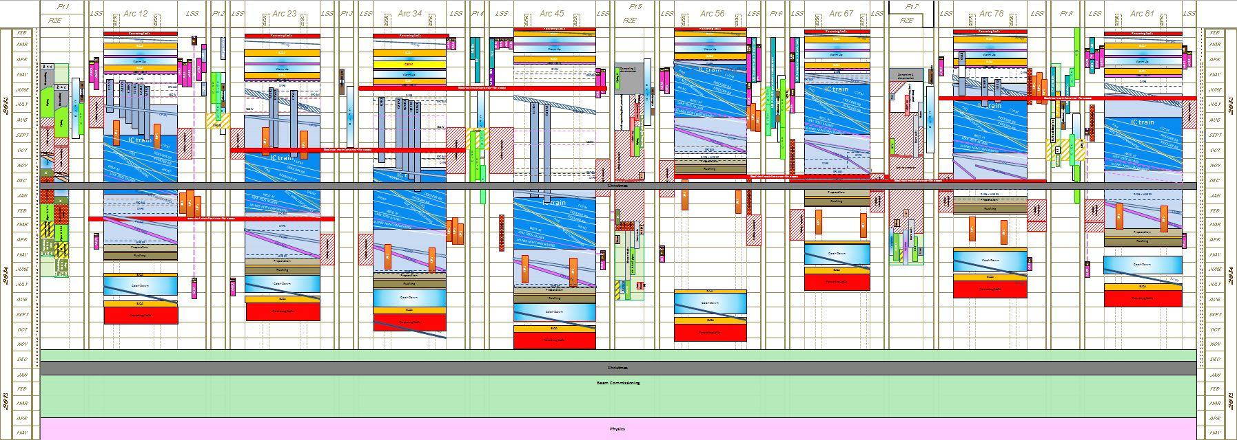
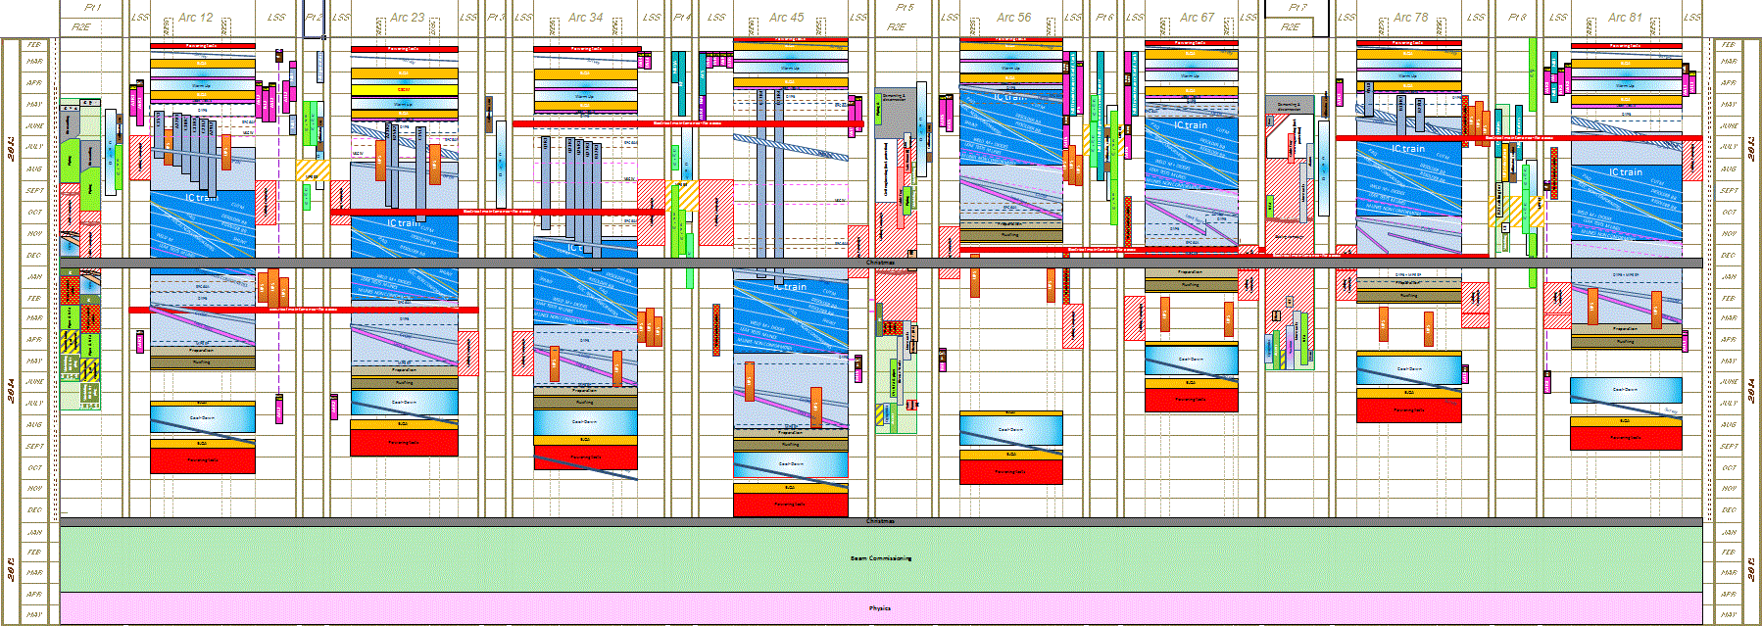
LS1 schedule (october 2012)
Courtesy of Katy Foraz, CERN
It is highly unlikely that the LHC will see beam in 2014 (politically corrected statement)

Slide 30
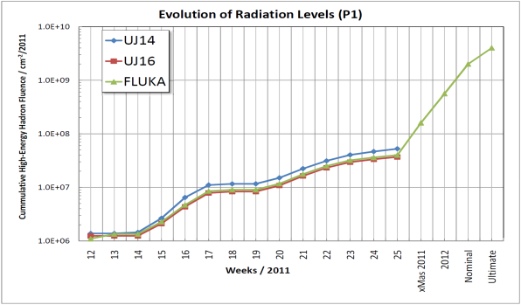
Radiation to Electronics (R2E)
Operation in 2011 has identified most critical equipment
Mitigation measures integrated “on-the-fly” if and when possible
2011/201212 Xmas Break (and Technical Stops):
  Relocation of most critical elements
  Additional shielding of most critical areas
Aim for operation in 2012 is to dodge radiation issues (no limit to the performance)
LS1 (2013-2014): relocate & shield all critical areas
Beyond LS1: major action required for power converters and other electronics in the tunnel
x50

Slide 31
From LS1 to LS2
Push the dipole field to the maximum practical value (6.5…6.8 TeV ?) that avoids extensive training and re-training (typically less than 100 quenches)
Accumulate physics at the new c.o.m. energy, 25 ns bunch spacing (efficient ?), without further changes (nominal operating parameters of the LHC)
Run flat-out for (say) 3 years at “nominal” luminosity, which we expect to largely exceed the 10³⁴ cm⁻² s⁻¹ (by ≈ 30 % ?)

Slide 32
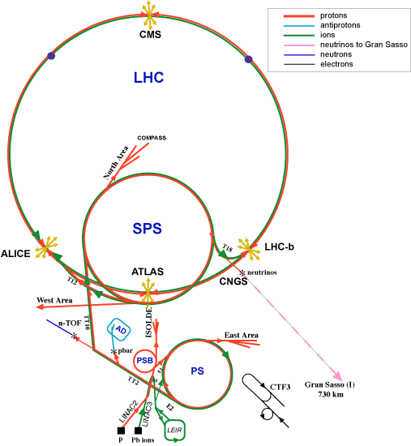
LS2 (2018): Injector Upgrades
Connect Linac4 to PS Booster,
New PS Booster injection channel
Upgrade PS Booster 1.4 ➔ 2.0 GeV
New Power Supplies, RF system etc.
Upgrade transfer lines & instrumentation
Upgrades the PS
Injection region for 2.0 GeV Injection
New/Upgraded RF systems
Upgrades to Feedbacks/Instrumentation
Upgrades to the SPS
Electron Cloud mitigation – strong feedback system, or coating of the vacuum system
Impedance reduction, improved feedbacks
Large-scale modification to the main RF system

Slide 33
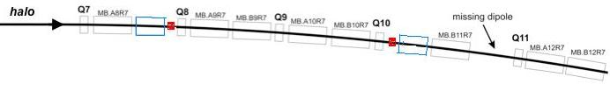
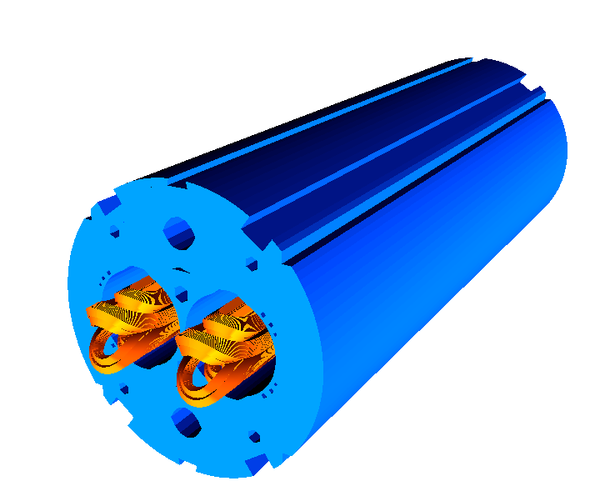

DS Upgrade: collimators & 11 T
LS2 2017-2018: IR2 (ions)
LS3 2021-2022: IR1, IR5 (HL-LHC), P3, P7 ?
MB.B8R/L
MB.B11R/L
11 T Nb₃Sn
∫BdL = 119.2 Tm @ I_{nom} = 11.85 kA
in series with MB with 20 % margin
LS2: 12 coldmass + 2 spares = 14 CM
LS3: 8 coldmass + 2 spares = 10 CM
Total 24 CM
LS2: 24 coldmass + 4 spares = 28 CM
LS3: 16 coldmass + 4 spares = 20 CM
Total 48 CM
11 m Nb₃Sn
3 m Collim
5.5 m Nb₃Sn
5.5 m Nb₃Sn
3 m Collim
5.5 m Nb₃Sn
3 m Collim.
5.5 m Nb₃Sn

Slide 34



11 T DS models
Single aperture demonstrator (MBHSP1) tested at FNAL
CERN model manufacturing started
Design of twin aperture in progress
MBHSP1 at FNAL
First 11 T copper coil winding completed at CERN
Twin aperture

Slide 35
From LS2 to LS3
Increase beam intensity from injectors
Run flat-out for (say) 3 years at “ultimate” luminosity, as dictated by (so far unknown) limits of beam intensity, stability, optics, and vacuum
Expect (typically) a factor 2 increase in peak luminosity, under increased heat and radiation loads
  Radiation induced faults (e.g. SEU)
  Beam losses (e.g. UFO’s)
  Ageing of equipment (e.g. magnet insulation)

Slide 36
LHC luminosity expectations
LHC target is 3000 fb⁻¹
220 fb⁻¹ by 2020
delivered
planned
Upgrade needed by the 2020’s:
HL-LHC
Lumi plot from M. Lamont (CERN)

Slide 37

High-Luminosity LHC: Goal
Implement a hardware configuration and a set of beam parameters that will allow to reach a peak luminosity of 5×10³⁴ cm⁻²s⁻¹ with levelling, and integrated luminosity of 250-300 fb⁻¹ per year (10 times the present LHC)

Slide 38








Scope of HL-LHC
Cryoplant for IR’s
IR quadrupoles
Cryoplant for RF cavities
Crab cavities
collimation
SC links
≈ 1 BCHF

Slide 39

Nb₃Sn knocks at the door
By courtesy of J. Parrell (OST)

Slide 40




LARP HQ (120 mm- 13 T)
Nb₃Sn has the potential to give a 50 % benefit in gradient (for the same aperture), or larger aperture (for the same gradient), at much increased temperature margin (factor 2 to 3)

Slide 41



SC links
By courtesy of A.Ballarino, CERN
HTS tapes
Round wires
Removal of the converters from the cavern
Repositioning the converters in the cavern

Slide 42


Role of crab cavities
Without crab cavity
With crab cavity
RF crab cavities deflect head and tail in opposite directions so that the collision is effectively head-on and the luminosity is maximized
The same principle can be used for luminosity leveling using the crab cavities at variable angle

Slide 43
Outline
Where do we come from
The present production at the LHC
The foreseeable LHC future
Beyond the LHC
A final message

Slide 44




Is there a physics beyond the LHC ?
Will the LHC serve the Decepticons to revive Megatron …
Amazing how much rubbish you can find on the web !!!
Or zap the conscience of Jed de Landa back to Maya time …
Or reveal that the Universe is a sentient being …
Or cause everybody to black-out and see a vision of the future ?

Slide 45



HE-LHC Scope
“[…] a 33 TeV centre-of-mass energy proton–proton accelerator in the LHC tunnel […] and the need for new injectors, possibly with 1 TeV energy”. (The High-Energy Large Hadron Collider, CERN–2011–003, also EuCARD–Conf–2011–001)
Technicolor, Supersymmetry, Extra dimensions: “[…] the need to explore the high energy frontier will remain. We will always be able to make that case, today and tomorrow”. (Elements of a Physics Case for a High-Energy LHC, J.D. Wells, pp. 1-5, CERN–2011–003, 2011)
“A project on the scale and innovation level of the HE-LHC has a long preparation lead time”. (CERN Accelerator Strategy, S. Myers, pp. 6, CERN–2011–003, 2011)

Slide 46

HE-LHC – (33 TeV cms)
HE-LHC
2030?
SPS+,
1.3 TeV, 2030?
2-GeV Booster
Linac4
By courtesy of R. Heuer

Slide 47
HE-LHC magnet challenges
27 km of very high field, accelerator grade magnets
  40 mm bore, 20 T dipoles
  40 mm bore, 500 T/m arc quadrupoles
  50 mm bore, 400 T/m IR quadrupoles
7 km of pulsed accelerator magnets with low loss
  100 mm bore, 5 T dipoles
5.6 km of transfer lines, from a SPS+ to HE-LHC
Field swing and field quality
Mechanics, protection, powering and stray field in the constrained LHC tunnel space
Increased heat loads (e.g. a factor 20 on q_{Synchrotron})
Cost and material availability
Dismantle the LHC to make space for the new ring

Slide 48
Technical superconductors
Nb-Ti
Nb₃Sn
HTS

Slide 49




A really high field dipole
HTS
Engineering extrapolation is difficult, but does not seem impossible
May require a genetic mutation in the art of SC magnet design an construction
Nb₃Sn
Nb-Ti
B_{coil}
x 2
x 3
By courtesy of E. Todesco

Slide 50

The big leap: a new tunnel !
John Osborne (CERN), Caroline Waaijer (CERN)
The optimal dipole field could be lower (e.g. 16 T) than projected for a HE-LHC in the LHC tunnel (20 T)
Higher collision energy possible !
Whichever the optimal solution,
a vigorous high field magnet R&D should start today

Slide 51

Timeline
It seems awfully early to talk about the next machine, and yet we are already late if we wish to have continuity !

Slide 52
Outline
Where do we come from
The present production at the LHC
The foreseeable LHC future
Beyond the LHC
A final message

Slide 53
Drawing the line, today
The production of physics material at the LHC proceeds very well, and the physics case for a HL-LHC is strong
The ensuing demands for technology R&D are many, intellectually interesting, technically challenging, and urgent
  Just on magnets (my toy) we are looking at new materials (Nb₃Sn, HTS), need a technology proof by 2015, production by 2020
  This will open a new portfolio of applications (laboratory, energy, medical)
HEP, and the LHC as its latest creation, is an ideal herald of innovation and advancement whose stewardship has an unbeatable record

Slide 54

Have no fear in the future of HEP…
… and thank you for your attention !

Slide 55





LHC twin-aperture dipole magnets
Concept perfected (design), demonstrated (models and prototypes) and realized on a large industrial scale
R. Perin
C. Wyss
L. Rossi

Slide 56





The LHC superconducting magnet zoo
By courtesy of S. Russenschuck (CERN)

Slide 57



Short Straight Sections
1994 – CEA short straight sections (SSS) prototypes reach CERN and are assembled in String-I
14 February 1996 – CNRS-CEA-CERN collaboration protocol signed for the procurement of 392 main quadrupoles and assembly in the LHC-SSS
2006 – production completed

Slide 58



High luminosity insertion
LHC point 5

Slide 59

Consolidation work in 2009

Slide 60















13 kA splice consolidation
Bus bars machining
Welds cutting with orbital cutting machine in place
Sleeve sliding
Shunts positioning and soldering
Kapton foil insulation along 250mm
Injection envelopes in place
Lower insulation cover insertion
Upper insulation cover insertion
Insulation covers Fixation
Resin injection into the envelopes
Spider insulation in place

Slide 61

Target parameters for
HL-LHC run
Efficiency is defined as the ratio between the annual luminosity target of 250 fb⁻¹ over the potential luminosity that can be reached with an ideal cycle run time with no stop for 150 days: t_{run}= t_{lev}+t_{dec}+t_{turn}. The turnaround time after a beam dump is taken as 5 hours, t_{decay} is 3 h while t_{lev} depends on the total beam current
SC Magnets
SC RF Cavities
SC Links
baseline
By courtesy of L. Rossi

Slide 62
The critical zone: magnet changes, cryogenics +…
ATLAS
CMS
3. For collimation we need to change also this part, a new 11 T dipole
2. Deep change also
matching section:
Magnets, collimators and SC RF Crab Cavities
1. New Magnets in the IRs and interface to detectors; relocation of Power Supplies via use of SC links
300 m x 4 +… ∼ 1.5 km long accelerator
In high radiation environment: 10…100 MGy

Slide 63


The forms of Nb₃Sn
Recent 23.4 T (1 GHz) NMR Magnet for spectroscopy built from Nb₃Sn (and Nb-Ti).
15-20 tons/year produced for NMR and HF solenoids, and experimental MRI
ITER: 500 tons in 2010-2015, comparable to LHC!
HEP Nb₃Sn:
  High Jc(1 T, 4.2K) = 3000 A/mm²
  Large filaments (50 µm)
  Cost is 5 to 10 times Nb-Ti
0.7 mm, 108/127 stack RRP from Oxford OST
1 mm, 192 tubes PIT from Bruker EAS
Notes:
This is not a big problem for HL-LHC, requiring 20 tonnes of superconductors, however it is major
problem for HE-LHC ,requiring in total 3000 tonnes of superconductor, most than half in Nb3Sn.
To gauge these figures in the context, LHC has used 1200 tonnes of Nb-Ti, while ITER requires about 500
tonnes of Nb3Sn.

Slide 64




11 T DS models

Slide 65







US-LARP: IR quadrupoles
SM
SQ
TQS
LQS-4m
LR
TQC
HQ

Slide 66



SMC tests at CERN
12.6 T
By courtesy of J. Perez and M. Bajko

Slide 67



SC Link tests
20 m flexible cryostat for prototype tests at CERN
Installation of a SC link cable in the 5 m flexible cryostat used for tests at Southampton university

Slide 68



A sample from crab cavities R&D
Compact cavities, small footprint
400 Mhz, 5 MV/cavity
Timing at fs level !
Y. Yakovlev et al.

Slide 69

A first shot for the HE-LHC
Notes:
20 T 33 Tev cm
16 T 26.5 TeV cm

Slide 70



New materials – Bi-2212
Round wire, isotropous and suitable for cabling!
HEP only users (good < 20K and for compact cable)
Big issue: very low strain resistance, brittle
Production ~ 0,
Cost ~ 5 times Nb3Sn
(Ag stabilized)
DOE program 2009-11 in USA let to a factor 2 gain. We need another 50% and more uniformity, eliminating porosity and leakage
By courtesy of L. Rossi

Slide 71


New materials – YBCO
Tape of 0.1-0.2 mm x 4-10 mm : difficult for compact (>85%) cables
Current is EXCELLENT but anisotropy is an issue;
More than 90% of world effort on HTS are on YBCO! Synergy with the community
Cost : today is 10 times Nb₃Sn, target is same price: components not expensive, process difficult to be industrialize at low cost
FP7 Eucard is developing EU YBCO
By courtesy of L. Rossi

