Slide 1
ATLAS
Overview & Higgs
Andrew J. Lankford
University of California, Irvine
on behalf of the ATLAS Collaboration

Slide 2
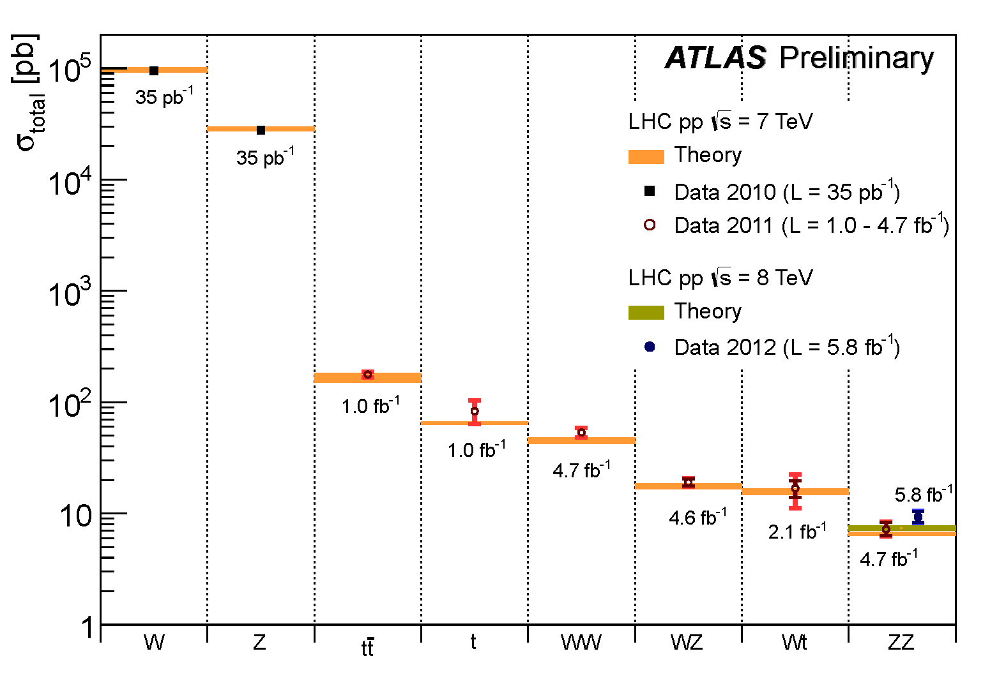
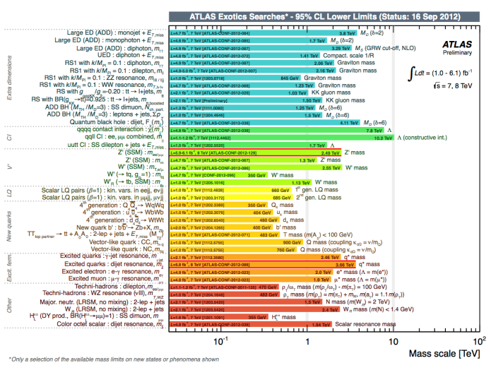
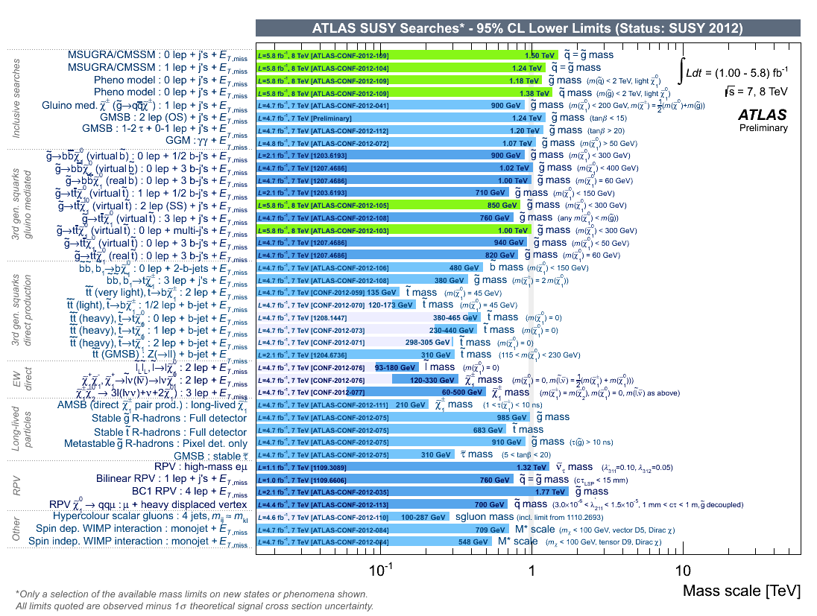
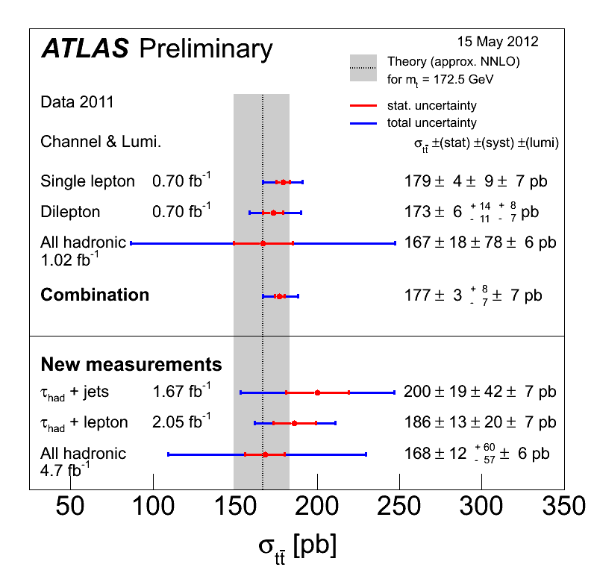
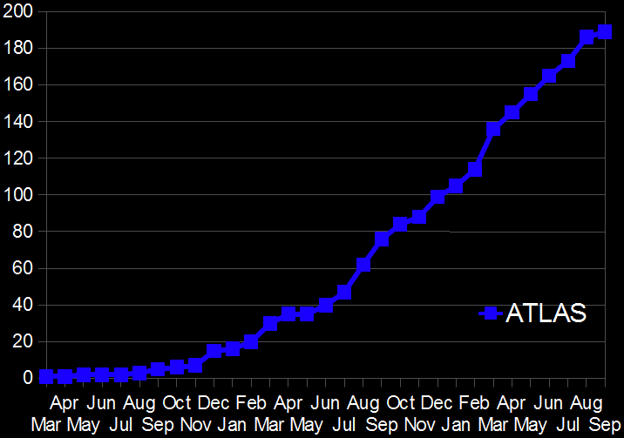
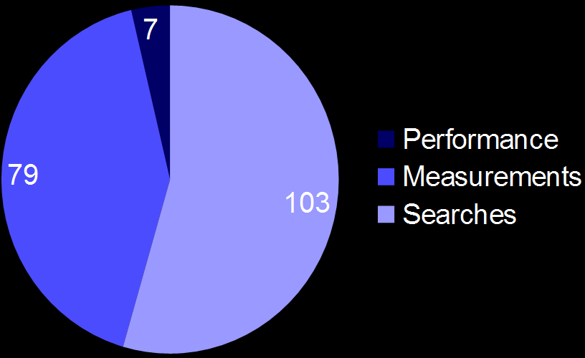
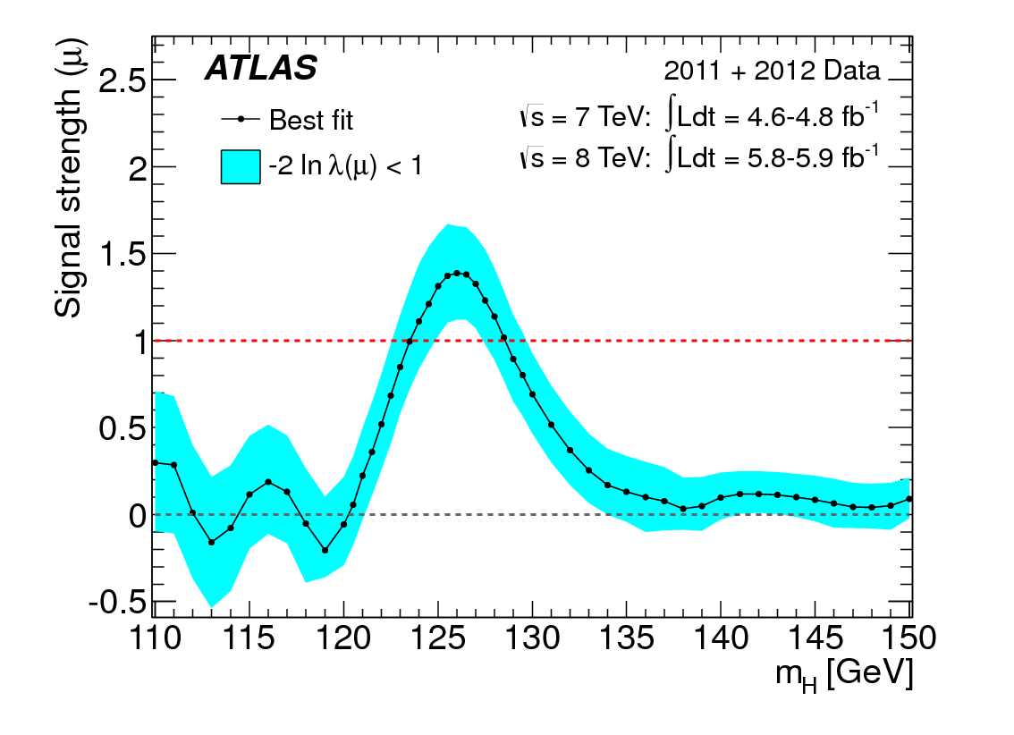

ATLAS Overview & Higgs
(Andy Lankford, UC Irvine)
189 papers, 395 Conference notes, as of 30 Sep 2012

Slide 3
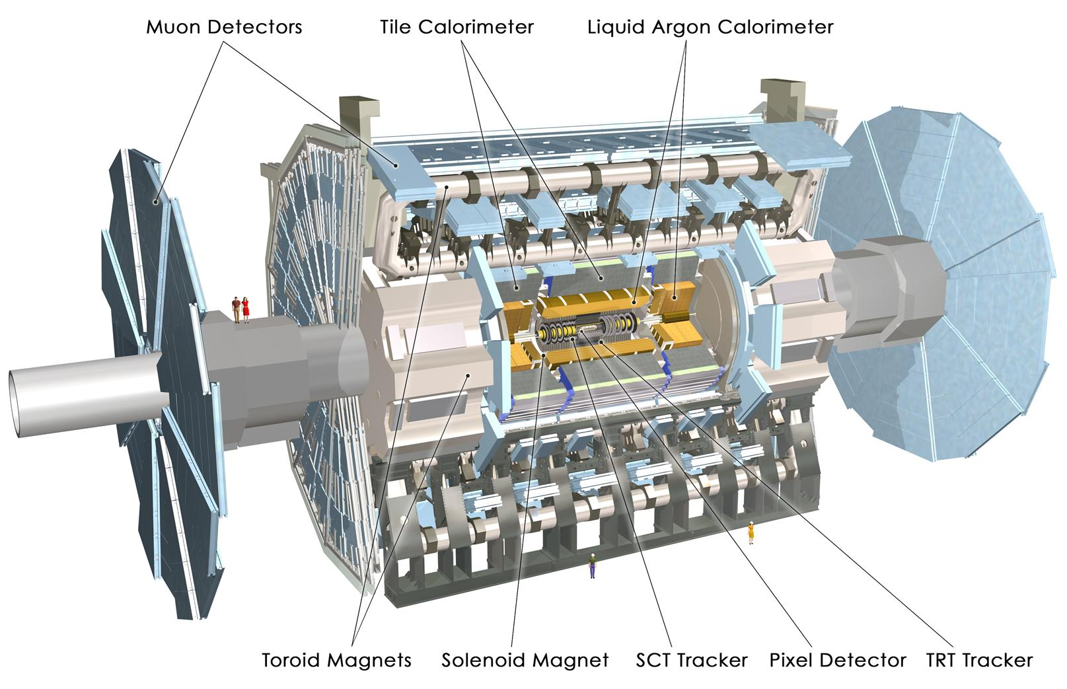
Muon Spectrometer (|η|<2.7) : air-core toroids with gas-based muon chambers
Muon trigger and measurement with momentum resolution < 10% up to E_{μ} ~ 1 TeV
Length : ~ 46 m
Radius : ~ 12 m
Weight : ~ 7000 tons
~10⁸ electronic channels
3000 km of cables
3-level trigger
reducing the rate from
40 MHz to ~400 Hz
Inner Detector (|η|<2.5, B=2T):
Si Pixels, Si strips, Transition Radiation detector (straws)
Precise tracking and vertexing,
e/π separation
Momentum resolution:
σ/p_{T} ~ 3.8x10⁻⁴ p_{T} (GeV) ⊕ 0.015
EM calorimeter: Pb-LAr Accordion
e/γ trigger, identification and measurement
E-resolution: σ/E ~ 10%/√E
HAD calorimetry (|η|<5): segmentation, hermeticity
Fe/scintillator Tiles (central), Cu/W-LAr (fwd)
Trigger and measurement of jets and missing E_{T}
E-resolution: σ/E ~ 50%/√E ⊕ 0.03
Notes:
3

Slide 4

Stepping stones, to a discovery (and many other nice results ... )
  > 20 years from conception to start of operation
  10 years of construction
  15 years of test beams, 20 years of detector and physics simulations
  8 years of world-wide computing data challenges
  17 Technical Design Reports

Slide 5
Stepping stones, to a discovery (and many other nice results ... )
  > 20 years from conception to start of operation
  10 years of construction
  15 years of test beams, 20 years of detector and physics simulations
  8 years of world-wide computing data challenges
  17 Technical Design Reports
More recently,
Outstanding performance of the LHC
Excellent ATLAS data-taking efficiency and data quality
Detector and trigger performance approaching ultimate expectation:
experience gained with 2011 data propagated to trigger, reconstruction, and simulation,
yielding improved detector understanding, alignment and calibration,
huge effort since Fall 2011 to prepare for higher pile-up in 2012 and mitigate impact
on trigger and reconstruction and identification of physics objects,
yielding sizeable gain in efficiency for e/γ/μ, jets, E_{T}^{miss} , pile-up dependence minimized …
Superb performance of the Computing Grid enabling physicists all over the world to do data analysis very effectively
Detailed studies of Standard Model processes, important in their own right and as background to searches
→ Huge amount of painstaking foundation work !

Slide 6
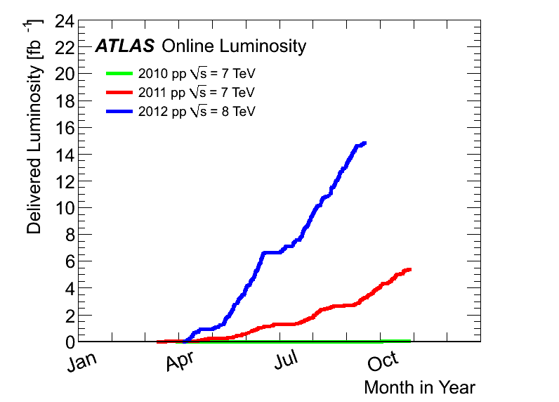
Outstanding performance of the LHC
Max luminosity:
~ 7.7 x10³³ cm⁻² s⁻¹
2012:
15 fb⁻¹
at 8 TeV
^{until end Sept}
4th July seminar
and ICHEP
2011
5.6 fb⁻¹
at 7 TeV
2010
0.05 fb⁻¹
at 7 TeV
BIG THANKS to the LHC team

Slide 7

Excellent ATLAS data-taking efficiency & data quality
Fraction of non-operational detector channels:
(depends on the sub-detector)
few permil (most cases) to 5%
Data-taking efficiency = (recorded lumi)/(delivered lumi):
~ 93.7%
Good-quality data fraction, used for analysis :
(will increase further with data reprocessing)
> 93 %
of the delivered luminosity used for physics
in spite of the very recent data
in spite of the harsher conditions in 2012
~ 90%

Slide 8
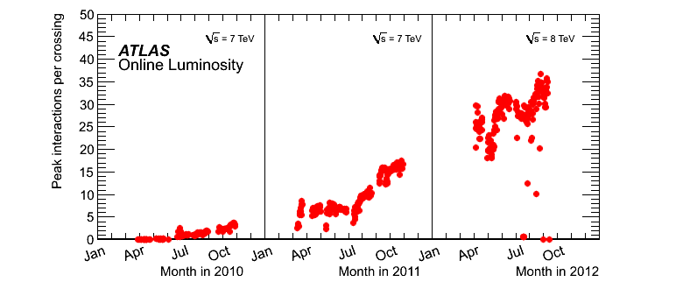
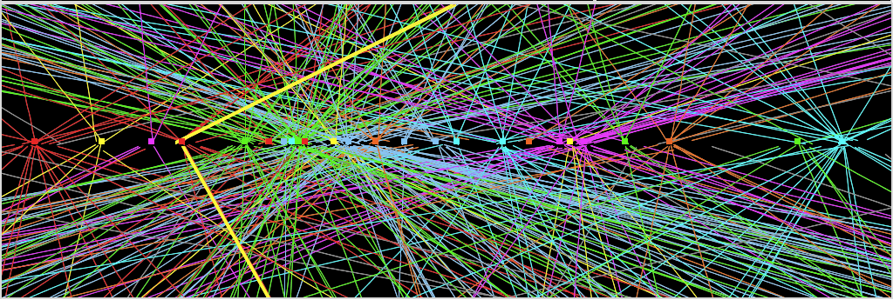
The BIG challenge in 2012: PILE-UP
Experiment’s
design value
(expected to be
reached at L=10³⁴ !)
Z→ μμ event from 2012 data with 25 reconstructed vertices
Z→ μμ

Slide 9
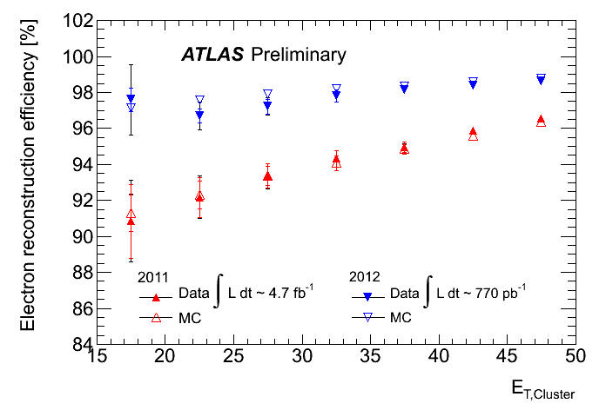
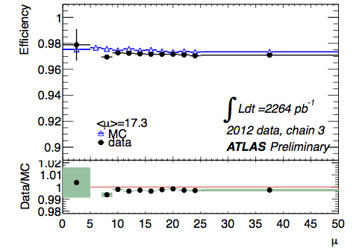
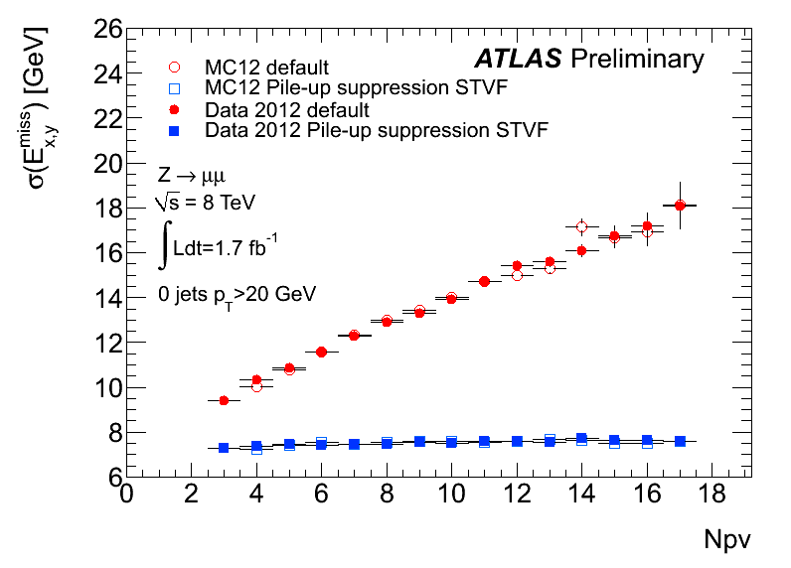
Improved e± reconstruction
to recover Brem losses
Muon reconstruction efficiency ~ 97%
down to p_{T} ~ 6 GeV over |η|<2.7
2012 Z→ μμ data
2012 Z→ ee data
Number of pile-up events
Stability of EM calorimeter response vs time
(and pile-up) during full 2011 run better than 0.1%
E_{T}^{miss} resolution vs pile-up before and
after pile-up suppression using tracks
2012 Z→ μμ data
Number of reconstructed primary vertices

Slide 10
Improved e± reconstruction
to recover Brem losses
Muon reconstruction efficiency ~ 97%
down to p_{T} ~ 6 GeV over |η|<2.7
2012 Z→ μμ data
2012 Z→ ee data
Detector performance approaching ultimate expectation
Number of pile-up events
Stability of EM calorimeter response vs time
(and pile-up) during full 2011 run better than 0.1%
E_{T}^{miss} resolution vs pile-up before and
after pile-up suppression using tracks
2012 Z→ μμ data
Number of reconstructed primary vertices

Slide 11
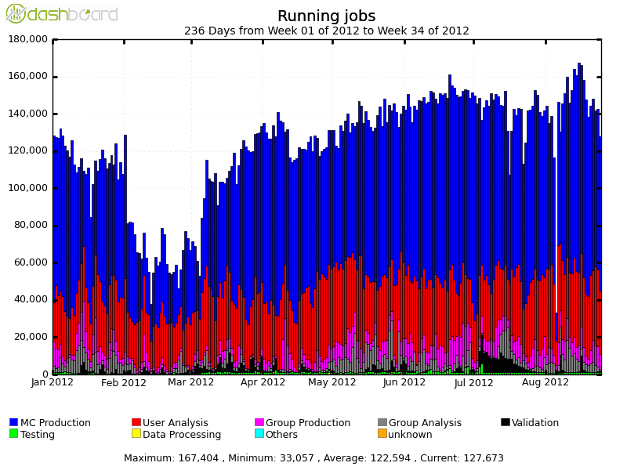
Superb performance of the WLCG:
LHC performance and high pile-up conditions also challenged the Computing system.
It would have been impossible to release physics results so quickly without
the outstanding performance of the WLCG (including the CERN Tier-0).
Number of concurrent ATLAS jobs Jan-Aug 2012
Includes MC production and
user and group analysis at
~ 80 sites all over the world
100 k
100 k
> 1500 distinct ATLAS users
do analysis on the GRID
Massive production of 8 TeV Monte Carlo samples
Available resources fully used (beyond pledges in some cases)
Very effective and flexible Computing Model and operation team → accommodate high
trigger rates and pile-up, intense MC simulation, analysis demands from worldwide users

Slide 12
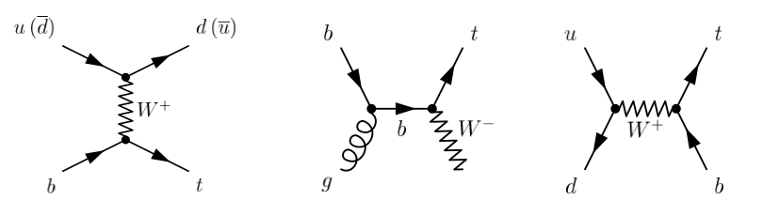
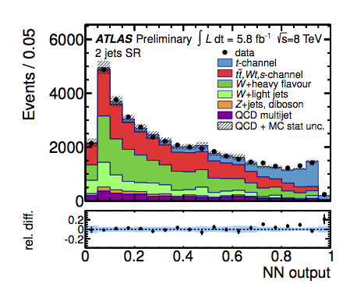
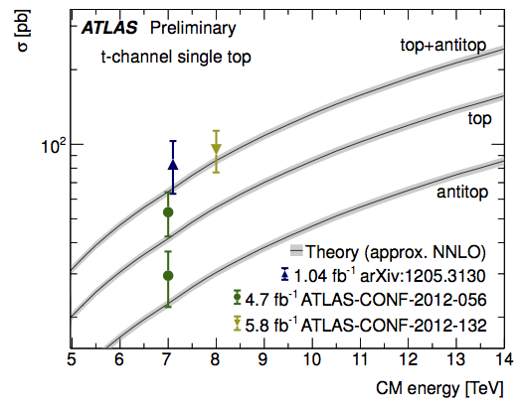

Detailed studies of SM processes: one (challenging) example of SM measurements: single top
All main physics objects in final state:
leptons, jets, b-jets, E_{T}^{miss}
Background to Higgs and other searches
Difficult to extract from tt and W+jets
backgrounds → requires “advanced”
analysis techniques (e.g. neural net)
t-channel
σ_{t} =87.8^{+3.4}_{-1.9} pb
Wt-channel
σ_{Wt} =22.4 ± 2.4 pb
s-channel
σ_{s} =5.6 ± 0.2 pb
σ_{t} (7 TeV) = 83 ± 20 pb σ_{t} (8 TeV)= 95 ± 18 pb
σ_{Wt} (7 TeV) = 17 ± 6 pb σ_{s} (7 TeV) < 26 pb

Slide 13
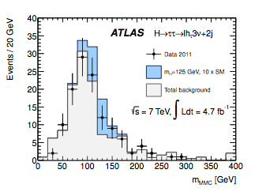
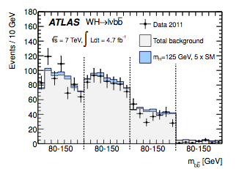
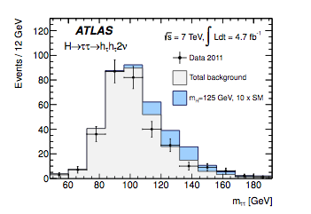
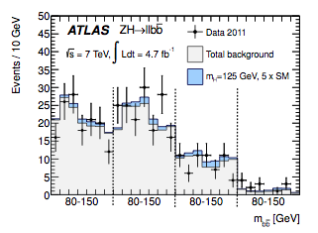
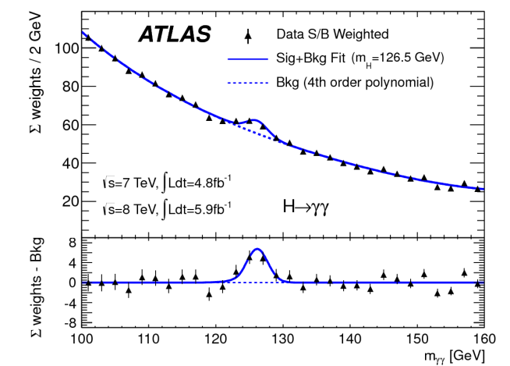
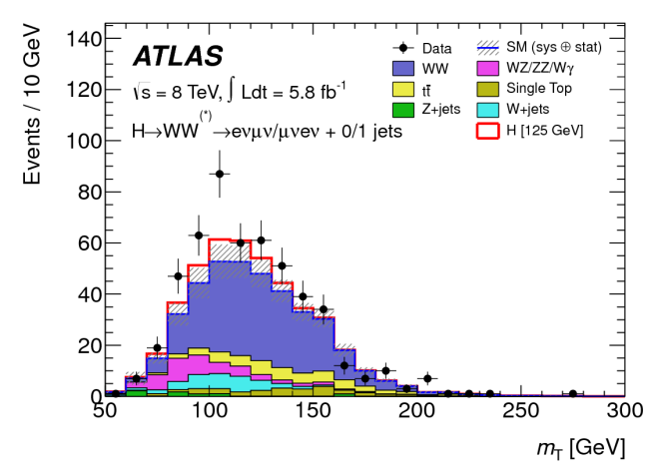
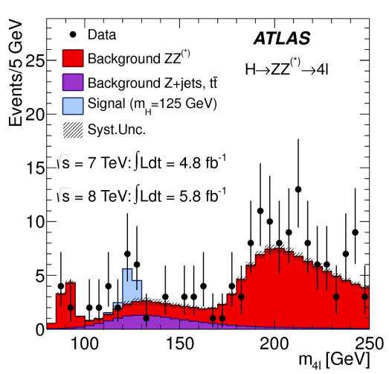
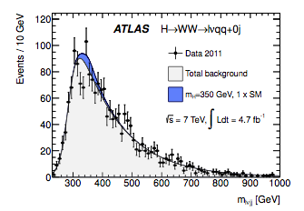
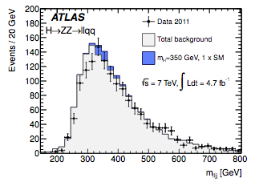
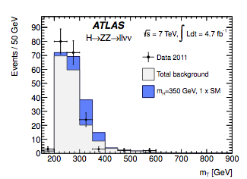
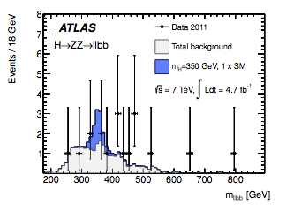
SM Higgs searches
Results reported here based on “ICHEP sample”:
~ 4.9 fb⁻¹ √s =7 TeV data (2011) + ~5.9 fb⁻¹ √s = 8 TeV data (2012) → total: ~10.7 fb⁻¹
for H→γγ, H→ZZ* → 4l, H→ WW* → lνlν
~ 4.9 fb⁻¹ of √s =7 TeV data (2011) for H → ττ, W/ZH → bb and high-mass channels
(Now ~16 fb⁻¹, growing)
New since ICHEP & PLB: first measurements of couplings

Slide 14
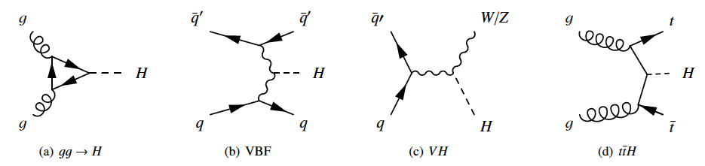
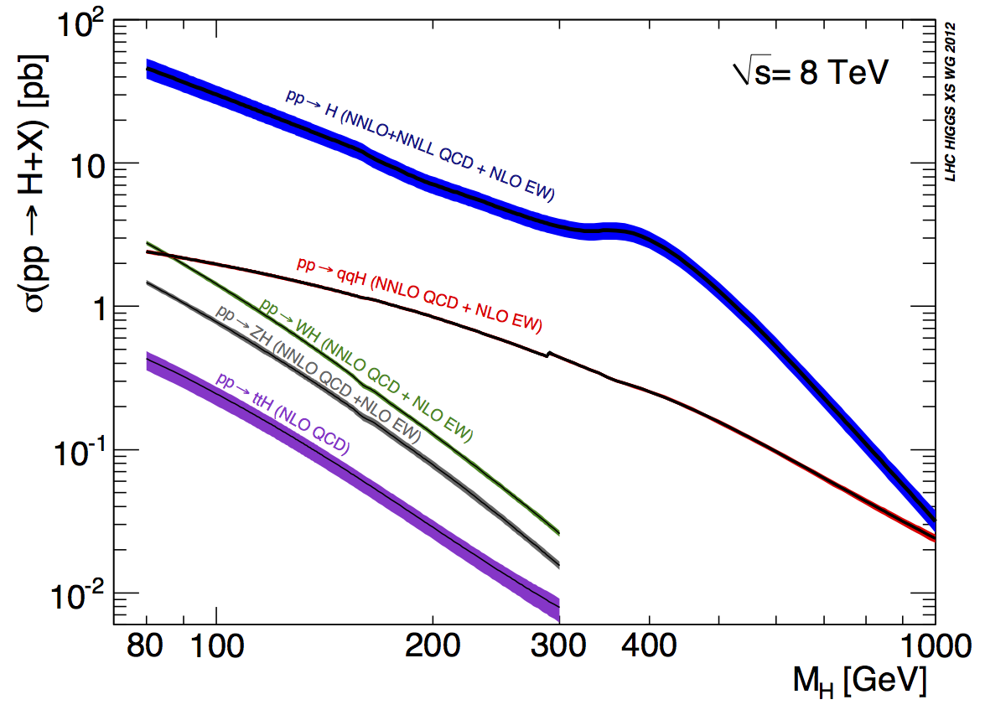
SM Higgs production cross-section and decay modes
~ 20 x Tevatron
for m_{H}=120 GeV
Most sensitive channels (decreasing order)
for 120 <m_{H}< 130 GeV:
H→ ZZ*→ 4l, H→ γγ, H→ WW*→ lνlν
H→ ττ, W/ZH→ W/Z bb
√s=7 → 8 TeV:
  Higgs cross-section increases by ~ 30% for m_{H} ~ 125 GeV
  Similar increase for several irreducible backgrounds: e.g. 20-25% for γγ, di-bosons
  Reducible backgrounds increase more: e.g. 30-40% for tt, Zbb
⇨ Expected increase in Higgs sensitivity: 10-15%

Slide 15
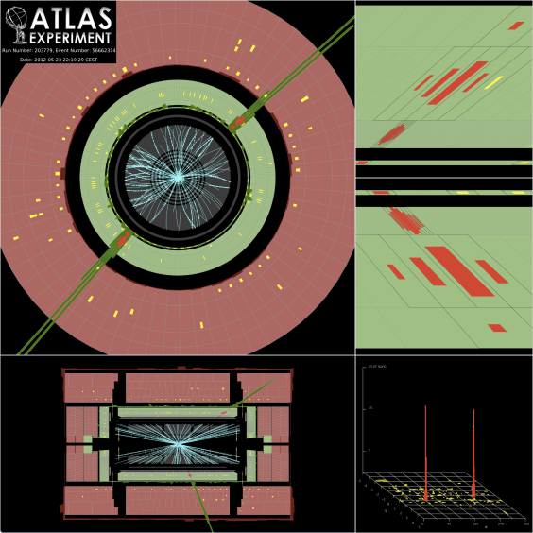
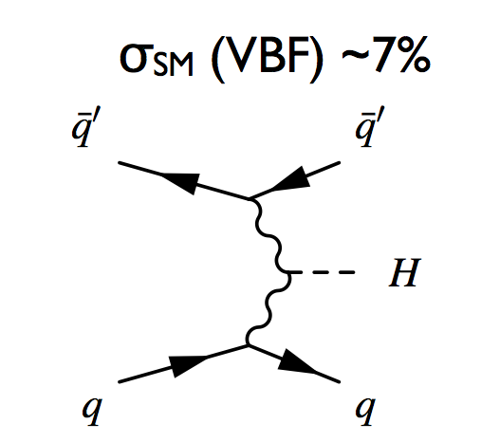
H → γγ
sensitive for 110 ≤ m_{H} ≤ 150 GeV
σ x BR ~ 50 fb m_{H} ~ 126 GeV
Simple topology: two high-p_{T} isolated photons
E_{T} (γ₁, γ₂) > 40, 30 GeV
Main background: γγ continuum (irreducible, smooth, …)
To increase sensitivity, events divided into 10 categories based on:
γ rapidity
γ converted or unconverted
p_{Tt} (p_{T}^{γγ} perpendicular to γγ thrust axis)
presence of 2 forward jets (targeting VBF process)
Result based on fit to all categories
2 jets with
p_{T} > 25-30 GeV
|η|<4.5
|Δη|_{jj} > 2.8
M_{jj} > 400 GeV
|Δφ| (γγ-jj) > 2.6
After all selections, expect (10.7 fb⁻¹, m_{H}~ 126 GeV)
~ 170 signal events
~ 6340 background events in mass window
→ S/B ~ 3% inclusive (~ 20% 2-jet category)
Crucial experimental aspects:
excellent γγ mass resolution to observe narrow signal peak above irreducible background
powerful γ identification to suppress γj and jj background with jet → π⁰ → fake γ

Slide 16
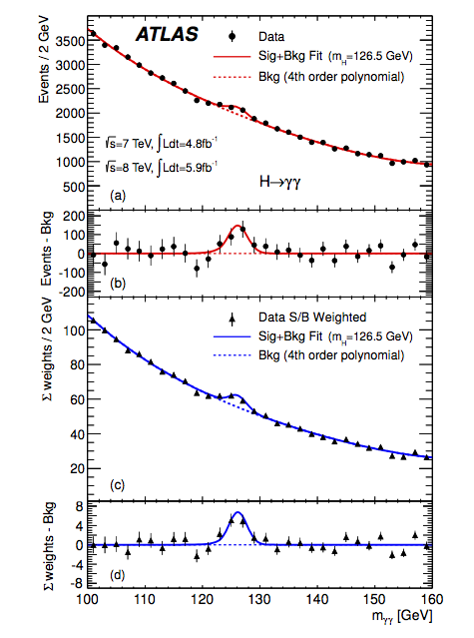
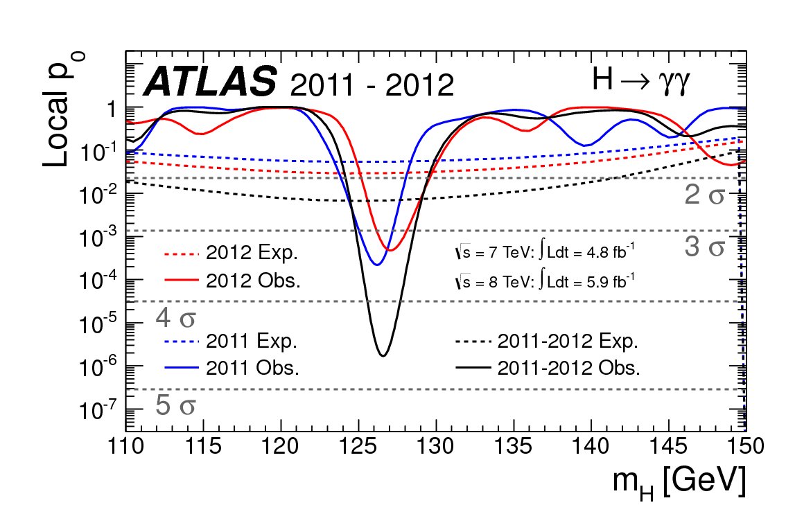
After all selections: 59059 events
p-value: consistency of data with
background-only expectation
Expected from
SM Higgs at
given m_{H}
“raw” mass spectrum
Data sample m_{H} of max local significance
significance obs. (exp. SM H)
2011 126 GeV 3.4 σ (1.6)
2012 127 GeV 3.2 σ (1.9)
2011+2012 126.5 GeV 4.5 σ (2.5)
weighted: w_{i} ~S/B in each category i
peak above a large smooth background,
relies upon excellent mass resolution

Slide 17
H → ZZ^{(*)} → 4l (4e, 4μ, 2e2μ)
sensitive for 110 < m_{H} < 600 GeV
σ x BR ~ 2.5 fb m_{H} ~ 126 GeV
Very small cross-section, but:
-- mass can be fully reconstructed → events should cluster in a (narrow) peak
-- pure: S/B ~ 1
4 leptons: p_{T}^{1,2,3,4} > 20,15,10,7-6 (e-μ) GeV; 50 < m₁₂ < 106 GeV; m₃₄ > 17.5-50 GeV (vs m_{H})
Main backgrounds:
-- ZZ^{(*)} : irreducible
-- low-mass region m_{H} < 2m_{Z} : Zbb, Z+jets, tt with two leptons from b-jets or q-jets
  suppressed with isolation and impact parameter cuts on two softest leptons
Crucial experimental aspects:
High lepton acceptance, reconstruction and identification efficiency down to lowest p_{T}
Good lepton energy/momentum resolution
Good control of reducible backgrounds (Zbb, Z+jets, tt) in low-mass region:
→ cannot rely on MC alone (theoretical uncertainties, b/q-jet → lepton modeling, ...)
→ need to validate MC with data in background-enriched control regions
Main improvements in analysis for 4th July seminar:
kinematic cuts optimized/relaxed to increase signal sensitivity at low mass
increased e± reconstruction and identification efficiency at low p_{T} and pile-up robustness
→ Gain 20-30% in sensitivity compared to previous analysis

Slide 18
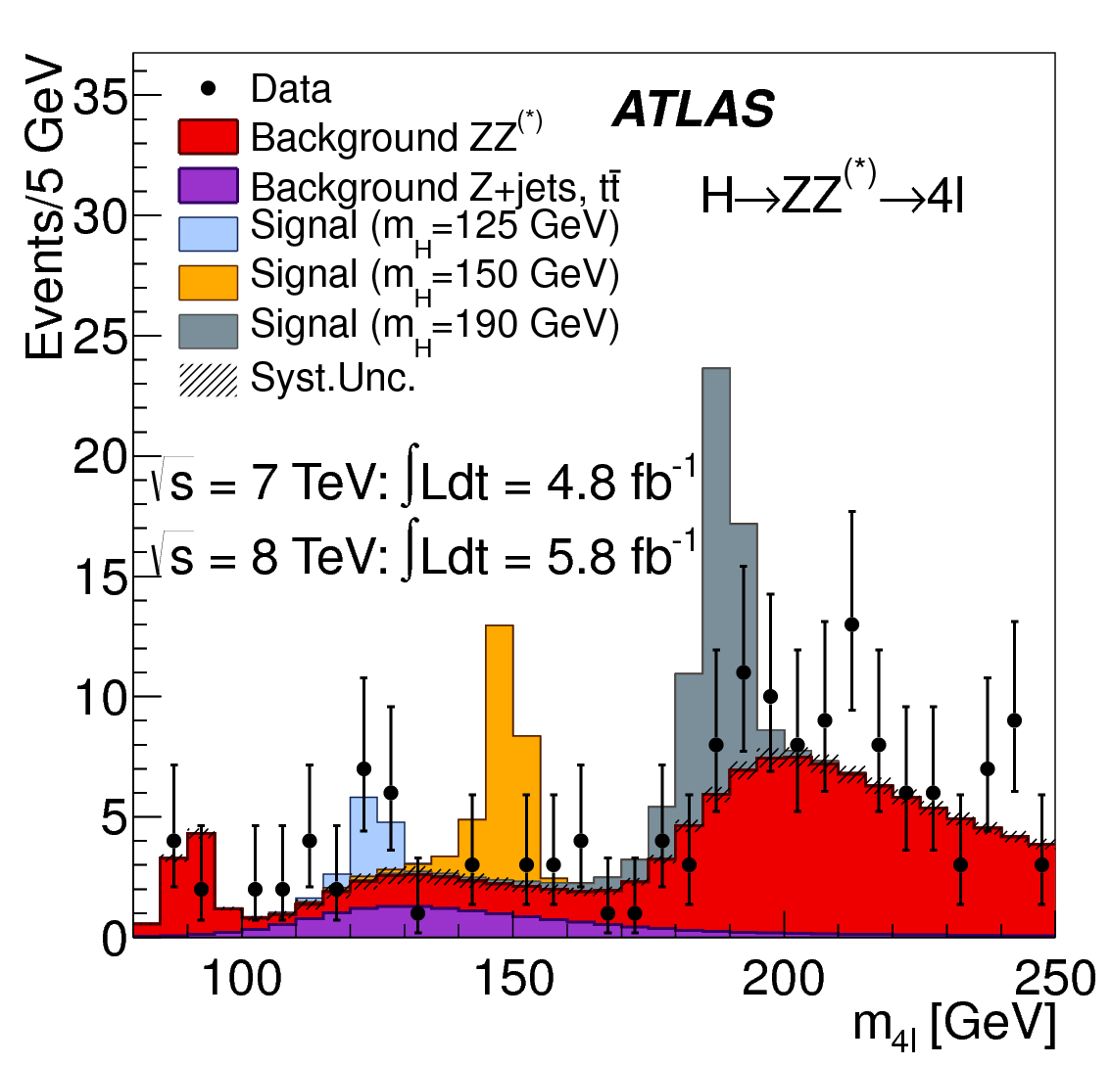
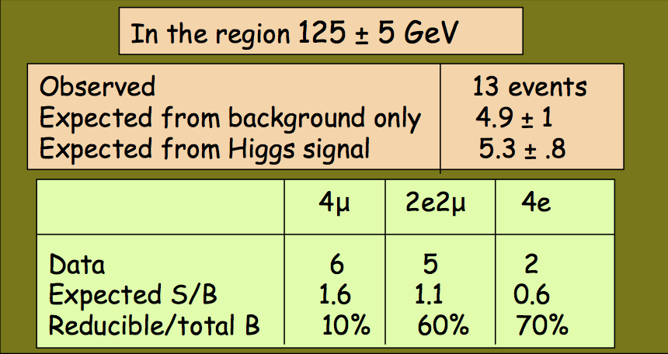
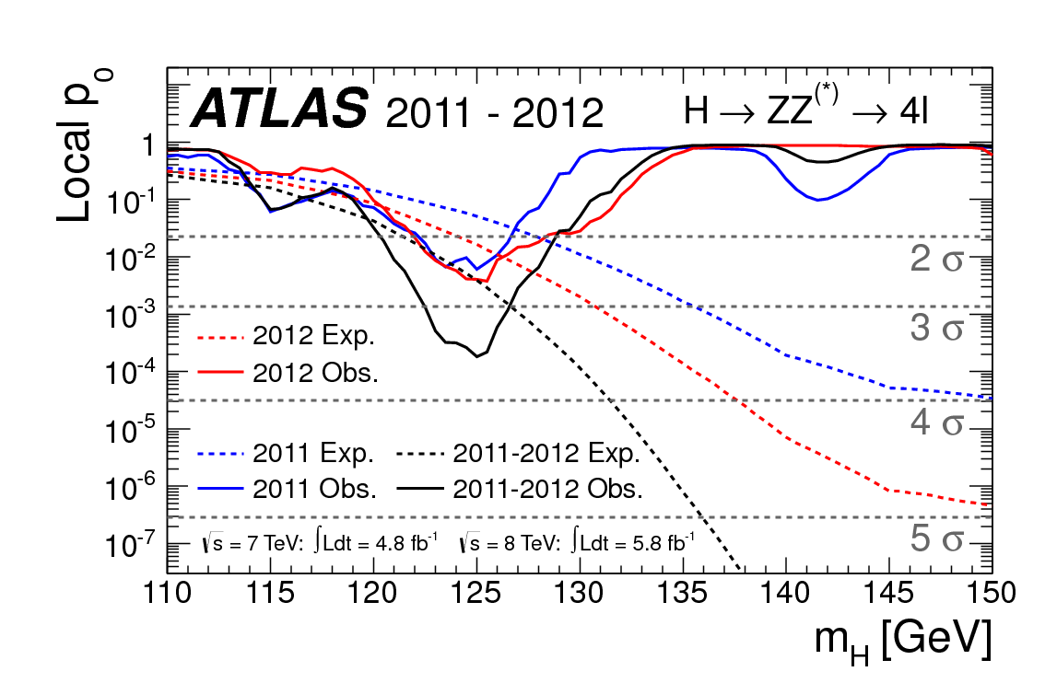
Reconstructed 4l mass spectrum after all selections
Data sample m_{H} of max local significance
significance obs. (exp. SM H)
2011 125 GeV 2.5 σ (1.6)
2012 125.5 GeV 2.6 σ (2.1)
2011+2012 125 GeV 3.6 σ (2.7)
small peak on a small background,
relies upon high efficiency

Slide 19
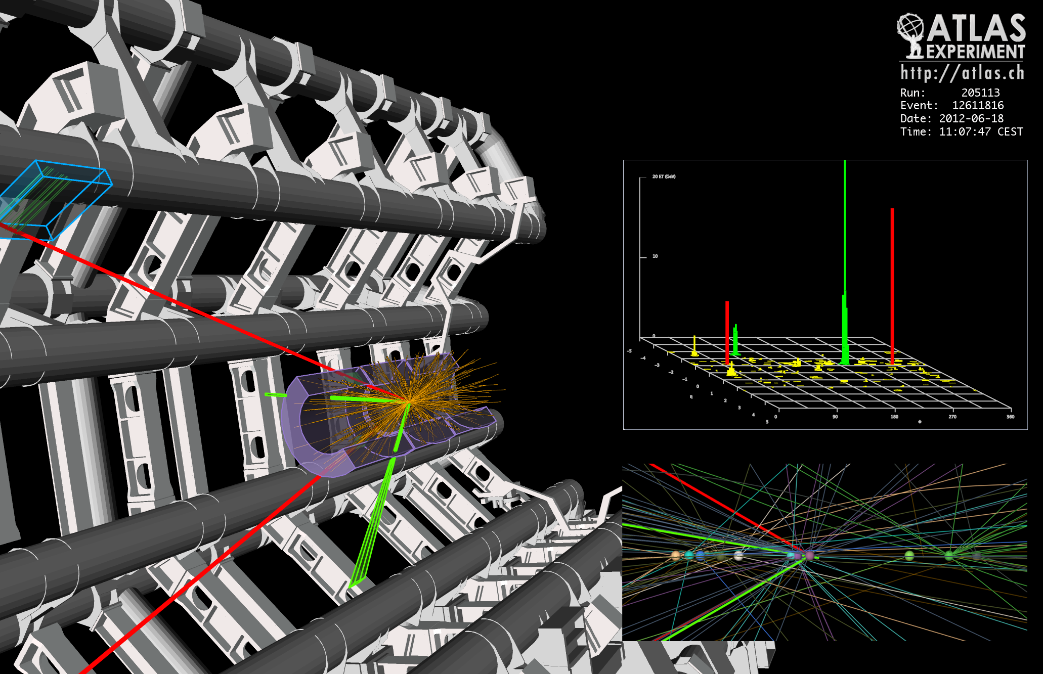
2e2μ candidate with m_{2e2μ}= 123.9 GeV
p_{T} (e,e,μ,μ)= 18.7, 76, 19.6, 7.9 GeV, m (e⁺e⁻)= 87.9 GeV, m(μ⁺μ⁻) =19.6 GeV
12 reconstructed vertices

Slide 20
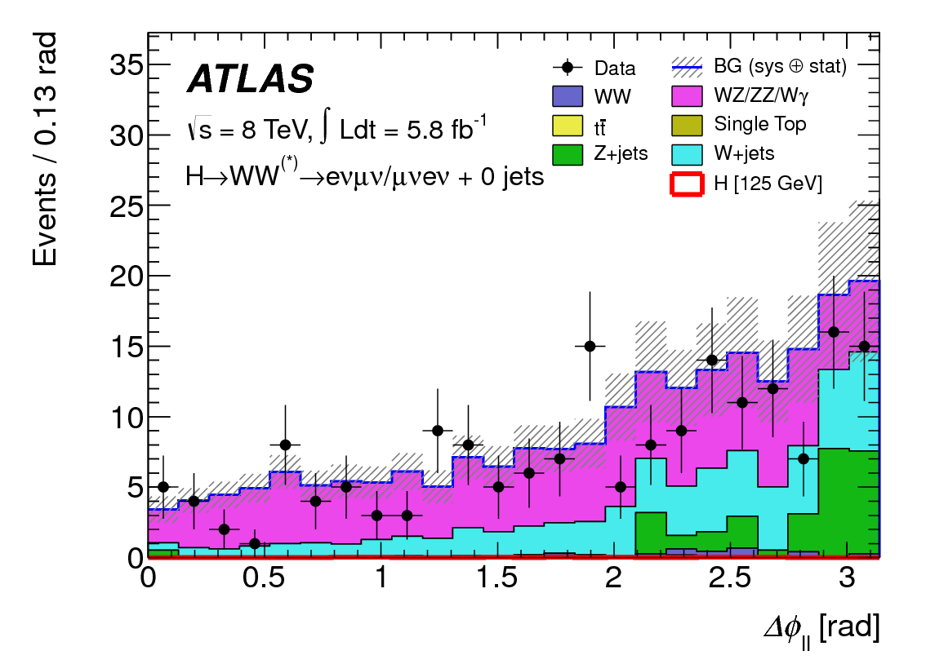
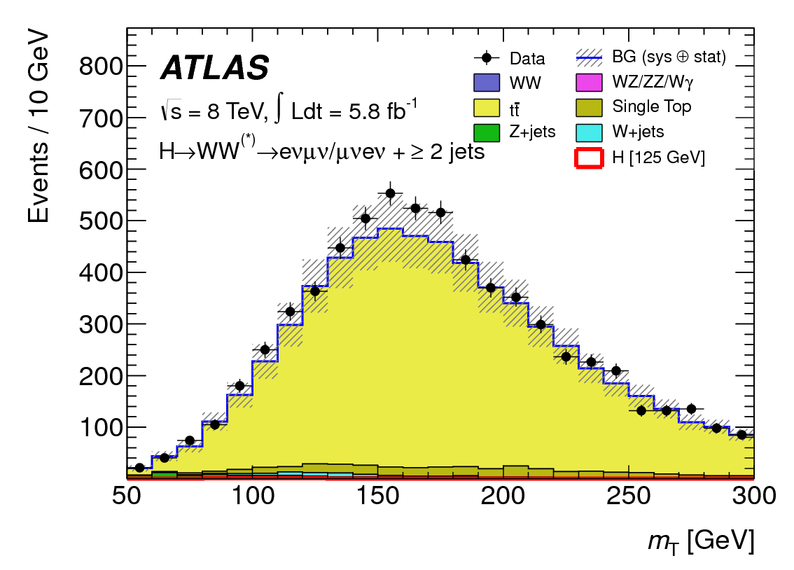
H →WW^{(*)} → lνlν (eνeν, μνμν, eνμν)
sensitive for 110 < m_{H} < 600 GeV
σ x BR ~ 200 fb for m_{H}~ 125 GeV
Large cross section
However: 2ν in final state → mass peak cannot be reconstructed → “counting channel”
H→ eνμν studied with 2012 data: ~ 85% of sensitivity, less Drell-Yan background
2 isolated opposite-sign leptons, p_{T} > 25, 15 GeV
Main backgrounds: WW, top, Z+jets, W+jets
→ large E_{T}^{miss} , m_{ll} ≠ m_{Z}, b-jet veto ...+ topological cuts: p_{Tll}, m_{ll}, Δϕ_{ll} (smaller for scalar Higgs)
Crucial experimental aspects:
understanding of E_{T}^{miss}
very good modeling of background in signal region → use signal-free control regions in data to constrain MC → use MC to extrapolate to signal region
Same-sign 0j
control region
Top 2j
control region

Slide 21
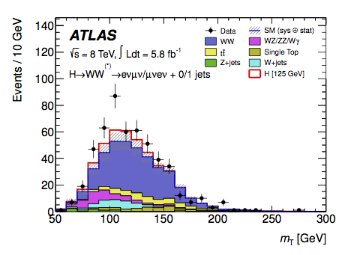

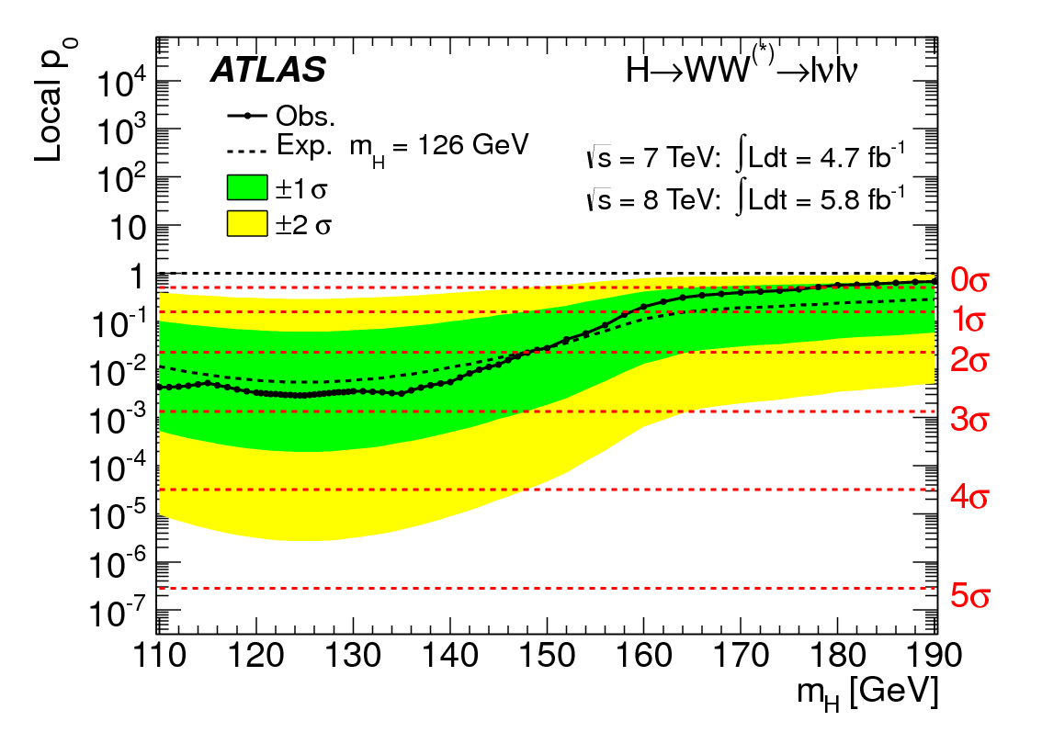
After all selections
Observed: 223 events
expected from
background only 168 ± 20
expected from
Higgs m_{H}=126 GeV 25 ± 5
Data sample m_{H} of max local significance
significance obs. (exp. SM H)
2011 135 GeV 1.1 σ (3.4)
2012 120 GeV 3.3 σ (1.0)
2011+2012 125 GeV 2.8 σ (2.3)
Expected from
SM Higgs with
m_{H}=126 GeV
Broad excess, extending over > 50 GeV
in mass, due to poor mass resolution

Slide 22
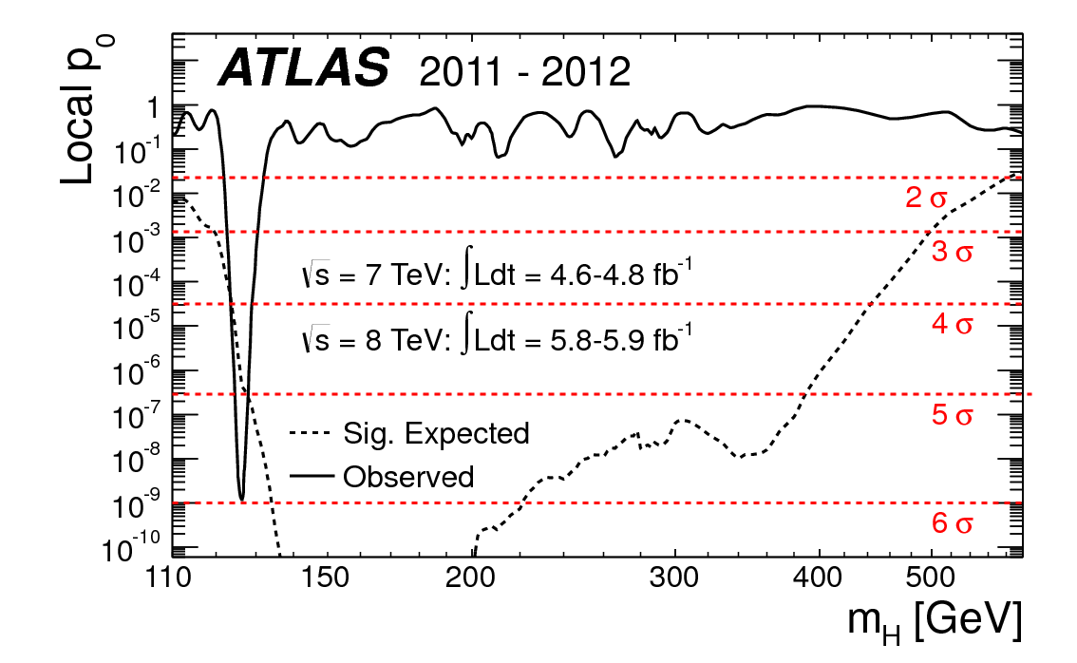
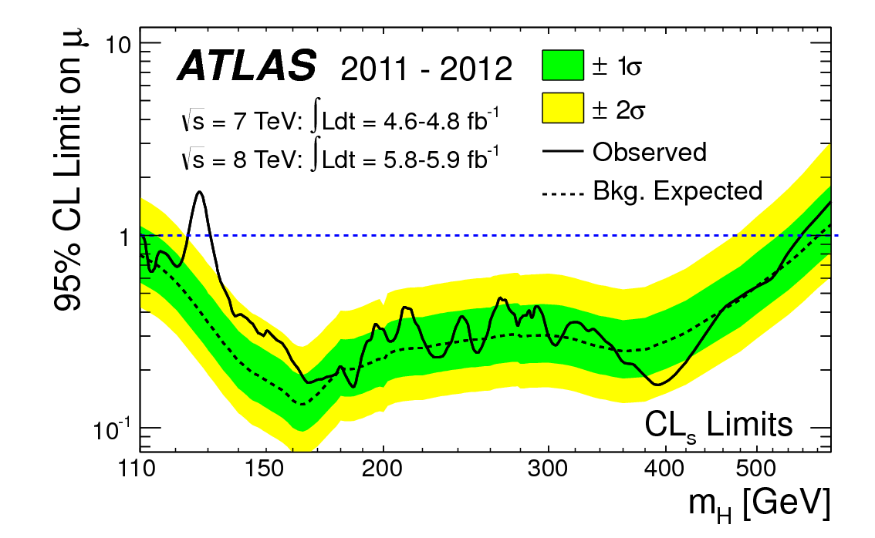
Combining all (12)
channels together
5.9σ
Excluded at 95% CL:
112-122, 131-559 GeV

Slide 23
Combining all (12)
channels together
5.9σ
Excluded at 95% CL:
112-122, 131-559 GeV

Slide 24
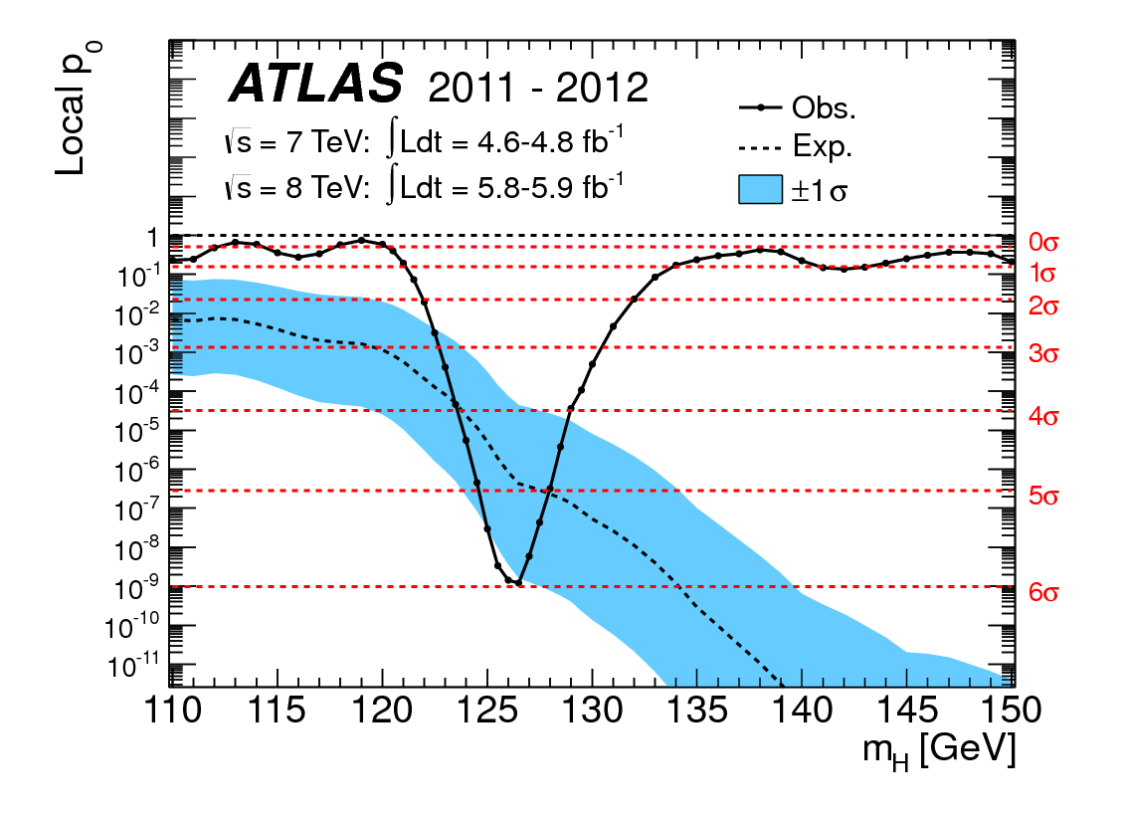
Combining all (12)
channels together
5.9σ
Maximum excess observed at
m_{H} = 126.5 GeV
Excluded at 95% CL:
112-122, 131-559 GeV
Local significance
= 5.9 σ
Probability of blgd. fluctuation
= 1.7 x 10⁻⁹
Global significance: ~ 5.2 σ

Slide 25
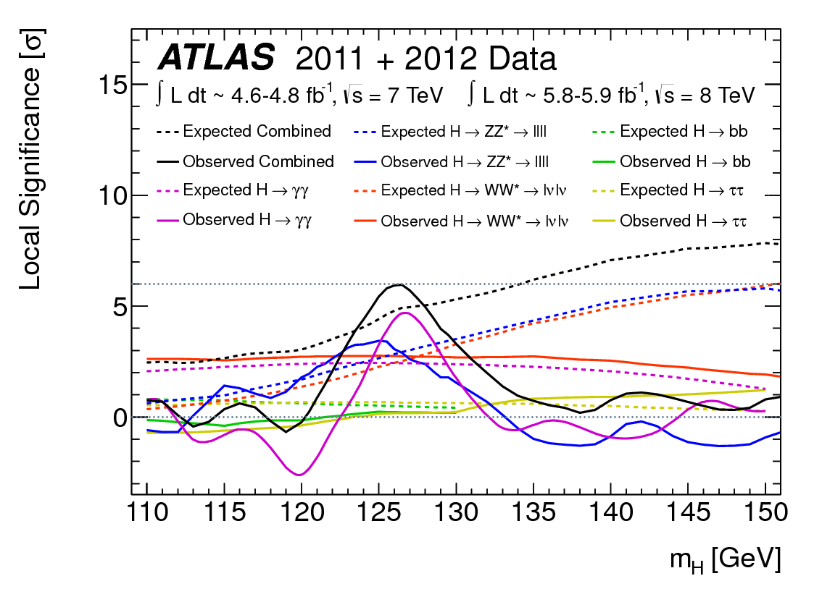
Breakdown of the
excess by channel
5.9 σ
Channel m_{H} of max local significance
significance obs. (exp. SM H)
H → γγ 126.5 GeV 4.5 σ (2.5)
H → 4l 125 GeV 3.6 σ (2.7)
H → lνlν 125 GeV 2.8 σ (2.3)
Combined 126.5 GeV 5.9 σ (4.9)
H → τ τ and W/Z H → W/Z bb:
~ no sensitivity (~3xSM cross-section)

Slide 26
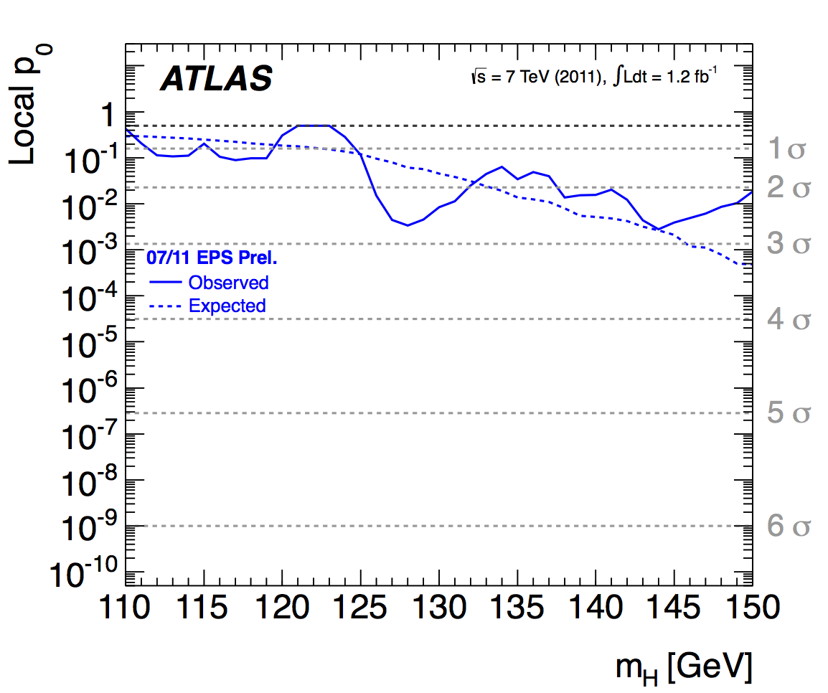
Evolution of the excess with time

Slide 27
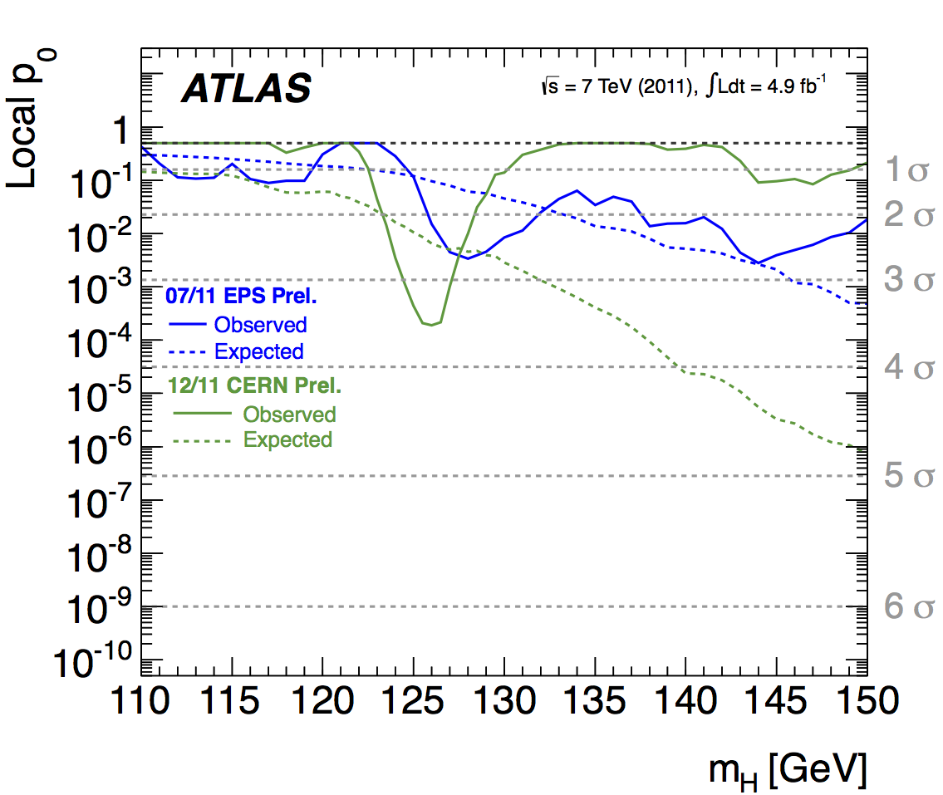
Evolution of the excess with time

Slide 28
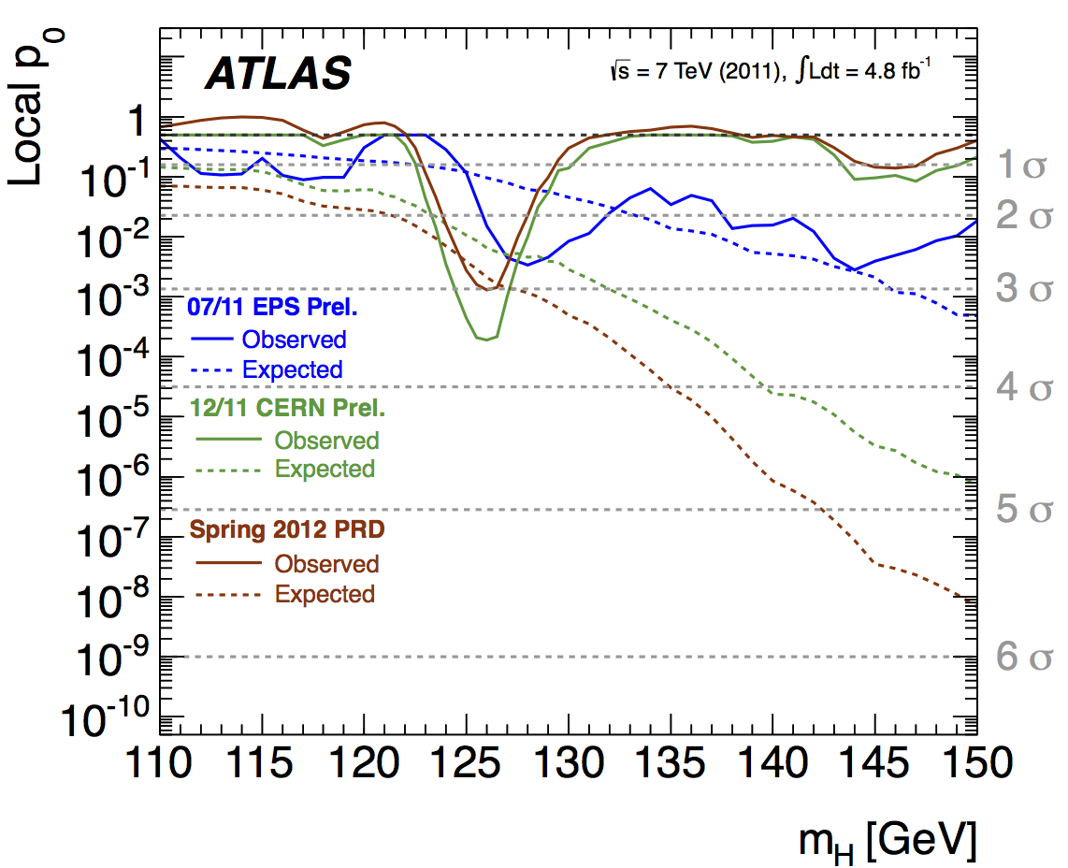
Evolution of the excess with time

Slide 29

Evolution of the excess with time
07/12 CERN Prel.

Slide 30

Evolution of the excess with time
07/12 CERN Prel.

Slide 31


Characterizing the new particle: mass and signal strength
2-dim likelihood fit to signal mass and strength
Estimated mass:
m_{H} = 126 ± 0.4 (stat) ± 0.4 (syst) GeV
μ = signal strength normalized to the SM Higgs expectation at m_{H} = 126 GeV
SM
Best-fit value at 126 GeV:
μ = 1.4 ± 0.3
good agreement with the expectation for
a SM Higgs within the present statistical
uncertainty

Slide 32




Characterizing the new particle: first measurements of couplings (examples ...)
Explore tension SM-data from H → γγ
different production modes (VBF, ggF)
New particles in the gg → H and H → γγ loops ?
μ_{γγ}=1.8 ± 0.5
BR (H → invisible or undetected) < 0.84 at 95% CL
Couplings to fermions k_{F} weakly constrained by direct H → ττ, bb;
indirect constraints from ggF (tt loop) indicate it’s non-vanishing

Slide 33



Searches for New Physics
No hints so far …
Higher energy, more luminosity to come
Di-lepton searches: Z’ limits
Di-jet searches: q* limits
Multi-jet + E_{T}^{miss}:
squark and gluino limits

Slide 34


Is the Higgs mass stabilized by New Physics ?
With ~ 30 fb⁻¹ by end 2012: expect to cover stop masses up to ~ 700-800 GeV and most of hole at m_{stop} ~ 200 GeV (by allowing branching ratios stop→ t χ⁰₁ and stop → b χ±₁ to vary)

Slide 35
Higgs: the next steps …
MORE DATA will be essential to:
Establish the observation in more channels (ττ, bb, more exclusive topologies …)
Measure nature and properties of the new particle (J^{CP}, couplings, ...) with increasing
precision → test compatibility with SM Higgs; how is Higgs mechanism implemented ?
How much does this “Higgs” contribute to restoring V_{L}V_{L} unitarity at high mass ?
Natural Higgs or fine-tuned Higgs ?
If natural: what stabilizes its mass (SUSY? other New Physics ?)?
End 2012:
Assuming ~30 fb⁻¹ (~25 fb⁻¹ 8 TeV + 5 fb⁻¹ 7 TeV) expect from a SM Higgs:
4-5 σ from each of H→ γγ, H → lνlν, H → 4l per experiment
~ 3 σ from H → ττ and ~ 3 σ from W/ZH → W/Z bb (already achieved by CDF+D0 !)
per experiment
Separation 0⁺/2⁺ and O⁺/O⁻ at 4σ level combining ATLAS and CMS
Future LHC plans:
2013-2014: shut-down (LS1)
2015-2017: √s ~ 13-14 TeV, L ~ 10³⁴ , ~ 100 fb⁻¹
2018: shut-down (LS2)
2019-2021: √s ~ 13-14 TeV, L ~ 2x10³⁴ , ~ 300 fb⁻¹
2022-2023: shut-down (LS3)
2023- 2030 ?: √s ~ 13-14 TeV, L ~ 5x10³⁴ , ~ 3000 fb⁻¹ (HL-LHC)

Slide 36



Spin/CP can be determined at > 5σ with 300 fb⁻¹ for a non-mixed state
With no constraints, ratios of couplings can
be measured with typical precisions:
  20-50% with ~ 300 fb⁻¹
  5-25% with 3000 fb⁻¹
per experiment
Measurements of rare decays w/ 3000 fb⁻¹ :
  ttH → ttγγ: 200 events
  H → μμ : 6σ
per experiment
Assuming Γ_{H} (SM) and one scale factor for
the fermion/vector sector → measure
k_{F}, k_{V} to 6% (3%) with 300 (3000) fb⁻¹
per experiment
Higgs self-couplings: ~ 3σ per experiment expected from
HH → bbγγ channel with 3000 fb⁻¹; HH→ bbττ also promising
~ 30% measurement of λ/λ_{SM} may be achieved
~ λv
m_{H}² = 2 λ v²
Note: -- these results are very preliminary (work of a few months) and conservative
-- physics potential of LHC upgrade is much more than just Higgs

Slide 37

Conclusions
Physics Letters B cover
ATLAS and CMS “Higgs discovery” papers published side by side in
Phys. Lett. B716 (2012)

Slide 38
Superb performance and accomplishments of the LHC accelerator, experiments, and Computing Grid in less than 3 years of operation.

Slide 39
Superb performance and accomplishments of the LHC accelerator, experiments, and Computing Grid in less than 3 years of operation.
ATLAS has recorded ~5.2 fb⁻¹ at √s =7 TeV in 2011 and 15.7 fb⁻¹ (and growing) in 2012 at √s =8 TeV
The whole experiment works very well, from smooth and efficient operation of the detector, trigger and computing to the fast delivery of physics results:
  first results for ICHEP with full 2012 dataset were available less than one week from
  data-taking, with a fraction of good-quality data used for physics (already) ~ 90% of the
  delivered luminosity.
Huge physics output covered in 198 papers and >400 CONFerence notes (as of 15/10/12):
not only Higgs: a wealth of measurements and searches; no New Physics yet …

Slide 40
Superb performance and accomplishments of the LHC accelerator, experiments, and Computing Grid in less than 3 years of operation.
ATLAS has recorded ~5.2 fb⁻¹ at √s =7 TeV in 2011 and 15.7 fb⁻¹ (and growing) in 2012 at √s =8 TeV
The whole experiment works very well, from smooth and efficient operation of the detector, trigger, and computing to prompt delivery of physics results:
  first results for ICHEP with full 2012 dataset were available less than one week from
  data-taking, with a fraction of good-quality data used for physics (already) ~ 90% of the
  delivered luminosity.
Large physics productivity, covered in 198 papers and >400 CONFerence notes (as of 15/10/12):
not only Higgs: a wealth of measurements and searches; no New Physics yet …
In July 2012 ATLAS reported the discovery of a new Higgs-like boson:
with significance ~6σ, driven by H→ γγ, 4l, with contributions also from H→ lνlν
signal strength: 1.4± 0.3 of the Standard Model Higgs expectation
mass: 126 ± 0.4 (stat) ± 0.4 (syst) GeV
first couplings measurements consistent with SM within present (large) uncertainties
If it is a SM Higgs boson, this mass makes several decay modes available for measurement:
→ accessible at LHC in γγ, ZZ* → 4l, WW* → lνlν, bb, ττ , and (HL-LHC) μμ
The era of precise “Higgs measurements” has started.
In parallel, quest for New Physics at TeV scale more and more compelling:
natural EW scale or desert scenario ? → LHC and its upgrade will have a lot to say.

Slide 41


These accomplishments are the results of more than 20 years of
talented work and extreme dedication by the ATLAS Collaboration,
with the continuous support of the Funding Agencies

Slide 42
These accomplishments are the results of more than 20 years of
talented work and extreme dedication by the ATLAS Collaboration,
with the continuous support of the Funding Agencies
The members of US ATLAS (and the US FA’s DOE/NSF) have played a major role in these accomplishments, in all aspects of the experiment, from construction and now maintenance & operation of all major ATLAS systems, through software & computing, to physics analysis.
Furthermore, these accomplishments are the results of the ingenuity, vision, and
painstaking work of the HEP community
(accelerator, instrumentation, computing, analysis)

Slide 43
References to physics results mentioned here
Higgs:
PLB 716 (2012) – arXiv:1207.7214
ATLAS-CONF-2012-127
ATLAS-PHYS-PUB-2012-004
Single top:
PLB 712 (2012) – arXiv:1205.3130
ATLAS-CONF-2012-131
ATLAS-CONF-2012-056
ATLAS-CONF-2011-118
arXiv:1205.5764
Searches:
ATLAS-CONF-2012-129
ATLAS-CONF-2012-056
ATLAS-CONF-2012-109
stop searches:
arXiv:1208.4305
arXiv:1209.4186
arXiv:1209.2102
arXiv:1208.2590
arXiv:1208.1447

