Slide 1
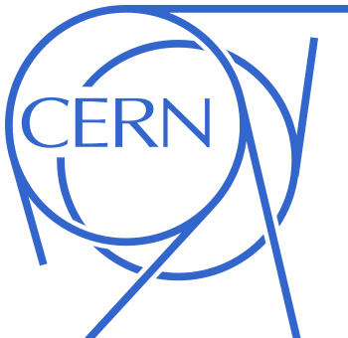

CERN-US Relations:
Past, Present & Future from a CERN Perspective
Rüdiger Voss
CERN International Relations Office
USLUO Annual Meeting, Fermilab| October 18-20, 2012
(updated from a presentation at USLUO 2011 @ ANL)

Slide 2
The post-SSC era
The demise of the SSC in 1993 and the approval of the LHC in 1994 catalyzed an unprecedented shift of paradigm in CERN-US co-operation:
  Massive migration of US-based physicists to the LHC
  Commensurate US investment in LHC Grid computing
  Significant participation in accelerator R&D, construction of components, and LHC commissioning
  Co-operation regulated by tripartite CERN-DOE-NSF agreements
CERN is grateful to DOE and NSF for their sustained support of the US LHC community

Slide 3
US contributions to LHC machine
Mainly in area of superconducting magnet technology:
  Production and test of SC cable
  Inner triplet magnets
  Beam separation dipoles
  Cryogenic and power feed boxes
  and more …
Coordinated by ANL, BNL and Fermilab
Total value US$ 200 million
Substantial contributions to LHC commissioning

Slide 4
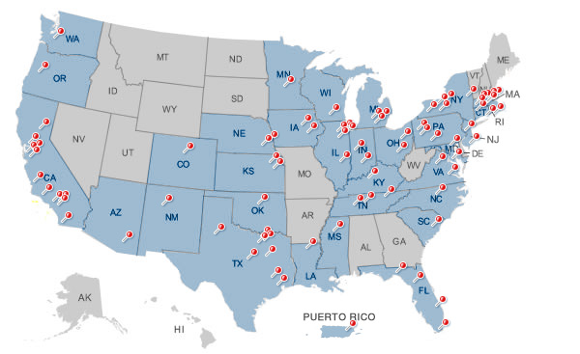
US contributions to LHC detectors
Nearly 100 US universities and national laboratories have made substantial and invaluable contributions to the LHC experiments
Detector | Universities | National Labs | Participants
ALICE | 8 | 3 | 75
ATLAS | 40 | 4 | ~ 700
CMS | 47 | 2 | ~ 800
LHCb | 2 |  | ~ 25
TOTEM | 2 |  | 3
Total | 91 | 6 | ≈ 1600
Statistics from www.uslhc.us

Slide 5
Financial participation in experiments
DOE and NSF have supported (and continue to support) a financial participation in the LHC detectors ≈ commensurate with the number of participating scientists
Detector | CORE construction | 2011 M&O (Cat. A)
ALICE | 10 MCHF (6%) | 0.4 MCHF (8%)
ATLAS | 88 MCHF (16%) | 3.9 MCHF (21%)
CMS | 120 MCHF (23%) | 4.7 MCHF (33%)
Total | 218 MCHF (18%) | 9.0 MCHF (24%)
CERN RRB statistics

Slide 6
The near future: LHC upgrades…
Significant US investments in accelerator upgrades through
  USLARP (post-NbTi technologies, accelerator physics and commissioning) – Fermilab a key player!
  Planned participation in FP7 EuCARD high luminosity project
CERN welcomes a participation in detector and Grid computing upgrades commensurate with the size of the US community

Slide 7
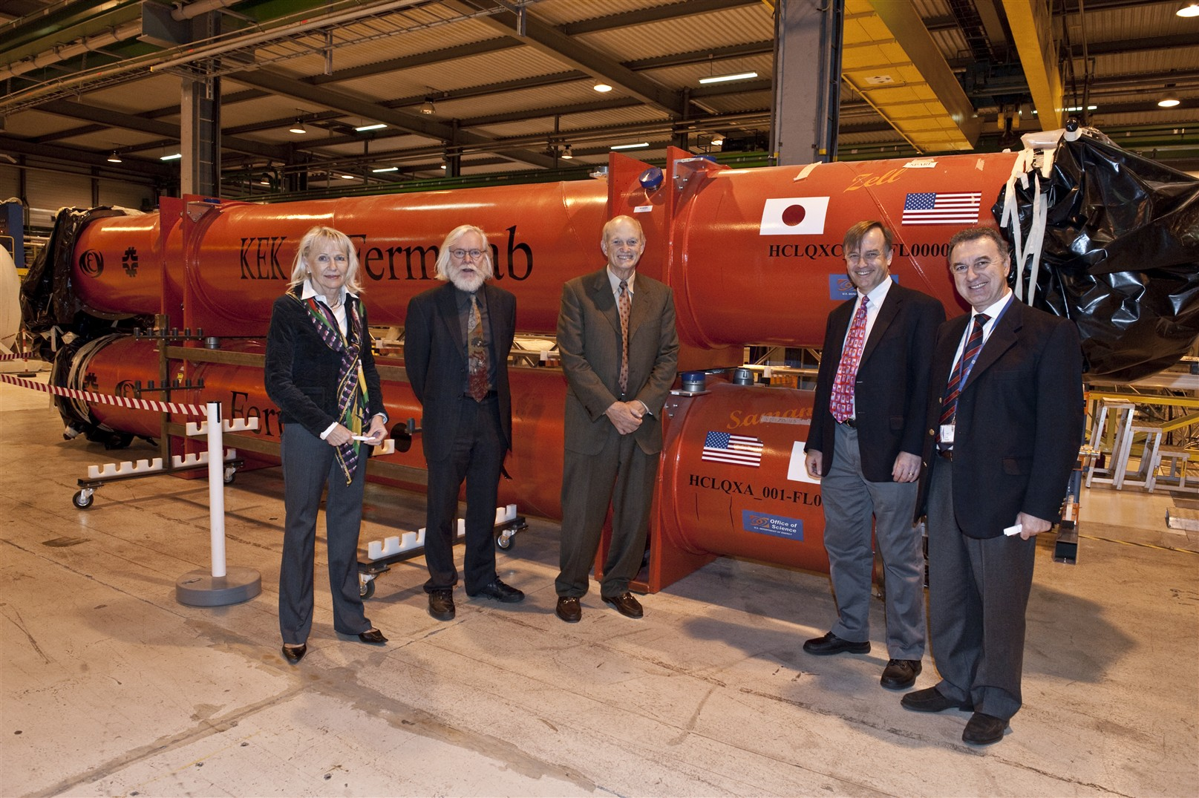
… to continue a successful collaboration

Slide 8
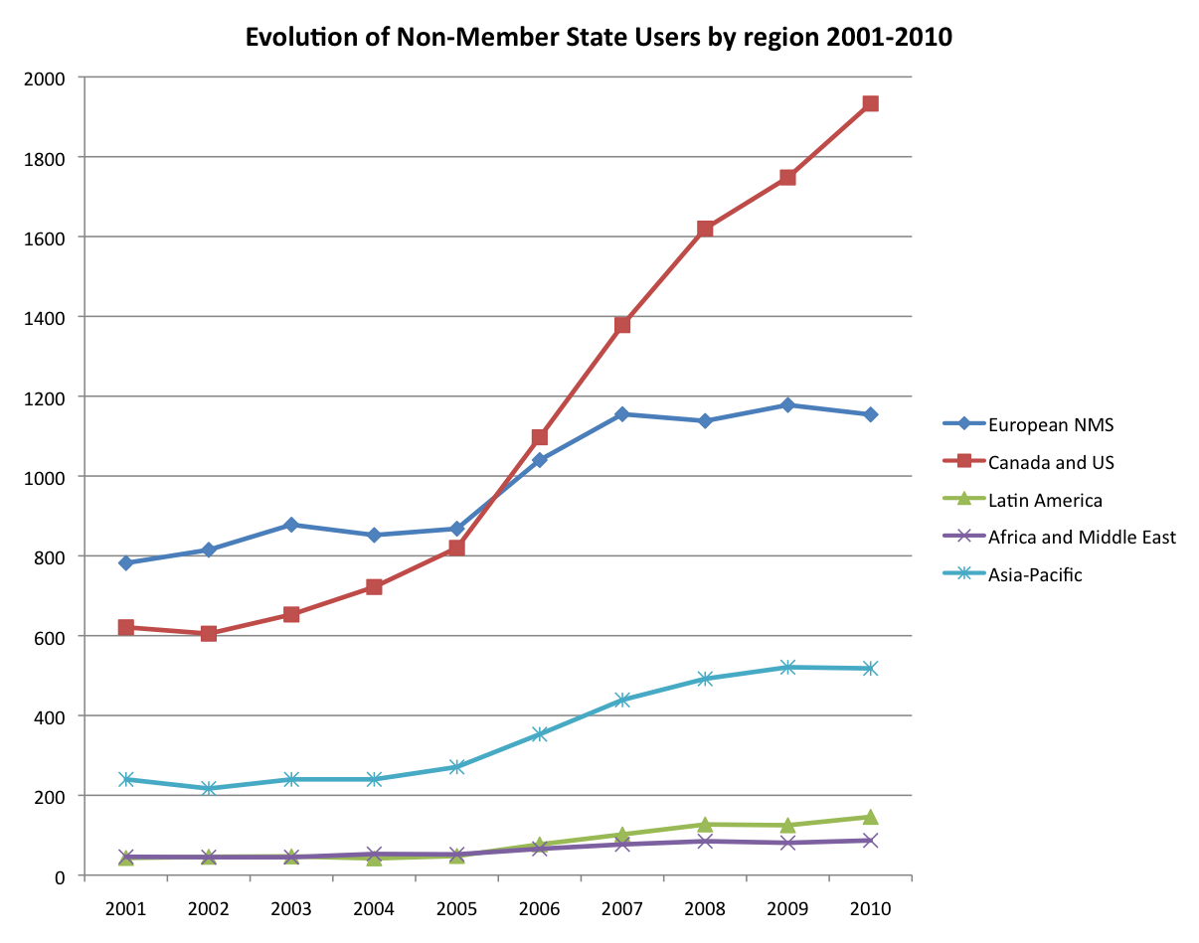
Non-Member State Users

Slide 9
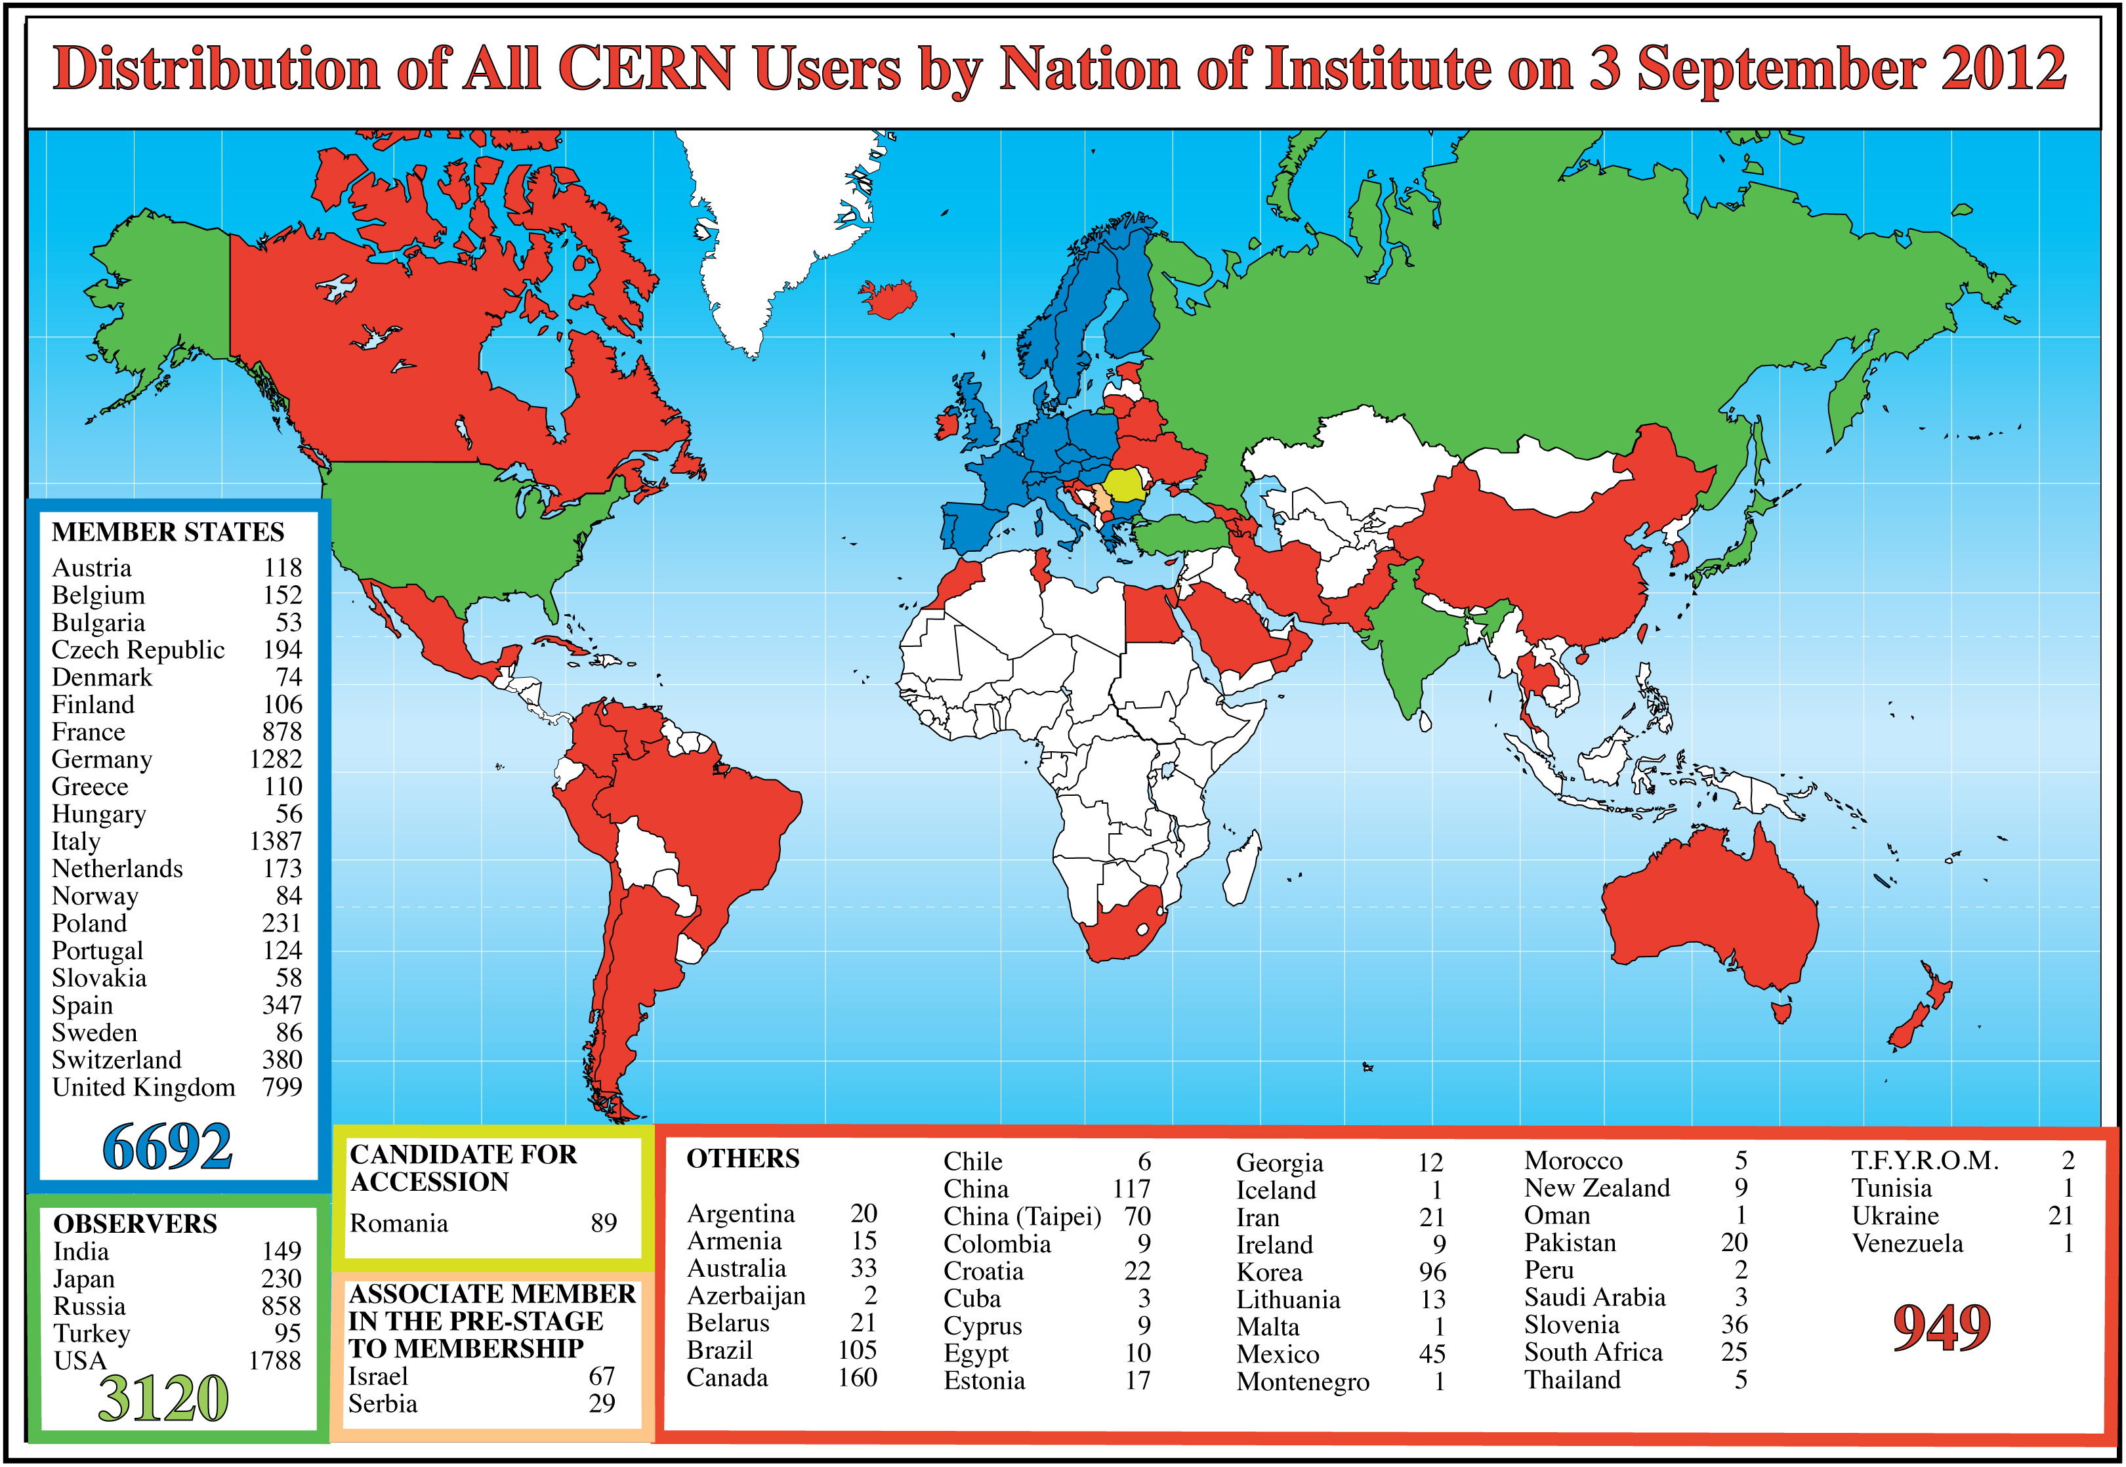
CERN Users by Institute

Slide 10
Today’s formal framework
US have Observer status at CERN
  Status quo – to be phased out under new membership policy
CERN-DOE-NSF Co-operation agreement on LHC activities (ICA-US-0058)
  Signed December 8, 1997 for 20 years duration
  Thereafter, automatic renewal on annual basis unless terminated by either party
  Protocols on accelerator co-operation (all expired) and on co-operation on ATLAS and CMS detectors (P026/LHC, concluded December 19, 1997 for 20 y)
MoUs for experiments and Grid computing

Slide 11
Where do we stand?
From a European perspective, the unprecedented Non-Member State participation in the LHC, spearheaded by the US, has brought about substantial scientific, technical and political benefits
Helped to establish CERN firmly as world’s leading center at the high energy frontier, in the perception of governments, funding agencies, and of the taxpayer

Slide 12
Where do we go from here?
The LHC has convincingly demonstrated the potential of US-CERN collaboration, and is widely perceived as a paradigm of successful US-Europe collaboration on megascience projects
To take this collaboration to the next-higher level, and to fully exploit its potential to the benefit of both partners, CERN welcomes an enhanced institutional participation of the US, in the framework of CERN’s new membership policy (aka ‘Geographical Enlargement’)

Slide 13
A bit of history
For > 50 years, the CERN Council has repeatedly interpreted the 1953 Convention as restricting membership to European states
In response to the strong global participation in the LHC – and in anticipation of the post-LHC era – the Council in 2010 approved the most significant shift in CERN’s membership policy thus far, opening CERN fully to non-European states (CERN/2918/Rev.)

Slide 14
Dimensions of enlargement
Full Membership open to non-European states
Associate Membership – in two flavours:
  Pre-stage to full membership: compulsory transition period on the way to full membership (2–5 years)
  Regular (‘steady state’) Associate Membership
Instrument of International Co-operation Agreements (ICAs) to be maintained
  ≈ 45 ICAs currently in force
Observer status to be phased out for states
  US presently one of 5+2 observers
  New states will not be admitted – number expected to decrease
  To be maintained for International Organizations (presently UNESCO, EU)

Slide 15
Associate Membership
A simplified view of the ‘steady state’ scheme:
Obligations
  Annual contribution to CERN budget corresponding to ≥ 10% of ‘theoretical’ full Membership contribution (minimum 1 MCHF/year)
Benefits
  Representation in CERN Council (no voting rights)
  Access to employment and education programmes (excluding tenured positions)
  Access to industrial contracts

Slide 16
New CERN-US Co-operation Agreement
CERN acknowledges that prospects for an (Associate) Membership of the US and the associated timeline are difficult to forecast today
Therefore CERN, DOE and NSF have agreed to work on a new Co-operation Agreement, to replace present ICA expiring in 2017
  Renewal of present ICA is not an option because funding exhausted
CERN proposes an open-ended umbrella agreement
  First draft examined by DOE legal services

Slide 17
New Co-operation Agreement (II)
Under an umbrella agreement, specific collaboration projects are implemented through Protocols
  Enhanced flexibility
  Focus on scientific and technical aspects
In case the US would join as AM, Co-operation Agreement would be replaced by Association Agreement
Protocols etc. could continue under (bilateral) Association Agreement

Slide 18
Looking beyond the US borders
Israel, Cyprus, Serbia, Turkey and Slovenia applied for (full) membership in 2008-2009
  Will have to go through Pre-stage Associate Membership
  Negotiations completed with Israel and Serbia: Associate Members (AMs) since October 2011/January 2012
  Cyprus signed on October 5, 2012 – waiting for ratification
  Expect others to join as AMs in 2013/2014
Brazil and Ukraine applied in 2012
In discussion with several other countries
  Good progress with India, Russia, ….
  The Canadian community, on various roadmaps, has issued a strong recommendation for Canada to join CERN as AM

Slide 19
Conclusions
The US-CERN partnership in building and operating the LHC has become a solid backbone of a successful scientific and technological collaboration of unprecedented, global dimension
CERN wants this partnership to continue and to expand, while strengthening at the same time the institutional links with the US

