Slide 1
USLUO Executive Committee Election Report
Daniela Bortoletto
and
Sarah Demers
(Election Committee)

Slide 2
USLUO Executive Committee Election Report
A
Daniela Bortoletto
and
Sarah Demers
(Election Committee)

Slide 3
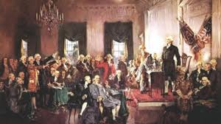
Our Constitution
“An Executive Committee (USLUEC) is elected by the USLUO membership.
It will consist of 12 people serving two-year terms, with 6 people elected
each year. At least one member of USLUEC will be from the US LARP community,
and at least one member will be a US ALICE or US LHCb collaborator.”
https://www.usluo.org/constitution/constitution
We address issues of balance among experiment, gender and experience
with non-voting observer members who are encouraged to participate
in all discussions.

Slide 4
Executive Committee through the end of 2012
Daniela Bortoletto - Purdue - CMS (2013)
Sridhara Dasu - University of Wisconsin - CMS (2013)
Sarah Demers - Yale - ATLAS (secretary, 2013)
Sandor Feher - Fermilab - LARP (2013)
Joey Huston - Michigan State - ATLAS (2012)
John Huth - Harvard - ATLAS (2012)
Boaz Klima - Fermilab - CMS (2012) Jane Nachtman - Iowa - CMS (2012)
Harvey Newman - Caltech - CMS (chair, 2013)
Randy Ruchti - Notre Dame - CMS (2012) Sheldon Stone - Syracuse - LHCb (2012) Mike Tuts - Columbia - ATLAS (2013)

Slide 5
Process
Binders full of Physicists?
physicist
Open Nominations?
physicist
physicist
physicist
physicist

Slide 6
Process
Binders full of Physicists?
physicist
Open Nominations?
physicist
physicist
physicist
physicist
Nominations open August 25 – September 7:
22 People Nominated
14 People Agreed to Stand for Election
THANK YOU to the community for your participation in this process!

Slide 7
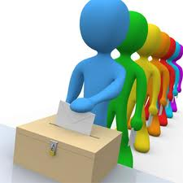
Voting
Voting was open September 19 – October 4
221 of our 900+ members voted

Slide 8
Congratulations to
Darin Acosta – CMS
Ken Bloom – CMS
Tom LeCompte – ATLAS
Usha Mallik – ATLAS
Sheldon Stone – LHCb
Julia Thom - CMS

Slide 9
Full Committee
Daniela Bortoletto - CMS Sridhara Dasu - CMS Sarah Demers - ATLAS Sandor Feher - LARP Harvey Newman - CMS Mike Tuts - ATLAS Darin Acosta - CMS
Ken Bloom - CMS
Tom LeCompte - ATLAS
Usha Mallik - ATLAS
Sheldon Stone - LHCb
Julia Thom - CMS

