Slide 1
ACCU Report News and User Issues
Darin Acosta (Non-Member State representative)

Slide 2
Advisory Committee of CERN Users
ACCU advises the Director General on the practical measures to be taken and administrative internal arrangements to be made by the CERN Management for the utilization of the CERN facilities for research. This concerns in particular the working conditions and the arrangements for technical support to the CERN Users for their activity at the CERN Laboratory.
Quality of life issues at the lab
Committee chair is Catherine Vander Velde
Committee membership is 1-2 appointed representatives from each member state, 4 representatives from non-member states, and 2 CERN staff members
http://cern.ch/ph-dep-ACCU/

Slide 3
ACCU Meetings In Past Year
Dec.7, 2011 (94th meeting)
March 7, 2012 (95th meeting)
June 15, 2012 (96th meeting)
Sept. 5, 2012 (97th meeting)
Agendas and detailed meeting minutes:
http://indico.cern.ch/categoryDisplay.py?categId=1058
Plus see my notes emailed to US LUO shortly after each meeting

Slide 4
Housing News
5 additional rooms being made in Bat.39 from former offices
70 additional rooms added in St. Genis
Work started to create shuttle stop in front of hostel
Bat.38 renovation should take place sometime soon
Long-term electronic waiting list for hostel still in progress, slated for Jan.2013
Short term waiting list via email already available
The hostel reception (via email) can book you into nearby hotels at CERN rate
Your Secretariat also may be able to help with local apartment-hotels

Slide 5
Results from Housing Survey
Results from June accommodation survey based on 1346 responses
Accommodation with a single room on the main CERN site was the driving need (>90%)
Other aspects are secondary, but comfort beats price.
For online booking, interest in being able to modify reservation and to have an online waiting list
With regard to additional services, 62% of users would choose a sports/fitness facility, even if a fee imposed
Considered more important than shopping delivery service, extended laundry, hairdresser
There are some classes and a (quite small) weight room now:
https://espace.cern.ch/club-fitness/default.aspx

Slide 6
Transportation
Shuttles
Usage increased 7% from last year
Check schedules, as sometime they get modified according to usage
Airport shuttle operates during work week, but bus/tram quite convenient
Car/Bike Sharing:
Car sharing launched Dec.1, 2011 (no payment to TEAM account required right now)
Bike sharing launched May 2011. Don’t need deposit. (long term use PH bikes do need one, 100CHF)
Cards available at GS carpool (B.130)

Slide 7
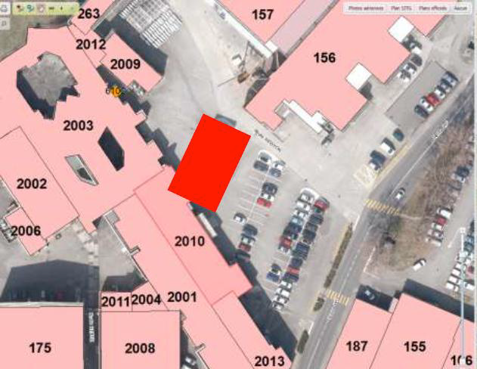
Transportation
Parking:
Meyrin site has 4200 parking spaces, but many people treat parking in high traffic areas near the main building and B40 as long-term parking
Please use the long-term parking by B156 and Linac
More parking places are to be added around the Globe
342 in total: 221 for CERN.
Bicycles:
New pedestrian/bicycle entrance opened to Prevessin site
A new bicycle entrance proposed and under approval for main CERN site to avoid crossing main road (twice!) when leaving Meyrin site and heading to France

Slide 8
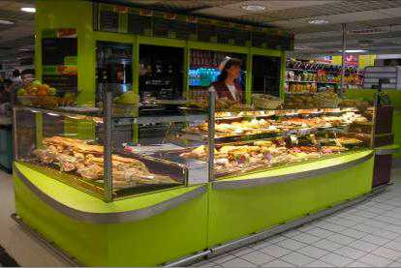
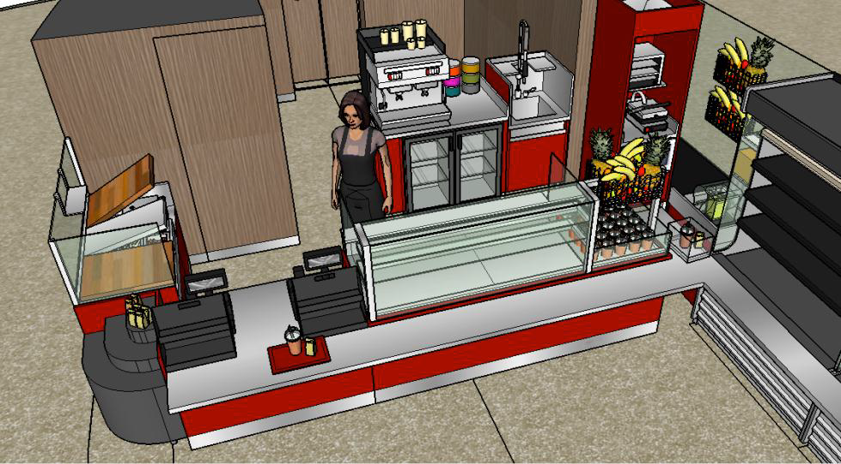
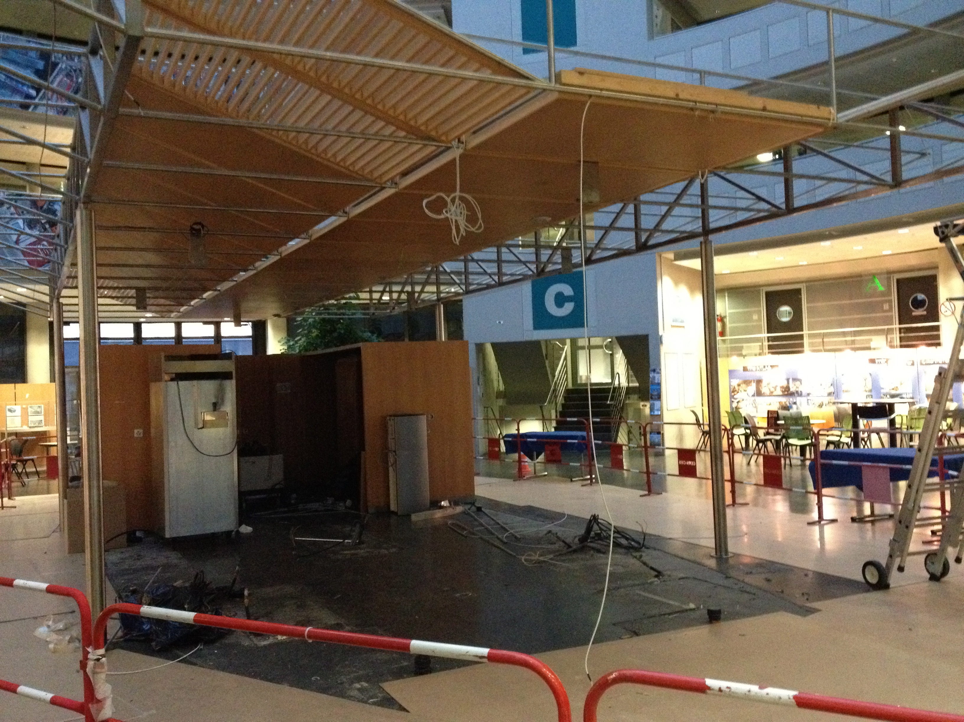
Snacks and Shops
Snack service shop next to R1, and also now by Gate B and B33 (CERN Reception)
One being added at P5 also
B40 cafeteria is under renovation to offer expanded service
Payment with RF ID card with preloaded money soon available

Slide 9
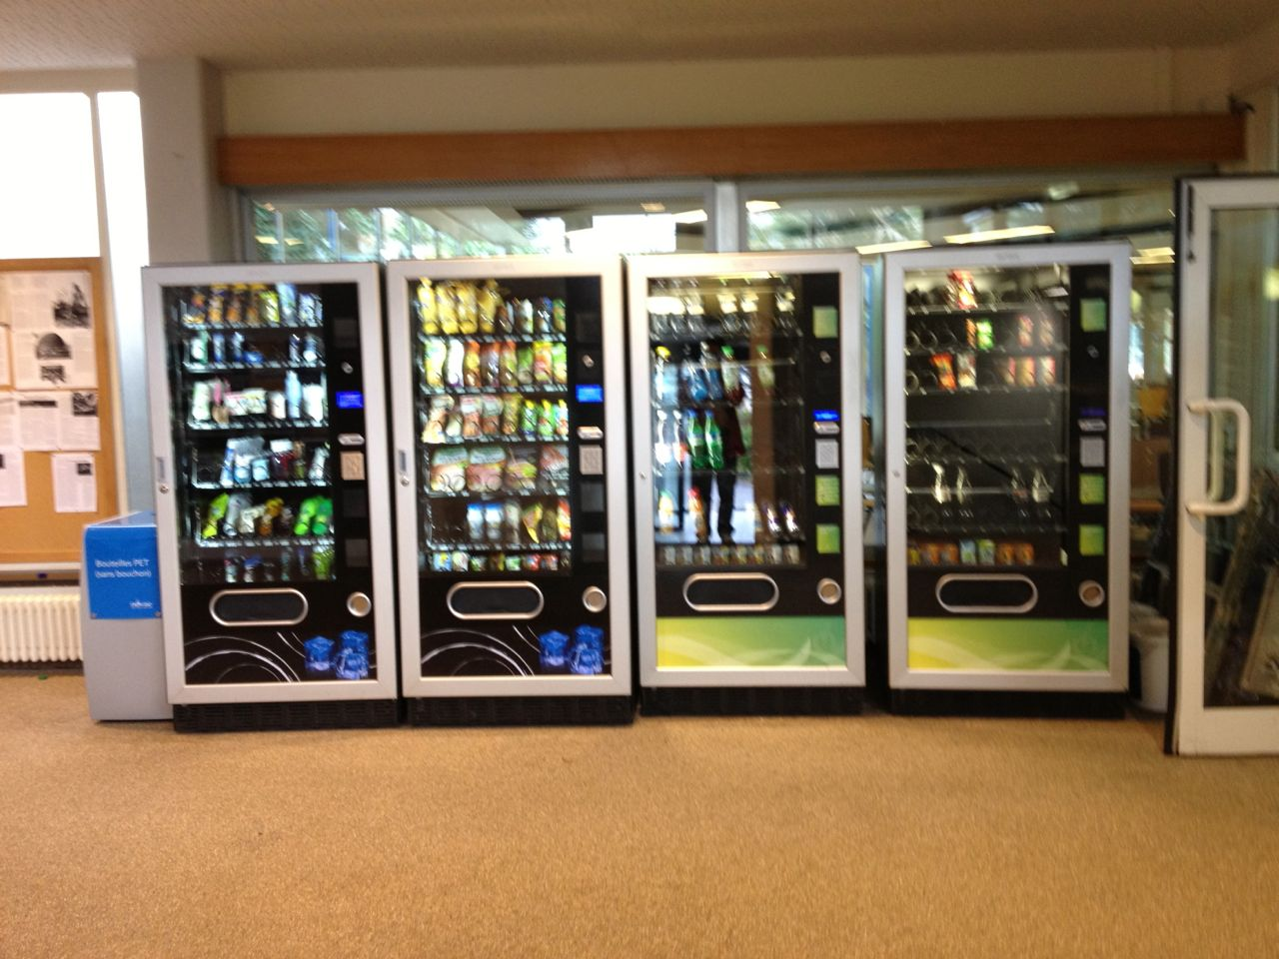
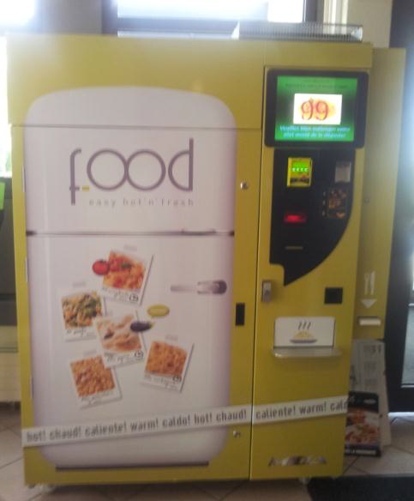
Further Snack Options
New vending machines in main building offer toiletries and some food options including milk
Have to buy your cereal outside, however…
Hostel reception offers toiletry items and has a pasta machine

Slide 10
Users Office Matters
Exceeded 10,000 users !
TEAM leaders should not sign blank registration forms. Please verify all info.
A reminder about end of users contract is sent 28 days before (IT sends 2 months in advance, plus there is a 2 month grace period)
Those needing a visa to France/Switzerland should take note on the new rules for Schengen Visa type D requests.
Users coming to CERN who are subject to visa restrictions will have to know in advance if they will live in France or in Switzerland and request the Visa at the corresponding Embassy
Users reminded to return residence cards when leaving

Slide 11
More Users Office Matters
CERN will look into insurance issues (occupational accidents, coverage during retirement, change in French insurance law in 2014) and report back in December
e.g. UNIQA Accidenta coverage by itself is not considered adequate
Affects those hired through TEAM accounts
Users Office to follow-up the implementation of an option to set a preferred name for users with long names.
Users Office to investigate possibilities of child care for age 6 and above in the local area, in collaboration with the Social Service

Slide 12
Misc
Recall single point CERN Service Desk
x77777, https://cern.service-now.com/service-portal/
Please send feedback if your tickets were left open for an unduly long time or were not solved satisfactorily
Videoconferencing: CERN is moving to Vidyo. Maintaining EVO support to the end of 2012
Draft data classification policy and proposed restrictions (sensitive, restricted, internal, public):
https://security.web.cern.ch/security/rules/en/dcp.shtml
Do Users support having a reading room in the library?

Slide 13
News from the DG
Not expecting additional money for User matters
Guidelines for parties and festivities at CERN is being reviewed in wake of some incidents
CERN is becoming international
Cyprus has become an Associate Member State
Brazil and Ukraine have applied
Russia and India imminent
CERN Open Day is last weekend of September 2013

Slide 14
Summary
Your CERN user concerns and input are very welcome!
Email: Darin.Acosta@cern.ch
Please let me know if you have any matters to raise to ACCU
Next ACCU meeting: Dec. 7, 2012

