Slide 1


Evidence for a state near 125 GeV in the search for the Higgs boson in the H→ZZ→4L channel
Matthew Snowball
University of Florida
https://twiki.cern.ch/twiki/bin/view/CMSPublic/PhysicsResultsHIG

Slide 2
The $10B Question(s)
Does Higgs exist?
What about Dark Matter?
Why isn’t there anti-matter?
Does SUSY exist?
Do extra dimensions exist?

Slide 3
Motivation
H→ZZ→4L known as the golden channel because
Large branching fraction at high mass,
similar sensitivity to H→γγ at low mass
Main mechanism is gg-fusion
It is the cleanest of all Higgs channels
4 well reconstructed, well measured leptons
Excellent mass resolution
No missing energy from undetectable particles
Theoretically simple channel
(possible to use Matrix Element analysis)

Slide 4
Beauty

Slide 5
Beauty is in

Slide 6
Beauty is in the Peak

Slide 7
Results

Slide 8
Results
Expected Significance: 3.8σ
Observed Significance: 3.2σ
Expected Exclusion Region: 121-570 GeV
Observed Exclusion Regions: 131-162, 172-525 GeV
(*) Personally responsible for development of HZZ4L_Combination and developer on CL tool

Slide 9
Summary
The H → ZZ → 4L analysis has been performed on the 5.05 fb⁻¹ of 7 TeV and 5.26 fb⁻¹ of 8 TeV data
The expected exclusion region is [121,570] GeV while the observed exclusion regions are [131,162] and [172,525] GeV
An excess is observed around 125.5 GeV with a local significance of 3.2σ with an expected significance of 3.8σ from a Standard Model Higgs

Slide 10
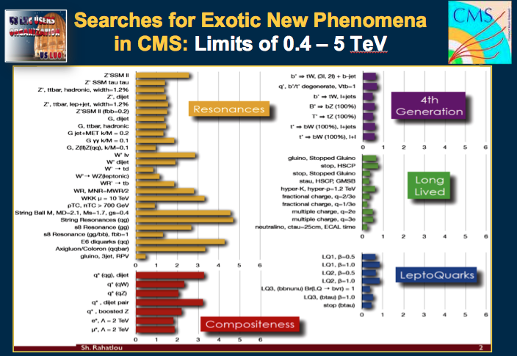
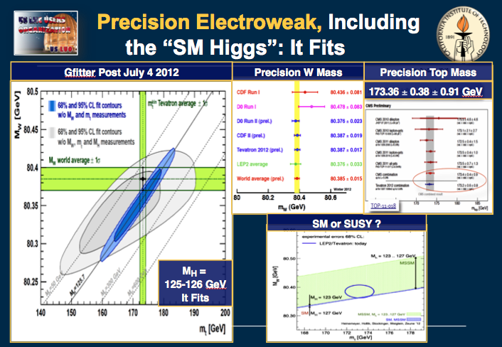
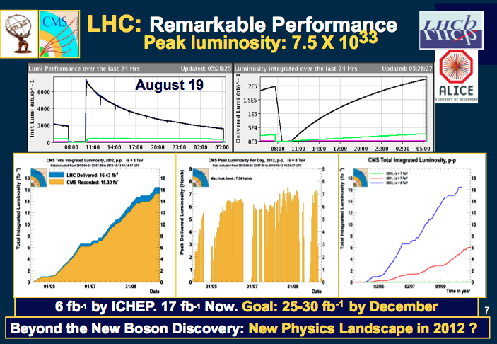
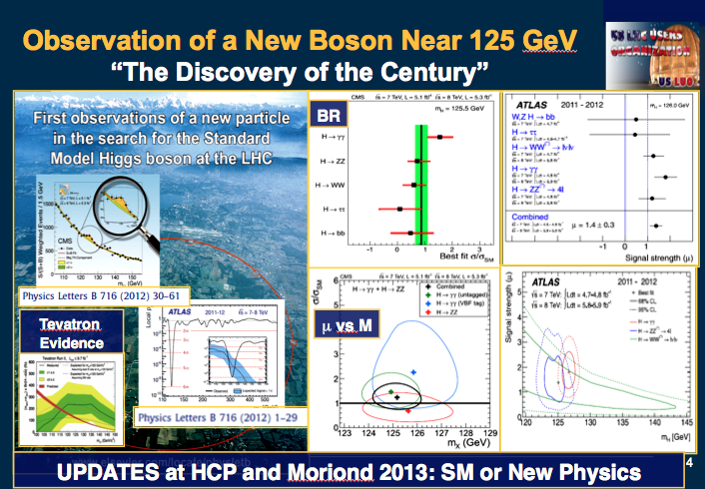
Highlights of the LHC Program

Slide 11

HZZ4L in the LHC Program
Higgs To ZZ To 4Leptons at the LHC

Slide 12
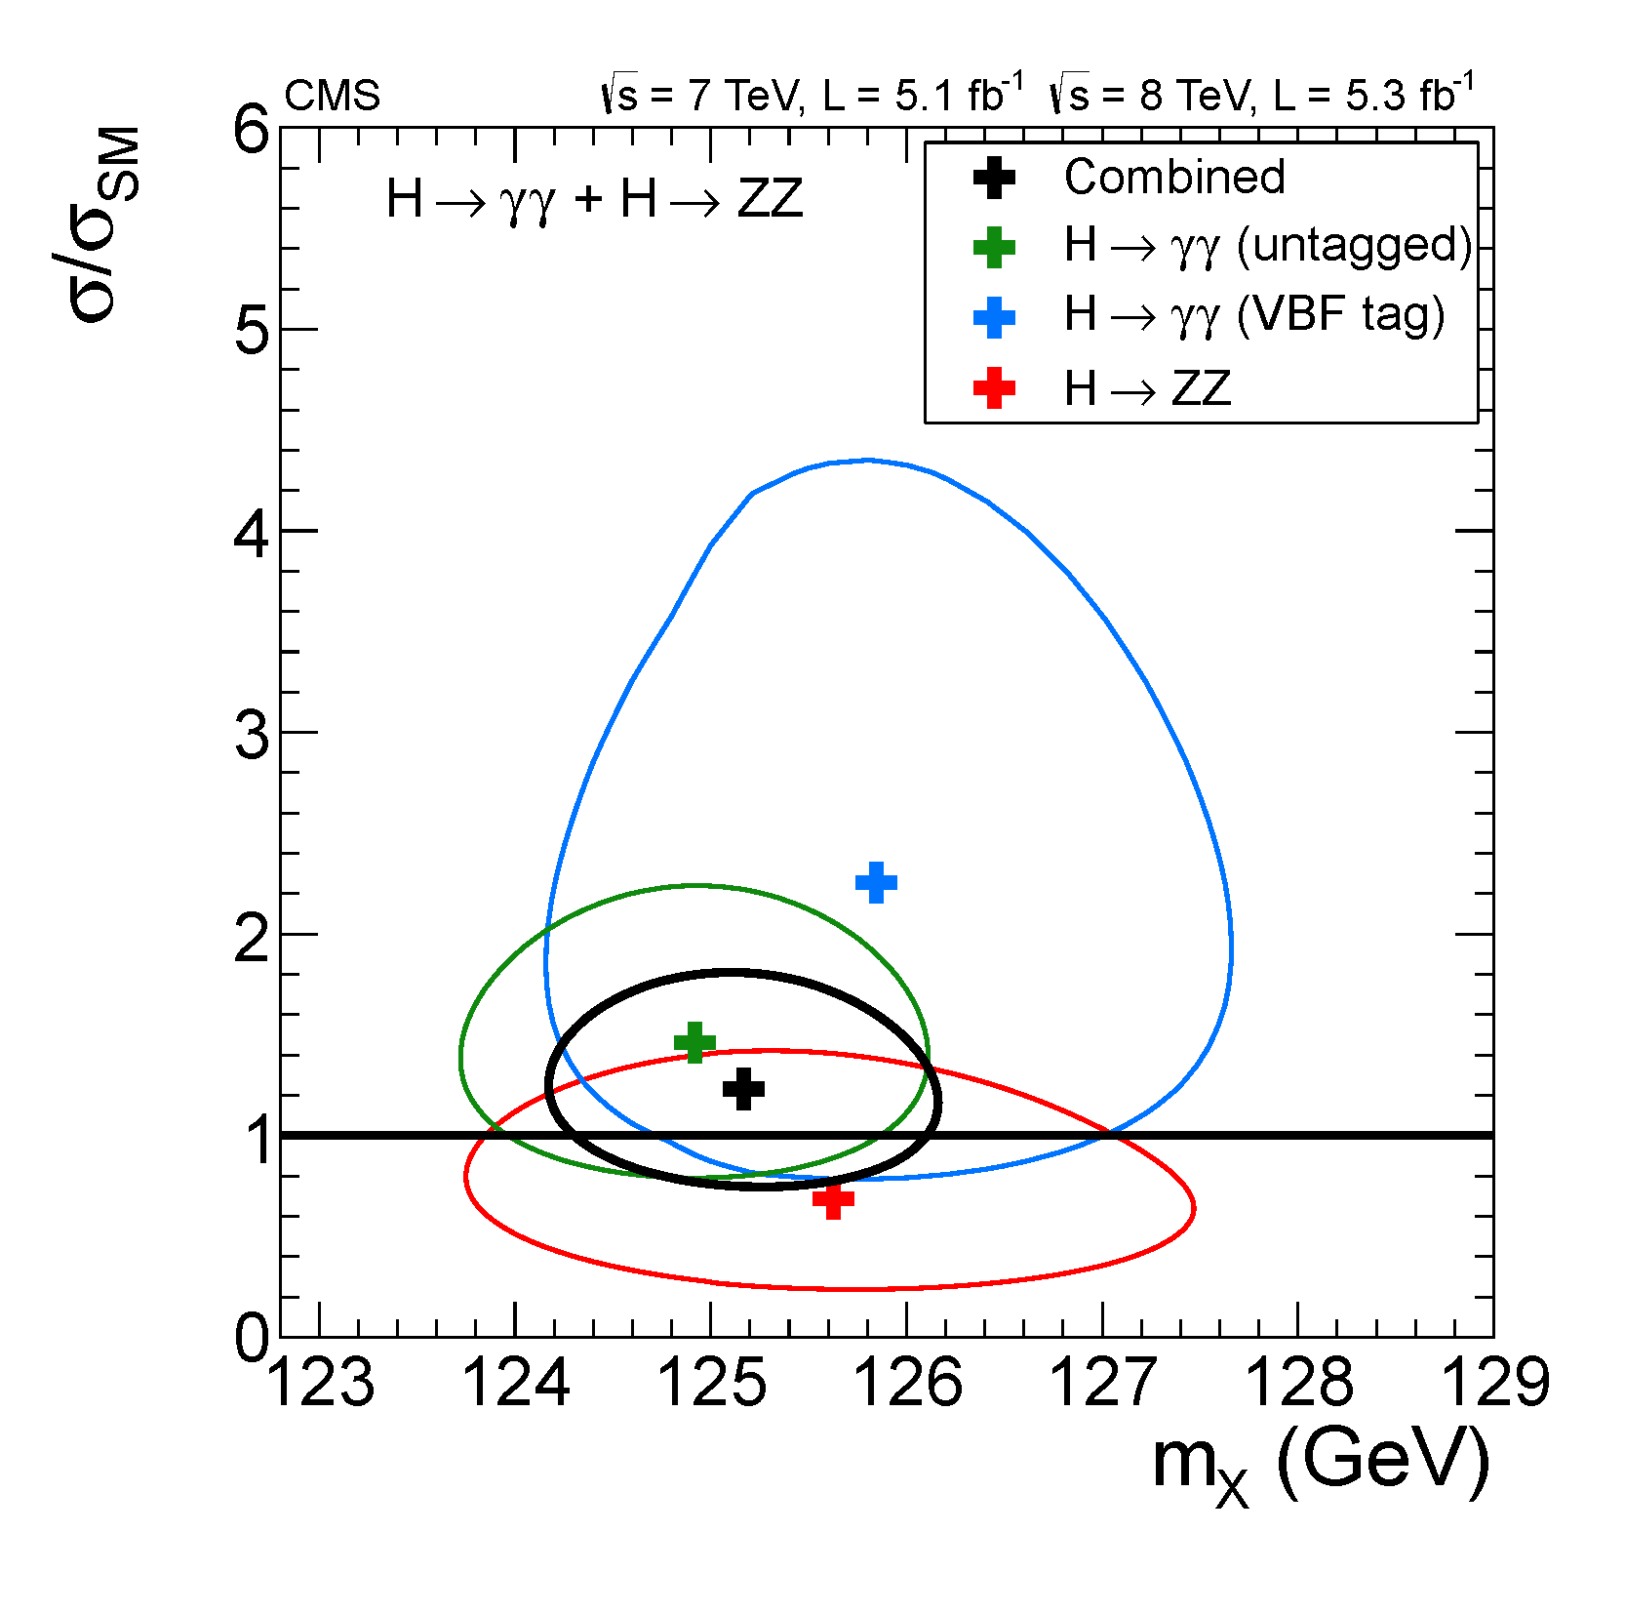
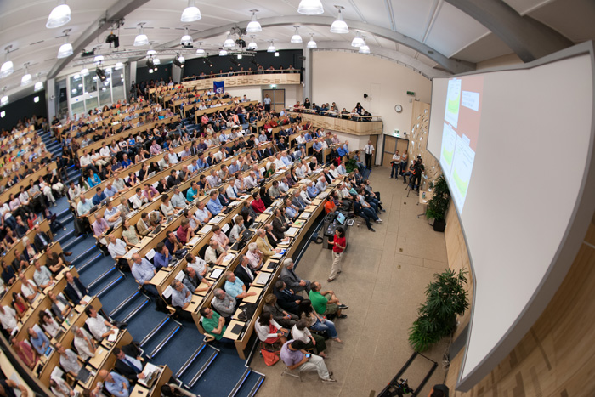
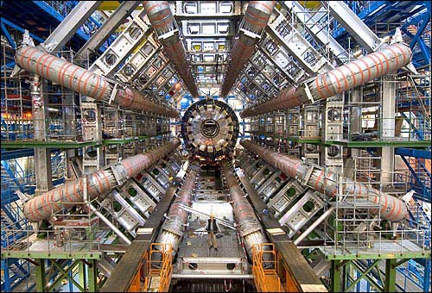
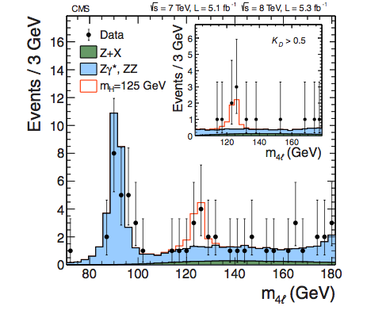
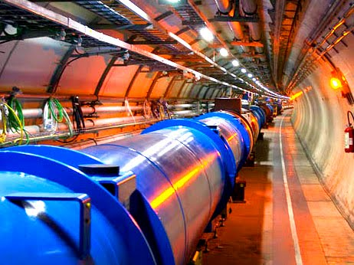
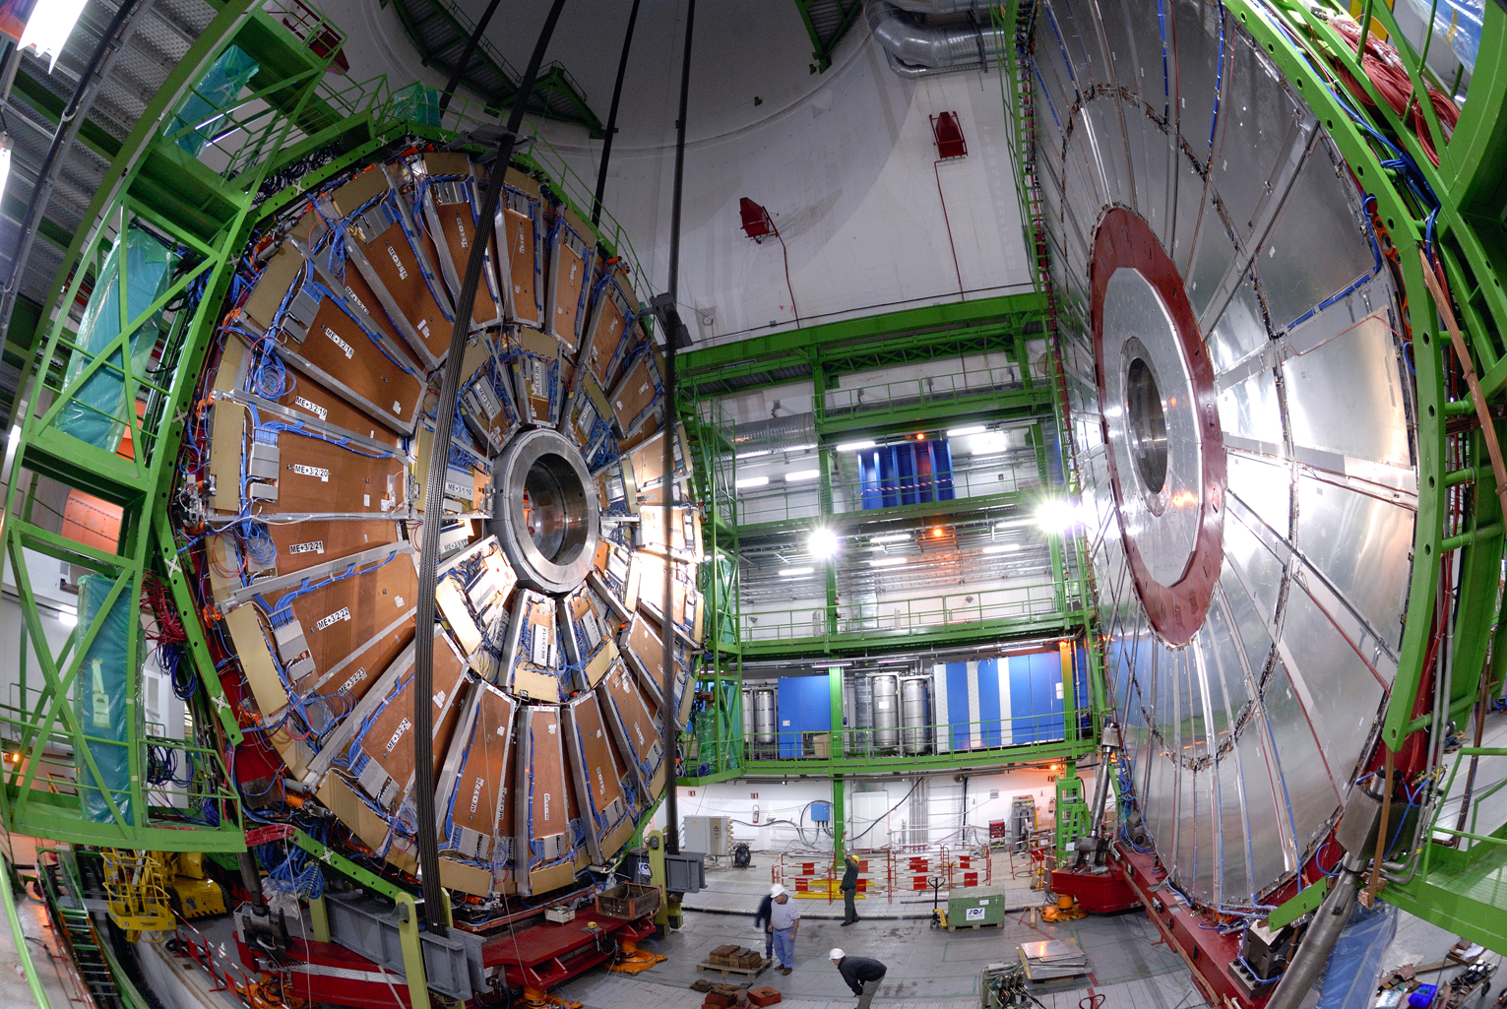

HZZ4L in the LHC Program

Slide 13
The $10B Question(s)
Does Higgs exist?
What about Dark Matter?
Why isn’t there anti-matter?
Does SUSY exist?
Do extra dimensions exist?

Slide 14
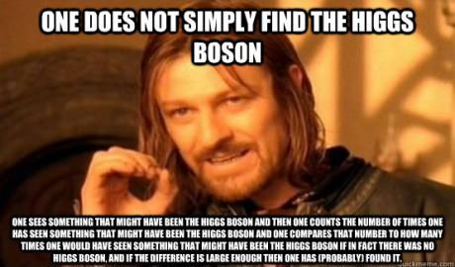
FIN

Slide 15
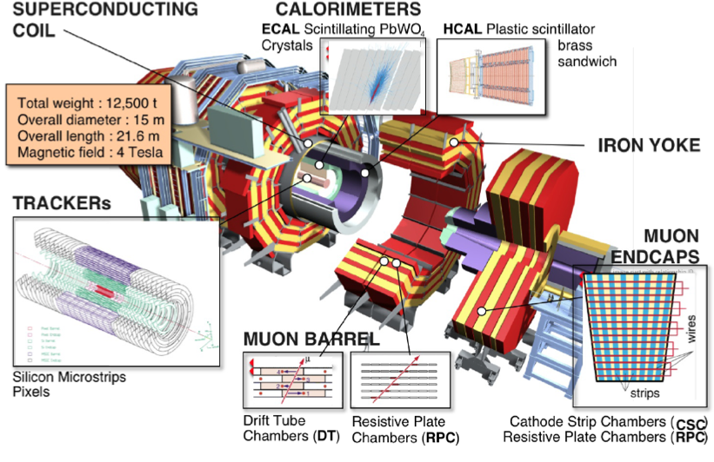
Compact Muon Solenoid

Slide 16
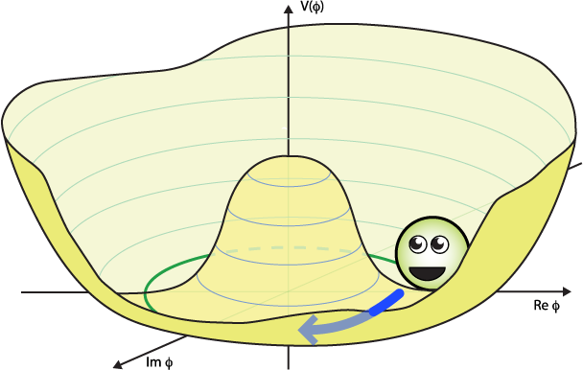
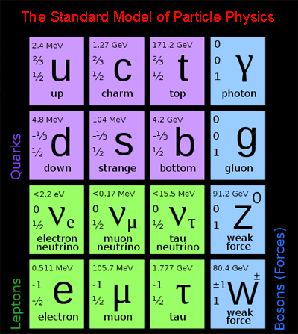
Why Higgs
The Standard Model (SM) describes most of what we know very well so far.
It consists of 3 generations of fermions
(spin ½ particles) with ascending masses.
There are 3 fundamental forces
(Weak, EM, Strong) and carriers of these forces known as bosons.
What the SM lacks is an explanation of how and why some of these particles have mass (W,Z).
Spontaneous electroweak symmetry breaking may be the answer to this. But this would require the existence of a new particle, the Higgs boson.

Slide 17
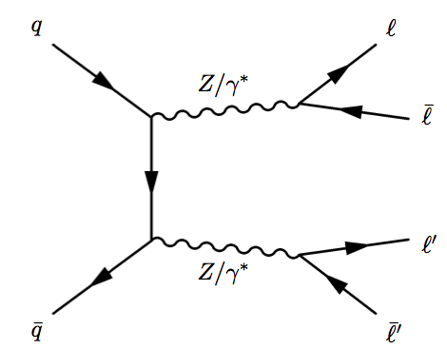
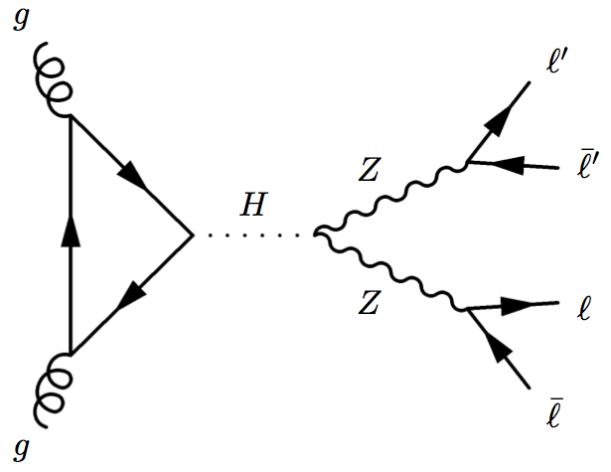
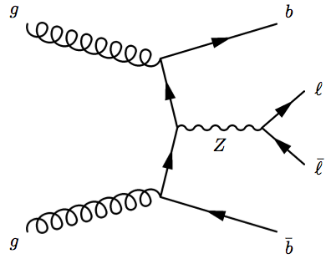
Signal and Background Definition
ZZ Irreducible Background
Main Signal
(VBF,Assoc. productions also contribute)
Reducible Background (Zjets, ttbar also contribute)
Notes:
- Z+gluon jets diagram also contributes to reducible background

Slide 18

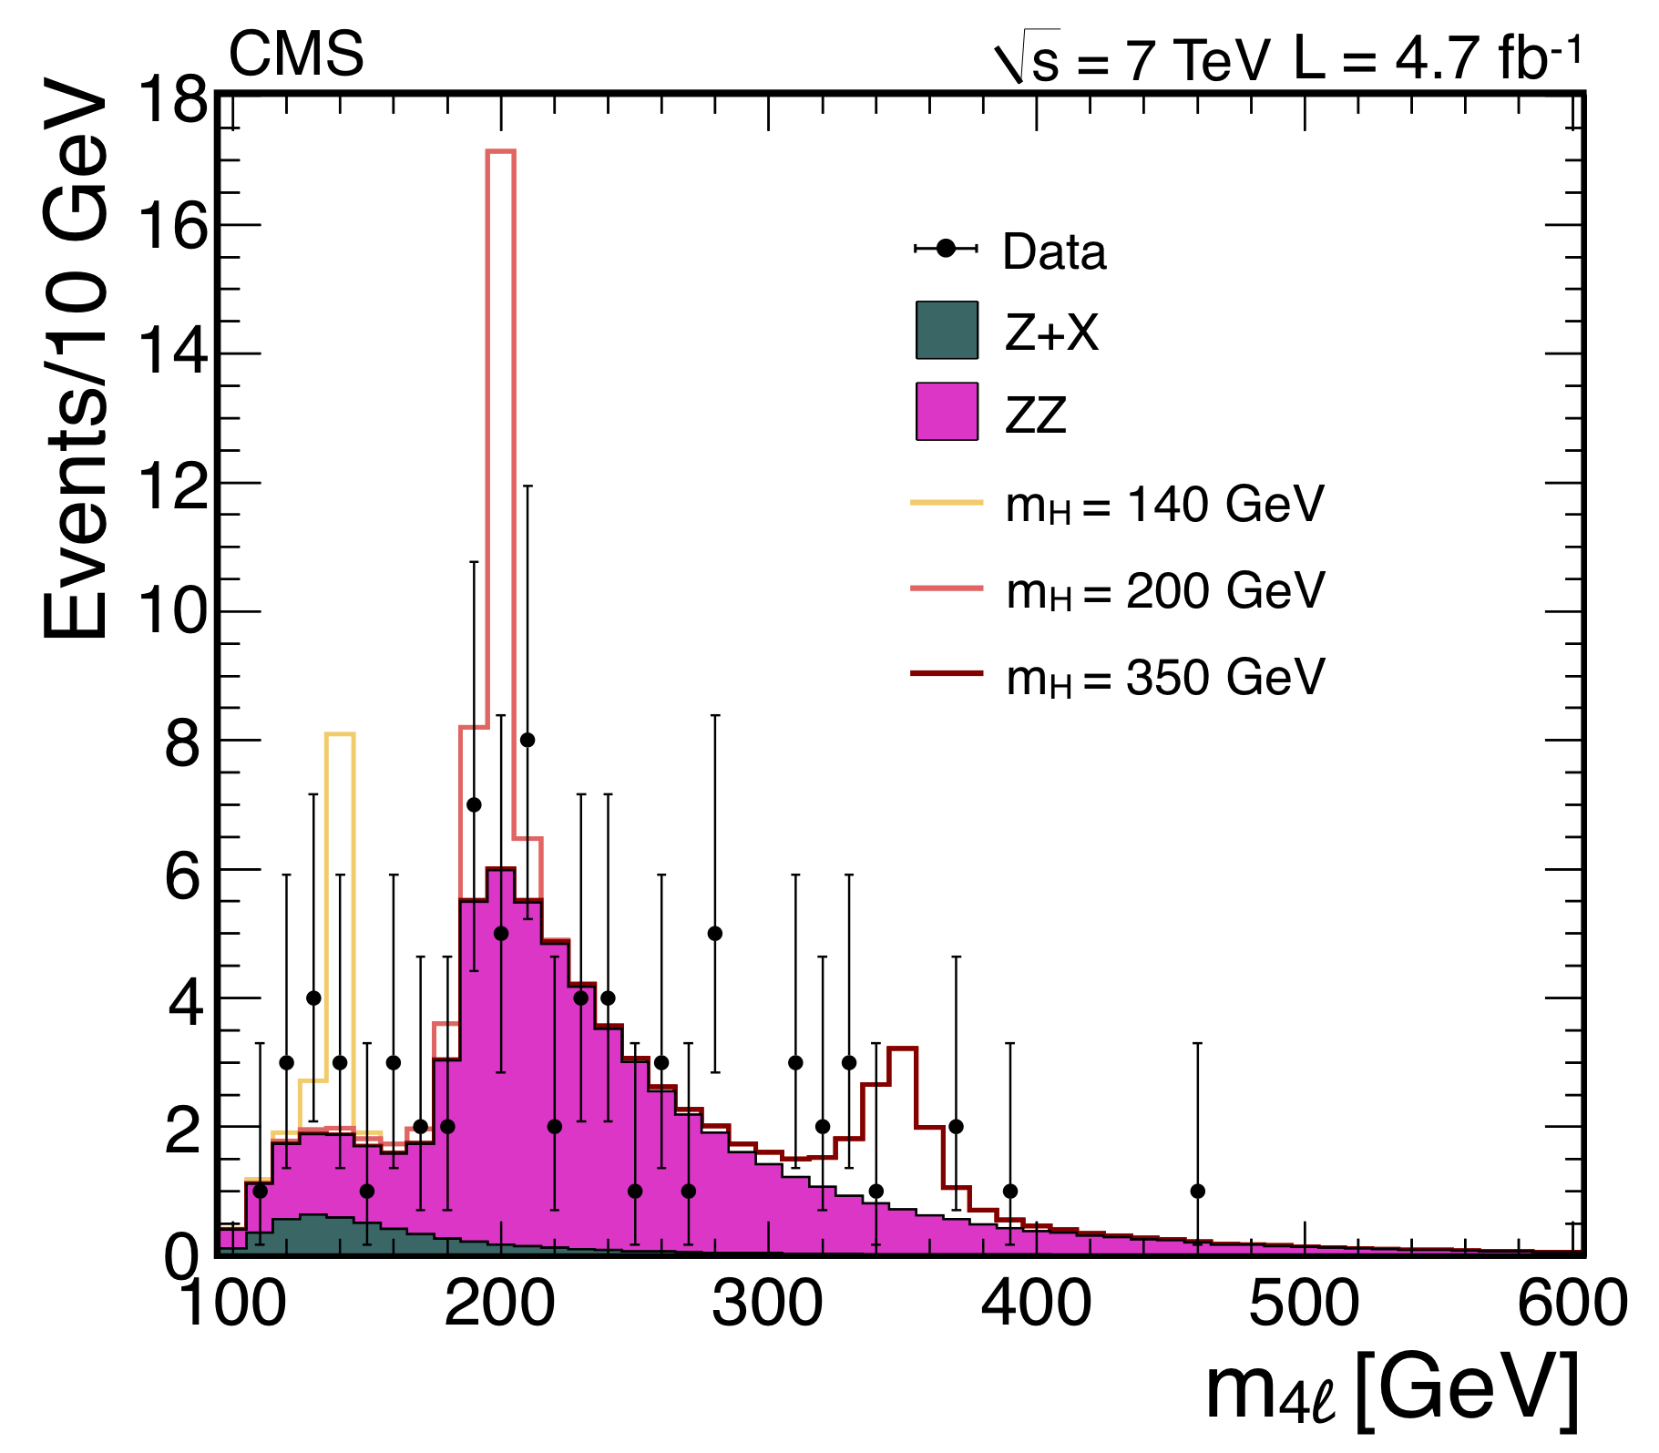
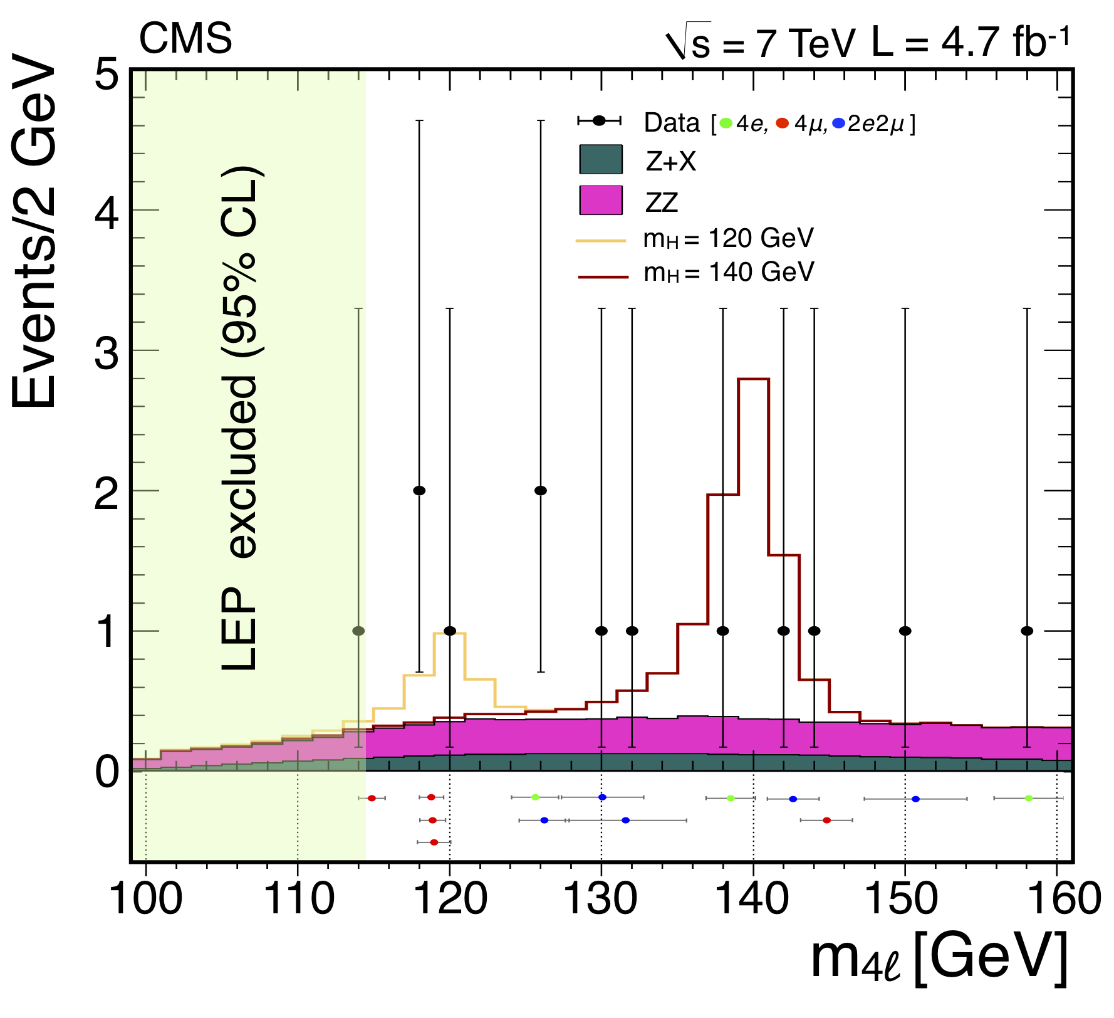
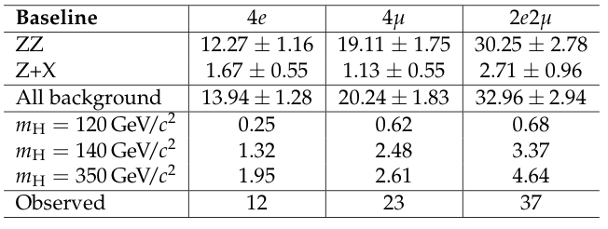
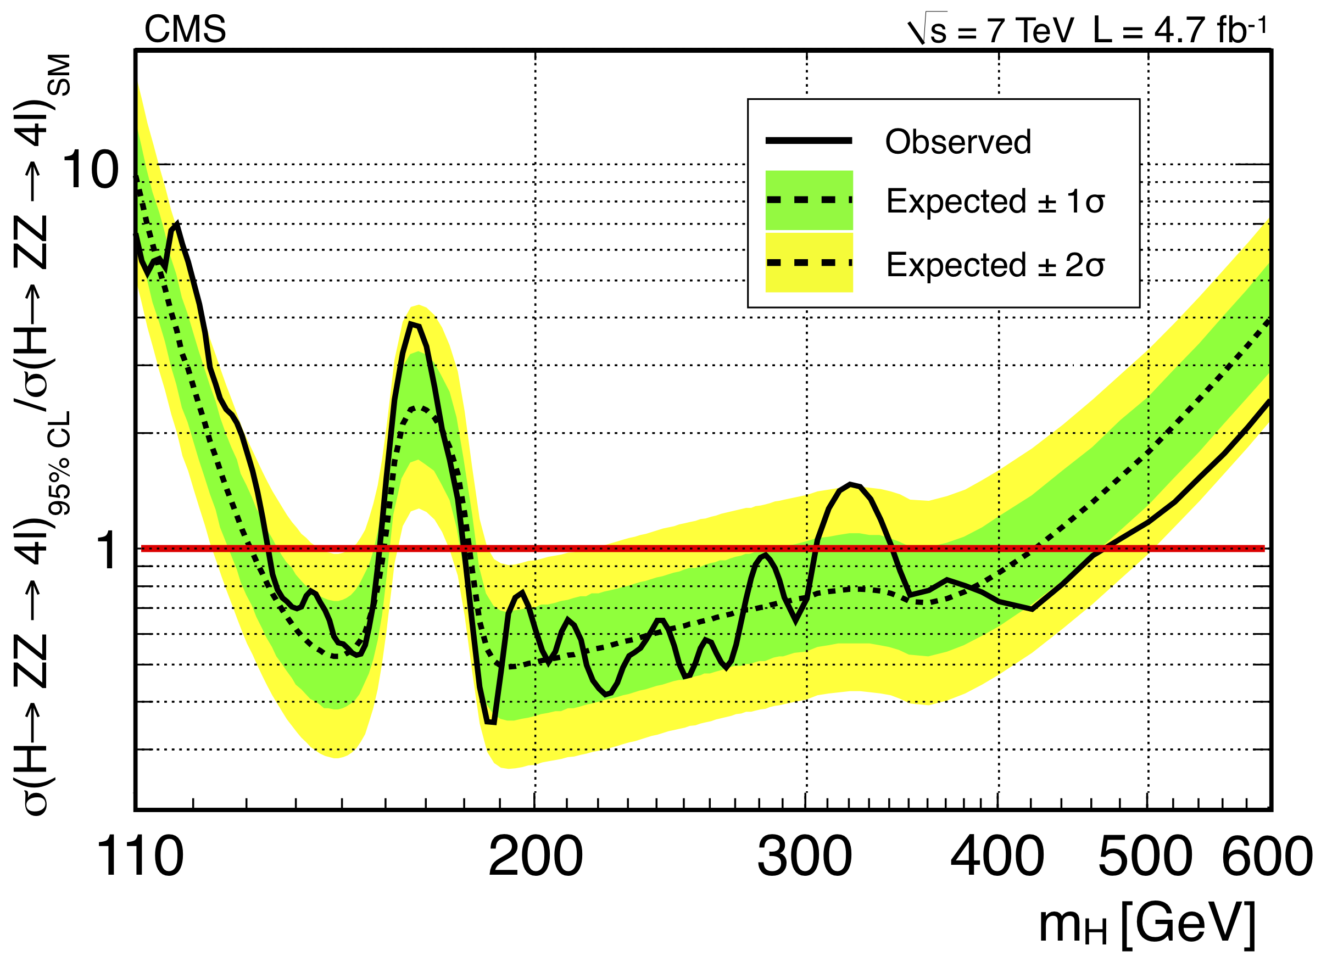
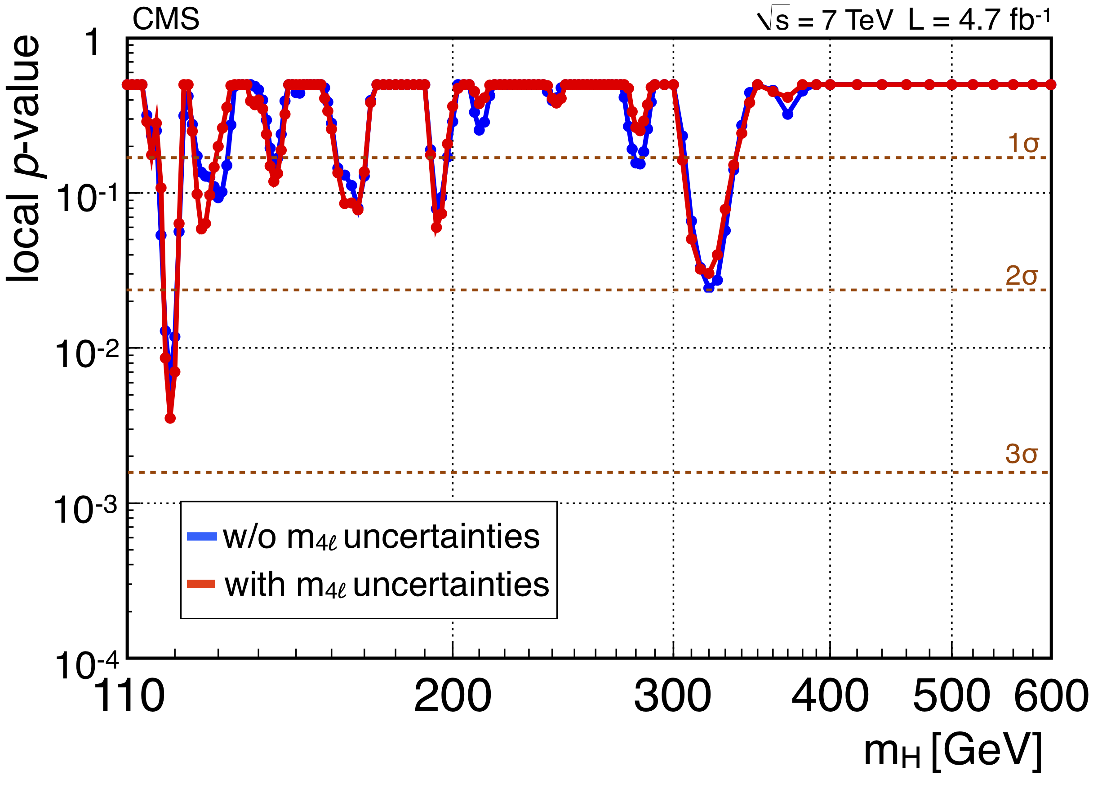
History Lesson
H→ZZ→4L Analysis was performed and published in 2011
on the full 2011 dataset (4.7 fb⁻¹ at 7 TeV). Results shown below.
2.7 sigma at 119 GeV
Excluded Regions:
[134,158] [180,305] [340,465] GeV

Slide 19
Event Selection Strategy
HLT: All events are required to pass a dilepton trigger (pt > 17,8)
Skim: We skim the large primary datasets for events with one pair of same flavor leptons
with mass greater than 40 GeV
Apply ID’s to all leptons in event
  BDT based ID with cut values optimized for different detector areas for electrons
  isPFMuon && (isGlobalMuon || isTrackerMuon) for muons
  significance of 3D impact parameter > 4, dxy < 0.5, dz < 1 on all leptons
  acceptance cuts: |η| < 2.4 (2.5), pT > 5 (7) for muons (electrons)
Select best Z candidates
  Z₁: Search for same flavor, opposite sign pair with mass closest to M_{Z0}(91.1876GeV)
    if there is a PFPhoton which is within 0.07 < δR < 0.5 with pT > 2, well isolated, and makes |M_{Z1}+γ – M_{Z0}| < |M_{Z1} - M_{Z0}| then keep it as a reclaimed FSR photon. Subtract photon contribution from Z₁ leptons’s isolation.
  Z₂: Search for same flavor, opposite sign pair made from the highest pT leptons remaining in the event
    if there is a PFPhoton which is within 0.07 < δR < 0.5 with pT > 2, well isolated, and makes |M_{Z2}+γ – M_{Z0}| < |M_{Z2} - M_{Z0}| then keep it as a reclaimed FSR photon. Subtract photon contribution from Z₂ leptons’s isolation.
If the event passes 4/6 m_{2L} > 4 GeV, pT_{1,2} > 20,10, ₄₀ < M_{Z1} < 120 GeV, 12 < M_{Z2} < 120 GeV, and M_{4L} > 100, keep event as Higgs candidate.

