Slide 1
ARD Department Meeting
Dan Broemmelsiek
10 Feb 2023

Slide 2
ORPS/NTS in January
LBNF Far Site Quarterly NO2 report 4th quarter CY2022 - Low
Small Fire at HAB – Low
  The afternoon of Friday, January 6th a Fermilab welder was welding the end plate to the bore tube of the transport solenoid vessel for the Mu2e project. While welding the technician assisting the welding noticed a movement inside the cryostat via the mirror used by the welder. The technician asked the welder to stop, the welder then noticed the movement (stated it looked like “flashing”). The technician realized there was an issue, that the multilayer insulation (MLI) inside the cryostat was likely on fire, and called the emergency line to dispatch the fire department. When the fire department arrived, the building fire alarm was not yet sounding as there was not enough smoke to cause the system to go into alarm. The fire department pulled the fire alarm pull station to evacuate the building. The fire was then extinguished utilizing CO2 extinguishers through openings of the cryostat. It took less than 10 minutes to extinguish the fire. The project solenoid personnel conferred with the fire department about utilizing a nitrogen gas purge to ensure the MLI would not continue burning and proceeded with installing the purge after acceptance.

Slide 3
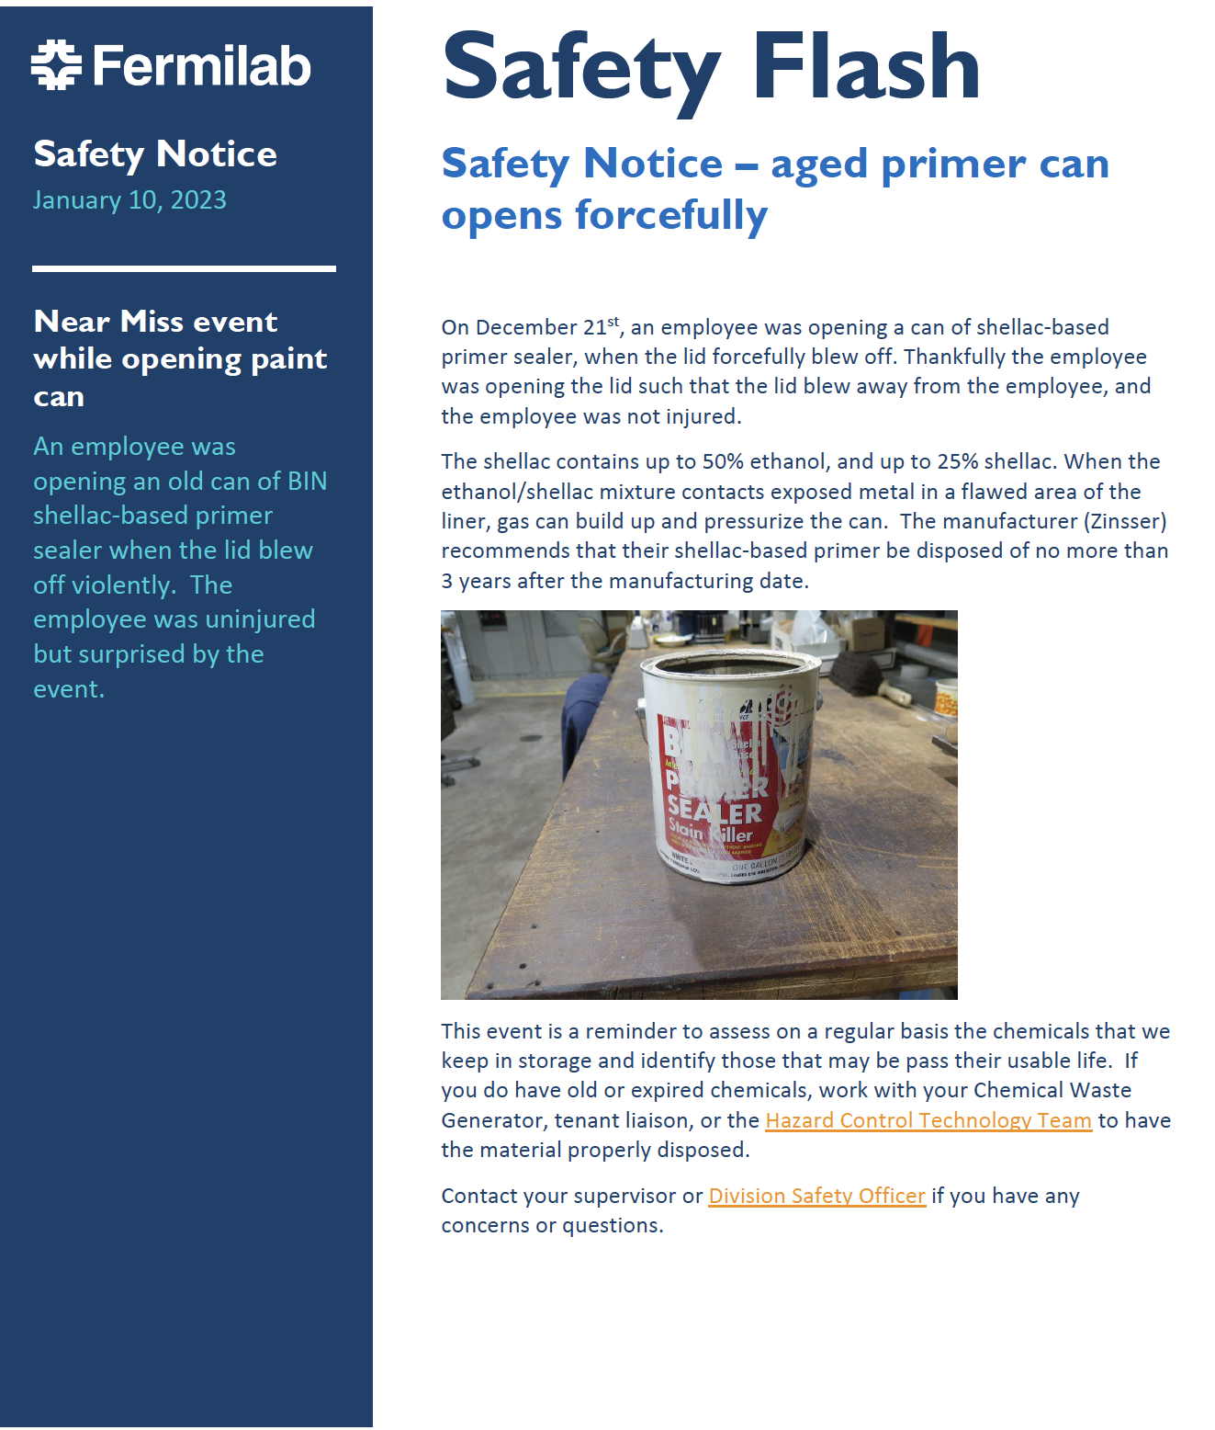
This event is a reminder to assess on a regular basis the chemicals that we keep in storage and identify those that may be pass their usable life. If you do have old or expired chemicals, work with your Chemical Waste Generator, tenant liaison, or the Hazard Control Technology Team to have the material properly disposed.

Slide 4
Benefits
  Short Term Disability (STD)/ Family Medical Leave (FML)
    STD and FML are now outsourced through MetLife as of 2/1/2023
    Lab employees should notice a faster turnaround, and more streamlined service
  Retirement Planning Workshops in March
    For those 10 years or less from retirement
  Fidelity New Hire Work
    2 Virtual Workshops register here
      Today, 2/9/2023 at 2pm
      Tuesday. 2/14/2023 at 11am
  Summer Day Camp

