Slide 1
Project X Energy Station Workshop Welcome
Steve Holmes
January 29-30, 2013

Slide 2
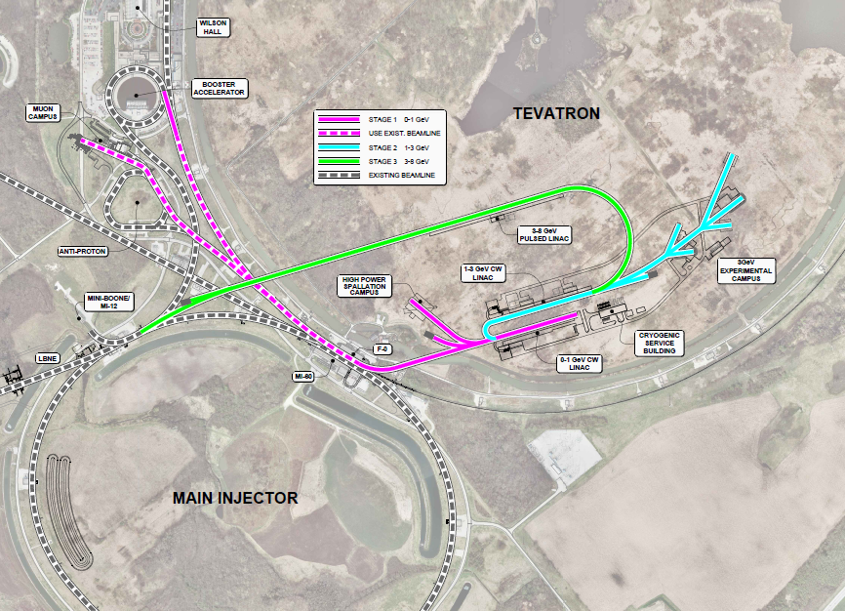
Overview
Project X is a multi-MW proton accelerator facility that will support a world-leading Intensity Frontier program at Fermilab.
Beam Power:
1 MW @ 1 GeV
3 MW @ 3 GeV
0.2 MW @ 8 GeV
2 MW @ 120 GeV
>6 MW Total
Stage 1

Slide 3
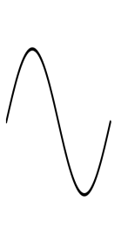
Bunch Patterns Stage 1
1 mA
f₀/2
1 GeV
0.91 mA
910 kW @ 40 MHz
0.09 mA
1 μsec
Peak Current: 3.64 mA

