Slide 1
Lepton Colliders at the Energy Frontier
Mark Palmer and Tor Raubenheimer
Snowmass CPM
October 10-12, 2012

Slide 2
Lepton Energy Frontier Collider Options
e+/e- storage ring
e+/e- linear collider with E < 1 TeV
e+/e- linear collider with E > 1 TeV
μ+/μ- collider
Also γ-γ option

Slide 3
Electron-Positron Storage Rings
LEP2 nearly got to the Higgs
Rings are relatively robust technology
Higher energy and luminosity designs have been suggested
LEP3: 1e34 cm⁻²s⁻¹ at 240 GeV in the LEP tunnel
TLEP: 1e34 cm⁻²s⁻¹ at 240 GeV in an 80 km new tunnel → upgrade to 80 TeV p-p collider (Blondel, et al, arXiv:1208.0504.)
Hard to get to much higher energies than 120 GeV
Limited by SR power as:
Significant challenges
Requires large energy bandwidth and difficult collective effects
Installation with LHC would be difficult
Optimization ongoing
B. Richter, Nucl. Instr. Meth. 136 (1976) 47-60

Slide 4
Electron-Positron Storage Rings (cont.)
 | LEP2 | LEP3 | LEP3** | TLEP**
Beam Energy [GeV] | 104.5 | 120 | 120 | 175
Circumference [km] | 26.7 | 26.7 | 26.7 | 82.4
Beam current [mA] | 4 | 7.2 | 7.2 | 6.4
Number of bunches | 4 | 4 | 50 | 466
Bunch population [10¹⁰] | 57.5 | 100 | 8.0 | 2.36
Horizontal emittance [nm] | 48 | 25 | 4.3 | 1.03
Vertical emittance [nm] | 0.25 | 0.1 | 0.02 | 0.005
β_{x}* [mm] | 1500 | 200 | 50 | 50
β_{y}* [mm] | 50 | 1 | 1 | 1
Hourglass factor | 0.98 | 0.67 | 0.76 | 0.80
SR power [MW] | 11 | 50 | 50 | 50
Bunch length [mm] | 16 | 2.3 | 1.5 | 1.3
Momentum acceptance [%] | 1.25 | 4.2 | 3.0 | 3.0
Beam-beam parameter / IP | 0.07 | 0.09 | 0.07 | 0.06
Luminosity [10³⁴ cm⁻²s⁻¹] | 0.0125 | 1.01 | 1.01 | 1.16

Slide 5
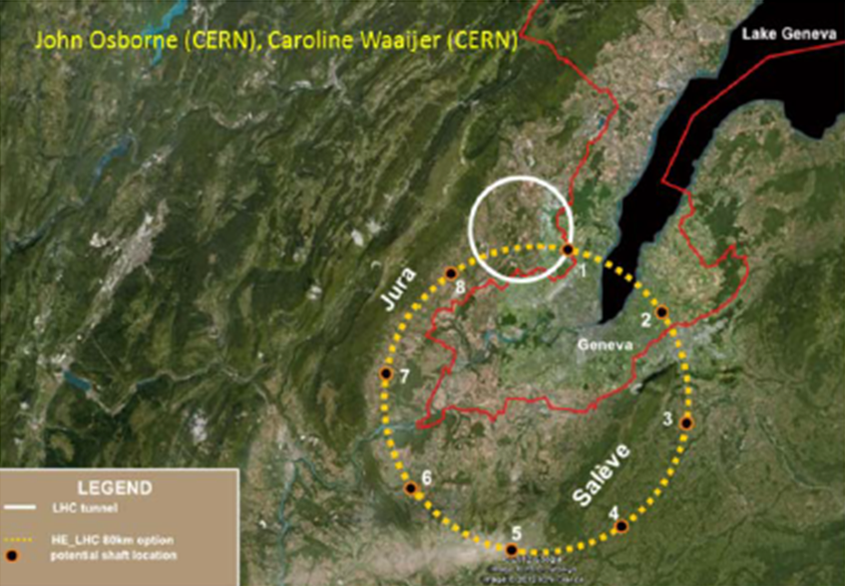
Possible 80 km TLEP option (future upgrade to ~80 TeV p-p collider)

Slide 6
Linear Colliders with E < 1 TeV
Lots of options
ILC design is the most robust
CLIC design also possible
γ−γ collider options may be a lower cost approach
Advanced accelerator concepts may be possible in far future
If ultimate goal is multi-TeV lepton collisions, probably should think about pursuing options with upgrade possibilities
Cost of demonstrating technology can be challenging

Slide 7
ILC Parameters
Centre-of-mass energy | E_{cm} | GeV | 250 | 350 | 500 |  | 1000
Beam energy | E_{beam} | GeV | 125 | 175 | 250 |  | 500
Estimated AC power | P_{AC} | MW | 128 | 142 | 162 |  | 300
Collision rate | f_{rep} | Hz | 5 | 5 | 5 |  | 4
Electron linac rate | f_{linac} | Hz | 10 | 5 | 5 |  | 4
Number of bunches | n_{b} |  | 1312 | 1312 | 1312 |  | 2450
Bunch separation | Dt_{b} | ns | 554 | 554 | 554 |  | 366
Pulse current | I_{beam} | mA | 5.8 | 5.8 | 5.79 |  | 7.6
RMS bunch length | σ_{z} | mm | 0.3 | 0.3 | 0.3 |  | 0.250
Electron polarisation | P₋ | % | 80 | 80 | 80 |  | 80
Positron polarisation | P₊ | % | 30 | 30 | 30 |  | 20
Luminosity (inc. waist shift) | L | ×10³⁴ cm⁻²s⁻¹ | 0.75 | 1.0 | 1.8 |  | 3.6
Fraction of luminosity in top 1% | L_{0.01}/L |  | 87.1% | 77.4% | 58.3% |  | 59.2%

Slide 8
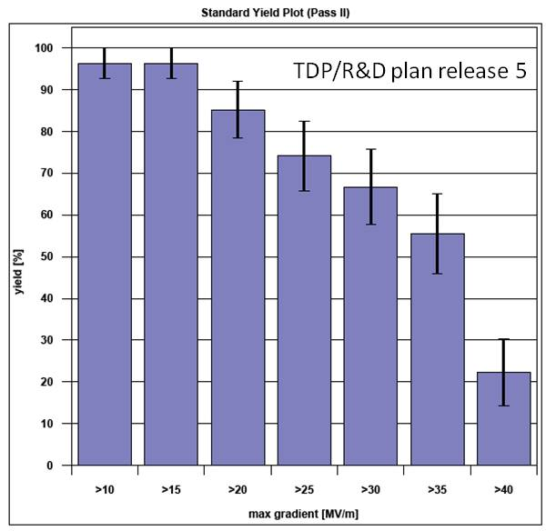
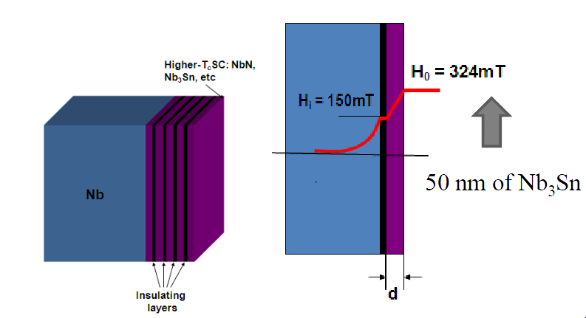
Superconducting Rf Cavities
ILC based on high gradient superconducting rf cavities
Potential for still higher gradients from geometry or new materials
ILC cavities reaching 35 MV/m routinely
~75% of magnetic field limit
R&D towards new materials and geometries for higher gradients
Materials with higher H_{c} and lower Rs: MgB₂, NbN, Nb₃Sn, …
Multi-layer materials to reduce fields in bulk material
Yield of ILC 1.3 GHz cavities
Yield ’10 ~ ’12:
> 90% @ 25 MV/m
~ 80% @ 28 MV/m
~ 70% @ 35 MV/m
50 MV/m → 75 MV/m
New Acceleration Techniques
Page 8
From Grigory Eremeev SFR’09

Slide 9
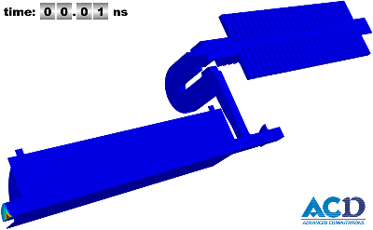
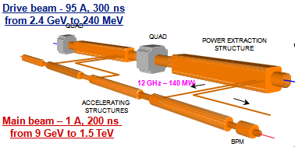
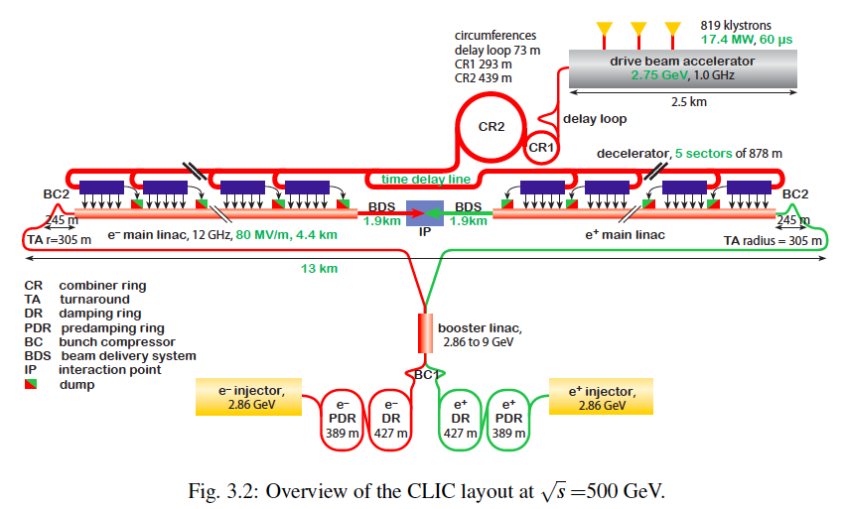
CLIC layout at 500 GeV

Slide 10
Potential Staged CLIC Parameters

Slide 11
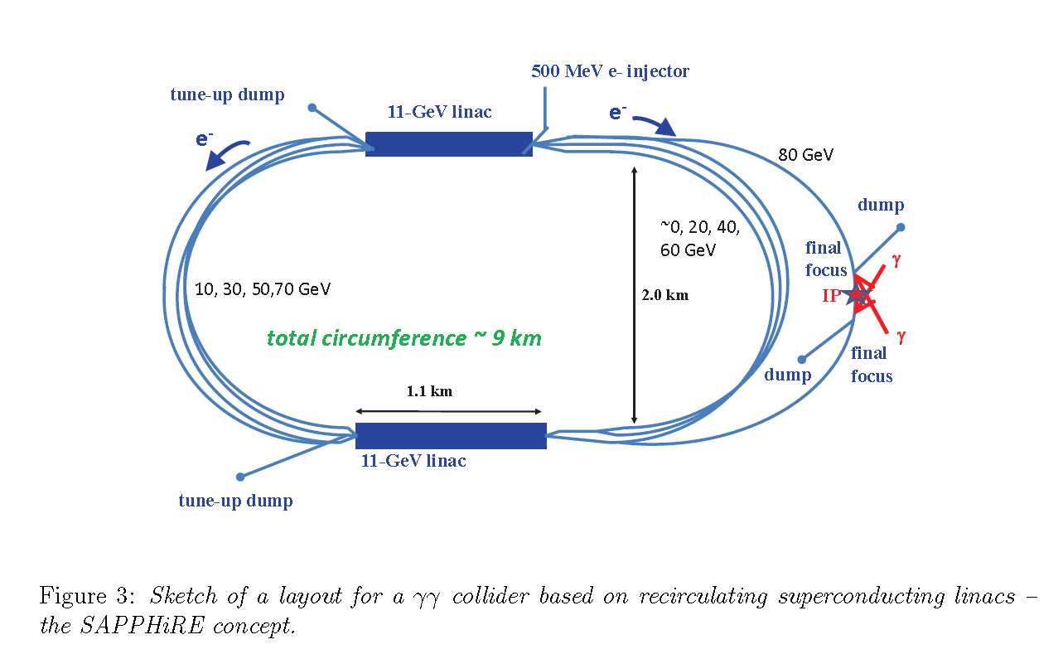
Gamma-Gamma Linear Collider Options
A Higgs factory might provide an entry for a ‘low-cost’ γ−γ linear collider and technology demonstration
e⁻− e⁻ cms energy of only ~160 GeV (γ−γ cms is roughly 80%)
Eliminates large portion of ILC infrastructure (e+ source, damping rings, bunch compressors, …) and should save significant $
Many options:
SLC configuration with single 85 GeV linac
Sapphire: 22 GeV recirculating linac in SLC-configuration
Expandable dual 85 GeV e- linacs in classic LC configuration
Sapphire
R ~ 1 km
85 GeV SCRF linac
Pol. Rf gun
~3 km

Slide 12
Linear Colliders with E > 1 TeV
ILC is ~ 50 km at 1 TeV
Possible to consider higher gradient SCRF materials or PWFA boost
CLIC design is aimed at upgradable design → 1.5 or 4 TeV
Geographic gradient of 4x higher than ILC
Advanced acceleration options (plasma, dielectric)
Plasma acceleration has made great progress however still huge challenges in beam quality and stability
Extremely low charge dielectric-laser accelerators may provide only reasonable parameters in multi-TeV regime
None of AARD options are close to being ready
Some plasma and dielectric options act as transformers taking high power beams → high energy beams
Possible to develop upgrade options for ILC-like technology?

Slide 13
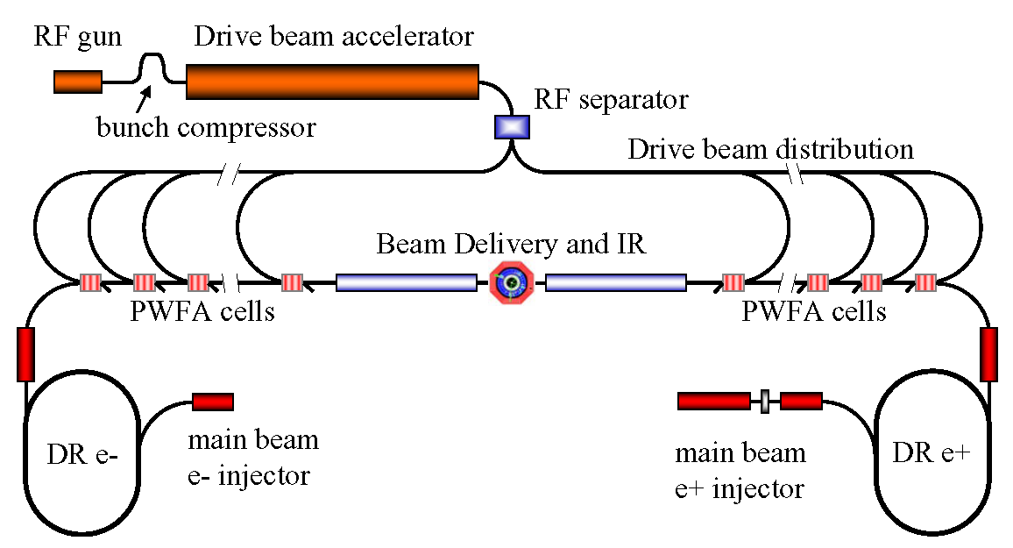
Concept of Beam-Driven Plasma Linac
Concept for a 1 TeV plasma wakefield-based linear collider
Use conventional Linear Collider concepts for main beam and drive beam generation and focusing and PWFA for acceleration
Makes good use of PWFA R&D and 30 years of conventional rf R&D
Concept illustrates focus of PWFA R&D program
High efficiency
Emittance pres.
Positrons
Allows study of cost-scales for further optimization of R&D

Slide 14
Possible Linear Collider Parameters
Case | 0.5 TeV ILC | 3 TeV CLIC | 10 TeV Dielectric Beam Acc. | 10 TeV Plasma Accelerator | 10 TeV Dielectric Laser Acc.
Energy per beam (TeV) | 0.25 | 1.5 | 5 | 5 | 5
Luminosity (10³⁴ cm⁻²s⁻¹) | 2 | 6.4 | 49 | 71.4 | 105
Electrons per bunch (×10⁹) | 20 | 3.7 | 4 | 4 | 0.002
Rep. rate (Hz) / number / train | 5 / 1312 | 50 / 312 | 50 / 416 | 17,000 / 1 | 25,000,000 / 1
Horizontal emittance γε_{x} (nm-rad) | 10,000 | 660 | 1000 | 200 | 0.1
Vertical emittance γε_{y} (nm-rad) | 30 | 20 | 10 | 200 | 0.1
β* x/y (mm) | 11 / 0.2 | 4 / 0.1 | 10 / 0.1 | 0.2 | 0.4
Horizontal beam size at IP σ*_{x} (nm) | 474 | 49 | 32 | 2 | 0.06
Vertical beam size at IP σ*_{y} (nm) | 3.8 | 1.0 | 0.3 | 2 | 0.06
Luminosity enhancement factor | 1.6 | 1.9 | 1.9 | 1.35 | 6.05
Bunch length σ_{z} (μm) | 300 | 50 | 20 | 1 | 335
Beamstrahlung parameter ϒ | 0.07 | 6.7 | 56 | 8980 | 0.4
Beamstrahlung photons per electron n_{γ} | 1.7 | 1.5 | 1.4 | 3.67 | 0.5
Beamstrahlung energy loss δ_{E} (%) | 4.3 | 33 | 37 | 48 | 4.3
Accelerating gradient (GV/m) | 0.031 | 0.1 | 0.5 | 10 | 0.5
Average beam power (MW) | 5.3 | 13.9 | 55 | 54 | 38
Wall plug power (MW) | 200 | 568 | ~1200 | ~1200 | ~550
One linac length (km) | 15.5 | 23.5 | 10 | 1.0 | 10.5
ILC and CLIC parameters from design reports; 10 TeV DBA scaled from Wei Gai communication; 10 TeV DLA and Plasma Accelerator from 2010 ICUIL/ICFA Workshop

Slide 15
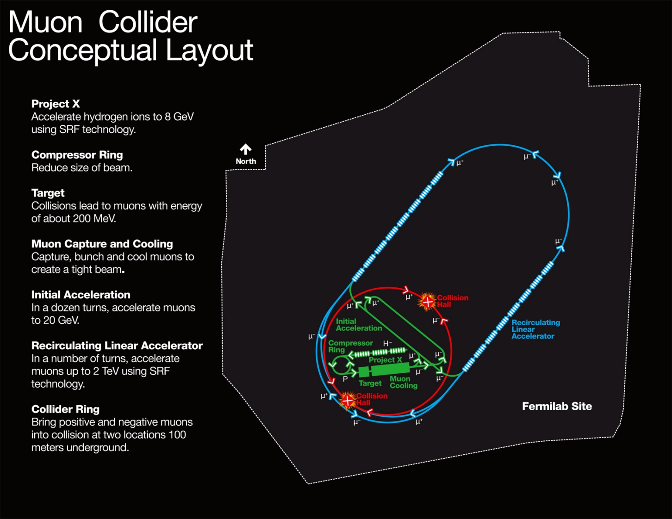
Muon Collider
Compact facility accelerating muons with recirculating linacs and rings
Major Challenges
Muon generation
Cooling of muons
Cost-efficient acceleration
Collider ring and backgrounds from decays
Being studied as part of MAP & proposed Lepton
Collider Physics Framework
For 3 TeV

Slide 16
Muon Collider Parameters
Depends on cooling scenario:
10³¹a~10³² cm⁻²sec⁻¹
s-channel: factor
of ~4×10⁴ in rate
P_{Wall} < 300 MW

Slide 17
Steps Toward a Muon Collider
NEUTRINO FACTORY
Project-X is being designed to deliver 4 MW of 8 GeV
Muon test facility would demonstrate capture and 1st cooling
NEUTRINO FACTORY
ν Factory Goal: O(10²¹) μ/year
within the accelerator
acceptance
Share same complex
MUON COLLIDER

Slide 18
Summary
Many options for next-generation lepton colliders
Storage rings can access Higgs but limited in energy reach
ILC-technology is essentially ready for construction
Important to understand upgrade options
CLIC/NCRF technology might provide an alternate approach with different upgrade possibilities and technology risks
Advanced accelerator concepts not ready but may provide path to future upgrades for LC concepts
Muon collider synergistic with US Intensity Frontier program and may provide path to future Energy Frontier

