Slide 1
QCD and the Strong Force
Joey Huston
Michigan State University
for the QCD conveners
John Campbell, Ken Hatakeyama, Frank Petriello

Slide 2
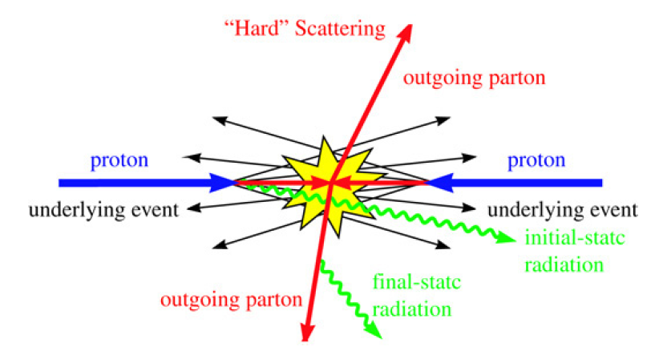
QCD
QCD plays a major role in basically every physics process under discussion in this workshop
When we talk about precision physics, or discovery physics, we need to understand the role of QCD corrections
Thus, we have an overlap, and hopefully a synergy, with every physics group in this workshop
For example, part of our session tonight will be jointly with the EWK group, given the interplay between QCD and EWK corrections for precision measurements

Slide 3
Charge
The charge for the QCD group (like every other group) is to determine the
current state of the art
what is likely/priority for the next 5 years?
what is likely/priority for longer time scale (20 years)?
Of course a) is the easiest, b) is less so and parts of c) are in the realm of pure speculation
We have broken down each question into a series of more definite sub-issues that should be addressed. For each issue, we include a discussion of the current status and outlook, some possible projects, and overlap/synergy with the other physics groups.

Slide 4
Question 1a
What are the prospects for future higher order calculations at NLO and matched with parton showers? What subtleties remain to be understood for precision measurements?
Techniques in calculation of pQCD cross sections have reached the point where any reasonable cross section can be calculated in a finite time. The current limit is 2->6 (W+5 jets, ttbar with decays).
Many existing calculations can also be recycled; 4 jet cross section has been used to calculate photon+3 jets and diphoton+2 jets
See extra slides

Slide 5
Question 1a
There remain open questions as to the best scale choice (and uncertainty) for complex multi-parton calculations, since a variety of physical scales may appear in the calculation
There are now attempts, such as MINLO, to choose nodal scales (plus appropriate Sudakov factors) in NLO multi-parton calculations that may shed light on this issue
Projects
collate cross section predictions where a choice of an optimal scale and range of uncertainty is not obvious (example: tTbB)
study effect of application of MINLO procedure to these (and other) calculations
where does this uncertainty cause problems for experimenters?

Slide 6
Question 1a
There have also been great advances in the inclusion of NLO multi-parton matrix elements in parton shower Monte Carlos, in a semi-automatic manner
We expect that any future NLO calculation can be straightforwardly implemented in a parton shower Monte Carlo
There have also been developments in addition of NLO parton states of different multiplicities, without double- or under-counting, in such a manner that theoretical final states can be generated similar to what is measured in the data, i.e. an inclusive Higgs sample where the 1 and 2 jet final states are described at NLO, and higher multiplicities are described at LO
Projects
detailed comparisons of predictions from different approaches for combining NLO+PS (Powheg, MENLOPS, aMC@NLO) for key physical processes (such as inclusive jet production)
compare multi-parton NLO PS predictions (MEPS@NLO for the moment) to fixed order predictions, to NLO PS predictions and to data
W+jets
Higgs+jets

Slide 7
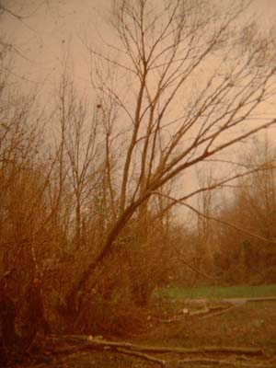
Question 1b
Once we have the NLO and NNLO calculations, how do we (experimentalists) use them?
If a theoretical calculation is done, but it can not be used by any experimentalists, does it make a sound? Or create a citation?
We need public programs and/or public ntuples
Oftentimes, the program is too complex to be run by non-authors
In that case, ROOT ntuples may be the best solution
see for example experience with Blackhat+Sherpa ntuples
Computing and storage are an issue both for the authors of these programs and for the users
overlap with computing group
Projects
study of B+S ntuple structure; questions of universality/possible improvements

Slide 8
Question 1c
Survey of the importance of EWK corrections. Do we need an EWK wishlist similar to the now-defunct NLO QCD one
Where are combined QCD-EWK corrections important?
Projects:
NLO (QCD+) EWK wishlist
Overlap
EWK group
See for example the workshop on EWK Corrections to Hard QCD Processes at the IPPP at Durham (Sep 24-26)
See http://www.ippp.dur.ac.uk/Workshops/12/EW_LHC
See also www.pa.msu.edu/~huston/atlas/ippp_ewk_summary.pdf

Slide 9
Question 1d
The frontier for NNLO is 2->2 processes
What processes do we need calculated?
What is the timescale?
Projects:
NNLO wishlist (build on Les Houches wishlist; see extra slides)
To date, most NNLO calculations are 2->1 (W/Z/Higgs)
Multiple NNLO calculations containing colorless final states (diphoton production, W+Higgs production) have recently been completed
Several partonic channels contributing to tt at NNLO have been completed and full result is expected soon
Work is proceeding on dijets, W/Z+jet, Higgs+jet

Slide 10
Question 1e
What are the prospects for including NNLO effects in a parton shower? To what extent are any physics analyses limited by the choice of either NLO+PS or NNLO?
Are measurements constraining subtle effects (recoil strategies, etc) in parton showering and/or NLO+PS calculations?
a la the ttbar symmetry at the Tevatron
A program/technique including NNLO QCD matrix elements in a parton shower Monte Carlo will not be forthcoming in the near future, but in principle, there is nothing that prevents such a development.
Note that the parton showers themselves are still at LL/NLL. What limitations does this result in?
Projects
do we need a parton shower that is fully NLL?
what is needed in parton showering to fully model what is observed in the data?

Slide 11
Question 2a
Can jet analyses be repeated with different (infra-red safe) jet algorithms and/or jet sizes?
Both major LHC experiments are using the antikT algorithm (which is good) but different jet sizes (which is bad). Physics analyses can be automated to the extent that there is no reason not to carry them out with several jet sizes and/or several jet algorithms. Each algorithm/size may illustrate different aspects of the underlying physics.

Slide 12
Question 2b
Can jet substructure, in particular for boosted systems, be put to wider use in other physics analyses?
There has been a great deal of attention given to jet substructure, especially for boosted systems. These tools can also be put to use for most physics analyses, again to try to understand the underlying physics better.
Projects
catalog general substructure tools/frameworks, a la FastJet or SpartyJet. What tools are missing?
Overlaps
top, bsm,Higgs

Slide 13
Question 2c
At what future luminosities might existing jet algorithms cease to be robust? What techniques may be introduced to stabilize them?
The antikT algorithm, and the accompanying techniques, have worked well at the LHC,even with current luminosities resulting in >=30 additional events per crossing. Studies need to be carried out to see at what pileup rates, existing jet algorithms may cease to be robust, and better clustering techniques may need to be developed.
Projects:
how do the existing jet substructure tools perform at high pileup rates (say nPU=100) and what kind of further developments may be necessary?
Overlaps
top, BSM, Higgs

Slide 14
Question 2d
Can particle flow techniques be taken advantage of in future jet algorithms?
Both ATLAS and CMS have used particle flow techniques to improve the jet energy scale determination. Such techniques are considered as crucial for future linear collider experiments, and it may be that new jet algorithms can be developed to take advantage of the commensurate granular resolution inherent in such techiques.
Projects:
how might jet reconstruction be improved given highly granular readout?

Slide 15
Question 2e
Can event shapes such as jettiness be useful in future measurements, and should the experimental collaborations study their implementation at the LHC?
There has already been some work by ATLAS and CMS, but this is an area that needs to be developed further
Projects:
develop it further

Slide 16
Question 3a
What impact will LHC data have on PDFs?
Projects:
what is the ultimate precision/limitations of collider-only PDFs?
There has been a great deal of work on understanding PDF predictions and uncertainties at the LHC, in particular by the PDF4LHC working group.
The DIS data, including both HERA and fixed target are the dominant ‘deciders’ in global fits. Collider cross sections, however, are often directly sensitive to the gluon distribution in a way that DIS data is not. As the statistical and systematic errors improve, the use of LHC data in global fits will accelerate. It is crucial that correlated systematic error information be published for all of this data.

Slide 17
Question 3b
How much better might an eLHC constrain PDFs? Is the improved precision necessary?
Projects:
what physics processes need the PDF precision that such a machine could provide? Are new fixed target measurements necessary as well?
The LHC probes PDFs in ranges outside of direct investigation possible in HERA. This will become even more true with higher running energies for the LHC, or a possible successor. An eLHC will serve to directly determine PDFs in this new kinematic regime.
The information provided will be superior to that determined by the inclusion of collider data in the PDF fits, but it should be investigated how necessary that increased precision might be.

Slide 18
Question 3b+
What are the prospects for improving the theoretical description of PDFs?
How important is a good knowledge of the photon PDF?
What does having a negative gluon imply?
For example, including QED corrections in the evolution, or even moving beyond NNLO. (See Durham EWK workshop for discussion of QED effects in PDFs.)
Projects:
evaluate importance of QED/EWK corrections for PDFs.
Overlap
EWK group

Slide 19
Question 3c
What are the prospects for improved measurements of α_{s} at the LHC and future colliders?
Measuring α_{s}, and its running, is one of the most fundamental of QCD tests
Projects:
what are the sensitivities of α_{s} measurements at the LHC and at future accelerators?

Slide 20
Question 4a
In what situations do we need better resummation techniques? Can we envisage future experimental measurements where severe phase space restrictions will be required?
Resummation techniques have greatly improved in recent years, for a variety of kinematic variables. What is needed, perhaps, is a catalog of situations where a better resummation formalism/technique is needed.
Projects:
catalog of situations where improvements in resummation are needed.

Slide 21
Question 4b
To what extent do current formalisms to resum large logarithms in jet-binned cross sections agree? Can we envisage more flexible resummation formalisms to handle more complicated observables?
Projects:
catalog measurements where jet vetoing/binning might be necessary, and estimate the possible effects on the uncertainty
Often it is necessary to apply jet vetoes/binning in a physics measurement, and thus in the corresponding theoretical QCD calculation. For example, the Higgs production process is known to NNLO, but the application of jet vetoes/binning can significantly increase the size of the uncertainty over that of the inclusive cross section.
There are now techniques to resum the effects of the vetoes, but it is not clear how the current techniques can be applied to the complex phase space that results from the application of jet algorithms.
See extra slides
Overlaps: Higgs

Slide 22
Question 5
Are there gaps in our understanding of diffractive and hard diffractive physics?
There are two main directions: (1) diffraction and forward physics as a means to study unresolved issues of QCD and to search for and to investigate any manifestations of new physics and (2) diffraction as a way to study soft physics.
For (1): one can study Higgs and BSM physics with forward proton tagging. This can serve as a spin-parity analyser/filter, allow for the measurement of the Higgs branching ratio into bottom quark pairs, and allow tests of CP violation in the Higgs sector. For heavier Higgs, it will also be possible to measure the Higgs width. One can also study the spin-parity assignments for any new quarkonium-type states.

Slide 23
Question 5 (cont)
At the LHC, and any future high energy colliders, there will be a large photon-photon flux, which can be used to produce a number of final states, including WW production, and light charginos. (See Durham EWK workshop.)
For (2): one can continue the study of the violation of factorization for diffractive scattering at ep and pp machines, measure dijet properties for a sample of pure gluon jets, and in general study hard diffractive production of a number of final states.
Projects:
how well can we predict/measure processes such as diffractive Higgs production? How does the photon-photon flux in a pp machine compare to that in a future linear collider? For what future physics topics would such measurements be useful?
Overlaps
Higgs

Slide 24
Question 6
How hampered are we by our limited understanding of non-perturbative physics?
Projects:
understand sensitivity of top mass definition to non-perturbative effects
This includes both effects such as jet fragmentation as well as the multiple parton interactions that make up the bulk of the underlying event. Another issue is the definition of kinematic quantities that have been treated in a classical sense to date, but for which increased precision requires a better theoretical basis; perhaps foremost among these is the measurement of the top mass to both the current precision and to the improved precision that will be possible with further LHC running and at future machines.

Slide 25
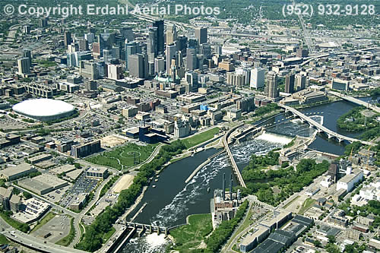
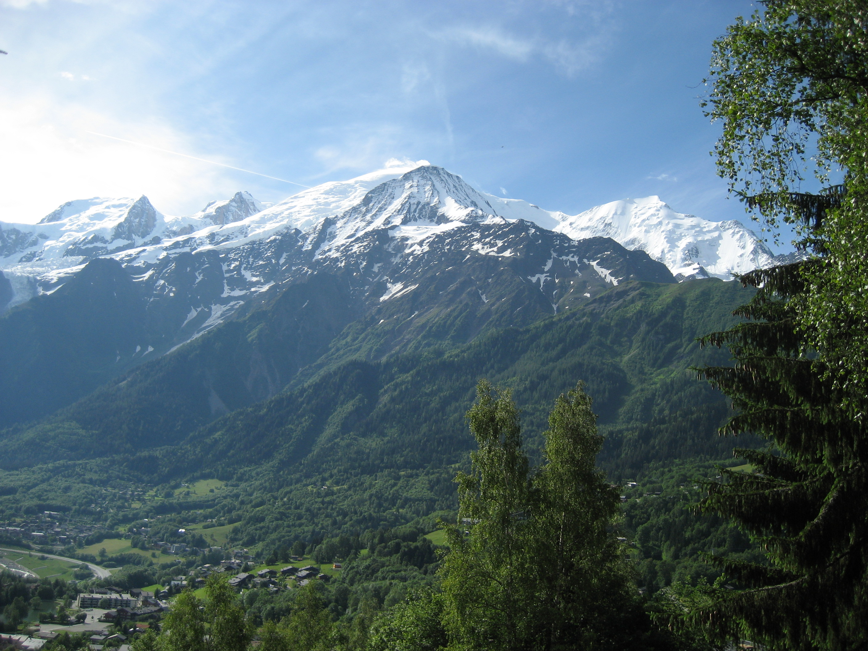
Snow-Houches
Many of these issues have been addressed in the Les Houches workshops which have taken place since 1999
witness the many Les Houches accords
the next workshop will be before the Minneapolis meeting (June 3-23 2013)
We will try to coordinate some of the common work between the two
+
==Snow-Houches

Slide 26
Evening session
7:30-9:00 West Wing WH10W
last half-hour with EWK group
ReadyTalk: 9343617 Passcode: 7907
Evo: Universe CPM2012-Energy Frontier HE5-QCD
See also pQCD computing session 1:15 PM
Nu’s Room WH12X

Slide 27
Extra slides

Slide 28
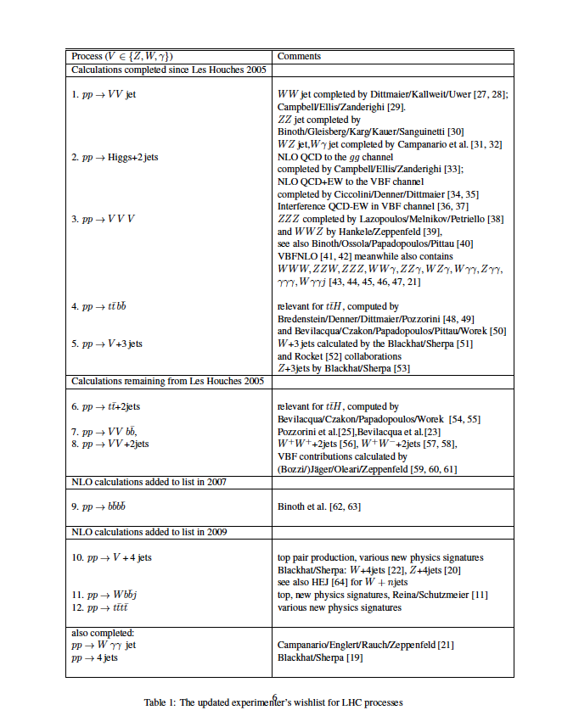
Question 1
Les Houches NLO wishlist, started in 2005, and incremented in 2007 and 2009 was officially closed in 2011, since all of the calculations on the list were complete, and there are no technical impediments towards calculations of new final states, either with dedicated or semi-automatic calculations
Note that dedicated calculations can be factors of 10 faster than semi-automatic

Slide 29
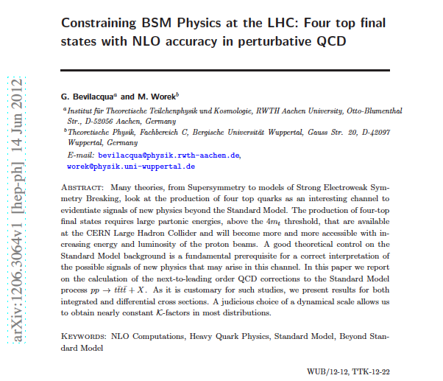
Last to be calculated
…the authors

Slide 30
ROOT ntuples
More complex to use than MCFM
no manual for example
and you don’t produce the events yourself
ntuples produced separately by Blackhat + Sherpa for
so TB’s of disk space
No jet clustering has been performed; that’s up to the user
a difference from MCFM, where the program has to be re-run for each jet size/algorithm
What algorithms/jet sizes that can be run depends on how the files were generated
i.e. whether the right counter-events are present
For the files on the right at 7 TeV (for W⁺ + 3 jets), one can use kT, antikT, siscone (f=0.75) for jet sizes of 0.4, 0.5, 0.6 and 0.7
bornLO (stands alone for pure LO comparisons; not to be added with other contributions below)
20 files, 5M events/file, 780 MB/file
Born
18 files, 5M events/file, 750 MB/file
loop-lc (leading color loop corrections)
398 files, 100K events/file, 19 MB/file
loop-fmlc (needed for full color loop corrections)
399 files, 15K events/file, 3 MB/file
real (real emission terms)
169 files, 2.5 M event/file, 5 GB/file
vsub (subtraction terms)
18 files, 10M events/file, 2.8 GB/file

Slide 31
Jet Clustering
For jet clustering, we use SpartyJet, and store the jet results in SJ ntuples
and they tend to be big since we store the results for multiple jet algorithms/sizes
Then we friend the Blackhat+Sherpa ntuples with the SpartyJet ntuples producing analysis ntuples (histograms with cuts) for each of the event categories
Add all event category histograms together to get the plots of relevant physical observables
http://projects.hepforge.org/spartyjet/
arXiv:1201.3617 (manual)
SpartyJet is a set of software tools for jet finding and analysis, built around the FastJet library of jet algorithms. SpartyJet provides four key extensions to FastJet: a simple Python interface to most FastJet features, a powerful framework for building up modular analyses, extensive input file handling capabilities, and a graphical browser for viewing analysis output and creating new on-the-fly analyses.

Slide 32
Reweighting
can reweight each event to
new
-PDF
-factorization scale
-renormalization scale
-α_{s} (tied to the relevant
PDFs)
based on weights stored in
ntuple (and linking with
LHAPDF)
so, for example, the events
were generated with CTEQ6,
and were re-weighted to
CTEQ6.6

Slide 33
Reweighting, cont.
complex:
carry both
single and double
logs
9
we run into the
sum over quarks
and antiquarks
again

Slide 34
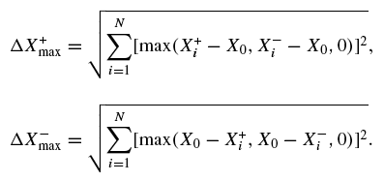
PDF Errors
Better than what is done in MCFM (as far as disk space is concerned); PDF errors are
generated on-the-fly through calls to LHAPDF. But then don’t store information for
individual eigenvectors.

Slide 35
Branches in ntuple

Slide 36
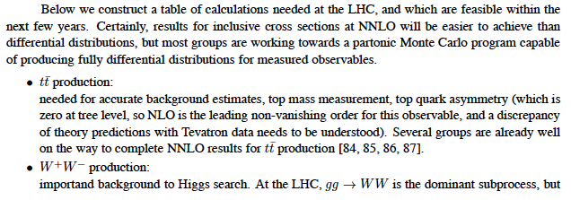
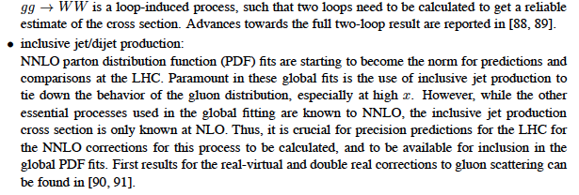
What’s next for the Les Houches NLO wishlist?
Nothing: I’m retiring the NLO wishlist
It’s being replaced by a NNLO wishlist plus a wishlist for EW corrections for hard processes

Slide 37
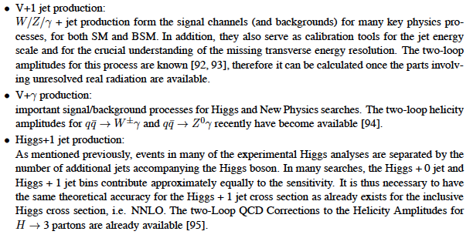
NNLO wishlist: continued

Slide 38
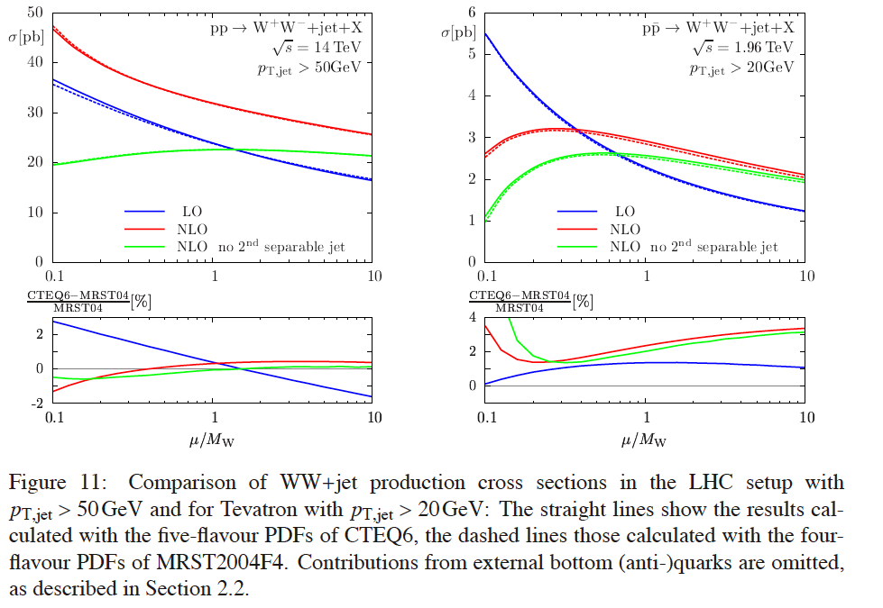
Jet vetos and scale dependence: WWjet
Often, we cut on the presence of an extra jet
This can have the impact of improving the signal to background ratio
…and it may appear that the scale dependence is improved
However, in the cases I know about, the scale dependence was anomalous at NLO without the jet veto, indicating the presence of uncancelled logs
The apparent improvement in scale dependence may be illusory

Slide 39
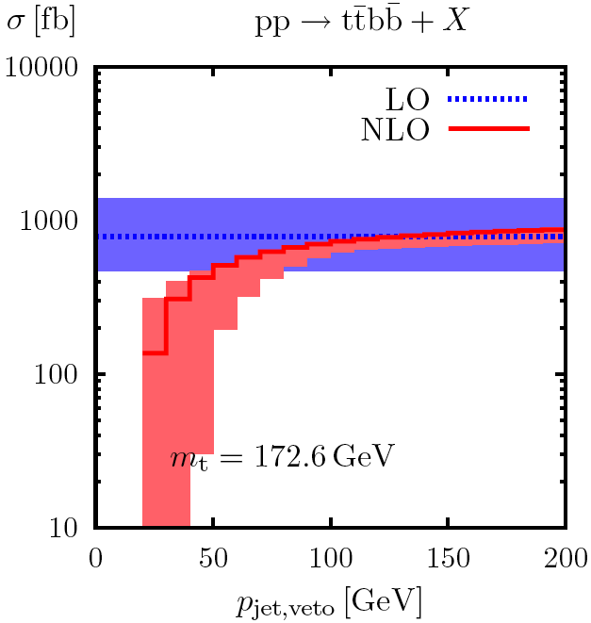
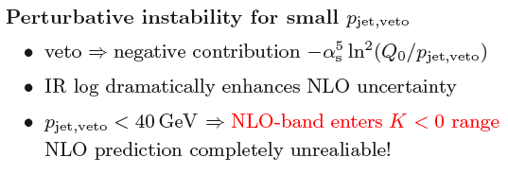
Consider tTbB
here scale dependence
looks ok at inclusive
NLO
useful to make
a jet veto, but
even a cut on
the extra jet
of 50 GeV/c
can greatly
increase the
scale
uncertainty

Slide 40
Uncertainties in the face of jet vetos/bins
For Higgs searches (with decays into WW*), important to divide sample into separate jet bins
backgrounds are different
physics is different (VBF shows up in 2 jet bin)
If I calculate the scale uncertainties naively, I get the following
Note that fixed order expansion gets unstable at low p_{T}^{veto}
Sudakov
double logs
ln²(p_{T}^{cut}/m_{H})

Slide 41
…should treat perturbation series for σ_{>=0jets}, σ_{>=1 jet}, σ_{>=2 jets} as independent with
uncorrelated systematic errors (i.e, add in quadrature)

