Slide 1
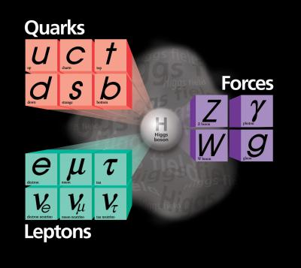
VLHC - Very Large Hadron Collider
Progress in experimental particle physics was always driven by advances in experimental tools
Accelerators and detectors
Over last ~40 years majority of discoveries have been made at the energy frontier hadron accelerators
VLHC is an accelerator with center of mass energy for proton-proton collisions of 40-200 TeV. The only way to
Create particles with masses well above 10 TeV
Study distances below 10⁻²⁰ cm
We have a lot of expertise building hadron colliders while innovative ideas are needed to keep this path viable
Staged approach to ~100 TeV hadron collider
Based on a relatively long tunnel

Slide 2
VLHC – Design Options
Low cost underground construction
New magnets technologies
VLHC could be built based on reasonable extrapolation of today’s expertise
Developments and technological advances would benefit the project and develop new technologies

Slide 3
Very Large Hadron Collider
VLHC is an experimental tool to advance our understanding of sub-atomic world by over an order of magnitude
Smaller distances probed
Higher mass objects created
The option is viable and with continuing technological advances could become even more affordable

