Slide 1
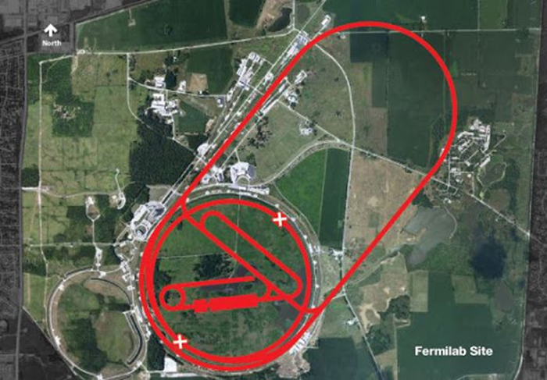
Muon Collider
Unique: s-channel Higgs Factory
Std Model and Multi-Higgs, L → few x 10³¹
Ultra Fine DE/E → few x 10-5
Upward evolution to 3 – 6… TeV cms
L → few x 10³⁴ → Recapture Energy Frontier
HEF → SUSY, NSD, W-fusion, “W-collider”
Z’ narrow resonance would allow
low luminosity 10³⁰ HEF program
(little or no cooling)
Staged program
that builds upon Intensity Frontier
Project-X
Muon Storage Ring
advanced Neutrino program
S-channel Higgs Factory
High Energy Frontier Machine
Compact footprint stages + synchrotron
Energy Frontier: 3 TeV cms (3.6 km circumference, 2 detectors)
L > 10³⁴ (350 fb⁻¹ /year)

Slide 2
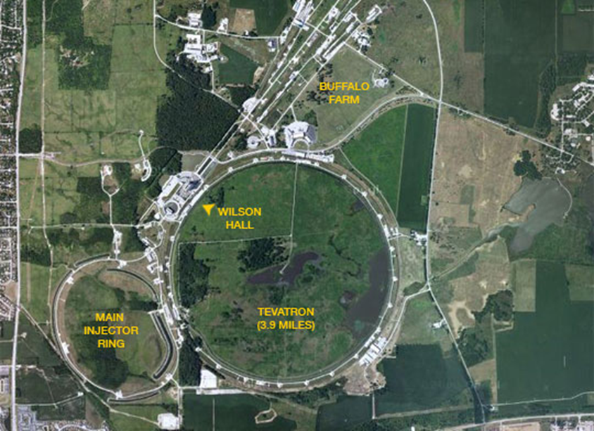
Muon Collider
Unique: s-channel Higgs Factory
Std Model and Multi-Higgs, L → few x 10³¹
Ultra Fine DE/E → few x 10-5
Upward evolution to 3 – 6… TeV cms
L → few x 10³⁴ → Recapture Energy Frontier
HEF → SUSY, NSD, W-fusion, “W-collider”
Z’ narrow resonance would allow
low luminosity 10³⁰ HEF program
(little or no cooling)
Staged program
that builds upon Intensity Frontier
Project-X
Muon Storage Ring
advanced Neutrino program
S-channel Higgs Factory
High Energy Frontier Machine
Compact footprint stages + synchrotron
Higgs Factory: 125 GeV cms
(350 m circum, 1-2 detector?)
L > 10³¹ (2 fb⁻¹ /year)

Slide 3
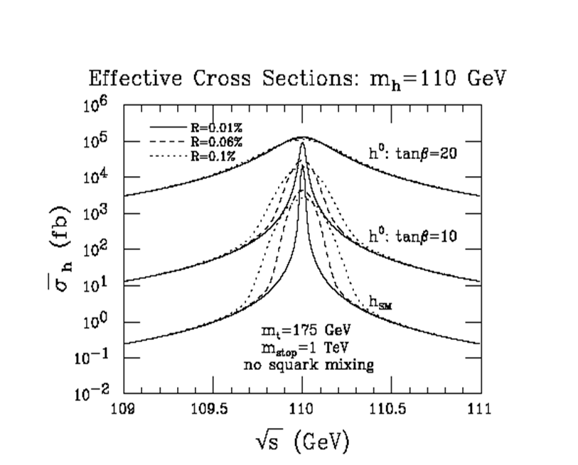
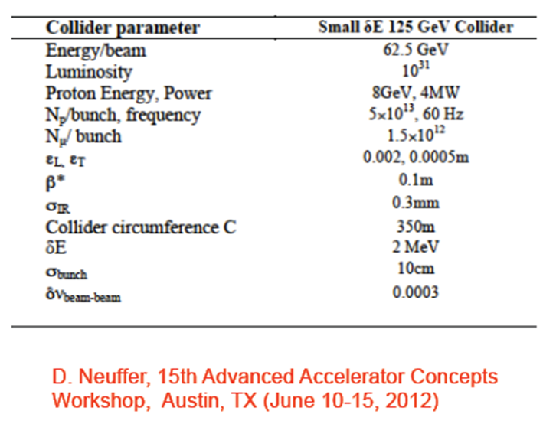
S-Channel Higgs Production
Barger, Gunion, Han
m_{H} = 125 GeV:

Slide 4
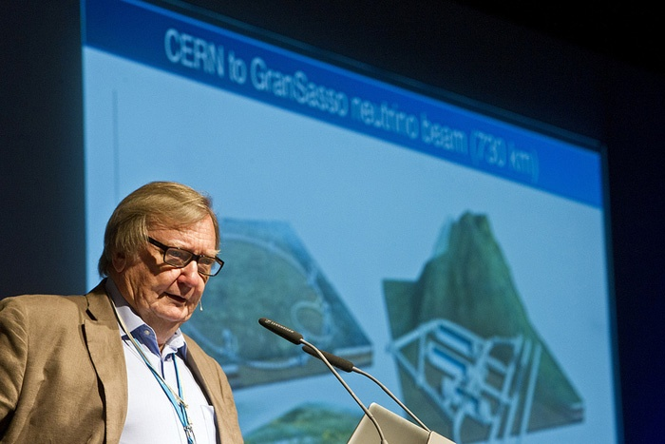
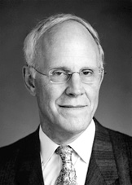
Carlo Rubbia thinks the next big experiment in particle physics should be a muon collider.
"With a Higgs of 125 GeV we need only a modest machine, perhaps not a large linear collider." Rubbia points out that muons colliding at a combined energy of roughly 125 GeV would suffice – just over half the energy of LEP and requiring a machine with a much smaller radius.
One physicist who shares Rubbia's vision is David Gross …
"A muon collider is a great idea," …
"and one that the US should take the lead on."
physicsworld.com/cws/article/news/50159

Slide 5
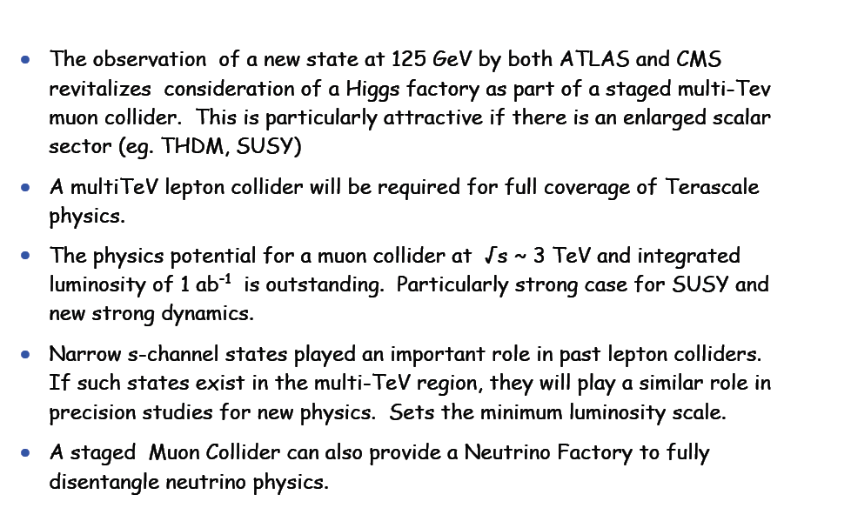
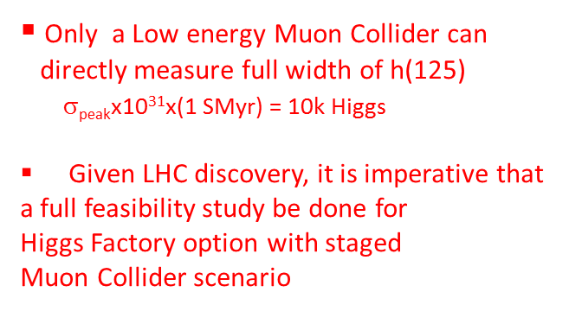
A Muon Collider provides a
Staged Pathway from the Intensity Frontier
to the Energy frontier via a Unique Higgs Factory
Physics and detector studies have begun and initial studies
indicate backgrounds can be handled with fast timing pixelated detectors.
More work (and help) is needed for a convincing demonstration.
Meet at UCLA, Spring 2013, https://hepconf.physics.ucla.edu/higgs2012/index.html

Slide 6
Backup

Slide 7
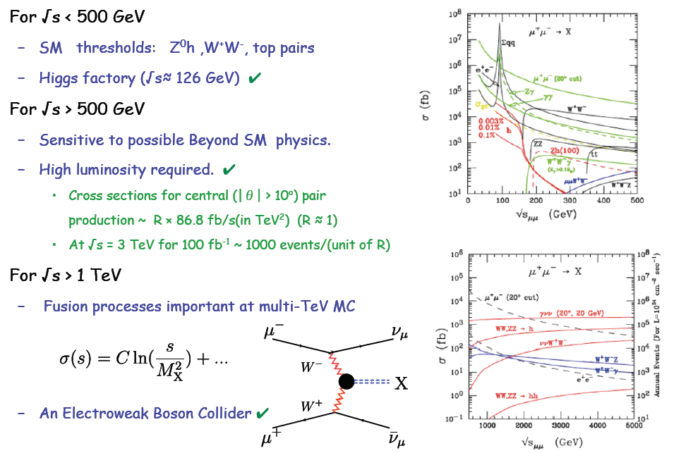
Evolution in Energy of Muon Collider

Slide 8
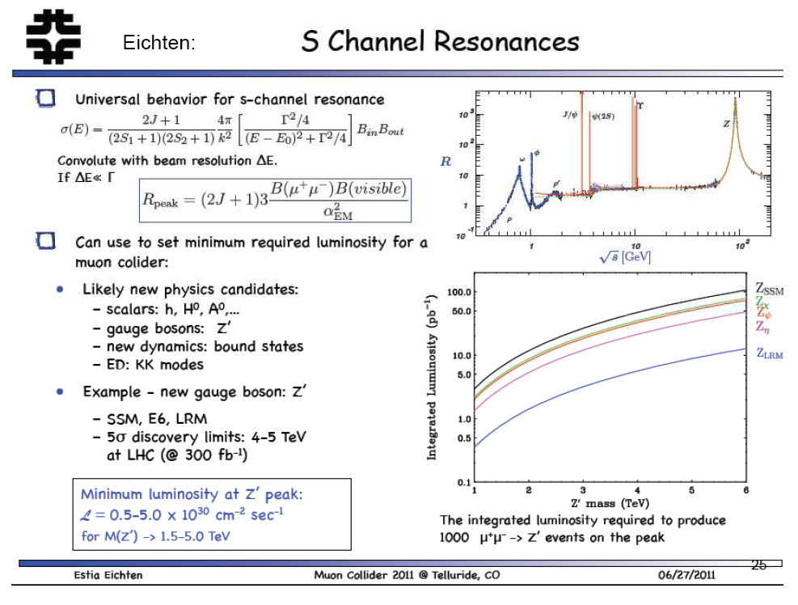
Example:

Slide 9


Slide 10
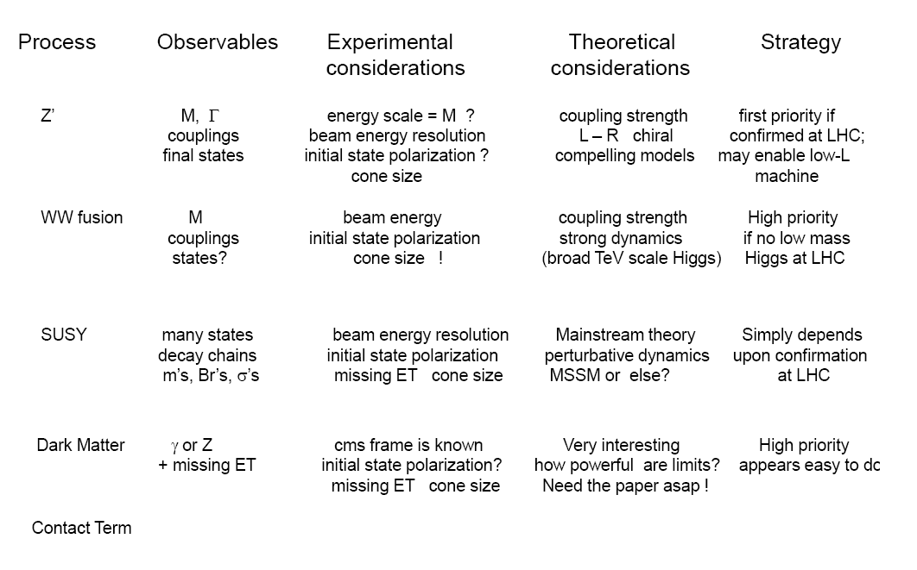
Rich High Energy Program Potential at Muon Collider
The Telluride 2011 Top Five Benchmark Studies

Slide 11
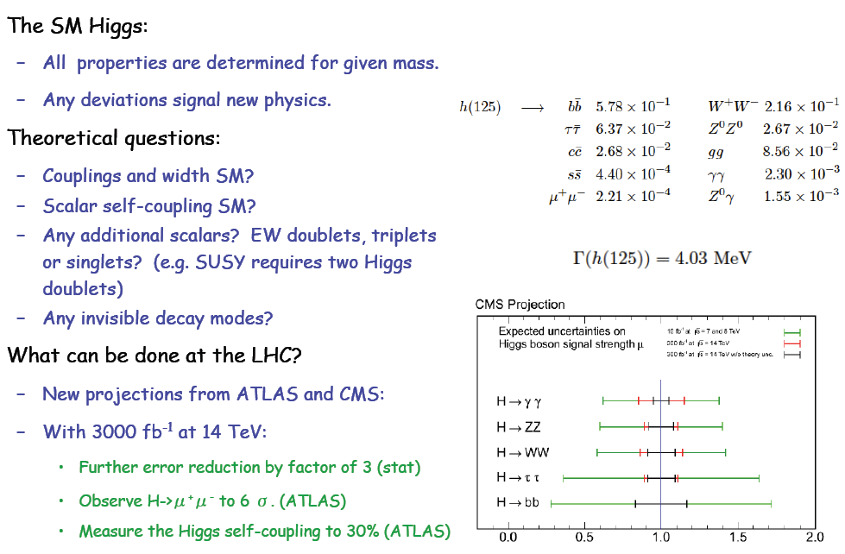

Slide 12
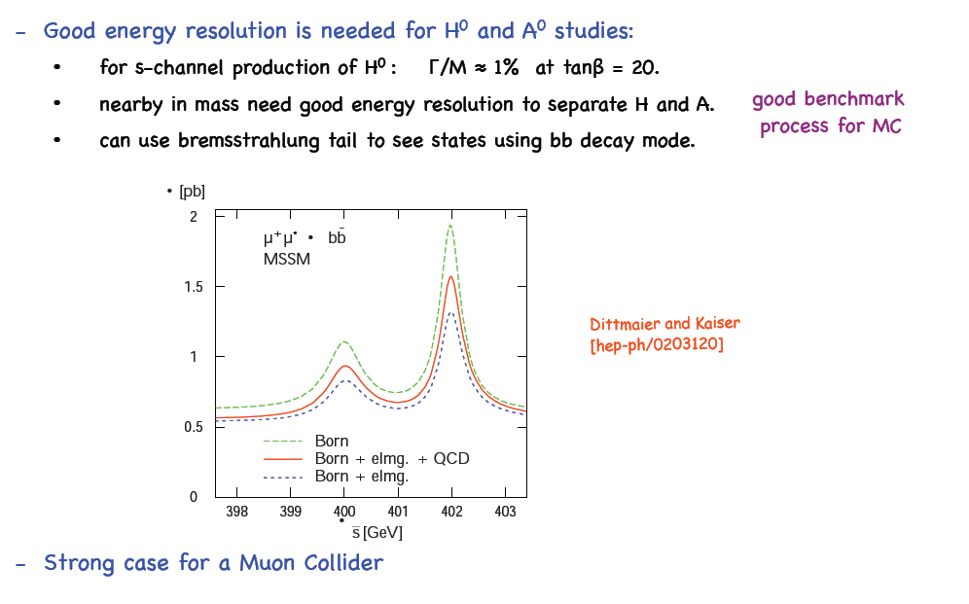

Slide 13
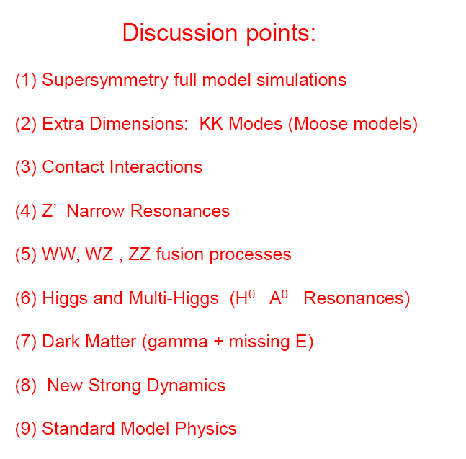
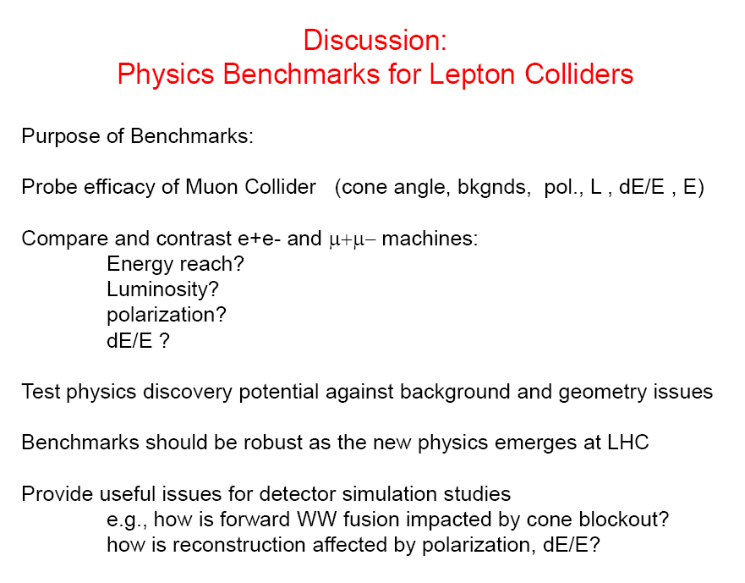
Rich High Energy Program Potential at Muon Collider
Telluride, June, 2011 Discussion Points

Slide 15
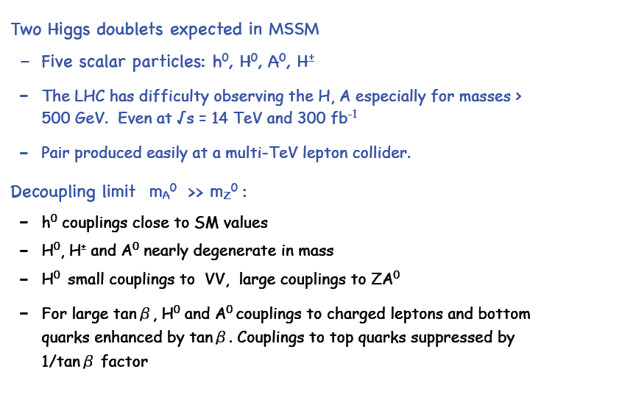

Slide 16
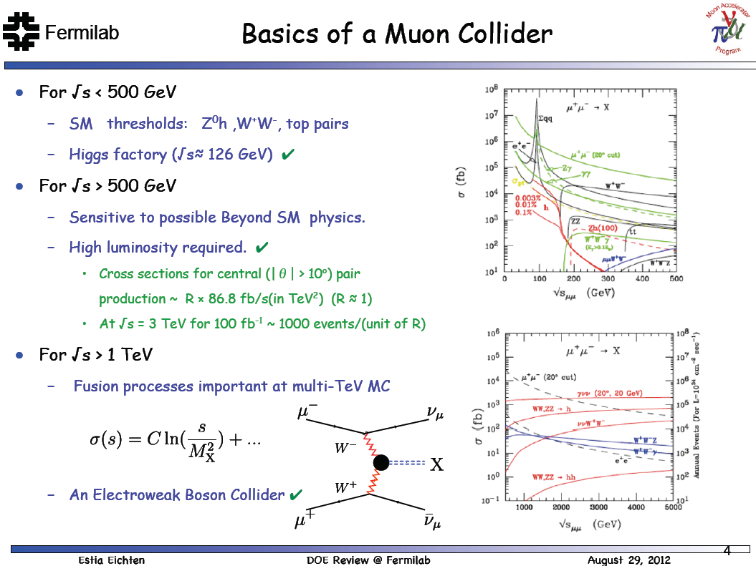

Slide 17
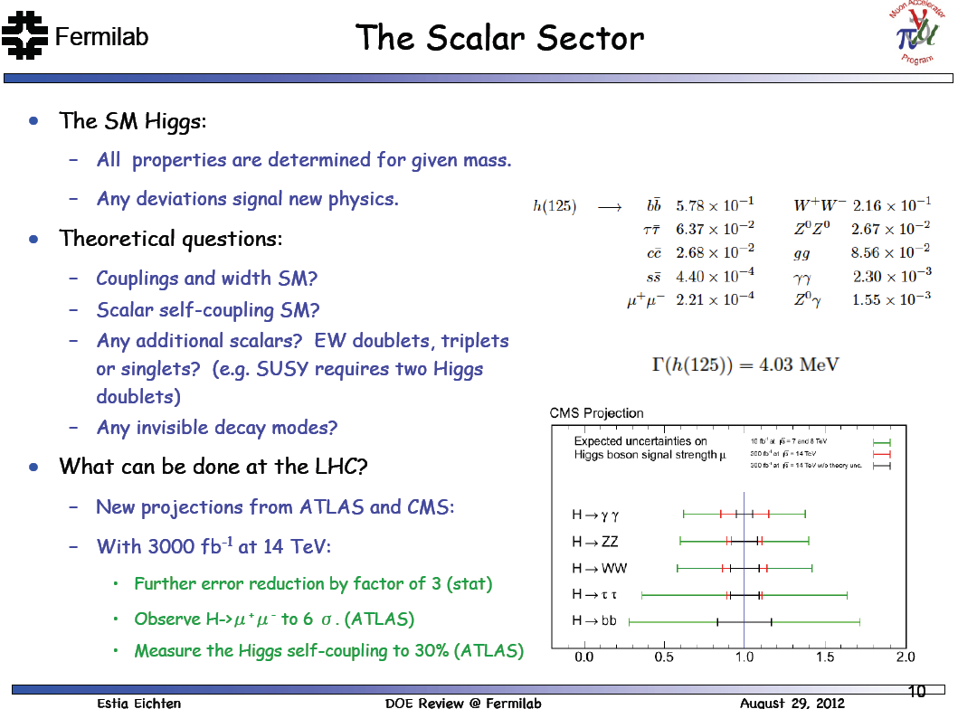

Slide 18
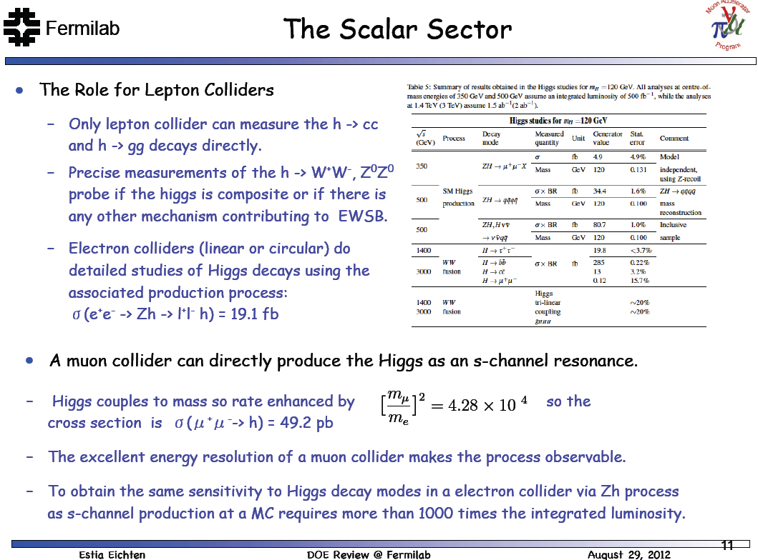

Slide 20
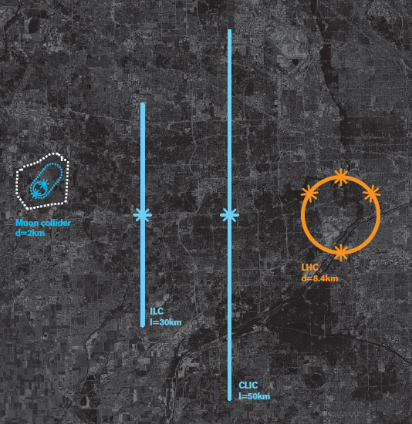

Slide 21
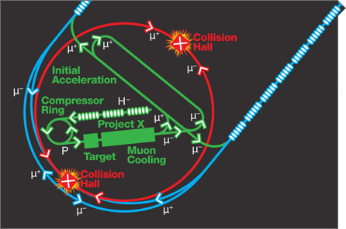

Slide 23


