Slide 1
Perspective from the
National Science Foundation
Saul Gonzalez
(On behalf of the Physics Division)

Slide 2
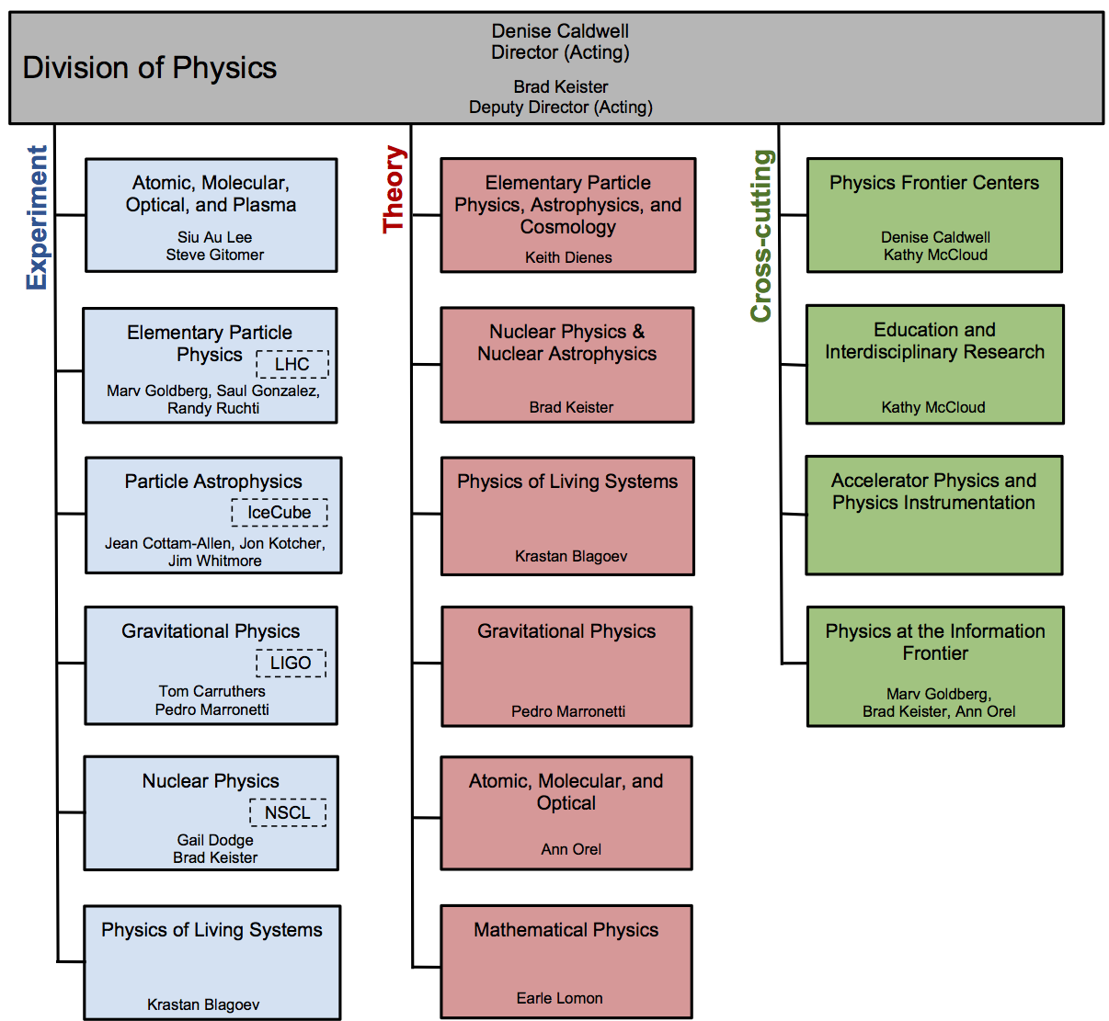

Slide 3
Context: DPF Charge to Conveners
“The American Physical Society's Division of Particles and Fields is initiating a long-term planning exercise for the high-energy physics community. Its goal is to develop the community's long-term physics aspirations. Its narrative will communicate the opportunities for discovery in high-energy physics to the broader scientific community and to the government.”
Key ideas: “long-term”, “aspirations”, “communication”, “opportunities”, “broader scientific community”, “government”

Slide 4
NSF Perspective
NSF Mission: “to promote the progress of science; to advance the national health, prosperity, and welfare; to secure the national defense; and for other purposes”
  Empowering university-based investigators
  Educate and train an exceptional and diverse scientific workforce
  Adding value through partnerships and broadening participation
Program Coordination and Execution
  Programs are coordinated with other U.S. and non-U.S. agencies and organizations
  Solicit advice and strategic direction from advisory committees such as HEPAP, AAAC, NSAC and from the National Academy of Sciences
Guiding Principles – NSB review criteria
  What is the Intellectual Merit?
  What are the Broader Impacts?

Slide 5
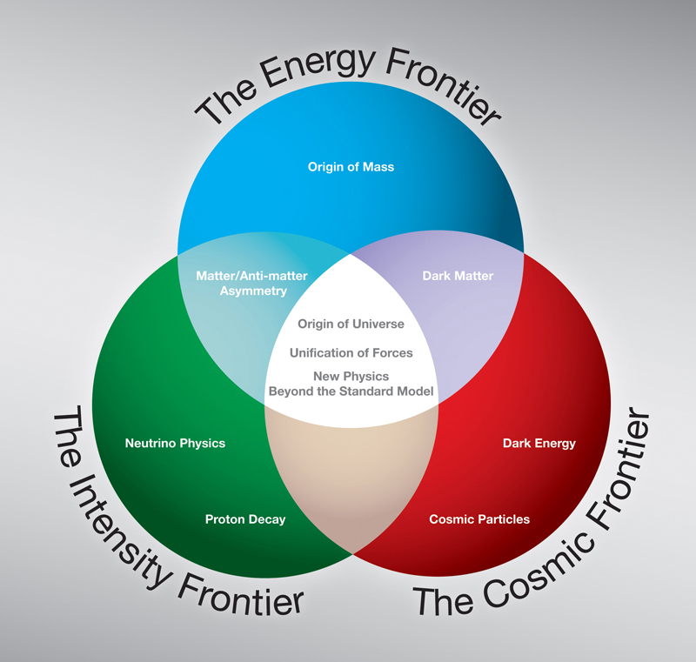
Particle Physics at the NSF
Scientific Frontiers:
  Energy Frontier - Elementary Particle Physics (EPP, THY)
  Intensity Frontier - Elementary Particle Physics (EPP, PA, THY)
  Cosmic Frontier - Particle Astrophysics (PA, THY)
Applications and Broader Impacts:
  Accelerator Science, R&D
  Detector R&D
  Computing / Data
  Education and Outreach

Slide 6
NSF Budget Context
MPS

Slide 7
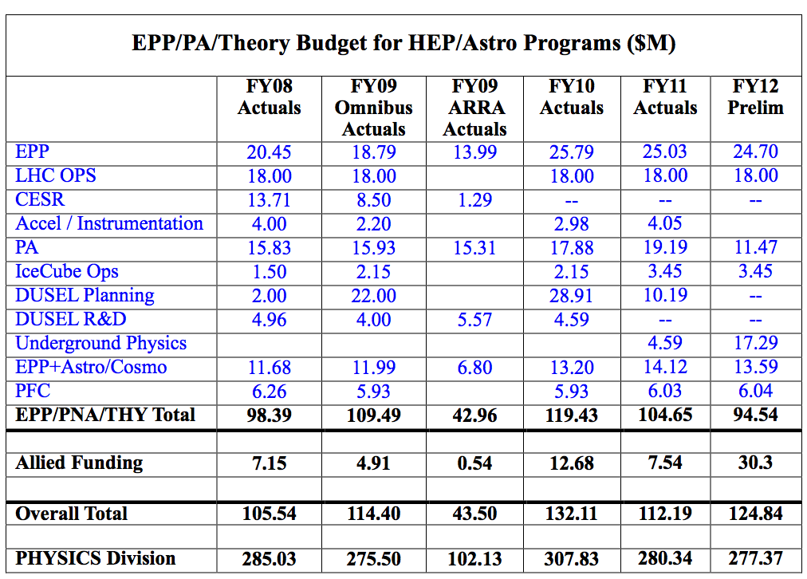
MPS/PHY Budget Context
Physics Division
Particle Physics
EPP/PA/THY

Slide 8
NSF Stake in DPF Working Groups
The DPF structure maps nicely to the science NSF supports (theory and experiment) and the science tools that cross-cut and broaden impacts
Science Tools→
Capabilities & Facilities
Education & Outreach
Instrumentation
Computing
Science
Cosmic | ✔✔ | ✔ | ✔✔ | ✔✔ | ✔✔
Intensity | ✔✔ | ✔ | ✔ | ✔✔ | ✔✔
Energy | ✔ | ✔ | ✔ | ✔✔ | ✔✔
✔ NSF-funded
✔ NSF Currently Participating

Slide 9
Where We Are Today
The physics and facilities landscape has changed in the last few years
Important discoveries
  θ₁₃ is “large”
  LHC “Higgs-like” discovery
Some challenges
  Tevatron shutdown, Energy Frontier at CERN
  DUSEL terminated
And great opportunities
  Intensity frontier – discovery through neutrino sector, rare processes
  LHC at design energy
  DM searches making steady progress, DE moving forward
  Synergies between all of the above

Slide 10
Issues and Constraints
U.S. budgetary climate is very challenging
  And a lot of competition out there for research funding
National Priorities (climate, energy, etc.)
  We are not the highest on the list – this is the new reality
There is a community-driven roadmap
  Any significant deviation from this roadmap needs to be very carefully considered
  Maintaining credibility of the planning process is important
Problem of long timescales for projects in the field
Geography – how to tie to other regions’ plans and make our plans relevant and unique for the U.S.?
Global financial outlook

Slide 11
Possible Approaches
Funding
  Need crisp science arguments
  Be prudent – focus on what is needed to advance the science
  Seek new partnerships
National Priorities
  Show relevance and mid-term impacts
  Articulate broader societal impacts
Planning process
  Focus on the most important science questions
  New investments should have well-defined science milestones
Articulate the Return on Investment
  What is the added value in terms of science if we build “X”? (even for upgrades!)
  What is the added value in terms of broader impacts on society?

Slide 12
NSF’s View of a Successful Snowmass
A survey of the state of particle physics science
  In the U.S. and in the global context
For each of the frontiers (and tools)
  The compelling physics opportunities, accompanied by crisp arguments
  How do they fit in the big picture?
This is the community’s voice. Eventually, we will need to sort out what we need from what we want to realistically address the important science questions
  HEPAP, P5, etc.
We do not expect a consensus, but we do hope for everyone to make a constructive case for the(ir) science
  A lot of noise would be counterproductive
Remember the key ideas of the charge: “long-term”, “aspirations”, “communication”, “opportunities”, “broader scientific community”, “government”

Slide 13
Final Comments
We are in the midst of very challenging budgetary climate
There are many opportunities at the three frontiers
We must plan, focus, and coordinate resources on excellent science with well-defined goals and potential impact
Past planning is important – we must keep it in mind and chart a rational, defensible path to new opportunities
Communication is essential to success, especially with the broader scientific community
We wish you well as you embark in this important exercise
The NSF will be watching with great interest and doing anything we can to inform the process.

