Slide 1
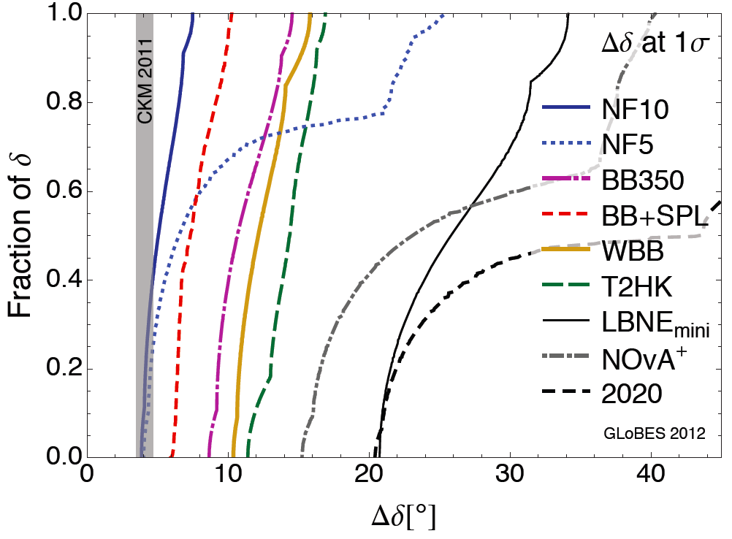
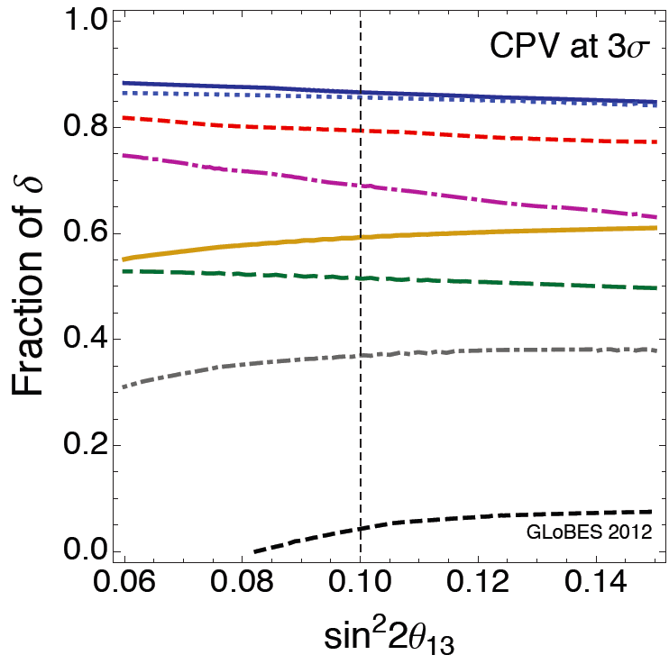
Neutrino Factory
K. Long
Imperial College London
Neutrino Factory baseline:
  10²¹ μ decay/yr
  E_{μ} = 10 GeV
  1500 < L < 2500 km
The facility of choice:
  Best discovery reach for CP violation;
  Best precision on CP phase, δ
Coloma, Huber,
Kopp, Winter
1209.5973

Slide 2
Incremental approach:
Incremental implementation of Neutrino Factory can start now with known technology:
  nuSTORM:
    10¹⁸ μ decay/year; E_{μ} = 3.8 GeV; momentum bite ± 10%
    Definitive sterile neutrino search
    Unique: measurement of ν_{e}N cross sections
      Service to present and future neutrino-oscillation experiments
  Neutrino Factory:
    Φ×M = {baseline}/50 – competitive with superbeam
    Φ×M = {baseline}/25 – competitive with MW class superbeam
    Φ×M = {baseline} – measurement of δ with precision
    comparable to CKM phase
IDS-NF (and nuSTORM) collaboration planning to contribute to the Community Summer Study laying out an incremental programme in which each increment has:
  First-rate physics programme;
  The R&D that underpins the next increment

