Slide 1
Observation Program 2023
Jixia Li
2023/2/14

Slide 2
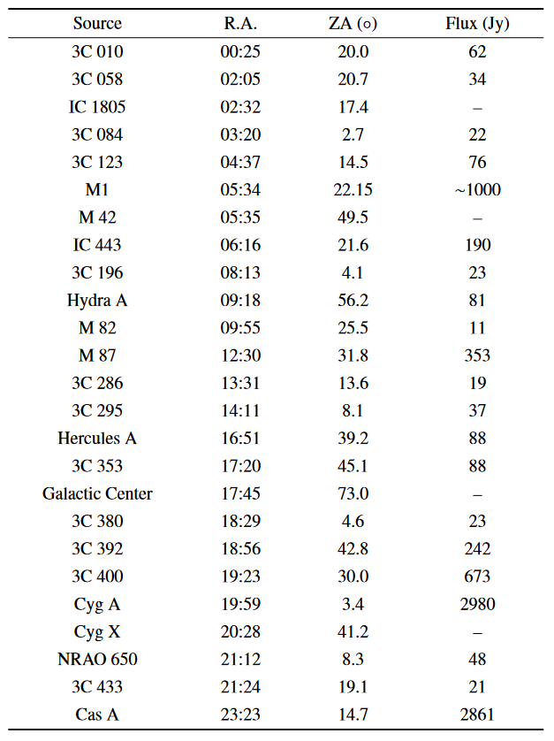
Observation program
Dec. range: 50 deg to 40 deg; step: 1 deg
Step duration: 3 days per step.
Total days: 33 days.
CNS: yes; 1 second’s up in every 300 seconds.
Calibrator:
Sun’s R.A.=22h12m @ Feb. 20th
Sources?
Sun

Slide 3
Observation program
Dec. NCP
See calibrator each day.
Total days: >30 days. 7days*5
CNS: yes; 1 second’s up in every 300 seconds.
Calibrator:
Sun’s R.A.=22h12m @ Feb. 20th
Sources?
Sun

