Slide 1
ACORN Project Update
Adam Watts
Engineering Retreat
21-February-2023

Slide 2
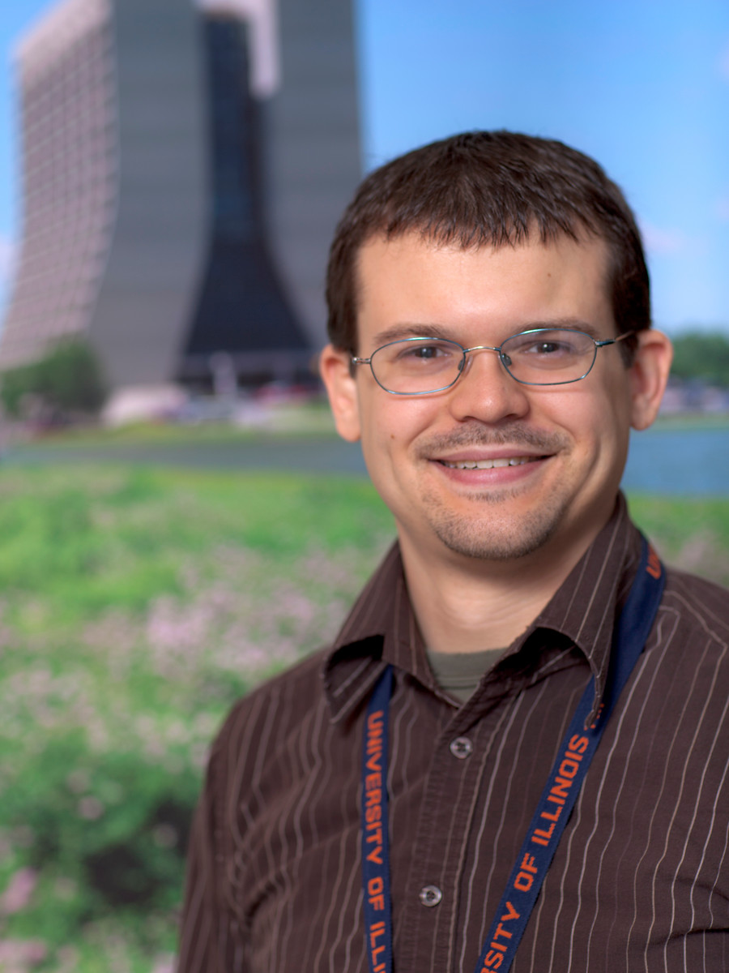
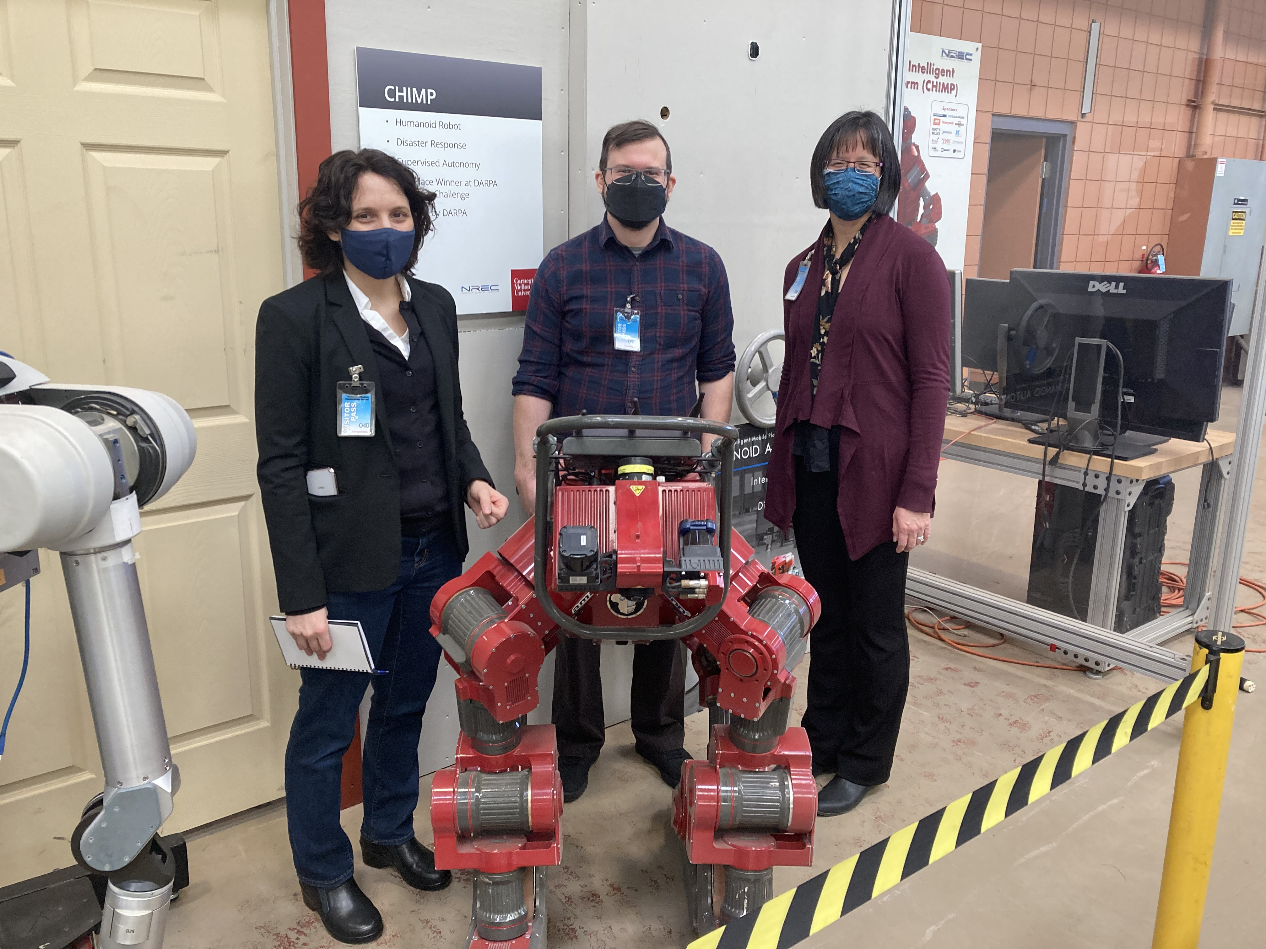
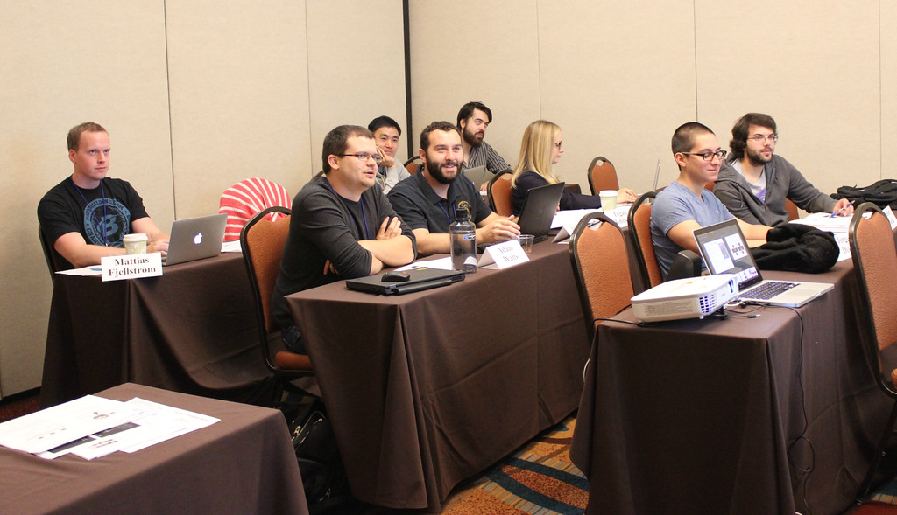
About Me
Summer Intern in AD Antiproton Source Target Hall group
AD Main Control Room Operator
AD External Beamlines Dept., Beamline Physicist, Machine Coordinator, Run Coordinator
AD Controls Dept.
ACORN project integration lead
ACORN acting L2 manager for Data Acquisition and Control
Operational motion control
Robotics Initiative member

Slide 3
Outline
ACORN overview and goals
Project Management
Data Acquisition and Control
Control System Infrastructure
Control System Applications

Slide 4
ACNET control system history of upgrades
The accelerator control system has been essential to scientific discoveries at Fermilab for decades.
System upgrades have been occurring throughout its history without causing major beam downtimes:
Upgrading from PDP-11 to VAX
Moving from VAX to Linux servers
Transitioning from a proprietary database to a commercial database
Moving from a commercial database to an open-source database
Introduction of Java Controls for central services, applications, and data acquisition.
Development and expansion of the Data Pool Manager central service
Countless fieldbus hardware upgrades (CAMAC module development, IRM/HRM, BSSB/MFTU)
The ACORN project represents the first major overhaul of the accelerator control system in the past 40 years. The scale of this project requires it to be a DOE O413 project.​

Slide 5
If we have seen further, it is by standing on the shoulders of giants.
- Isaac Newton (paraphrased), presumably referring to accelerator control systems

Slide 6
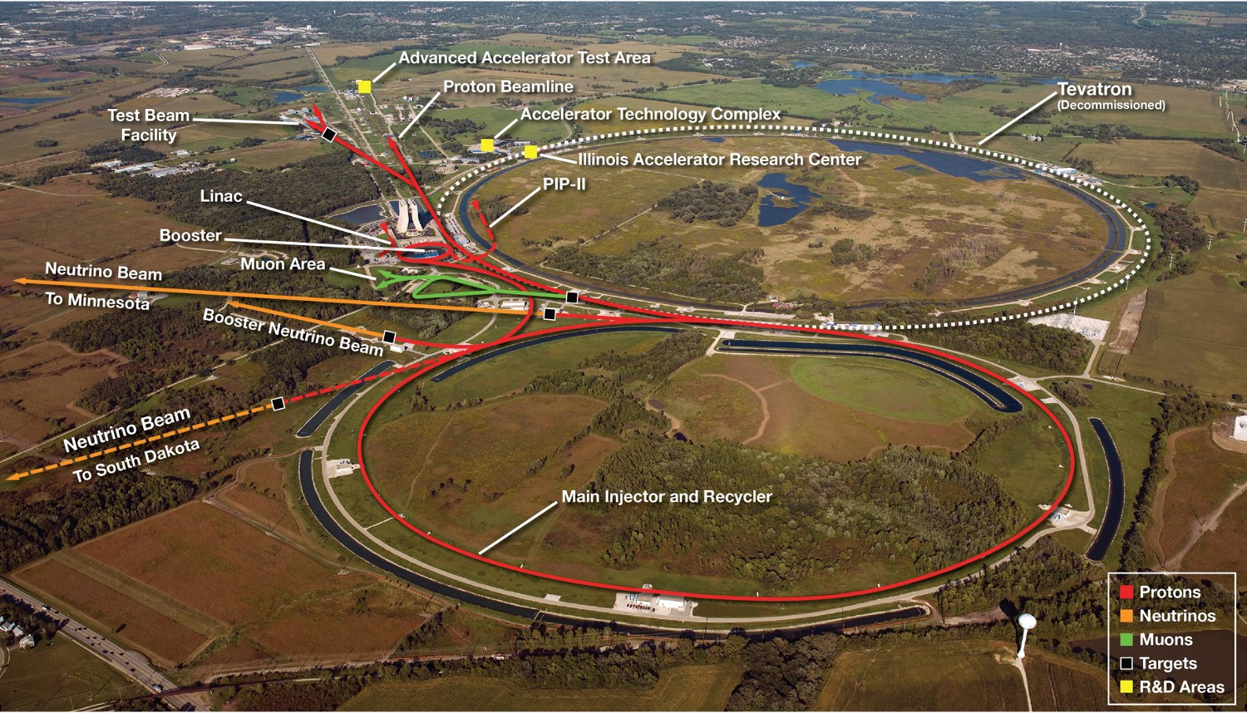
Accelerator Controls Operations Research Network (ACORN)
The ACORN Project is a DOE O413 project that will modernize the laboratory’s accelerator control system and replace end-of-life accelerator power supplies.
Approve Mission Need (CD-0) was approved August 28, 2020.
Approve Alternate Selection and Cost Range (CD-1) is projected to occur Q2 FY24 (March 2024).
Total Project Cost (TPC) range: 100 – 142M$
Project Completion (CD-4): 2028 – 2030

Slide 7
Project Scope Considerations
ACORN is working toward a DOE-approved baseline conceptual design (i.e. CD-1), which sets the scope of the project.
Any of our technical WBS elements could take up our entire proposed budget alone; for example, modernizing all legacy magnet power supplies.
Careful scoping will need to balance with timeline and total project cost
Implementation will require a phased approach: not feasible (or desired) to first decommission current control system before installing upgrades
Project integration will be key to implement upgrades while serving operational needs, even with long shutdowns

Slide 8
Tasks and Deliverables for CD-1
We are here.
2/20/23
Adam Watts | 2023 Engineering Retreat

Slide 9
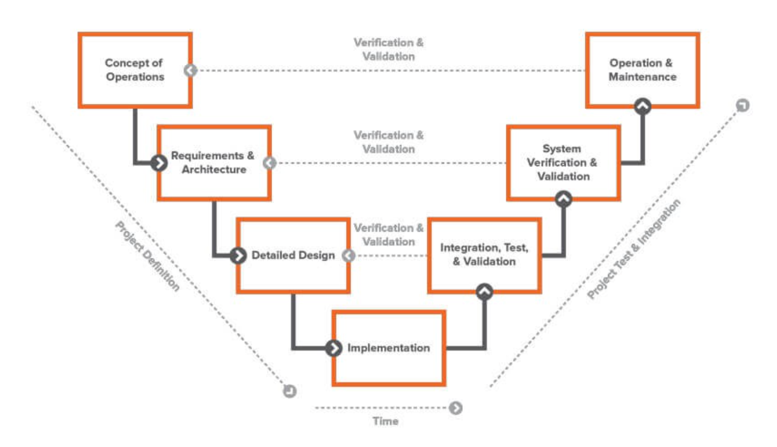
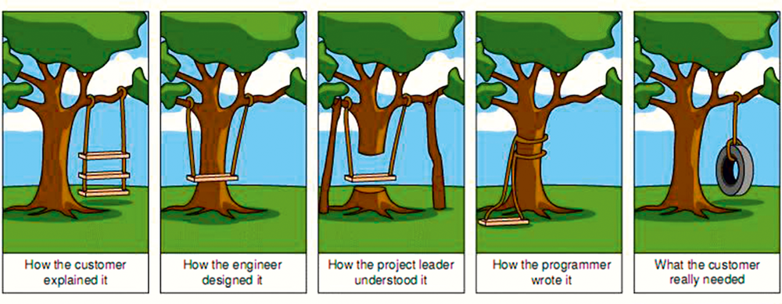
Requirements Gathering
Systematically interviewing stakeholders
Started by capturing as requirements the functions of the control system as it currently exists
Held review of existing requirements, received very useful feedback from system experts at FNAL and abroad
Planning targeted interviews to determine future requirements, functional and technical
Requirements will be documented in relational software (Jama)
Implementation of subsystems will be validated against requirements against requirements to ensure project success
Source: https://www.jamasoftware.com/requirements-management-guide/systems-engineering/what-is-systems-engineering

Slide 10
Alternatives Analysis for CD-1
The accelerator complex operates with a single, unified control system encompassing hardware and software for controlling ten miles of accelerator components and beam transfer lines.
ACORN has four alternatives to consider for CD-1:
Maintain status quo.
One-for-one replacement of accelerator control system hardware and software components. Maintain the current control system architecture.
New architecture with centralized command and control.
New architecture with decentralized command and control.

Slide 11
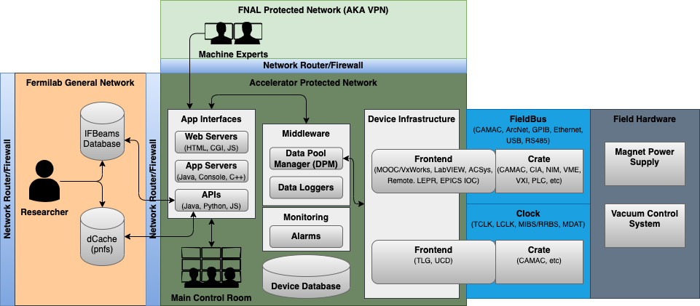
Current Accelerator Control System Architecture

Slide 12
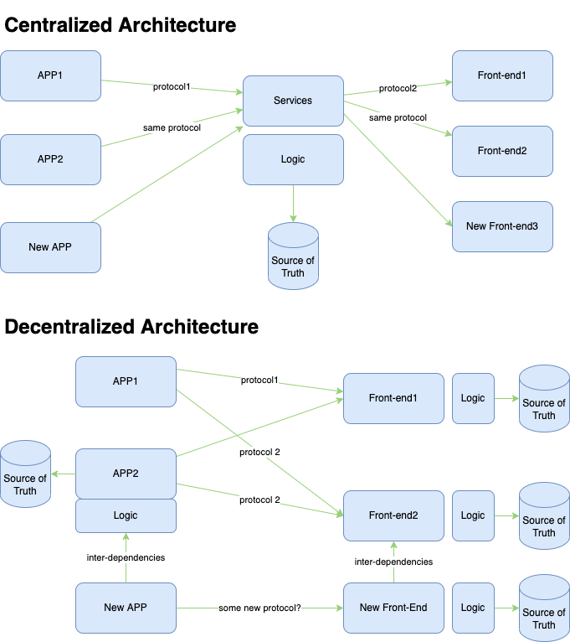
Alternatives Analysis
The Alternatives Analysis will compare two disparate architectures for a future control system
Evaluation criteria examples are:
How well stakeholder requirements are met.
Lifecycle cost
Difficulty/cost in transitioning from the current system to the alternative in question
Difficulty/cost of integrating emerging technologies
Operational risks due to technology obsolescence, vendor lock-in, hidden costs, heterogeneity of solutions
Many more
Research and Development projects at this stage of ACORN are prioritized to inform the Alternatives Analysis and Baseline Conceptual Design

Slide 13
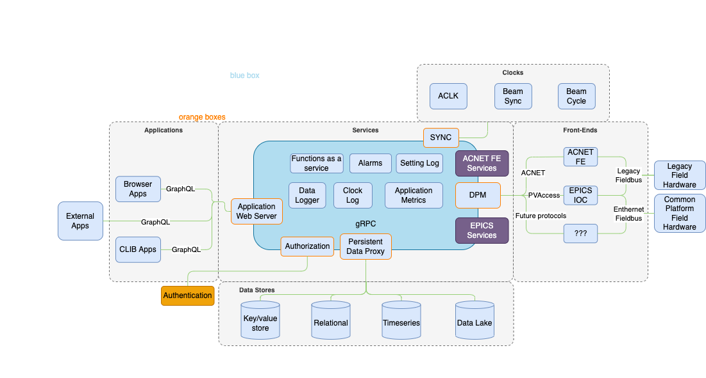
Alternative Architecture Example: Centralized

Slide 14
Research and Development
ACORN has received significant funding to pursue R&D for control systems and power supplies
Goal is to explore options, determine feasibility, design, prototype
Currently focusing on projects that inform the Alternatives Analysis and the Baseline Conceptual Design
Develop cost estimates through prototyping
Feasibility of particular paths
Projects that illustrate advantages/disadvantages of alternatives
Post CD-1 R&D will inform the Preliminary Design
Opportunity to show whether an approach works at al: Null result is still important
Documentation is critical

Slide 15
ACORN WBS 204.01: Project Management
Personnel
Project Manager: Erik Gottschalk
Administrative Support: Lila Anderson
Documentation and Standards: John Diamond
Project Integration: Adam Watts
Highlights
Review of current control system functional requirements
Organizing EPICS collaboration at FNAL
Developed organized, standardized hiring process
Inventory of all operational CAMAC systems, integrating stakeholder feedback

Slide 16
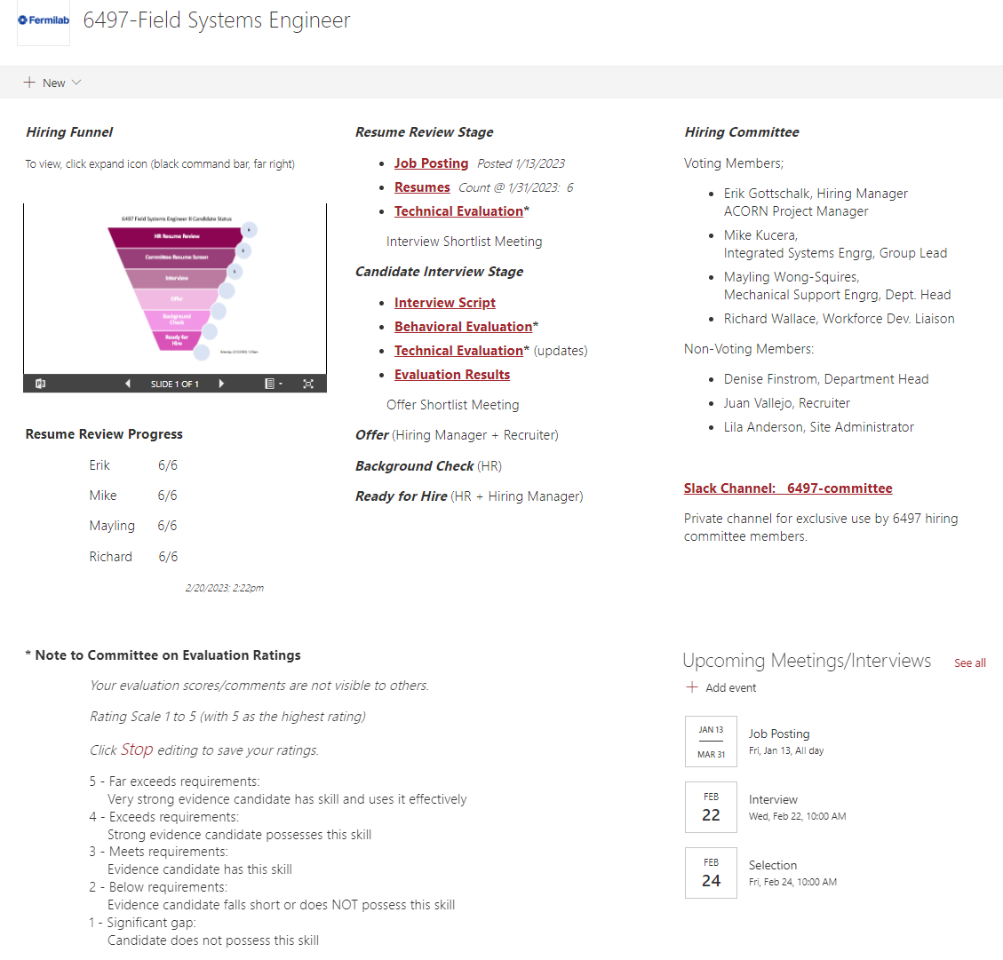
ACORN WBS 204.01: Project Management
Developed standard Sharepoint site template for organizing hiring committees’ efforts.
Site dedicated to each job opening
Embedded calendar, link to dedicated private Slack channel for discussion, links to job posting and resumes
Tracking of hiring progression
Integrated candidate evaluation and results analysis
Starting to be used outside ACORN for division-wide organization of hiring

Slide 17
CAMAC Inventory
First phase of requirements gathering regarding fieldbus hardware. Targeted interviews

Slide 18
CAMAC Inventory
With much help from Operations and Machine groups, inventoried all ~1000 operational CAMAC modules. Stakeholder opportunity to flag functionality in need of upgrade.

Slide 19
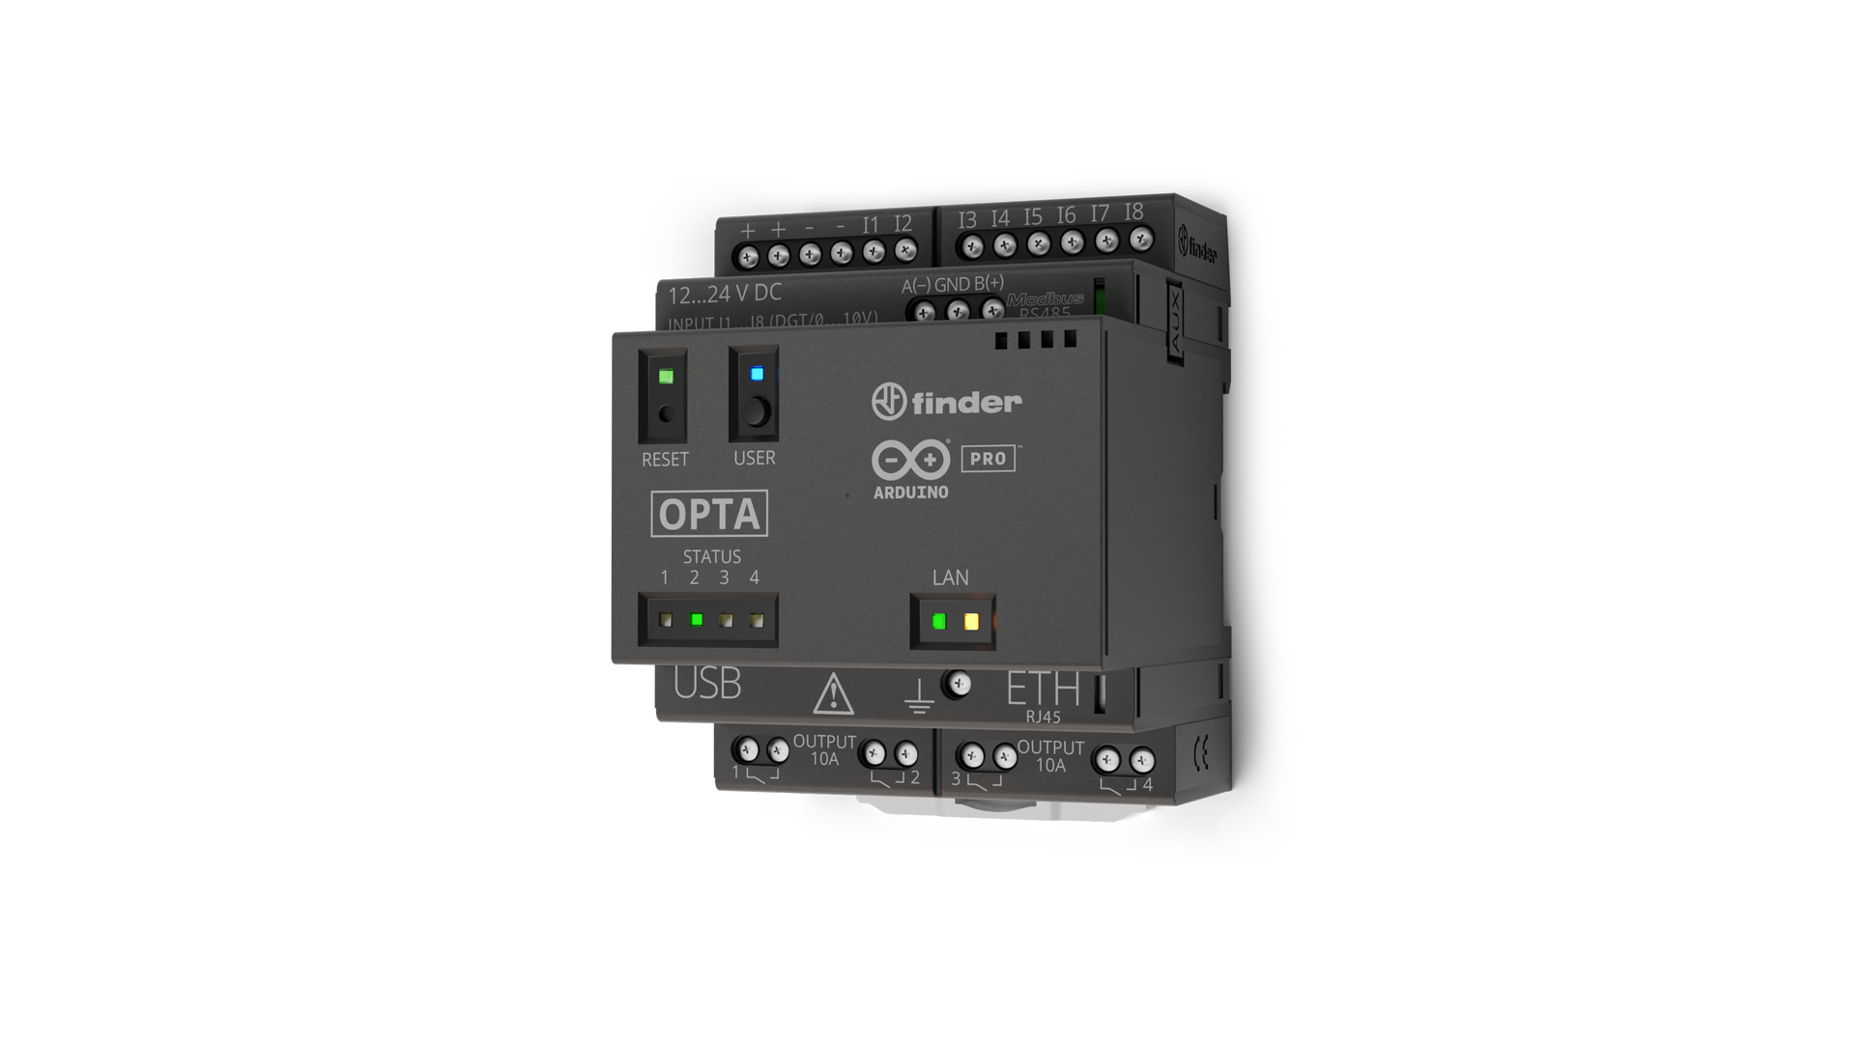
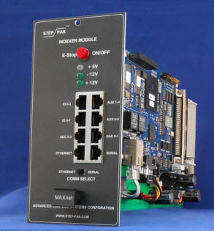
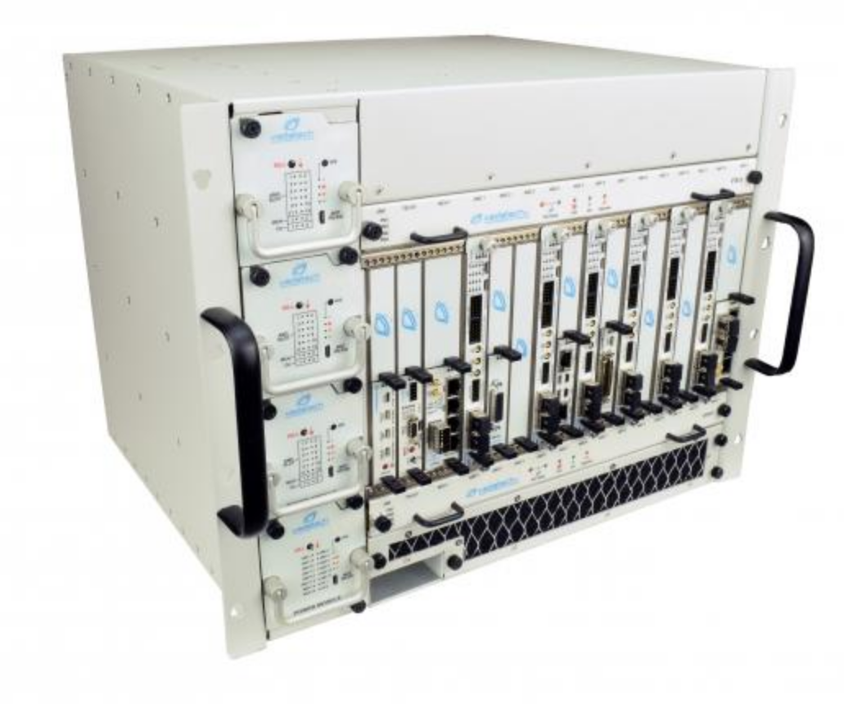
ACORN WBS 204.03: Data Acquisition and Control
Personnel
L2 Manager (acting): Adam Watts
Several Controls dept. members helping out with R&D (Novak, Neswold, Coburn, Gonzalez Velarde)
R&D highlights
Industrial controls: Investigate and prototype open PLC alternatives, firmware version control, support for industry standards such as OPC-UA and MQTT
Motion control: Build test stand to prototype ethernet-capable network interfaces (phase out legacy equipment), develop scaled-down low-cost standard systems
Fieldbus (CAMAC replacement): Build test stand to prototype MTCA.4 fieldbus systems for data acquisition, power supply control, digital input/output, real-time edge computing, precision timing

Slide 20
Data Acquisition: Focused Requirements Gathering
Initial stakeholder interviews targeted at broad use case discovery
Interview script was formal and consistent for all stakeholders
Intent was to capture current control system functionality as requirements
Highly successful thanks to AD participation
Shift in focus to targeting Data Acquisition future requirements
Strong initial indication from stakeholders in AD of data acquisition needs
ACE Workshop presentations (Hazelwood, Dey)
CAMAC inventory information-gathering
Important for ACORN to catalog specific requirements and their criticality
Separate quality-of-life from must-haves for future operation
A less-formal process, much more discussion to really understand needs

Slide 21
Data Acquisition Stakeholder Discussions
Working to develop targeted questions to start the conversation
What we’ve heard so far is a good starting point
Higher-resolution, less multiplexing, more channels, waveform acquisition
Questions to build requirements
Minimum required digitization resolution? Sample rate? Number of channels at worst-case locations? Simultaneity of readbacks?
How critical to mission need are each of these requirements?
Example: scale from 1 (would be nice) to 10 (cannot operate without it)
Group discussions likely more appropriate for this level of discussion
This is a process, and adjustments after discussions are appropriate.
Prioritizing toward lab’s mission need is our goal
We appreciate taking time to provide this feedback to ACORN.

Slide 22
ACORN WBS 204.04: Control System Infrastructure
Personnel
L2 Manager: Anthony Tiradani
L3 Central Services Systems: Maria Acosta Flechas
L3 Control System Network: Andrew Densch-Giese
L3 Integration and Testing Systems: Mariana Gonzalez Velarde
R&D highlights
Prototype rapid deployment (Kubernetes) cluster for virtualized containers (servers, front-ends, central services, etc.)
Elastic Analysis Facility (EAF); virtualized data analysis environment. Allows users to, for example, run Jupyter notebooks for data analysis from the control system in the browser.
Evolution of persistent storage data-loggers (“data lake”).
Expanding Data Pool Manager central service (DPM) to serve both ACNET and future protocols such as EPICS

Slide 23
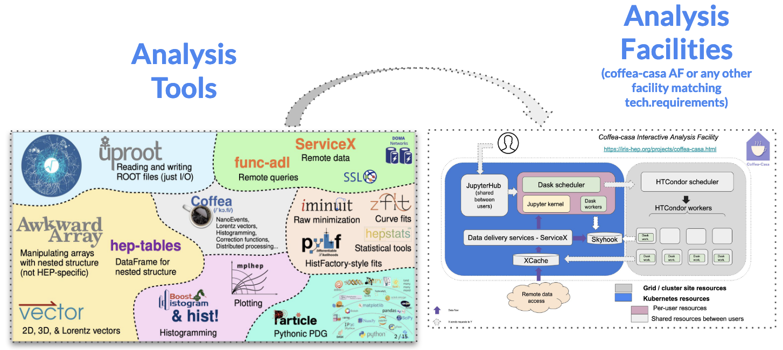
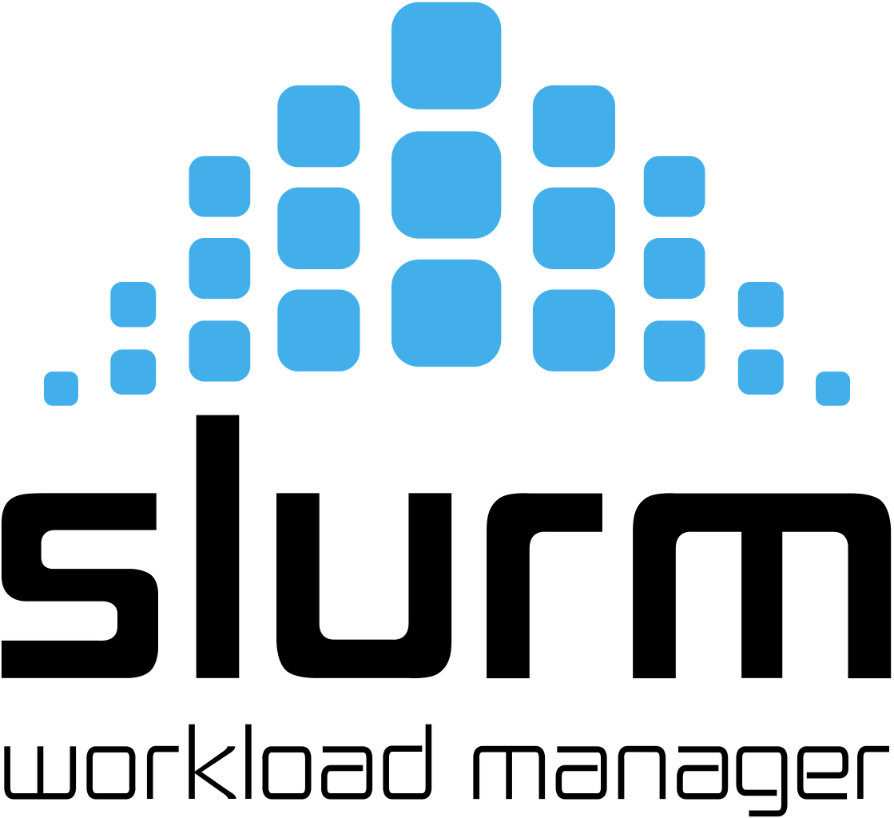
ACORN and the Elastic Analysis Facility
What is an Analysis Facility? “The infrastructure and services that provide integrated data, software and computational resources to execute one or more elements of an analysis workflow. These resources are shared among members of a virtual organization and supported by that organization.”
EAF is a JupyterHub-based computing facility enabling Fermilab’s experiments and accelerator research groups for fast data analysis, AI/ML model training and Inference as a service runs on-the-fly.
ACORN is leading a collaboration effort between EAF and AD, defining data needs for future accelerator operations in order to help design and deploy environments suited for modern accelerator data analysis.
Beta testing is ongoing! visit us at https://analytics-hub.fnal.gov
and https://eafjupyter.readthedocs.io for documentation.

Slide 24
ACORN WBS 204.05: Control System Applications
Personnel
L2 Manager: Beau Harrison
L3 Application Framework: Rich Neswold
L3 User Applications: Michael Guzman
L3 User Interface: Rachael Hill
R&D highlights
User Interface Style guide based on Human Factors and accessibility best practices (partnership with Idaho National Laboratory)
Prototyping web user applications using different modern frameworks and protocols (React, typescript, GraphQL)
Building processes to support modern development workflows, practices, and tools like GitHub for version control and documentation, Continuous Integration / Continuous Deployment (CI/CD, streamlined development/testing/delivery of software)

Slide 25
Closing remarks
ACORN is a part of AD and the Controls department.
If what we’re doing sounds interesting, reach out to us to learn more.
If you have skills that can help build the future control system, talk to us.
If you have specific requirements of the control system, talk to us.
We adhere to the DOE O413.3B project procedures and timelines.
Our success is built on the past work and cooperation of our peers.

Slide 26
Thank you!

