Slide 1
ASIC - Application Specific Integrated Circuits (ETD)
19 ASIC designers (2 JA) + 1 open position
1 scientist, 2 Application Physicist
1 test engineer, 1 engineering associate
Other matrixed personnel

Slide 2
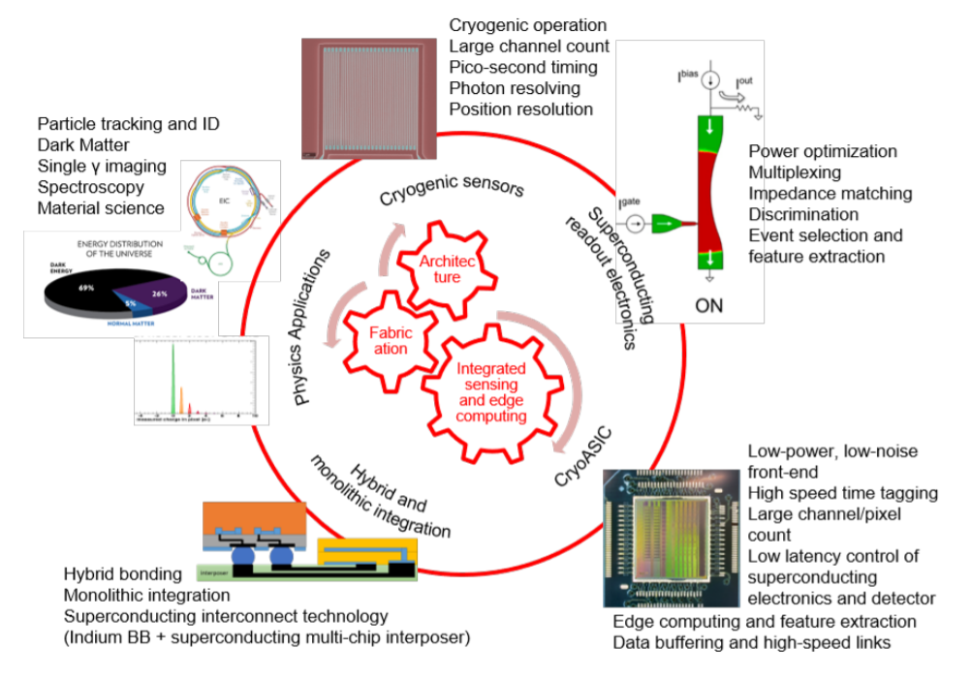








DOE Microelectronics Codesign
“Hybrid Cryogenic Detector Architectures for Sensing and Edge Computing enabled by new Fabrication Processes” (HYDRA)
Two complementary cryogenic state-of-the-art single-photon and particle detectors:
the Skipper CCD-in-CMOS silicon detector
a hybrid detector platform based on superconducting nanowires
Development and co-design of:
advanced fabrication and integration techniques
novel optimized hybrid readout architectures
cryo-ASICs and cryotron-based superconducting electronics for integrated sensing and data reduction at source, through feature extraction and edge computing.

Slide 3
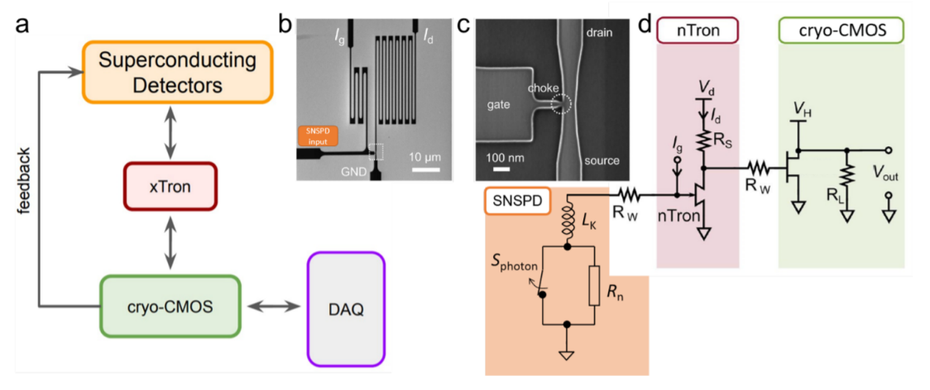
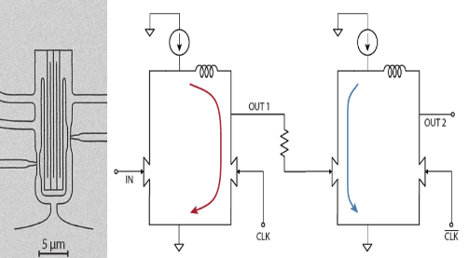
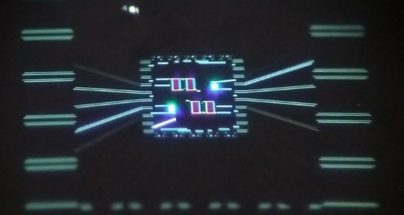
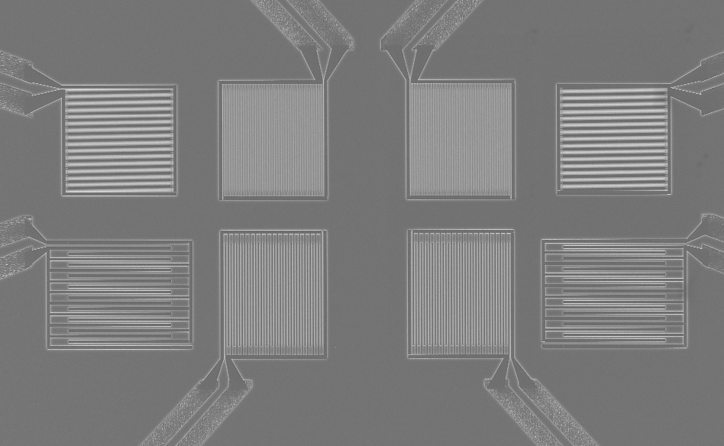
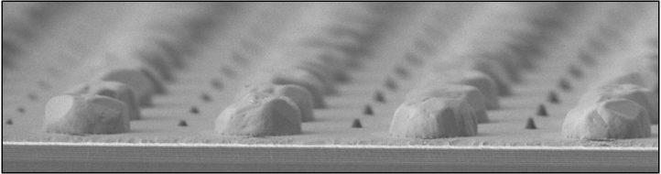
Office of Science programs
HEP
  Development of Skipper-in-CMOS and large-area, high-rate single photon imaging
  Novel fast timing cryogenic detectors (e.g. high-η detectors, beam instrumentation)
  integrated sensing and edge computing.
BES
  New materials, chemistry, synthesis, and fabrication for superconducting particle detection
  Large focal plane arrays for single-photon detection
ASCR
  Novel low-power computing architectures based on superconducting nanocryotron
FES
  Rad hard cryogenic instrumentation
NP
  Identified detector applications for the EIC as well as high-flux fixed target experiments (JLAB)

Slide 4


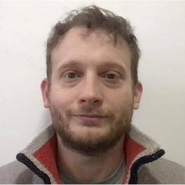
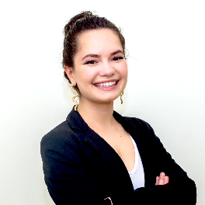
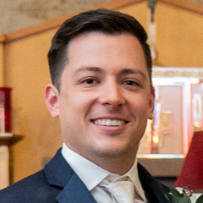

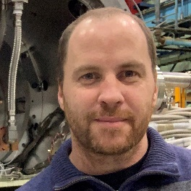


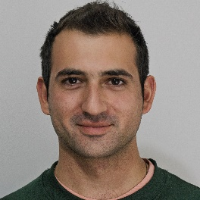


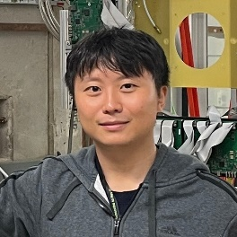
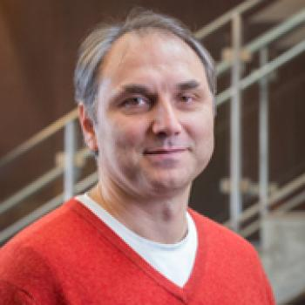




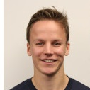
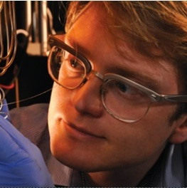
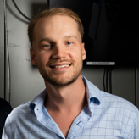
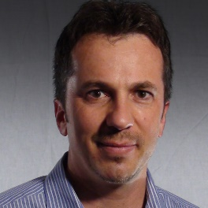


The Team
6 Thrust:
cryoASIC
Lead: Davide Braga, Adam Quinn , Ben Parpillon, Manuel B. Valentin, Olivia Seidel, Kyle Woodworth, Farah Fahim (Fermilab)
Skipper-in-CMOS
Lead: Juan Estrada, Guillermo Fernandez Moroni, Agustin Lapi, Fernando Chierchie (Fermilab), Lorenzo Rota, Gang Liu (SLAC)
Superconducting Electronics
Lead: Karl Berggren, Owen Medeiros, Matteo Lupi, Reed Foster (MIT)
Superconducting Detectors
Lead: Whitney Armstrong, New postdoc: Sangbaek Lee,
Tomas Polakovic, Valentine Novosad. (Argonne)
Cryogenic Integration
Lead: Matthew Shaw, Boris Korzh, Emanuel Knehr (JPL)
Codesign Tools
Lead: Ricardo Borges, Andy Pender (Synopsys)
…

Slide 5
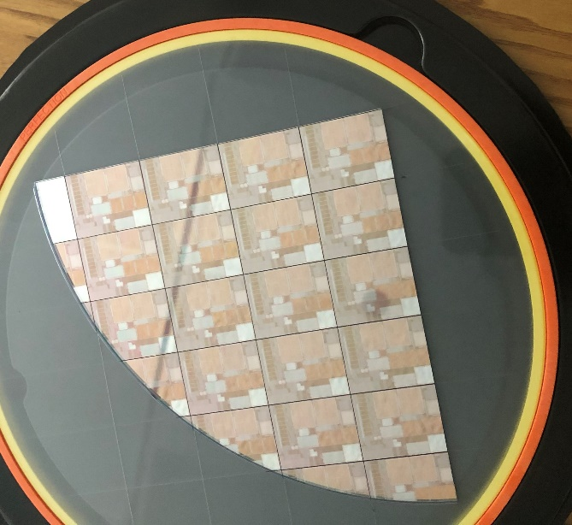
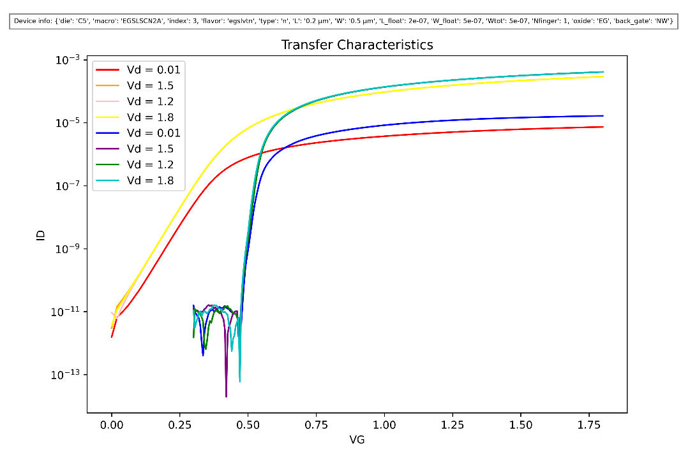


Cryogenic modeling of transistors
Transistor behavior changes significantly a cryogenic temperature → complex ICs (with millions of transistors) require accurate models (similar to radiation models for LHC)
Characterization of advanced nanoscale CMOS (22 nm FDSOI) for cryogenic temperature. Collaboration with leading semiconductor company.
Developing cryogenic models for analog circuit design (EPFL), as well as fully EDA-compatible transistors models for complex digital and system-on-chip simulation and design (Fermilab-Synopsys)

Slide 6
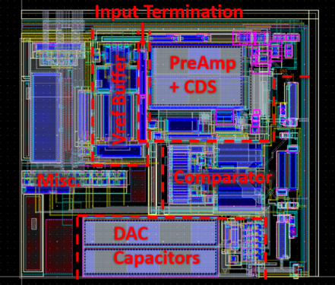
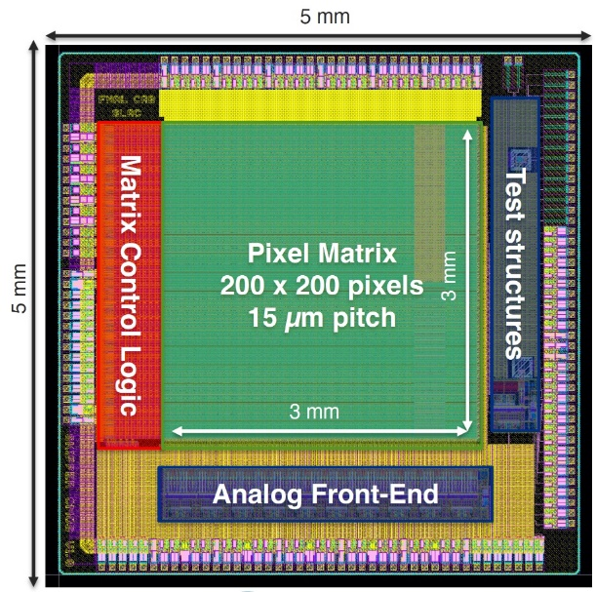
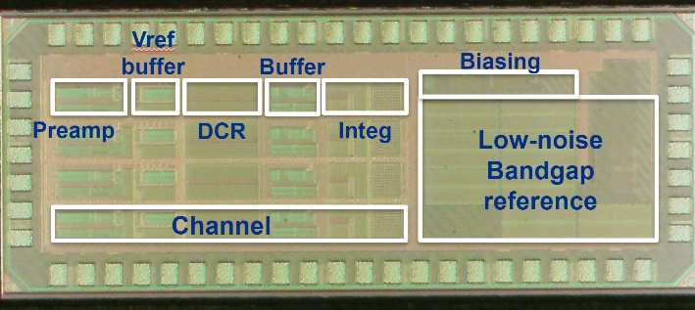
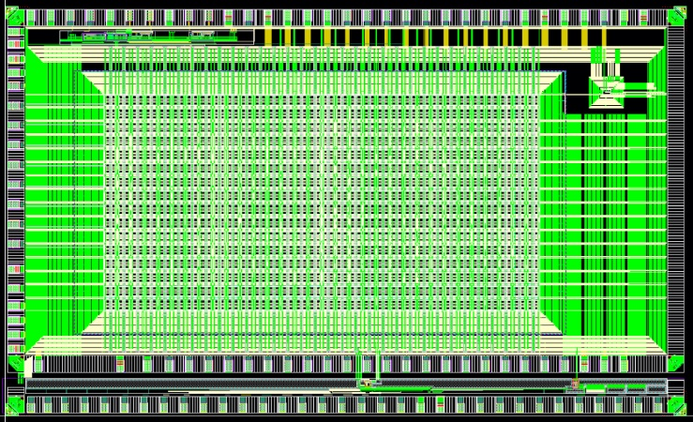
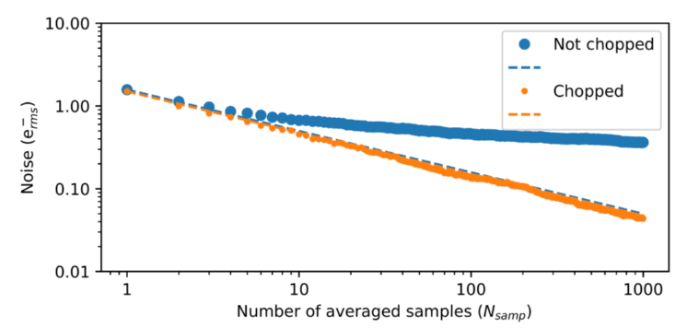
Skipper CCD and CCD-in-CMOS Activities
MIDNA: Sub-electron skipper-CCD readout cryogenic ASICs​ ​
Four parallel readout channels (2.5mm x 1mm)​
On-chip voltage bandgap reference and biasing​
Reduced Integrator offset and chopping by default. ​
Reference voltage buffered on each channel.
Working well, test ongoing​
Skipper CCD-in-CMOS Sensor
Collaboration with leading CMOS foundry (Tower Semiconductor) to develop Skipper-CCD in commercial CMOS process
Prototyped ASIC has 400 variations (pixel designs/process splits) to evaluate best design
Testing underway
Full-reticle large area prototype to follow
Would be ideal for 3D integration
Highly-parallel readout ASIC for Skipper-on-CMOS
Developed low-power in-pixel ADC for highly parallel readout (→ high frame rates)
First two prototypes about to be tested
Next: third ASIC for integration with the sensor, followed by full reticle ASIC for 3D integration with sensor
10b, 100KSPS in-pixel ADC (~30x30µm)
SPROCKET ASIC: 64x32 pixels (09/22)
Image sensor ASIC
Testing at Fermilab

Slide 7
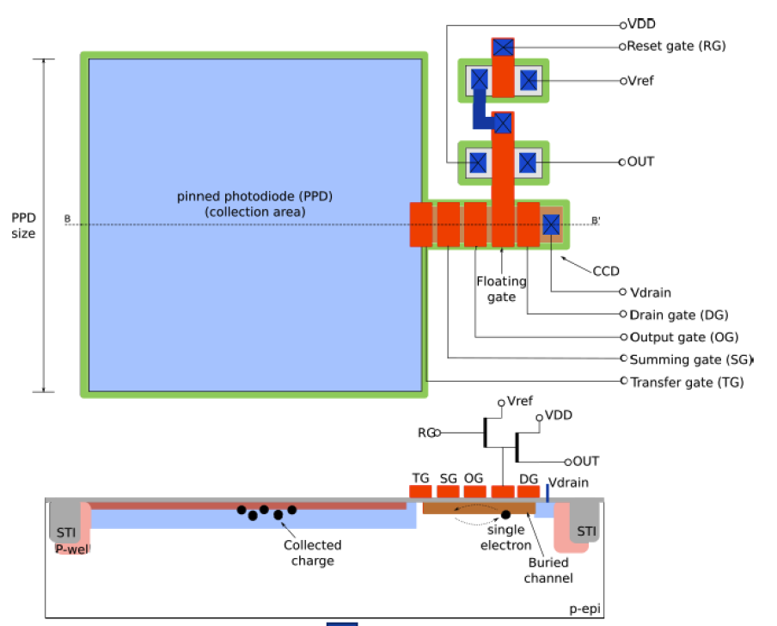
Skipper-in-CMOS
Project: Skipper CCD in CMOS Sensor with Non-Destructive Readout Co-Design
Goal: Design and Fabricate Single-Photon Image Sensor Prototype
Innovation:
  Sensor with Pinned PhotoDiode (PPD) for conversion
    Much higher Conversion Gain than CCD (100uV/e- vs 3uV/e-)
    Low leakage
    Lower noise per measurement than CCD
  Skipper CCD for charge manipulation
    High charge transfer efficiency
    Enables Non-Destructive Readout (NDR) capability
    Enables noise averaging feature
  Co-integrated CMOS process
    Readout parallelization capabilities
    Much faster readout time than CCD*
    Finer feature size
    High-Volume capability
Proposed Pixel: MAPS with CCD
PPD
CMOS AFE
CCD
CMOS AFE
CCD
Ref: Stefanov, K. D. (2020). Simulations and Design of a Single-Photon CMOS Imaging Pixel Using Multiple Non-Destructive Signal Sampling. Sensors , 20(7)

Slide 8
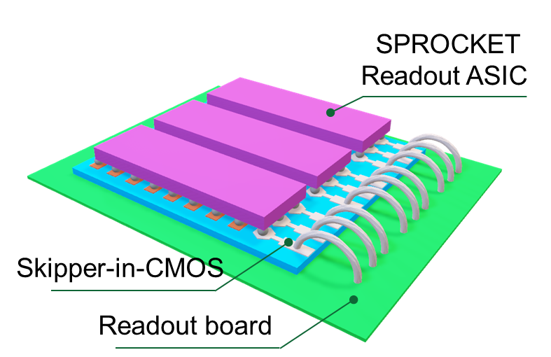



Skipper-in-CMOS: 3D image sensor
Scientific Achievement
Design of novel 3D Skipper-in-CMOS detector has started. Design of both the readout IC and the image sensor is ongoing.
Significance and Impact
Will enable large-area image sensor with Skipper readout, with high fill-factor and readout noise < 1 el.
Research Details
  Defined process options with semiconductor foundry (Tower Semiconductor) for Skipper-in-CMOS image sensor
  Very encouraging initial results for the sensor
Sensor test chips and testing at Fermilab

Slide 9
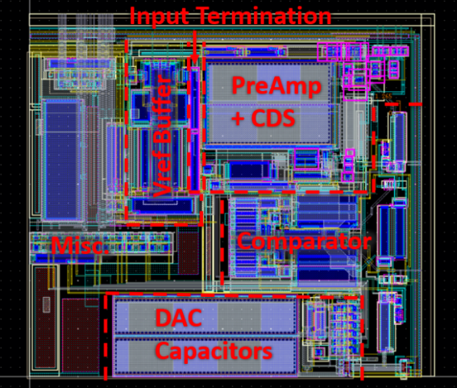
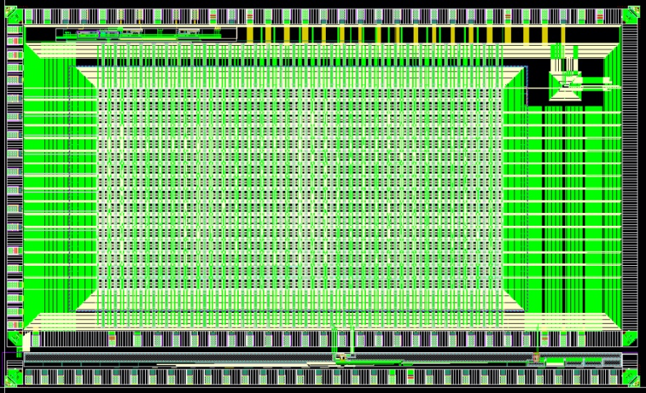

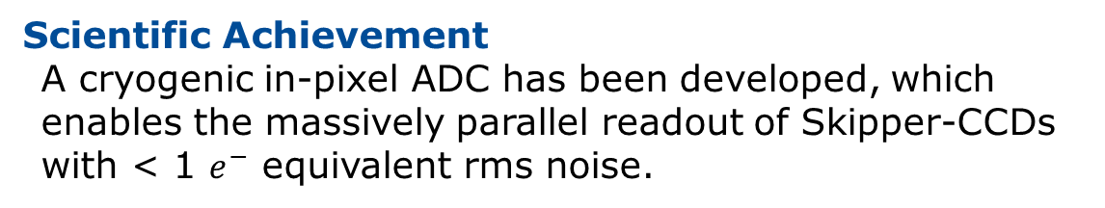
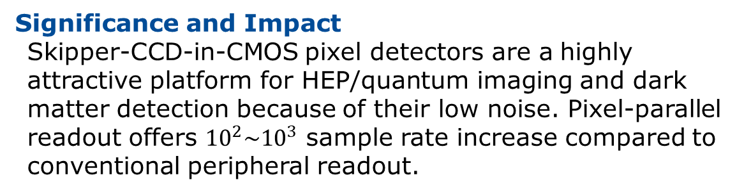
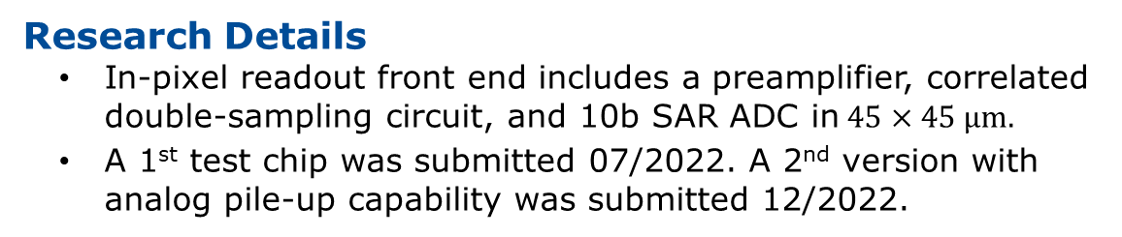
Sub-$e_{rms}^{−}$ Pixel-Parallel Readout for Skipper-CCDs
Scientific Achievement
A cryogenic in-pixel ADC has been developed, which enables the massively parallel readout of Skipper-CCDs with < 1 $e^{−}$ equivalent rms noise.
10b, 100KSPS in-pixel ADC (~30x30µm)
Significance and Impact
Skipper-CCD-in-CMOS pixel detectors are a highly attractive platform for HEP/quantum imaging and dark matter detection because of their low noise. Pixel-parallel readout offers ${10}^{2}\sim {10}^{3}$ sample rate increase compared to conventional peripheral readout.
SPROCKET ASIC: 64x32 pixels (09/22)
Research Details
  In-pixel readout front end includes a preamplifier, correlated double-sampling circuit, and 10b SAR ADC in$45×45 μm.$
  A 1st test chip was submitted 07/2022. A 2nd version with analog pile-up capability was submitted 12/2022.
A. Quinn, M.B. Valentin, T. Zimmermann, D. Braga, S. Li, S. Memik, F. Fahim FERMILAB-CONF-22-449-PPD

Slide 10

Hybrid nanowire-based superconducting detector platform
Hybrid architecture for cryogenic detectors, based on the co-design of:
superconducting sensor (SNSPD),
nanocryotron-based superconducting electronics (xTRON),
cryoCMOS ASIC
Qing-Yuan Zhao et al 2017
Supercond. Sci. Technol. 30 044002
development of the technology required for overall integration at cryogenic temperatures (Matt Shaw – JPL)
SC and cryo-CMOS modeling and extraction (Synopsys, EPFL)
Goal: scalable, large count detector with edge computing and integrated sensing
Device-circuits-system codesign will concurrently enable large channel count, power optimization, impedance matching, edge compute and feature extraction, and data processing

Slide 11
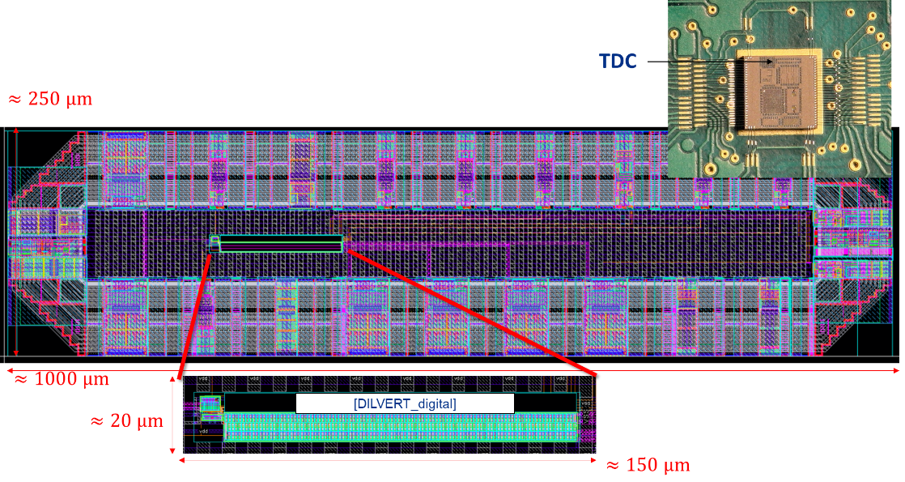

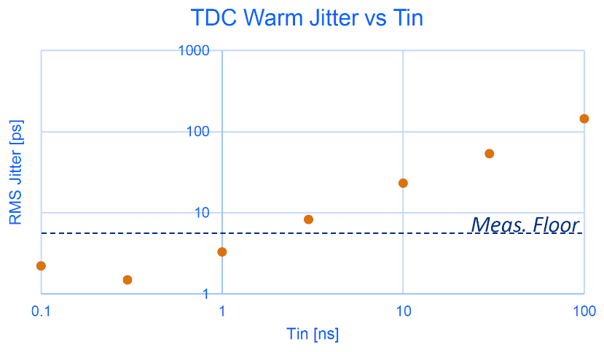
A <5ps cryogenic Time-to-Digital Converter for nanowire readout
Scientific Achievement
First cryoASIC block for the readout of nanowires has been prototyped and currently being tested
Significance and Impact
First functional block of cryoASIC to interface with nanocryotron readout. Demonstrates fast timing at low power. Next step will be a multichannel prototype
Research Details
  Warm and cold results confirm <5ps_{RMS} jitter
  0.5mW/channel
  Minor improvements identified and understood
  To be tested with LGAD

Slide 12
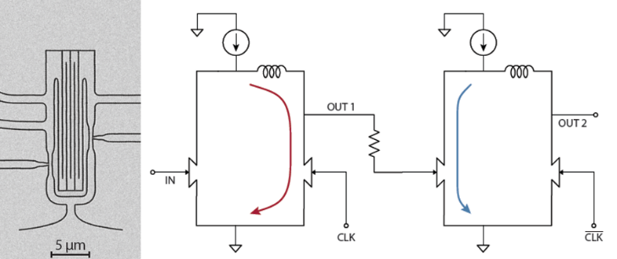
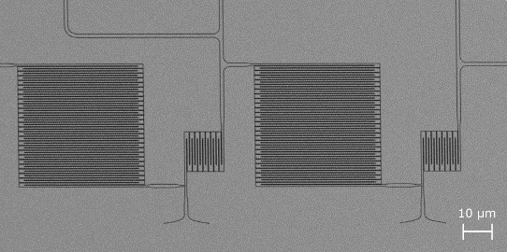
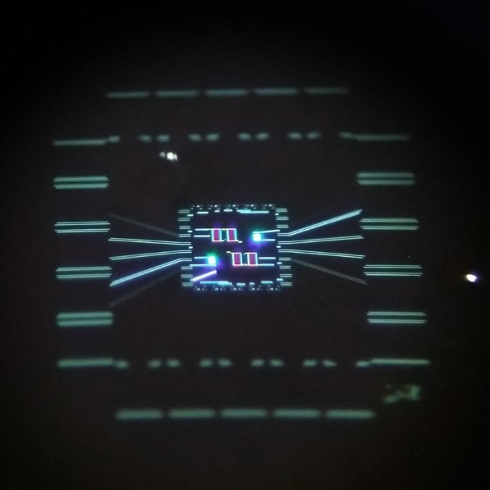
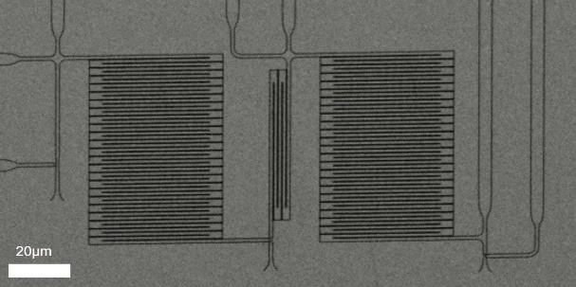




Advances in Superconducting Nanowire Fabrication and Measurement
Logic Blocks
Scientific Achievement
Novel nanowire cryotron (nTron) circuit architectures for interfacing superconducting circuits with cryogenic CMOS have been created.
Binary Counter
Significance and Impact
Multi-nTron circuits can perform binary counting, shifting, and can be made into standard logic cells for classical computing.
Integration with ASICs with improved device fabrication and modeling.
Shift Register
Research Details
Few nTron circuits have been designed, fabricated and tested.
https://arxiv.org/abs/2302.04942
Superconducting nanowire circuits
12

Slide 13

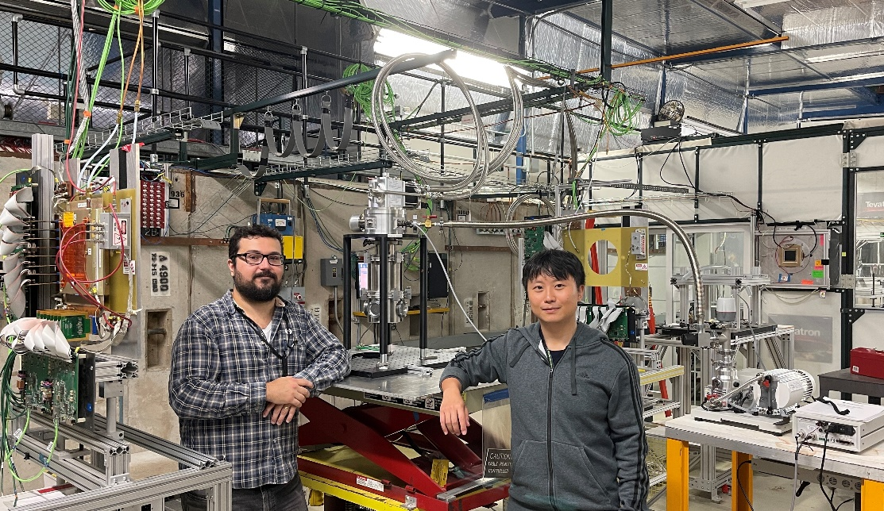
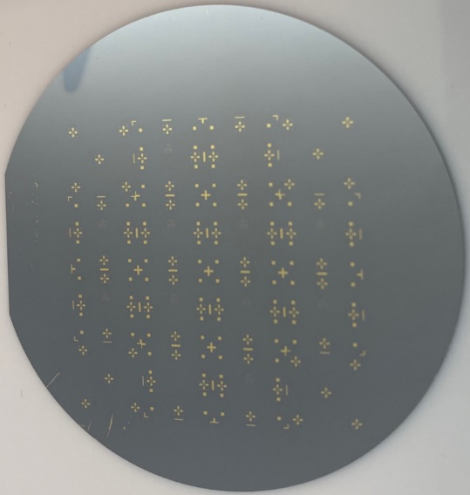
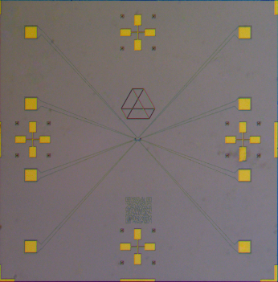
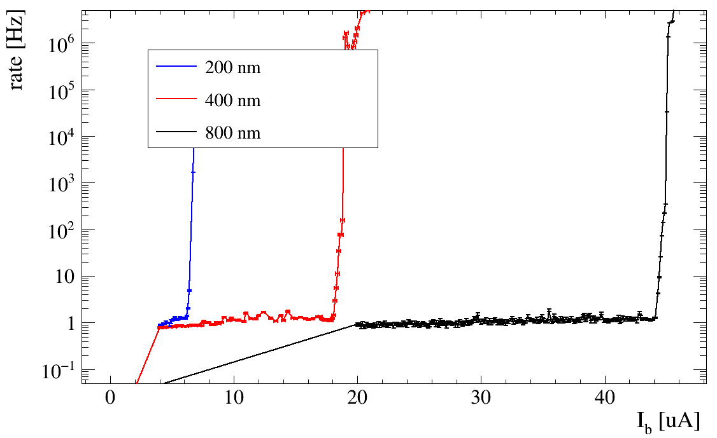
Superconducting Nanowire Particle Detectors
Fermilab Test Beam Facility
Scientific Achievement
Particle detector cryostat installed at Fermilab Test Beam Facility - ready to conduct tests with 120 GeV proton beam
Significance and Impact
First test of superconducting nanowire particle detectors with high energy proton beam
Key feasibility demonstration as high energy hadron detector for the Electron Ion Collider
FTBF testbed will facilitate testing of prototype hybrid devices soon
Devices fabricated by Tomas Polakovic
Research Details
  100nm, 200nm, 400nm, and 800nm wire width pixel devices fabricated at Argonne for beam tests.
  Characterized in similar cryostat testbed located at Argonne with radioactive sources
Very recently, awarded EIC-related Generic Detector R&D to establish similar testbed at JLab
30x30 μm² pixels
8x8 mm² chips

Slide 14
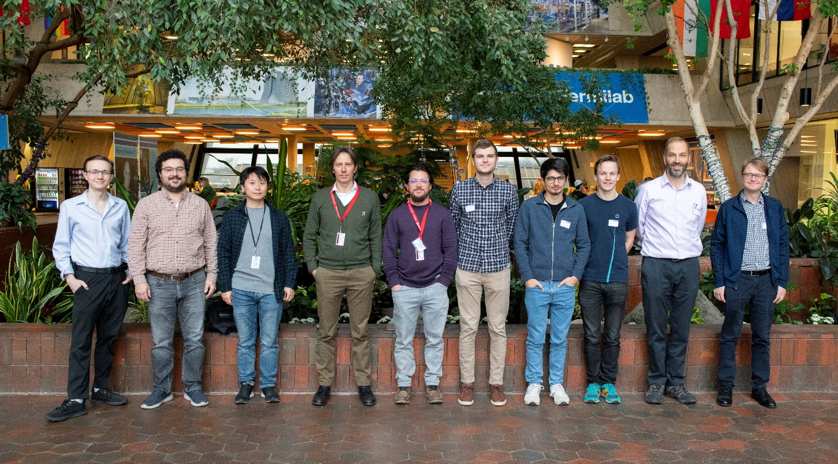
Recent highlights
Synergies with other Microelectronics Codesign Programs:
Nitride materials and interfaces for radiation hard integrated neutron detection (Nancy Haegel, NREL):
  Design of readout ASIC to demonstrate AlGdN neutron sensing
Abisko: Designing Neuromorphic Hardware, Software, and Applications Concurrently using AI-enabled Methods (Jeffrey Vetter, ORNL):
  Design of SNSPD and nanocryotron-based Spiking Neural Network
Collaboration meeting at Fermilab
SNSPD test beam at FTBF
Cryogenic TDC ASIC tested at cryo (<5ps jitter)
Several cryogenic ASICs currently in test or design phase
Recent Collaboration Meeting at Fermilab (Jan23)

