Slide 1
SBND Detector Move
Shishir Shetty and Team.
All Engineer’s Retreat
23 February 2023

Slide 2
Transportation Overview
Objective: Ship the detector from DAB to the Near Detector Building
Introduction
Route
Challenges
Planning
Summary

Slide 3
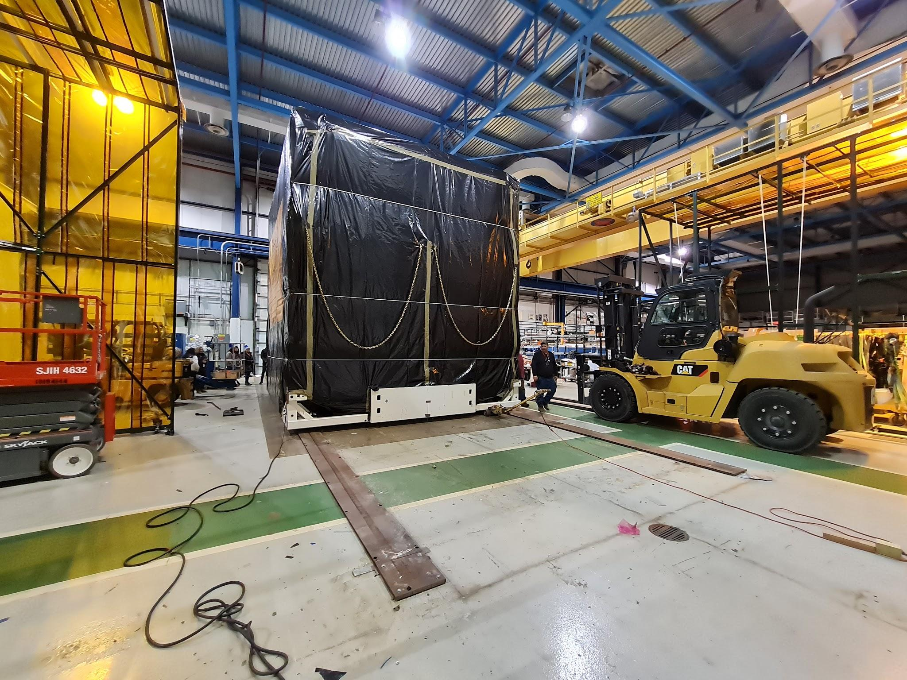
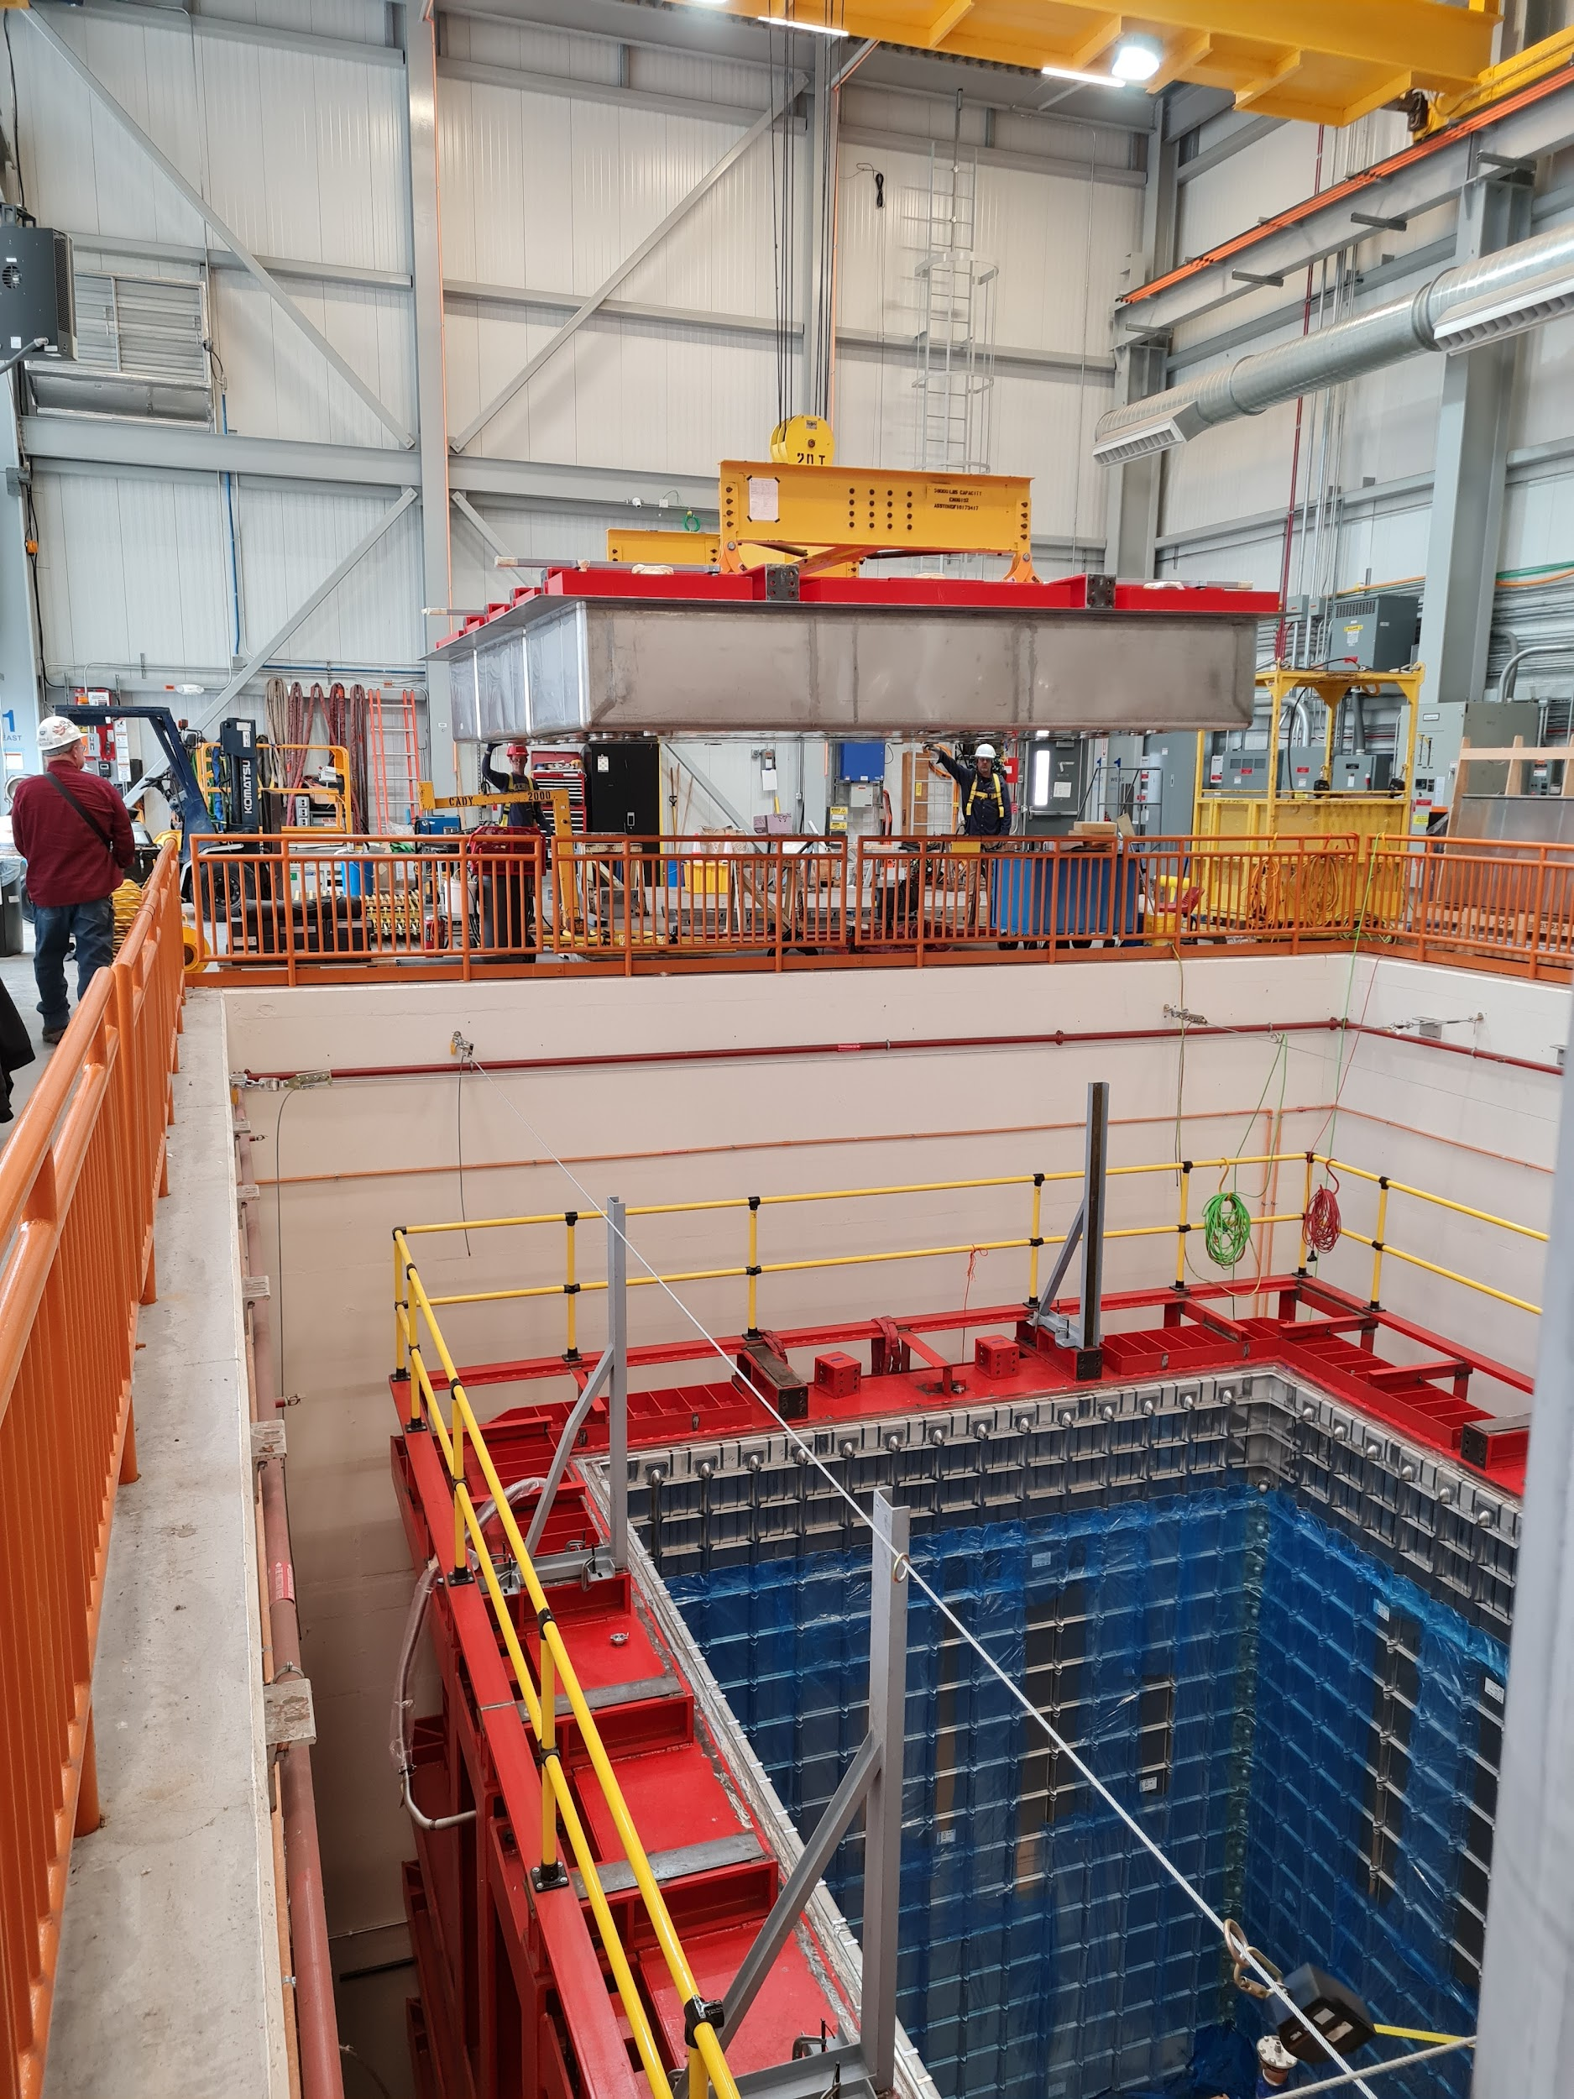
Introduction
Journey
Ring Road Route
D-Zero
Near Detector Building

Slide 4
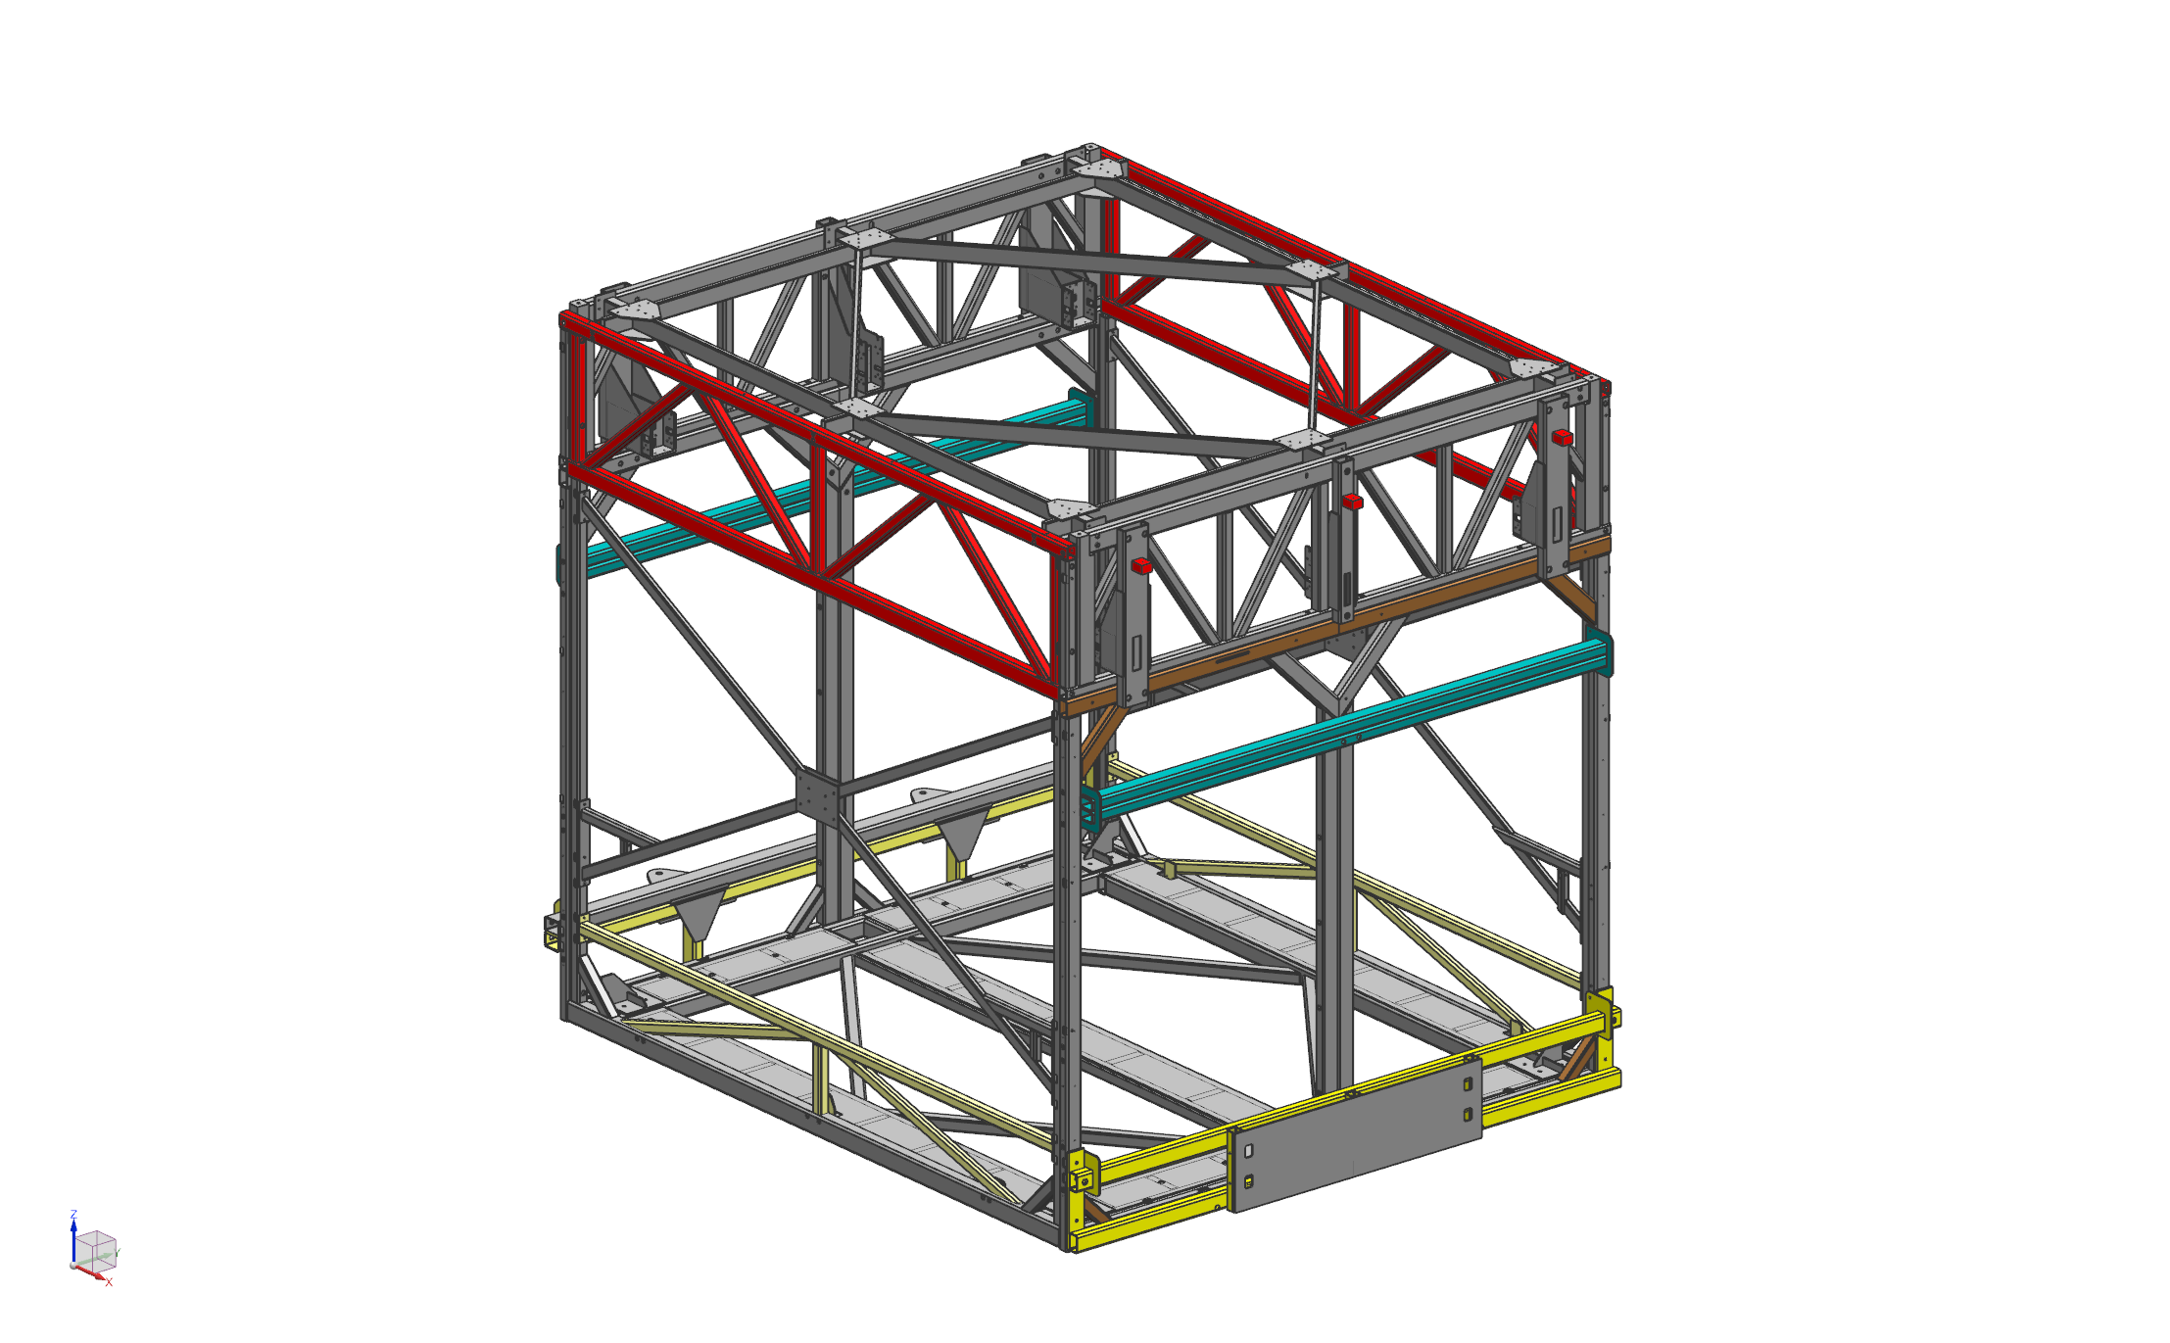
Introduction
The ‘atf’ is engineered to facilitate the assembly and transportation.
‘atf’ technical specifications:
Dimensions: 21 ft (length) x 18.5 ft (width) x 20 ft (height)
Frame Weight: 43,000 lbs.
TPC Weight: 20,000 lbs.
ASME Standards: BTH-1 and BTH 30.20
Risk and Planning: FESHM 10210 – Equipment Transport and FESHM 10200 – Critical Lift
‘atf’

Slide 5
Challenges
Challenges
High C.G. – Unstable load
Heavy
Vibrations and shocks
Dust and Moisture
Obstacles
Front
Back
C.G.
9’4”
10’4”
Front to C.G. | 10’4” | Sides to C.G. | 9’3” | Bottom to C.G. | 9’4”

Slide 6
Route
There were two possible routes to move the detector from DAB to SBN-ND. We ran some trials to pick the best route based on the following parameters:
Shocks on the route
Inclinations on the route
Obstacles on the route
Traffic and Runtime

Slide 7
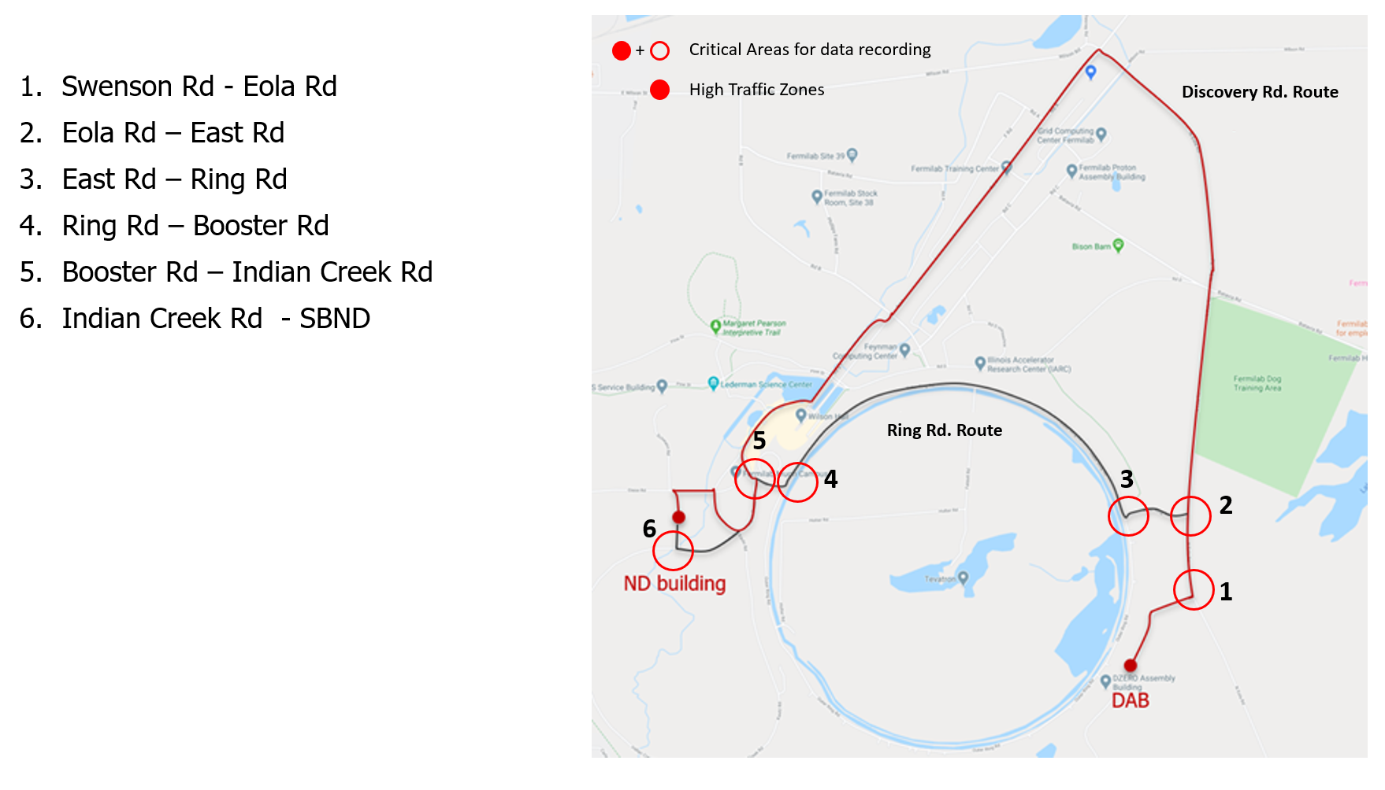
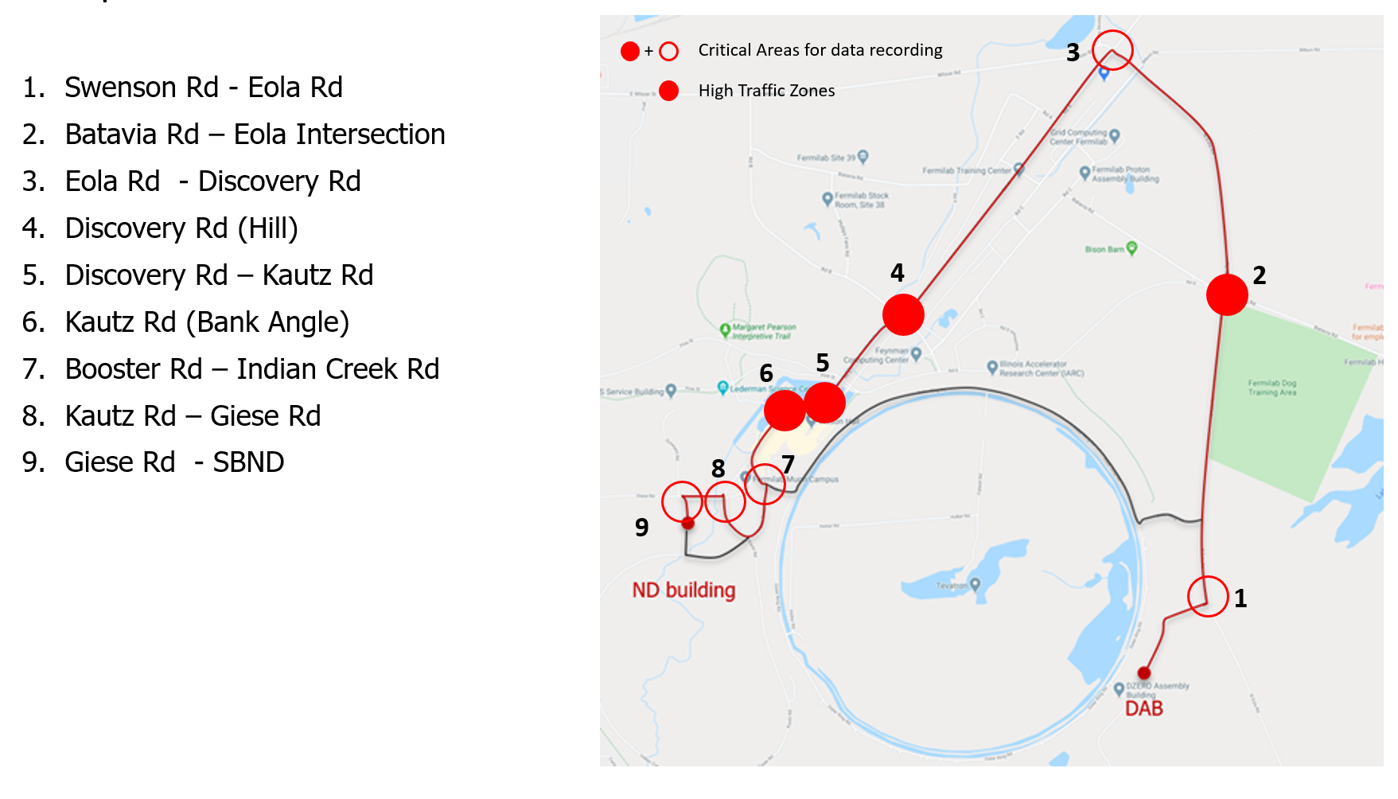
Route – Trials
Route options:
Ring Rd. Route
Discovery Rd. Route

Slide 8
Route - Trials
Trial Runs:
Three trial runs along the Main Ring Road Route and Discovery Road Route.
Trail Run 1: Preliminary trail conducted to understand the footprint of the trailer, runtime, obstacles and traffic mitigation
Trail Run 2A and 2B: Loaded run with 66,900 lbs., sensors, width and height measurement retractable beams.
Speed = 2.5 – 3 mph
Accelerometers: To record g-force data along the route
Inclinometer: To record the role and pitch data.
Obstacles like signposts, lamps, trees, overhead lines and postholes were noted and addressed with ISD (erstwhile FESS).

Slide 9
Payload Specifications
Dimensions:
18.5’
21’
20’
5.5’
5.5’

Slide 10
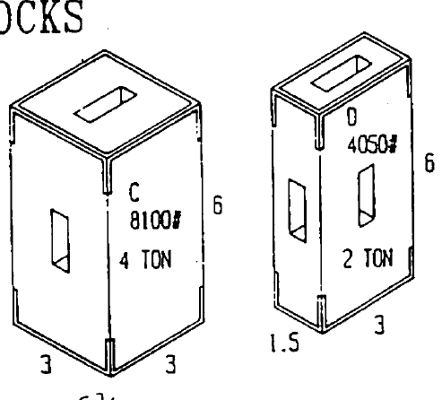
Route - Trials
Trial run 2A and 2B – Load setup:
Total weight = 33.15 Tons
C.G. of Test load = 6’6” (2’10” below the detector C.G.)
Item | Quantities | Weight | Status
D Block | 4 | 8 Tons | Completed
C Block | 4 | 16 Tons | Completed
Bridge | 1 | 9.15 Tons | Completed
21’
4
2
2
4
4
4
11’3”
9.15
5’3”
2
2

Slide 11
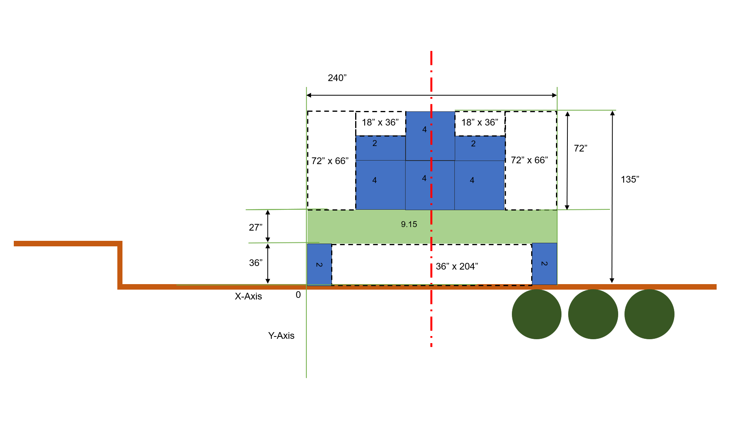
Route Trials
Center of Gravity (C.G.): Test Load
Test Load | 66,540 lbs. | Ground to Bed | 3’6” | Bed to C.G. | 6’6”

Slide 12
Route Trials
DAQ: Accelerometer and Inclinometer – Trial 2B
Inclinometer: Top Center
Accelerometer: Top Center
Inclinometer: Back Right
Inclinometer: Middle Left

Slide 13
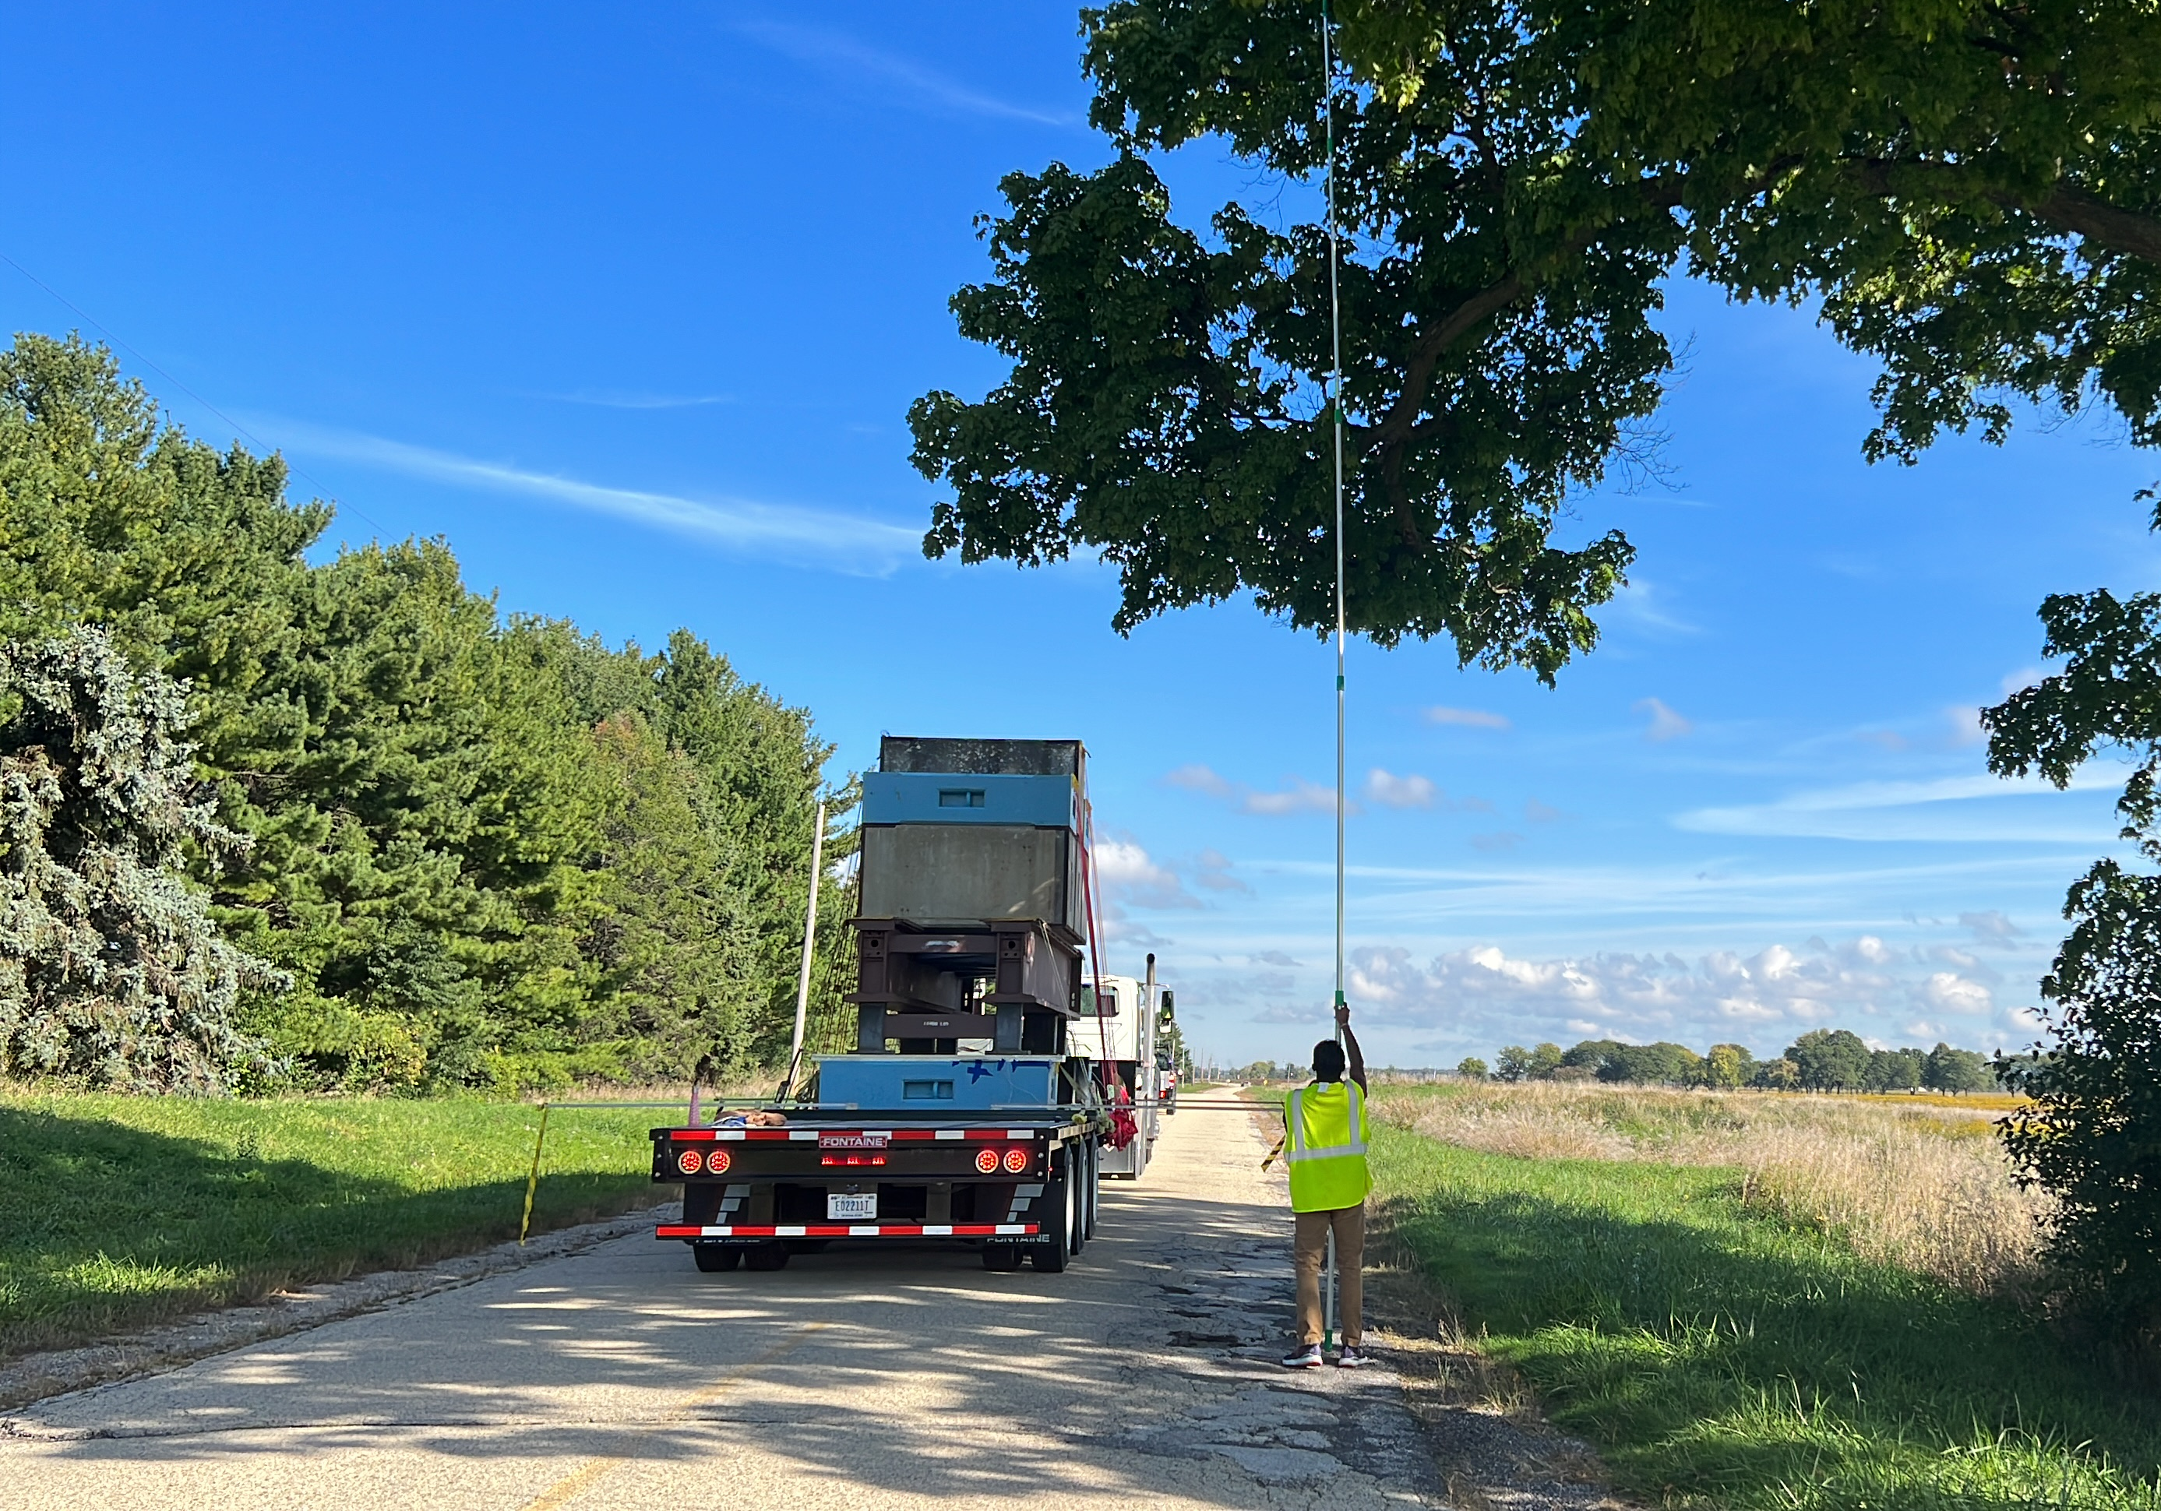
Route - Trails
Trial 2A – Discovery Road Route
Loaded trailer
Height measurement
Width measurement

Slide 14
Route - Picking a route
Inclinometer Data:
Critical angle
Critical angle
Trail 2B – Ring Road Route
Trail 2A – Discovery Road Route

Slide 15
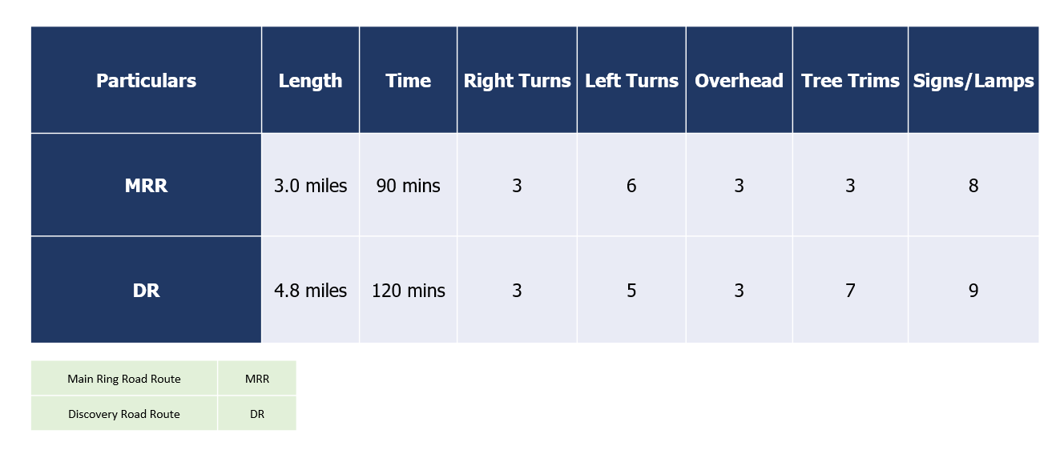
Route - Picking a route
Obstacles:
Misc.** - weights account for beams, dampers, chains, etc.

Slide 16
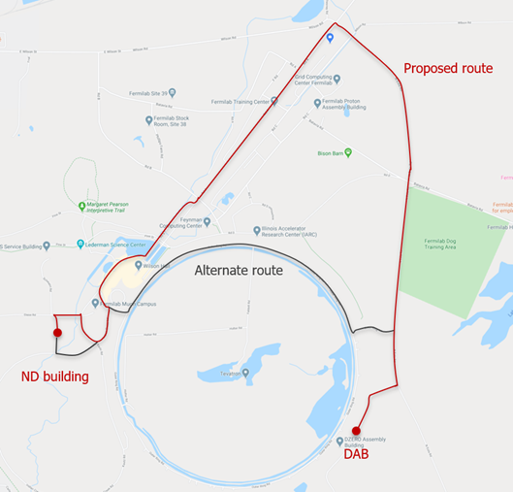
Route - Picking a route
Ring Road Route
Accelerometer – Max 0.17G
Inclinometer – Max 4.13 (for a 5 sec span)
Shorter Route
Minimal traffic
Less Obstacles
Road condition favorable after patch work
VS
Discovery Road Route
Accelerometer – Max 0.14G
Inclinometer – Max 5.70 (for a 5 - 7 min span)
Longer Route
More traffic
More obstacles
Road condition favorable with minimal patch work
✅
✅
Ring Road wins! 🎉

Slide 17
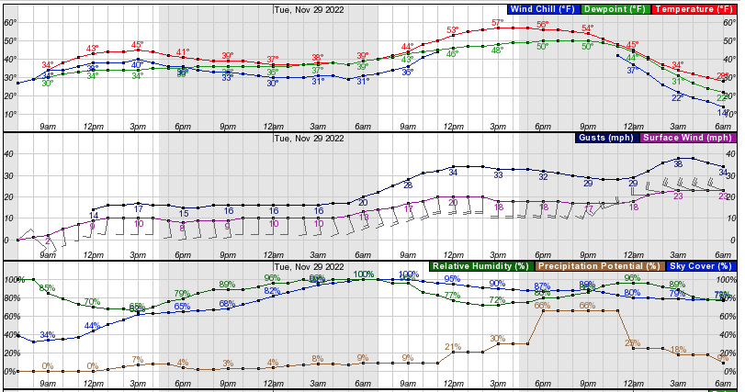
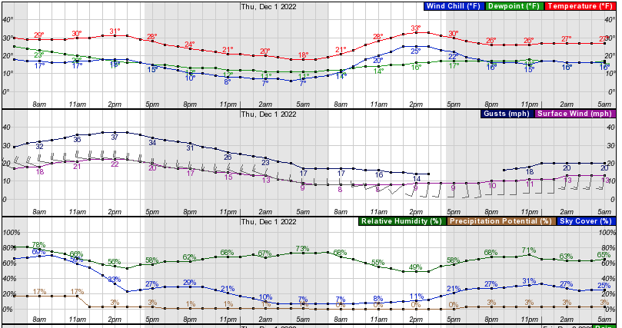
Challenges
Weather: Postponed due to weather unfavorable weather conditions
Tuesday, November 29, 2022
Windy
Thursday, December 1, 2022
Cold but less windy

Slide 18
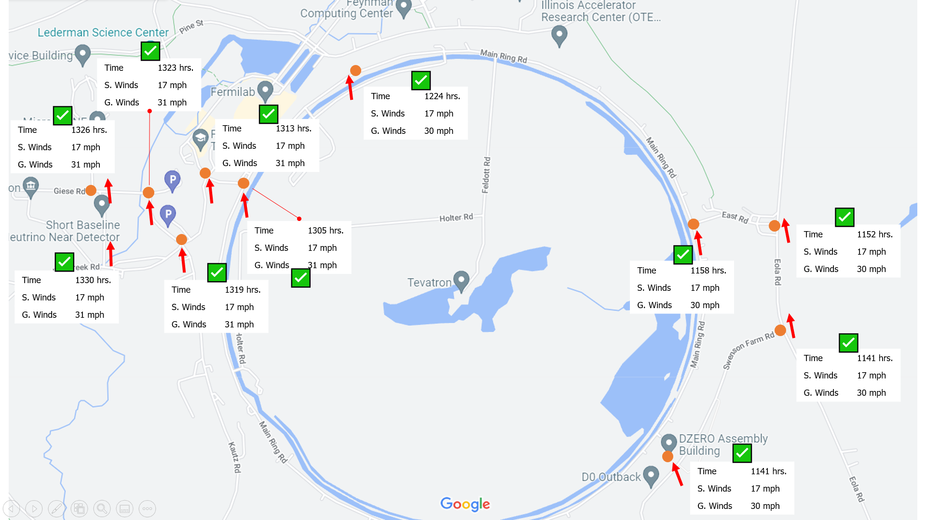
Challenges
Wind effect: Superimposition of wind data on to the trial run data to understand the wind dynamics

Slide 19
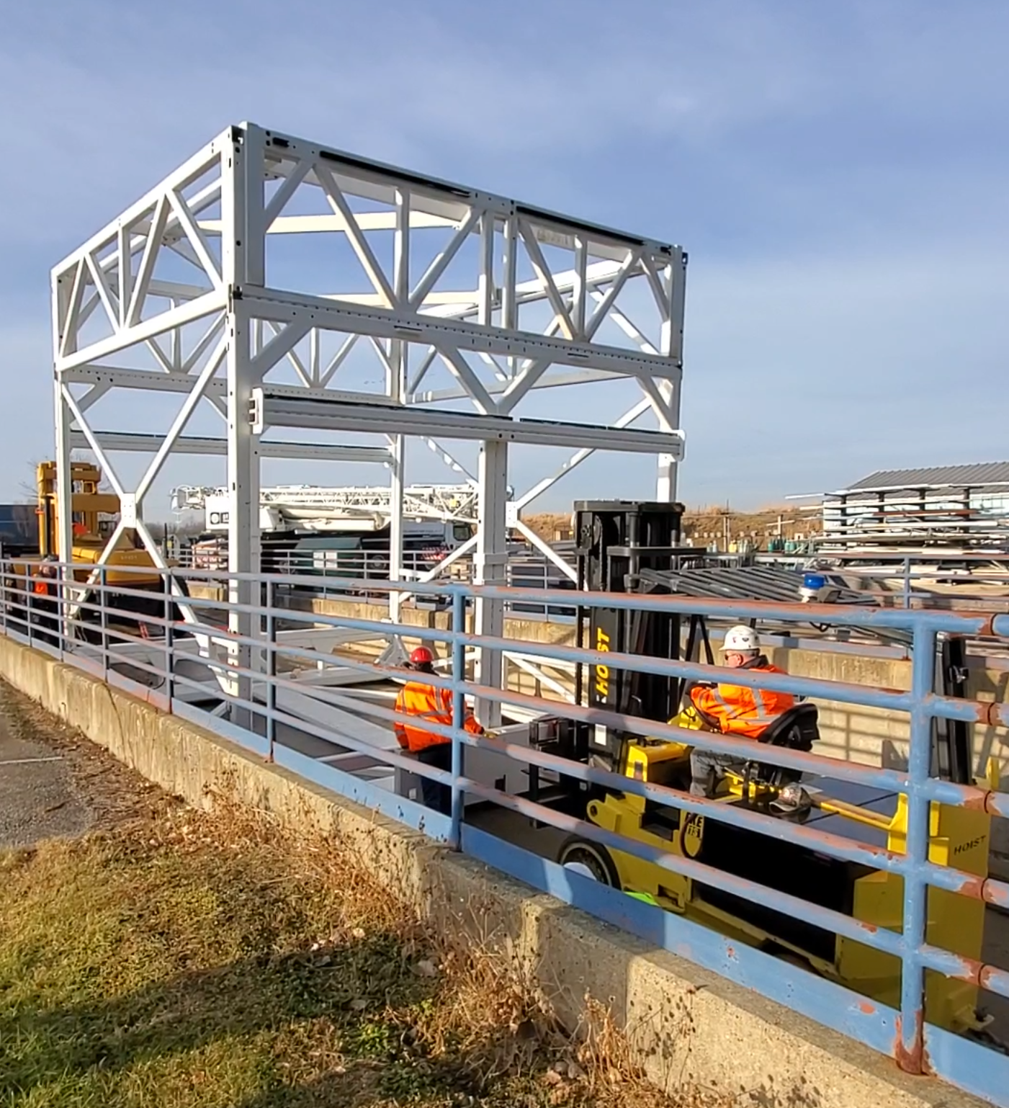
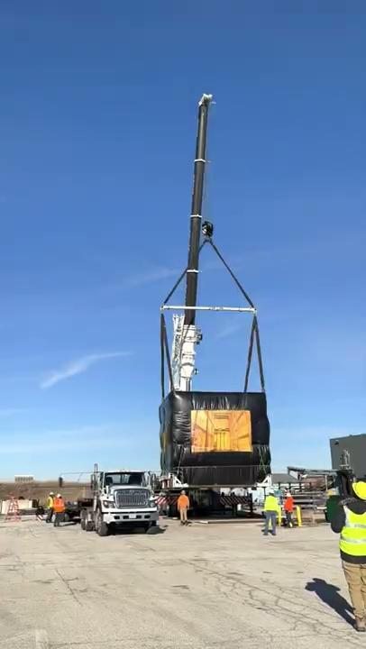
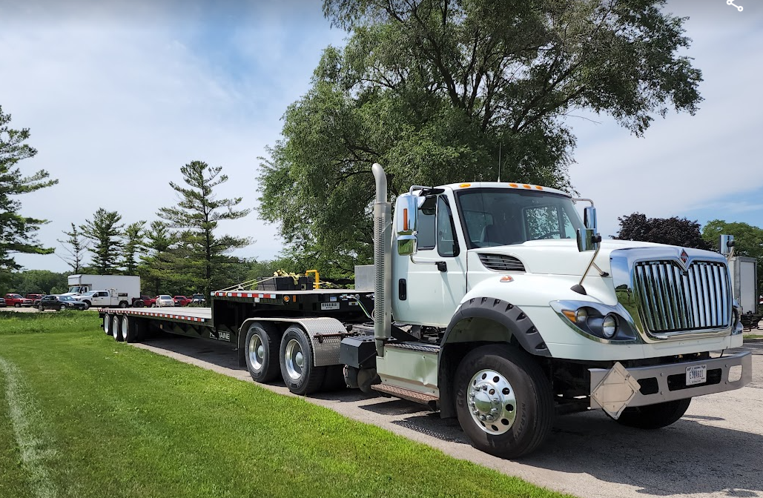
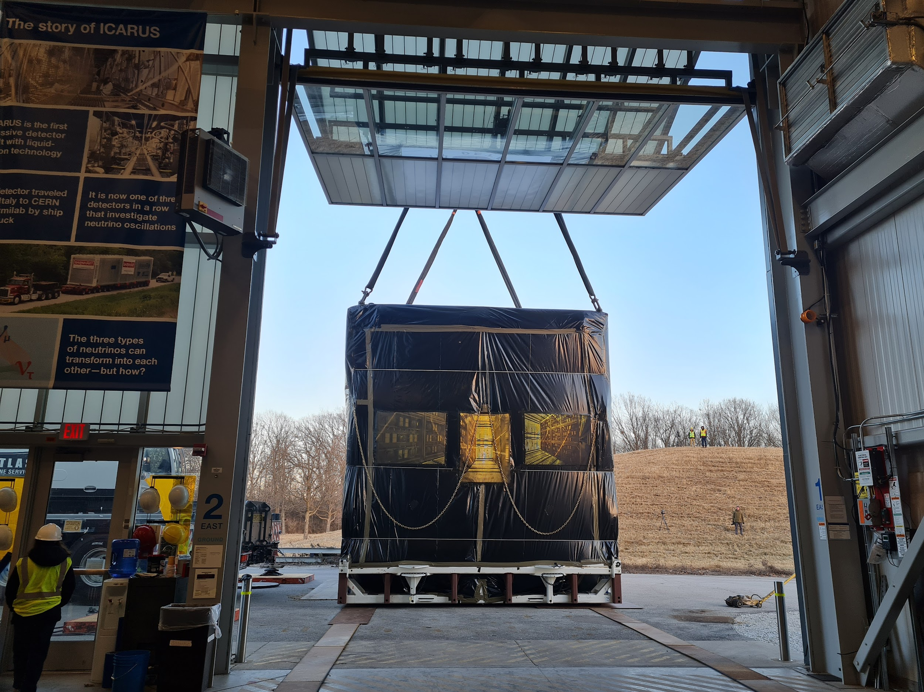
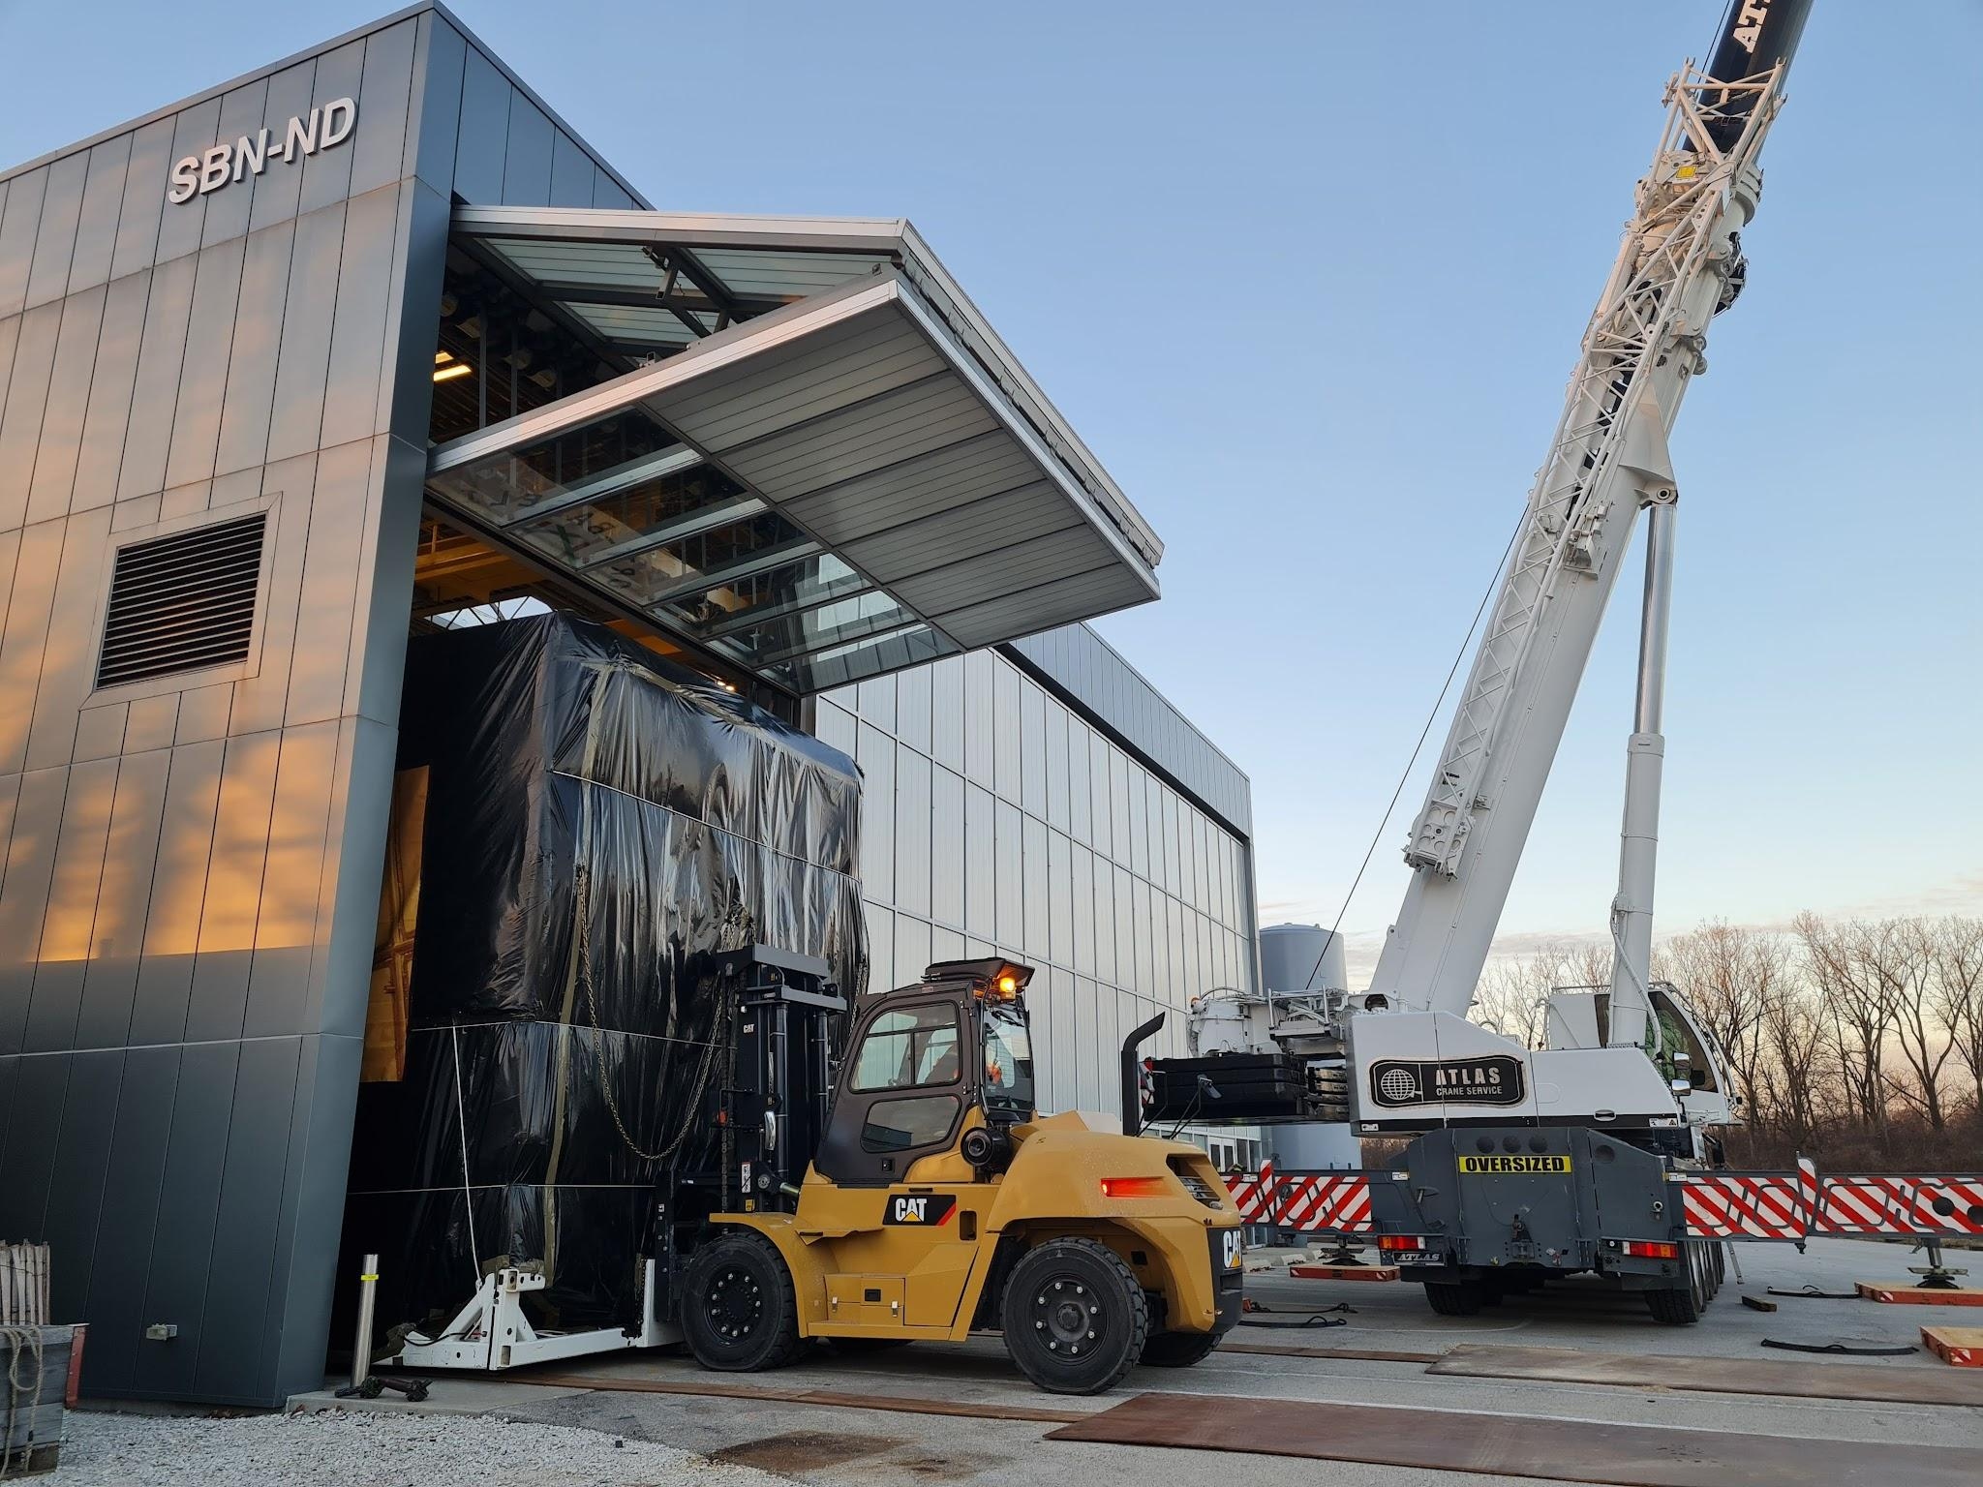
Planning
Work plan was split into 5 parts and crew were designated roles accordingly
Work and Lift Plan – SBN DocDB 28587
More than 40 personnel involved
Rigging at DAB
Lift at DAB
Transport
Lift at ND
Rigging at ND

Slide 20
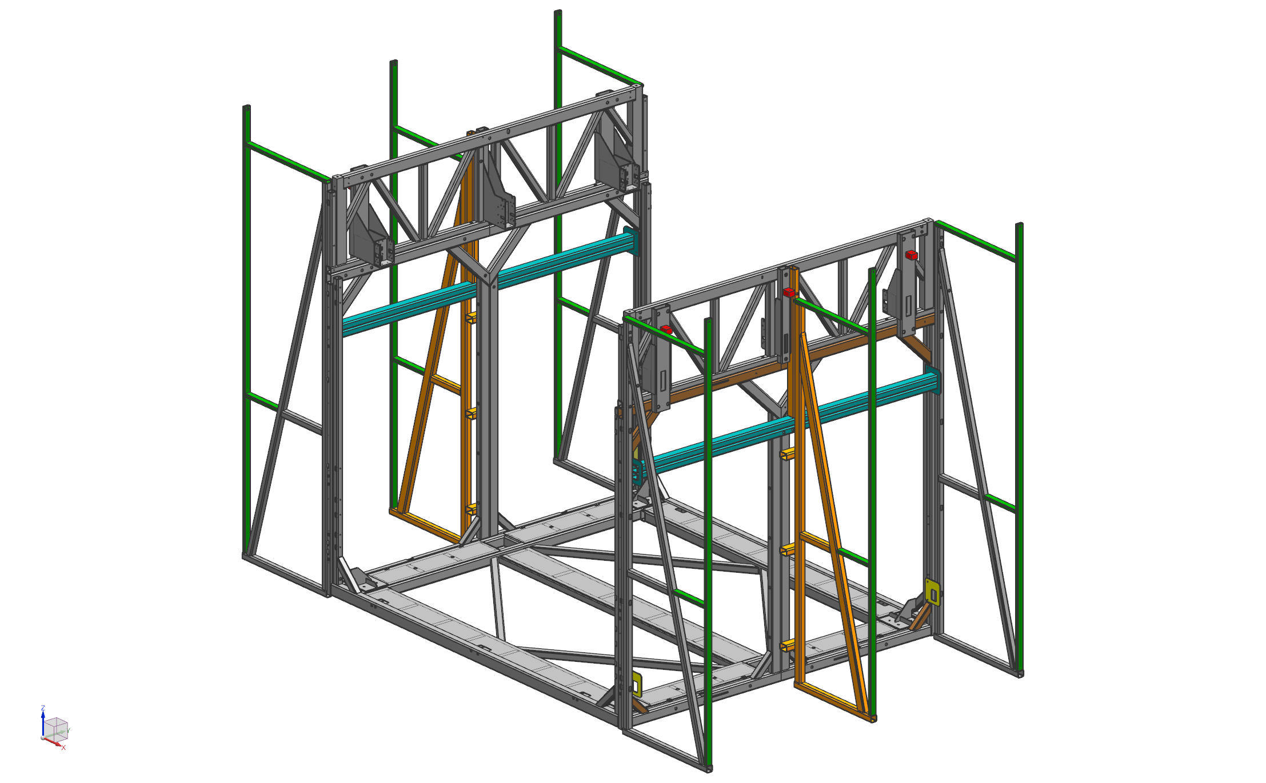
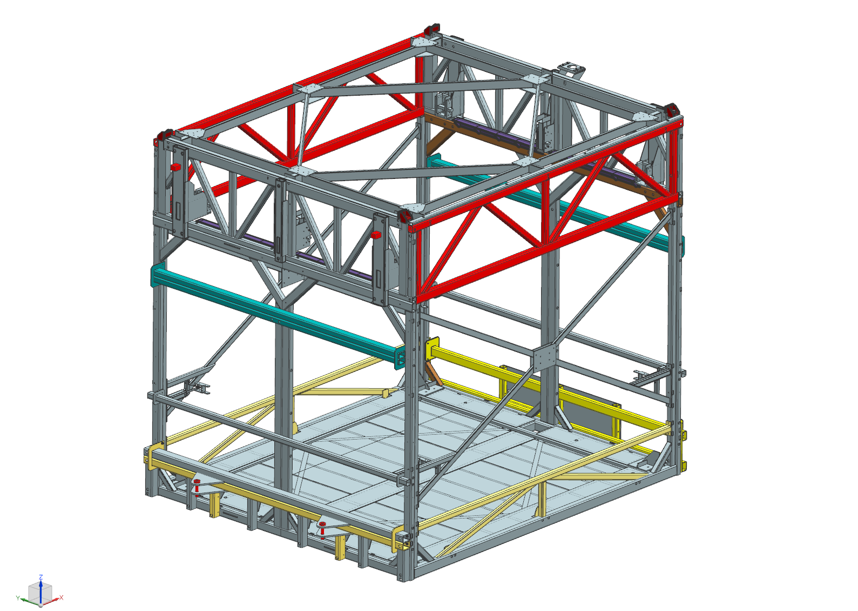
Planning
Preparation
‘atf’ – assembly configuration
‘atf’ – transport configuration

Slide 21
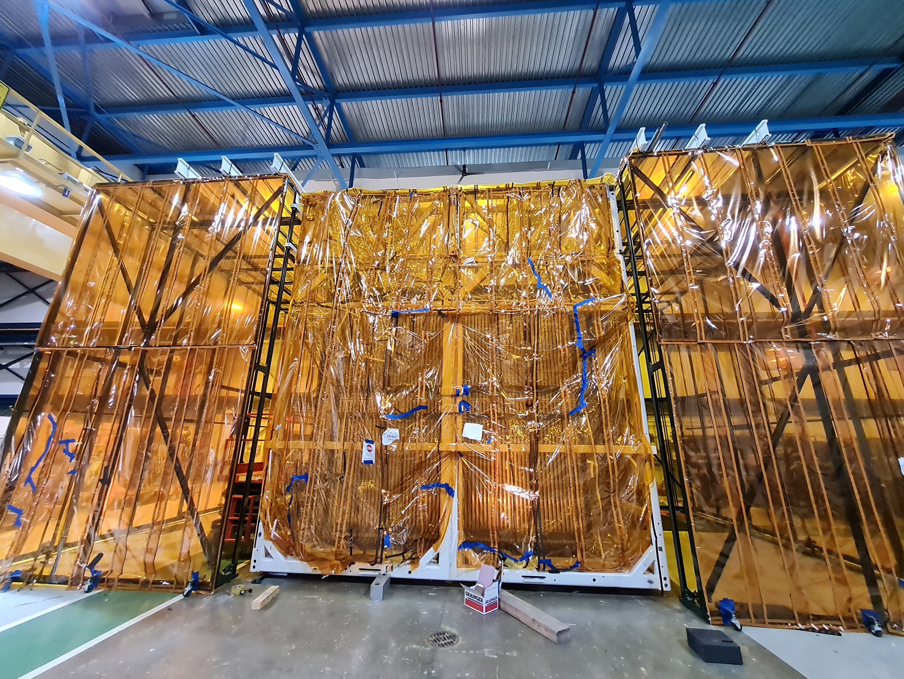
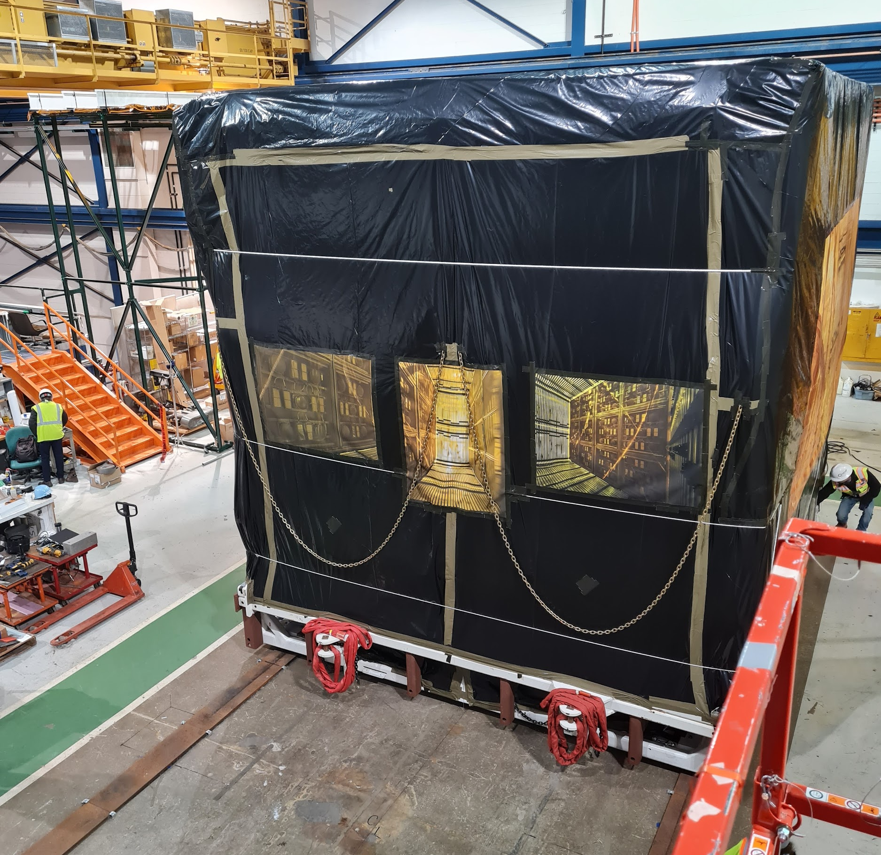
Planning
Preparation
Shape-shift
Assembly configurations
Transport configurations

Slide 22
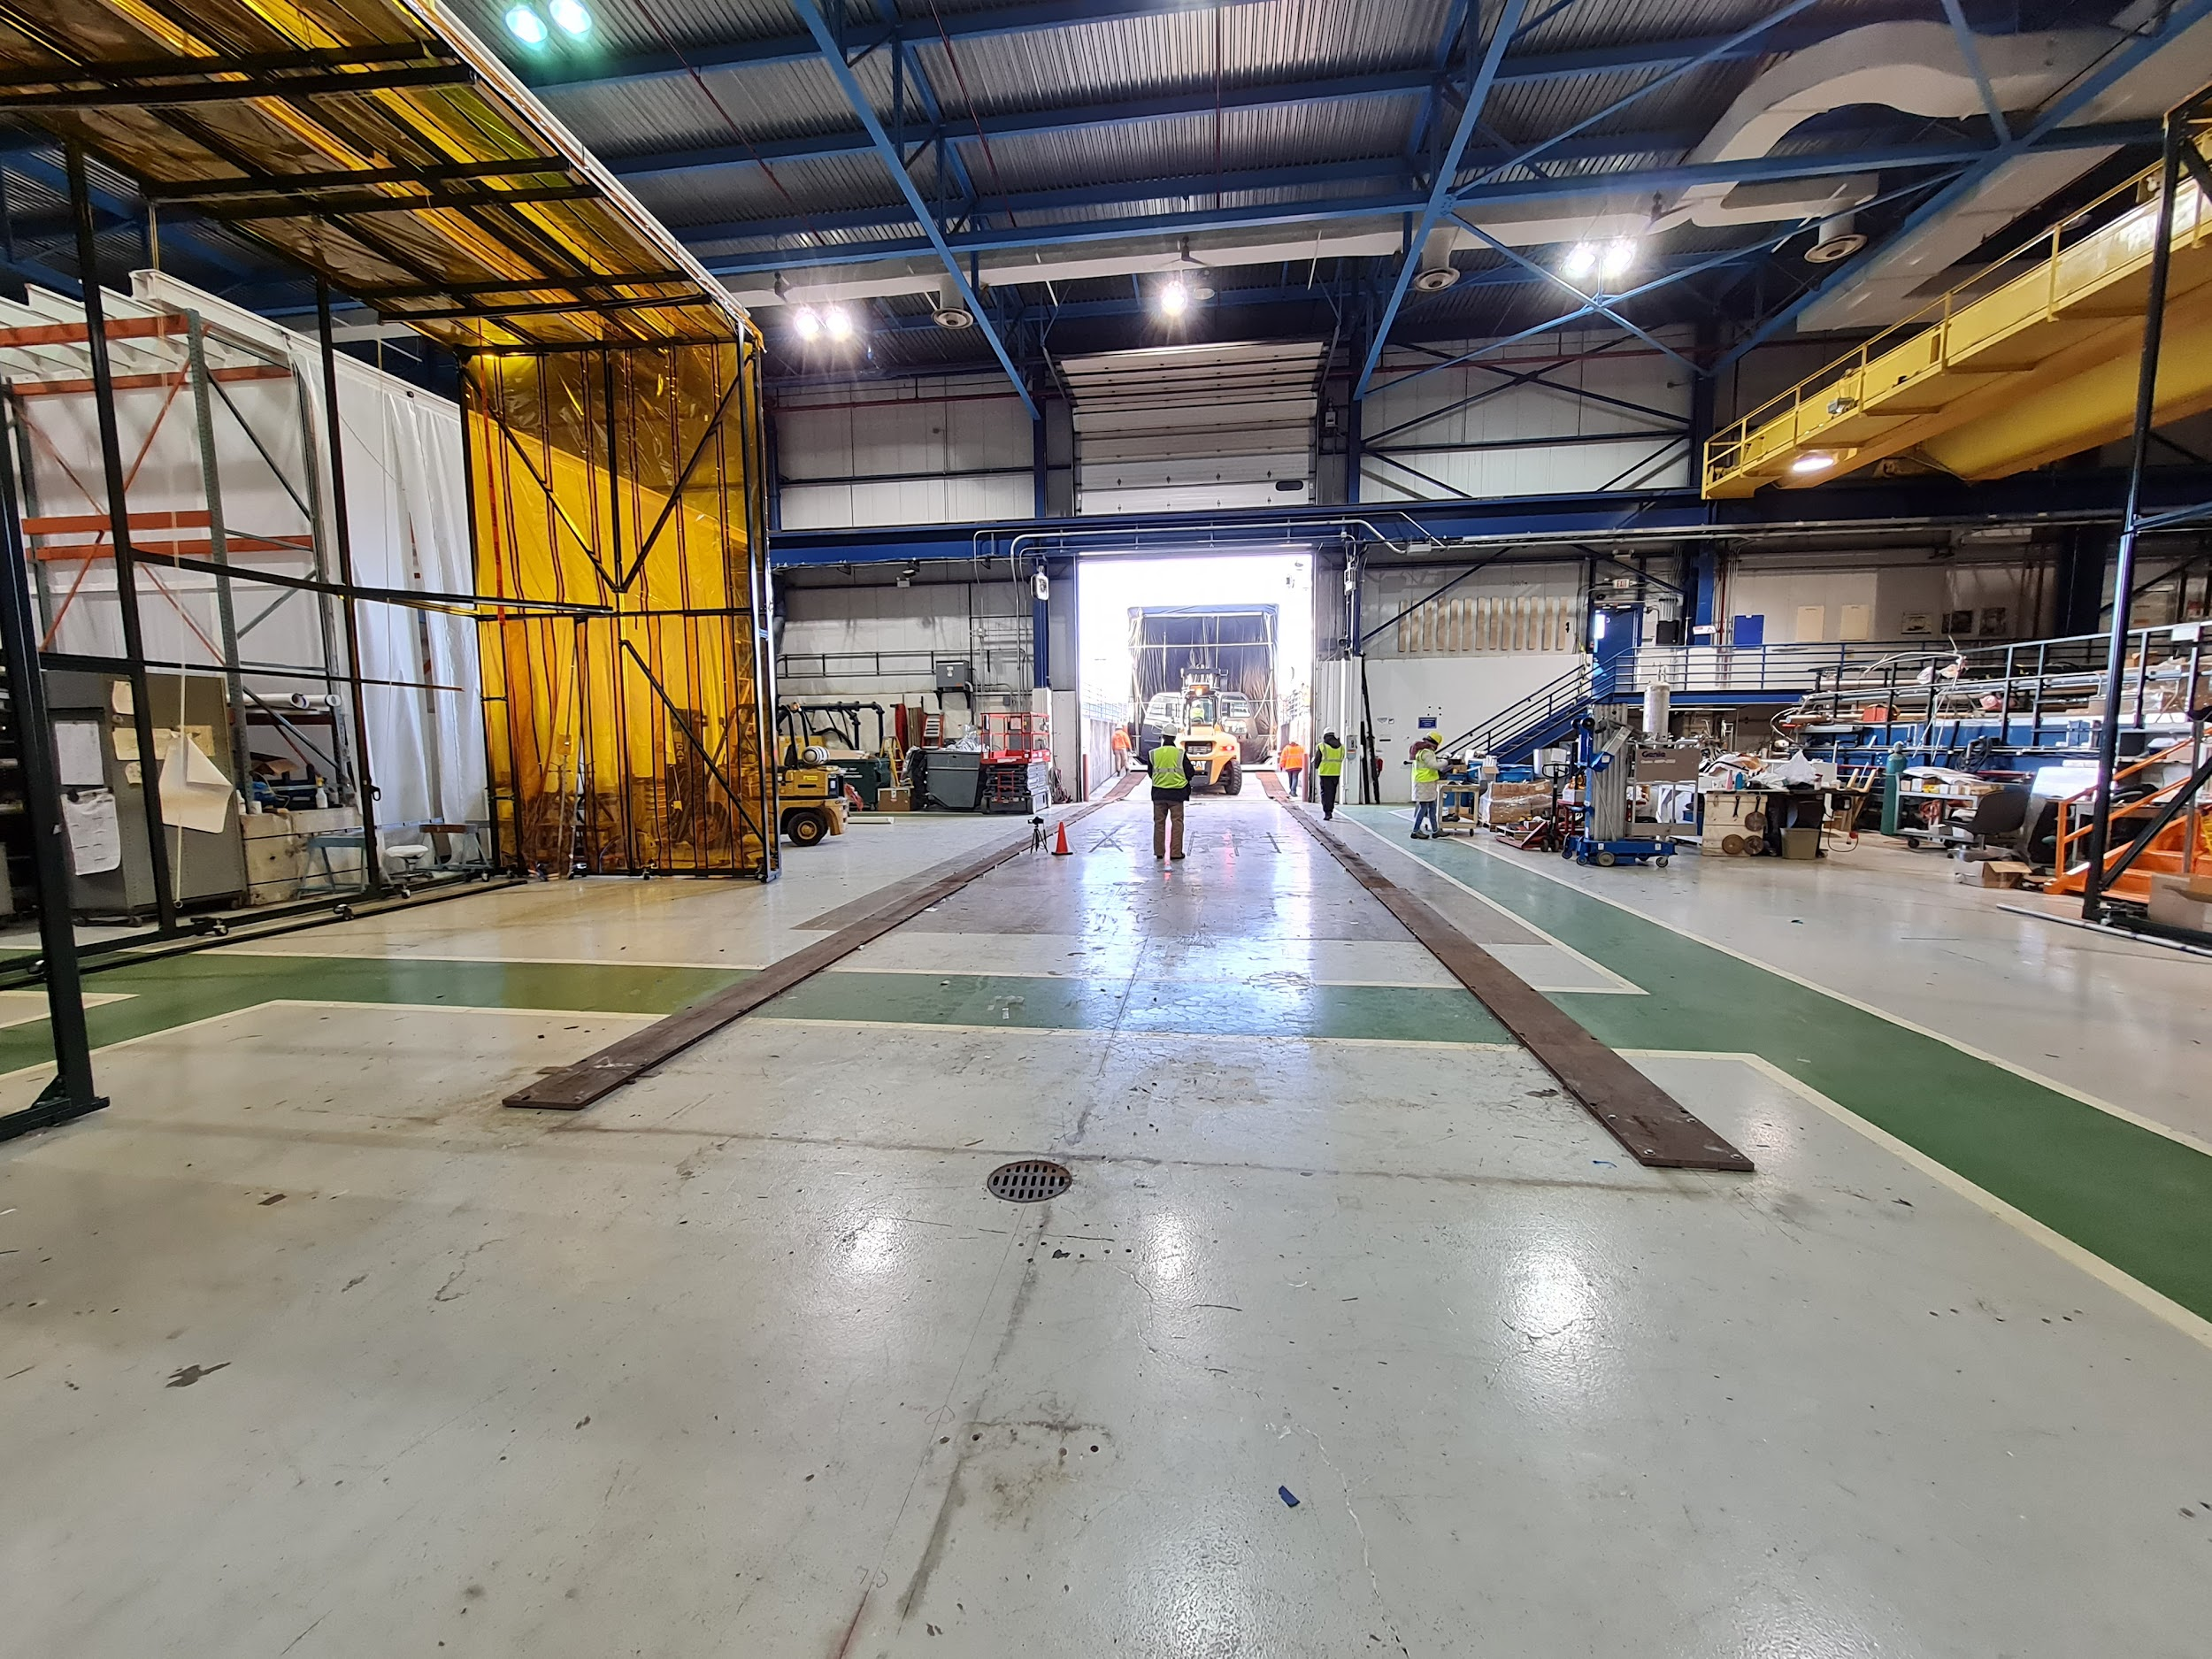
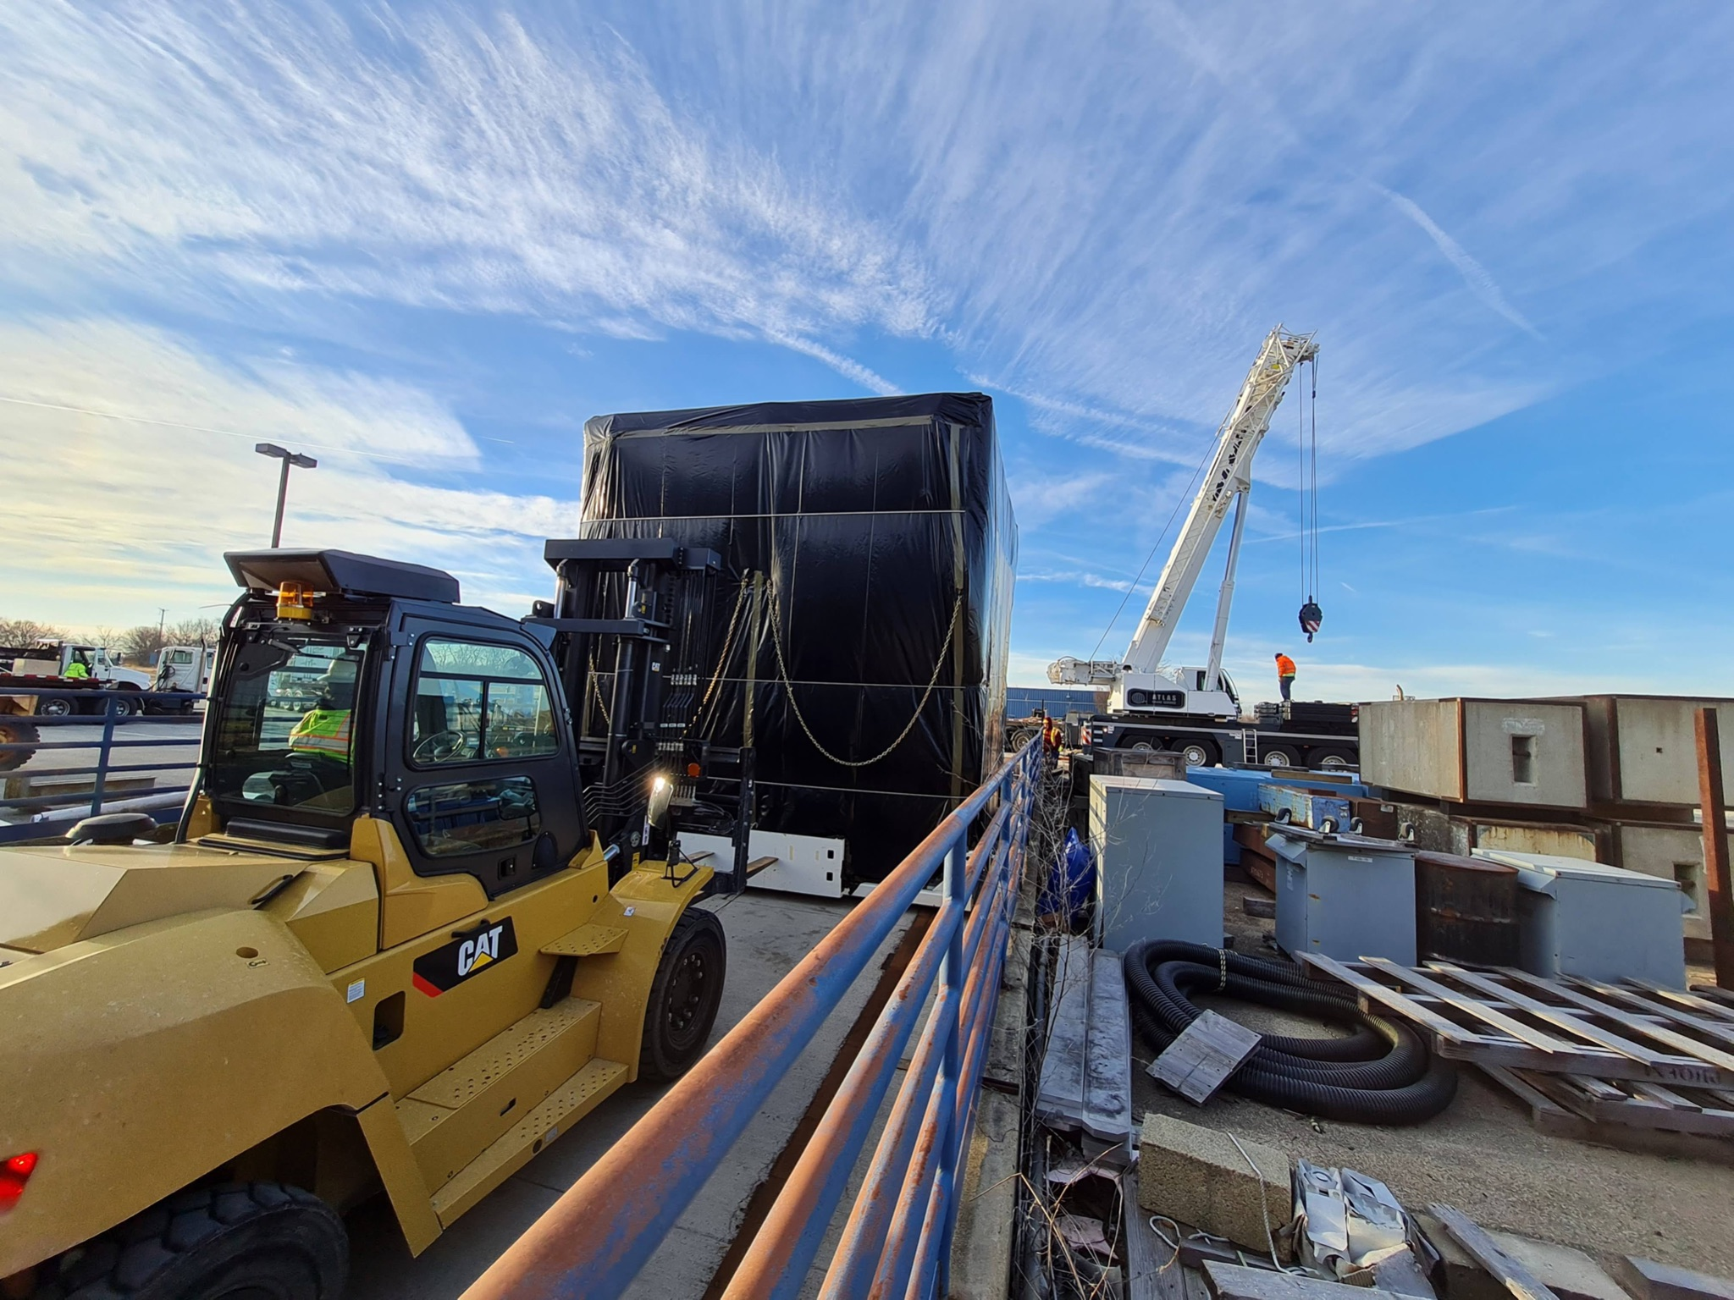
Planning
Rigging at DAB
Clearing the DAB door
Work area
Pulling up the ramp

Slide 23
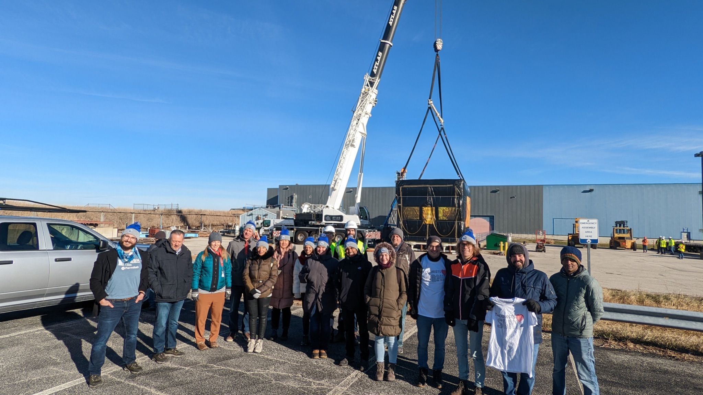
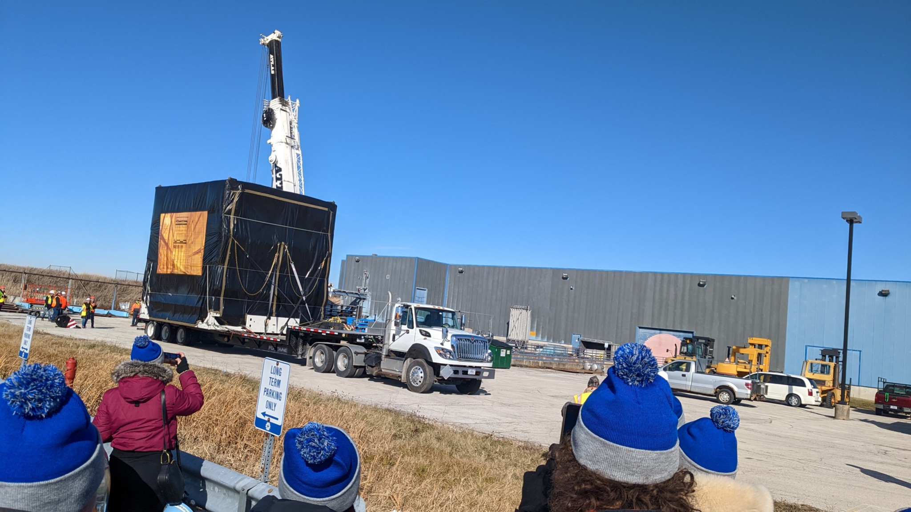
Planning
Lifting at DAB
Spectators
Lifting area
Loading

Slide 24
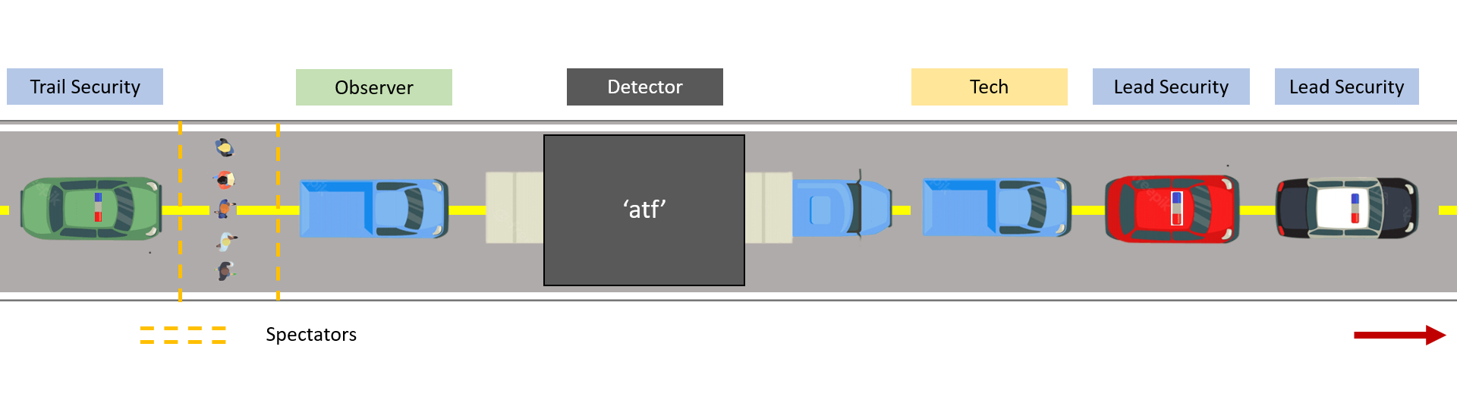
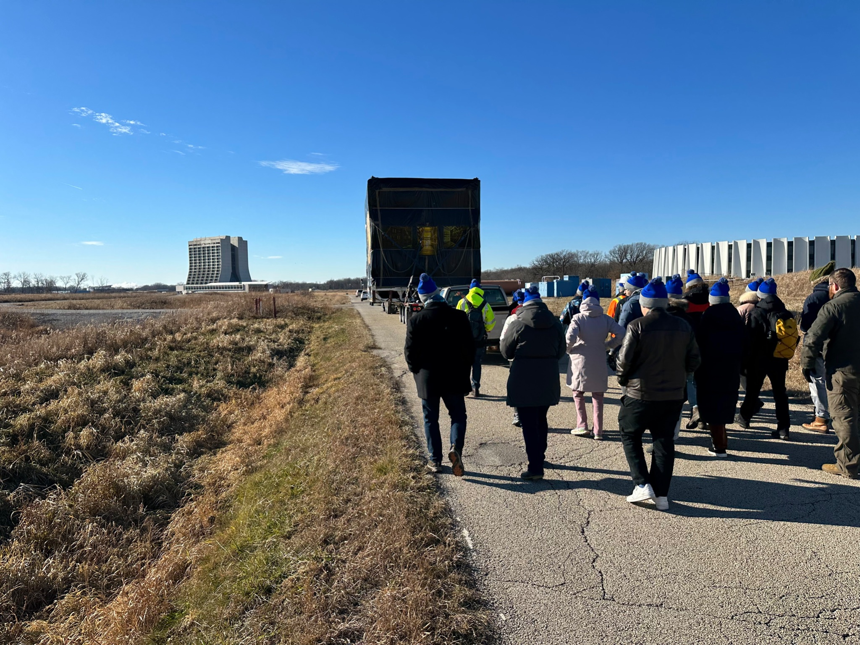
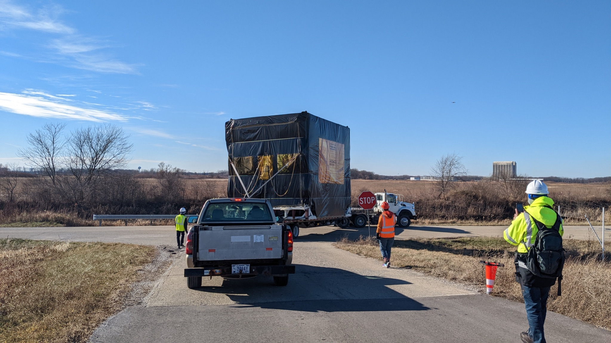
Planning
Transport
Spectators
Critical Turns

Slide 25
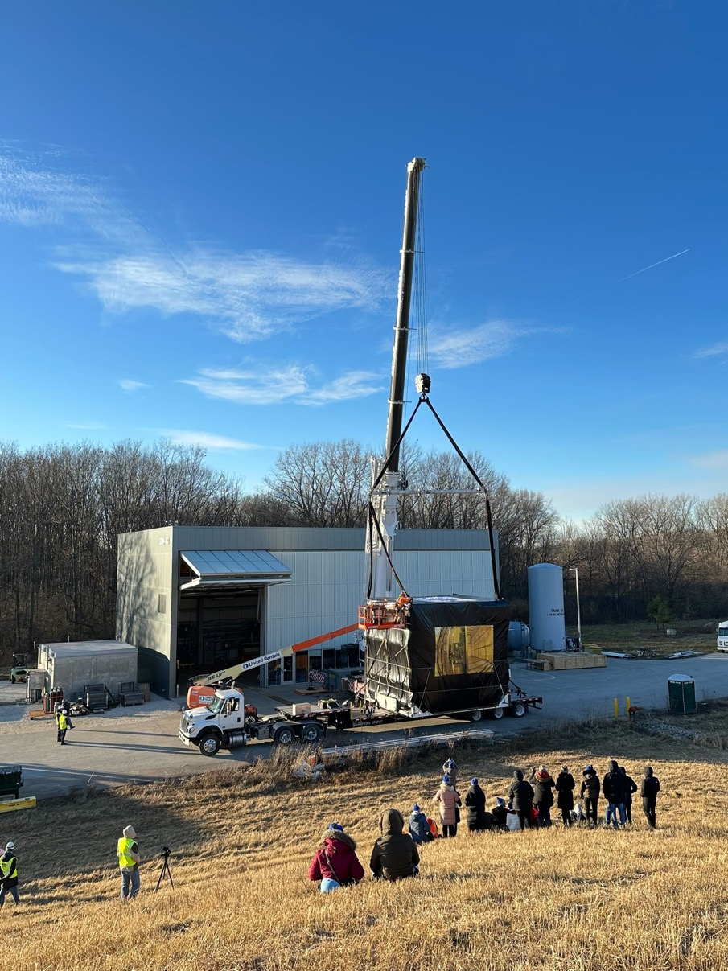
Planning
Lifting at ND
Lifting area
Unloading
Spectators

Slide 26
Planning
Rigging at ND
Unloading
Work area
Pushing

Slide 27
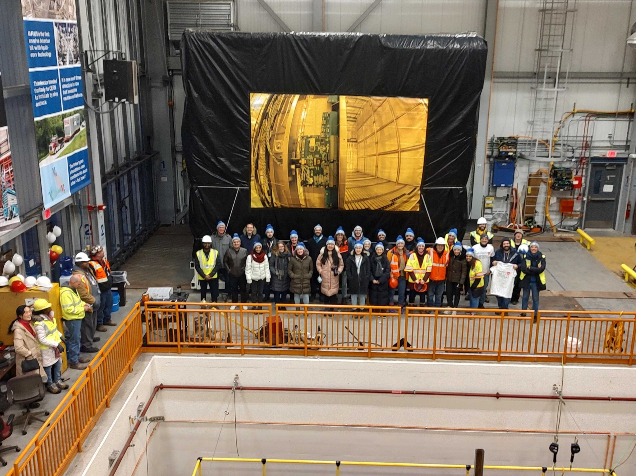
Planning
New Home

Slide 28
Planning
New Home
Courtesy – Ryan Postel

Slide 29
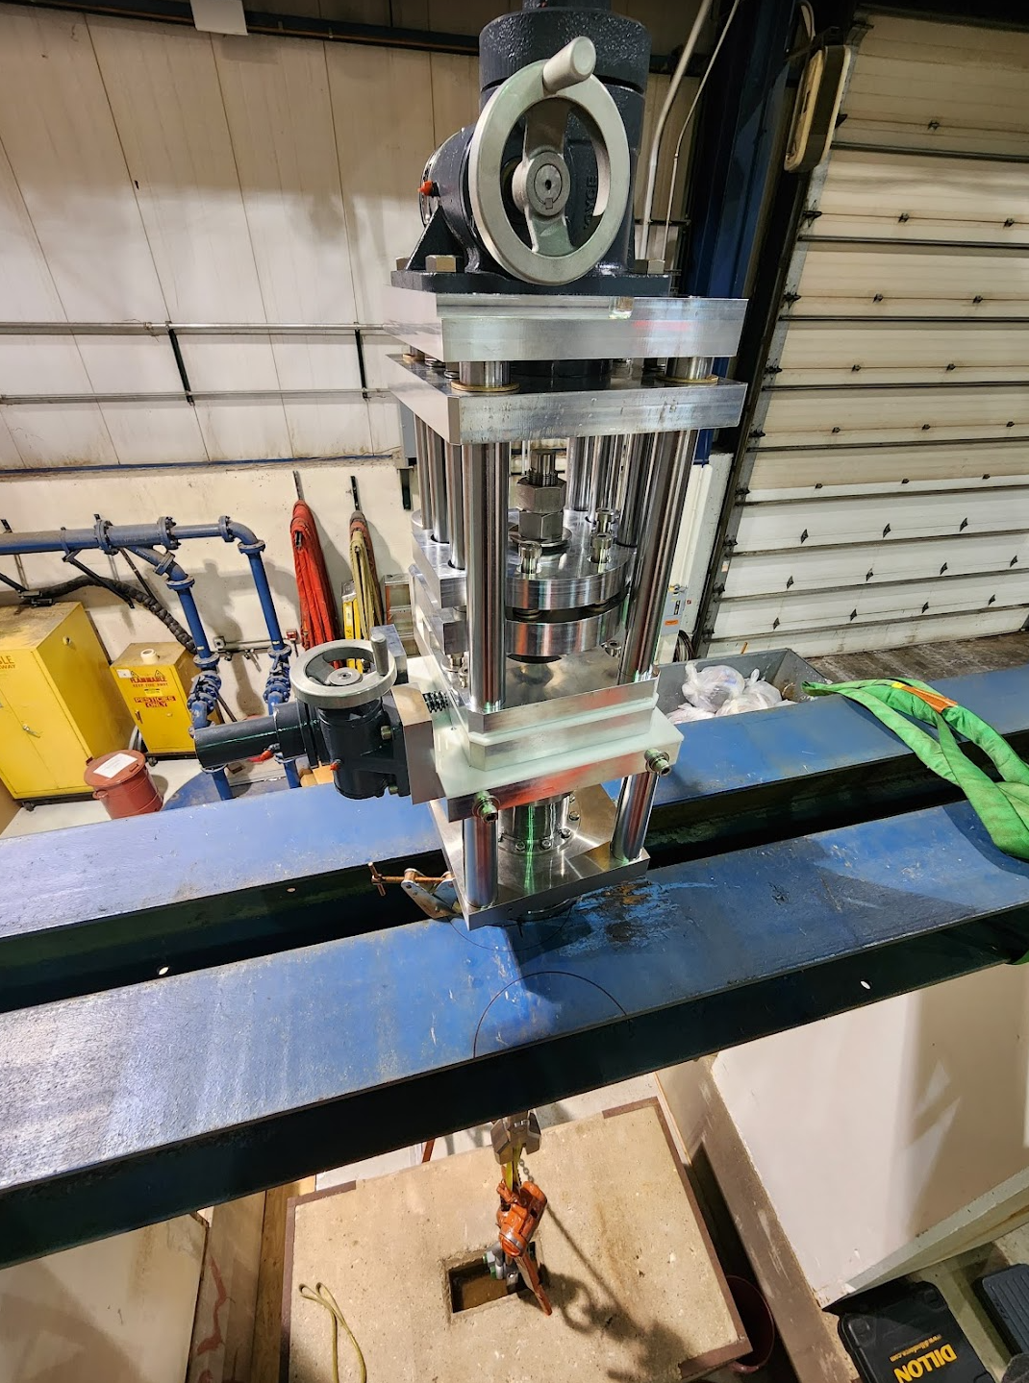
Planning
New Home
Couple TPC to the Top Cap
Provide X-Y-Z manipulation for minor adjustments.
Worm gear ratio = 24:1
Vertical:
Y manipulation
Lateral:
X manipulation
Longitudinal:
Z manipulation

Slide 30
Summary
Walking through the draft work plan with the whole crew, a week before the move, helped us fill the gaps in our process
Walking through the final work plan with the whole crew, 2 days before the move, helped everyone understand what their roles were.
Trials and load tests boosted our confidence significantly
Our skillset, experience and teamwork helped us improvise in tricky situations.
Involving other departments such as ES&H, ISD (erstwhile FESS), Security department, Dispatch, Transport panel and Lifting panel, ahead of time helped us smoothen the process.
Processes like Failure Mode & Effect Analysis (FMEA – SBN DocDB 28590) & Prevention through Design (PtD – SBN DocDB 28612) helped us mitigate risks.
Effective and transparent communication with all the stakeholders was a huge plus
Planning and visualizing as many steps as possible makes it extremely easy to troubleshoot unforeseen situations.

Slide 31
Thank you!
Detector Move Timelapse Video

Slide 32
Appendix

Slide 33
Route Trials
Center of Gravity (C.G.): ‘atf’
Front
Back
C.G.
9’4”
10’4”
‘atf’ + detector | 65,000 lbs. | Ground to Bed | 3’6” | Bed to C.G. | 9’4”

Slide 34
Planning and Logistics
Secure Points and Legs
Secure Points to strap/chain
Legs
Trailer

Slide 35
Route Trials
DAQ: Accelerometer and Inclinometer – Trial 2A
Inclinometer: Top Center
Accelerometer: Top Center
Inclinometer: Back Right
Inclinometer: Front Left

Slide 36
Route - Picking a route
Inclinometer Data:
Critical angle
Critical angle
Trail 2B – Ring Road Route
Trail 2A – Discovery Road Route

Slide 37
Route – Picking a Route
Accelerometer Data: Shocks along the width of the trailer
Trail 2B – Ring Road Route
Trail 2A – Discovery Road Route

Slide 38
Route - Picking a Route
Accelerometer Data: Shocks along the length of the trailer
Trail 2B – Ring Road Route
Trail 2A – Discovery Road Route

Slide 39
Route - Picking a Route
Accelerometer Data: Vertical shocks
Trail 2B – Ring Road Route
Trail 2A – Discovery Road Route

