Slide 1
Muon Department Meeting ESH March 6, 2023
Lisa Reger and Katie Swanson

Slide 2
Topics
Training
Reminders and updates
FESHM updates
Fermilab Today
Weekly Event Review Summaries
Safety Flash
Injuries and Illnesses in December and January
Work planning and control reminders
MMR review process
3/6/2023
Lisa Reger & Katie Swanson | Muon Department Meeting

Slide 3
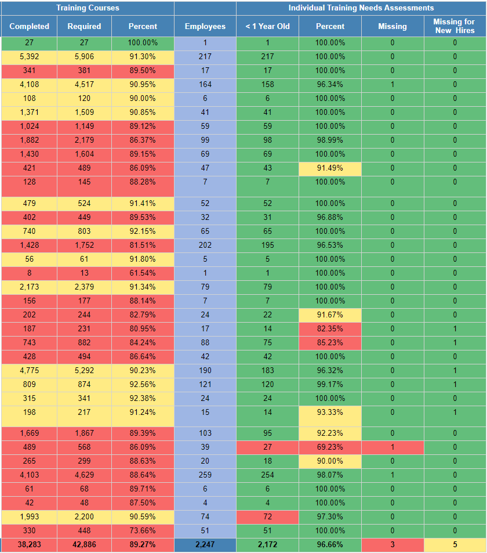
ESH Training and ITNA Status for employees – as of 03/01/2023
Last month:
3/6/2023
Lisa Reger & Katie Swanson | Muon Department Meeting

Slide 4
Training Reminders and Updates
ITNA
Must be completed for new employees
Reviewed/Revised on an annual basis or when job assignments or hazards change
New Training
Fermilab Emergency Preparedness Awareness Training
Available beginning March 1st
Required annually
3/6/2023
Lisa Reger & Katie Swanson | Muon Department Meeting

Slide 5
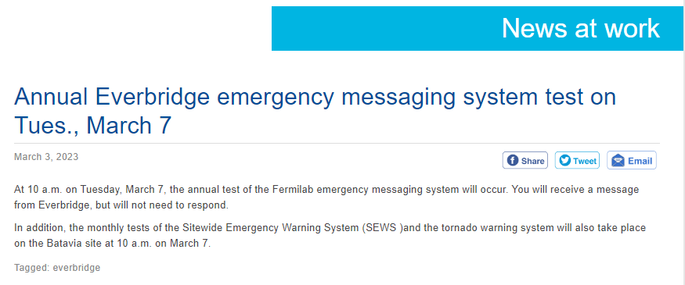
Everbridge Emergency System, SEWS, Tornado Warning Testing
3/6/2023
Lisa Reger & Katie Swanson | Muon Department Meeting

Slide 6
FESHM Updates
Chapter 7020 – ES&H Program for Subcontractor Safety Other Than Construction
Open for lab-wide comments until March 14th, 2023
Changes are:
Required ESH review of documents
Added activities to “Higher Level Hazard” category
Aligned requirements in Section 4 to new terminology and program expectations
Removed Service Coordinator, Service Manager and Point of Contact, replaced with Subcontractor Coordinator
Link to the draft chapter here
Chapter comments required to be entered here
3/6/2023
Lisa Reger & Katie Swanson | Muon Department Meeting

Slide 7
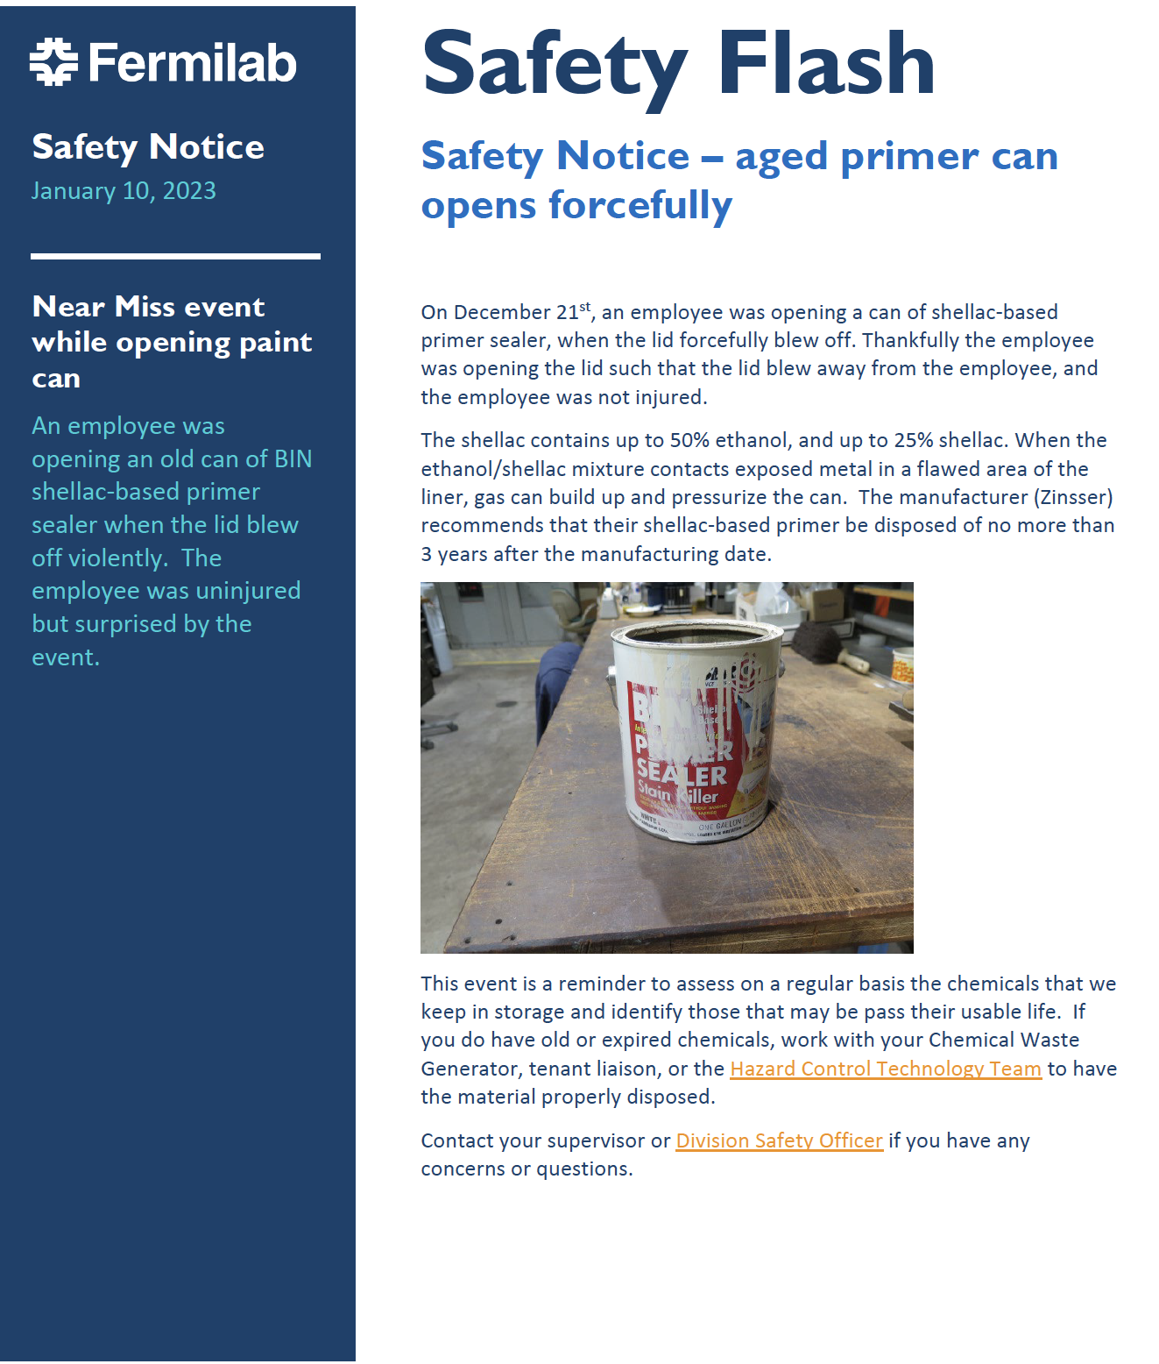

Slide 8
Safety Flash – Aged Can of Primer Opens Forcefully
On December 21, 2022, an employee was opening a can of shellac-based primer sealer, when the lid forcefully blew off. The employee was opening the lid such that the lid blew away from the employee, and the employee was not injured.
The shellac contains up to 50% ethanol and up to 25% shellac. When the ethanol/shellac mixture contacts exposed metal in a flawed area of the liner, gas can build up and pressurize the can.
The manufacturer (Zinsser) recommends that their shellac-based primer be disposed of no more than 3 years after the manufacturing date.
This event is a reminder to assess on a regular basis the chemicals that we keep in storage and identify those that may be pass their usable life. If you do have old or expired chemicals, work with your Chemical Waste Generator, tenant liaison, or the Hazard Control Technology Team to have the material properly disposed.
Contact your supervisor or Division Safety Officer if you have any concerns or questions.
See https://esh-docdb.fnal.gov/cgi-bin/sso/RetrieveFile?docid=7010&filename=2023-01

Slide 9
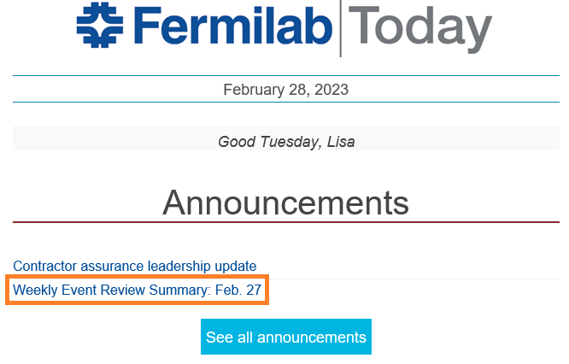
Weekly Event Review Summaries
Posted weekly in Fermilab Today
February 27th
February 20th

Slide 10
Injuries/Illnesses in December
December 2nd – DART, APS-TD
The technician was assisting in unloading a magnet from a flatbed trailer at IB2. They were attempting to loosen a very tight tie down ratchet strap utilizing their body weight to push the ratchet bar down. While doing this the bar spun in the placement hole causing their body to shift forward falling toward the ground. They then put their hand down to brace themselves, but first made contact with the left ring finger forcefully impacting the ground. After this happened, they had pain in the left ring finger, and it appeared abnormal. The individual was transported to medical by a supervisor where they were treated and then sent out for x-ray. Diagnosed with torn tendon in finger. This is a DART case due to restrictions.
December 16th – First Aid, AD
The employee was walking to the E4R entrance door. They were carrying a tool bag in their left hand and an electrical testing meter in their right hand. When they stepped on the concrete pad in front of the door, their right food slipped on ice that had formed at the edges of the pad, causing them to fall forward and land on the concrete pad. The employee landed such that the right side of their body (rib cage) came down on the meter. The employee got up from the pad and their supervisor, who was in the area with them, drove the employee to the Medical Office. The employee received first aid treatment and was returned to work with limitations which did not prevent them from performing their routine job functions.
December 16th – First Aid, ISD
Employee was tasked with picking up a pallet from CUB. Upon arrival the items were not palletized for immediate pick up and the employee walked up the ramp to the loading dock to assist with palletizing the shipment. When walking down the ramp to get to the forklift their right leg went out from under them after stepping off the ramp and on the pavement. The employee fell back and their left leg stayed planted - extending their left knee.

Slide 11
Injuries/Illnesses in January
January 11th – Report Only, Sec
For approximately 4 weeks the employee is having headaches, sinus pressure, sore throat, ear pressure and dizziness while being in her office. She generally associates this with a mold allergy. She is in her office 1-2 times a week. The DSO met with the employee today to review her work area and is asking IH to check the area. The employee is looking to have an air purifier put in her office.
January 19th – First Aid, Comm
Employee was getting up from a table when he tripped over a protruding desk leg. As he fell, he turned over a chair and hit the chair with the right side of his torso. Employee reported to FOMO on 1/19/2023 with contusion and pain. First aid given.
January 30th – First Aid, ESH
Employee developed blurred vision and slight pain in right arm while working at desk. Once vision returned to normal employee reported to the Fermilab Fire Department. Employee was evaluated by the Fermilab Fire Department and the Batavia Fire Department. Employee then went to Delnor Hospital with a family member. FOMO will follow up with the employee.

Slide 12
FESHM 2060 - SHAPE - Work Planning & Control Process
Evaluate
Authorize
Work
Scope of Work
Perform
Work
Hazards &
Controls
Evaluate
Post Job Debrief
Scope of Work
Identify Scope of Work
Lessons Learned
Update Work Plan and HA
WPC
Work Safely!
What
Where
Who
When
How
Why
Perform Work
Work within Controls
Hazards & Controls
Stop and reevaluate if conditions change
Clean up
Release work
Identify Hazards and Controls
Authorize Work
Engineered Controls
RWP, LOTO, etc.
SOP, HAs, Permits
Checklists, Travelers
Training
PPE
Gain approval to work
Approving Supervisor
Work Planner
Point of Contact
Workers

Slide 13
Work Planning Reminders
Ensure everyone understands the scope of the job. Best way is to complete a job walkdown, include persons involved with the job, then create the plan.
Conduct a pre-job briefing. Communication is key, allow clarification of the steps of the job, PPE, etc.
Perform the job within that scope and plan. If the scope changes and affects the work plan or hazards, stop and re-evaluate. Update the plan as necessary.
Evaluate the work conducted, any global lessons learned that others may benefit from? Your group may benefit from? Communicate it.

Slide 14
Updating the Work Plan
The work plan must be updated when:
The scope changes
New hazards are identified
Mitigations identified are found to be ineffective or inadequate
The work planner must review the changes and authorize before continuing. SMEs may be needed to review as well, depending upon the new hazards or control measures.
Updated work plan should be communicated to workers and affected individuals.

Slide 15
New MMR Review Process
All MMRs require an RSO review
Verify impacted designations
If clarification is needed, RSOs will contact the MMR requestor
RSO email
ESH_RSO@fnal.gov

Slide 16
Questions?
Katie Swanson, Division Safety Officer
kswanson@fnal.gov
Lisa Reger, Division Safety Specialist
reger@fnal.gov
Lisa Reger & Katie Swanson | Muon Department Meeting

