Slide 1
DUNE FDR: FD2 Photon Detector System
W Pellico (PD Team)
Power over Fiber
18-4-2023

Slide 2
PoF Outline
PoF Team
W. Pellico
A Feld
W. Shi
J Werthen
D Totani
F Cavanna
J Wu
MH Yang
S Sacerdoti
D Martinez
R Rivera
H Souza
K Bora
L Minjoo
D Silverio
J Rodriguez
A. Heindel
Overview (1-2 slides)
Progress over the past three years
Our final operation parameters
Technology Components Highlights
Lasers (1 Slide)
Fiber (1 Slide)
Photovoltaics (1 Slide)
Complete System Layout (2 slides)
From PoF housing to Cathode Electronics
Control and Operations
Safety (1 Slide)
Testing
Operations
Conclusion (1 Slide)
W. Pellico PoF: DUNE FDR: FD2 Photon Detector System

Slide 3
PoF R&D Roadmap (previous review – now)
Cold box Proof of Principle PoF Demo
Resolve Issues from CB1
Final Design Delivery with Installation Plan
Ramp up PoF Large Scale Layout and Tests
Si based PoF Initiation – Prototyping
Plan for FY22 CB
PoF Tests/
Certified
2021
Si 977 nm system
Tested in First CB tests
Successful but not FD
Today-ish
Sign off on Safety
Final Layout
Electrical Review
2022
Improved GaAs
Light leakage
2018
Proposed
Concept
2019
Si Based Testing
977 nm 3 W system
Commercial System
Worked but ……
Noisy
Low Efficiency
2023
Improved GaAs
Met noise Req.
Power optimized
2022
GaAS 808 nm system
Improved efficiency
Reduced hardware test

Slide 4
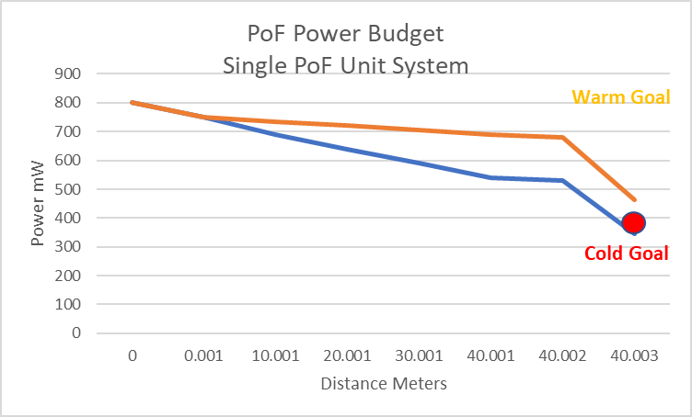
PoF Operating Guidelines
PoF System
COLD SIDE POWER NOTES
Designed to above required/unit for 30-year viability
To have redundancy the system is designed to be capable of >2x/unit
Noise – < 1 PD per 10us
Safety – meets DUNE/FNAL ES&H
Contamination - mostly previously used
WARM SIDE POWER NOTES
Safety – Class 4 to Class 1 conversion
Capability – Cold plus system loss budget
Cost – OTS products as much as possible
Viability – Designed to be repairable
Laser Power | OPC (Optimum) | Fiber
2 W/unit Max | 400 - 700 mW | 6 W
800 mW Op Pt | 600 mW Op Pt | 600-800 mW
Plan
To test warm, it will be necessary to have both OPCs on.
The final cold operating point will be either one unit at ~800 mW or
Two units at 400 mW. Neither will stress the system -

Slide 5
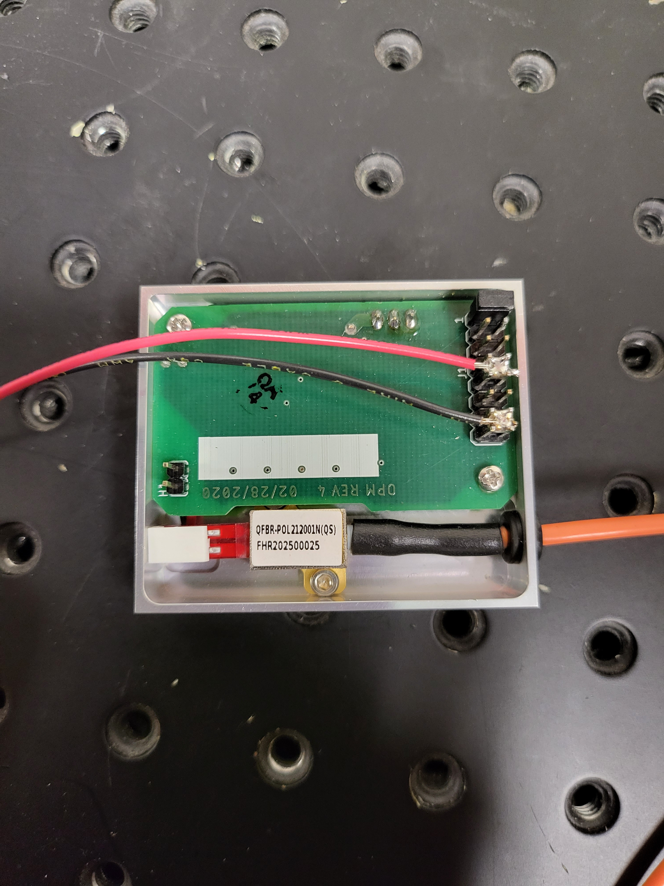
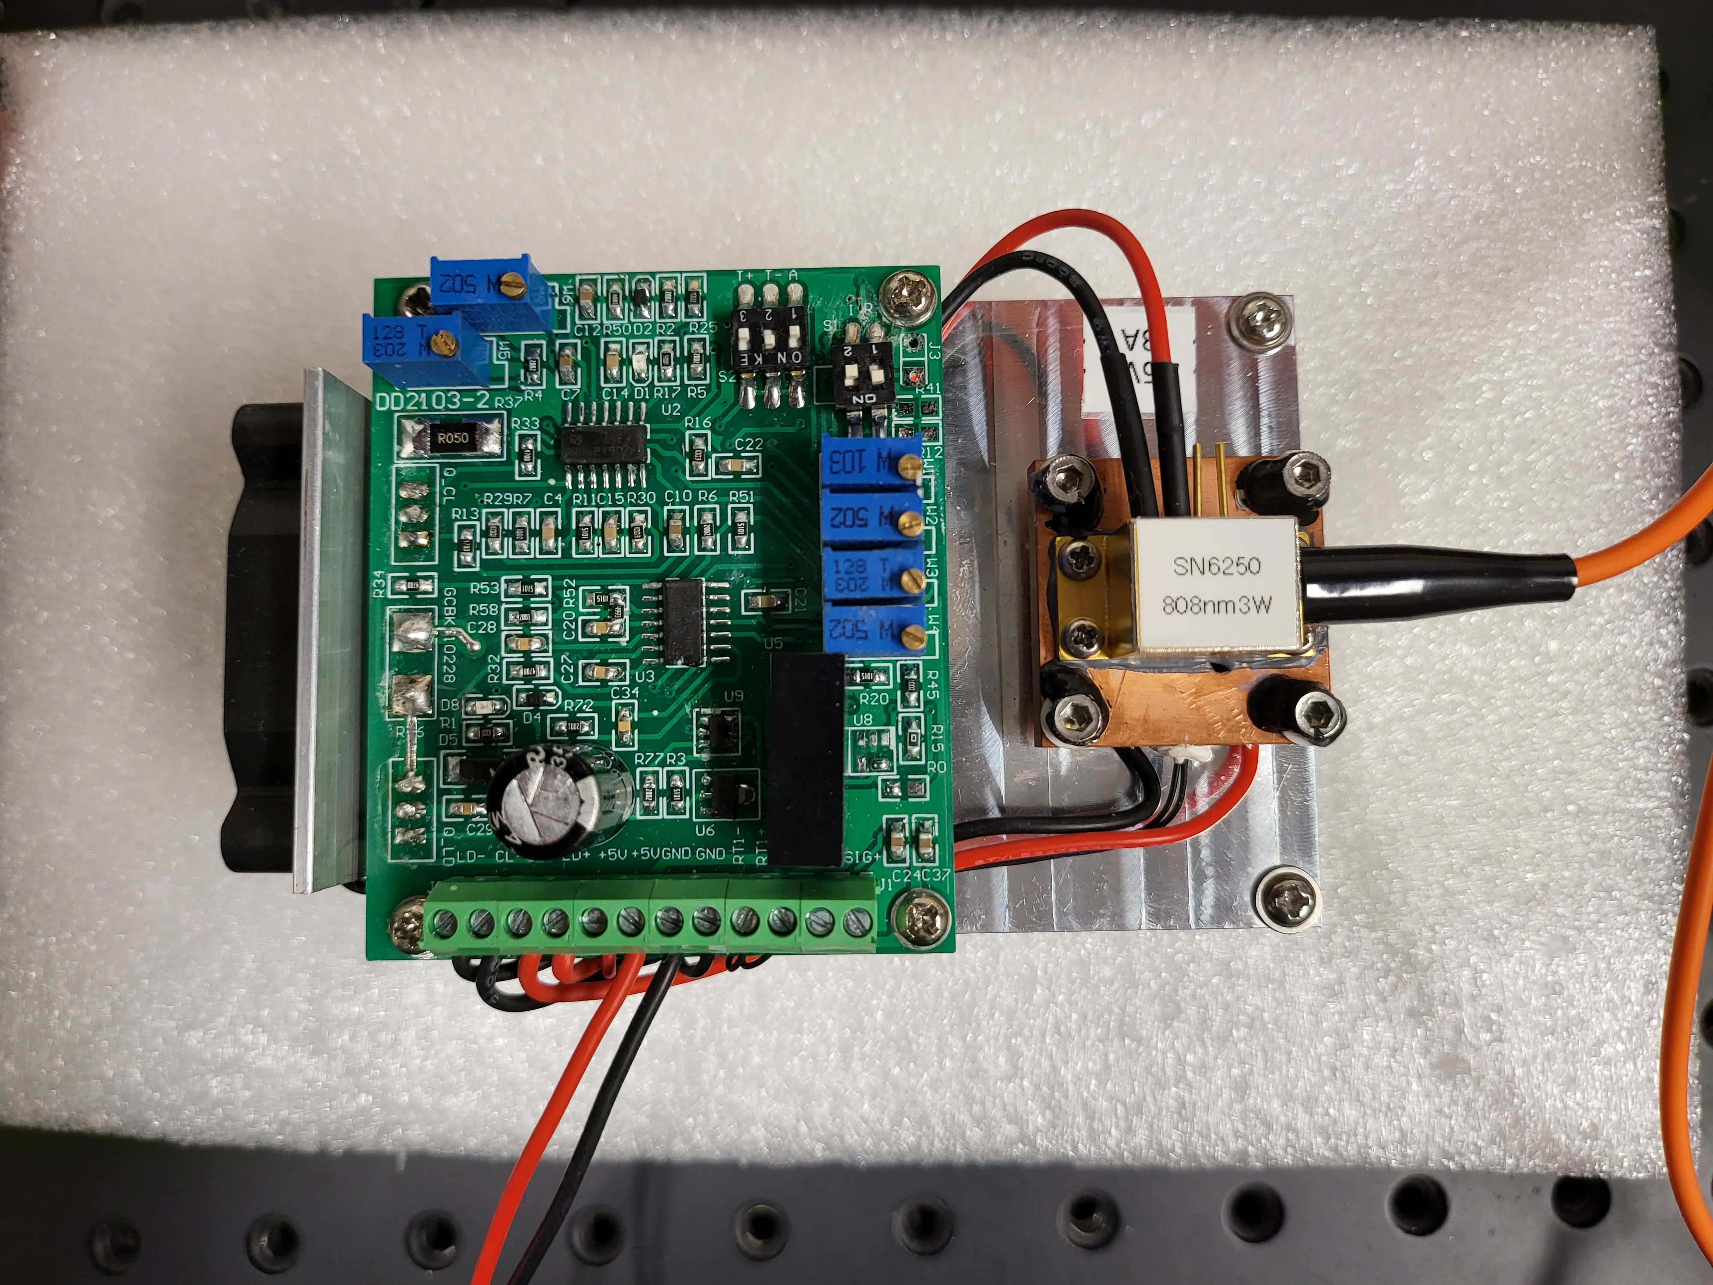
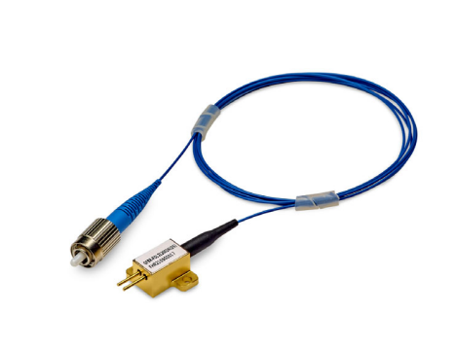
Lasers
We have tested several 808 nm cw lasers.
Power: Wanted a laser capable of 2x operating point
Stability: Better than 10% power flatness
Cost: Commercial unit with limited features required
Lifetime: >10-year lifetime at full power
The AFBR-POL2120 is equipped with a pigtail fiber and an FC/PC optical connector. It consists of a laser chip, operating at 808 nm wavelength at a case temperature of 25°C. The hermetically sealed package protects the laser chip.

Slide 6
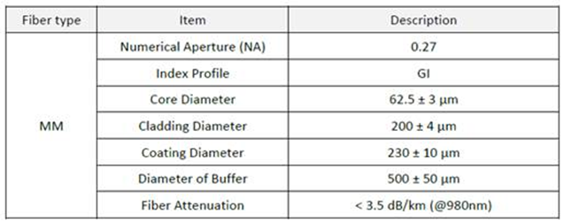
Fiber
We tested about 10 fibers
Light Leakage: Several parameters play a role
Power handling: Not a concern at our level but we started higher
Efficiency: PoF choices all had similar efficiency numbers @ 808
Cryogenic Compatibility: Jacket was only concern – not the fiber
Durability: Jacket was only concern – not the fiber
Cost: Most of our fiber choices were not significant costs
Why is this fiber unique?
It has a large 200 um cladding – helps contain light leakage
It has a double jacket – 500 um and 1.5 mm – again for better light containment.
The fiber could be improved – but not under the pressures of the project. A significant improvement in fiber efficiency could be found in changing the coating to a ‘softer’ material – like silicon. I believe that would improve delivery efficiency 25% to 30%.

Slide 7
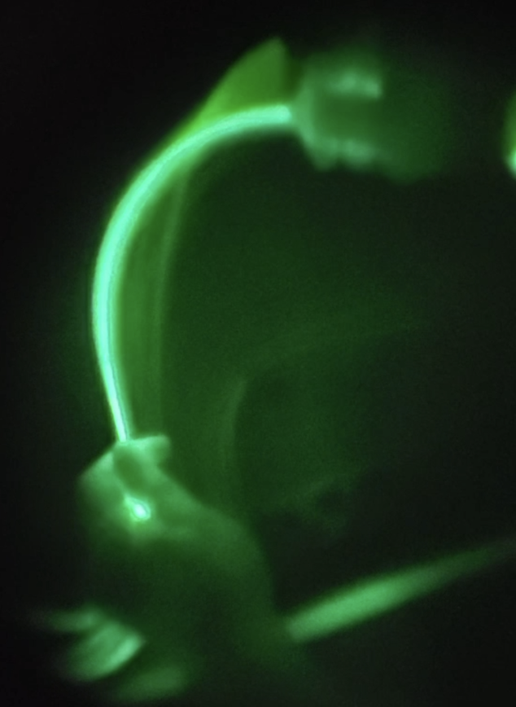
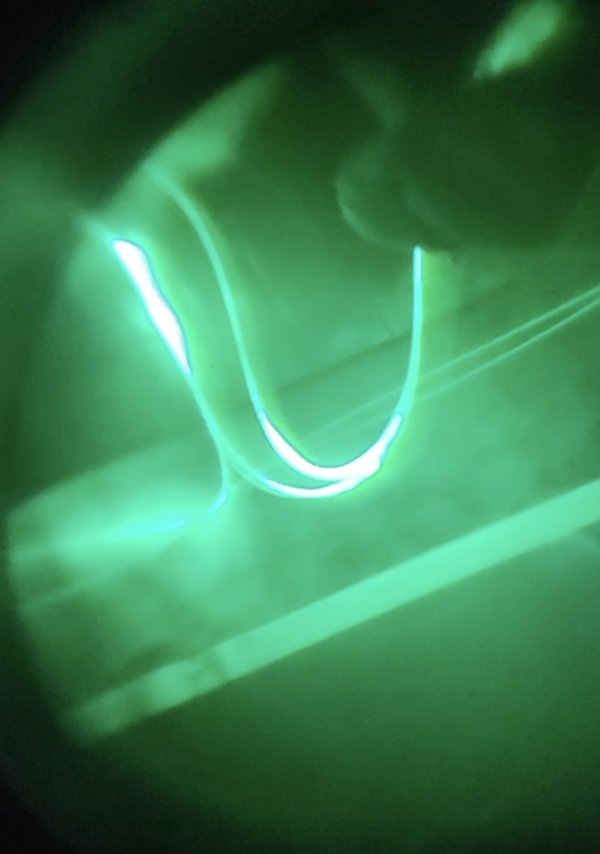
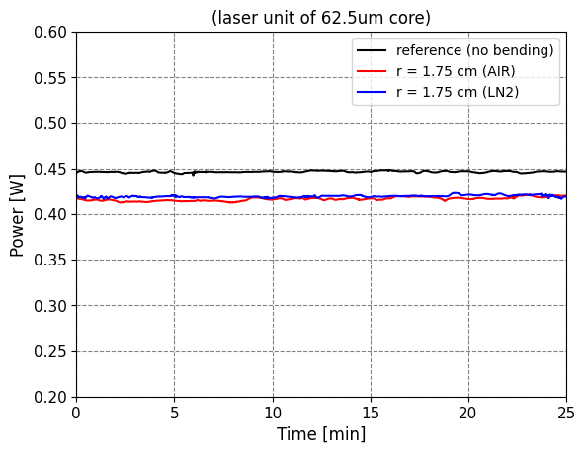
Fiber Tests Examples
Fibers underwent a number of tests:
Bending stress testing
Light leakage
Thermal Cycling
Loss measurements
Comparing results to literature, with vendors, NASA and other experts.
No surprises were found – but optimization was required. More could be done to improve performance – less loss or if desired to carry more power in the future.
Bend Test – Pwr

Slide 8
Optical Photovoltaic Converter - OPC
We examined both Si and GaAs
Si – 977nm based system
Si is cheaper for standard warm operations more W/$
Si was our proof of principle test in 2020
GaAs – 808nm based system
Higher efficiency at cryo temps
R&D is rapidly expanding due to space-based systems
Improved rad hardness
Higher cost – but improving due to demand
We went two routes – needed to improve from off the shelf
UIUC – Researching improved efficiency through semiconductor
Broadcom – Improved efficiency through packaging
Focal length, Material Size/Power Handling
Wrote a paper on the improvements – good press for Broadcom

Slide 9
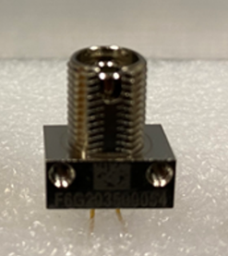
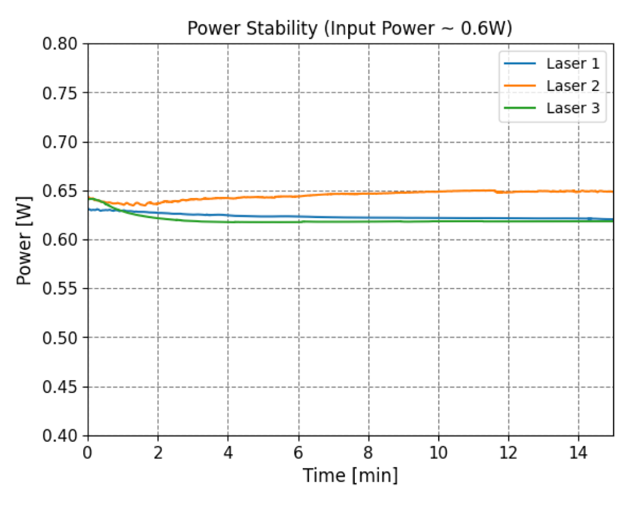
GaAs Achieved power needs, regulation and relibility
During the development of the GaAs cryo use – additional R&D was/is desired.
A contract with University of Illinois school of engineering was started
GaAs potential at cryo temps was not fully investigated
Carrier freeze out was evident
Tunnel junctions at cold temp became more resistive
Build units that meet VD PD specification
Extreme low temp ops with efficiencies of room temp devices
No contaminants
Use of approved material – namely epoxies/sealants
In the end a partnership between FNAL, Broadcom, UIUC and GoPower
The final version (V4) has undergone several noteworthy
improvements to achieve the higher efficiency at cryo
Temps and to reduce impact of cryo on optics.
The work will continue outside of the VD project to test
new ideas – 1500 nm, Rs reduction etc…..

Slide 10
DUNE/PD has helped push the technology
We have worked with our industrial partner to set new limits!
We have both industrial and university partners in this effort.

Slide 11
PoF Rack - Safety
Meetings with lab laser safety and project safety has continued to ensure we meet all ES&H requirements.
This work has been progressing with the development of smaller systems for the past three years. Several documents describing the system and deployment have been written with final documents expected to be completed over the next couple of months. We are starting with the prototype PoF housing unit – then will provide to our VD partners.
PoF Laser Housing Unit
Version 2.b 4/01/2023
The description provided in this document is for a prototype 8 laser system design. The housing unit has undergone several iterations to better meet VD rack layout, fiber routing and laser safety guidance. The design is done to ensure safe reliable extended operation.
The design is based upon 8 lasers per housing unit with two housing units per power over fiber (PoF) rack. The laser housing units consists of the following key components:
Safety Documentation Underway

Slide 12
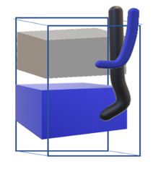
Final Rack Layout and Controls
The optimization of the Laser housing and controls is in progress with a module being assembled and expected to be tested in May.
The work will move to Stony Brook and SDSM this summer for full testing and training.

Slide 13
Conclusion
PoF has been proven to deliver clean power at required levels to an isolated cryogenic electronic system. Work moved form concept, to an optimization stage, to deployment in serval short years.
The work ahead will focus on documentation, production and deployment testing.
Would like to think about PoF for future uses – this effort has significant LAB/DOE support and industrial partnerships.

Slide 14
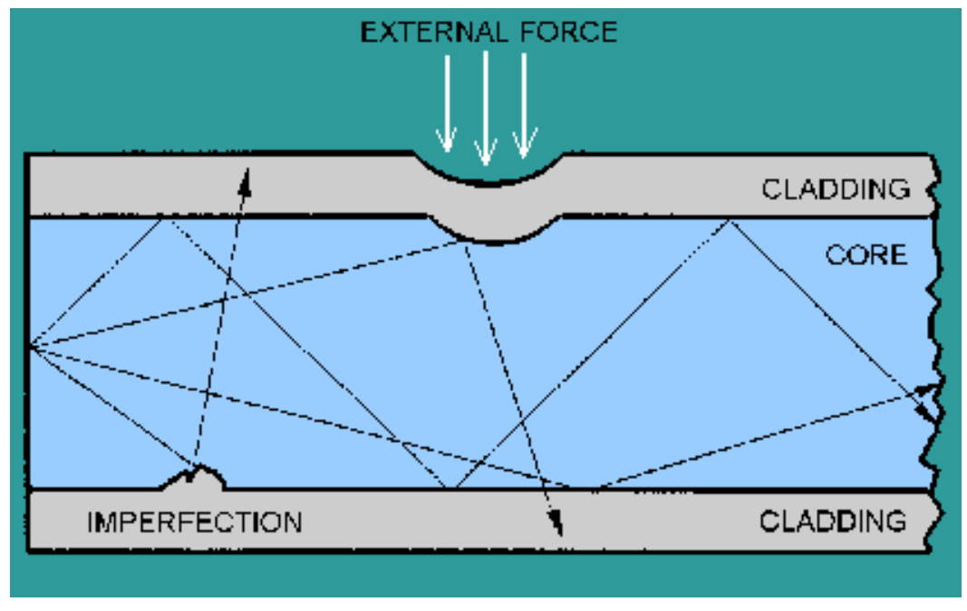
Extra Slides
Cold Temp Fiber Paper:
Analysis of optical fiber performance at extreme temperature in low earth orbit
. OptikVolume 250, Part 2, January 2022, 168344
The loss of optical fiber at low temperature is mainly caused by micro bending loss. It is a kind of bending loss, which can be divided into micro bending loss and macro bending loss.
……at low temperature, the temperature coefficients of the coating layer of the fiber are inconsistent with those of the fiber core and the fiber cladding, which are different due to deformation, resulting in micro bending loss.
W. Pellico PoF: DUNE FDR: FD2 Photon Detector System

Slide 15
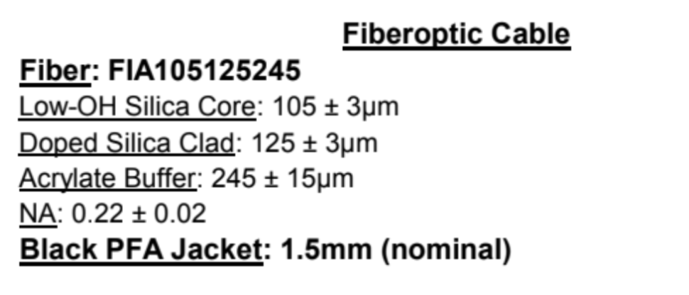
We are considering a backup optical fiber from Molex company that meets our VD SoF and PoF requirements.

Slide 16
Optical Fiber: Thermal Stress
We have performed a thermal cycling stress test, submerging and extracting the fibers and PTFE tube sample from the LN2.
We inserted eight optical fibers into a tube and bent it into a circle with a diameter of 9cm
The cycling submerges the material for 9 min, takes 1 min raise up, waits 9 min in air and then takes 1 min to lower back into the LN2 (~129 cycles).

Slide 17
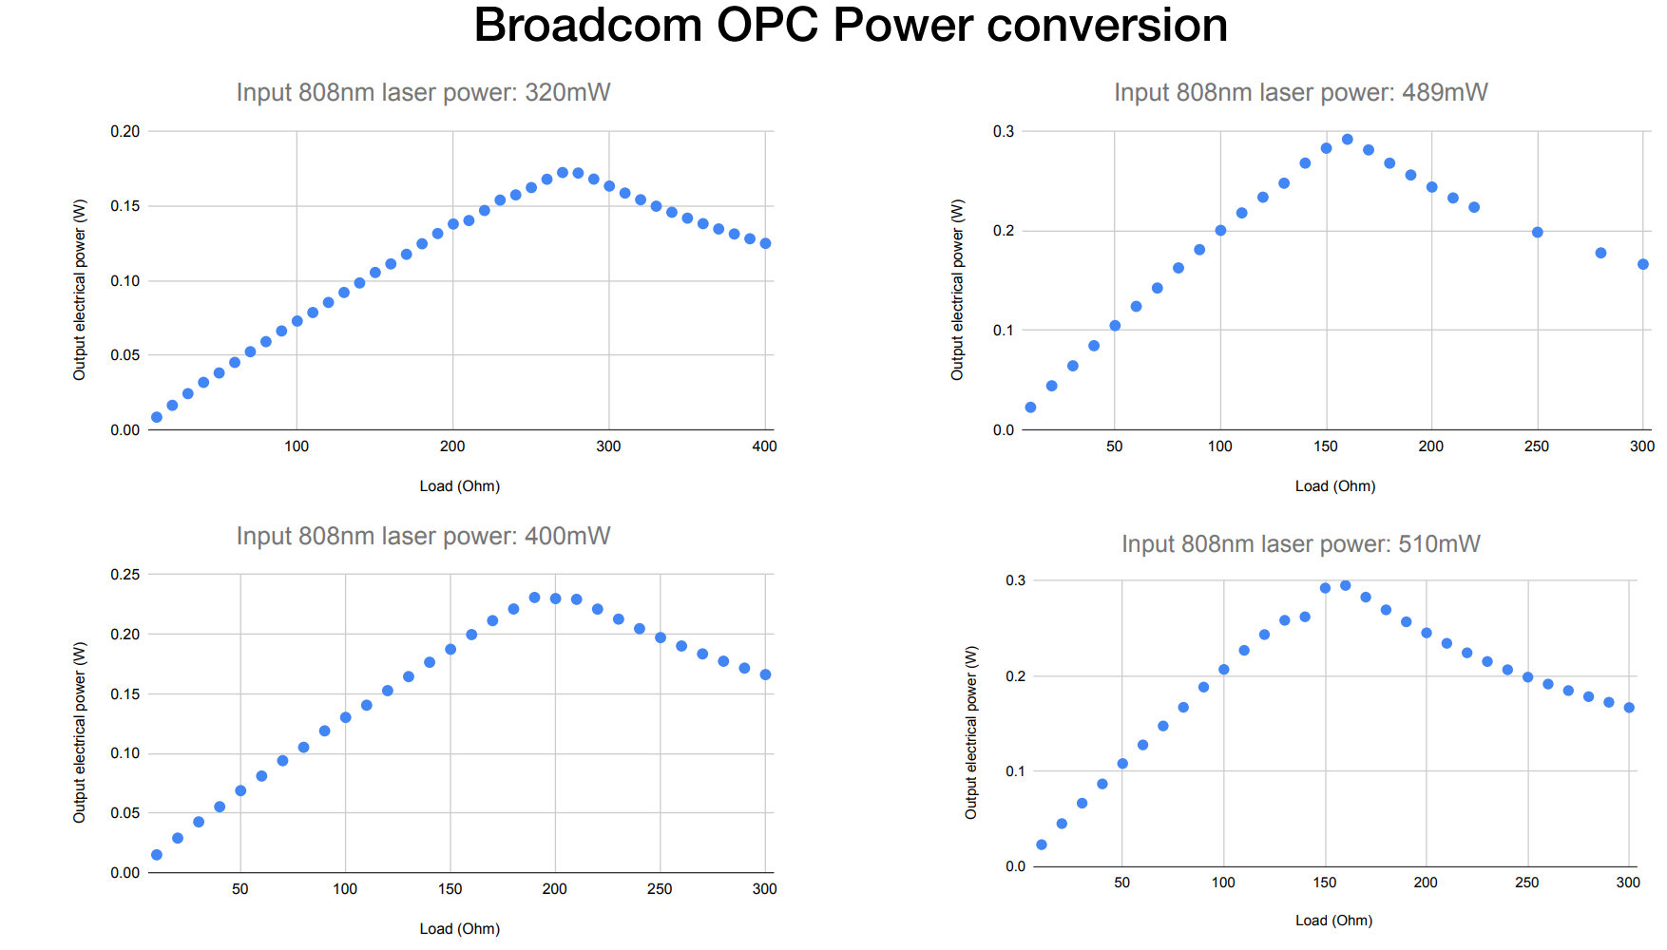
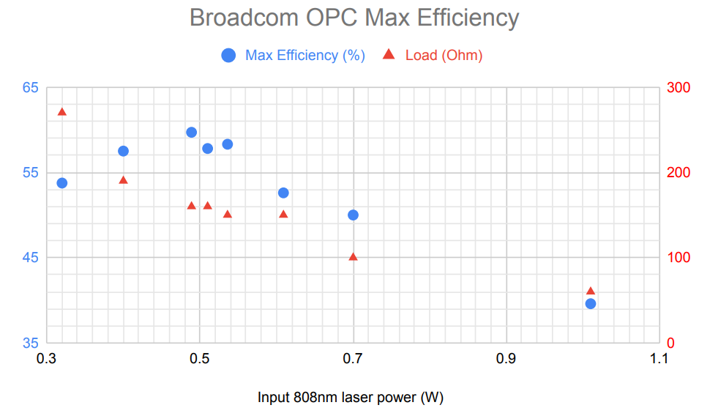
Full set of tests for each OPC unit Power, Efficiency, Leakage (I-V curves across loads)
We have been putting together a testing and assembly standards.
Each laser, fiber and OPC will have a traveler that provides information on assembly and test performance.

Slide 18
Vendor updated unit tests – V4 OPC
Newer OPCs have are slightly larger and matched cryo optics
Higher current and power capability -
W. Pellico PoF: DUNE FDR: FD2 Photon Detector System

Slide 19
Backup –Reliability Examples (More from JPL)
I was recently told by Siemens, one of the first to deploy PoF in the late 90’s that an HVDC installation between Australia and Tasmania has been running non-stop without any component failure, incl OPC, laser and fiber, for more than 23 years. Likewise, even earlier installations by ABB in the north of Sweden have been, and still are, running non-stop since 1997. In fact, at one point I was there to replace all lasers which had been sourced from ……. The problem was that on very cold nights (-35C), the current sensing system had stopped working. It turned out that using 850nm lasers with OPCs optimized for 808nm meant that at the cold temperatures for the OPCs, they no longer responded to 850nm light. At least not as long as the lasers were comfortably located inside a control room at room temperature….; after switching all the lasers to 808nm, the problem disappeared. Little did I know back then that fast-forward 25 years, we’d be pushing the OPC to longer wavelengths for ostensibly the same reason albeit lowering the operating temperature by another 150 K.
Best regards
Jan
Chief Photonics Scientist, Broadcom
We did conduct some reliability tests over the 62.5um black fiber in the past. The fibers are installed in an outdoor high voltage (22.4kV) environment, one end was secured on the high voltage busbar and the other end on the ground. In this test setup, the fibers were exposed to high voltage, high humidity (with rain falls), and UV from the sun. Over 3 years of testing, we did not see any problem with the fibers.
Regards,
John Wu
VP, System Engineering Dept.

Slide 20
Hello Bill, Ryan (NREL), Nikos (NREL),
+also added Denis from the Broadcom team for the technical discussion.
As part of our standard product qualifications, we’ve done many tens of thousands of device*hours of each of high-temperature-operating-life (HTOL), low-temperature storage (LTS), high-temperature storage (HTS), and temperature cycling (TMCL), as well as other reliability tests that are probably less relevant in this case, such as temperature humidity bias (THB), mechanical shock (MS), mechanical vibration (MV), etc.
The good news is that for our laser power converters, I do not recall seeing any real signs of degradation from these tests, i.e. within the uncertainty of the measurements, the performance after is not really distinguishable from the performance before or from a group of devices without any aging.
Now of course, the conditions for the lower temperatures for the LTS and the TMCL is only ~-40 ºC, but as Ryan mentioned similar III-V PV chips are also known to work well within extreme conditions in the context of space PV.
Furthermore, we expect the degradation mechanisms to be thermally activated, so the HTOL should be the best test for that (normally done at 85 ºC with the laser ON). For the cryogenic case, all such degradation mechanisms would be super slow because of the low temperatures.
As for the hot electrons as in CMOS or FET, the device design does not include such tight geometries, so we do not expect this should be a concern.
Anyway, Denis and I were thinking maybe we could try to run some devices at 1W of optical input at 77K continuously for 100 hours or something like. Presumably we would not be able to see any degradation. I do not think we can detect < than 1 part in ~500, so at best it would be sort of less than 5 years equivalent.
What do you think?
Or is NREL or FNAL readily equip for testing in cryogenic conditions for longer than that?
I do not think it is necessary to monitor during the test, just maintain the cryogenic temperature with the laser ON with a dummy load, and then we can re-test after from our side.
My son is working at the David Florida Labs of the Space Agency, they do a lot of testing like that but he tells me they do not do “long” runs in cryo conditions.

