Slide 1
Visiting Faculty Program (VFP)
Informational Webinar
Talent Acquisition, Diversity & Inclusion Department
4 August 2021

Slide 2
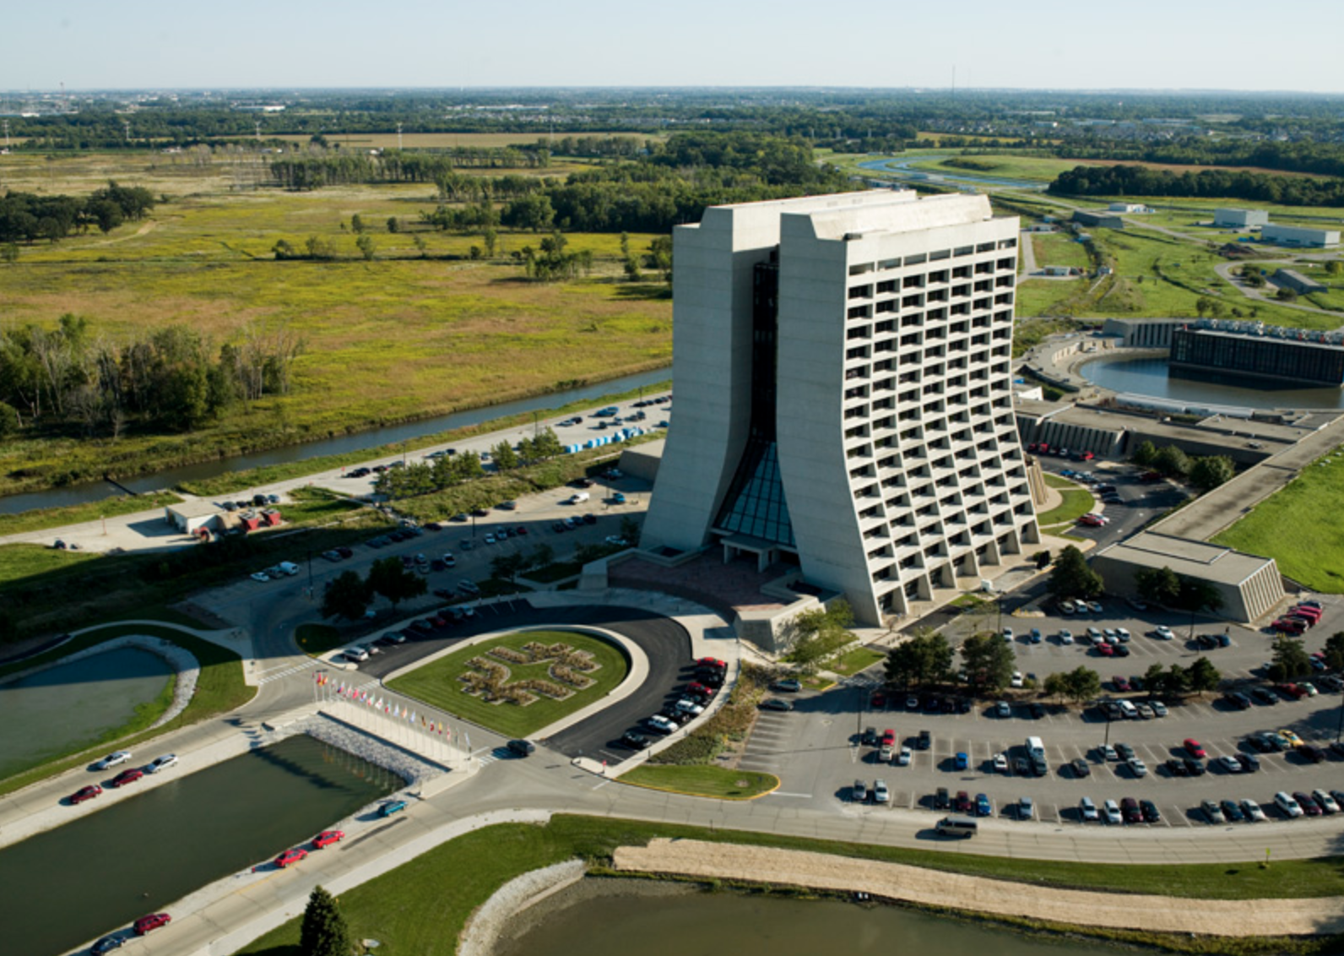
“The Visiting Faculty Program (VFP) seeks to increase the research competitiveness of faculty members and their students at institutions historically underrepresented in the research community in order to expand the workforce vital to the Department of Energy (DOE) mission areas.”
“The experience enables visiting faculty to develop skills that translate to programs at their home institutions, which in turn helps sustain the scientific vibrancy required to grow the STEM workforce pipeline in key DOE science mission areas.”
U.S. Department of Energy

Slide 3
Overview
University/college faculty collaborate with Fermilab scientists, engineers, and computing professionals on a research project of mutual interest
Faculty members have the option to invite up to two students (one of which may be a graduate student) to participate in the project
Faculty/student teams come to Fermilab for 10-weeks during the summer to work on the research project with Fermilab staff
The teams can return to Fermilab for up to 3 consecutive summers
The application process includes a research project proposal co-written by the VFP faculty/Fermilab team

Slide 4
Overview
The program is sponsored and managed by the DOE Office of Science’s Office of Workforce Development for Teachers and Scientists (WDTS) in collaboration with DOE labs
The Talent Acquisition, Diversity & Inclusion Department manages the VFP at Fermilab
The Summer 2021 VFP session included 11 Fermilab-faculty teams!

Slide 5
Benefits of the VFP
The program brings attention to all the exciting research happening at Fermilab
It’s a great way to expand our diverse recruiting network and help attract Fermilab’s future workforce
The VFP can act as a training program in areas of specialized knowledge and skills that Fermilab needs
Faculty members build collaborative relationships with DOE research scientists and become familiar with scientific user facilities
Students participate in enrichment activities, including professional development (research project report and oral presentation), laboratory tours, scientific lectures and seminars

Slide 6
Benefits of the VFP
Participating faculty members receive a 10-week stipend of $14,000
Participating undergraduate students receive a stipend of $600 per week during the internship (Participating graduate students are supported by their home academic institutions and the VFP provides no additional stipend)
Faculty and undergraduate/graduate students are reimbursed for their round-trip travel expenses to and from Fermilab
Housing is provided for faculty and undergraduate/graduate students

Slide 7
Eligibility Requirements - Faculty
Must be a United States Citizen or Lawful Permanent Resident
Must be a full-time faculty member at an accredited U.S. college, university, or community college historically underrepresented in the U.S. research community
Faculty members at a university categorized as R1 or R2 (Carnegie Classifications) are not eligible, unless the applicant is a faculty member at a Historically Black College or University (HBCU)
Must be a full-time faculty member in an area of physics, chemistry, biology (non-medical), engineering, environmental sciences, geology or geosciences, mathematics, materials sciences, or computer or computational sciences
List of ineligible institutions

Slide 8
Eligibility Requirements - Students
Must be a United States Citizen or Lawful Permanent Resident
Must be invited to participate by the applying faculty member
Must be 18 years or older at the time the program begins
Must be currently enrolled as a full-time student in an area of science, mathematics, engineering, or technology at the same university/college as the applying faculty member
Must have a cumulative Grade Point Average (GPA) of at least 3.0 on a 4.0 scale

Slide 9
Application Process
All applications to the VFP program must be completed through the online application system
Documents required for application:
Contact and Academic Information
Research Proposal
Essays
Current Curriculum Vitae (CV)
Undergraduate transcripts
Two Recommendations
The research project proposal is co-developed between the faculty and Fermilab team (project co-Principal Investigators) and submitted online
Submitted proposals are reviewed and evaluated based on three criteria (shown on next slide)

Slide 10
Application Process
“The merit review process evaluates three criteria, listed below in order of decreasing importance:
Scientific and/or technical merit of the project, including DOE mission relevancy and the influence that the results might have on the direction, progress, and thinking in relevant scientific fields of research; the likelihood of achieving valuable results; and the scientific innovation and originality indicated in the proposed research.
Appropriateness of the proposed method or approach, including the logic and feasibility of the research approaches and the soundness of the conduct of the research.
Competency of the personnel and adequacy of proposed resources, including the background, past performance, and potential of the investigator(s); and the research environment and facilities for performing the research.”

Slide 11
Timeline
Event/Task | Deadline | Deadline Type
VFP webinar for interested faculty | Late August (TBD) | Fermilab date
Fermilab/faculty teams identified | October 8th | Fermilab date
Online application opens | October 20th | DOE date*
Applications due | January 12th | DOE date*
Offer notification period begins | February 1st | DOE date*
All DOE offers and notifications complete | April 12th | DOE date*
Start of Summer 2022 VFP | June 6th | Fermilab date
*The DOE dates shown are for the Summer 2021 program session. Dates for the Summer 2022 program session are not yet available.

Slide 12
Next Steps
Currently looking to establish Fermilab/faculty teams for Summer 2022
The VFP is competitive across the entire national lab complex, there isn’t a quota per lab. We are encouraging as many proposals as possible!
Contact Kathrine Laureto (klaureto@fnal.gov)
If you are interested in participating
If you know faculty members who might be interested in participating
If you have any questions or comments about the program
VFP Sharepoint site has PowerPoint slides
For more information, visit:
Fermilab VFP webpage
Department of Energy VFP webpage

Slide 13
Thank you for your time!
Are there any questions?

