Slide 1
PIP-II Project
Luisella Lari, Ph.D. ,
In-Kind Contribution Manager
54th Annual Users Meeting
2-Aug-2021

Slide 2
Outlines
Motivation & PIP-II Project Overview
PIP-II Project Status & Recent Major Achievements
Near future goals & Summary
2-Aug-2021

Slide 3
Motivation & PIP-II Project Overview
2-Aug-2021

Slide 4

PIP-II Project Meets the P5 Report Mandate
Recommendation 13: Form a new international collaboration to design and execute a highly capable Long-Baseline Neutrino Facility (LBNF) hosted by the U.S. To proceed, a project plan and identified resources must exist to meet the minimum requirements in the text. LBNF is the highest priority large project in its timeframe.
Recommendation 14: Upgrade the Fermilab proton accelerator complex to produce higher intensity beams. R&D for the Proton Improvement Plan II (PIP-II) should proceed immediately, followed by construction, to provide proton beams of >1 MW by the time of first operation of the new long-baseline neutrino facility.
2-Aug-2021

Slide 5

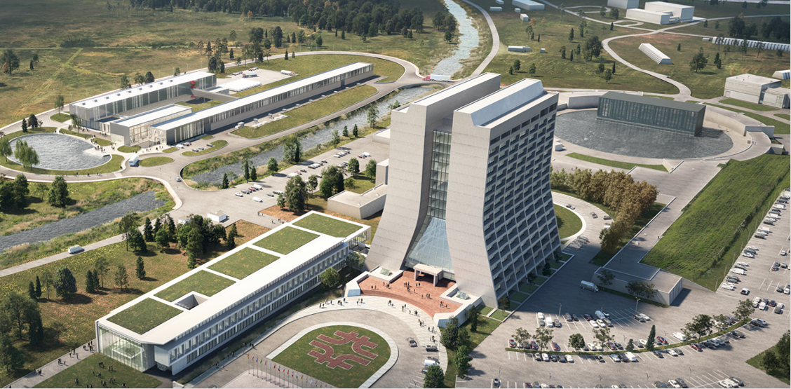
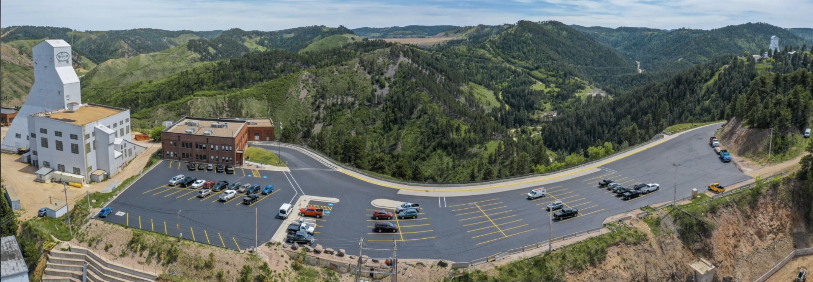
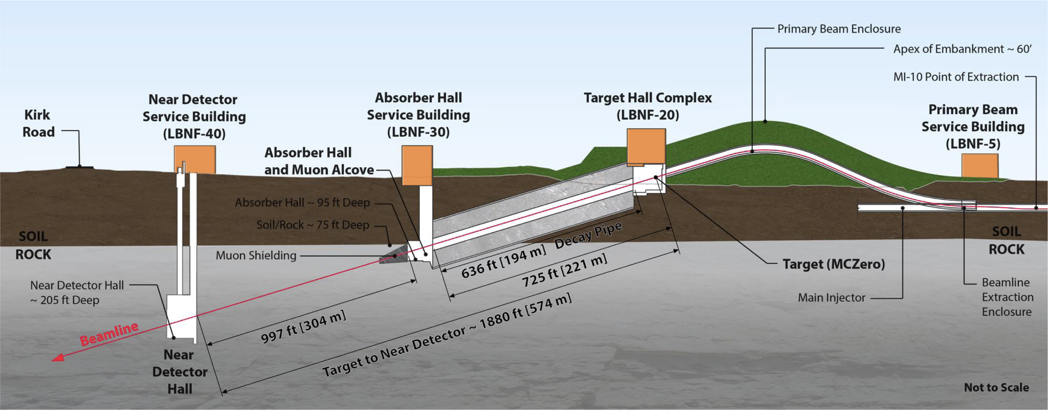
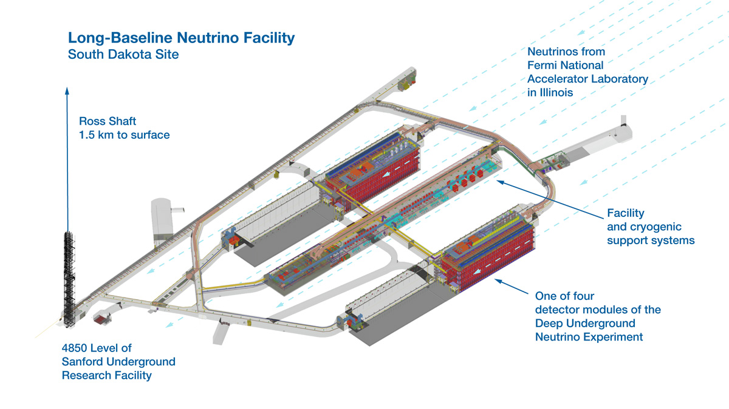

LBNF / DUNE / PIP-II
Sanford Underground Research Facility
Lead, SD
Deep Underground Neutrino Experiment (DUNE) (LAr 4 x 10 kt (fiducial mass) detectors)
Located in the Depth Underground Caverns (1.5 km) (part of the LBNF scope)
Fermilab Complex and PIP-II
Provide 1.2 MW beam power
Batavia, IL
1300 km
Target (part of LBNF scope )
and Near Detector (part of DUNE scope)
Characterize primary $ν$ beam
Batavia, IL
2-Aug-2021

Slide 6
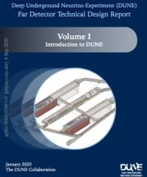
PIP-II P5 Report defines the PIP-II Mission Need Statement (MNS)
The MNS for PIP-II identifies three primary goals:
Deliver high beam power to LBNF/DUNE to achieve world-first results;
  1.2 MW proton beam power on LBNF Target;
Ensure sustained high reliability operation of the Fermilab complex;
Provide a platform for future upgrades to the accelerator complex;
DUNE Far Detector Technical Design Report, Jan 2020
Building the world’s most powerful neutrino beam cost-effectively
2-Aug-2021

Slide 7
PIP-II Path to 1.2 MW on LBNF Target
Increase the number of protons per extracted Booster pulse from 4.3x10¹² to 6.3x10¹²
Reduce Main Injector cycle from 1.33 s to 1.2 s
Increase Booster rep. rate from 15 Hz to 20 Hz
  Enable operations in energy range 60-120 GeV
PIP-II scope
New 800 MeV superconducting Linac as Booster injector
Conventional Facilities
Linac to Booster Transfer Line
Upgrades to Booster, Recycler Ring (RR), and Main Injector (MI)
Cryoplant Building
2-Aug-2021

Slide 8
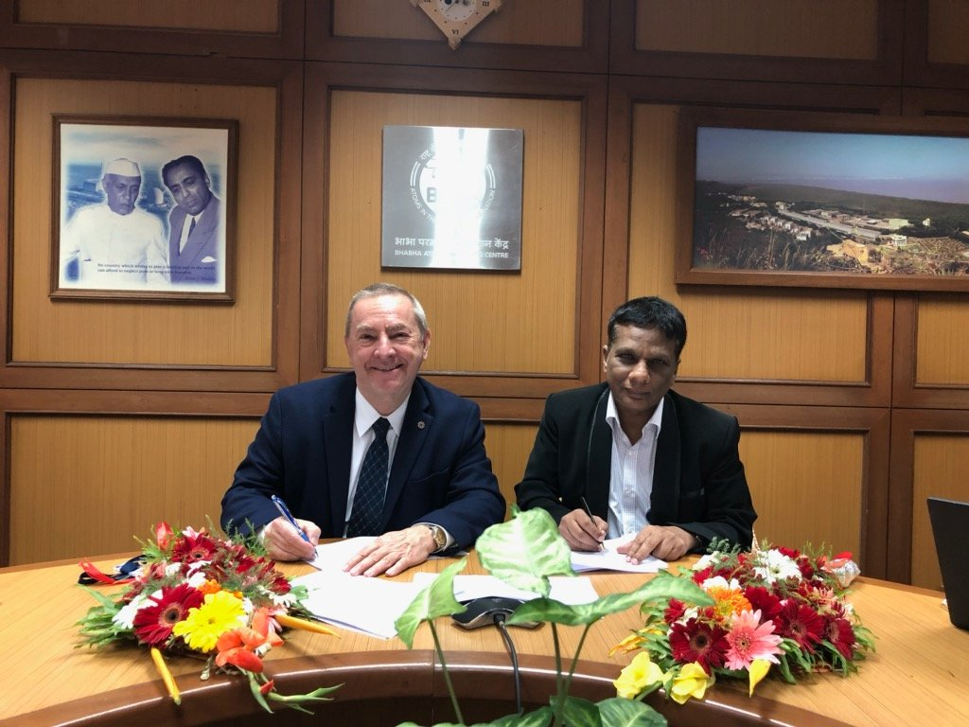

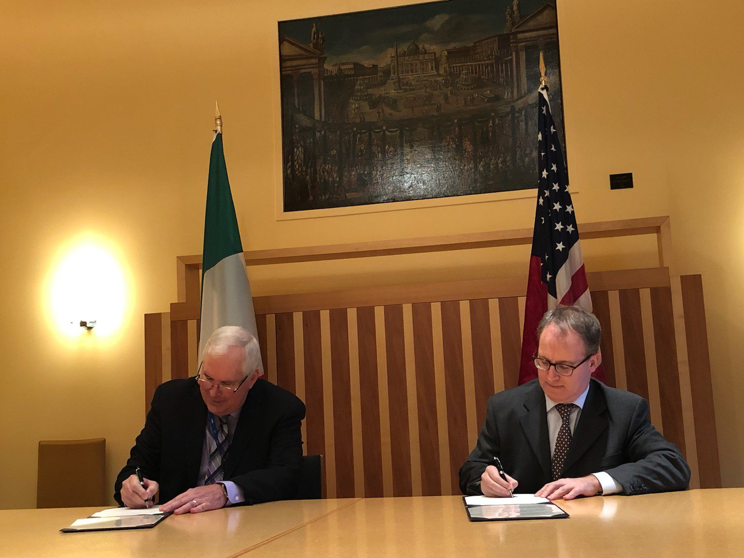


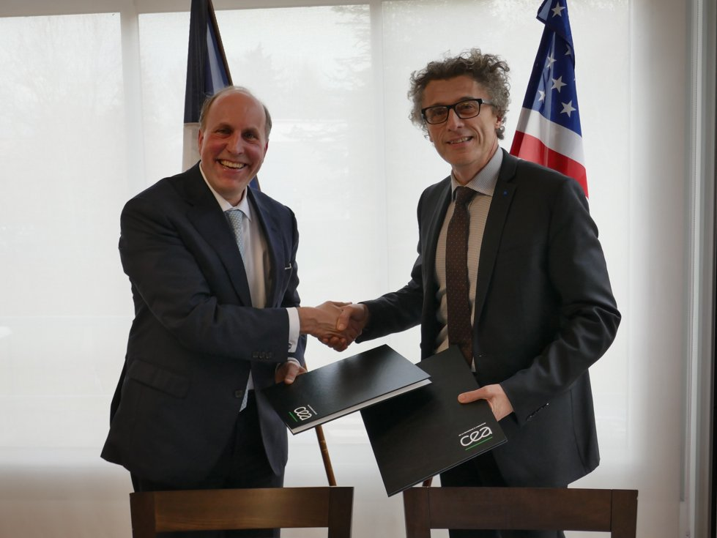

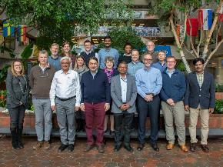

International Partners Contribute to PIP-II Scope
Bring Expertise, Capabilities
India, Department of Atomic Energy (DAE) (started 2009)
  Substantial engineering / manufacturing experience; Superconducting magnets for LHC; 2 GeV synch light source
  Contributions: Cryoplant, RT/SC magnets, SRF cavities, CM comp., RF amplifiers
Italy, INFN (started 2016)
  Internationally recognized leader in superconducting RF technologies
  Contributions: SRF Cavities (LB650)
UK, STFC UKRI (started 2017)
  Substantial engineering and manufacturing experience; Construction, operation of synch light & neutron sources SRF cavity processing and testing for ESS
  Contributions: SRF Cryomodules (HB650)
France, CEA, CNRS/IN2P3 (started 2017)
  Internationally recognized leader in large-scale CM assembly
  Contributions: SRF cavity testing (SSR2), Cryomodules (LB650)
Poland, WUST, WUT, TUL (started 2018)
  Substantial engineering / manufacturing experience; CDS, LLRF, QC for XFEL, ESS
  Contributions: Cryo Distribution, LLRF
8
2-Aug-2021

Slide 9






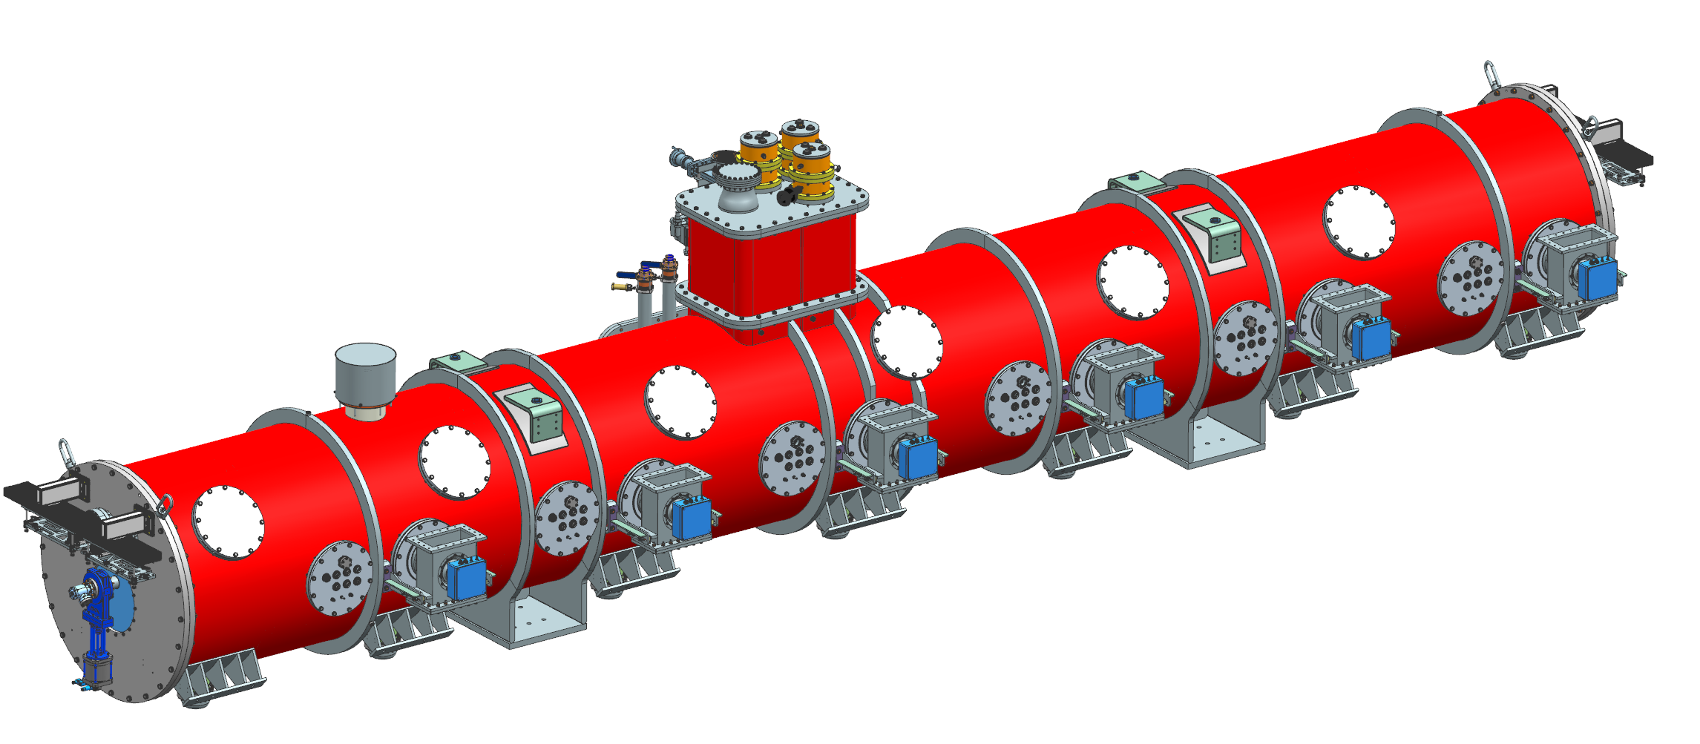

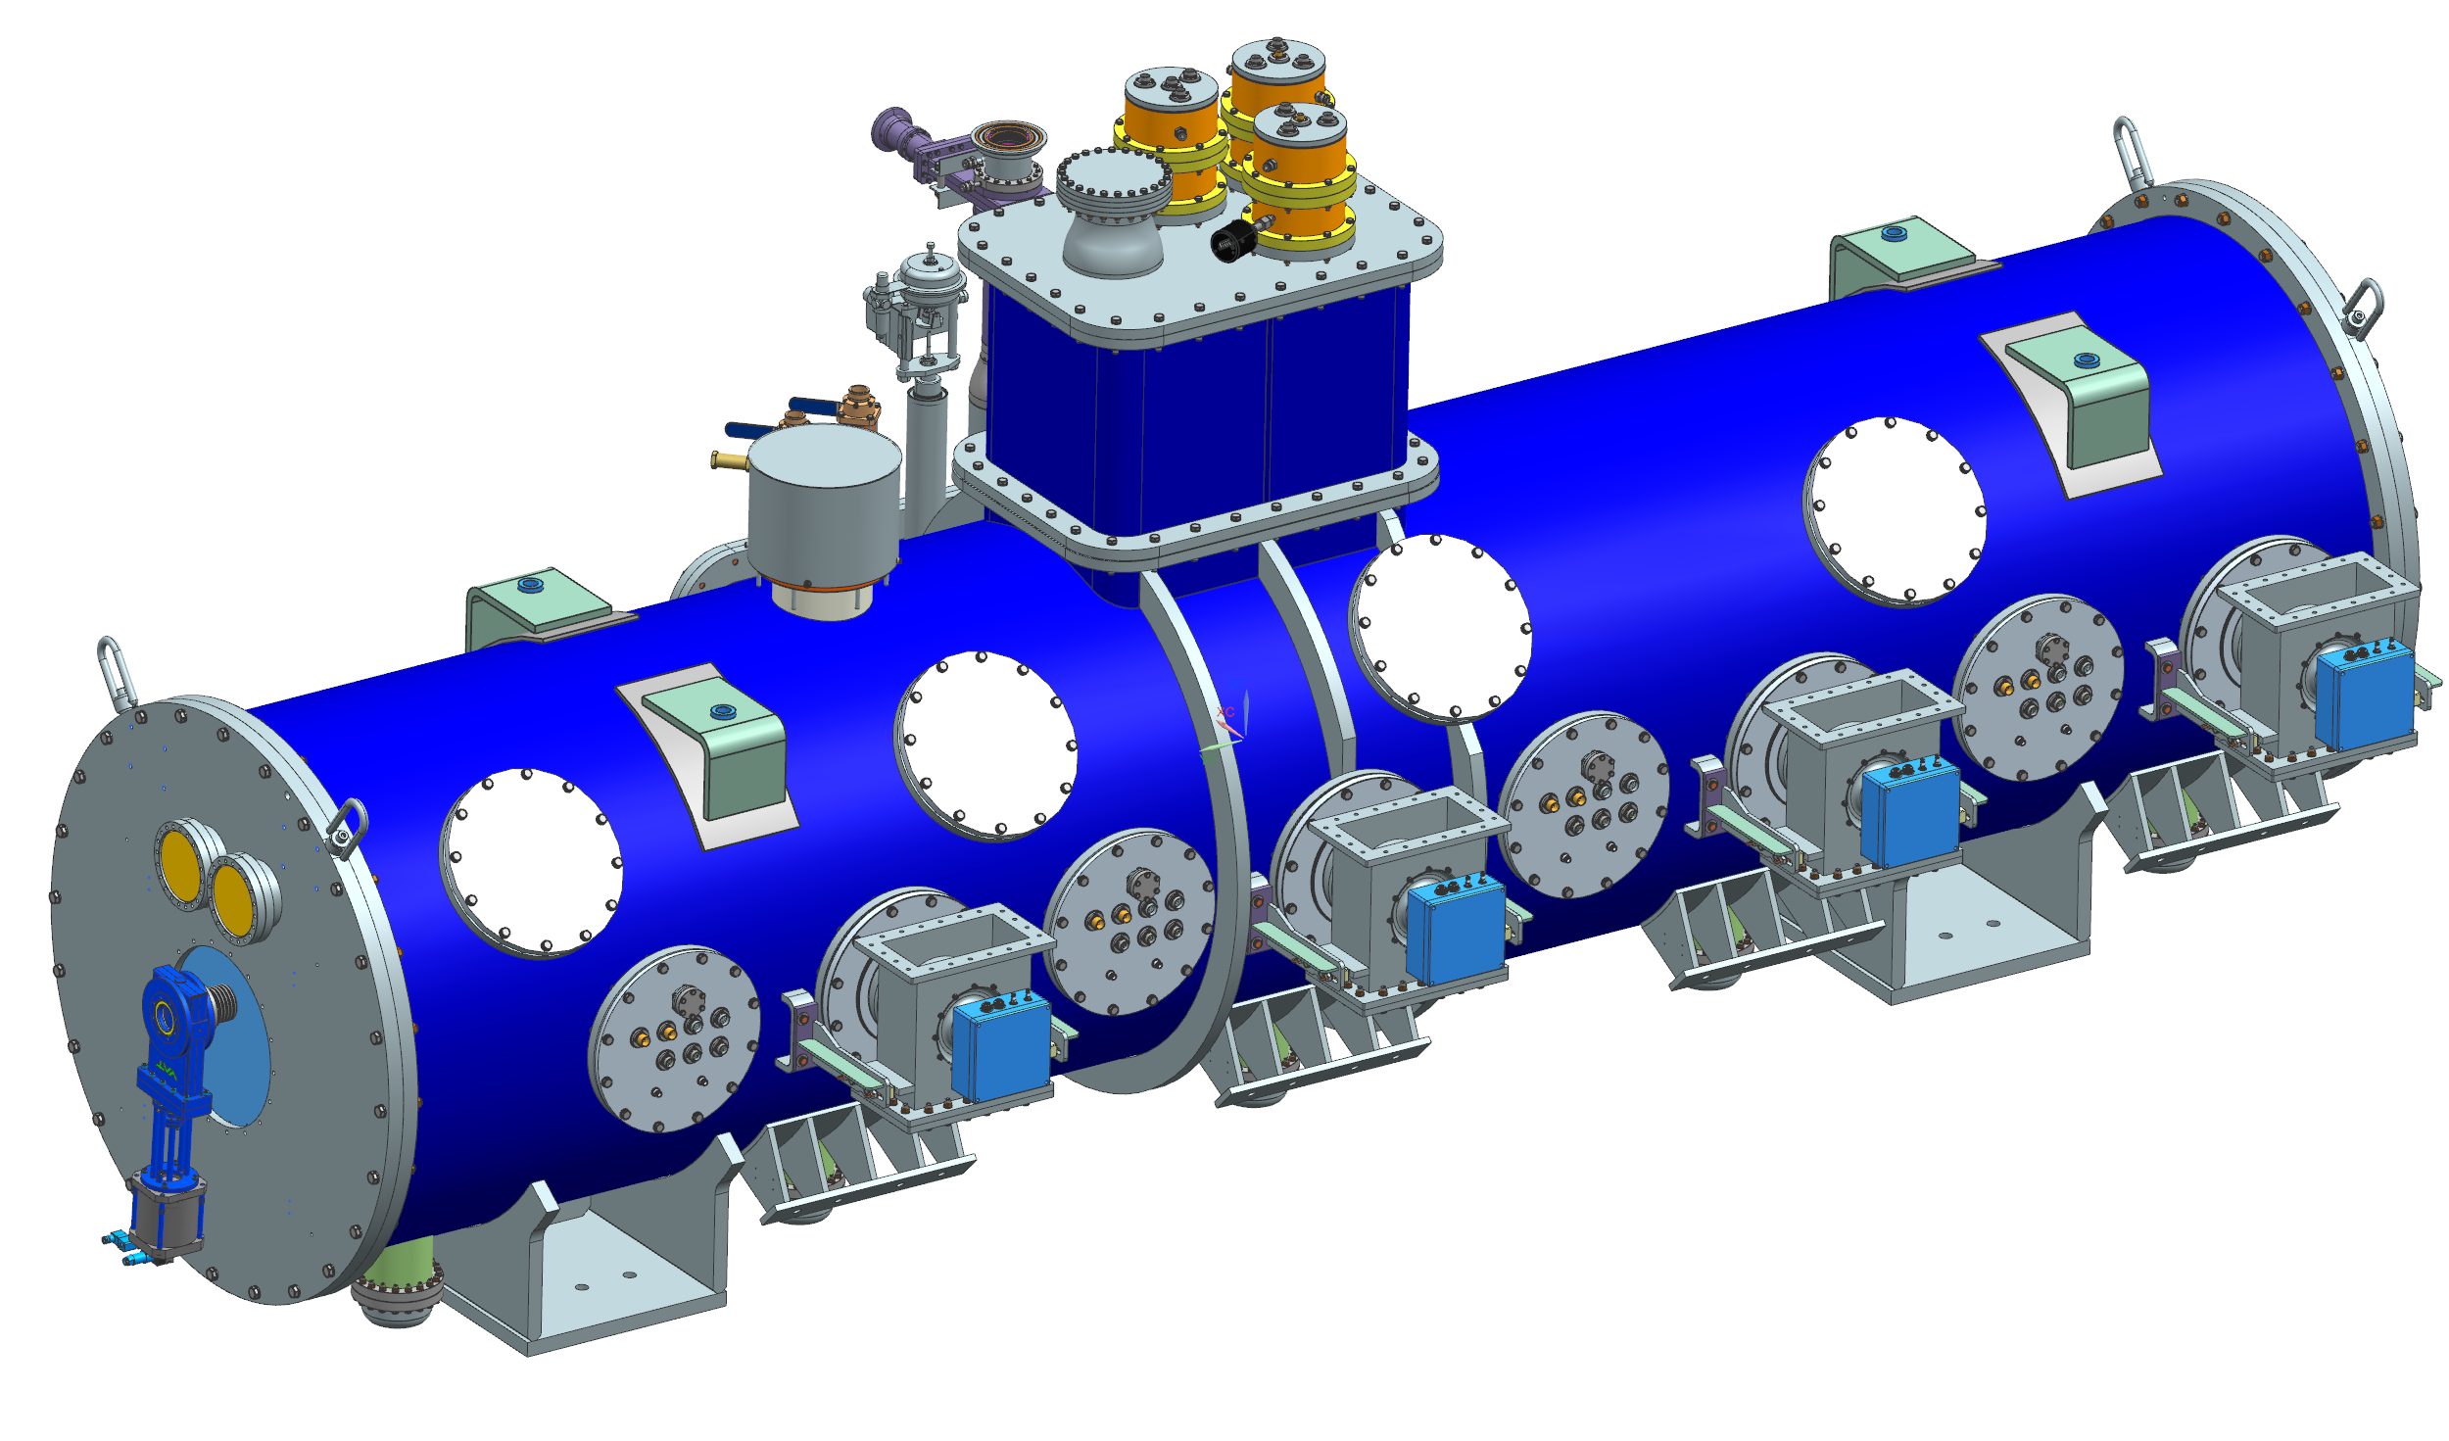
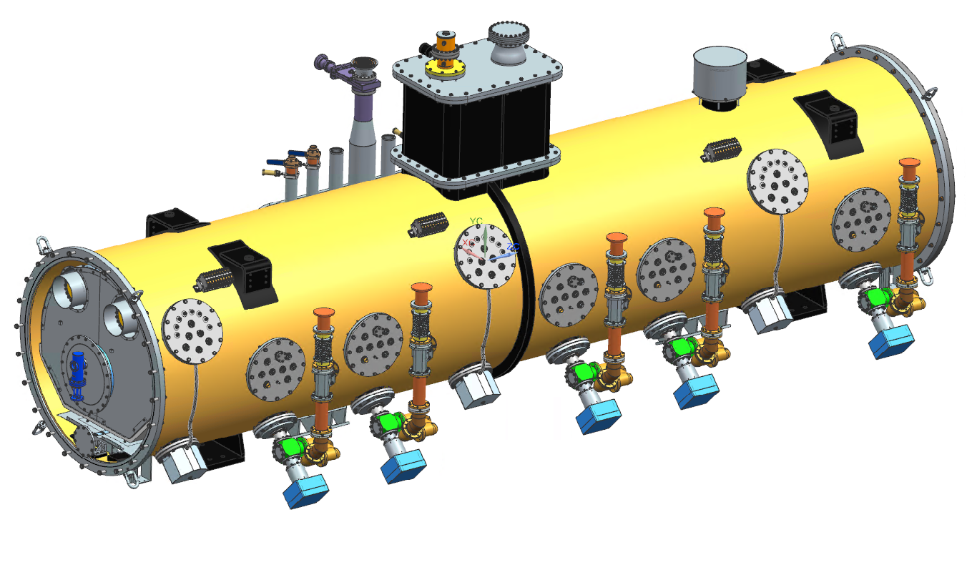
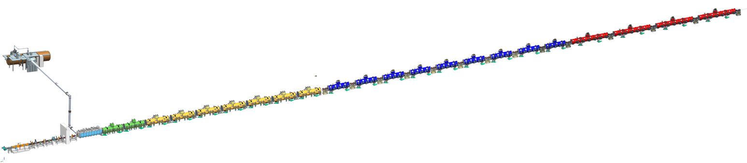

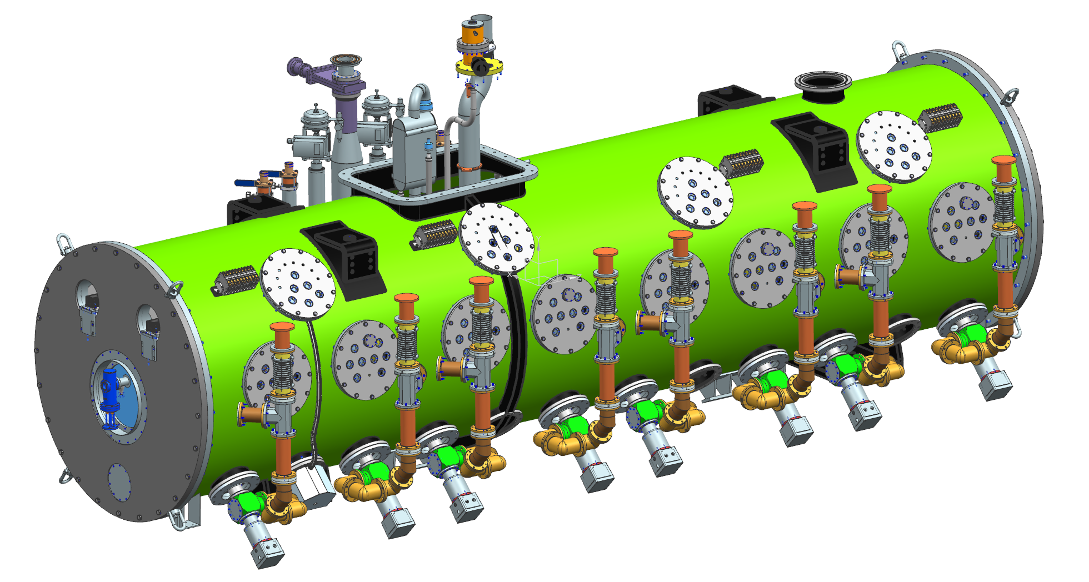


PIP-II 800 MeV SRF Linac
Elliptical
HB650 X 4
650 MHz
Elliptical
LB650 X 9
650 MHz
Single Spoke 2
SSR2 X 7
325 MHz
Single Spoke 1
pSSR1 X 2
325 MHz
HWR
162.5 MHz
833 MeV
Cryoplant
2.5kW @ 2K
516 MeV
177 MeV
Superconducting
CDS
RFQ
32 MeV
H- Ion source
10 MeV
2.1 MeV
PIP-II is the first U.S. accelerator project to be built with
significant international contributions
Room Temperature
9
2-Aug-2021

Slide 10
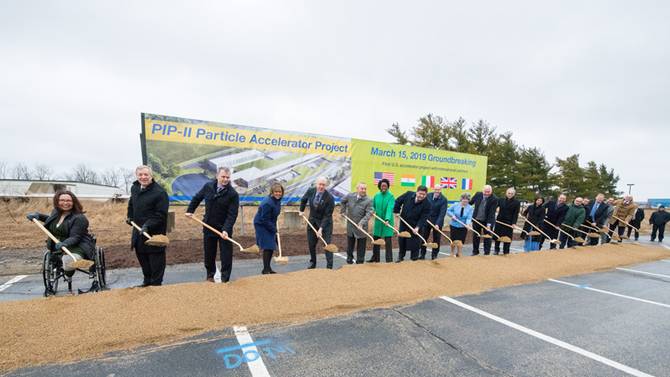
PIP-II Major Milestones
Mar 2019
Linac Complex
Ground-Breaking
Jul 2020
Cryoplant Bldg.
Construction
Approved
Oct 2026
Shutdown Complex
Operations For
Booster Connection
Sep 2024
Linac Tunnel
Occupancy
2016
2019
2020
2021
2022
2023
2024
2025
2026
2027
2028
2018
2017
Jan 2027
SRF Linac
Comm. Begins
Dec 2020
Approve Scope, Cost,
Schedule
TPC $978M
(+$310M IKC)
(CD-2)
April 2022
Approve Technical
Construction
(CD-3)
Dec 2028
Project Completion
Start of Operations
(Early CD-4)
Jan 2016
Approve
Mission Needs
(CD-0)
Mar 2018
Approve Alternative
Selection (CD-1)
Mar 2021
Approve Long-Lead
Procurements
(CD-3a)
2-Aug-2021

Slide 11
PIP-II Project Status and Recent Major Achievements
2-Aug-2021

Slide 12
2021 – Significant Progress in PIP-II SRF Cavities & CM Performance Validation
Additional details B. Giaccone’s talk
2-Aug-2021

Slide 13
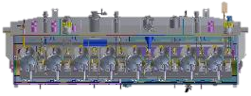

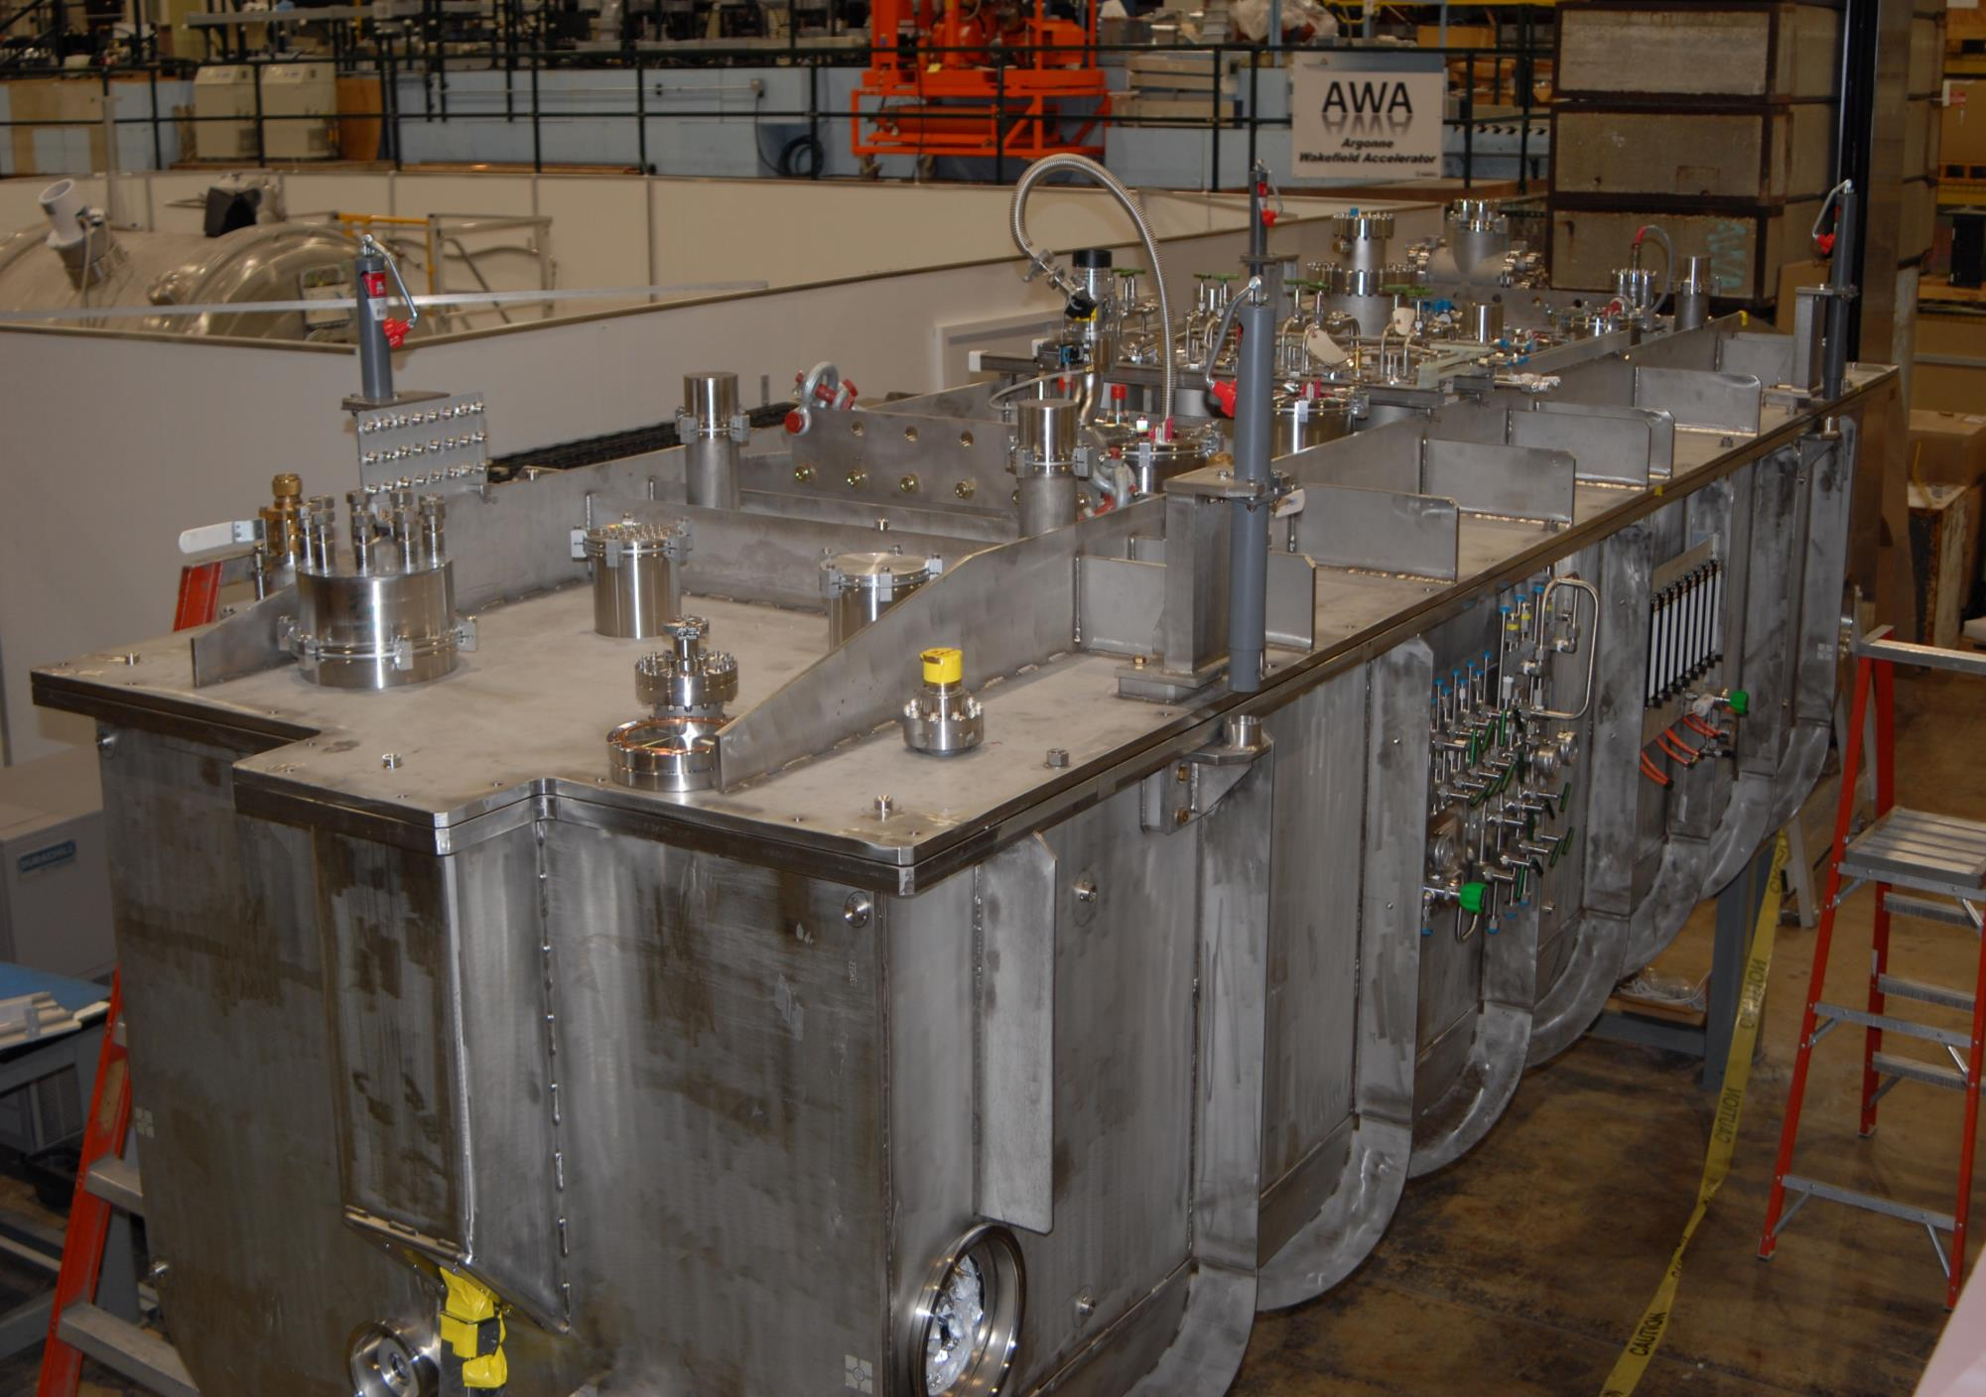
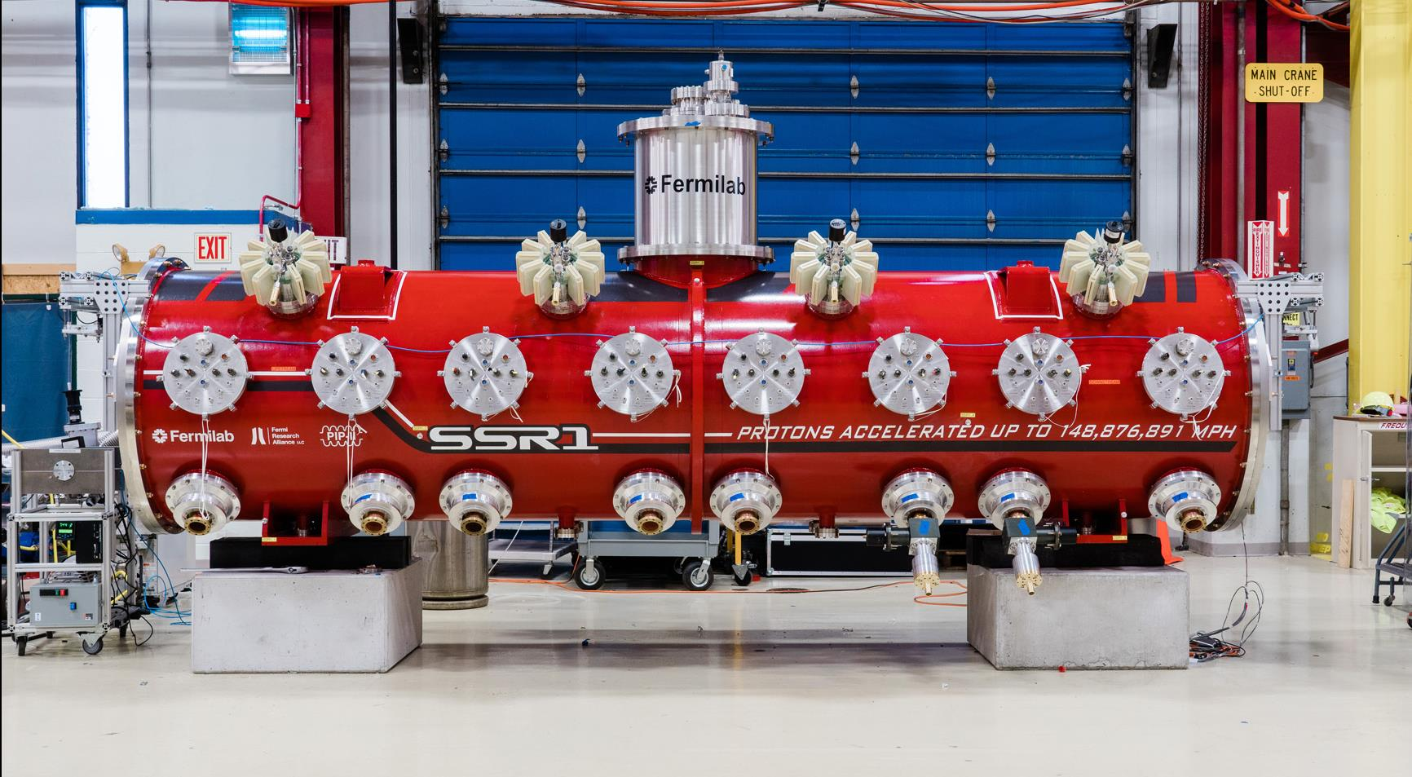

2021 – HWR and SSR1 Prototype CM Performance demonstrated
HWR
SSR1
SSR2
LB650
HB650
2-Aug-2021

Slide 14
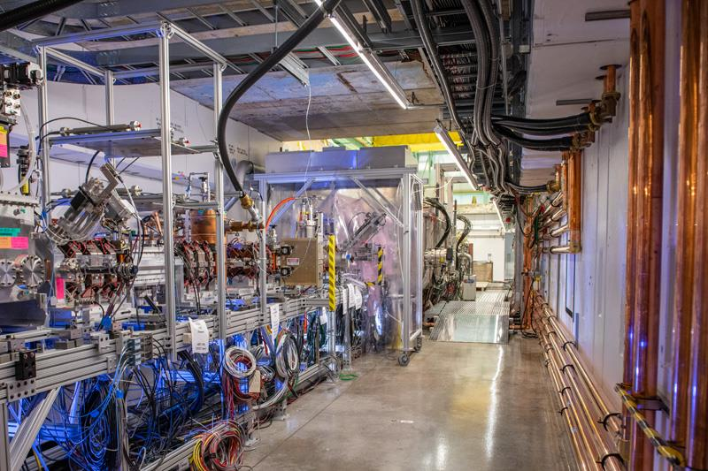
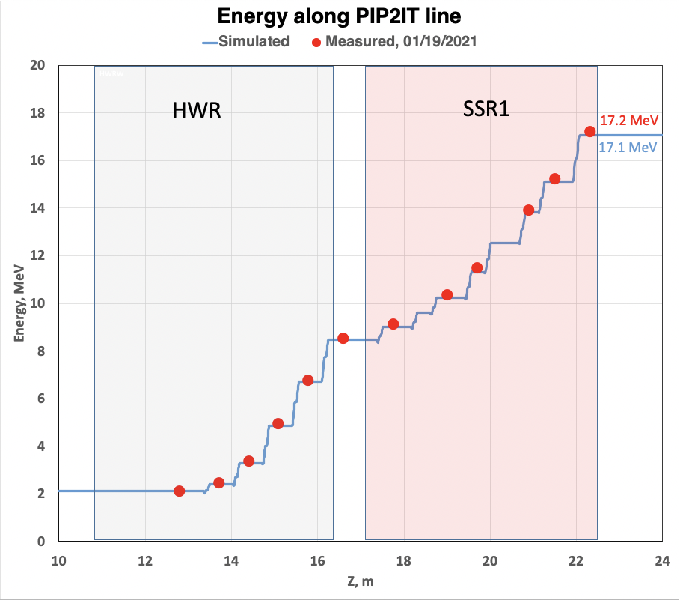


2021 – PIP-II injector Test (PIP2IT) Successfully Commissioned
PIP2IT Served as Testbed for PIP-II and Critical System
PIP2IT is nearly full-scale of PIP-II Front-End with the first two Cryomodules
LBNF parameters: 2 mA ×0.55 ms×20 Hz
17.2 MeV
2-Aug-2021

Slide 15
2021 – PIP-II injector Test (PIP2IT) Successfully Commissioned
PIP2IT fulfilled its Mission: Critical Technology Demonstrated;
Partner Deliverables Integrated;
Risk Mitigated/Retired
2-Aug-2021

Slide 16
2021 – Cryoplant Building construction progress
PIP-II Cryogenic Plant Building – 29 July 2021
Completion foreseen for approximately December 2021
25 June 2021
2-Aug-2021

Slide 17
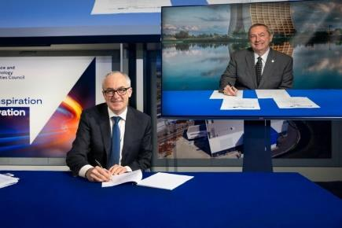
2021 – International Highlights
July-2021 - DAE approved the Cryoplant Purchase.
June-2021 - Project Planning Documents with INFN have being approved and signed.
May-2021 - “First” Project Planning Documents with UKRI STFC have being approved and signed.
2-Aug-2021

Slide 18
Near future goals & Summary
2-Aug-2021

Slide 19

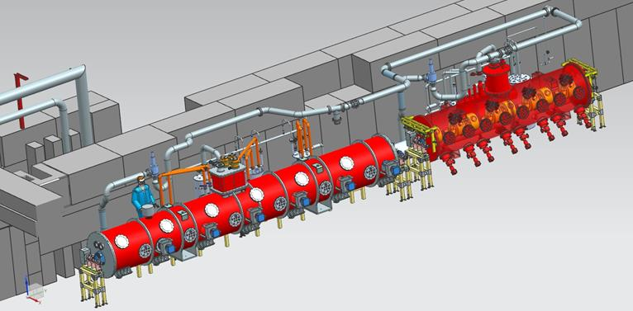
Major PIP-II Milestones to complete in FY2022
Complete the Cryoplant Building Construction
Complete Proto HB CM Assembly
Convert PIP2IT in a PIP-II Cryomodule Test Facility
Complete CD-3 DOE IPR – Start of Construction/Execution
2-Aug-2021

Slide 20
https://pip2.fnal.gov/
Summary
PIP-II will enable the world’s most intense beam of neutrinos to the LBNF/DUNE; modernize Fermilab’s accelerator complex enabling science for decades to come;
PIP-II is breaking a new ground, since it is the first DOE/SC accelerator to be built with significant international contributions;
PIP-II International Partnership is making excellent technical progress towards completion of the design, demonstration of critical technologies, and project construction;
Strong support from Fermilab, Partners, Physics Community, OHEP, Office of Science, DOE, Congress;
Thanks to the Fermilab Users Community for your support
2-Aug-2021

Slide 21
PIP-II Linac a look into the future
PIP-II Linac (800 MeV)
  PIP-II is designed/capable of 1.6 MW of beam power @800MeV
  PIP-II can deliver beam to multiple users concurrently
    CW compatibility + MEBT chopper + Additional RF/Fast Switching Magnet separators
  Prospective users
    Mu2e-II and other low energy muon experiments;
    Beam Power upgrade;
2-Aug-2021

Slide 22
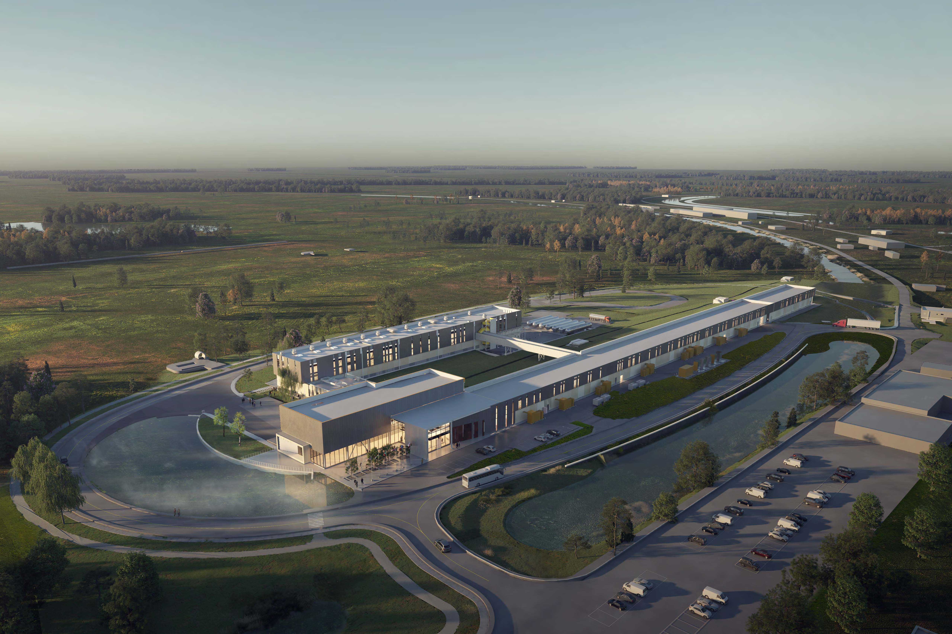
Thanks
2-Aug-2021

