Slide 1
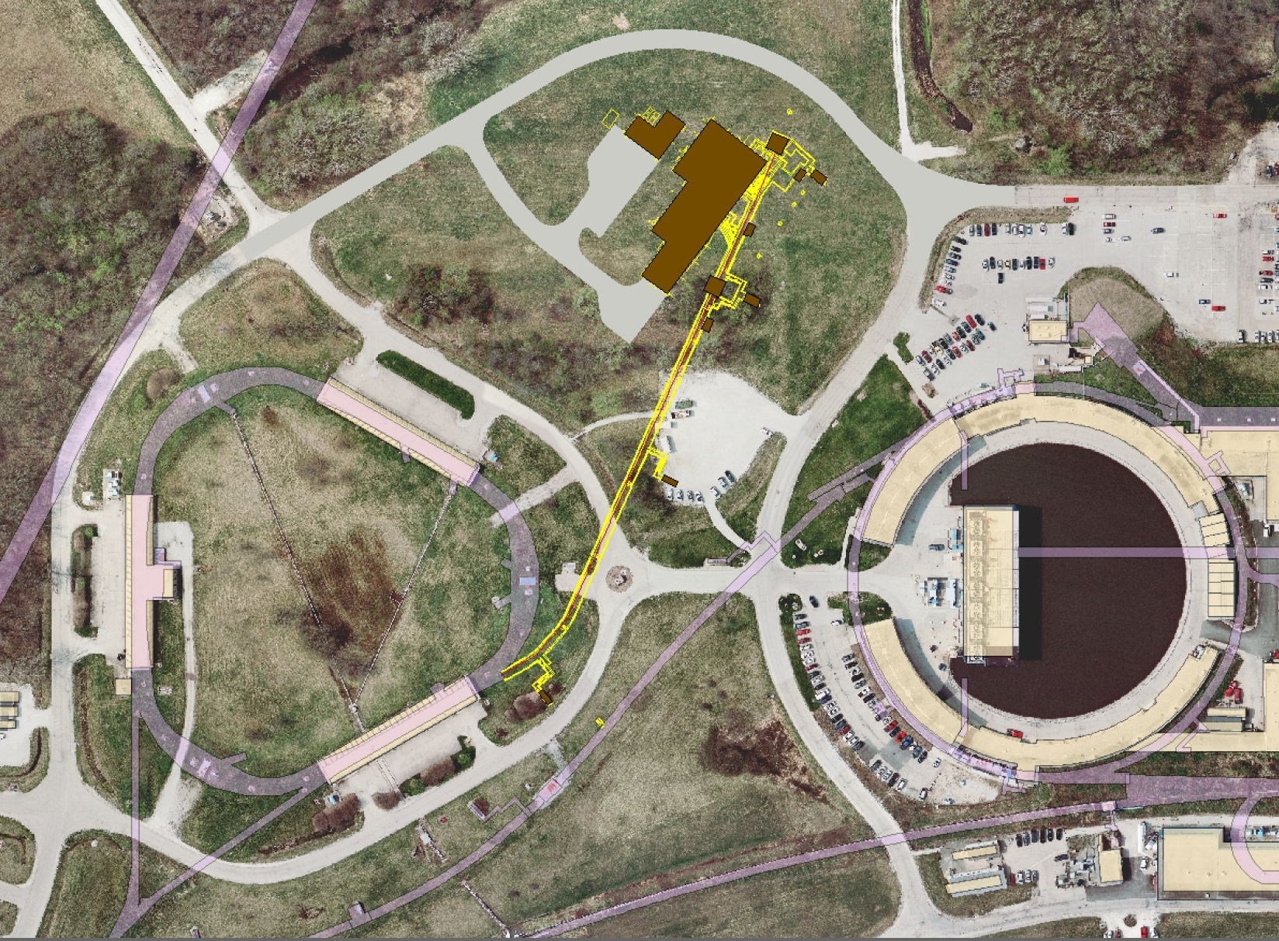
Accelerator Instrumentation plans for g-2
Brian Drendel
August 27, 2012

Slide 2
Instrumentation needs for g-2
Muon Campus
Beam Requirements
Funding and Deadlines
What needs to be done?

Slide 3
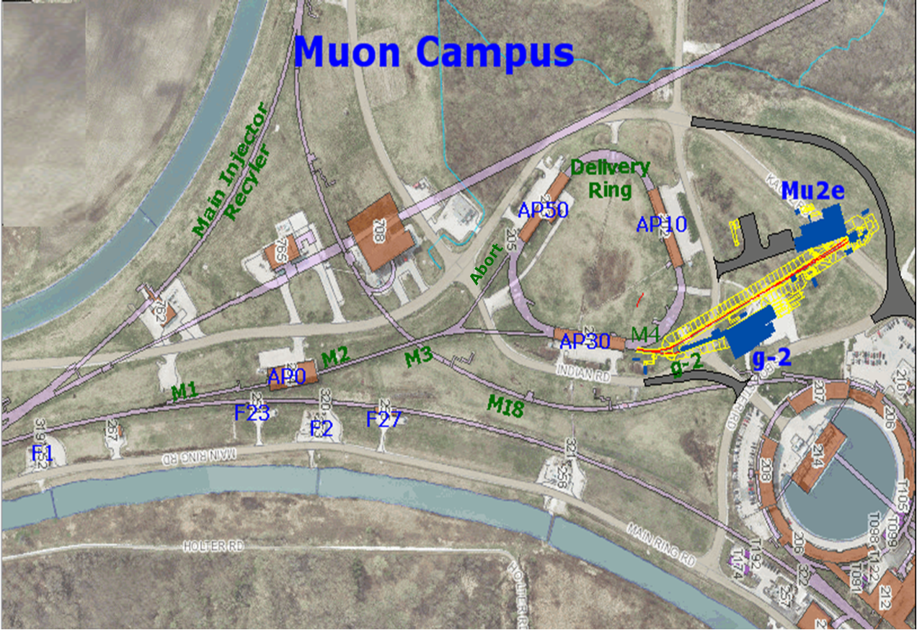
Muon Campus
Pbar Department changed to Muon Department
The Beam lines and Ring(s) may be combined into a “muon campus” that would serve multiple experiments
    Muon g-2
    Mu2e
Notes:
Define the three different areas of instrumenation
-Primary Proton Beam
-Mixed secondaries
-Muon secondaries
Emphasize M2/M3/Delivery Ring/Abort and M4/g-2 lines.

Slide 4
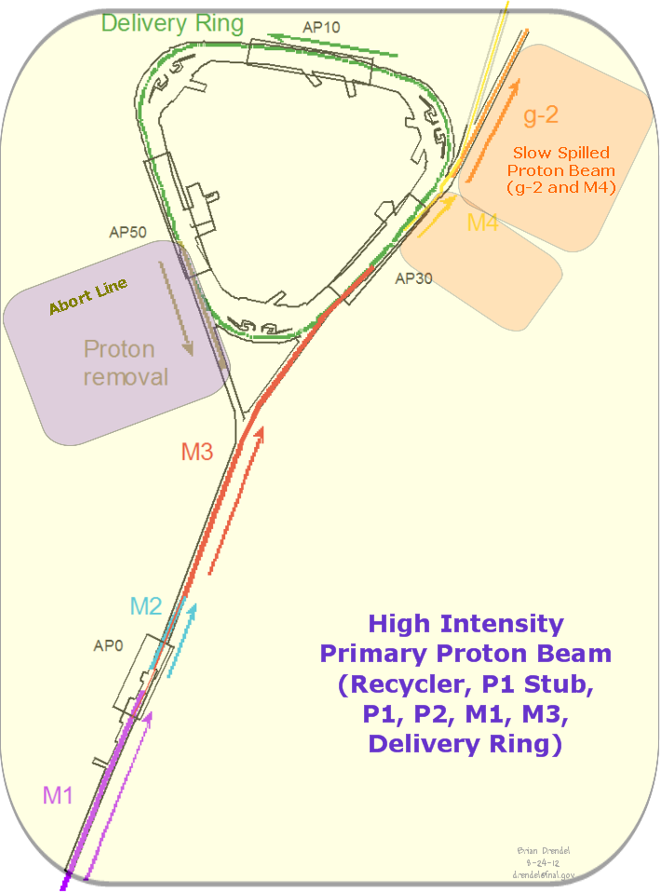
Mu2e Operations
Primary Protons
  Recycler
  P1 Stub
  P1, P2
  M1
  M3
  Delivery Ring
Slow Spill Protons
  M4
  g-2
2x10^7 per slow
spill slice
5x10^10
Or
1x10^12
8.9 GeV/c
2.515 MHz
1x10^12
Notes:
Since we have 8.9GeV/c beam throughout, we can inject 2.5MHz protons into the lines for tune-up.

Slide 5
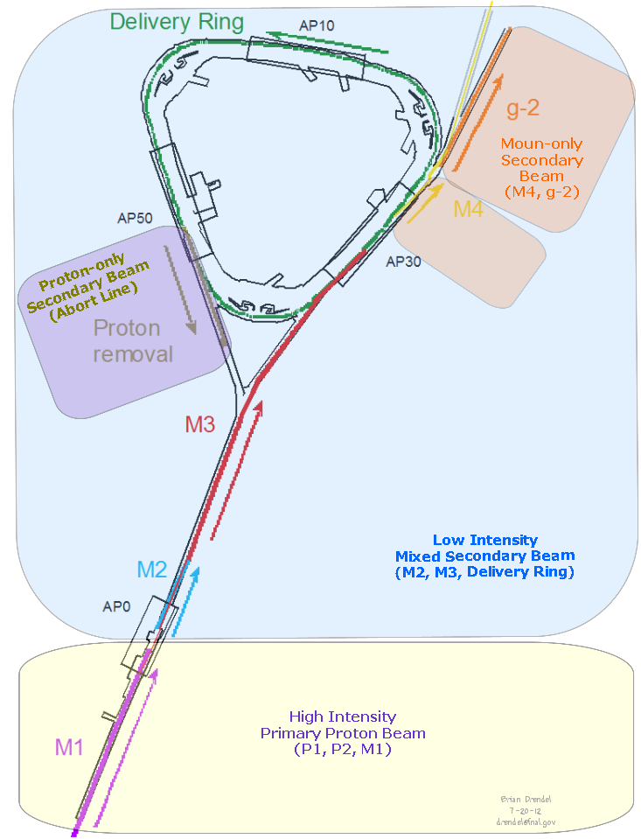
G-2 Operations
Primary Protons
  Recycler
  P1 Stub
  P1, P2
  M1
Mixed Secondaries
  M2
  M3
Proton Secondaries
  Abort Line
Muon Secondaries
  M4
  g-2
<2x10^5
~2x10^7
3.1 GeV/c
2.515 MHz
5x10^8 → 1x10^7
8.9 GeV/c
2.515 MHz
1x10^12
Notes:
Since downstream of the target is 3.1 GeV/c, we cannot inject 8.9GeV/c “reverse protons” down the M3 line and Delivery Ring for tune-up.

Slide 6
Beam Requirements
Beam Line/Ring (Service Building) | g-2
Recycler->P1 Stub->P1->P2->M1 (Ap1) (MI Buildings, F0, F1, F2, F23, F27, AP0) | Primary Proton Beam 1.0E12 Single 2.515 MHz bunch 120 nsec wide 8.89 GeV/c <rate>=12Hz with burst up to 100Hz
Target (AP0) | σx = 0.5mm, σy = 0.5mm
M2 (AP2) ->M3 (AP3) (AP0, F27, AP30) | Mixed Low intensity secondaries Upstream (dp/p = ± 10%, 40π transverse) (1.7 x 10⁶ μ⁺, 9.7 x 10⁷ π⁺, 1.2x 10⁸ protons) Downstream (dp/p = ± 2%, 35π transverse) (3 x 10⁵ μ⁺, 1.0 x 10⁶ π⁺, 2.4x 10⁷ protons) 3.1 GeV/c
Delivery Ring (AP10, AP30, AP50) | 3.1 GeV/c Secondaries (3 x 10⁵ μ⁺, 10 π⁺, 2.4x 10⁷ protons) Circulates a few turns, then extract the entire bunch
Abort Line (old downstream AP2) (AP50) | Low intensity Protons 3.1 GeV/c 2.4x 10⁷ in 10msec burts
M4 (new), g-2(new) (AP30, MC-1, Mu2e) | Low intensity muons 3.1 GeV/c < 3 x 10⁵ μ⁺ pulse every 10msec
Notes:
Production per proton at the exit of IQ4 in the upstream AP2 line for 1E12 on target with a ±10% momentum cut and 40π emittance (Cary Yoshikawa):
Pi+ = 9.9E-7
Muon+ = 1.7E6
Proton = 1.2E-8
e+ = 7.9E-5
Total = 2.2E8
To the gap monitor in D10, assuming ±2% dp/p and 35π emittance. [TURN 1,2,3,4,5]
Pi+ = 1.1E-6 5.8e4 3.2e3 1.7e2 9.3e0
Muon+ = 3.4E5 3.3e5 3.2e5 3.14e5 3.1e5
Proton = 2.4E-7 2.4e7 2.4e7 2.4e7 2.4e7
e+ = 1.6E-5 1.53e5 1.53e5 1.49e5 4.46e5
Total = 2.56E7 2.45e7 2.448e7 2.446e7 2.445E7
Assume ~80% of the pions are gone by the time you get to the Delivery Ring

Slide 7
How Instrumentation gets funded
Mu2e
  Specific to Mu2e
  Mu2e Document Database (http://mu2e-docdb.fnal.gov/)
AIPs (Beam Transport and Delivery Ring; Recycler, etc…)
  Common to both g-2 and Mu2e
  Beams Document Database (http://beamdocs.fnal.gov/)
g-2
  Specific to g-2
  g-2 Documents Database (http://gm2-docdb.fnal.gov/)

Slide 8
Important g-2 Dates
October 1, 2012: Conceptual Design Report (CDR) Complete
  Instrumentation section draft (G2M-doc-449)
November 1, 2012: BoEs Complete
December 1, 2012: Internal Director’s Review
January 15, 2013: Lehman Review for CD-1.

Slide 9
Also in FY’13
Transport and Delivery Ring Accelerator Improvement Plan (AIP) scheduling.
Technical Design Report (TDR) for Mu2e
Plans for g-2 beam studies

Slide 10
Mu2e Instrumentation Needs
Mu2e (CDR – Mu2e-doc-1169)
  Delivery Ring DCCT – Mu2e-doc-1573
    Well understood and costed.
  Delivery Ring Tune Measurement – Mu2e-doc-1573
    Would like to request Schottky Option
    Need engineering time to design a system.
  Extraction Profile Monitors - Mu2e-doc-2123
    16 SWICs in M4 line
  Extraction Intensity Monitors- Mu2e-doc-2123
    2 retractable Ion Chambers in M4 line
  Extraction Loss Monitors- Mu2e-doc-2123
    10 BLMs in M4 line

Slide 11
DR AIP Instrumentation Needs
Beam Line Instrumentation – (Covers P1, P2, M1) Beams-doc-4150
  Beam Line Toroids
  Beam Line BPMs
  Beam Line BLMs
  Beam Line Profile Monitors
Delivery Ring Instrumentation – Beams-doc-4151
  Delivery Ring BPMs
  Delivery Ring BLMs
  Delivery Ring SEMs

Slide 12
RR AIP Instrumentation Needs
Recycler???
  Where is costing for RR instrumentation covered?
  Does existing instrumentation work as-is?
P1 Stub
  2 Multiwires
  2 BPMs
  2 BLMs
1x10^12

Slide 13
G-2 Instrumentation Needs
Mixed Secondaries (M2/M3/Delivery Ring):
  Toroids:
    Beam studies shows can only be used down to the 1e9 level.
  Ion chamber:
    1 or 2 in M2 – can be of the permanent variety.
    M3 and Delivery Ring – Need to be retractable.
  Beam Position Monitors
    AP3 – 2.5MHz, but can’t see g-2 intensities
    AP2 – 53MHz, maybe used during beam studies.
    Delivery Ring – 53MHz upgrade to 2.5MHz for Mu2e but can’t see g-2 intensities.
  Wall Current Monitor: M2, M3, DR
    More expensive than Ion Chambers but is transparent to the beam.
  SEMs
    High Gain Preamps design/manufacture
    Brittle cabling? May need to pull new cable on SEMs that move.
    SEM can/wires maintenance?
    Move spares to the Delivery Ring for tune-up since BPMs won’t work for g-2.
  BLMs
    Two different styles of BLMs will be in the Delivery Ring.
    How to switch back and forth. Can scintillator/phototube stay in rad area for Mu2e
1x10^7
to
5x10^8

Slide 14
G-2 Instrumentation Needs
Proton Secondaries (Abort Line)
  The Mu2e instrumentation already planned won’t work for g-2.
    BPM – can’t see g-2 intensities
    Toroid – can’t see g-2 intensities.
  What will work?
    SEM – with high gain preamp?
    Ion chamber
    BLMs
<2x10^7

Slide 15
G-2 Instrumentation Needs
Muon Secondaries (M4 and g-2 lines)
  Ion chambers
    M4 line – retractable
    G-2 line
  SWICs
    M4 line – 4 before the split
    g-2 line – 5
  BLMs
    M4 line – 4 before the split
    g-2 line - 5
<2x10^5

Slide 16
To Do List?
Proof read your section of the g-2 CDR and send me corrections.
  Please send me your corrections.
  This is our first priority.
BoEs for g-2:
  Need to cost labor and M&S for g-2 specific instrumentation needs.
    M2, M3 and Delivery Ring
    Abort line
    M4 and g-2 lines.
Need costing for spring 2013 beam studies
  Two ion chambers in the AP2 line
  A couple of SEMs with high gain preamps in the AP2 line
  SY style resonant detectors?
  What else?
Mu2e Costing
  Need Engineering time to design and updated costing on Delivery Ring tune measurement system.
  Would like to make a larger Schottky Detector the default option.
AIPs
  Need updated beam line and Delivery Ring
  P1 Stub? Recycler?

Slide 17
Supplemental Slides
Slides presented to the AD/Controls and AD/Instrumentation Department in 2011 and 2012.

Slide 18
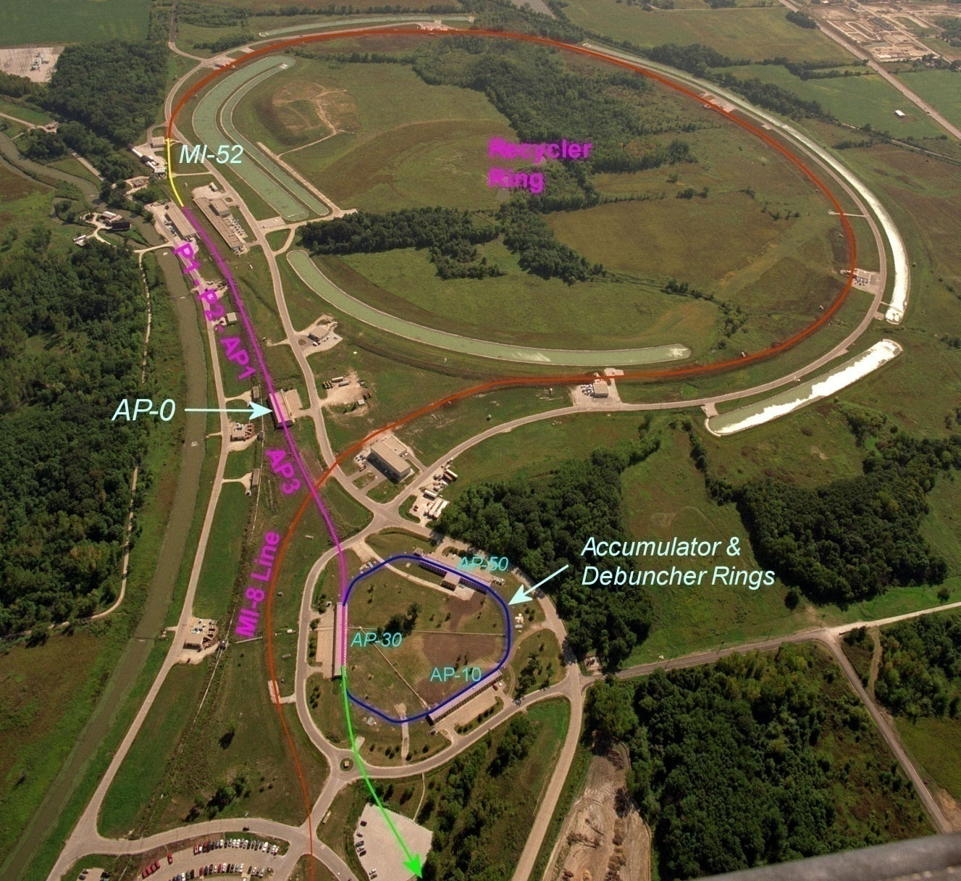
Beam path from Booster to the g-2 and Mu2e experiments
  A Booster batch of intensity ~4E12 is sent to the Recycler.
  The batch is divided into 4 2.5 MHz bunches, which are individually extracted to the Debuncher.
External beamline
J. Morgan

Slide 19
Beam path from Booster to the g-2 and Mu2e experiments
The bunches are transported to either the Target Station at AP0 or Debuncher via multiple beam lines
Extracted at MI-52 from Recycler to the P1 beam line (new)
g-2:
P1 → P2 → AP1 → Target Station → AP3 → Debuncher Ring
Mu2e:
P1 → P2 → AP1 → AP3 → Debuncher Ring
External beamline
J. Morgan

Slide 20
Beam path from Booster to the g-2 and Mu2e experiments
New AP-3 to Debuncher beam line connection for final 50 meters
Abort in 50 straight section can be used for:
  g-2: proton removal
  Mu2e: proton clean-up
Beam in Debuncher is extracted to the external beamline (new)
  g-2: entire pulse extracted at once
  Mu2e: Beam resonantly extracted.
External beamline
J. Morgan

Slide 21
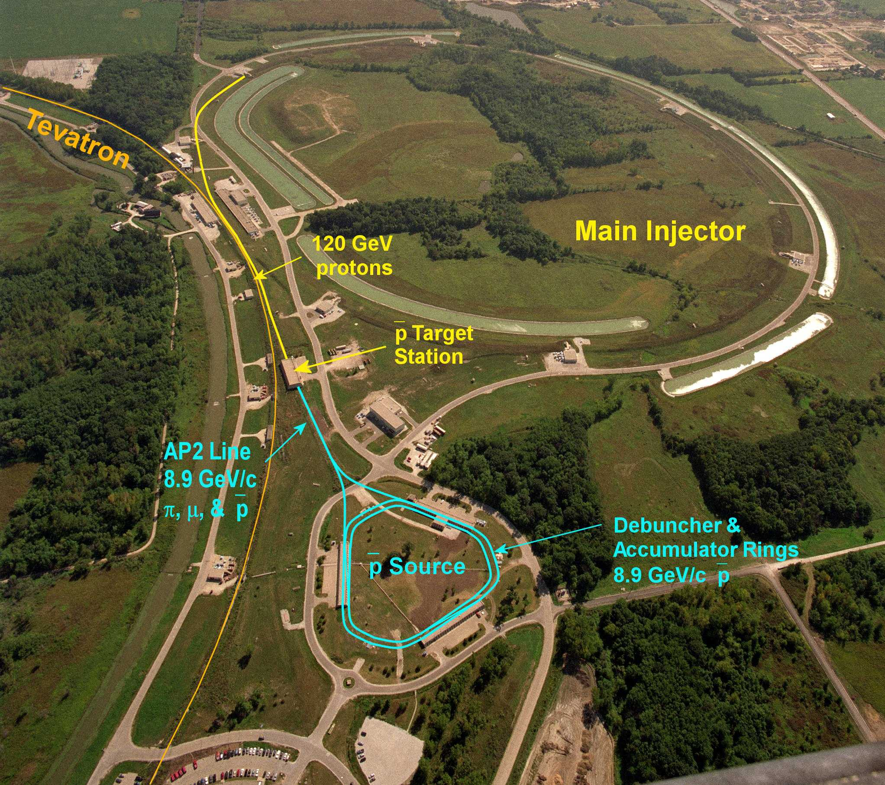
What we’re starting with – the Pbar source

Slide 22
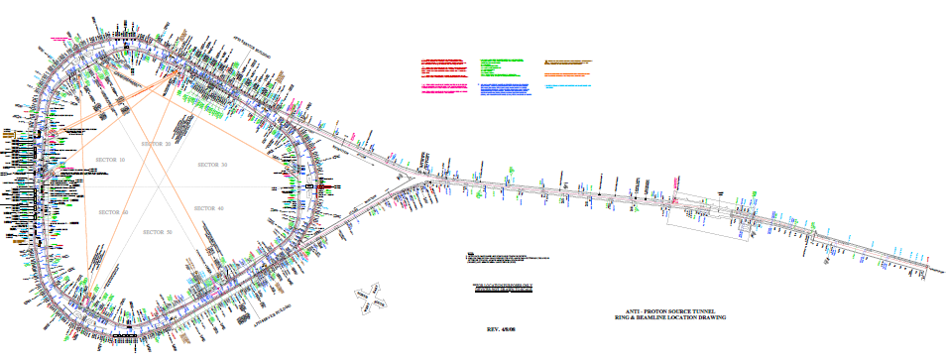
Experimental Setup for Beam Studies
Select 8.9Gev & 3.1Gev
Secondaries for both positive
and negative particle
target
vault
Take 120Gev
& 8Gev
at ~ 1E12 POT
704
measure beam intensity at beginning and end of beam line
and compare to simulated values
733
Note: Distance from 704 to 733 is ~ 255m
Pion decay at 8.89Gev is ~ 60% survive
Pion decay at 3.1Gev is ~ 28% survive
Notation:
120->-8 = 120Gev primary, 8Gev negative secondaries

Slide 23
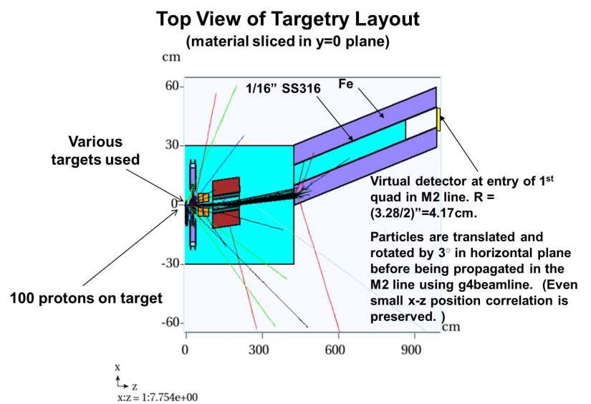
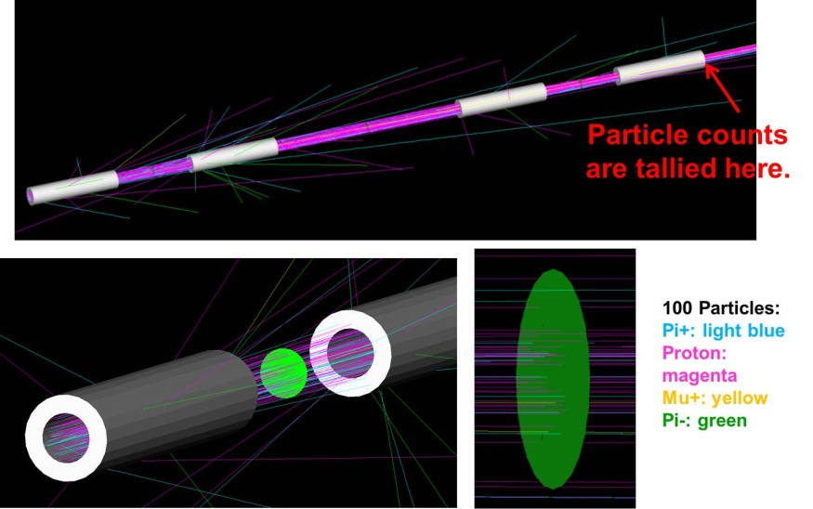

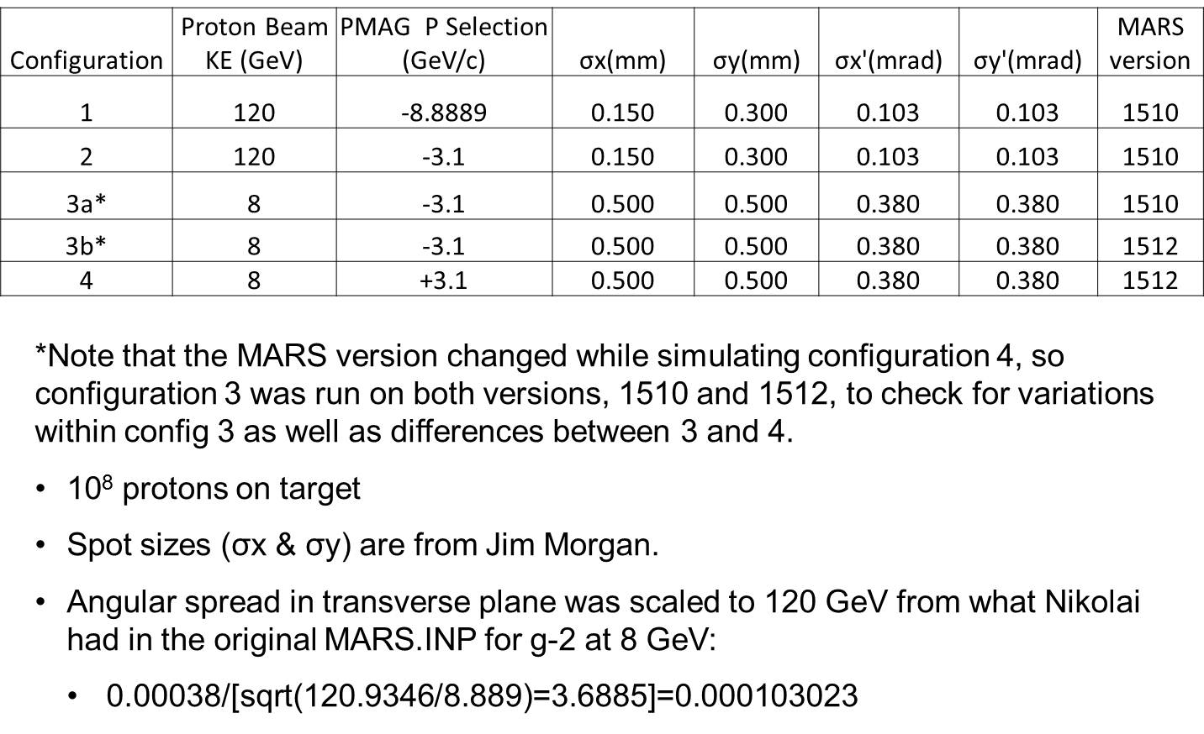
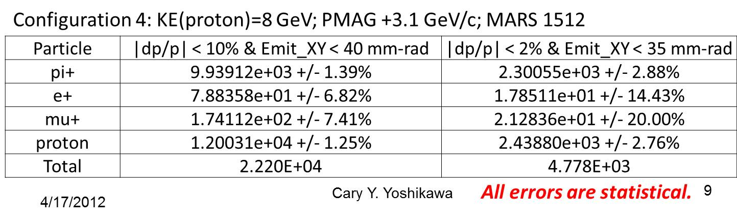
Simulations for Beam Studies
Example of simulated results for 8->3.1Gev Pos Secondaries
Used MARS to predict target yield estimates.
Used G4 beamline to estimate front of the beamline.
Estimated end of the beamline with smaller dp/p and emittance. Not a full beamline simulation.
Simulated for various combinations of Primary and secondary energies.
Initial Simulation Parameters

Slide 24
g-2 Operations
For each 1.33 sec Nova cycle, g-2 will use four Booster batches will be spread through the first eight of the twenty 15 Hz ticks.
During that time:
  One 8.9 GeV/c Booster batch injected to RR, divided into four 2.5MHz bunches.
  One bunch is sent to the AP0 target, where 3.1 GeV/c secondaries are sent to the Delivery Ring
  The secondaries circulate in the Delivery Ring a few times and the entire bunch is extracted to g-2.
  Repeat for all four bunches.
  Repeat Booster batch injection three more times.
Repeat on next Nova cycle.

Slide 25
Antiproton Source
Beam lines
  A 120 GeV/c proton beam is transported to the Target Station via AP-1 every 2.2 seconds
An 8.89 GeV/c negative secondary beam travels down AP-2 and is injected into the Debuncher
8.89 GeV/c antiprotons are bunch rotated and stochastically cooled in the Debuncher, then transferred to the Accumulator via the D/A line
Antiprotons are accumulated over hours, then transferred to MI via the AP-3 and AP-1 lines
8.89 GeV/c protons can be “reverse injected” or sent in the reciprocal direction of the antiprotons for tune-up

Slide 26
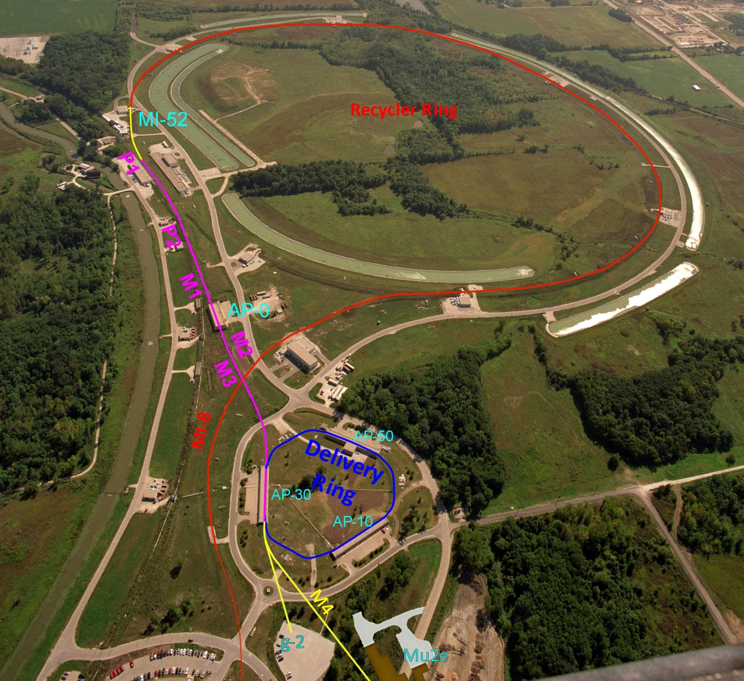
Beam path from Booster to the g-2 experiment
  An 8.89 GeV/c Booster batch is sent to the Recycler, where it is divided into 4 2.5 MHz bunches, which are individually extracted to the Debuncher
The bunches are transported to the Target Station at ~10 ms intervals
Extracted at MI-52 from Recycler to the P1 beam line
P1 → P2 → M1 → Target Station
The 3.1 GeV/c secondary beam is transported to the Delivery Ring
Target Station → M2 → M3 → Delivery Ring
Mu2e Abort in 50 straight section can be used for g-2 proton removal
Beam in Debuncher is extracted to the M4 line
The g-2 line connects M4 to the g-2 experimental hall

Slide 27
g-2/Mu2e Configuration
  The Accumulator and D/A line are no longer needed and will be used for parts
  M1 is the new name for AP-1, apertures will be improved to accommodate the larger 8.89 GeV/c primary beam
AP-2 will be removed and a similar, but shorter, secondary line will be called M2
The secondary beam will be transported to the D30 straight section instead of D50
The new line connecting M2 to the Delivery Ring in the D30 straight section will be called M3
M2 and M3 will have a higher quadrupole density than AP-2 did (4 m spacing upstream of bend, increasing to 6 m downstream)
M3 needs to be designed for use by both g-2 and Mu2e
The old injection region for AP-2 will become an abort for Mu2e and could be used for proton removal for g-2
The extraction line will be called M4
The g-2 line connects M4 to the experiment

Slide 28
Muon g-2
Beam lines
  An 8.89 GeV/c proton bunch, 120 ns long, is transported to the Target Station via M-1 at an average rate of 12 Hz, with 100 Hz bursts (16 bunches, 10 ms interval)
A 3.1 GeV/c Positive secondary beam travels down M2 and M3 and is injected into the Debuncher in the 30 straight section with Lambertsons and a kicker
Some of the pions decay into 3.09 GeV/c muons as they travel down M2/M3
The M2 and M3 lines have an increased quadrupole density to improve muon efficiency
Muons can circle the 550 meter Debuncher as many times as desired
The abort located in the 50 straight section can be used to remove protons
3.09 GeV/c muons are extracted into the M4 line, then bends into the g-2 line that transports them to the experiment

Slide 29
Mu2e needs to use the same Beam lines
What’s different?
  An 8.89 GeV/c proton bunch, 120 ns long, is transported to the Debuncher via AP-1 and AP-3 (bypassing the Target Station) at an average rate of 6 Hz with 18 Hz bursts
The 8.89 GeV/c bunch is injected into the Debuncher in the 30 straight section with Lambertsons and a kicker
A 2.5 MHz RF system maintains the short bunch as it circulates in the Debuncher
The proton bunch is resonantly extracted with an electrostatic septum and Lambertsons into the Extraction beam line, that transports them to an external Target Station to produce an intense muon beam
The remaining proton beam that is not resonantly extracted is aborted in the 50 straight section and transported to a dump

Slide 30
Recycler to P1 line connection
From Mu2e CDR
Recycler
Q523
Q522
Q521
Q520
ODH Barrier
Q901
RRLAM
Q903
Q902
0.7364 m
HBend
Q904
P1 line
Q706
Q705
Q704
Q703
Q702
Q701
I:LAM52
VBend
C
B
A
Main Injector
V700
Q527
Q526
Q525
Q524
Q523
Q522
Q521
Q520
New beam line connects Recycler to P1 line.
Meiqin Xiao

Slide 31
John Johnstone

Slide 32
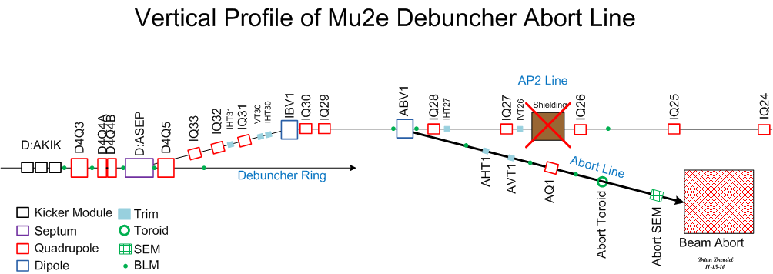
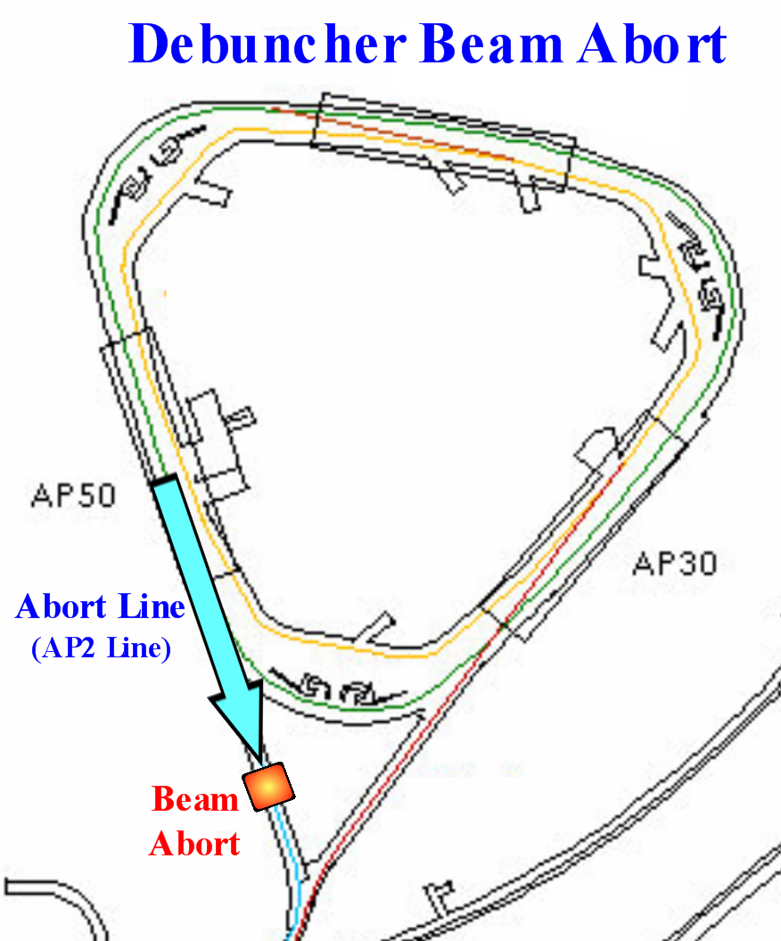
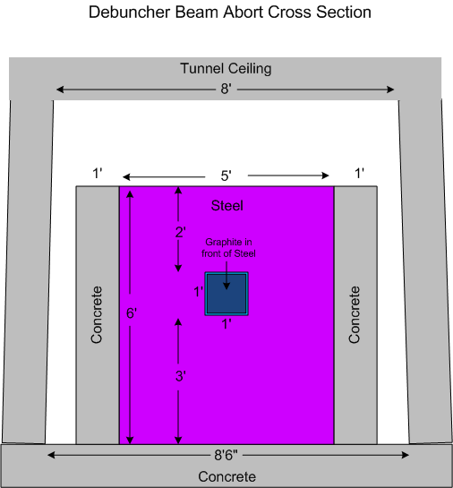
Beam abort/proton removal
D50
Transport

Slide 33
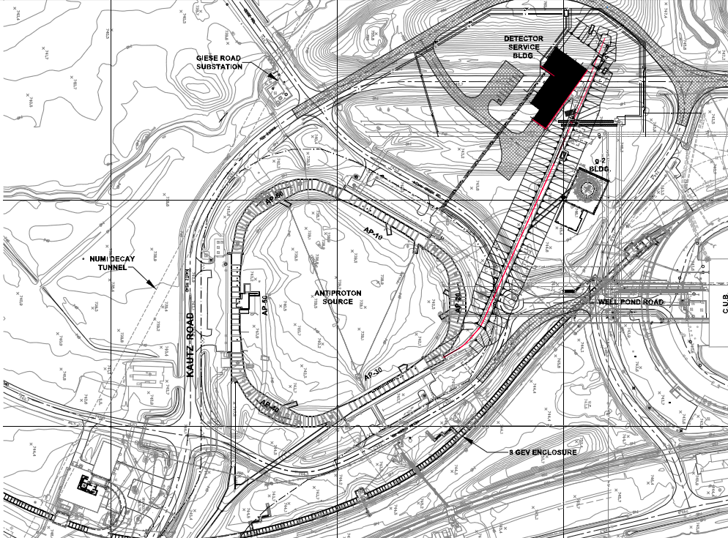
External beam line
Mu2e
g-2

Slide 34
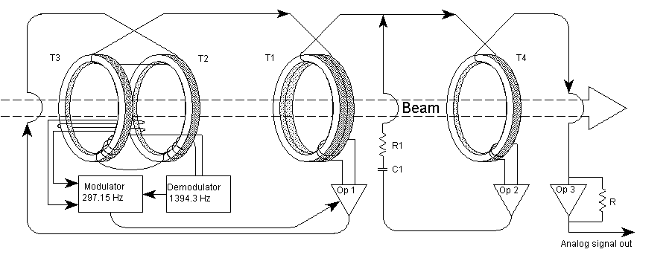
Direct Current Current Transformer
DCCT was the primary intensity measuring device in the Debuncher Ring.
    Accuracy is one part in 10⁵ over the range of 10¹⁰ to 300 x 10¹⁰ of beam current.
    Due to the slow sample rate and large beam intensity scale, the DCCT is not useful to measure the low intensity secondary beam that will circulate a small number of turns around the Debuncher ring during g-2 operations.
    The DCCT will be used to measure beam intensity for Mu2e operations.
Notes:
-A DCCT or Direct Current Current Transformer is a device used to measure the quantity of circulating beam with high precision. Accuracy is one part in 10⁵ over the range of 10^10 to 300 x 10^10 of beam current.
The pickups are supermalloy tape-wound toroidal cores with laminations, which act to reduce eddy currents. Beam goes through the hole of the donut and acts as a single turn on the toroid transformer. The beam sensing electronics are attached to wire windings on the toroids. Passing beam induces magnetic flux in the toroids and the electronics sense the second harmonic of the 801 Hz pilot signal (caused by the non-linear hysteresis characteristics of the toroid) and produces an equal and opposite current that minimizes the harmonic and thus keeps the net toroid flux at zero. T1 senses the AC portion of the beam while T2, T3, the modulator, and demodulator sense the signal caused by the DC portion. The DC and AC signals are summed in OP1, which drives each toroid just hard enough to cancel the beam-induced flux. The beam cancellation signal is measured across the heatsinked power resistor R. The accuracy of the measurement is dependent on the resistance staying constant.
The DCCT toroids are contained in 40 inch long by 10 inch diameter structures that reside in straight section 10 of both rings. Signals go to a receiver chassis upstairs at AP10. Each receiver chassis has a slow (1 Hz), medium (100 Hz) and fast (220Hz) output. Each output can be configured to be sampled on a small scale (5 mA/V) or full scale (40 mA/V).
Due to the slow 1 Hz sample rate and large beam intensity scale, D:IBEAM is not useful to measure g-2 beam

Slide 35
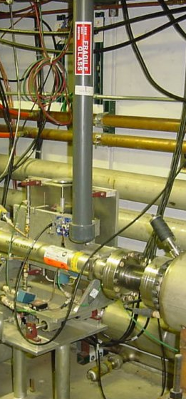
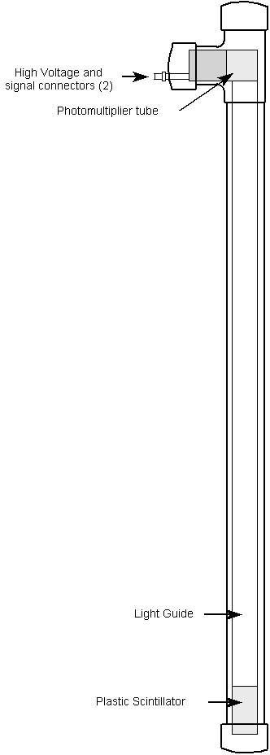
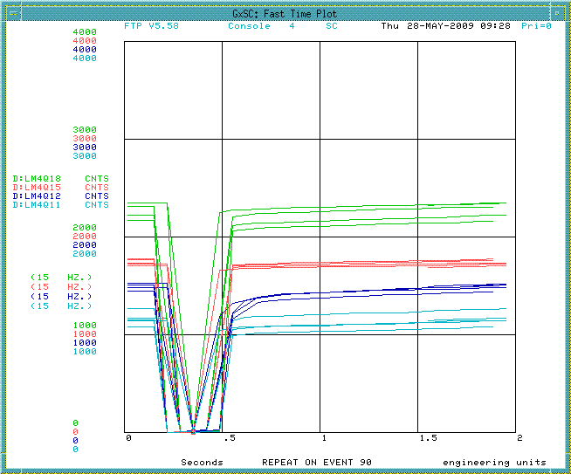
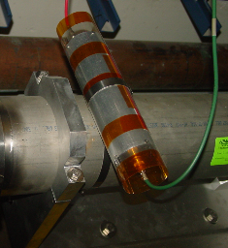
Beam Loss Monitor
Tevatron ion chamber loss monitors (lower left) will be used in the P1, P2 and M1 lines.
No coverage in M2, M3 M4 and g-2 lines.
More sensitive plastic scintillator design (top left and right) already exist in the Debuncher. This is being upgraded to the ion chambers for Mu2e. This may be a problem if we have to switch back and forth between g-2 and Mu2e.
Notes:
- There are two types of Beam Loss Monitors (BLMs) in the Antiproton Source, ion chamber and plastic scintillator with a photomultiplier tube (PMT). The ion chamber BLMs can be found in the P1, P2, AP-1 and part of the AP-3 beamlines and are used to monitor losses during stacking and pbar transfers. The plastic scintillator BLMs are distributed throughout the Accumulator and Debuncher rings and can be used for studies or for locating loss points.
- The ion chamber monitors are the same as those used in the Tevatron. The BLM detector is a sealed glass ion chamber with a volume of 110 cubic centimeters that is filled to 1 atmosphere with Argon. A high voltage power supply is daisy- chained to a string of BLMs and provides about a 1,500 Volt bias to the chamber. The output goes upstairs on an RG58 signal cable to a beam loss integrator and then to a Multiplexed Analog to Digital Converter (MADC). The MADC is read by the control system in the usual way.
- The plastic scintillator design BLM is sensitive to a small number of particles, something the ion chamber loss monitors aren’t. The loss monitors are made up of a 4"x2"x1/2" piece of plastic scintillator glued to a 36" long Lucite light guide (see Figure 7.3). At the end of the light guide, a small Lucite coupling attaches it to an RCA 4552 PMT. The PMT's were recycled from old “paint can” loss monitors and are relatively rugged. The intent of the light guide is to keep the scintillator near the magnets but to extend the phototubes up and away from the region of beam loss. This assembly is mounted in a housing made up of PVC pipe and has feed-throughs for the high voltage and signal cables.
- P1, P2, AP1 Repurpose BLM chassis from Tevatron and assemble integrator cards. Refurbish some of the existing ion chambers. Repurpose additional ion chambers from the Tevatron. Debuncher: For Mu2e operations, the current BLM system will be replaced by Tevatron style BLMs, but this may not be appropriate for the smaller g-2 beam intensities.
- The existing Debuncher BLM system was designed for low intensity secondaries and may be more suitable for g-2 operations. Debuncher Abort Line: Need to develop a plan for BLMs in the Debuncher abort line
Extraction Line Need to develop a plan for BLMs in the extraction line.

Slide 36
Optical Transition Radiation
An OTR may allow us to distinguish pions from protons from muons in the M3 line.
Metal foil in the beam.
Reflected OTR directed to camera
Two dimensional profile of the beam that gives transverse profile, position and intensity.
All secondaries have the same momentum, but also have different gammas since their rest energies are different.
The optical distribution of each type of particle will be different.
OTR was tested in Pbar with 120GeV protons, but never the lower intensity 8 GeV secondaries.
OTRs may be able to be used to measure beam intensities of the secondary g-2 beam down to 10⁵.
OTRs may be able to measure beam profiles and distinguish between types of particles down to 10⁷. This option starts to get expensive due to the camera cost.
Notes:
- Optical Transition Radiation (OTR) is generated when a charged particle beam transits the interface of two media with different dielectric constants. An OTR detector works by placing a metal foil in the path of the beam. The interface between the vacuum and foil creates OTR when beam hits the foil. The foil is thin to minimize beam scattering and is placed at an angle with respect to the beam, so that the reflected OTR can be directed to a camera. The camera can then record a two dimensional beam profile that includes information about the transverse profile, transverse position, emittance, and intensity of the beam.
- OTR detectors are a commonplace diagnostic in electron accelerators. Fermilab experts are attempting to expand the use of this diagnostic to proton and antiproton beams in the various transfer lines. A prototype OTR detector was installed in the AP1 beamline just downstream of EB6 (D:H926) for evaluation. Figure 7.10 is a block diagram of the AP1 OTR system. Foils were composed of 20 mm Aluminum or 12 mm Titanium. It was found that the Aluminum foil provided a brighter signal, but the Titanium foil was more resistant to particle flux. As a result, the choice of OTR foil is dependent on the expected particle flux in the line. A single lens is used to focus the OTR signal onto a radiation-hardened Charge Injection Device (CID) camera. To minimize radiation damage, the camera and lens are placed as far away from the foil as the optics will allow. The foil is located in the beampipe vacuum with a transparent vacuum window between it and the camera and lens which are enclosed inside a light-tight box. Motion control is provided to adjust the angle of the foil and the focus of the camera. For best focus, the camera is placed at the Scheimpflug angle, which defines where the best focus occurs when the subject plane (foil) and image plane (camera) are not parallel. Controlling electronics are connected to a Labview PC located at the F27 service building. Data collection is currently an expert-only task, as
there is not yet an ACNET interface to this system.
-OTR images were successfully gathered for 120 GeV proton beam during stacking, providing a 2-dimensional beam profile that (unlike a SEM) included the rotation of the beam ellipse. The OTR is downstream (stacking direction) of the AP1 to AP3 line split so that the vacuum windows won’t cause pbar emittances to grow during transfers to the Recycler. Also, the OTR was most suitable as a 120 GeV diagnostic because the lower energy 8 GeV beam generates a wider optical distribution, resulting in less light collection. The optical distribution of the OTR peaks at roughly 1/g, where . The gamma (g) for 8 GeV protons is approximately 13 times smaller than that of 120 GeV protons, so the optical distribution generated by the OTR would be about 13 times larger.
Experts also considered installing an OTR detector in the AP2 line. In this case, one could use secondary particles rather than Pbars to make the OTR signal. All negatively charged secondaries going down the AP2 line have a momentum of 8.9 GeV/c, but all have different gammas since their rest energies are different. As a result, the optical distribution for each type of particle would be different. Beam in the AP2 line is overwhelmingly dominated by pions, which outnumber Pbars by orders of magnitude. In addition, the pions have a gamma that is seven times larger than that of an equal momentum pbar, making the spot size seven times smaller. Consequently, experts believe that it is feasible to put an OTR in the AP2 line if desired.

Slide 37
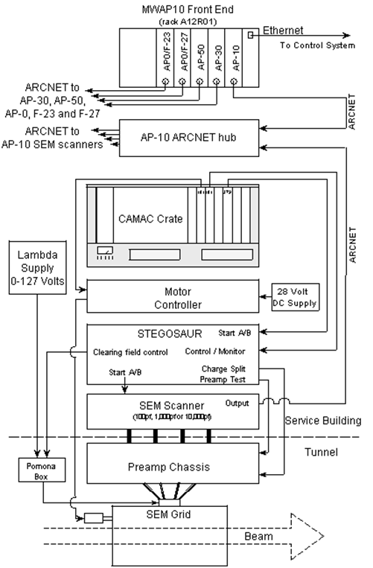
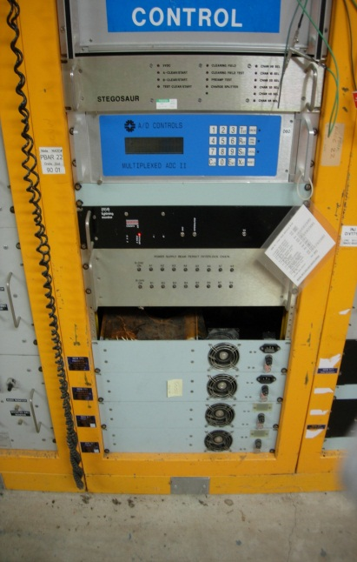
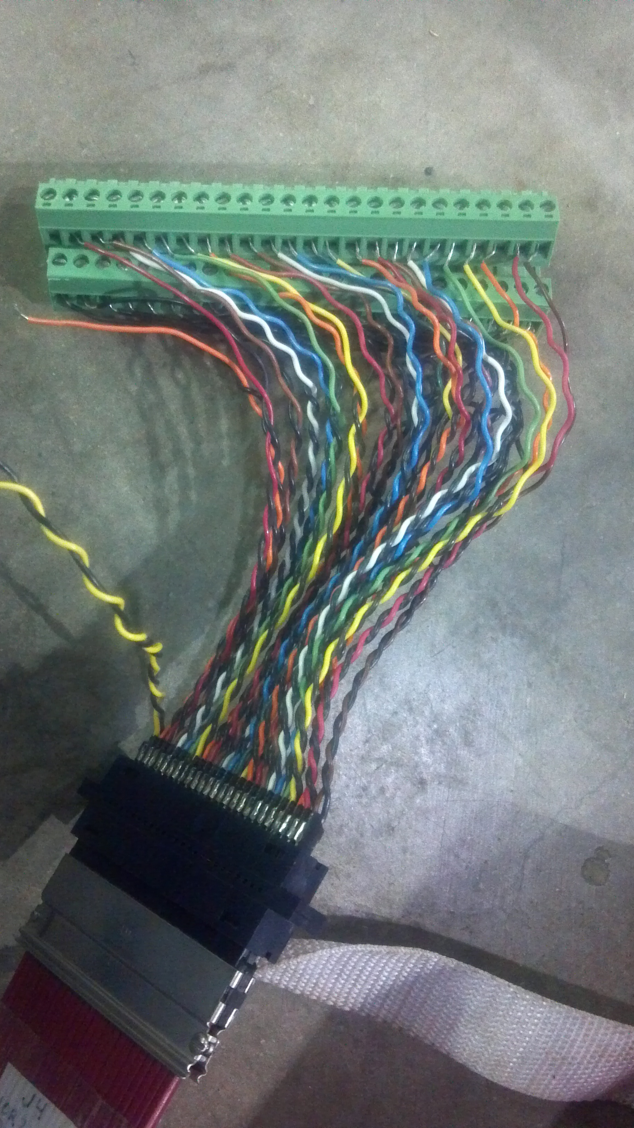
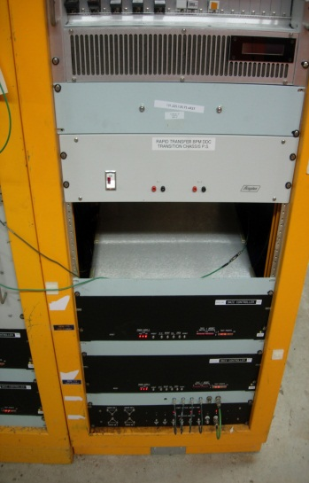
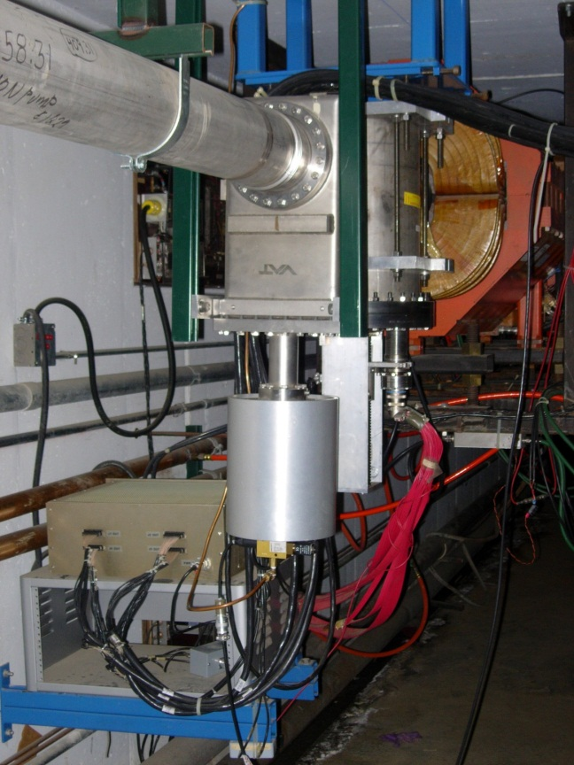
SEM System

Slide 38
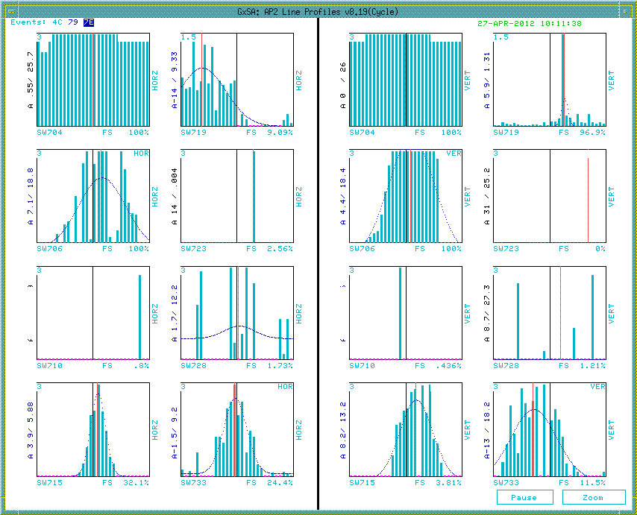
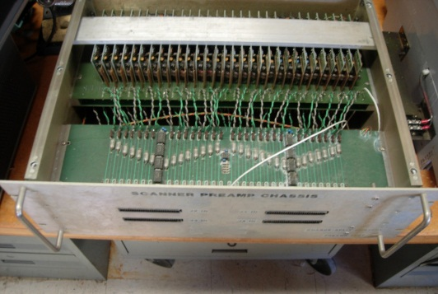
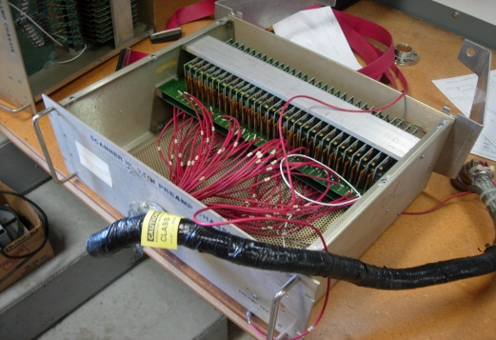
Beam Studies – AP2 SEMs
AP2 Line SEMs RAW data for 3.1GeV/c secondaries from 1E12 protons on target.
Only 2 of 6 hi gain preamps worked for 8/3.1
715 and 733 provide profiles.
Not enough spare cards to build
additional units for AP2 & g-2 line
Need preamp redesign with possible increased dynamic range for g-2 and M4 (mu2e) line
Need to develop a set of specs for design.
Low gain preamp
Gain of 250
~ 25 units + spare
High gain preamp
Gain of 1000
Only 6 units

Slide 39
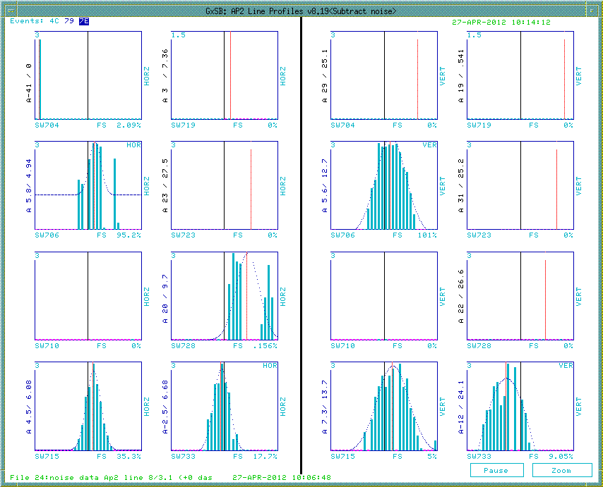
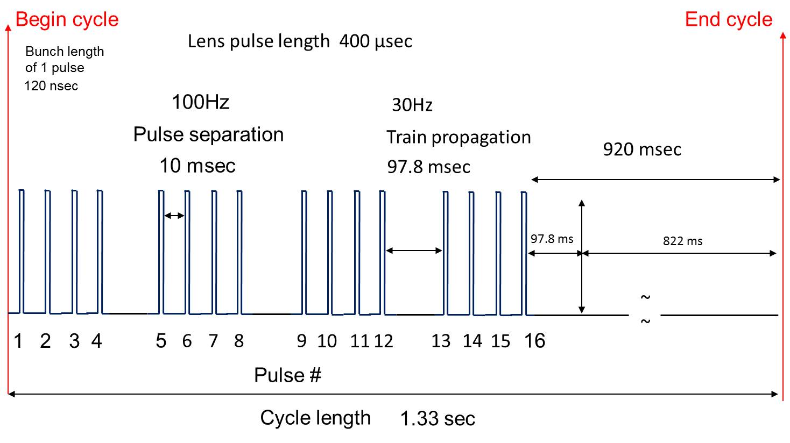
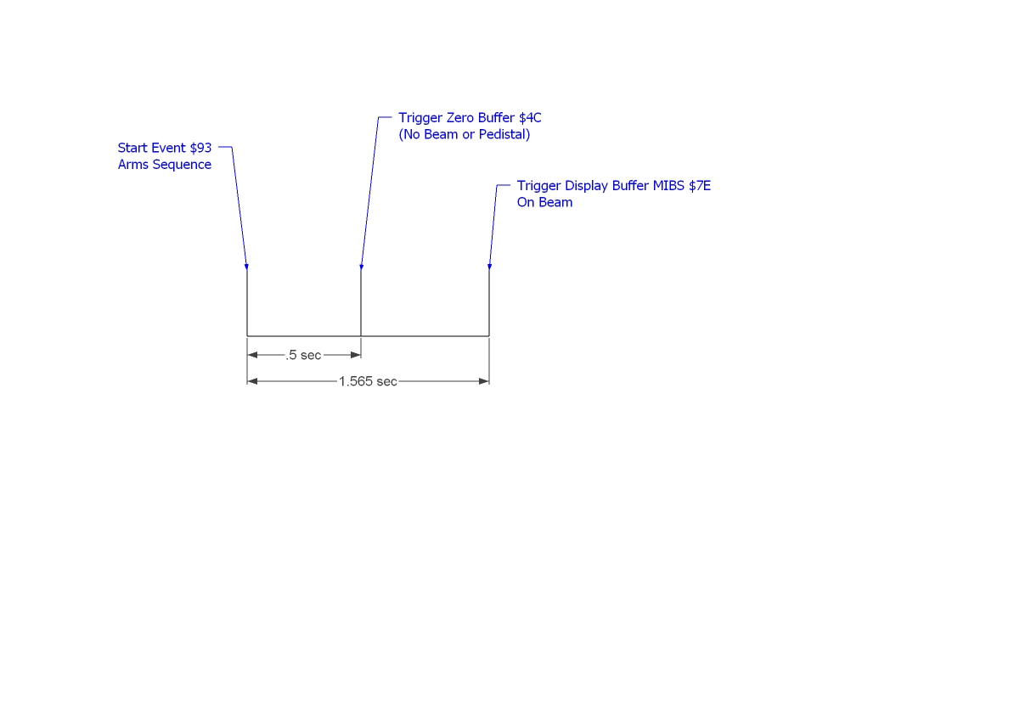
Beam Studies – Reducing Noise
AP2 Line SEMs with manual (file) noise subtraction for 3.1GeV/c secondaries from 1E12 protons on target.
Need triggered background subtraction (BGS). The new scanner will provide this feature.
New scanner time difference from background and beam frame -> ~ 3msec.
Would like to get profiles for all 16 g-2 pulses with BGS. Looks achievable.

Slide 40
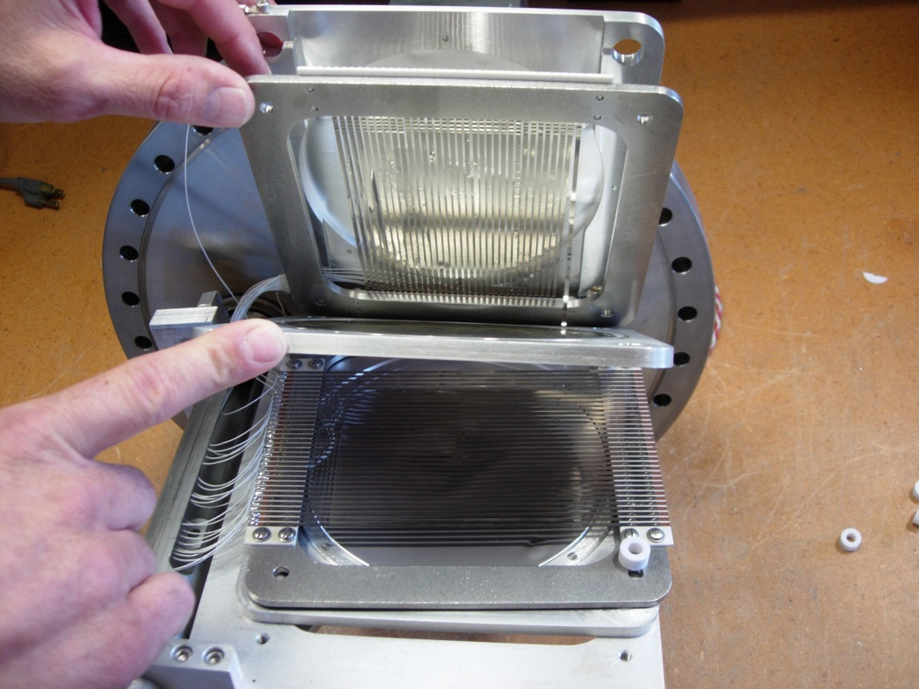
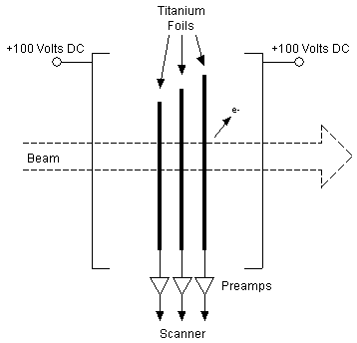
Clearing Fields
We understand that there can be an increase in signal to noise by using clearing fields (CF) (for low intensity signals).
Currently, CF not used or supported. 100V power supplies are removed. AP1,AP2,Ap3 had sufficient intensities without them.
Hooked up the CF to 1 SEM during beam studies and applied 100v but did not see any differences.
Need expert technical help to assess.

Slide 41
Instrumentation for Beam Tests
target
vault
target SEM
TOR109
TOR105
715
SEM
706
SEM
719
SEM
710
SEM
TOR724
723
SEM
704
SEM
TOR704
TOR105 calibrated / used for stacking but beam loss between 105 and 109 with 8GeV beam on target so use TOR109
728
SEM
ion chamber
BPMs
733
TOR733
SEM
(M. Convery)
mode | ion chamber | SEM 733 | SEM 715 | SEM 710 | SEM 706 | SEM 704 | BPMs | TOR 724 | TOR 704
120→8- | not installed | ✓ | ✓ | ✓ | ✓ | ✓ | ✓ | ✓ | ✓scope trace
120→3- | ✓ | ✓ | ✓ | ✓ | ✓ | ✓ | ✓ | ✓ | ✓scope trace
8→3- | ✓ | preamp removed as test | ✓ high-gain preamp | no high-gain preamp | ✓ high-gain preamp | high-gain preamp bad | on spectrum analyzer |  | ✓scope trace
8→3+ | ✓ | ✓ high-gain preamp | ✓ high-gain preamp | no high-gain preamp | ✓ high-gain preamp | high-gain preamp bad | ✓ signals up to 705 |  | ✓scope trace

Slide 42
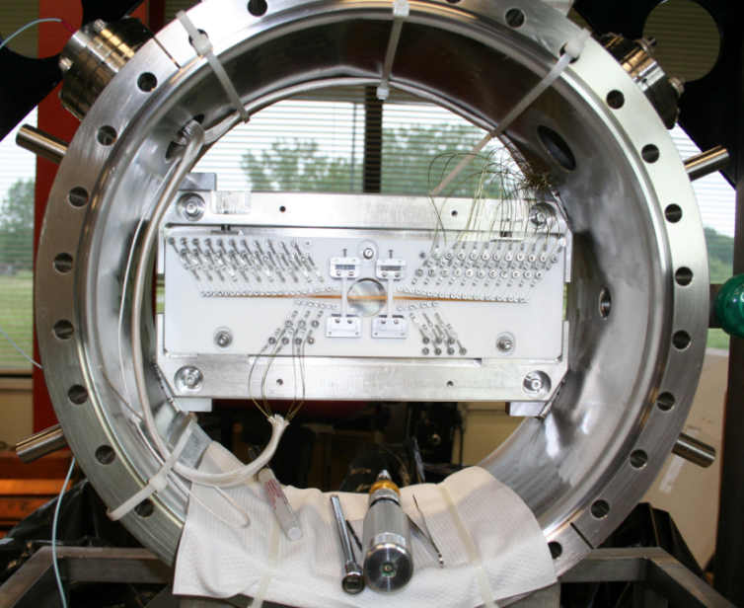
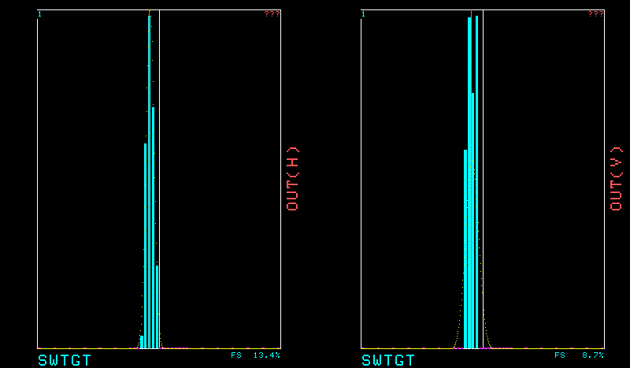
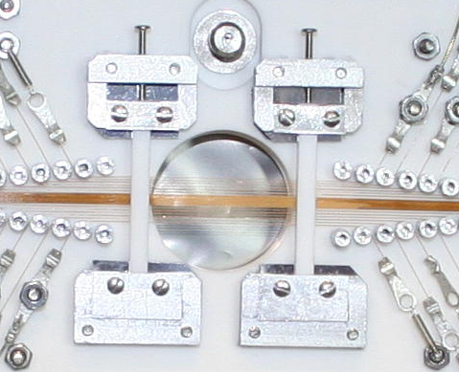
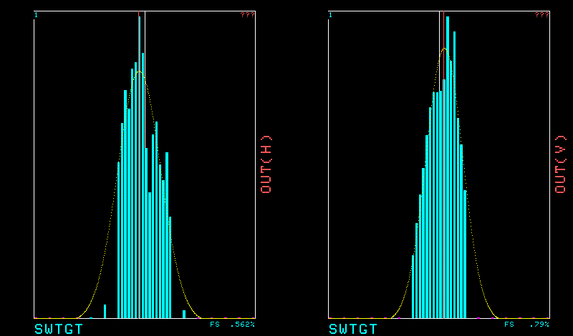
Target Secondary Emission Monitor
Spot Sizes are comparable to values used in the simulation.
Spot size is bigger for 8 GeV beam on target than 120 GeV, as expected
σ=0.13mm
σ=0.22mm
120 GeV
σ=0.5mm
σ=0.5mm
8 GeV
reduced to 0.7mm, 0.7mm
with 40% loss of efficiency
(M. Convery)

Slide 43
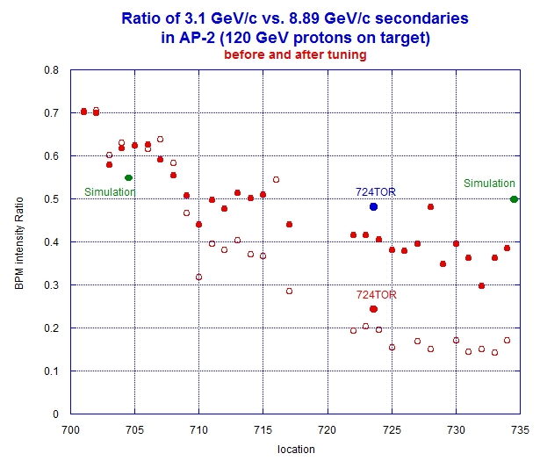
Results from BPM’s for
120->8Gev & 120->3.1 Gev Negative Ions
Simulation point include pion decay
(J. Morgan)

Slide 44
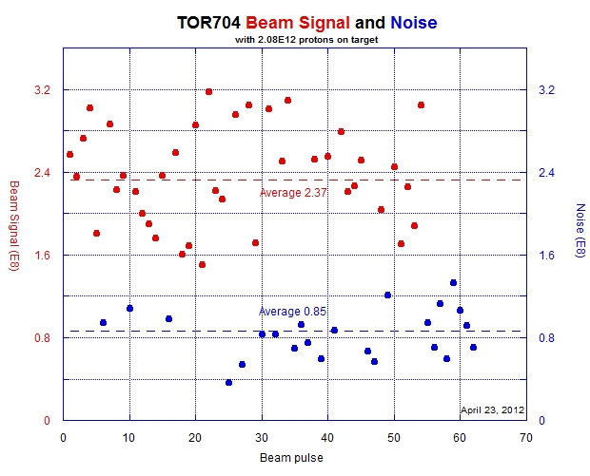
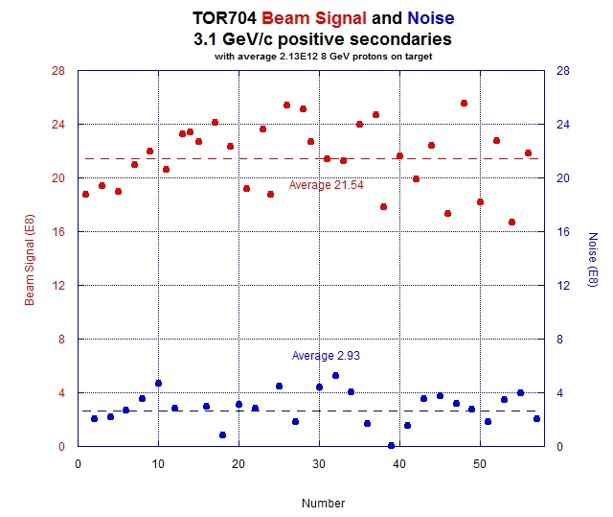
Toroid 704 Data- Absolute Intensity
Beginning of Line
8->3.1 Gev Negative Ions
8->3.1Gev Positive Ions
J. Morgan
If subtract noise from signal get
Intensity of 1.52 E8 for 2.08 E12 POT
Expected from Simulation = 1.02 E8
If subtract noise from signal get
Intensity of 18.6 E8 for 2.13 E12 POT
Expected from Simulation = 4.73 E8
This is an over estimation for (+) case

Slide 45
Tor704 Beam Response
J. Morgan
2.13E12 8.9Gev/c primaries, 3.1 GeV/c POSITIVE secondaries.
Approximately double the POT to be used for g-2.
Average intensity 1.86E9 with signal subtracted from noise.
Simulation results predict 4.7E8

Slide 46
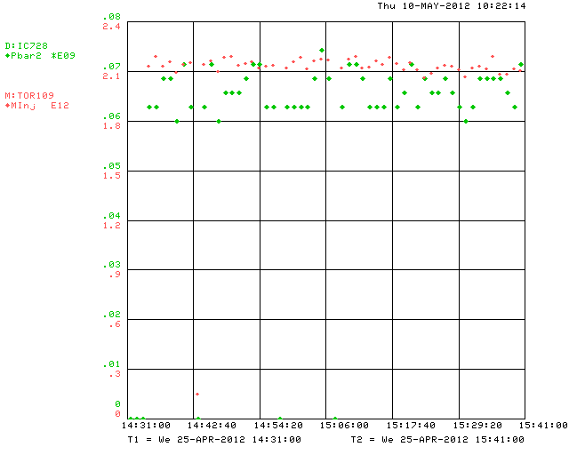
IC728 Beam Response
J. Morgan
2.1E12 8.9Gev/c primaries, 3.1 GeV/c positive secondaries.
Approximately double the POT that will be used for g-2.
Ion chamber measures ~6.6E7.
Cary’s simulation results predict 6.7E7.

Slide 47
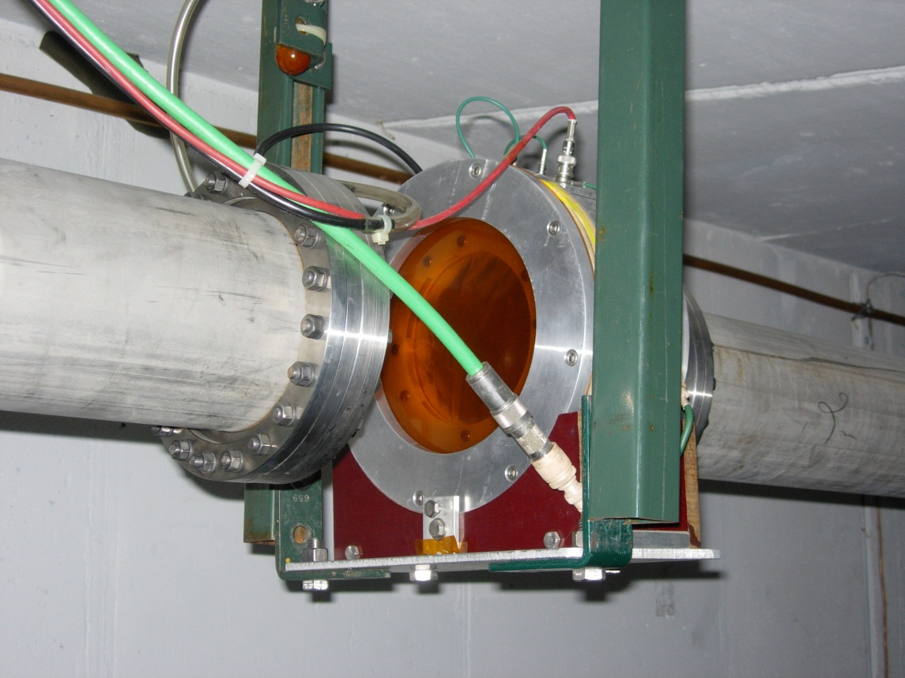
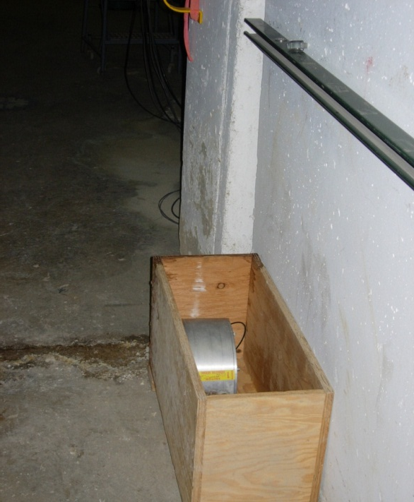
IC728
Original ion chamber.
Removed, but still in the tunnel
Believed to have a gas leak
Second ion chamber was installed.
No gas leak, but relative calibration is questionable.

Slide 48
Monitoring g-2 Secondaries
By the way, in the BNL experiment, the monitoring of the secondary pi/mu beam was done with 6 Segmented Wire Ion Chamber (SWICs) and three ionization chambers to monitor the total beam flux at critical locations.
O
\
\
\----------------------------------O\
\
\
O
The g-2 beamline at BNL had two bends. The first selected the pion momentum,
and the 2nd selected the muon momentum. The O's in the above ASCII art show
roughly where the ionization chambers were. Of course the ring only accepts a very
particular muon momentum so these bends were more about killing off unwanted
pions then about selecting the muon momentum.
You can imagine, we will want a similar setup here. SWICS distributed throughout
the beamlines to give us the profiles and ionization chambers to give us quick feed
back on flux at points where significant tuning is probably required.
Best,
Chris
C. Polly

Slide 49
Antiproton Source
  Some of the existing Instrumentation from the Antiproton Source will be reused for g-2 operations. Below are the beam conditions under which our existing instrumentation are designed to work.
  Primary Beam (P1, P2, and AP1 Lines):
    Particles: Protons
    Intensity: 8E12
    Momentum: 120.9 GeV/c
    Eighty 53MHz buckets
    Bunch Train: 1.695µsec
    Rate: One pulse every 2.2 sec.
  Mixed Secondary Beam (AP2):
    Particles: Pbar, µ-, π-, e-
    Total Intensity (AP2): 2E11 -> 2E10
    Momentum: 8.89 GeV/c
  Pbar Secondary Beam (Delivery Ring and Accumulator)
    Particles: Pbar
    Intensity (D/A Line): 2E8
    No Accumulator for g-2
Notes:
The goal is to repurpose as much of the existing Antirproton Source instrumentation as possible for use with g-2 and Mu2e operations. When existing systems cannot be used, additional unused components from Collider operations (Tevatron and Recycler) will be used when possible to minimize the cost of implementing new instrumentation.
We have a fully instrumented set of beam lines and rings in Pbar.
Toroids:
-5 toroids in the primary beam lines: P1 (2), P2, AP1 (2)
-4 toroids in the secondary beam lines: AP2 (3), D/A
BPMs:
-P1 (30), P2(18), AP1 (18) and AP3 (58) fully equipped with Echotek BPMs
-Delivery Ring (120):
SEMs:
P1 (6), P2 (4), AP1 (5), AP3 (7), AP2 (8), D/A (4), DR (2), Acc (1)
IC:
AP2 (1)

Slide 50
Muon g-2
  Below are the expected beam conditions for g-2 operations. Particle intensities are estimated beam simulations performed by Cary Yoskikawa (GM2-doc 299).
  Primary Beam (P1, P2, and M1 Lines):
    Particles: Protons
    Intensity: 1E12
    Momentum: 8.89 GeV/c
    Single 2.515MHz bucket
    Bunch Length: 120nsec
    Rate: 12Hz with 100Hz bursts (20 bunches, 10ms interval)
  Mixed Secondary Beam (M2, M3 and Delivery Ring):
    Particles: Protons, µ+, π+, e+
    Total Intensity: 2E8 -> 2.5E7
    Momentum: 3.1 GeV/c
  Proton Secondary Beam (Beam abort lines)
    Intensity: 2E7
  Muon Secondary Beam (M4 and g-2 lines)
    Particles: µ+
    Intensity: 3E5
J. Morgan
J. Morgan
Notes:
Notice differences in intensity, RF frequency and bunch structure between Pbar and g-2.
Beam properties between Pbar and g-2 operations are different, meaning that the existing instrumentation often can not be used “as-is.” In some cases we are lucky and simple electronics upgrades, with components often repurposed from the Tevatron and Recycler, can be made to the existing systems to make work with g-2 operations. In other cases, the original instrumentation will not be funcitonal for g-2.

Slide 51
Instrumenation Beam Studies
Primary Proton Beam (P1, P2, M1):
    Beam intensity and energy that will be used during g-2 operations can easily be recreated during beam studies.
    RF structure of studies beam is different than g-2 operations.
    We are hoping this to be fairly straight forward to use existing instrumentation with some minor upgrades.
Mixed g-2 Secondary Beam (M2,M3 and Delivery Ring):
    Beam intensity and energy that will be used during g-2 operations can easily be recreated during beam studies.
    RF structure of studies beam is different than g-2 operations.
    Beam intensities in the M2 and M3 lines will have three orders of magnitude less than the equivalent lines used in pbar operations, but comparable to D/A line intensities.
    Modifications to instrumentation (adding preamps, etc…) will be required, and in some cases challenging.
    Some additional instrumentation may be required.
Muon Secondary Beam (M4 and g-2 Line):
    Muon beam will be three orders of magnitude smaller than the D/A line.
    Measuring the low intensity muon secondaries will be challenging.

Slide 52
Beam Study Modes
120 Gev/c Protons
1E11
-8.89Gev/c
1E10
Stacking
Pbars
1)
8E12
target
AP1
704
AP2
733
120 Gev/c Protons
-3.1Gev/c
2)
target
AP1
704
AP2
733
8.9 Gev/c Protons
-3.1Gev/c
3)
target
AP1
704
AP2
733
120 Gev/c Protons
+3.1Gev/c
4)
target
AP1
704
AP2
733
8.9 Gev/c Protons
2E8
+3.1Gev/c
2E7
Similar
to
g-2
5)
1E12
target
AP1
704
AP2
733

Slide 53
How can we measure beam intensity and position?
Intensity
  Toroid
  Ion Chamber
  Wall Current Monitor
  Beam Position Monitors
Positions and Profiles
  Beam Position Monitors
  Segmented Wire Ion Chambers
  Secondary Emission Monitor

Slide 54
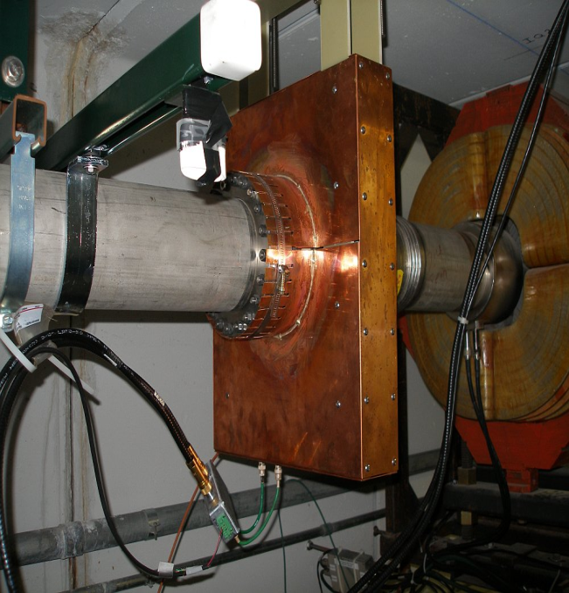
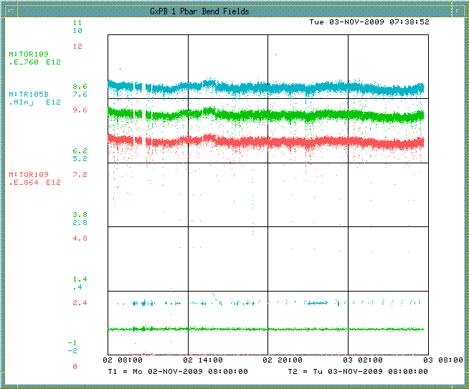
Toroid
Toroids exist in the transport lines to monitor beam intensity.
Primary Protons:
  Toroids in the P1, P2 and M1 lines will still be used to measure high intensity primary beam and will need minimal maintenance.
  Upgrade electronics to lab standard? Adds costs but VME crate, controllers and timing cards can be repurposed from other accelerator locations.
Secondary Beam:
  Previously used toroids to measure low intensity secondary pbar beam of approximately 10¹⁰ but required high gain and careful filtering.
  Don’t have good high frequency response. Will be able HARDER to see the single 2.515MHz bunch.
  The preamp shielding was sufficient for stacking beam, but may need to add additional shielding.
  Toroids in the M2 and M3 lines may not be able to measure the low intensity secondaries for g-2 operations.
  Beam studies were attempted looking for low intensity secondaries.
Notes:
Two toroids in P1, one in P2, two in the M1 line, three in the old AP2 line and one in the D/A line.
Toroids configured for high intensity running can measure 10^12 or 10^13.
Use existing Toroids and insulators in the P1, P2 and M1 beam lines. Some work needed on some of the stands, signal cables and calibration cables. A couple of Toroids may need to be added or moved. VME crate, controllers and timing cards re-purposed from other accelerator locations.
Toroids for low intensity pbars in the AP2 line measured 10^10 to 10^11, but won’t be able to be used in the M3 line. A pulse of 10¹⁰ particles in 1.6 microseconds is equivalent to 1 mA of current flowing through the toroid. This produces an output signal of only 1 mV, requiring high gain and careful filtering. In the AP2 line we connected to scopes.
Pearson single turn large aperture toroids are located in the transport lines to monitor beam intensity. They are beam transformers that produce a signal that is proportional to the intensity (1 V for every 1 A of current). The toroids make use of integrators that sample over a gated period that is defined by a Main Injector Beam Synch (MIBS) timer.
-

Slide 55
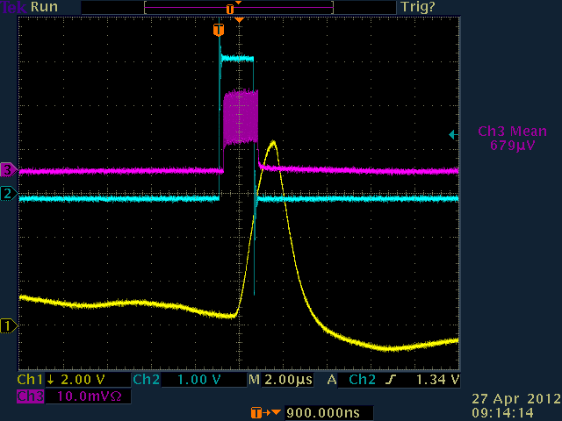
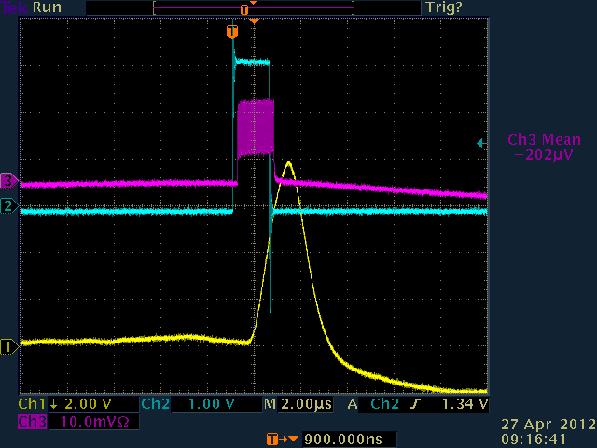
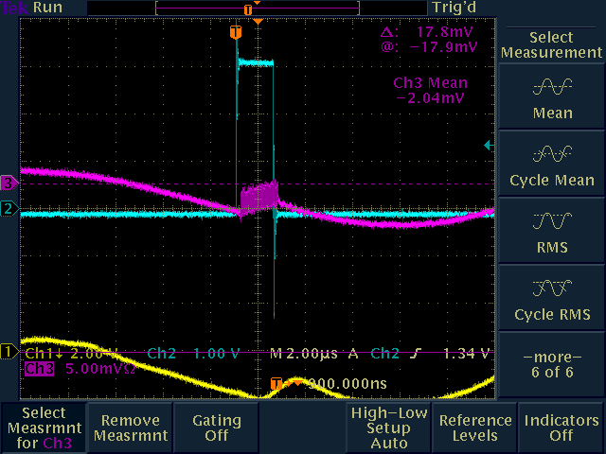
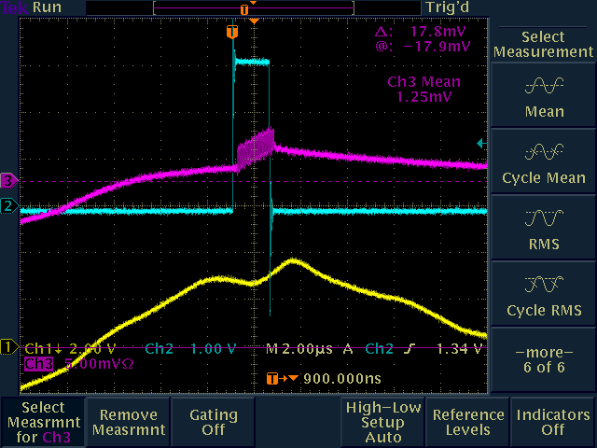
Tor704 Test Signal Response
2E9
Test Pulse
2E8
Test Pulse
Notes:
-Put high gain preamps
-Advantage of toroid is you can plug in a test signal in the upstairs electronics to calibrate the output signal.

Slide 56


Tor704 Beam Response
No Beam
Beam
Similar conditions to g-2 we see a small beam signal.
  1E12 protons on target (8.9 GeV/c) with 3.1 GeV/c secondaries
  Tried to setup software to get the scope peak and calculate intensity.
    Had trouble with intensities this low.
  Picking out the peak by eye, we get about 5e8, or about two times what the model says.
Notes:
-Tor704 in the upstream AP2 line with high gain preamp electronics.
-Bottom line is the expected beam intensities make a barely measureable signal on Tor704 in the upstream AP2 line.

Slide 57



Tor724 Test Signal Response
No Signal
2.4E9
Test Pulse
2E8
Test Pulse
Notes:
-Tor724 in the downstream AP2 line with high gain preamp electronics.
-Model shows beam at Tor724 should be a factor of 8 reduction, or 2E7.
-We barely see a test pulse signal at 2E8.
- We see no signal at Tor724 when beam is run down the line.
-Toroid will get even less signal with the short 2.515MHz bunch.
-In short, we will not be able to use Toroids for low intensity operations.

Slide 58


Ion Chamber
Contains a high voltage electrode and a signal electrode and is filled with gas (Helium, ArC02, etc…). Particles pass through the chamber and ionize the gas giving a signal proportional to beam intensity.
Can measure smaller beam currents than toroids, and bunch structure and particle charge do not impact response.
Good for measuring beam in the 10⁵ to 10¹¹ range.
Can be calibrated to ~5%.
Ion chambers require a vacuum break.
Two options are non- retractable (inexpensive) and ones installed in a vacuum can that are retractable (expensive).
Have a pool of spares available plus a couple potentially available from BNL.
For g-2 operations, we could put one at the end of the M2, one at the end of M3, one in the Delivery Ring and one in the g-2 line.
  Any ion chambers in the Delivery Ring or M4 line would need to be retractable to be compatible with Mu2e operations.
Notes:
-IC728 is the only location in Pbar/Muon that has an ion chamber.
-One that has a leak and a second one.
-If we can’t locate spares we may have to build some.
-Work includes calibrating the existing toroid and building additional ones.
- M2 (1), M3 (1), DR(?), M4, g-2
Requires a vacuum break, ArCo2, degrades beam quality.
Good for measuring beam intensities from 10^5 to 10^11
Used to use one in the AP2 line at the 728 location. Further back also at 704 and 806
-The ion chamber has a high voltage electrode at -300V and a signal
electrode contained in a chamber filled with helium gas. Secondary particles
traveling down the AP-2 line pass through the chamber and ionize the helium
resulting in a current path to the signal electrode. The result is a signal
proportional to the beam intensity.
-A small amount of helium passes out of the ion chamber through a
bubbler, however the loss rate is very small.
An ion chamber is able to measure smaller beam currents than a toroid
so it is an appropriate choice for low intensity secondaries.
- The ion chambers have a tendency to leak gas into the beampipe

Slide 59

IC728 Beam Response
8.9Gev/c primaries, 3.1 GeV/c positive secondaries.
Beam intensity plot stepping down from 2E12 on target to ~1E11.
Ion chamber tracks beam on target.
Ion chamber intensities (not calibrated) measured from 8E7 down to ~5E6.
Notes:
-Even the uncalibrated toroid signal seems to match the model over the tested range within a factor of 2.

Slide 60

Wall Current Monitor
Wall current monitor could be used to measure the beam intensity.
During Pbar Operations we used a wall current monitor in AP1 for both high intensity 53MHz protons and low intensity 2.5MHz Pbars.
AD/Instrumentation is designing a prototype WCM for to measure Mu2e spill (slices of 2e7 every 56msec).
For g-2 operations, we might be able to add a WCM to the Delivery Ring and/or the beam lines to measure low intensity circulating beam intensity.
Pros: Passive device
Cons: More expensive ($30K) to build than a non-retracting ion chamber ($5K).
No included in the studies since AP1 high intensity primary beam.
8E12 53MHZ Proton Beam
82 bunches
7E10 2.5MHZ Pbar Beam
Notes:
Beam with a bunch structure causes current to flow on the inside of a metallic beam pipe, such as the stainless steel beam pipes used in the Antiproton Source. By breaking the metal beam pipe with an insulating ceramic gap and placing a resistor across the gap, one can measure the voltage drop across the resistor that is proportional to the beam current.
The frequency response of the pickup rolls off on the low end because of beam pipe conditions external to the pickup, so the pickup is housed in a shielding box loaded with ferrite material to provide a known value of inductance. The geometry of the ceramic gap and the resistors are chosen to form a properly terminated transmission line. The low frequency response of the wall monitor is determined by the time constant set by the ferrite (16 mH) and the gap resistance (0.5Ω), it is about 5 kHz. The characteristics of the ferrite inductors also set the high frequency response of the pickup. Two types of ferrites and a coating of microwave absorbing paint inside the shielding box are used to provide an even frequency response to 6 GHz.
As beam passes irregularities like bellows in the beam pipe, it induces microwave fields at frequencies determined by the dimensions of the beam pipe structures. That energy travels down the inside of the pipe and can be detected by the wall monitor. To avoid those noise problems, ferrite chokes are installed on both ends of the wall detector.
Signals are taken off the gap at four points around the circumference and summed to minimize sensitivity of the output signal to variations in beam position within the pipe. The overall sensitivity of the monitor, accounting for gap resistance, summing of the four signals, 50Ω terminating resistor, etc. is approximately 0.15Ω.

Slide 61
Beam Position Monitors
BPMs were used in Pbar Operations to measure beam position with sub-millimeter resolution for autotune steering program.
  Three different styles of BPMs.
  Preamps used for downstream AP2 (10¹⁰ particles)
  Two cascaded preamps for a total gain of 50dB used for ~ 2 x 10⁸ D/A line beam.
P1, P2, M1 and M3 BPMs are designed to see four 2.5MHz bunches.
  Minor electronics changes required.
M2 and Debuncher BPMs can only see 53MHz and will be upgraded to Echotech standard with 2.5MHz electronics.
  Repurpose Tevatron BPM crates
  Repurpose Recycler BPM electronics
Where can we use BPMs?
BPMs can be used for primary beam autotune.
BPMs may be usable for mixed secondaries in the M2, M3, and Delivery Ring.
BPMs cannot be used for muon secondaries in the M4 or g-2 or lines.
Notes:
Delivery Ring BPM Plan:
-Removing old BPM electronics hardware from the Delivery Ring (Debuncher).
-Modify Recycler analog transition boards to handle expected signal intensity produced by a 1e12 ppb (2.5 MHz) in the Delivery Ring.
-Design a plate which transitions N-type connectors to DB-9 connectors allowing BPM signals to connect to 2.5 MHz transition board DB -9 input connectors.
-Design and test 2.5 MHz filters in the digital down-converter boards installed in the Debuncher.
-Install VME64X crates in Delivery Ring service building.
-Purchase MVME5500 processor boards to be used as crate controllers or if any available from TeV BPM system use those.
-Make # of Top Plates for the relay racks where the VME64X crates will be installed.
-Modify transition boards to handle signal intensity in the 2.5 MHz channel which is already implemented in the existing transition boards.
-Develop front-end software in the BPM system that can be used with Debuncher control system.
-Develop code to process signals from the digital down converter boards and produce a beam position signal.
Beam Line BPM Plan
-P1, P2, M1 (AP1) and M3 (AP3) lines have an Echotek-based BPM system , no software is required for these lines. It is based on detecting 2.5MHz single bunch on a single pass by digitizing at 80 MHz.
-Hardware changes to the 2.5 MHz channel to handle the input signal level consist on adding an external attenuator at the top plate for each BPM pickup.
-The Debuncher Abort line has 8 BPM’s. It will require two 2.5 MHz recycler transition boards and two 8 channel echotek boards. It will need 1 VME64X -9 channel slot crate, one MVME5500 processor and one timing board.
Pbar has three different styles of BPMs.
Provide sub-millimeter resolution of the horizontal and vertical positions.
Debuncher BPM’s are cylindrical with an 18 cm diameter. BPM's can also be found in the AP1, 2 and 3 beamlines. The AP-1 line has 7.6 cm diameter combined horizontal and vertical BPM’s at every quadrupole location while the AP-2 and AP-3 lines are single-plane and 13 cm in diameter, generally alternating planes at quadrupole locations.
The 120 Debuncher BPMs are divided into six “houses” of 20 BPMs each (10 horizontal and 10 vertical) – can only see 53MHz beam.
The P1, P2, AP1 and AP3 lines all share the Echotek style BPM electronics that were built as part of the “Rapid Transfers” Run II Upgrade. Electronics racks reside in MI60-S (P1 Line), F1 (P2 Line), F23 (AP1 and AP3 Lines), F27 (AP3 Line) and AP30 (AP3 Line). These BPMs are designed to detect seven to 84 consecutive 53MHz proton bunches in reverse proton or stacking mode, and four 2.5MHz pbar bunches in Accumulator to Recycler antiproton transfer mode. There are two crates used to process the BPM data: the analog crate and the VME crate. Figure 7.7 gives an overview of the Echotek BPM layout.
-Signals from the BPM A and B plates in the tunnel are sent up to the service buildings via RG8/RG213 cables and are connected to the back of the analog filter cards in the analog crate. The analog cards filter, attenuate and amplify the analog BPM signals as needed. Each analog card can handle two BPMs (four BPM plate signals) which are processed and output through the front panel cables to Echotek cards in the BPM VME crate. The analog crate also contains a test/control module that handles setup of the filter modules including test pulses. The entire crate is powered with an external +5V power supply that is found near the bottom of the rack.
- Secondary particles in the AP-2 line have the same 53MHz bunch structure as the targeted proton beam, so BPM’s can be used to detect beam position. There are 34 BPMs in the AP-2 beam line and seven BPMs in the D to A line that share common design features. When stacking, the number of antiprotons and other negative secondaries (mostly pions and electrons) in the AP-2 line is relatively small, on the order of 1 x 10¹¹ at the beginning of the line and 1 x 10¹⁰ at the end of the line. The beam intensity in the D to A line is even smaller, with ~10⁸ or less reaching the Debuncher. In addition, the AP-2 BPMs on the Debuncher end of the line see significant electrical noise from the Debuncher Injection kicker. For these reasons, the AP-2 and D to A Line BPMs could not be used for measuring pbars in past years. In 2005, new BPM electronics were designed for use in the AP-2 line. After the electronics were installed and deemed a success, they were then propagated to the D to A line BPMs. AP-2 BPMs can be used to look at both bunched stacking secondaries and bunched reverse proton beam while D to A line BPMs are only used under special conditions. During stacking, the D to A BPMs are only used with the Pledge Pin application (currently P155) for tuning on closure into the Accumulator. The D to A line BPMs can also be used to look at bunched reverse protons.
As beam decreases in intensity while traversing the AP2 and the D to A lines, increasing amounts of amplification is needed before the signals can be processed. The upstream AP2 BPM (701-715) plate signals are sent straight up to the F27 service building where they are amplified by 20dB RF amps. The downstream AP2 BPM (716-734) plates have low noise Hittite amps with 25dB gain located in the tunnel. The D/A line BPMs must read even lower intensities, so two cascaded Hittite amps with a total gain of about 50dB are attached to the pickup plates in the tunnel.
P1, P2, AP1 and AP3 lines hardware and Echotek electronics are already in place and are already are capable of seeing 2.5MHz beam.
Debuncher BPM tunnel hardware can be reused. Electronics would need to be removed and replaced with the Echotek system to see the 2.5MHz beam.
Echotek electronics would be repurposed from the Tevatron and Recycler.
Beam only circulates in the Debuncher three times, we need to determine if we can see this beam with the proposed BPM system. Debuncher abort line would use the AP2 line BPM tunnel hardware and update the electronics to the Echotek system.
We will not likely be able to use them in AP3, Debuncher, Abort or Extraction Line

Slide 62

AP2 BPMs
8.9Gev/c primaries, 3.1 GeV/c positive secondaries.
Beam intensity plot stepping down from 2E12 on target to ~1E11.
Only first couple of BPMs in the AP2 line have intensity data with 1E12 POT.

Slide 63

AP2 BPMs
1E12 8.9Gev/c primaries, 3.1 GeV/c positive secondaries.
We only see beam intensity data on the first five BPMs.
Units are not calibrated to number of particles.
This beam that is eighty 53MHz buckets and not a single 2.515MHz bucket as will be seen in g-2 operations.
Notes:
-The single 2.515MHz RF bunch at 1E12 should be easier to see than the same intensity spread out over 55dB.
-upgrades to electronics
-Experts believe we will be able to see BPM signals in the M2 and M3 lines.
Dynamic range is 55dB

Slide 64



Segmented
Wire
Ion
Chamber
Displays transverse beam profiles using 48 horizontal and 48 vertical wires
Measures beam intensities from 10⁵ to 10¹³, so they can be used to measure the low intensity secondaries.
Commonly used at Fermilab in Switchyard and other areas with low beam intensity.
Destructive beam measurement. 7E9 lost in one pass from 5E12.
Two styles: SY and Bayonet (spare pool?).
ArC0₂ gas flows through vacuum can.
3-4 mil titanium vacuum window.
Vacuum boxes don’t normally hold good vacuum. 10⁻⁶ torr at best.
SWICs could be used in the M4 and g-2 lines for g-2 operations.
May need to be used in the M2, line M3 line and Delivery Rings if SEMS don’t work..
Notes:
48 Horizonal and 48 vertical wires near ground. Center diagonal at HV
ArC02 gas flows through vacuum can
3 to 4 mil titanium vacuum window separates vacuum can from beam line
Gas ionizes – positive ions move toward signal wires.
Destructive measurement of beam.
Each SWIC loses 7E9 per 5E12
Two styles – SY (square box – wires rotate vertically) and Bayonet can (wires move up/down)
Vacuum cans have 4” beam flange, but can accommodate up to 6”
Wire spacing 0.5 to 3mm
Measure beam intensities from 10^5 to 10^13.
Instrumentation doing an inventory from spares. There appears to not be enough spares to cover everything, so additional ones would have to be made.
Vacuum boxes don’t normally hold good vacuum. 10^-6 tor at best.

Slide 65


Secondary
Emission
Monitor
Measure the beam profile using 30 horizontal and 30 titanium strips.
Beam particles have elastic collisions with the strips, dislodging them, creating current. 2.5% to 5% efficient.
Destructive measurement like the SWIC, but operate at beam pipe vacuum and have no gas.
We have an ample supply of SEMs already installed in the AP2 and AP3 lines that could provide coverage for the M2 and M3 lines with minimal expense.
New preamps and clearing foils may need to implemented to work with the lower g-2 intensities.
  D/A line SEMs have special high gain preamps that make them 260 times more sensitive. Three are only five of these preamps.
SEMs “may” be able to be used for low intensity secondaries in the M2, M3 and Delivery ring.
SEMs will not work for M4 and g-2 lines for g-2 operations.
SEMs can be used for occasional diagnostics in the beam lines for M2e operations.
Notes:
SEM grids are used to measure the beam profile in the horizontal and vertical planes. SEMs consist of rows of 30 vertical and 30 horizontal titanium strips that can be placed in the path of the beam. Beam particles have elastic collisions with electrons in the strips and dislodge them (see figure 7.8). This causes a current to flow in the strips, which is amplified by preamplifiers.
Wire spacing is either 1.5mm or 3mm and most are 3mm.
- SEMs: P1 (6), P2 (4), AP1 (5), AP3 (7), AP2 (8), D/A (4), DR (2), Acc (1)
For every forty protons or antiprotons passing through the SEM, one electron is dislodged yielding a detector efficiency of 2.5%. A
- clearing voltage of +100 VDC can be applied to foils placed before and after the strips to improve the work function of the titanium and double the efficiency to 5%. Since a small amount of the beam collides with the titanium strips, SEM grids are not completely passive devices. Most SEM grids are located in the transport lines, although a few are located near injection and extraction points in the rings to be used during initial tune-up. If one of the ring SEM grids is left in, beam will be rapidly lost.
The SEM grids operate at beam pipe vacuum pressure and thus have no gas gain like the Segmented Wire Ionization Chambers (SWICs) found in Switchyard. Preamp boxes are used to amplify the signals generated by the SEM. Preamp boxes contain a pair of motherboards with 30 preamp boards plugged into each (one horizontal and one vertical set). Some versions of the preamp box have charge splitters that, when selected, attenuate the signal to the preamps 15 times when the charge split input is +5V. D to A line SEMs use preamps with two available gain configurations. Switching the gains requires a tunnel access. D to A line SEM gains are up to 260 times more sensitive than those of the other SEMs due to the low beam intensities found during stacking.
P1, P2, AP1 and AP3 :
Existing SEM/Multiwire tunnel hardware will be used.
Some refurbishing will be required on some of the cans.
Electronics will be upgraded to an instrumentation standard.
Debuncher There is currently one SEM in the Debuncher Ring.
Debuncher Abort One or two existing AP2 SEMs can be used for the Debuncher abort line
Extraction Line Need to develop a plan for SEMs in the extraction line.
BNL SWICS and/or ion chambers
Instrumentation experts will determine if we can use the SWICs and Ion Chambers used by the BLN g-2 decay line.

Slide 66

Beam Studies – Target SEM
AP0 Target SEM with 1E12 of 8.89GeV/c protons on target and spot sized optimized.
Similar to Muon g-2 conditions except this profile is measured from a bunch train of 81 bunches 53MHz beam.
Muon g-2 beam will be a single 2.5MHz 120nsec bunch.

Slide 67



Beam Studies – AP2 SEMs
AP2 Line SEMs for 3.1GeV/c secondaries from 1E12 protons on target.
Noise
  Raw data is noisy
  Manual background subtraction
  Hardware background subtraction?
Preamps
  Six “high gain” preamps
  Only two worked in 8/3.1
  Design a new preamp?
Clearing Foils
  Clearing foils can increase signal to noise for low intensity signals.
  Was not used for Pbar Operations.
Manual Noise Subtraction
Clearing Foil
Noisy Signals
Low gain preamp
Gain of 250
~ 25 units + spare
High gain preamp
Gain of 1000
Only 6 units
Notes:
AP2 Line SEMs RAW data for 3.1GeV/c secondaries from 1E12 protons on target.
Only 2 of 6 hi gain preamps worked for 8/3.1
715 and 733 provide profiles.
Not enough spare cards to build
additional units for AP2 & g-2 line
Need preamp redesign with possible increased dynamic range for g-2 and M4 (mu2e) line
Need to develop a set of specs for design.
AP2 Line SEMs with manual (file) noise subtraction for 3.1GeV/c secondaries from 1E12 protons on target.
Need triggered background subtraction (BGS). The new scanner will provide this feature.
New scanner time difference from background and beam frame -> ~ 3msec.
Would like to get profiles for all 16 g-2 pulses with BGS. Looks achievable.
We understand that there can be an increase in signal to noise by using clearing fields (CF) (for low intensity signals).
Currently, CF not used or supported. 100V power supplies are removed. AP1,AP2,Ap3 had sufficient intensities without them.
Hooked up the CF to 1 SEM during beam studies and applied 100v but did not see any differences.
Need expert technical help to assess.

Slide 68

Beam Studies – SEM Intensity
SEMs for measuring beam intensity?
Needs to be calibrated – as long as profile has good fit.
SEM 733V
Intensity
(Poor fit at end)
SEM 715H
Intensity

Slide 69
Summary
Intensity measurement studies were made with beam intensity conditions similar to that expected for g-2 operations:
  1E12 primary proton beam on target at 8.9GeV/c.
  3.1 GeV/c secondary beam in the AP2 line
The RF structure of the beam during our studies did not match g-2 operations.
  Studies: 1.69usec bunch train of eighty 53MHz bunches
  g-2 operations: Single 120nsec 2.515MHz bunch

Slide 70
Summary
Primary Proton Beam (P1, P2, M1):
    Intensity: Toroids, BPMs
    Position: BPM
    Profile: Multiwire/SEM
Mixed g-2 Secondary Beam (M2,M3 and Delivery Ring):
    Intensity: Ion chamber or Wall Current Monitor or BPM (maybe)
    Position: BPM (maybe)
    Profiles: SEMs (maybe), SWICs (if SEMs don’t work)
Muon Secondary Beam (M4 and g-2 Line):
    Intensity: Ion Chamber
    Position/Profile: SWICs

Slide 71
What’s next?
After the current long shutdown we will have another opportunity to complete beam intensity studies.
  Can we get studies beam with 2.515MHz structure?
  Can we lower the AP2 intensity to 3E5 to emulate the M4 and g-2 lines?
  Need to build a studies plan?
  Where will the funding come from to complete our instrumentation studies?
Which diagnostics will work for the low intensity mixed secondaries
  Will the BPMs work?
  Can we use existing SEMs instead of building SWICs.
  Are the beam intensities just too small for us to use Toroids ?
  Ion Chambers (stationary vs retractable)? Recycle BNL vs FNAL spares vs building new?
  Will the NuMI slow spill Wall Current Monitor work for g-2?
How much effort will be required for the BNL instrumentation (ion chambers and SWICs) be interfaced to the FNAL controls?

Slide 72
References
J Morgan, B Drendel, et al, Antiproton Source Rookie Book, Fermilab Accelerator Division Document Database #2872, June 2010.
B. Drendel, Accelerator Controls and Instrumentation for Mu2e and g-2, g-2 Document Database #159
C. Yoskiwawa, “Simulations of the g-2 Test Beams,” Muon g-2 Doc database #299, April 2012.

Slide 73
References
Werkema, et al, Mu2e Accelerator Conceptual Design Report, Mu2e Document #
Glenzinski, D., Status of the Mu2e Experiment, Mu2e Document #, December 2011
Polly, C., Bringing Muon g-2 to Fermilab, g-2 Document #115, October 2011.
Polly, C., G Minus 2 Experiment, g-2 Document 82, September 2011.
Morgan, J. , Debuncher Injection and Extraction, g-2 Document #148, November 2011.
Ray, R., Project Overview: Independent Design Review of Mu2e, Mu2e Document #1526, May 2011.
Werkema, S., Accelerator Division Impact Statement for the TAPAS Proposal, Beams Document #4012, December 2011.

Slide 74
References
Nathan Eddy, Elvin. Harms, Requirements for P1, P2, AP1, AP3, A1 line BPM upgrades, Beams Document Database #1279, https://beamdocs.fnal.gov/AD-private/DocDB/ShowDocument?docid=1279, September, 2004.
Nathan Eddy, Rapid Transfer BPM 53MHz Signal Expectations, Beams Document Database #1768, https://beamdocs.fnal.gov/AD-private/DocDB/ShowDocument?docid=1768, April, 2005.
Nathan Eddy, BPM Filter Module for Transfer Lines, Beams Document Database #1849, https://beamdocs.fnal.gov/AD-private/DocDB/ShowDocument?docid=1849, May 2005.
Nathan Eddy, Beam Monitoring and Control with FPGA Based Electronics, Beams Document Database # 2541, https://beamdocs.fnal.gov/AD-private/DocDB/ShowDocument?docid=2641, February, 2007.
Vic Scarpine, First Tests of an Optical Transition Radiation Dector for High-Intensity Proton beams at Fermilab, Beams Document Database #846. https://beamdocs.fnal.gov/AD-private/DocDB/ShowDocument?docid=846, September 23, 2003.
Vic Scarpine, Prototype OTR Design Review. Beams Document Database #555. https://beamdocs.fnal.gov/AD-private/DocDB/ShowDocument?docid=555, April 10, 2003.
Vic Scarpine, Optical Transition Radiation (OTR) Detectors and Beam Diagnostics. Beams Document Database #2110, https://beamdocs.fnal.gov/AD-private/DocDB/ShowDocument?docid=2110, January 24, 2007.
Vic Scarpine, G. R. Tassotto, A. H. Lumpkin. Proposed OTR Measurements of 120 GeV Proton and Antiprotons at FNAL, 2004 Beam Instrumentation Workshop, 2004.

Slide 75
References
J Morgan, B Drendel, et al, Antiproton Source Rookie Book, Fermilab Accelerator Division Document Database #2872, June 2010.
B. Drendel, Accelerator Controls and Instrumentation for Mu2e and g-2, g-2 Document Database #159
K. Unser, A Toroidal DC Beam Current Transformer with High Resolution, IEEE Transactions on Nuclear Science, Vol. NS-28, No.3 , June 1981.
S.D. Holmes, J.D. McCarthy, S.A. Sommers, R.C. Webber, and J.R. Zagel, The TEV I Beam Position Monitor System.
J. Zagel, SEM Test Event Generator = STEGOSAUR, Unpublished.
K. Gollwitzer, D. Peterson, J. Budlong, M. Dilday, D. Nicklaus, Patrick Sheahan, Antiproton Source Debuncher BPM using Synchronous Detection, Beams Document Database #1019, http://beamdocs.fnal.gov/AD-public/DocDB/ShowDocument?docid=1019, February, 13, 2004.
Bill Ashmanskas, Debuncher BPM Intensity, http://pbardebuncher.fnal.gov/wja/docs/bpi10d/, May 22, 2006.
Bill Ashmanskas, AP2 BPM Boards, http://pbardebuncher.fnal.gov/wja/docs/ap2bpm/, March 2007.

