Slide 1
SSR Status Update at Fermilab
SSRs team at Fermilab
February 23, 2022
ALL Partners Coordination Meeting

Slide 2
EPDM for PIP-II/SSRs scope
Engineering Process Documentation Management (EPDM) | Teamcenter No.
Prototype SSR1 | ED0001256
Production SSR1 | ED0011856
Pre-production SSR2 | ED0001257
Production SSR2 | ED0011912
The EPDMs listed contain all the references for the Design, Procurement, Fabrication, Assembly and Testing for all components and subassemblies for the cryomodule.

Slide 3
Flow-down of Requirement and Interface Specifications

Slide 4
Overall status and upcoming activities
Prototype SSR1 CM
Completed. Currently used to get residual magnetic field within the coldmass.
Pre-production SSR2 CM
Design completed. All POs awarded.
Planning incoming inspections and finalizing assembly phases.
A series of meeting is going to start this month between the design and assembly teams.
Production SSR1 CMs (Total 2)
Cavities fabrication is ongoing.
Finalizing design of CM and preparing procurement of major sub-assemblies. FDR in April.
Production SSR2 CM (Total 7)
Nb procurement is ongoing.
UPDATE

Slide 5
SSRs Niobium and Cavities
SPM: P. Berrutti
Presenter: M. Parise

Slide 6
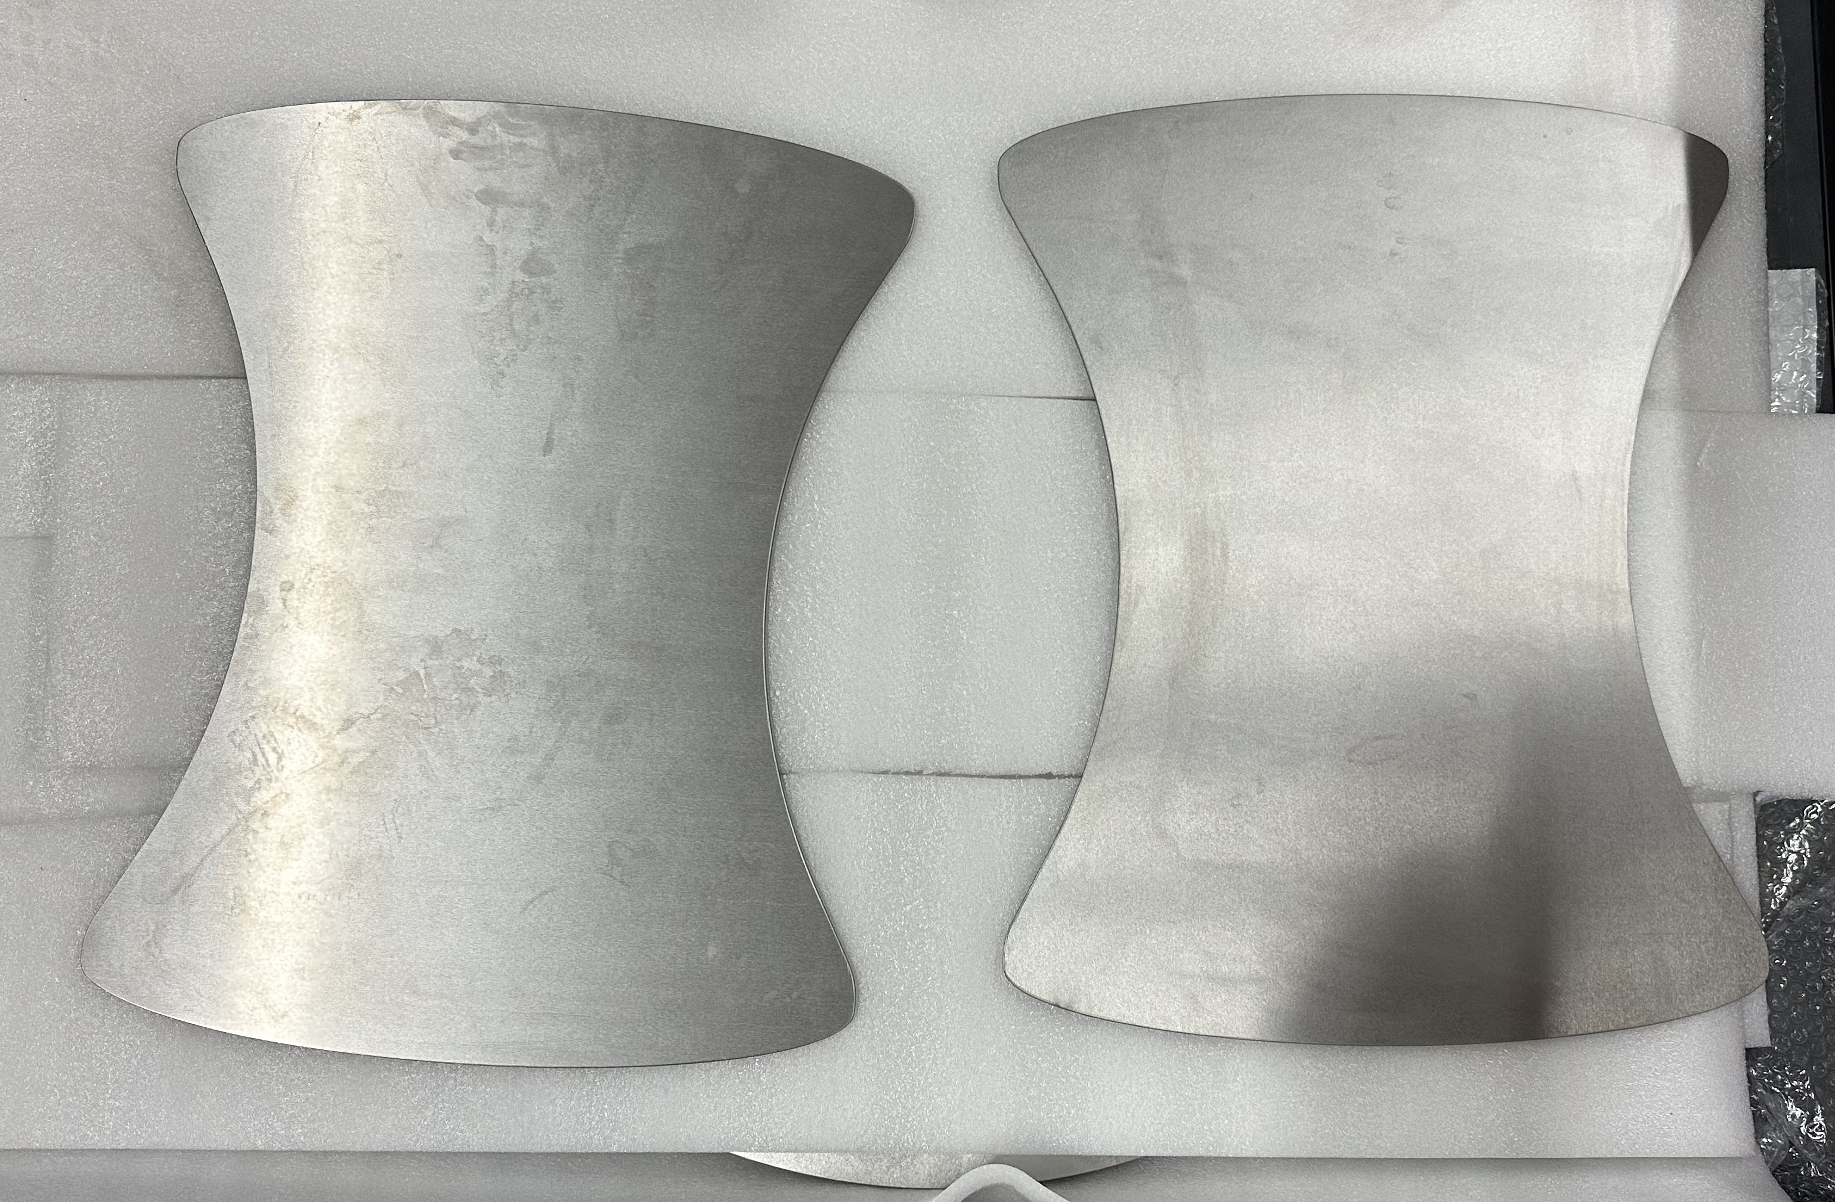
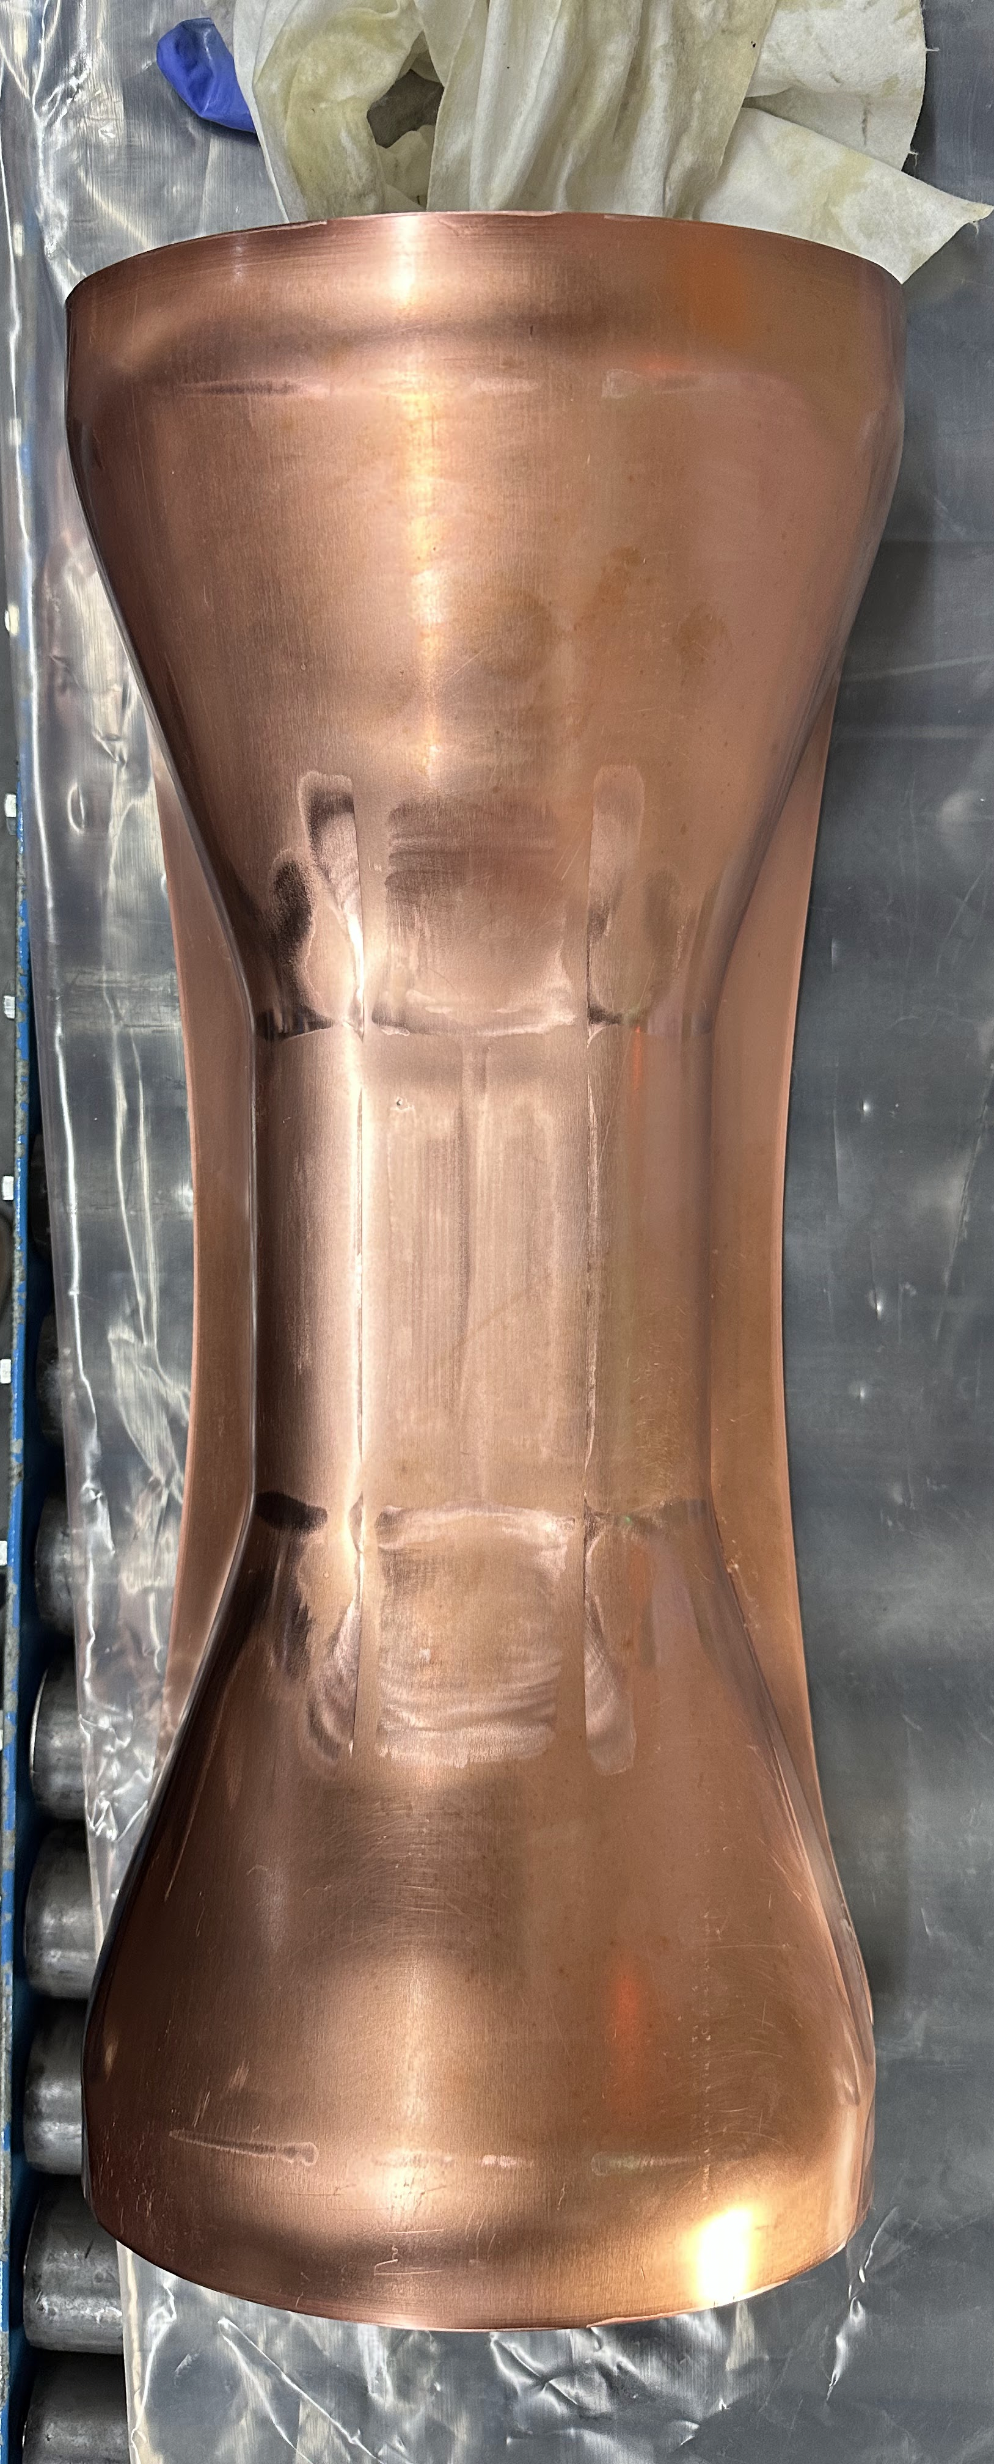
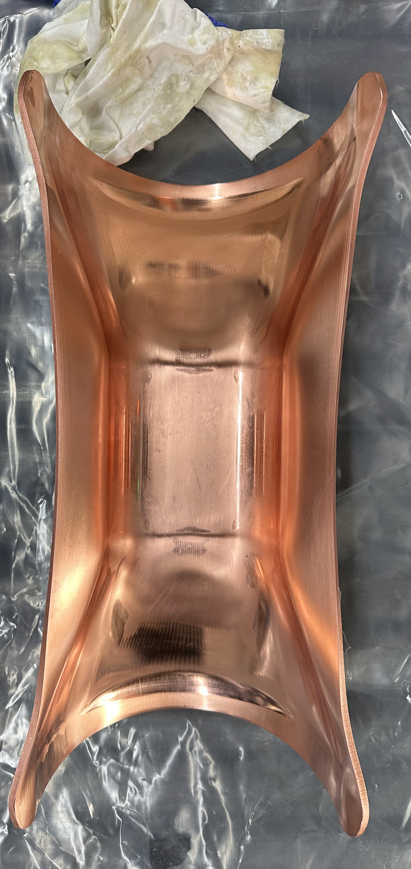
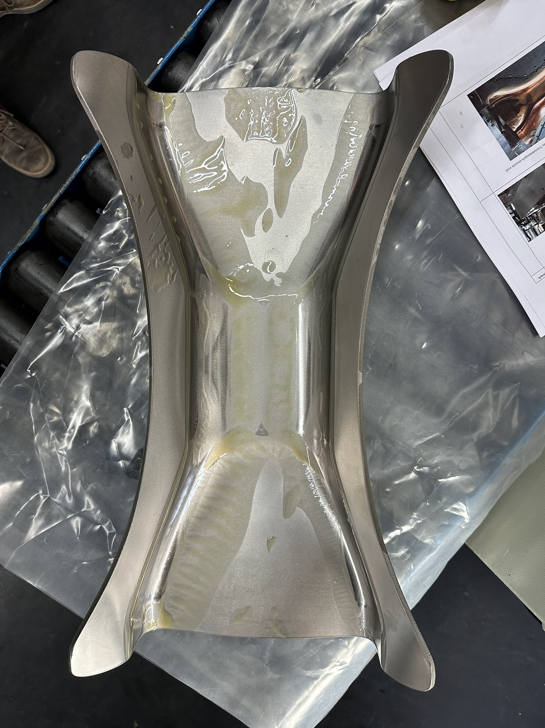
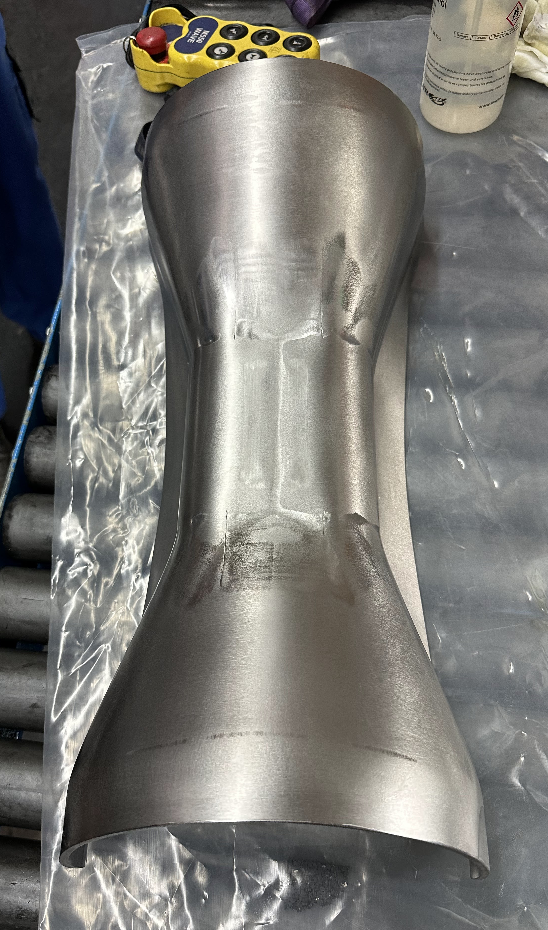
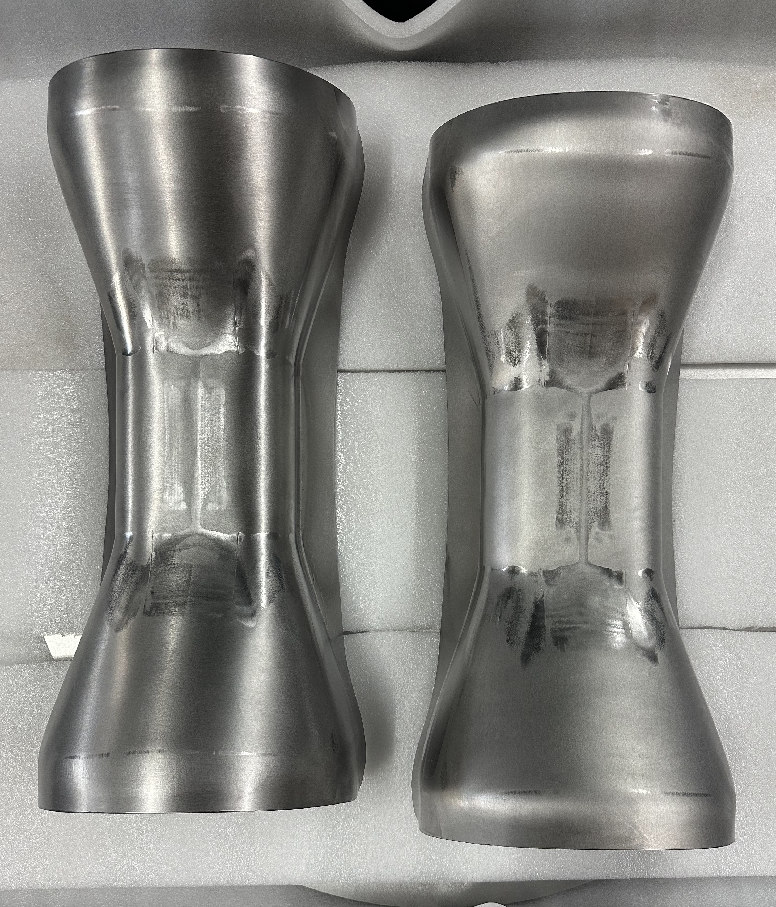
Niobium
RI spokes forming
SSR1
Awarded second PO for CM2 to Ningxia
SSR2
RFP for Production Niobium is being prepared
Cavities
SSR1
PO 690591 with Zanon for the fabrication of 9 Production Cavities. Next milestone is the MRR to be scheduled in March/April 2023.
SSR2
Fabrication and processing
Cavities 001 and 003 were tested and limited by FE. Actions are being discussed with vendor.
Cavity 001 is at Fermilab and STC is being prepared for cold testing it
RI is working on the fabrication of 3 cavities. MRR was performed. First cavity (manufactured and processed) ready in late June 2023.

Slide 7
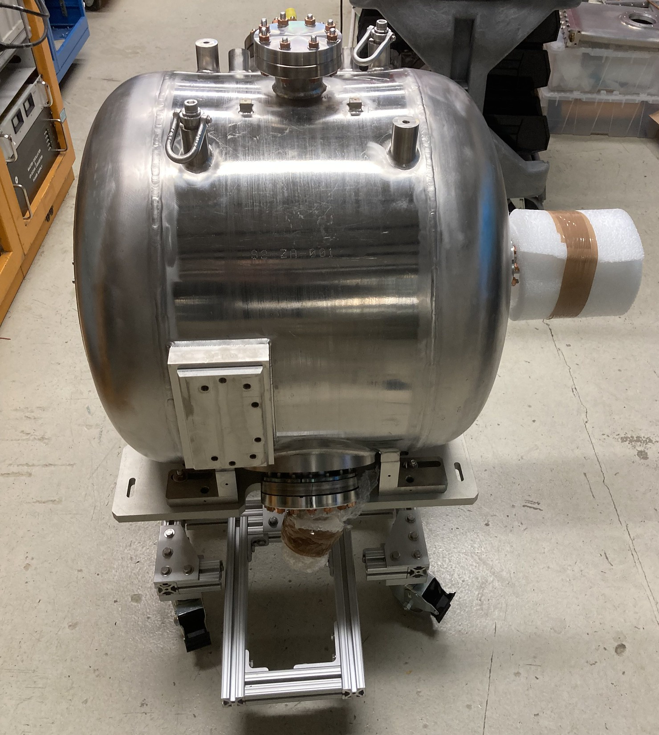
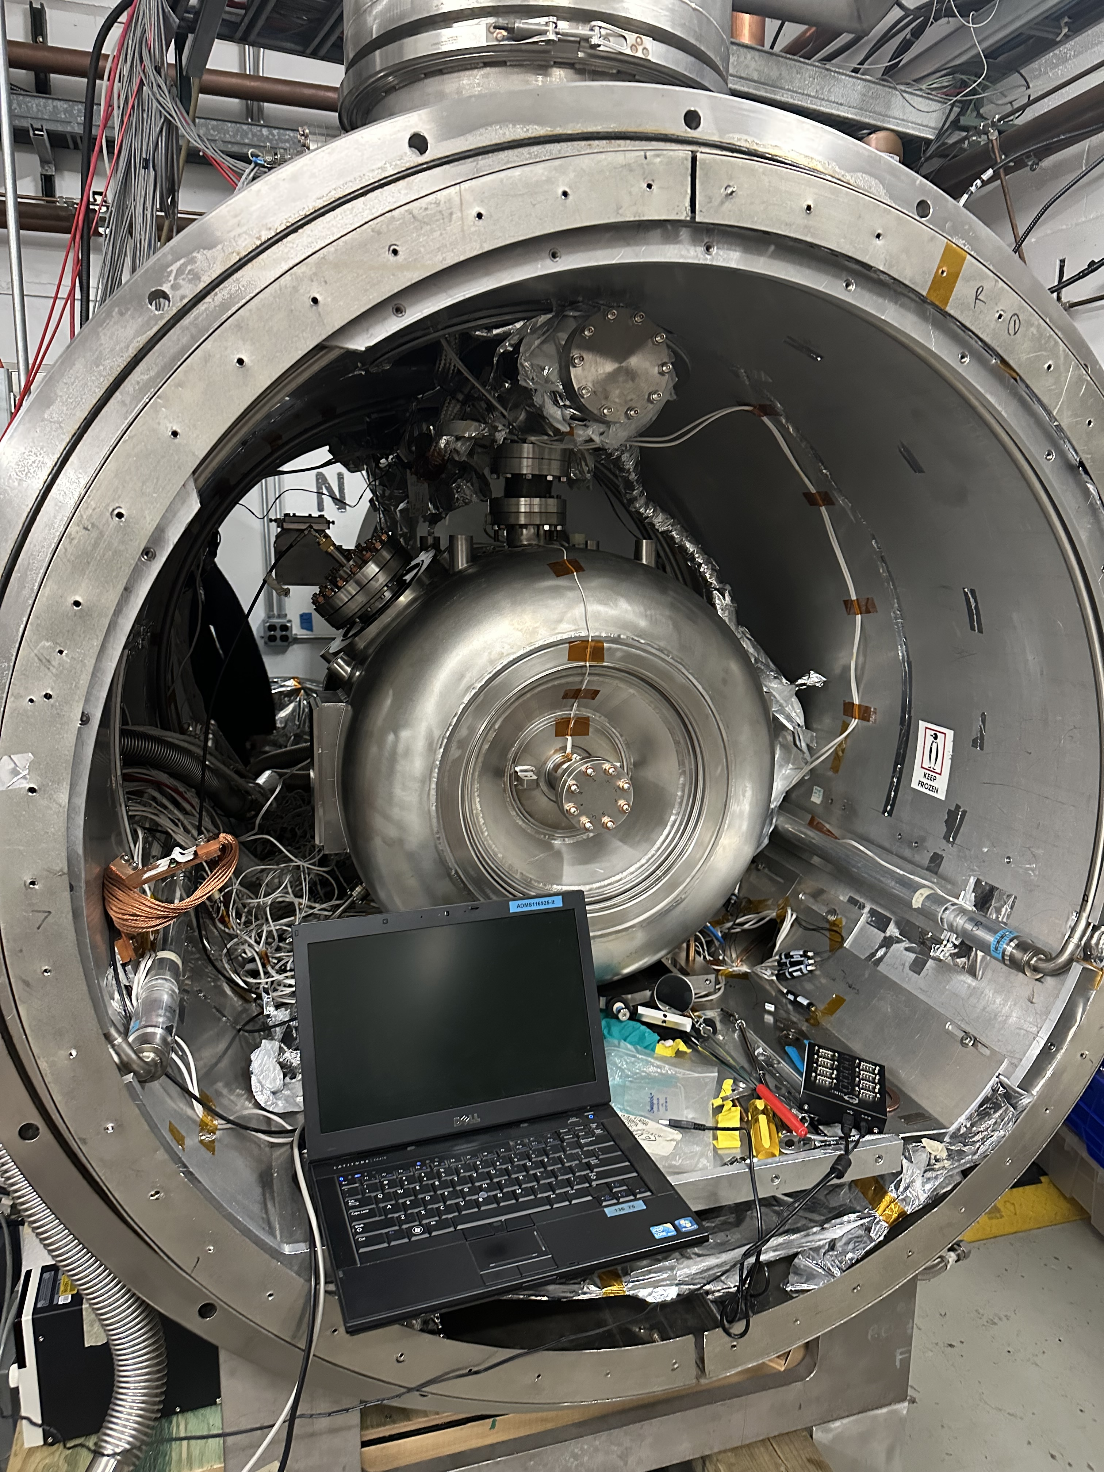
Cavities
S2-ZA-001 inside STC
S2-ZA-001 at MDB

Slide 8
SSRs Solenoids
SPM: Miao Yu
Presenter: Miao Yu

Slide 9
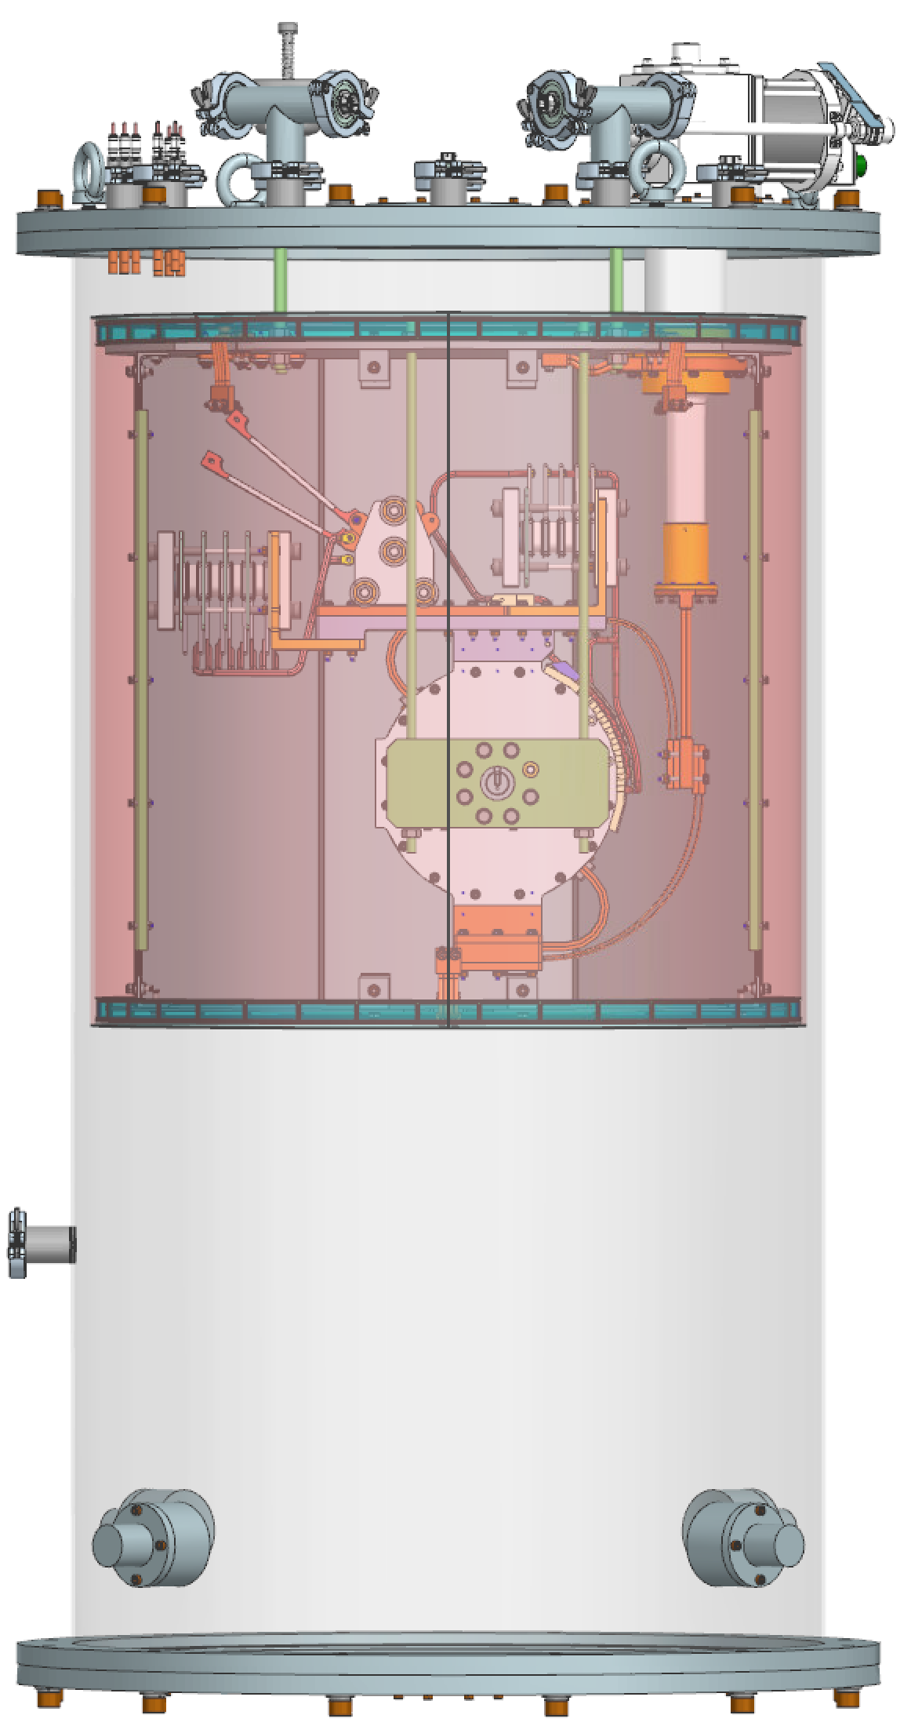
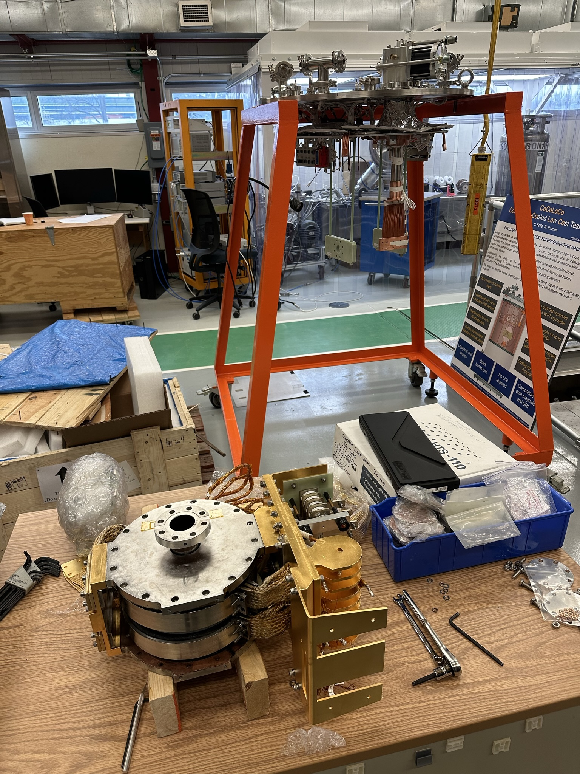
SSR solenoid status update – FNAL activities
The prototype assembly work is resumed this week.
Assembly procedure is being drafted during the work.
Plan to finish the assembly in a week, following with QA/QC (resistance, Ls, Q ring test, and Hipot test)

Slide 10
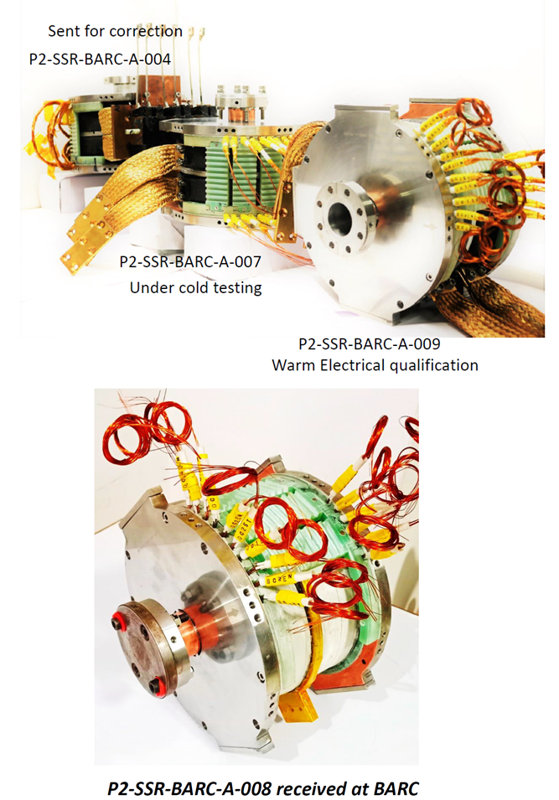
SSR solenoid status update – BARC activities
The pre-series magnet P2-SSR-BARC-A-007 test is completed. The test report is being prepared.
Electrical measurement – Electrical resistance, Inductance and Q factor
Warm magnetic field measurement
Warm Transfer function measurement
Cold Transfer function measurement Solenoid
Cold Transfer function measurement horizontal dipole corrector
Cold Transfer function measurement Vertical dipole corrector
Axial field mapping of Solenoid at various currents
Axial field mapping of dipole Vertical corrector
Axial field mapping of Horizontal dipole corrector
The pre-series magnet P2-SSR-BARC-A-009 has some test issues that need further investigation.
P2-SSR-BARC-A-008 and P2-SSR-BARC-A-003 are under warm magnet measurement.
Plan to ship two magnet at the same time (007 with 009 or 003)
Prepare the documents for FDR while testing the magnets.

Slide 11
SSRs Couplers
SPM: N. Solyak
Presenter: N. Solyak

Slide 12
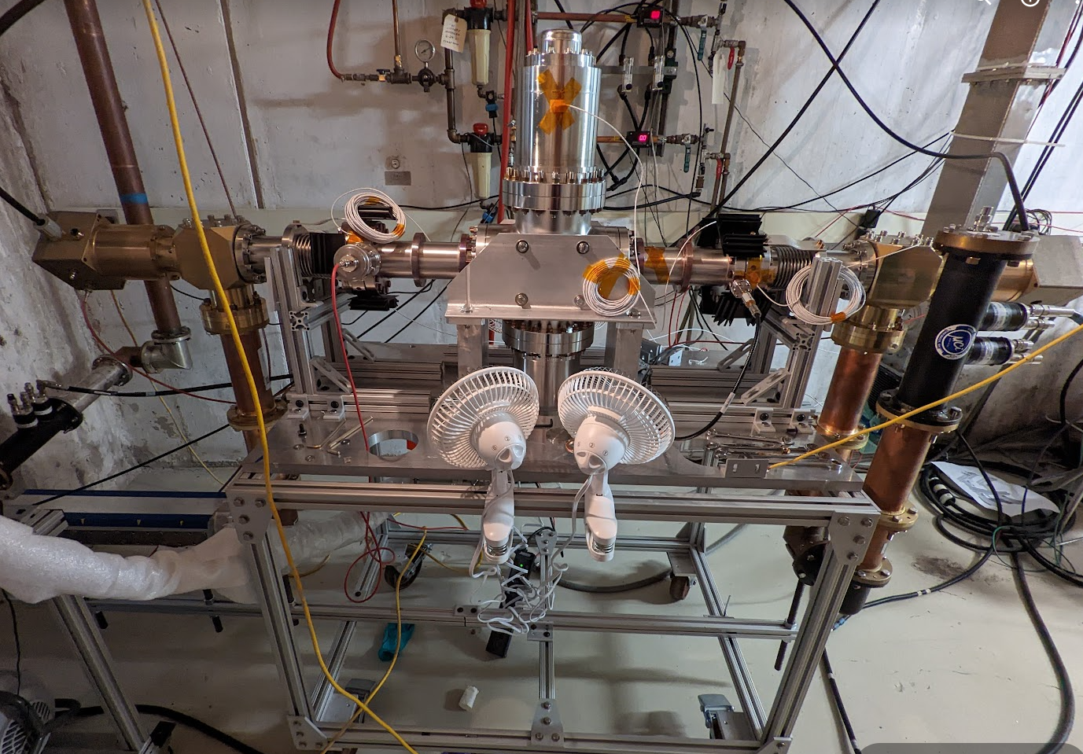
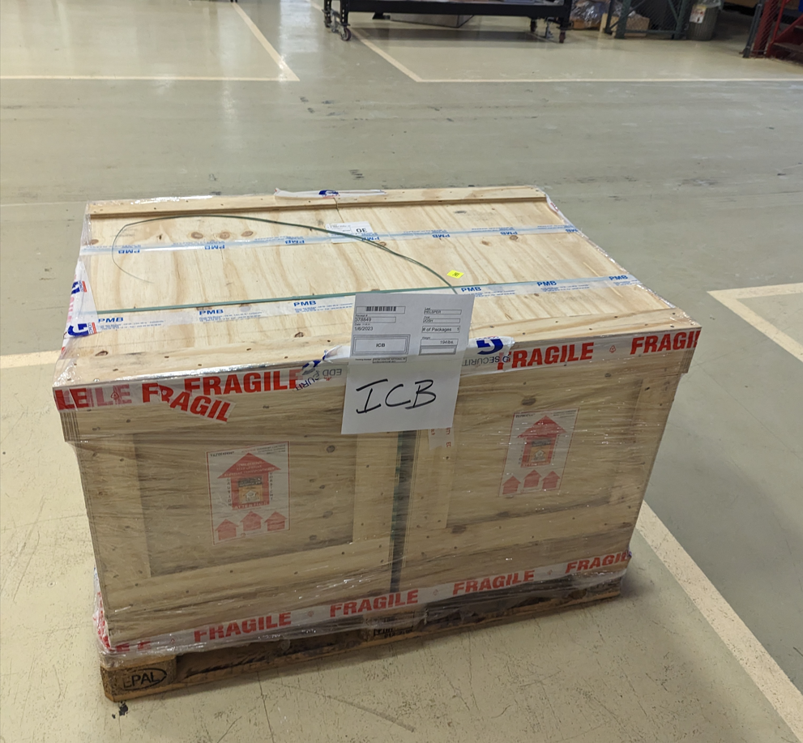
Couplers
Planning procurement of all (50+) production SSR couplers
Continue testing ppSSR2 couplers
First test of Ti-N vs no coating showed little difference in performance. To be tested again, including 1x IJCLab coupler.

Slide 13
SSRs CM design
SPM: M. Parise Presenter: M. Parise

Slide 14
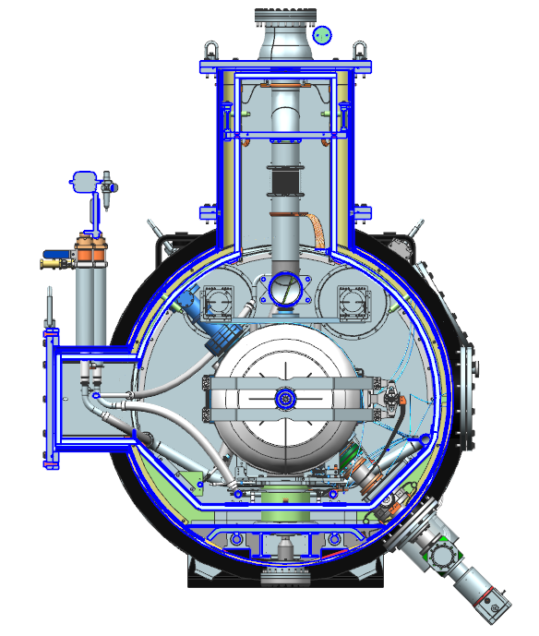
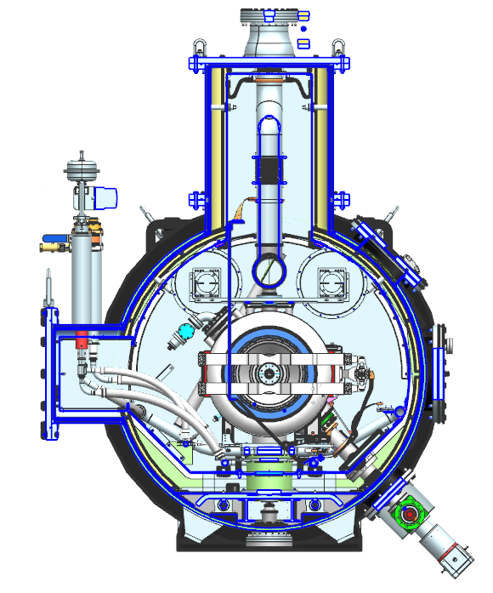
SSRs Cryomodule Cross-section
Pre-production SSR2 (F10138829)
Production SSR1 (F10142933)

Slide 15
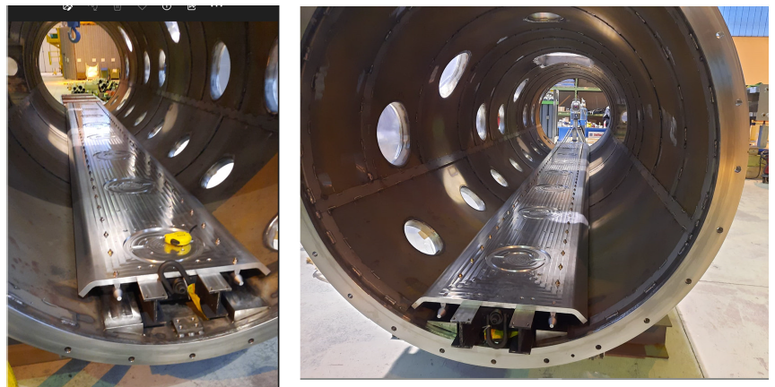
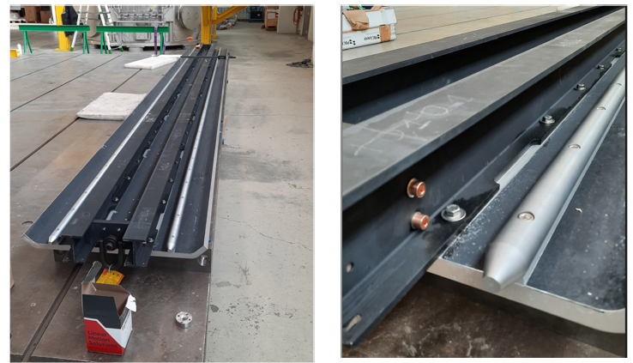
SSR2 Cryomodule Procurement
Rails were assembled and aligned on the strongback;
The strongback was inserted into the vacuum vessel;
Next is vessel painting and support post assembly on the strongback.

Slide 16
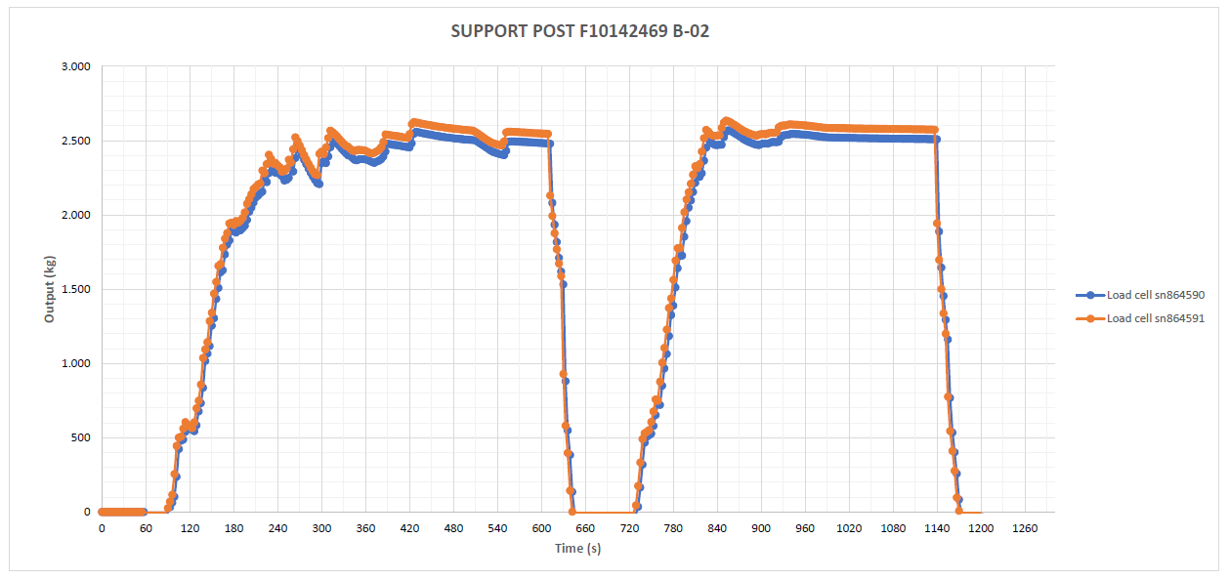
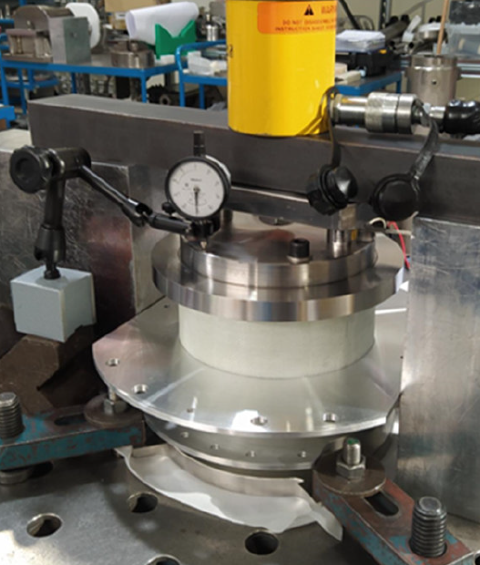
SSR2 Cryomodule Procurement
The 1st support post is being characterized at the University of Pisa.
The second post was assembled and successfully traction tested.

Slide 17
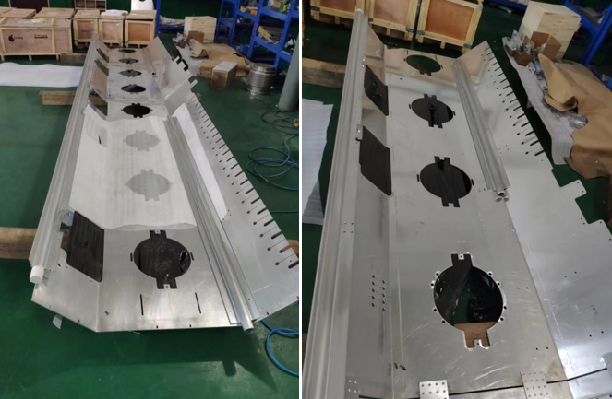
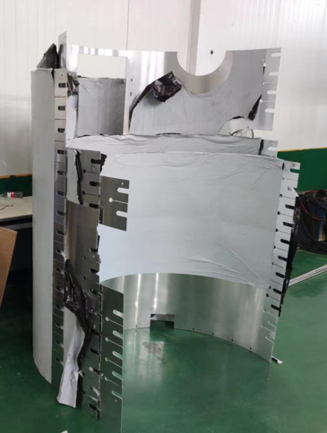
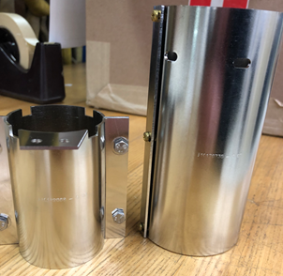
SSR2 Cryomodule Procurement
Global magnetic shield manufacturing ongoing – 1st parts delivered and QC completed
Thermal shield machining is ongoing – design changes are being implemented

Slide 18
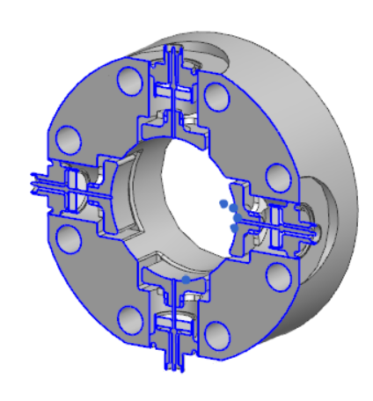
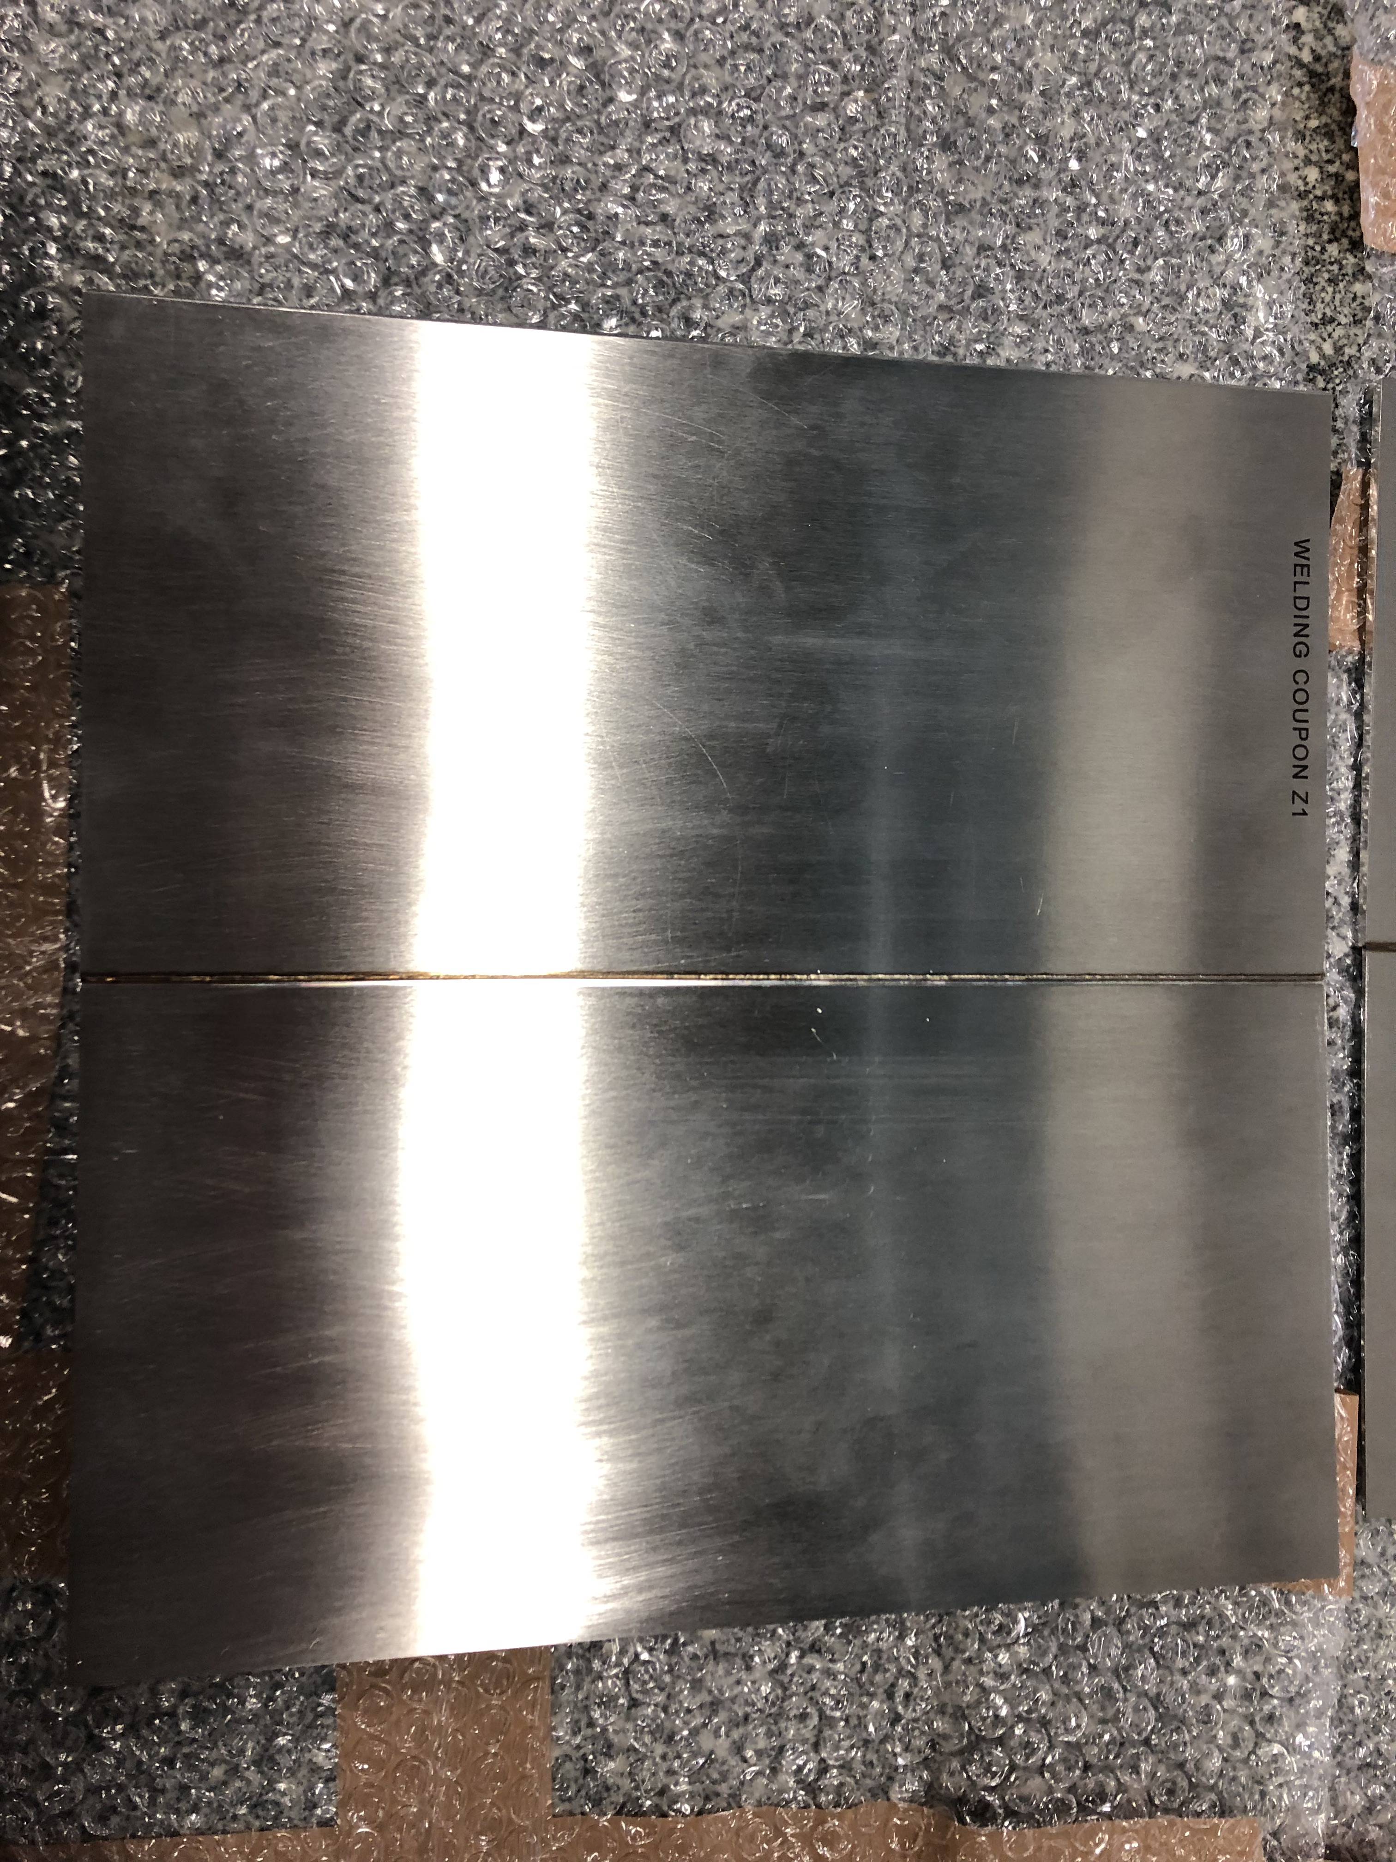
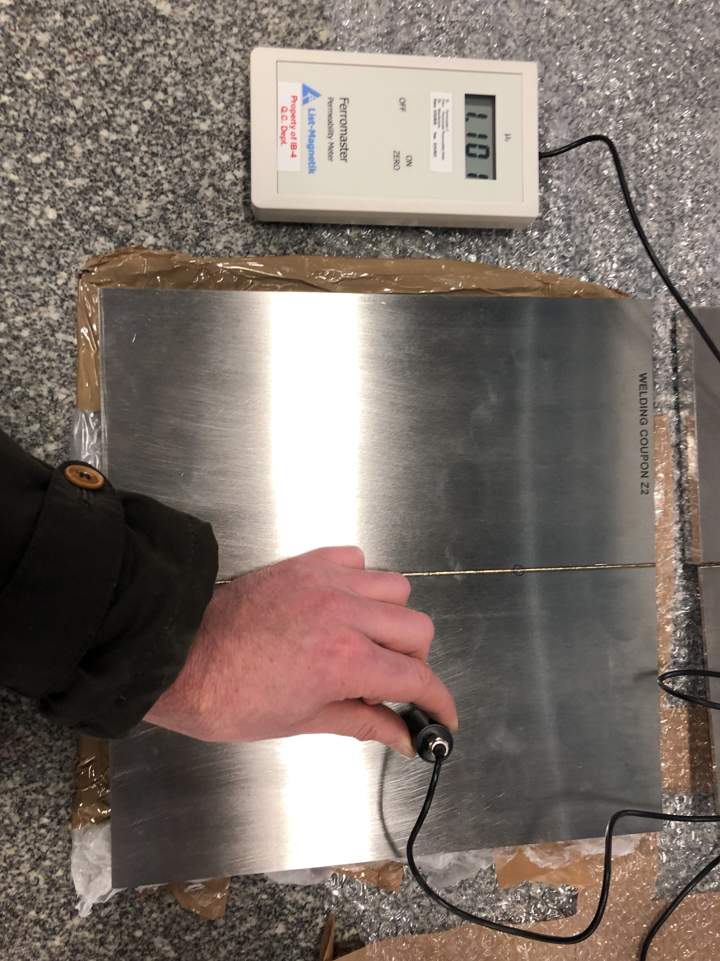
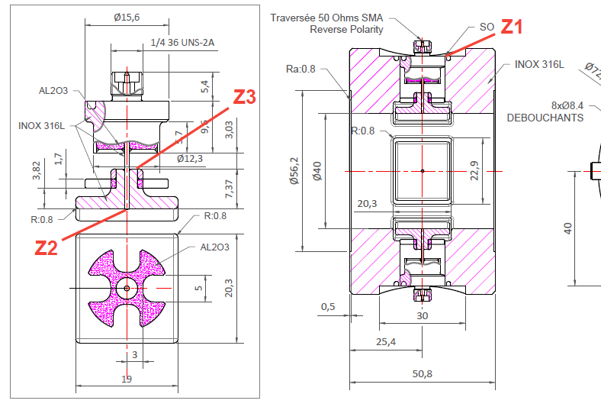
SSR2 Cryomodule Procurement
MRR was done with Solcera on 01-18-23, fabrication activities to be started

Slide 19
Action items from previous meetings
BARC: cavities tooling Technical discussion ongoing
BARC: Plan tuner Manufacturing Readiness Review Completed!
Release TRS/ISD for the SSR2 cryomodule Released!!!

Slide 20
Action Items

