Slide 1
IJCLAB status/updates on SSR2 activities
Patricia Duchesne, Sandry Wallon, Nicolas Gandolfo, Longuevergne David
On behalf of PIP-II team at IJCLab

Slide 2
OUTLINE
Progress on SSR2 cavity
Progress on Coupler
Progress on Tuner
Other points

Slide 3
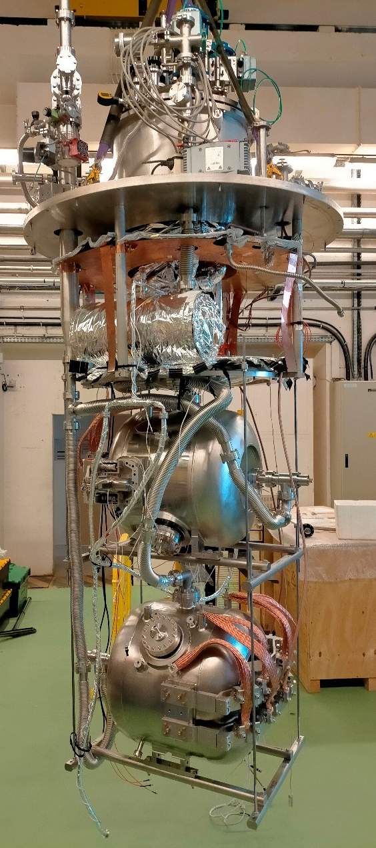
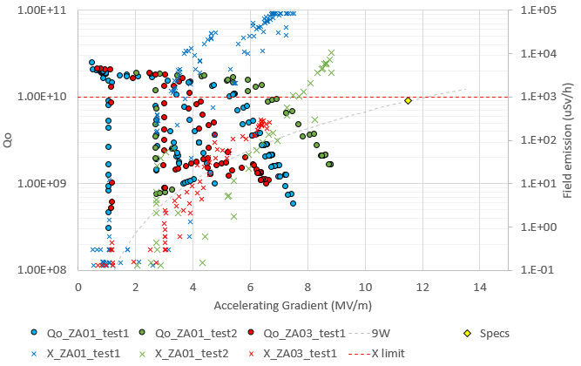
Recent key technical achievements (cavity and tuner)
3 tests in vertical cryostat:
1st test of ZA01 + tuner (October 2022)
ZA01 didn’t reach specs because of strong field emission
Internal inspection + HPR + baking @ IJCLab
2nd test of ZA01 + ZA03 + tuners (January 2023)
ZA01 and ZA03 didn’t reach specs because of field emission
2 tuners tested and validated
ZA01 shipped to Fermilab
Test as received in STC
ZA02 (fully prepared at IJCLab)
Assembled in clean room
Baking next week
Vertical test mid of March

Slide 4
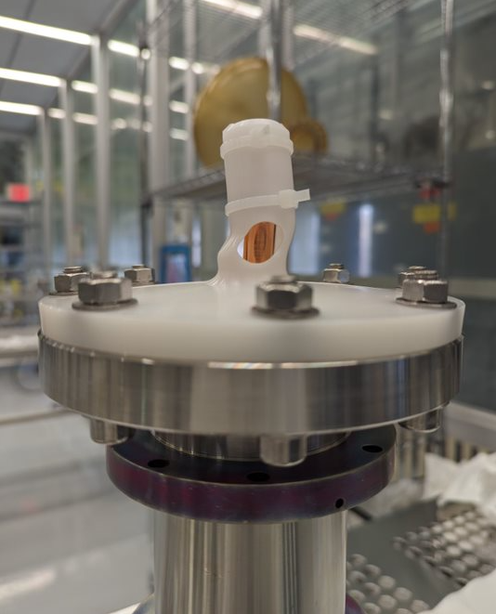
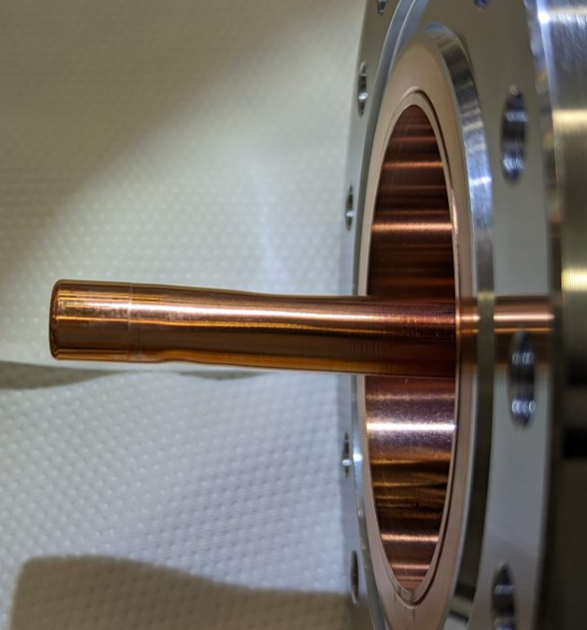
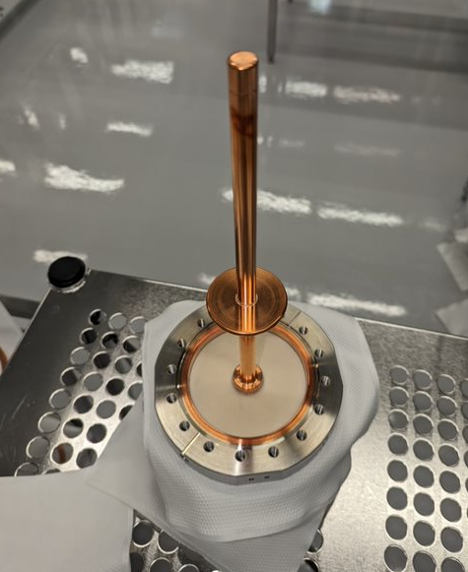
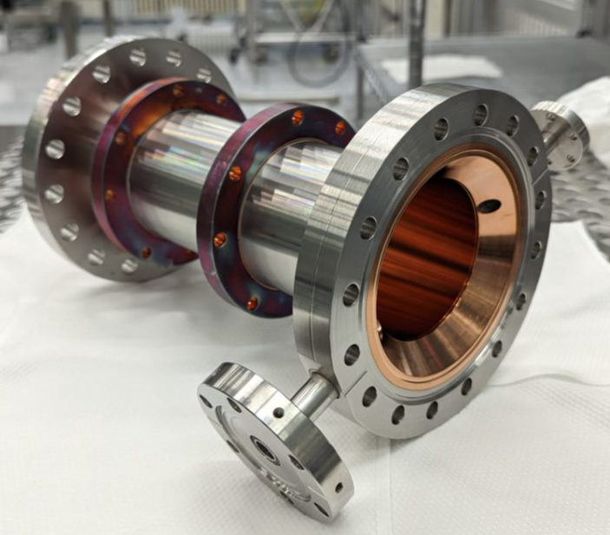
Recent key technical achievements (couplers)
4 couplers under fabrication at PMB
2 vacuum side have been shipped to Fermilab in January directly from company
1 vacuum side has been damaged during handling
1 vacuum side is ok and will be power tested at Fermilab
Overall quality is very good (copper plating, brazing, …)
Cleanliness not perfect
RF power test to be performed at Fermilab in coming weeks
Warm ends to be finished in march
Some difficulties with copper plating (non uniformities around bellows)
IJCLab will proceed with assembly test of full coupler at PMB in mid-March.

Slide 5
Other points
Schedule
Finalized. Milestones validated in PPD part2
PPD
PPD part2 finalized
PPD part1 pending
Documentation
Acceptance plan : to be drafted by Fermilab
Acceptance criteria list : preliminary list edited.
All documentation as procedures, reports, travelers are being edited and improved with prototypes parts
First reports and travelers for ZA01 sent to Fermilab

