Slide 1
An Overview of High-Energy Neutrino Astronomy
Dan Hooper – Fermilab and the University of Chicago
Fermilab Neutrino Seminar Series
February 23, 2023

Slide 2
The Many Forms of Modern Astronomy
Dan Hooper – High-Energy Neutrino Astronomy
Until the middle of the 20th century, essentially all of astrophysics was conducted using visible light
Today, we use a variety of other messengers to collect complementary information
Modern astrophysics relies on electromagnetic radiation at IR/UV/optical/radio/X-ray/gamma-ray wavelengths, as well as cosmic rays, neutrinos, and gravitational waves
Due to their very weak interactions, neutrinos are particularly valuable as probes of our universe’s most extreme environments

Slide 3
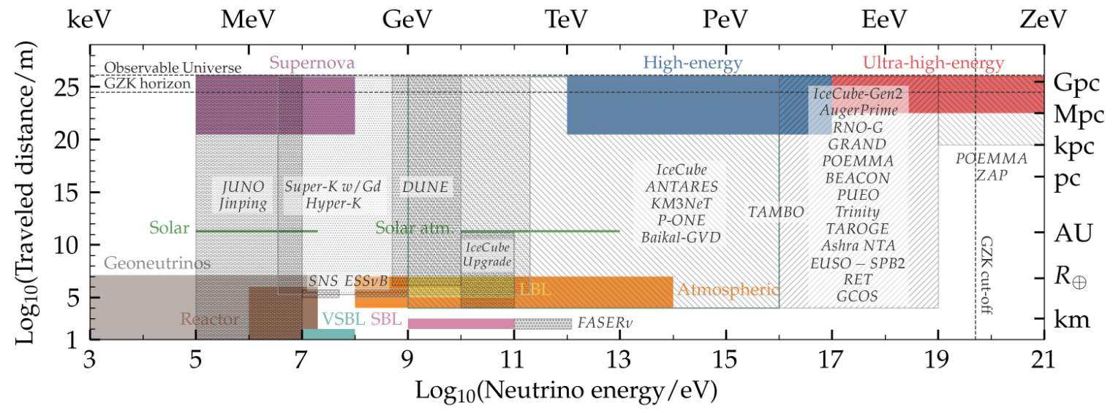
Neutrino Telescopes
Dan Hooper – High-Energy Neutrino Astronomy
The field of high-energy neutrino astronomy is currently dominated by IceCube at the South Pole (KM3NeT is also currently under construction in the Mediterranean); these detectors are primarily sensitive to neutrinos with energies between ~10² and ~10⁸ GeV
At lower energies (~MeV, ~GeV), experiments such as Super-K, DUNE
At the highest energies, GRAND, RNO-G, PUEO, POEMMA, EUSO-SPB2, etc. all look promising
Ackermann et al., Snowmass White Paper, 2203.08096

Slide 4
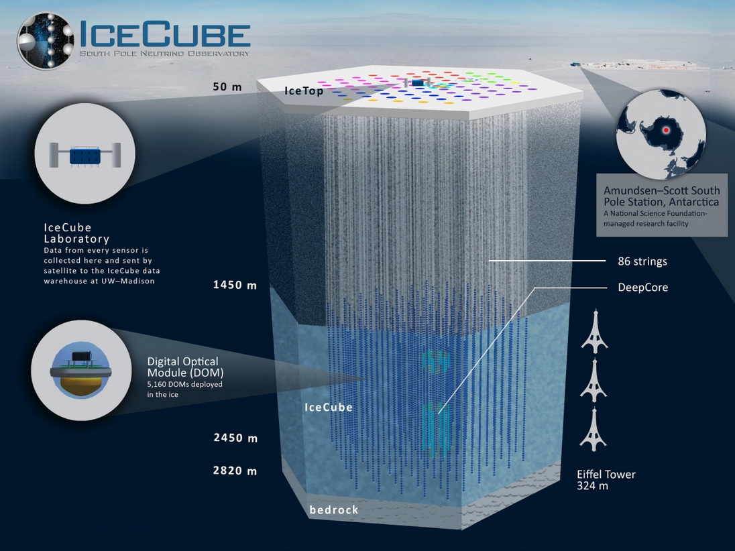
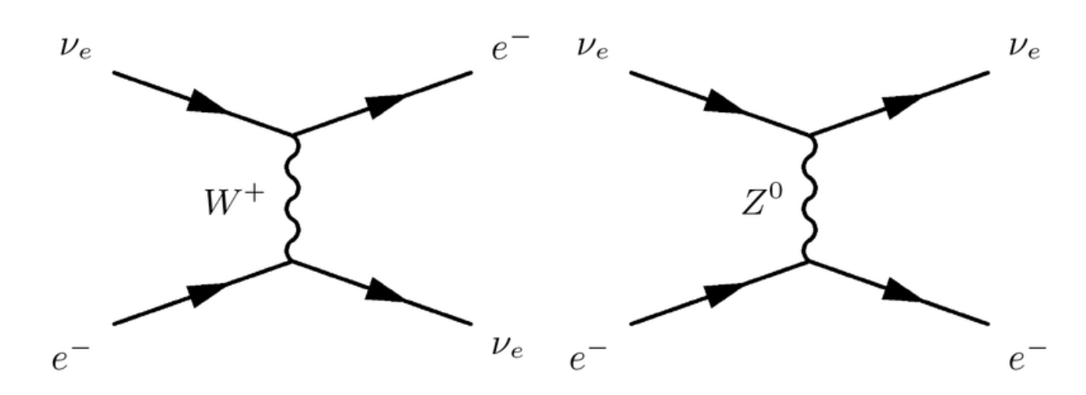












The IceCube Neutrino Observatory
Dan Hooper – High-Energy Neutrino Astronomy
IceCube consists of ~5000 optical modules connected to vertical strings distributed throughout a ~1 km³ volume of Antarctic ice
IceCube can detect:
1) Muon tracks from CC $ν_{μ}$ events
2) Showers from CC or NC events
3) Events specific to PeV-scale $ν_{τ}$’s (double bangs, lollipops)
1)
$$ν_{μ}$$
$$μ^{−}$$
2)
3)
$$q$$
$$q^{′}$$
$$ν_{μ}$$
$$q$$
$$q^{′}$$
$$q$$
$$q^{′}$$
$$ν_{τ}$$
$$τ^{−}$$

Slide 5
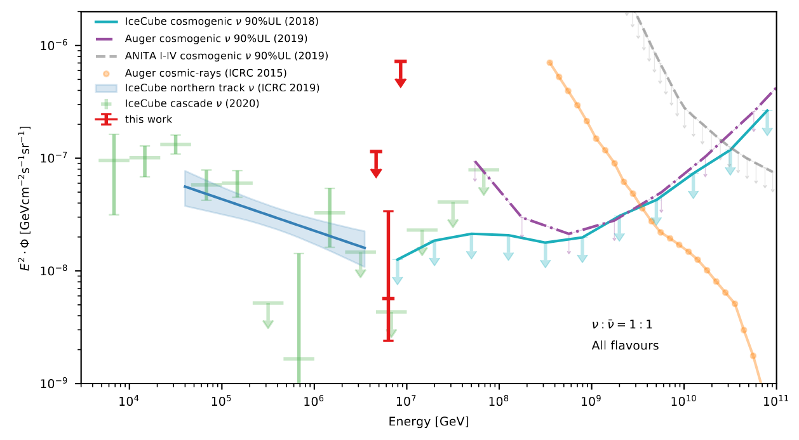
IceCube’s High-Energy Neutrinos
Dan Hooper – High-Energy Neutrino Astronomy
IceCube has measured a diffuse spectrum of astrophysical neutrinos, ranging in energy from several TeV to several PeV (at least)
Approximately isotropic, with a roughly power-law spectrum dN/dE ~ E^{-2.3}
The origins of these particles remains unknown, but they are almost certainly connected to the origin of the (high-energy) cosmic ray spectrum
IceCube, arXiv:2110.15051

Slide 6
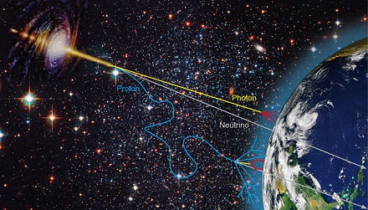
Multi-Messenger Astrophysics
Dan Hooper – High-Energy Neutrino Astronomy
Cosmic rays are observed with energies up to ~10¹¹ GeV, but we have not yet identified the sources of these extreme particles
High-energy gamma rays and neutrinos can each provide us with clues about the nature of these sources
Unlike gamma rays, high-energy neutrinos are only produced through hadronic interactions, and are not significantly attenuated
Unlike cosmic rays, neutrinos point in the directions of their sources

Slide 7
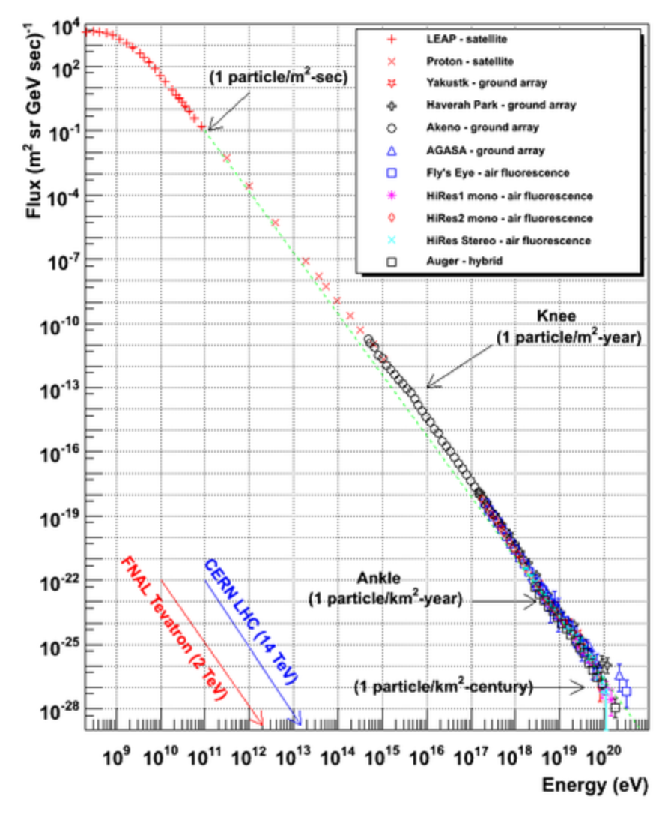
The Cosmic-Ray Spectrum
Dan Hooper – High-Energy Neutrino Astronomy
Extends from several MeV to above 10¹¹ GeV
At low and intermediate energies, this spectrum is dominated by protons (with some helium)
At higher energies, it is instead dominated by a mixture of nuclear species
Includes spectral features known as the “knee” and the “ankle”

Slide 8
Origin of Cosmic Ray Spectrum?
Dan Hooper – High-Energy Neutrino Astronomy
Many questions about the origin of the cosmic rays remain open
At energies below the knee, the cosmic rays originate mostly from Galactic sources, while the cosmic-ray spectrum beyond the ankle is extragalactic in origin (the details of this transition are still hotly debated)
Galactic cosmic rays are generally thought to originate from supernova remnants, while the sources of the extragalactic cosmic rays have not yet been identified
Galactic
?
Extra-Galactic

Slide 9
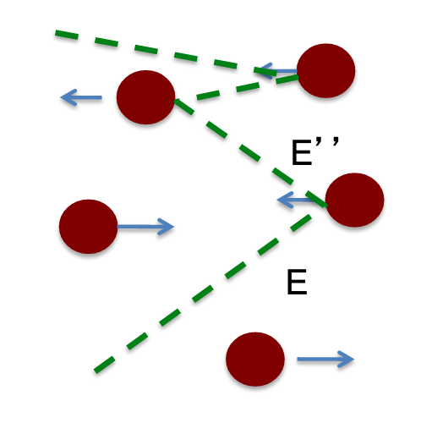
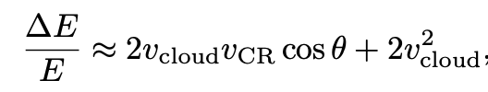
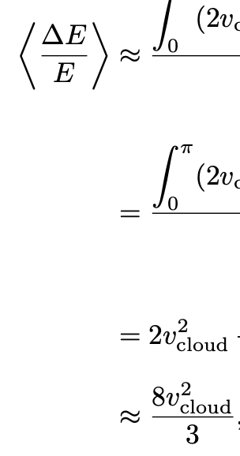
Second Order Fermi Acceleration
Dan Hooper – High-Energy Neutrino Astronomy
In 1949, Enrico Fermi proposed that cosmic rays could be accelerated by repeatedly bouncing off randomly moving magnetic clouds
Although such deflections leave the energy of the cosmic ray unchanged in the center-of-momentum frame, the energy in the lab frame changes in such collisions:
Averaging over many collisions at random impact angles, this yields a positive result:
Although this mechanism can accelerate particles in principle, it is very slow and is not a realistic explanation for the origin of the observed cosmic-ray spectrum

Slide 10
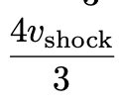
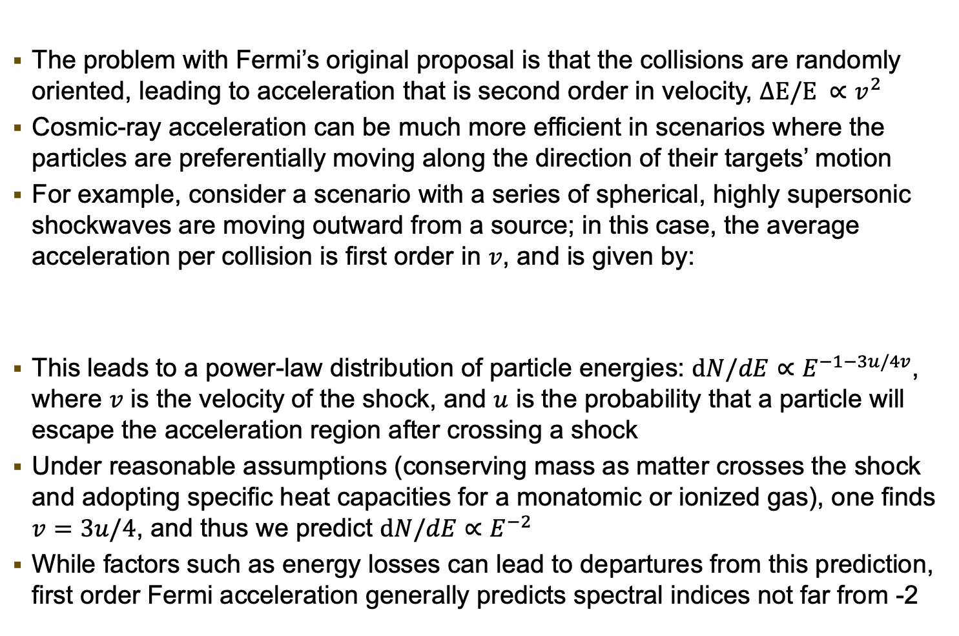
First Order Fermi Acceleration
Dan Hooper – High-Energy Neutrino Astronomy
The problem with Fermi’s original proposal is that the collisions are randomly oriented, leading to acceleration that is second order in velocity, $ΔE/E ∝v^{2}$
Cosmic-ray acceleration can be much more efficient in scenarios where the particles are preferentially moving along the direction of their targets’ motion
For example, consider a scenario with a series of spherical, highly supersonic shockwaves are moving outward from a source; in this case, the average acceleration per collision is first order in $v$, and is given by:
This leads to a power-law distribution of particle energies: $dN/dE∝E^{−1−3u/4v}$, where $v$ is the velocity of the shock, and $u$ is the probability that a particle will escape the acceleration region after crossing a shock
Under reasonable assumptions (conserving mass as matter crosses the shock and adopting specific heat capacities for a monatomic or ionized gas), one finds $v=3u/4$, and thus we predict $dN/dE∝E^{−2}$
While factors such as energy losses can lead to departures from this prediction, first order Fermi acceleration generally predicts spectral indices not far from -2

Slide 11
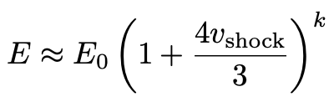
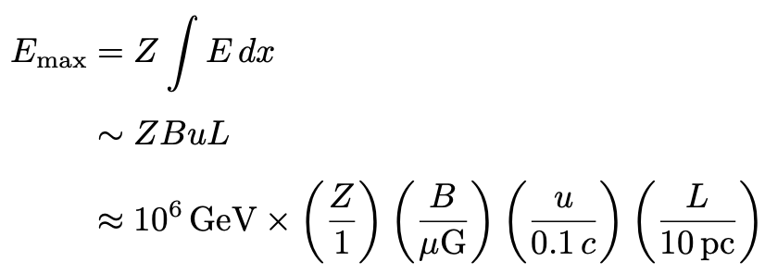
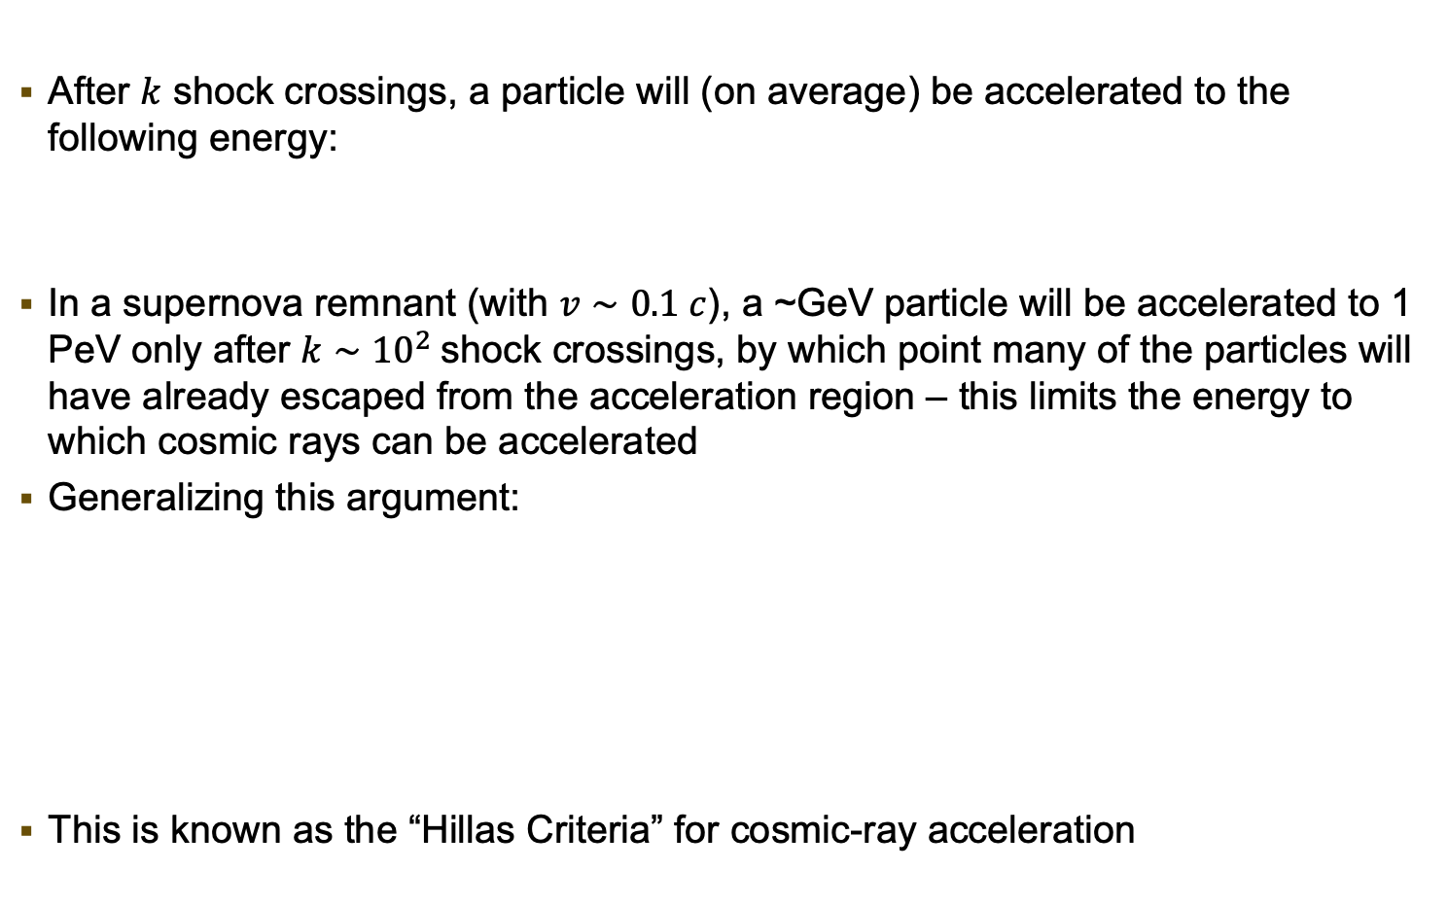
The Maximum Energy of Cosmic Ray Acceleration
Dan Hooper – High-Energy Neutrino Astronomy
After $k$ shock crossings, a particle will (on average) be accelerated to the following energy:
In a supernova remnant (with $v∼0.1 c$), a ~GeV particle will be accelerated to 1 PeV only after $k∼{10}^{2}$shock crossings, by which point many of the particles will have already escaped from the acceleration region – this limits the energy to which cosmic rays can be accelerated
Generalizing this argument:
This is known as the “Hillas Criteria” for cosmic-ray acceleration
(Faraday’s Law)

Slide 12
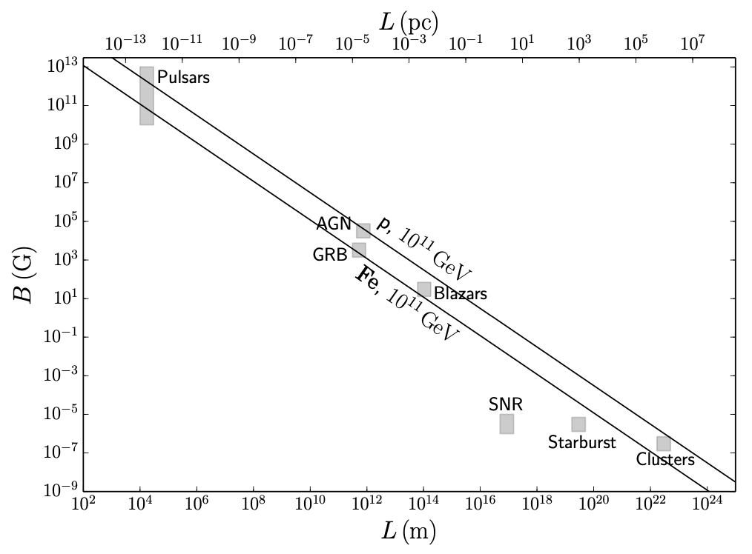
The Maximum Energy of Cosmic Ray Acceleration
Dan Hooper – High-Energy Neutrino Astronomy
“Hillas Plot”

Slide 13
The Maximum Energy of Cosmic Ray Acceleration
Dan Hooper – High-Energy Neutrino Astronomy
AGN/GRB/Starburst Galaxies/Clusters/???:
Although the sources the extragalactic cosmic rays have not yet been identified, there are several proposing candidates
“Hillas Plot”
Galactic Supernova Remnants: Responsible for most of the cosmic rays up to ~PeV, but cannot accelerate particles to higher energies

Slide 14
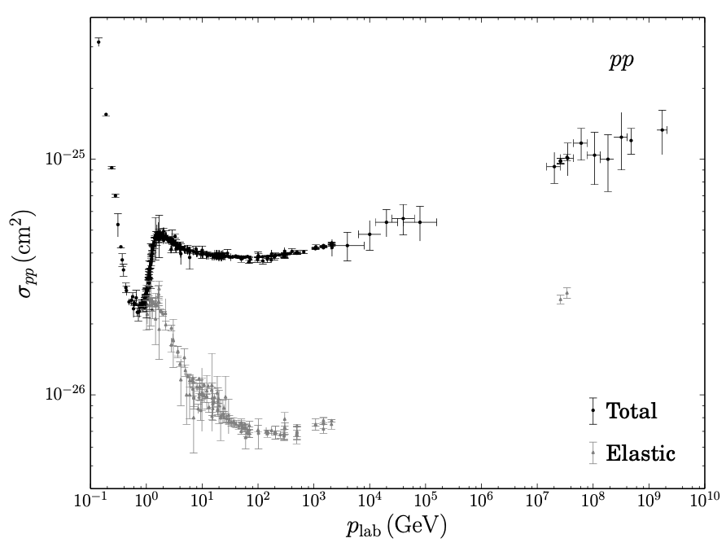
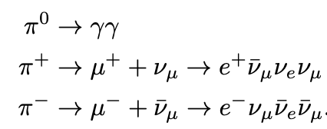
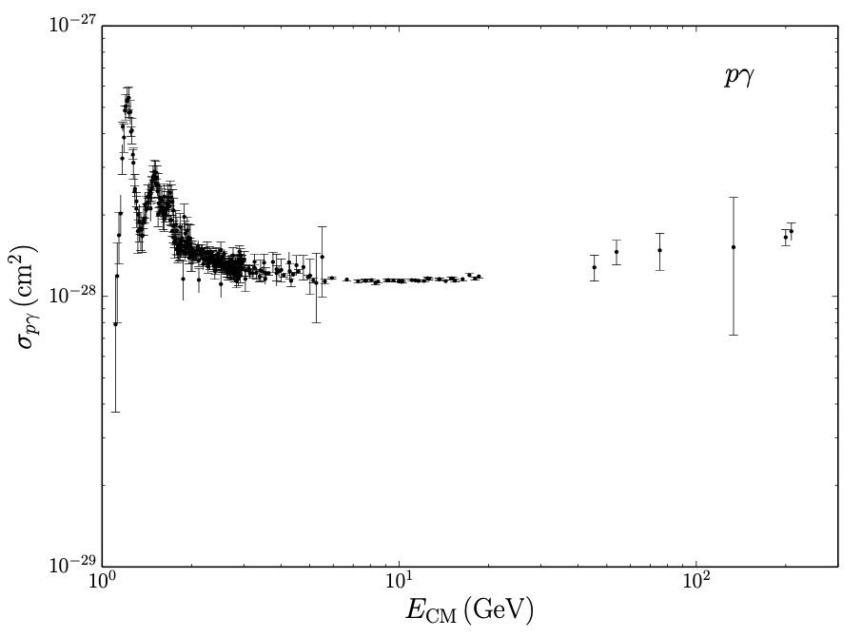
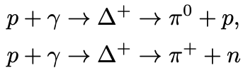

The Neutrino/Gamma Ray/Cosmic Ray Connection
Dan Hooper – High-Energy Neutrino Astronomy
High-energy protons produce pions through their inelastic scattering with gas and radiation, and those pions decay to produce photons and neutrinos
Sources of cosmic rays are inevitably sources of gamma rays and high-energy neutrinos
For $pp$scattering, the cross section is relatively flat, and thus the resulting neutrino spectrum should roughly trace that of the cosmic rays
For $pγ$ scattering (ie. photohadronic production), the cross section features significant enhancements associated with hadronic resonances

Slide 15
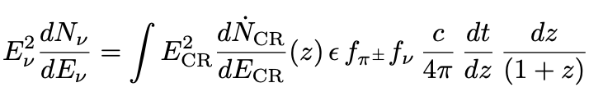
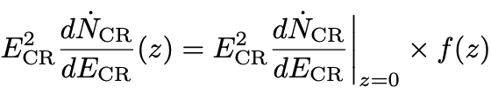
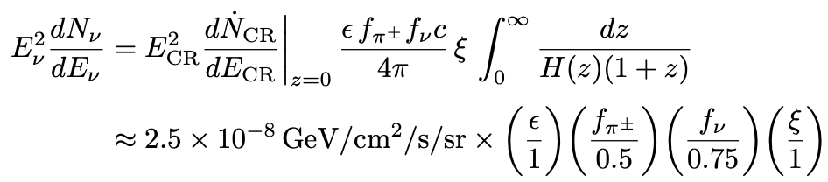




From the Cosmic Ray Spectrum to the High-Energy Neutrino Spectrum
Dan Hooper – High-Energy Neutrino Astronomy
There is an argument that goes back to the late 1990s which relates the expected neutrino flux to the observed cosmic-ray spectrum (Waxman-Bahcall)
For sources that are optically-thin (with little absorption), these are related as follows:
The fraction of energy in CRs that goes into $π$’s
$$f_{π}∼\frac{1}{2}, \frac{2}{3}$$
$$f_{ν}∼\frac{3}{4}$$
$ξ∼1−6$(for realistic $z$ dist.)
“Waxman-Bahcall Bound” (for optically-thin sources)

Slide 16
IceCube’s High-Energy Neutrinos
Dan Hooper – High-Energy Neutrino Astronomy
In this context, let’s consider the diffuse neutrino spectrum measured by IceCube
IceCube, arXiv:2110.15051

Slide 17

IceCube’s High-Energy Neutrinos
Dan Hooper – High-Energy Neutrino Astronomy
In this context, let’s consider the diffuse neutrino spectrum measured by IceCube
This suggests that IceCube’s neutrinos originate from the sources of the high and ultra-high energy cosmic rays
Waxman-Bahcall Bound ($ξ=1−6$)
IceCube, arXiv:2110.15051

Slide 18

IceCube’s High-Energy Neutrinos
Dan Hooper – High-Energy Neutrino Astronomy
Two Possibilities:
1) IceCube’s neutrinos come from the main sources of the cosmic rays, which feature $ε∼0.1−1$
2) IceCube’s neutrinos come from optically thick sources (which absorb most of the particles they accelerate before they escape)
Waxman-Bahcall Bound ($ξ=1−6$)
IceCube, arXiv:2110.15051

Slide 19
IceCube’s High-Energy Neutrinos
Dan Hooper – High-Energy Neutrino Astronomy
Where do these neutrinos come from? Some long-standing hypotheses include:
-Gamma-Ray Bursts (GRB)
-Blazars
-Other Active Galactic Nuclei (AGN)
-Star-Forming/Starburst Galaxies

Slide 20
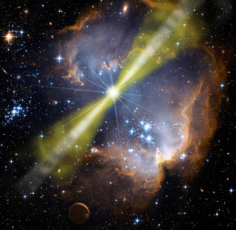

Gamma-Ray Bursts
Dan Hooper – High-Energy Neutrino Astronomy
Extreme explosions, typically featuring $\sim {10}^{53}−{10}^{57}$GeV/s over ~1-100 s, making them the most energetic and luminous events in the universe
Long duration (> 2 s) GRB are thought to be triggered by the collapse of a massive star
Short duration (< 2 s) GRB are generally associated with the merger of a neutron star with another neutron star or black hole

Slide 21
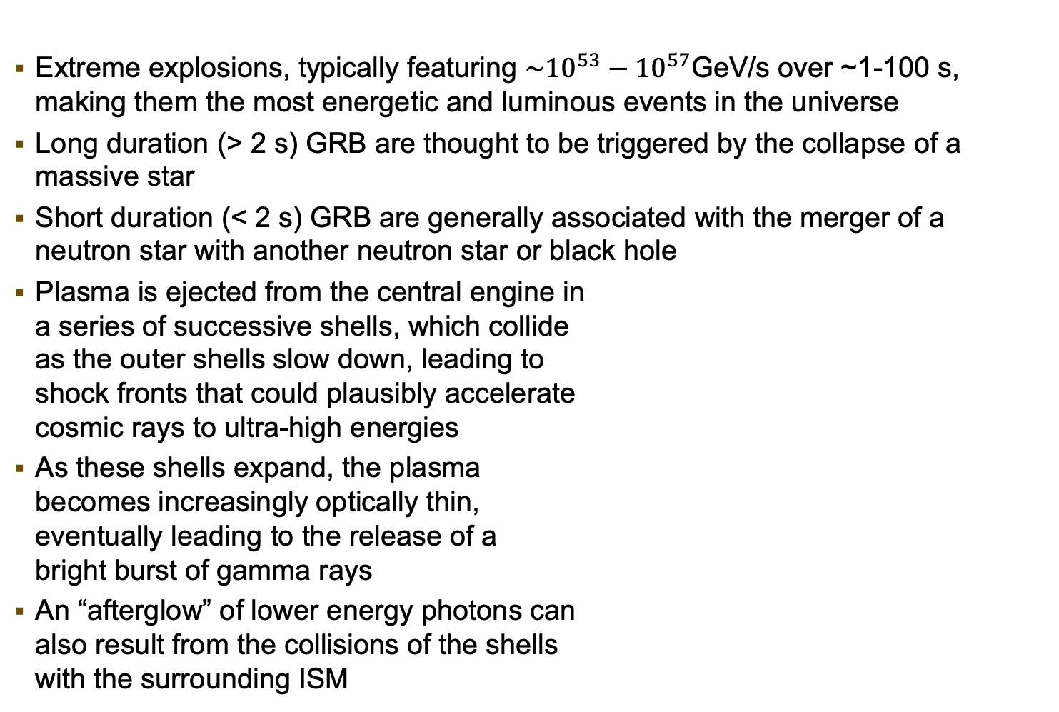
Gamma-Ray Bursts
Dan Hooper – High-Energy Neutrino Astronomy
Extreme explosions, typically featuring $\sim {10}^{53}−{10}^{57}$GeV/s over ~1-100 s, making them the most energetic and luminous events in the universe
Long duration (> 2 s) GRB are thought to be triggered by the collapse of a massive star
Short duration (< 2 s) GRB are generally associated with the merger of a neutron star with another neutron star or black hole
Plasma is ejected from the central engine in a series of successive shells, which collide as the outer shells slow down, leading to shock fronts that could plausibly accelerate cosmic rays to ultra-high energies
As these shells expand, the plasma becomes increasingly optically thin, eventually leading to the release of a bright burst of gamma rays
An “afterglow” of lower energy photons can also result from the collisions of the shells with the surrounding ISM

Slide 22
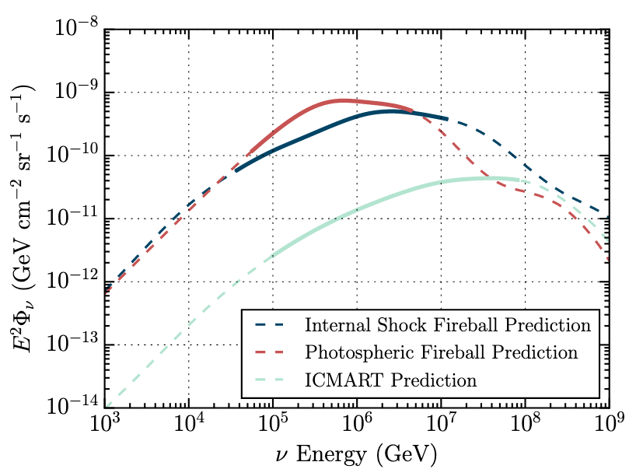
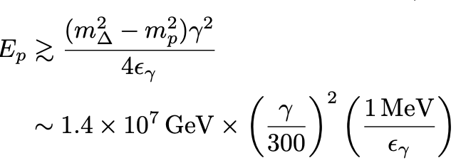
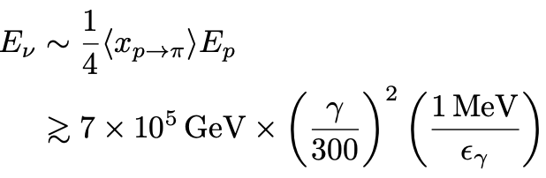

Neutrinos From Gamma-Ray Bursts
Dan Hooper – High-Energy Neutrino Astronomy
If protons are accelerated by GRB shocks, they will scatter with gamma rays to produce pions and thus neutrinos
To produce pions through the $p γ→Δ→p+ …$ resonance, the energy of the protons must satisfy the following:
Leading to neutrinos of energy:
We thus expect GRBs to produce a spectrum of neutrinos that peaks at roughly ~1 PeV
The optical depth for these interactions is around $ε∼0.1$for typical GRB
Thus, if GRB produce the ~1-100 PeV cosmic rays, they should also produce a neutrino flux that is not too far below the Waxman-Bahcall bound
IceCube, arXiv:1702.06868

Slide 23
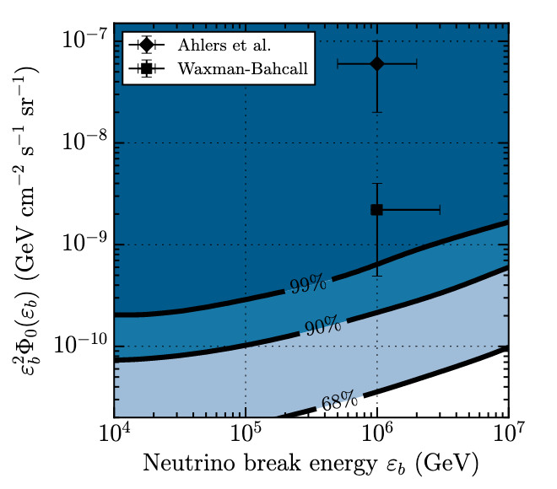

Neutrinos From Gamma-Ray Bursts
Dan Hooper – High-Energy Neutrino Astronomy
Compared to other source classes, the GRB hypothesis is relatively easy to test
Individual GRB are very bright and brief, allowing us to search for coincidences in both time and direction – with very low background
No such correlations have been observed
These results have taught us that:
1) GRB are not a significant source of high-energy neutrinos
and
2) GRB are not responsible for the for the acceleration of the ~PeV-EeV cosmic rays
$$ε=0.1, ξ=1$$
IceCube, arXiv:1702.06868, 1601.06484, 1412.6510, 1204.4219

Slide 24
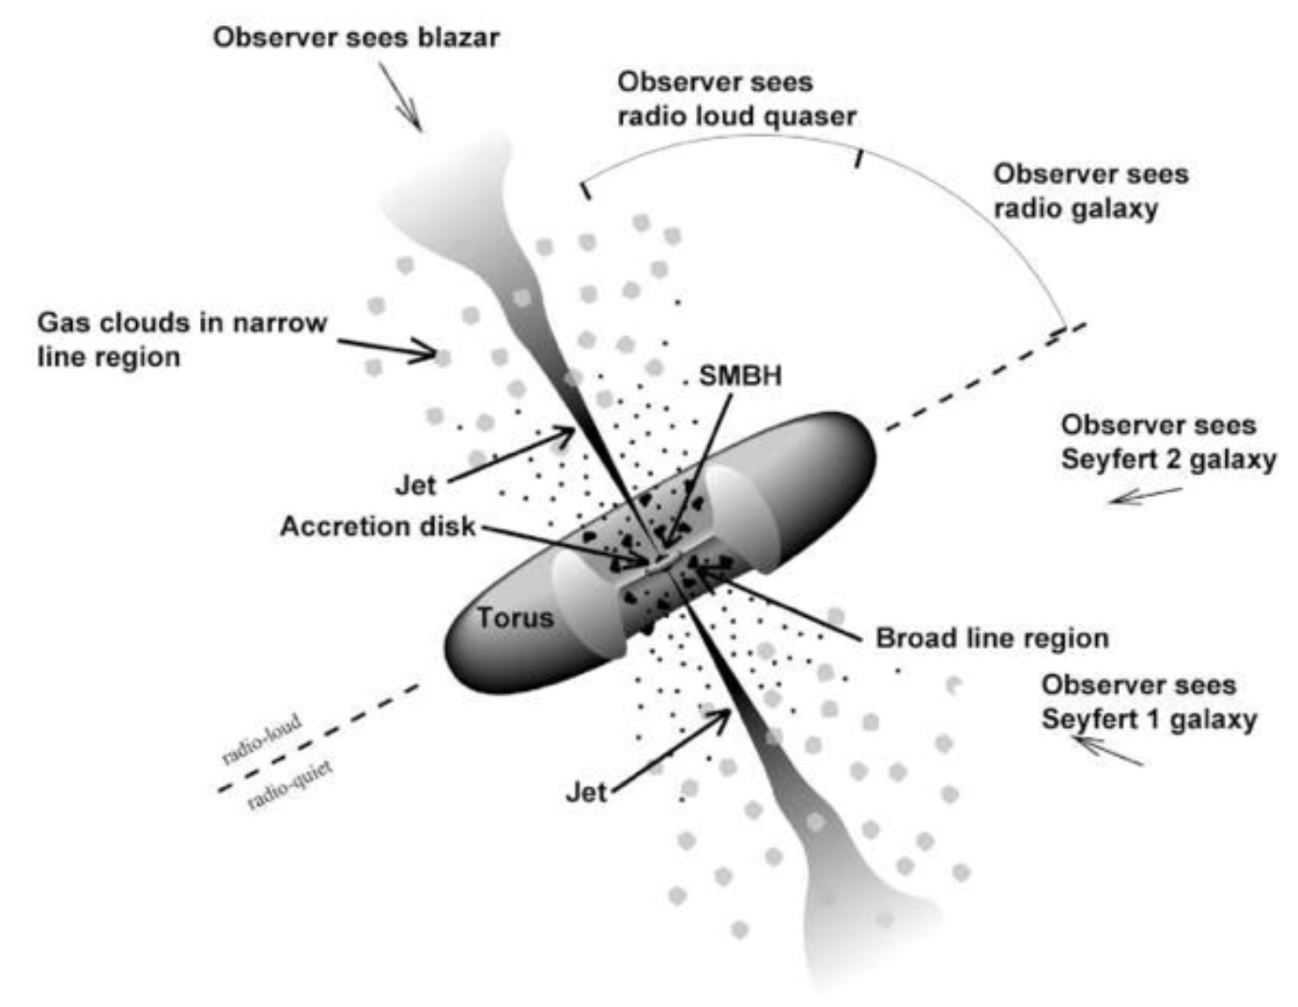
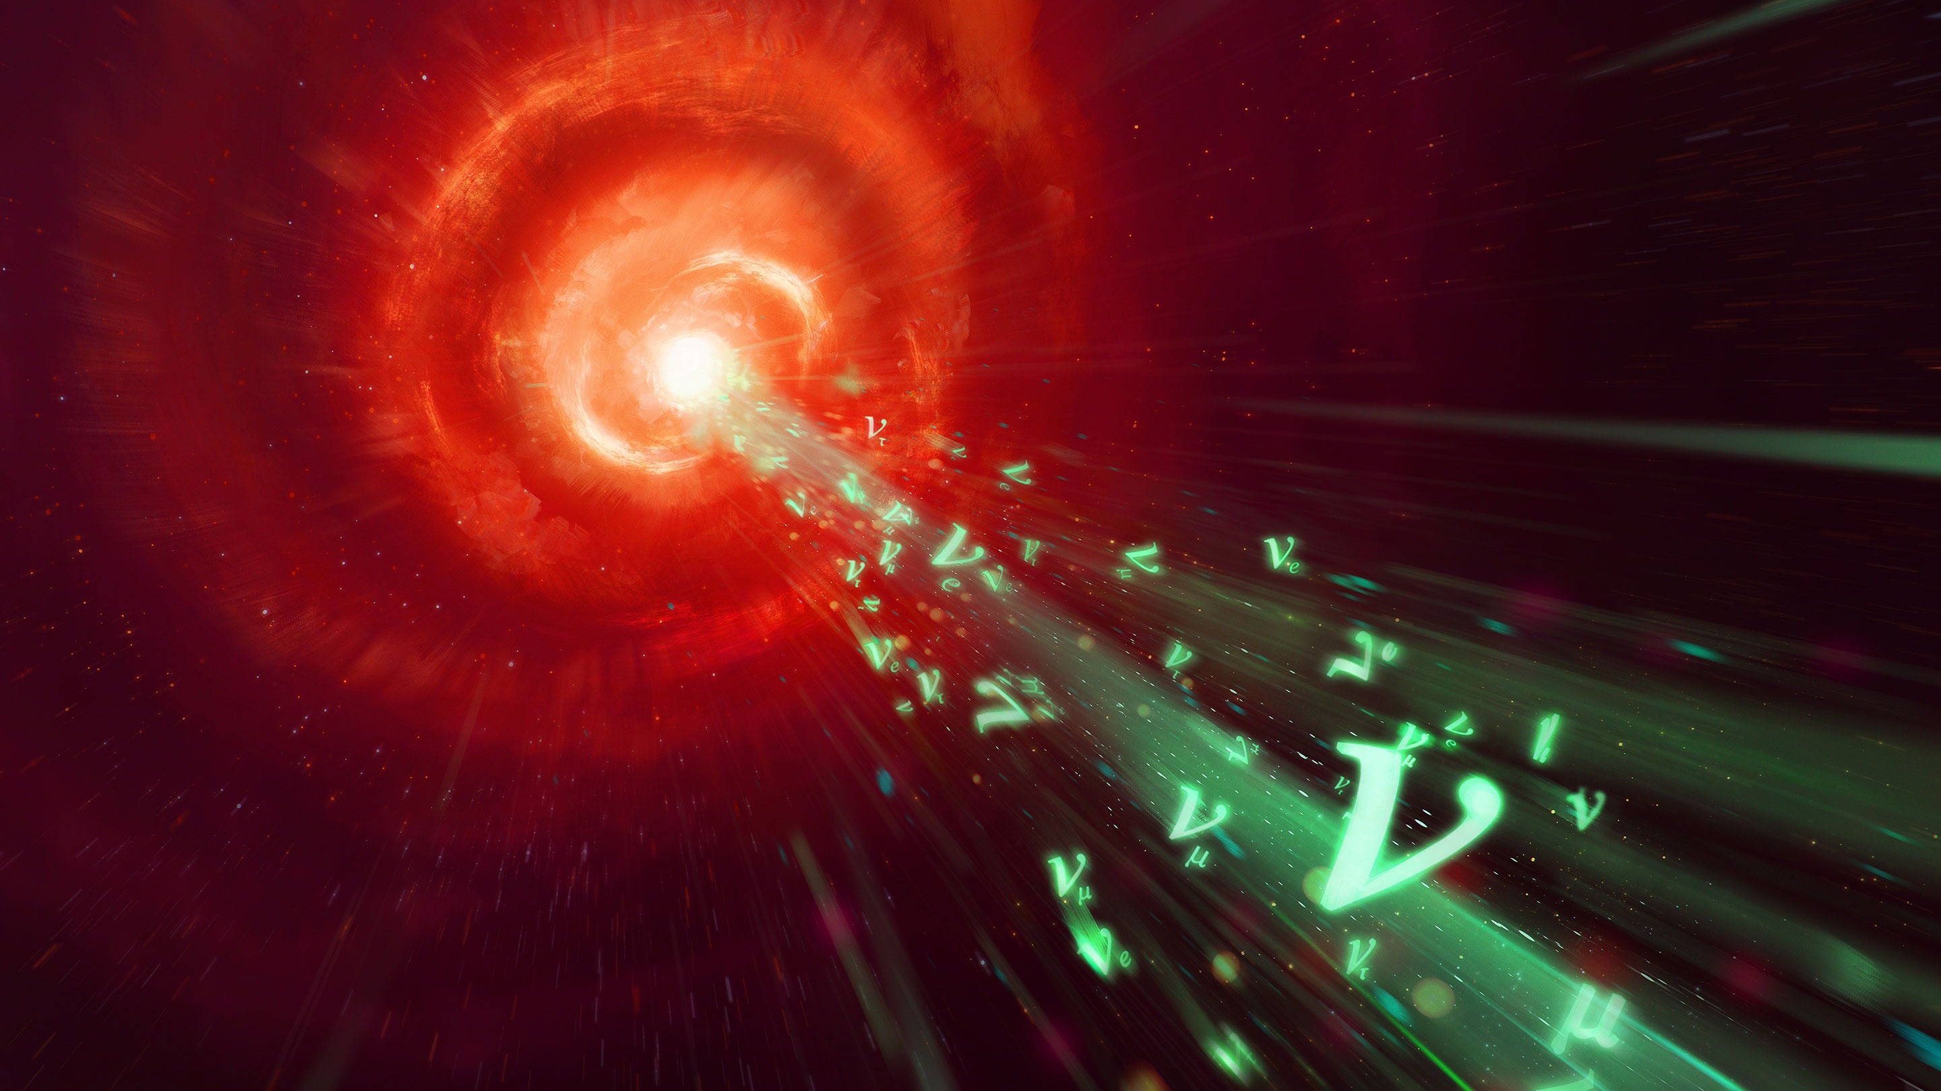
Blazars and AGN
Dan Hooper – High-Energy Neutrino Astronomy
All (or almost all) massive galaxies have a supermassive black hole at their center; ~1-10% of these are active galactic nuclei (AGN): bright sources of high-energy radiation, powered by accretion of matter onto the black hole
AGN are the most luminous persistent sources of electromagnetic radiation in our universe
There are many different classifications of AGN, depending on whether they have a jet, and on the orientation of that jet relative to the observer – blazars are AGN with a jet pointing in our direction

Slide 25
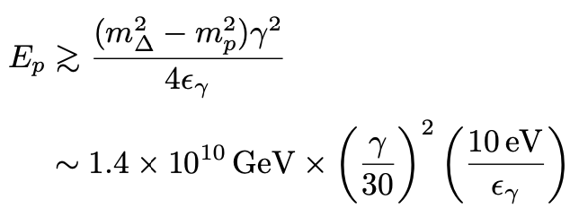
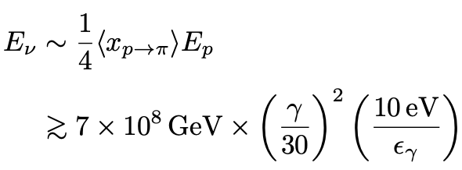
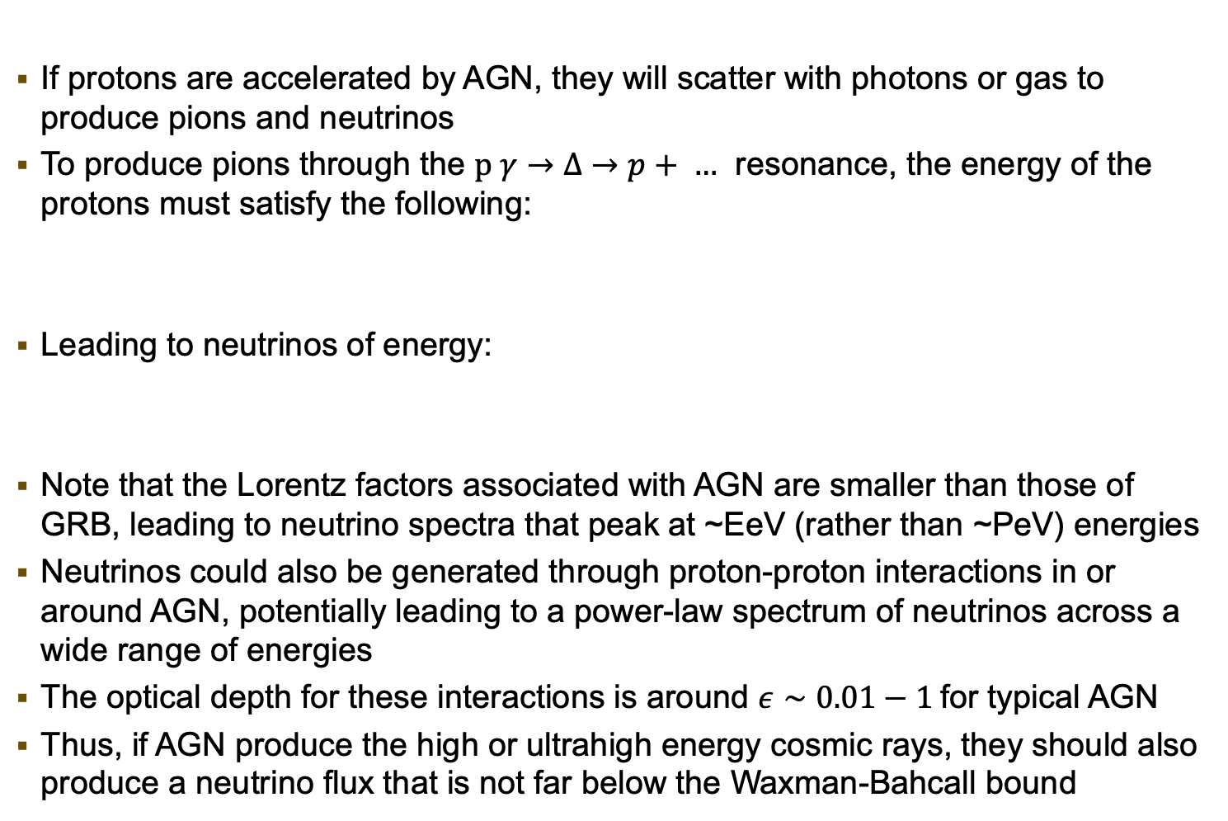
Neutrinos From AGN
Dan Hooper – High-Energy Neutrino Astronomy
If protons are accelerated by AGN, they will scatter with photons or gas to produce pions and neutrinos
To produce pions through the $p γ→Δ→p+ …$ resonance, the energy of the protons must satisfy the following:
Leading to neutrinos of energy:
Note that the Lorentz factors associated with AGN are smaller than those of GRB, leading to neutrino spectra that peak at ~EeV (rather than ~PeV) energies
Neutrinos could also be generated through proton-proton interactions in or around AGN, potentially leading to a power-law spectrum of neutrinos across a wide range of energies
The optical depth for these interactions is around $ε∼0.01−1$for typical AGN
Thus, if AGN produce the high or ultrahigh energy cosmic rays, they should also produce a neutrino flux that is not far below the Waxman-Bahcall bound

Slide 26
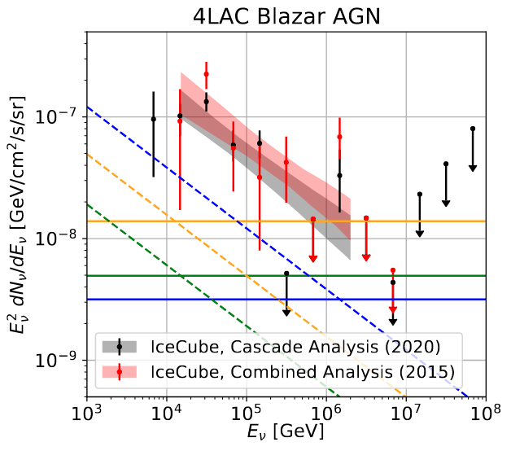
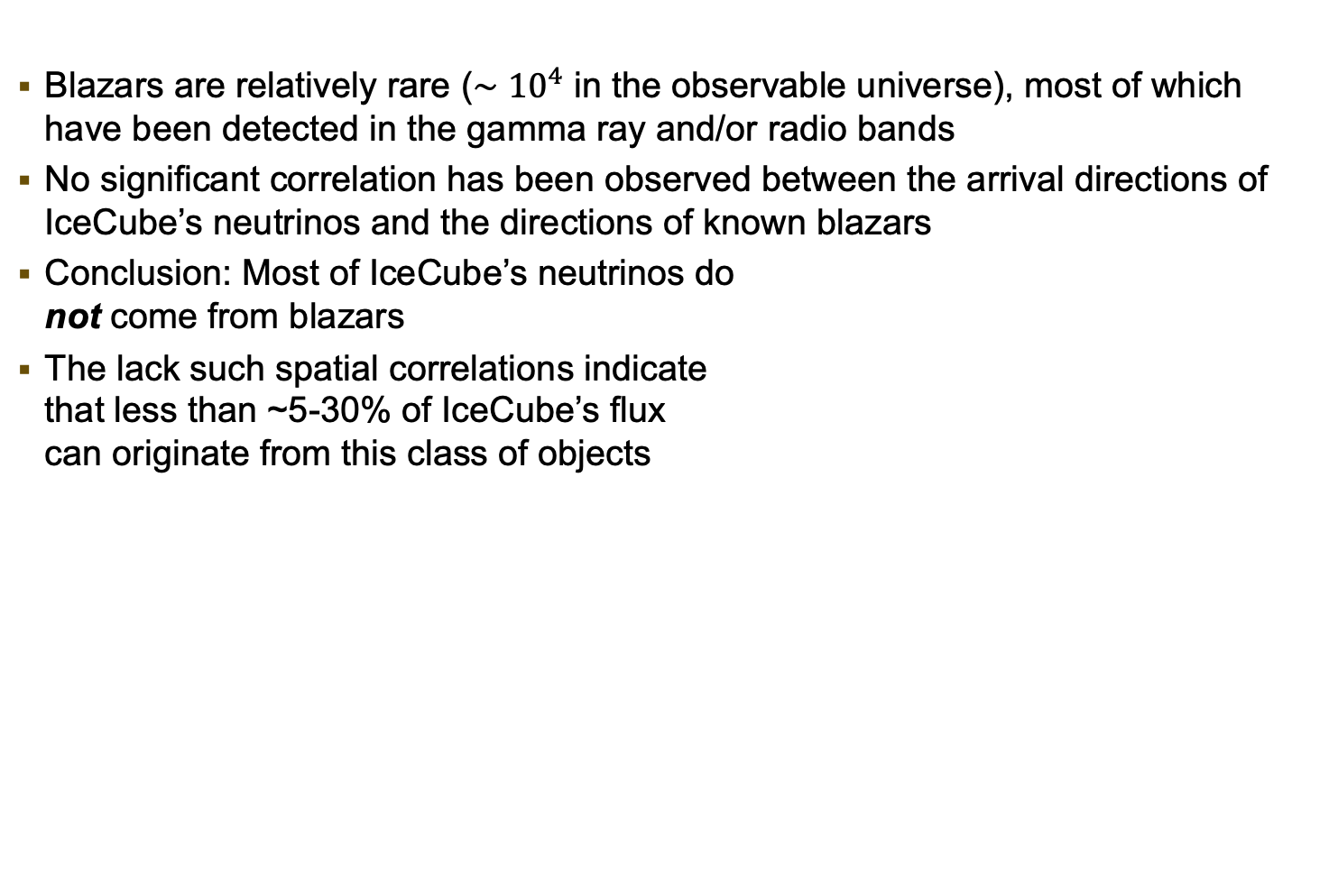
Neutrinos From Blazars
Dan Hooper – High-Energy Neutrino Astronomy
Blazars are relatively rare ($∼{10}^{4}$ in the observable universe), most of which have been detected in the gamma ray and/or radio bands
No significant correlation has been observed between the arrival directions of IceCube’s neutrinos and the directions of known blazars
Conclusion: Most of IceCube’s neutrinos do not come from blazars
The lack such spatial correlations indicate that less than ~5-30% of IceCube’s flux can originate from this class of objects
Smith, DH, Vieregg (2020)
Kun et al, 2203.14780; Smith et al, 2007.12706; Aartsen et al, 1611.03874

Slide 27
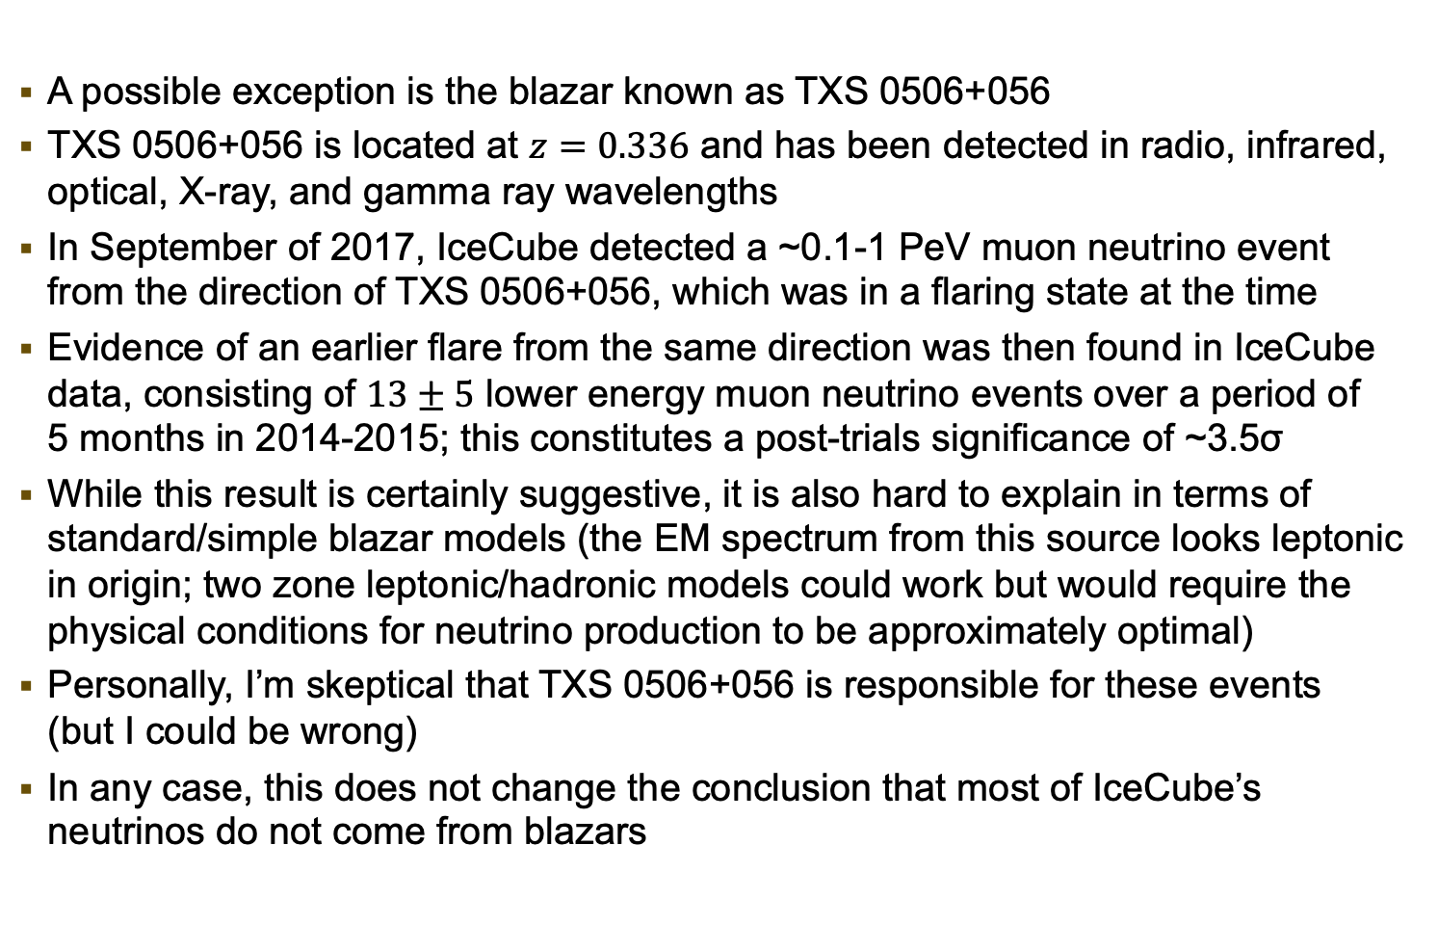
TXS 0506+056
Dan Hooper – High-Energy Neutrino Astronomy
A possible exception is the blazar known as TXS 0506+056
TXS 0506+056 is located at $z=0.336$ and has been detected in radio, infrared, optical, X-ray, and gamma ray wavelengths
In September of 2017, IceCube detected a ~0.1-1 PeV muon neutrino event from the direction of TXS 0506+056, which was in a flaring state at the time
Evidence of an earlier flare from the same direction was then found in IceCube data, consisting of $13±5$ lower energy muon neutrino events over a period of 5 months in 2014-2015; this constitutes a post-trials significance of ~3.5σ
While this result is certainly suggestive, it is also hard to explain in terms of standard/simple blazar models (the EM spectrum from this source looks leptonic in origin; two zone leptonic/hadronic models could work but would require the physical conditions for neutrino production to be approximately optimal)
Personally, I’m skeptical that TXS 0506+056 is responsible for these events (but I could be wrong)
In any case, this does not change the conclusion that most of IceCube’s neutrinos do not come from blazars
IceCube, arXiv:1807.08794, 1807.08816
See also Murase et al. 1807.04748, Keivani et al. 1807.04537, Cerruti et al. 1807.04335

Slide 28
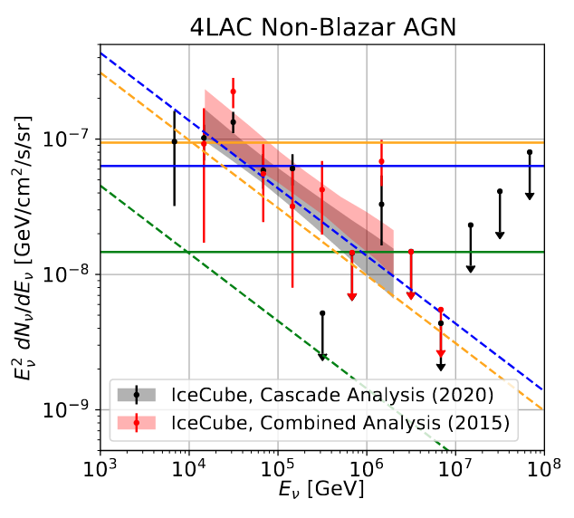

Neutrinos from Non-Blazar AGN
Dan Hooper – High-Energy Neutrino Astronomy
The lack of any correlation between IceCube’s events and the directions of known objects demonstrate that the sources of IceCube’s neutrinos are more numerous and more faint than GRB or blazars
For every blazar, there are $∼{10}^{4}$AGN
It remains possible that AGN could generate the entire neutrino flux observed by IceCube
IceCube is approaching the level of sensitivity that would be needed to test this hypothesis
Smith, DH, Vieregg (2020)

Slide 29
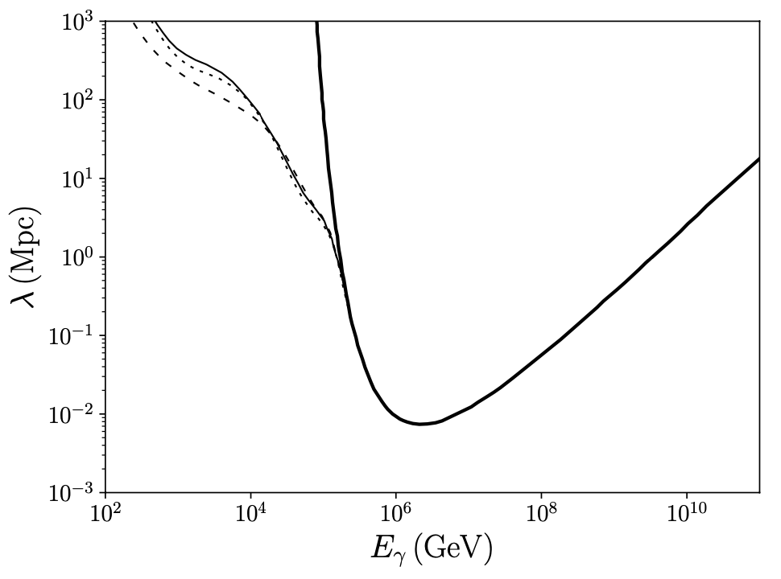
A Multi-Messenger Argument for the Sources of IceCube’s Neutrinos
Dan Hooper – High-Energy Neutrino Astronomy
If the sources of IceCube’s neutrinos are optically thin, they should also generate a significant flux of TeV-PeV gamma rays (you can’t make charged pions without making neutral pions)
At >TeV energies, photons undergo pair production with the CMB/CIRB, leading to an electromagnetic cascade that results in a background of ~GeV-TeV gamma rays
The spectral shape of this background is largely insensitive to the injected spectrum and redshift distribution – the isotropic gamma-ray background is an EM “calorimeter”
Other than blazars (which are mostly resolved), the extragalactic gamma-ray sky is dominated by a combination of non-blazar AGN and starforming galaxies

Slide 30
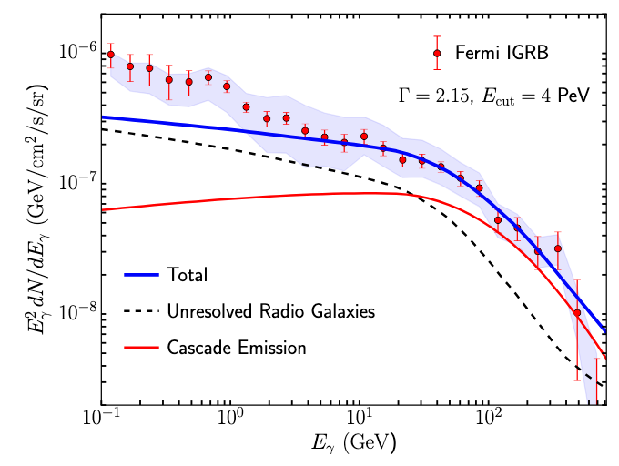
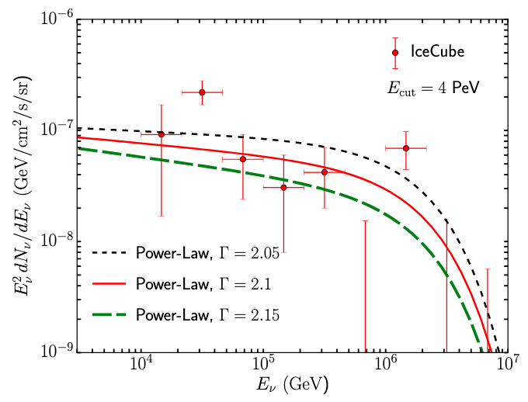


A Multi-Messenger Argument for the Sources of IceCube’s Neutrinos
Dan Hooper – High-Energy Neutrino Astronomy
Consider a population of faint sources that produce (charged and neutral) pions through $pp$ scattering, with a power-law spectrum
For a given value of the injected spectral index, maximum energy, and redshift distribution, we can relate the resulting neutrino spectrum to the corresponding gamma ray spectrum
If we saturate the isotropic gamma-ray background, the neutrino spectrum approximately matches that measured by IceCube
Unscattered Emission
(using the $z$ dist. of FR-I type radio galaxies)
Hooper, JCAP, arXiv:1605.06504

Slide 31


A Multi-Messenger Argument for the Sources of IceCube’s Neutrinos
Dan Hooper – High-Energy Neutrino Astronomy
So long as the sources of IceCube’s neutrinos are optically thin, they must be the same sources that produce most of the isotropic gamma-ray background measured by Fermi
Using observed correlations between IR/radio and gamma-ray emission, (non-blazar) AGN and starforming galaxies have been shown to dominate the isotropic gamma-ray background
A combination of these source classes seem likely to produce most of IceCube’s neutrinos
Unresolved AGN
Blanco, Linden, JCAP, arXiv:2104.03315
Hooper, Linden, JCAP, arXiv:1604.08505

Slide 32



NGC 1068
Dan Hooper – High-Energy Neutrino Astronomy
NGC 1068 (also known as M77) is a nearby (14.4 Mpc) barred spiral galaxy with a non-jetted AGN
In 2022, the IceCube Collaboration reported an excess of $79±22$TeV-scale neutrino events from the direction of NGC 1068 (post-trials significance of $4.2σ$)
The neutrino spectrum from this source seems to be very soft ($γ∼3.2$)
IceCube
As seen by Hubble
IceCube, Science, arXiv:2211.09972

Slide 33
NGC 1068
Dan Hooper – High-Energy Neutrino Astronomy
The upper limits on the TeV-scale gamma-ray emission from the MAGIC telescope strongly constrain the nature of this source
You can’t make high-energy neutrinos (from charged pions) without making high-energy photons (from neutral pions) – where are all of the TeV-scale photons that should come with these neutrinos?
If these neutrinos really do come from NGC 1068, the ~TeV photons must be very efficiently absorbed and reemitted at energies below ~10-100 MeV, making this an example of an optically thick source, aka, a “Hidden Source”
This scenario could be tested with future MeV-scale satellite-based telescopes (AMIGO, e-ASTROGAM)
IceCube
IceCube, Science, arXiv:2211.09972
Fermi
MAGIC

Slide 34



Cosmogenic Neutrinos
Dan Hooper – High-Energy Neutrino Astronomy
Due to scattering with the CMB, our universe is opaque to protons with more energy than
If the ultra-high energy cosmic rays were mostly protons, this would lead to a flux of $∼{10}^{8}−{10}^{9}$ GeV neutrinos near the Waxman-Bahcall bound
For decades, this was often cited as a “guaranteed flux” of ultra-high energy neutrinos
Waxman-Bahcall
Kotera, Allard, Olinto, arXiv:1009.1382

Slide 35

Cosmogenic Neutrinos
Dan Hooper – High-Energy Neutrino Astronomy
Measurements by Auger suggest that the highest-energy cosmic rays are not mostly protons, but instead consist of a mixture of nuclear species
To generate neutrinos, these nuclei must first undergo photodisintegration (via scattering with IR backgrounds), followed by the resulting nucleons scattering to produce pions (if above threshold)
This leads to a strong suppression of the neutrino flux, making this signal difficult to detect (even with next generation experiments)
DH, Taylor, Sarkar, arXiv:0407618
Allard, et al., arXiv:0605327
Heinze, et al, arXiv:1901.03338

Slide 36
IceCube’s High-Energy Neutrinos
Dan Hooper – High-Energy Neutrino Astronomy
When I give talks about neutrino astronomy at particle physics conferences, I often find some people asking, “But this is all astrophysics! Why should I care?”

Slide 37
High-Energy Neutrinos as Probes of New Physics
Dan Hooper – High-Energy Neutrino Astronomy
Neutrino telescopes allow us to measure the interactions of neutrinos at higher energies and over longer baselines than is possible in any existing laboratory experiment
Such measurements can not only be used to learn about astrophysical objects and environments, but can also serve as a probe of physics beyond the SM

Slide 38

High-Energy Neutrinos as Probes of New Physics
Dan Hooper – High-Energy Neutrino Astronomy
Neutrino telescopes allow us to measure the interactions of neutrinos at higher energies and over longer baselines than is possible in any existing laboratory experiment
Such measurements can not only be used to learn about astrophysical objects and environments, but can also serve as a probe of physics beyond the SM
Ackermann et al (Snowmass White Paper), arXiv:2203.08096

Slide 39


Probes of New Interactions?
Dan Hooper – High-Energy Neutrino Astronomy
As an example, consider a light Z’ that couples to muons (or muons and taus), with a gauge coupling selected to explain the FNAL/BNL measurements of g_{𝜇}-2
Over cosmological distances, such a Z’ would cause high-energy neutrinos to scatter with the cosmic neutrino background, leading to resonant absorption features at
This could even provide an explanation for the observed dip at ~0.2-1 PeV
DH, Iguaz, Serpico, arXiv:2302.03571
DiFranzo, DH, arXiv:1507.03015
DH, arXiv:0701194

Slide 40


Neutrino Decay?
Dan Hooper – High-Energy Neutrino Astronomy
Perhaps one or more neutrino species are unstable?
If one or two neutrino species decay into lighter neutrinos, this would impact the ratio of neutrino flavors that reach Earth
Neutrinos from pion decay are produced with $ν_{e}:ν_{μ}:ν_{τ}=1:2:0$, which after oscillations becomes $ν_{e}:ν_{μ}:ν_{τ}=0.90:1.18:1.02$
Current measurements are consistent with these predictions, allowing us to constrain $τ/m>10$ s/eV
Beacom, Bell, DH, Pakvasa, Weiler, arXiv:0211305
IceCube, arXiv:2011.03561

Slide 41
WIMPs and the Dark Matter Landscape
Dan Hooper – High-Energy Neutrino Astronomy

Slide 42
WIMPs and the Dark Matter Landscape
Dan Hooper – High-Energy Neutrino Astronomy
“WIMPs”
~10 MeV-100 TeV
The Case for WIMPs:
If we assume that the dark matter was in thermal equilibrium at some point in the early universe, and that the early universe was radiation dominated, then we can conclude the following:
1) The dark matter must be heavier than a few MeV (to avoid ruining BBN)
2) The dark matter must be lighter than ~100 TeV (to avoid overproduction)
To freeze-out with the measured dark matter abundance, such a particle must annihilate through something comparable to the weak force – the “WIMP Miracle”
From this perspective, dark matter candidates with roughly weak-scale masses and interactions – “WIMPs” – are particularly well motivated

Slide 43

The Sensitivity of Neutrino Telescopes to Dark Matter Annihilation
Dan Hooper – High-Energy Neutrino Astronomy
Arguelles et al, arXiv:1912.09486

Slide 44

Dan Hooper – High-Energy Neutrino Astronomy

Slide 45

The Future
Dan Hooper – High-Energy Neutrino Astronomy
PUEO
GRAND
IceCube-Gen2
Ackermann et al., Snowmass White Paper, 2203.08096

Slide 46

The Future
Dan Hooper – High-Energy Neutrino Astronomy
Existing data indicates that IceCube’s neutrinos come from many relatively faint sources (ruling out blazars and GRB, for example)
Testing our best remaining hypotheses (non-blazar AGN, starburst galaxies) is beyond the current reach of IceCube, but within the reach of proposed next-generation efforts
Ackermann et al., Snowmass White Paper, 2203.08096

Slide 47
Summary
Dan Hooper – High-Energy Neutrino Astronomy
Exciting activity and new results continue to develop in many areas of astro-particle physics – neutrinos, cosmic rays, gamma rays, and more
IceCube’s neutrinos are the key to identifying the sources of the high and ultra-high energy cosmic rays; at present some combination of AGN and star-forming galaxies seem most likely
A variety of scenarios involving physics beyond the Standard Model can be tested using existing and planned neutrino telescopes – probing neutrino interactions at higher energies and over longer baselines than is possible in existing laboratory experiments

Slide 48


