Slide 1
Cold Tests of SSR1 Cavities
A. Sukhanov, FNAL-IBS Workshop
March 1, 2023

Slide 2
Outline
Introduction
Vertical test results
Horizontal test results
Prototype CM results
Summary

Slide 3
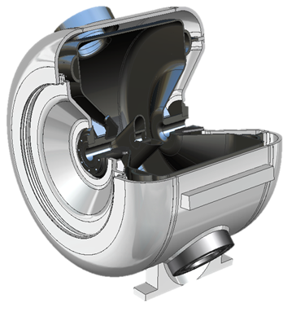
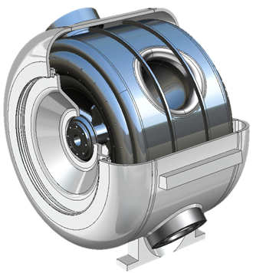
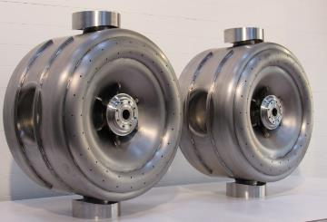
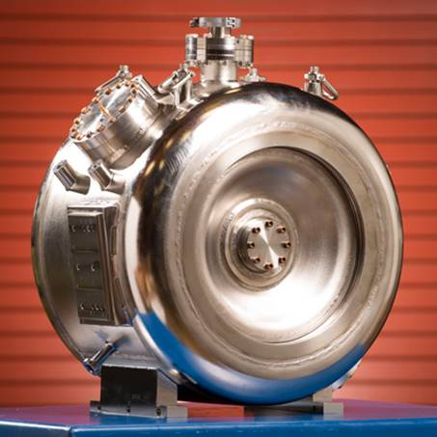
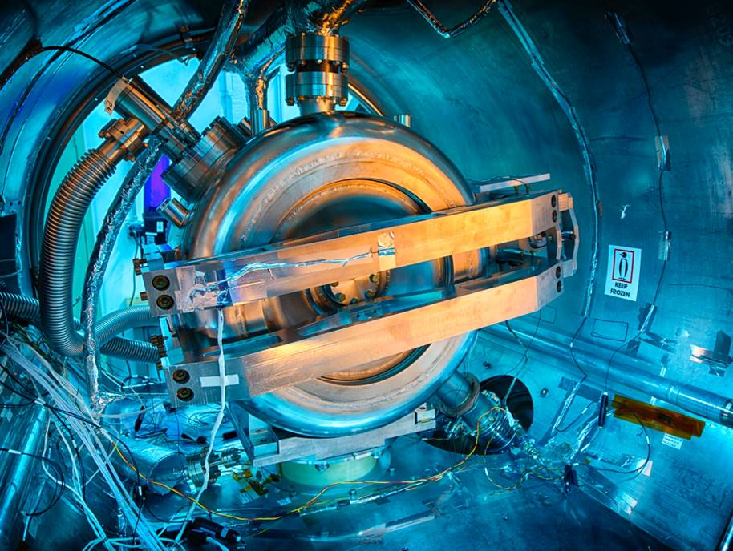
Prototype SSR1 Cavities
12 prototype cavities were produced
  10 at Fermilab (US) and 2 at DEA BARC/IUAC (India)
  Stainless steel Helium vessel
Prototype cavities went through extensive testing program
  All 12 bare cavities were qualified in vertical test cryostat (VTS)
  10 jacketed cavities fully integrated with high power coupler and tuner were qualified in horizontal test cryostat
  8 cavities selected for prototype cryomodule assembly
  SSR1 pCM successfully tested and accelerated H- beam in PIP2IT test

Slide 4
VTS and STC Testing

Slide 5
SSR1 Cavities Processing and Preparation
Preparation for VTS:
  Bulk BCP: 2x(60-75) um
  Vertical HPR
  High T bake: 600 C, 10 h
  Light BCM: 20-30 um
  HPR: Vertical + Horizontal
  Low T bake: 120 C, 48 h
Preparation of jacketed cavity for STC:
  Light BCP: 5-10 um
  US cleaning
  HPR: Vertical + Horizontal
  Low T bake: 120 C, 48 h
STC qualified cavities stored under vacuum
Purged with dry N2 during pCM cryo-string assembly
Important steps for mitigation of FE and MP

Slide 6
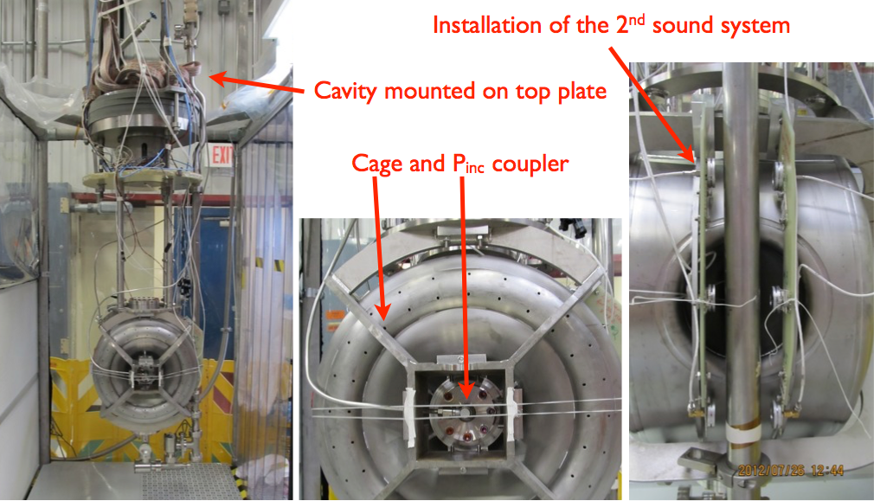
Vertical Tests of Bare SSR1 Cavities
Installation of bare SSR1 cavity to VTS top plate

Slide 7
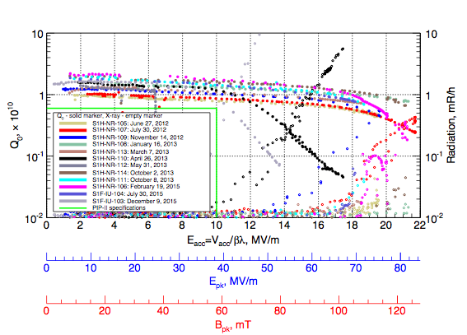
VTS Results
All 10 FNAL and 2 BARC/IUAC bare cavities were qualified at VTS

Slide 8
VTS Results
All 10 FNAL and 2 BARC/IUAC bare cavities were qualified at VTS
Summary of Q0/Ploss measurements
 | Location in CM | 1 | 2 | 3 | 4 | 5 | 6 | 7 | 8
 | Serial # | S1H-NR-106 | S1H-NR-110 | S1H-NR-112 | S1H-NR-109 | S1H-NR-114 | S1F-IU-104 | S1H-NR-113 | S1H-NR-111 | Total CM, W | Average, W
pCM Phase I | Eacc, MV/m | 4.88 | 4.63 | 4.78 | 7.32 | 7.8 | 7.56 | 7.32 | 10
 | Q0, 1e8 | 208 | 143 | 123 | 110 | 170 | 158 | 119 | 143
 | Ploss, W | 0.2 | 0.3 | 0.3 | 0.8 | 0.6 | 0.6 | 0.8 | 1.2 | 4.9 | 0.6
pCM Phase II | Eacc, MV/m | 10 | 8.78 | 8.05 | 10 | 9.76 | 10 | 8.54 | 10
 | Q0, 1e8 | 172 | 130 | n/a | 100 | 167 | 137 | 115 | 143
 | Ploss, W | 1.0 | 1.0 | n/a | 1.7 | 1.0 | 1.3 | 1.1 | 1.2 | 8.3 | 1.2
 | Eacc, MV/m | 11.47 | 11.47 | 11.47 | 11.47 | 11.47 | 11.47 | 11.47 | 11.47
 | Q0, 1e8 | 167 | 86 | n/a | 99 | 148 | 135 | 103 | 134
 | Ploss, W | 1.4 | 2.7 | n/a | 2.3 | 1.5 | 1.7 | 2.2 | 1.7 | 13.5 | 1.9

Slide 9
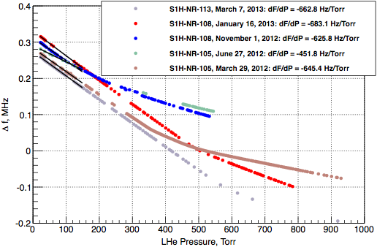
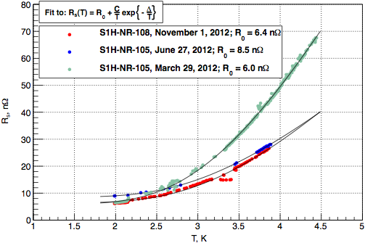
VTS Results
All 10 FNAL and 2 BARC/IUAC bare cavities were qualified at VTS
Average df/dp of unconstrained bare SSR1 cavities was measured at 650 Hz/Torr and agree well with design target value for bare cavity (model verification)
At 2K SSR1 cavity average surface resistance is 7-8 nOhm and determined mainly by the residual component which depends on the Nb properties (RRR) and magnetic environment

Slide 10
Test of jacketed SSR1 Cavities at STC
After qualification of bare cavities at VTS they were jacketed and prepared for test at Spoke Test Cryostat (STC)
  Light BCP(5-10um), ultra-sonic cleaning, vertical/horizontal HPR assembly with low power matched coupler (LPC), leak check, 120C 48h bake
Pre-qualification tests with LPC
  Cavity resonance frequency
  Maximum field (or admin. limit), Q0 vs Eacc, FE radiation level and onset field
  df/dp, LFD coefficients
After cavity pre-qualified with LPC, it was prepared for the final qualification test for CM assembly with high power coupler (HPC) and tuner
  Verification of HPC performance off-resonance up to 5 kW
  Maximum field (or admin. limit), Q0 vs Eacc, FE radiation level and onset field
  df/dp, LFD coefficients
  Tuner performance (tuning range, tuning sensitivity)

Slide 11
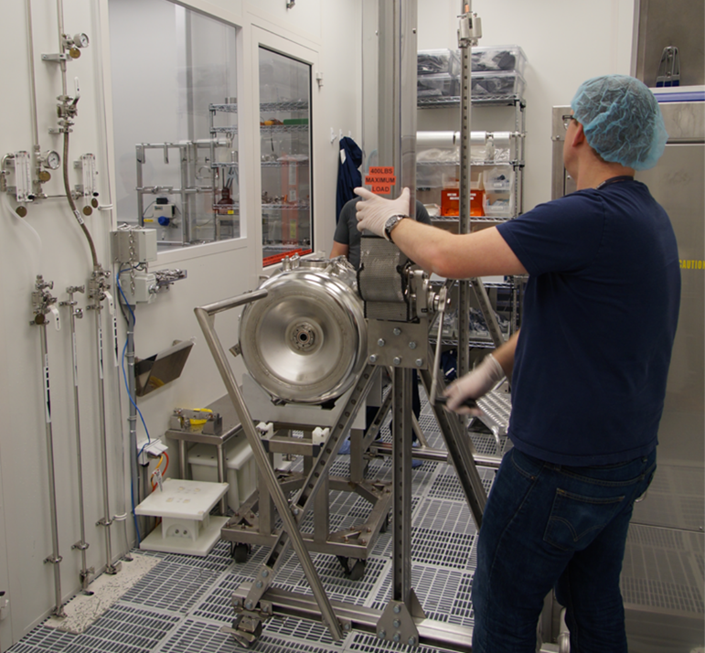
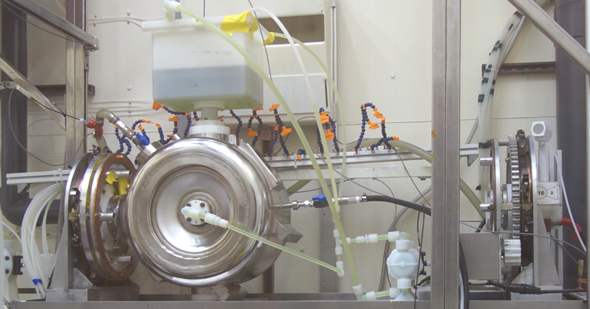
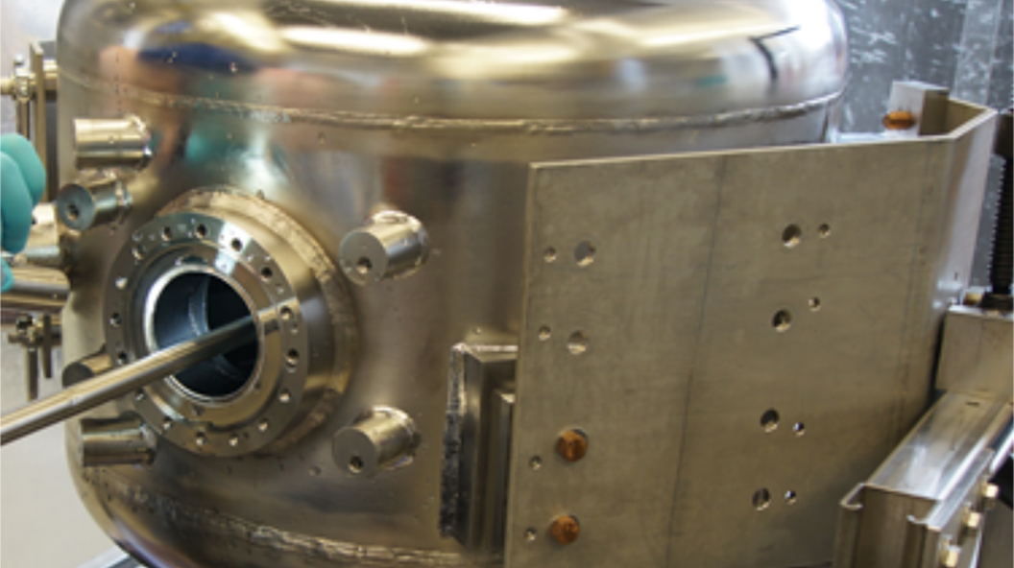
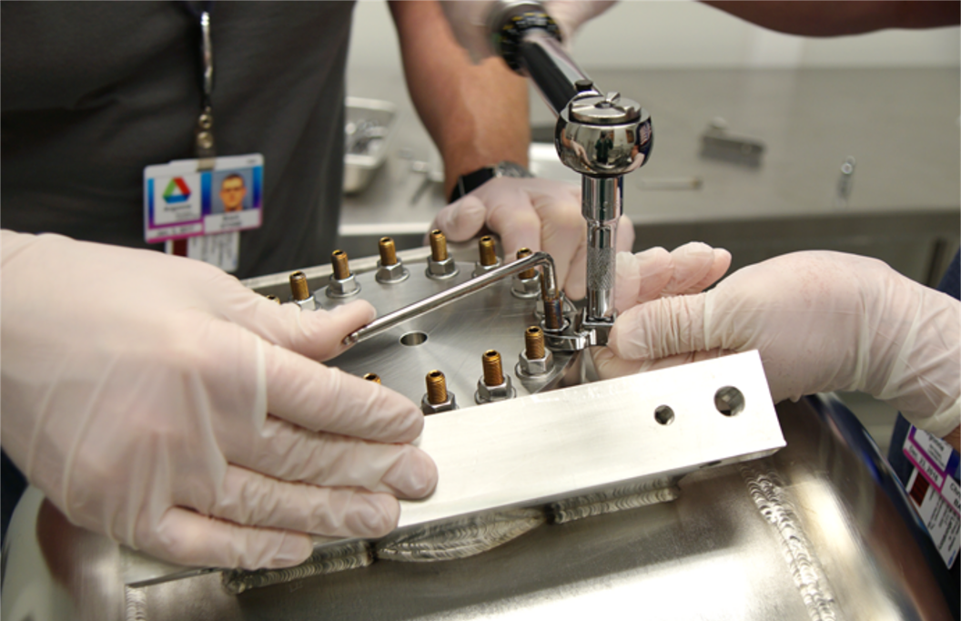
Processing of Jacketed SSR1 Cavities at ANL
Vertical HPR
BCP
Horizontal HPR
Coupler flange (LPC) assembly

Slide 12
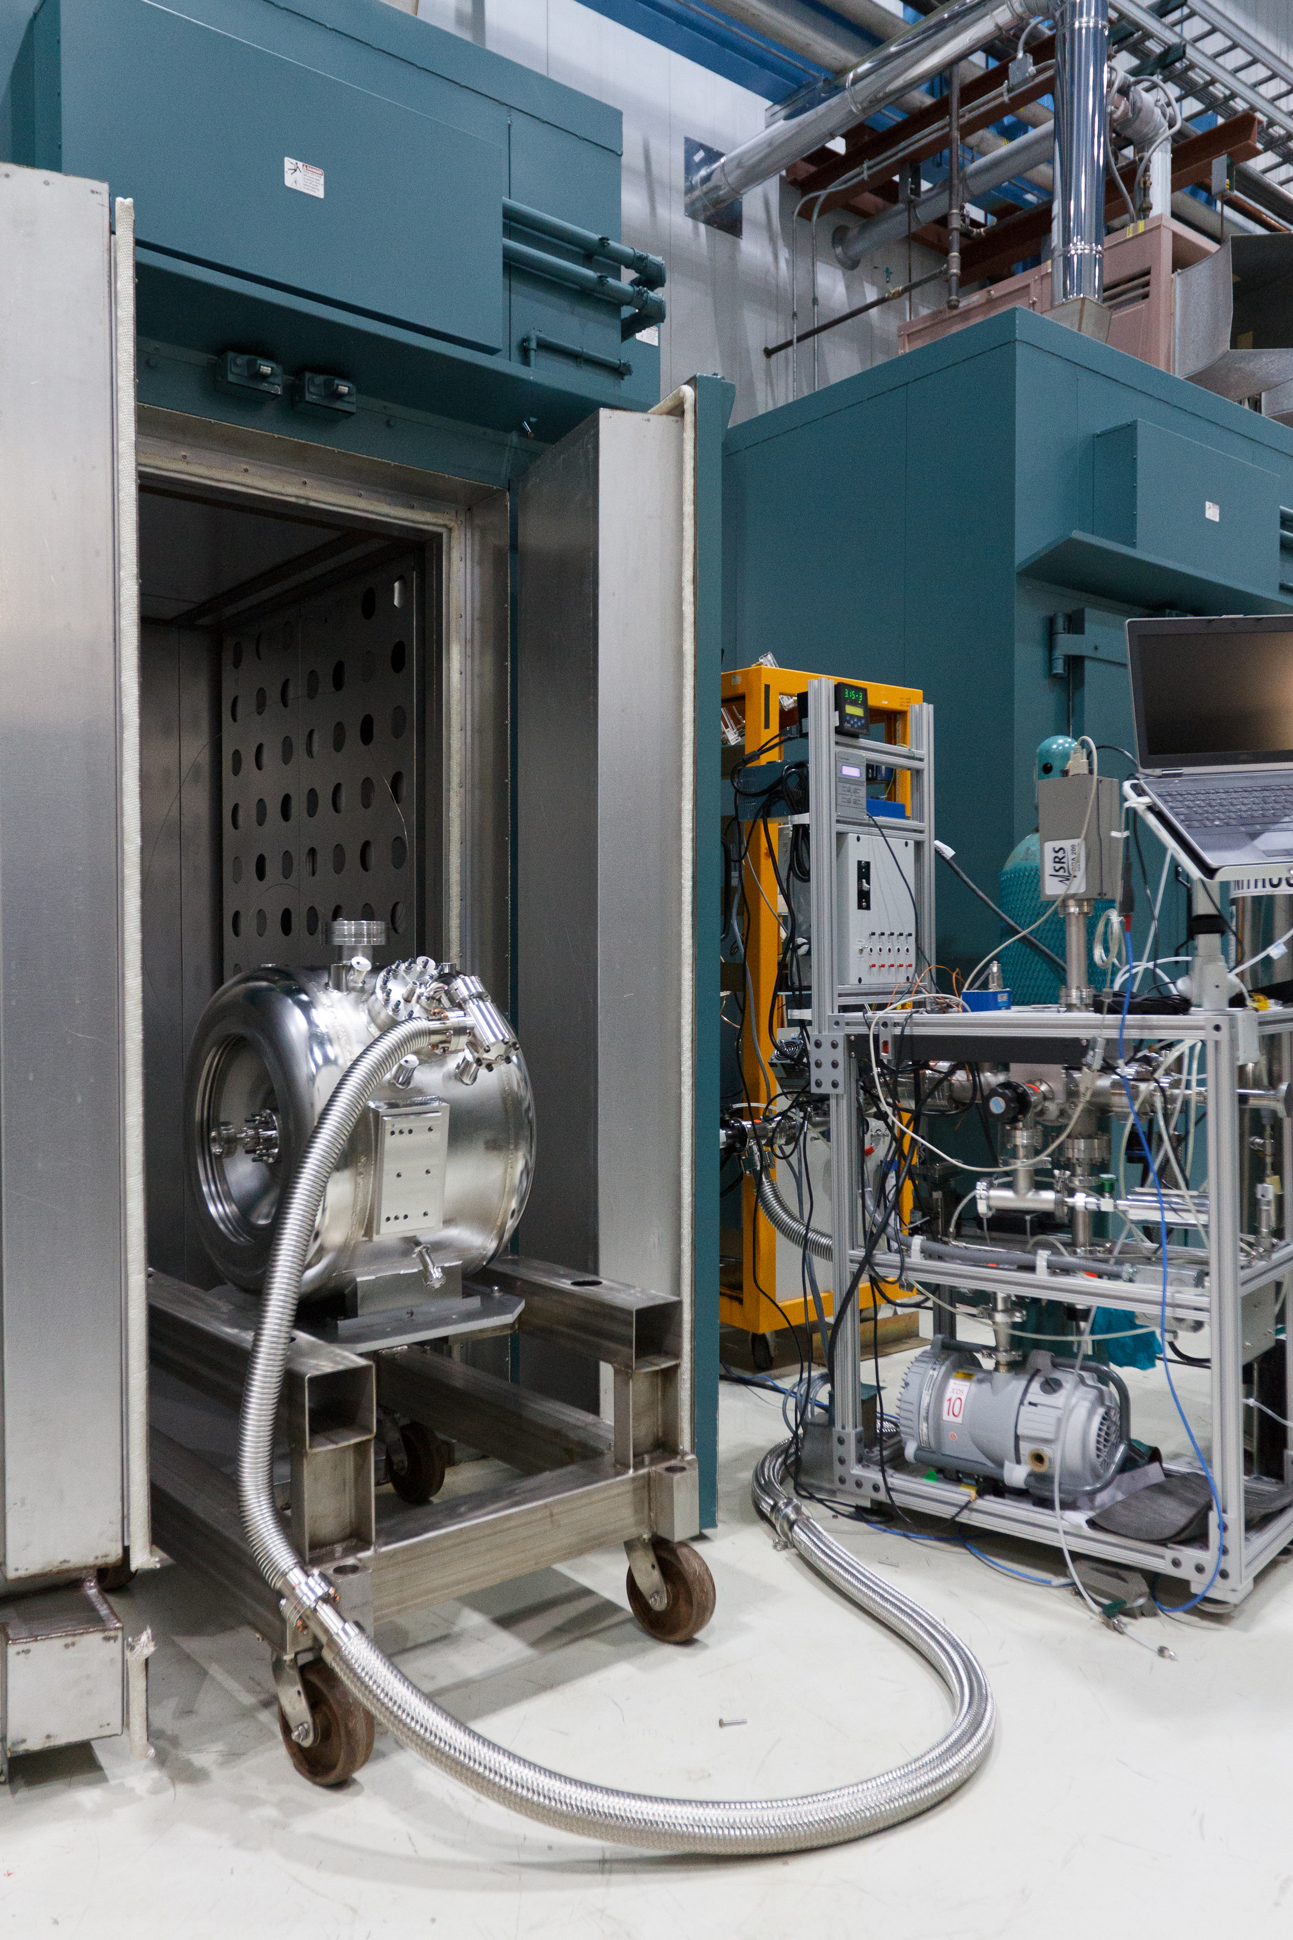
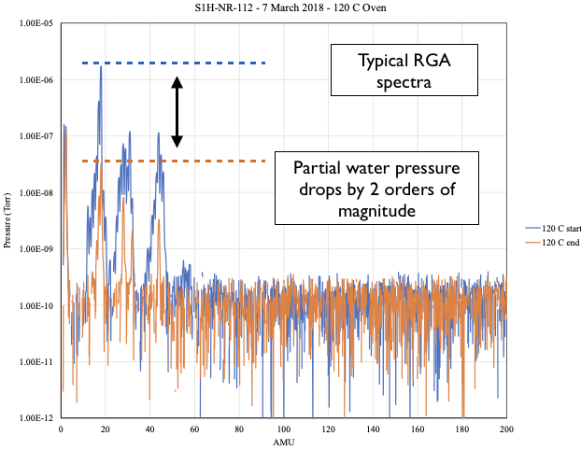
Preparation and Installation at Fermilab
120C 48h bake

Slide 13
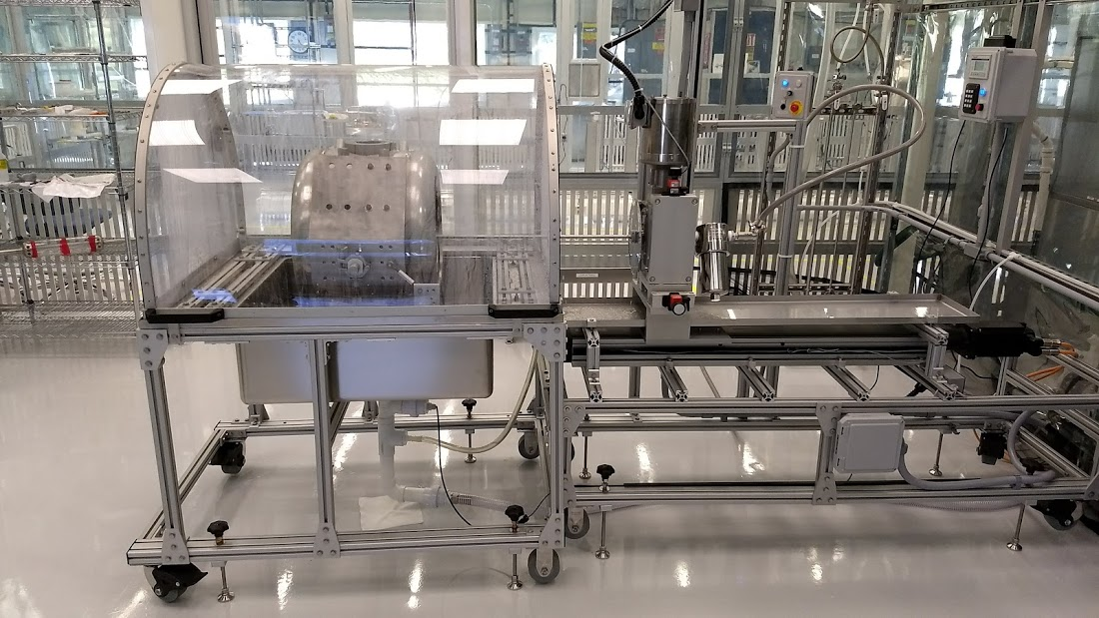
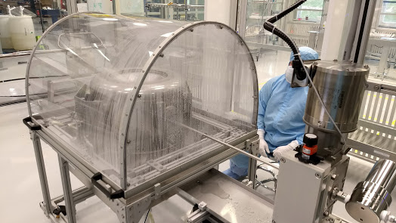
Preparation and Installation at Fermilab
Lab2 - dedicated facility for SSR1 cryomodule assembly
Horizontal HPR system

Slide 14
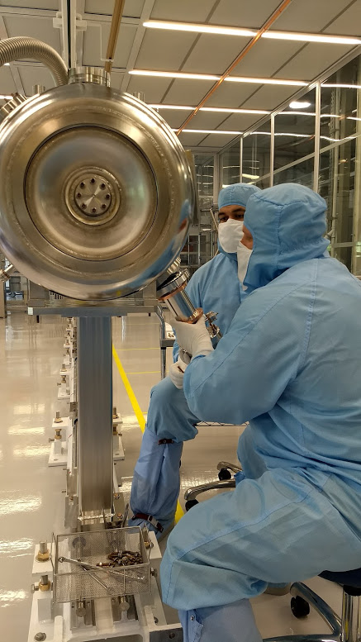
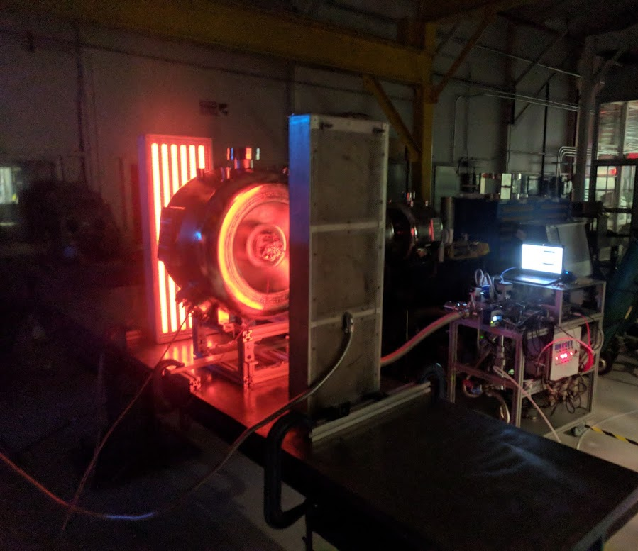
Preparation and Installation at Fermilab
Lab2 - dedicated facility for SSR1 cryomodule assembly
High Power coupler assembly
Low T bake system based on IR panels

Slide 15
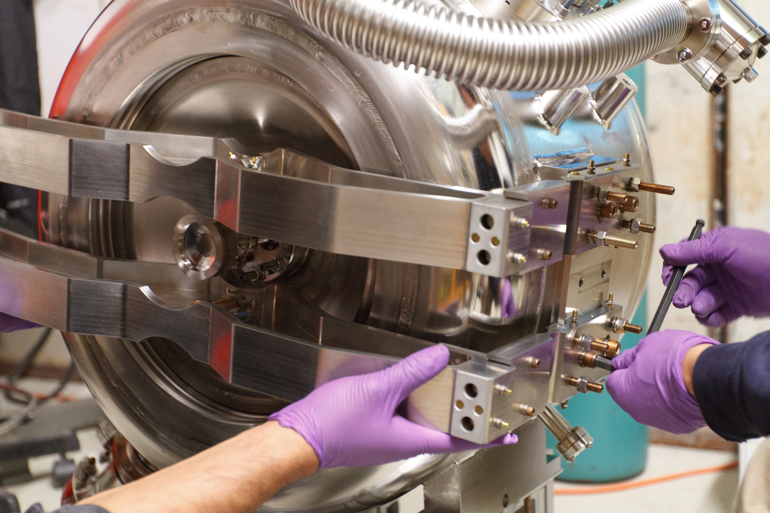
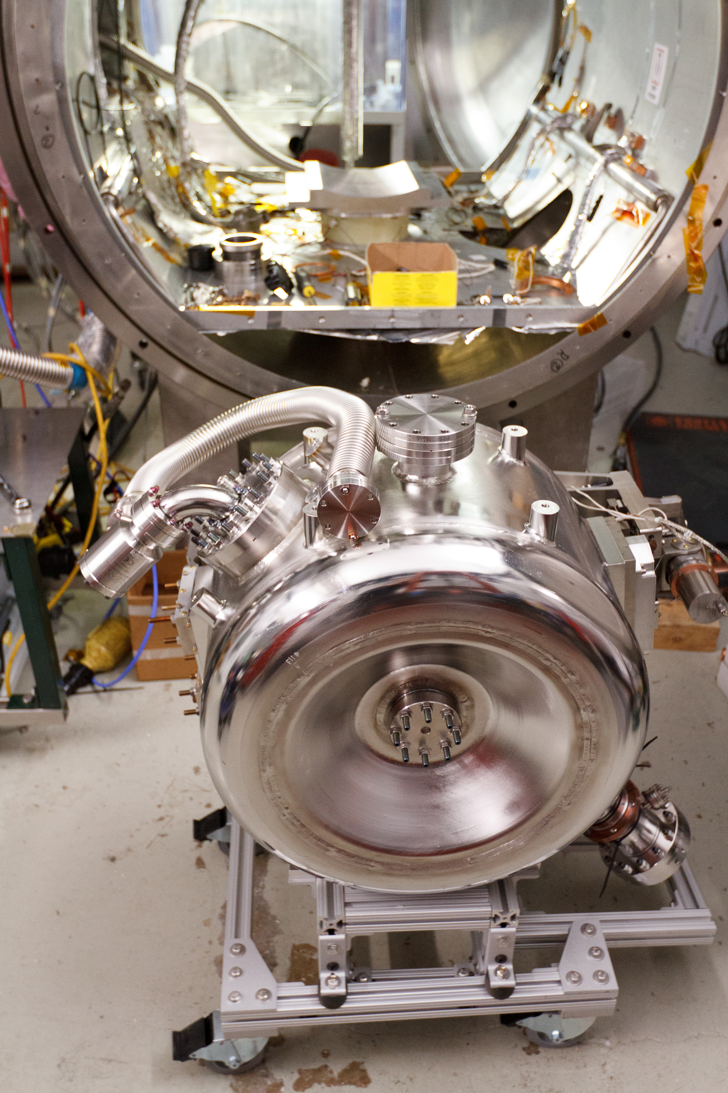
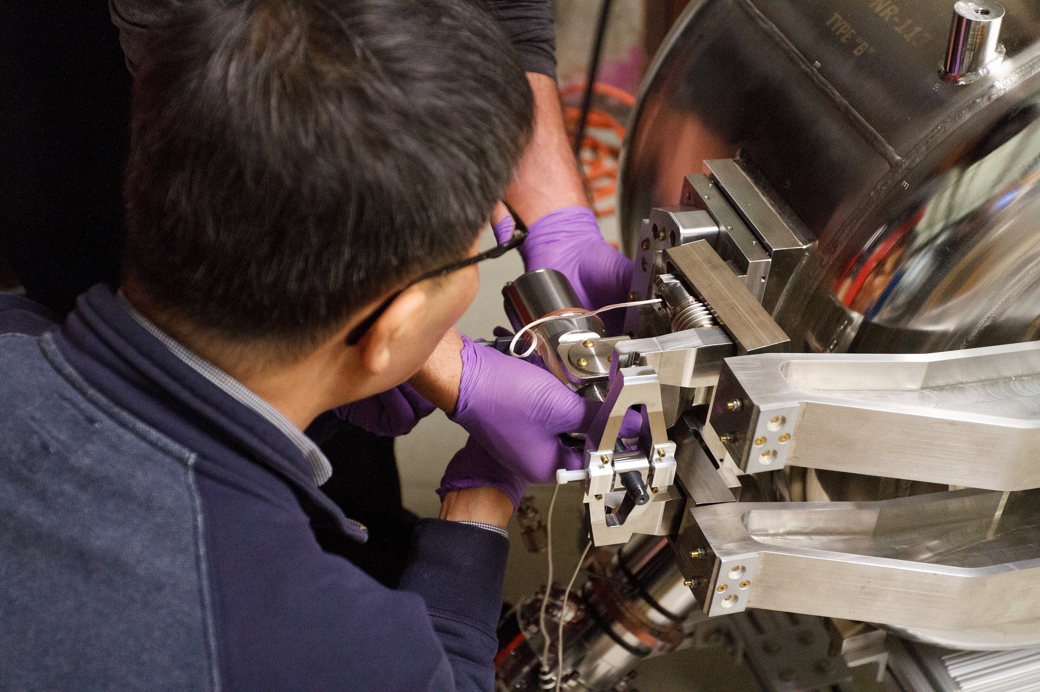
Tuner Assembly and Installation to STC
Tuner assembly
Ready for STC!

Slide 16
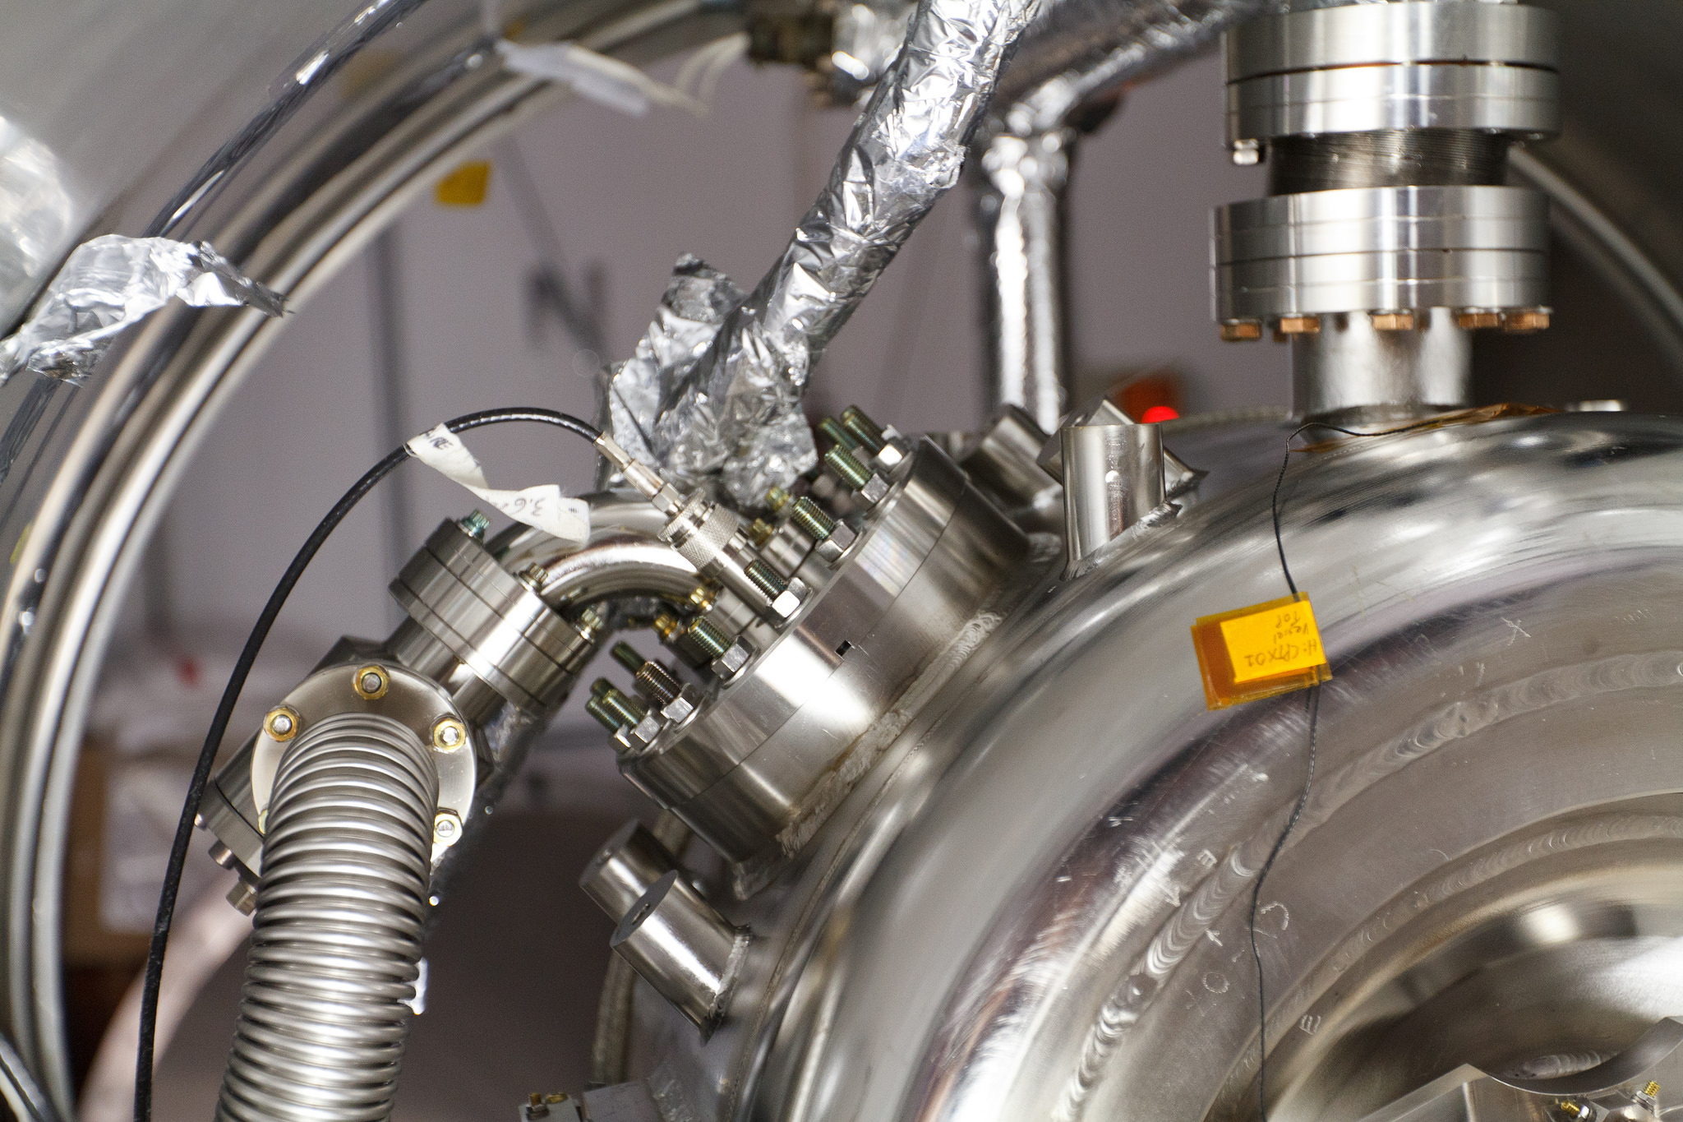
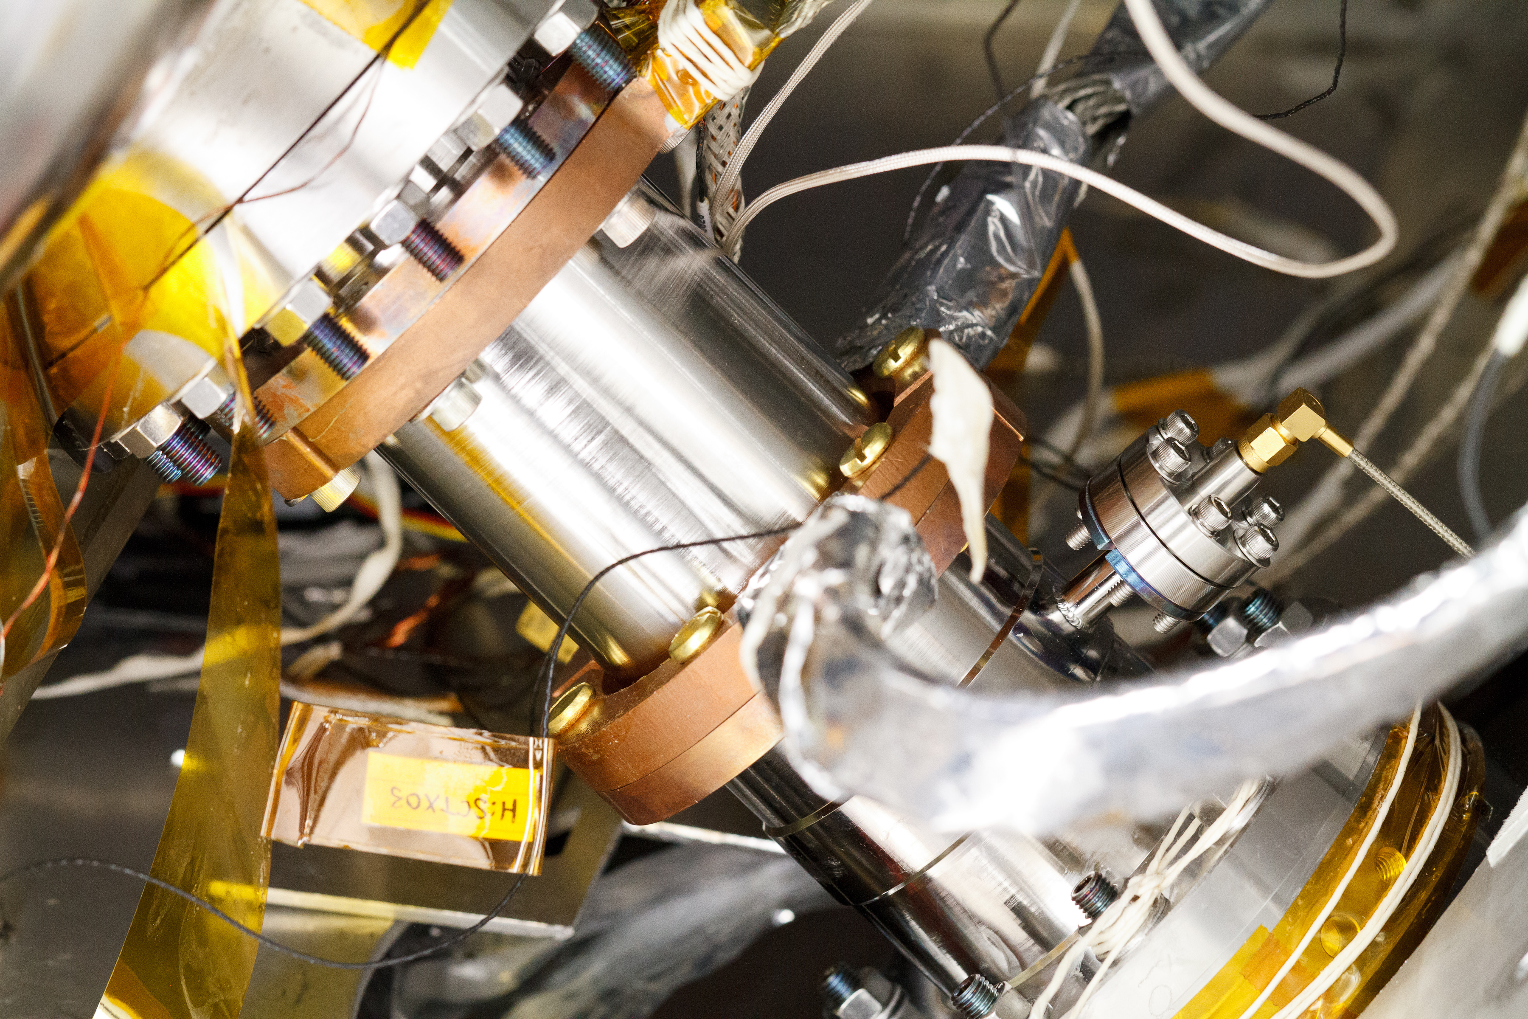
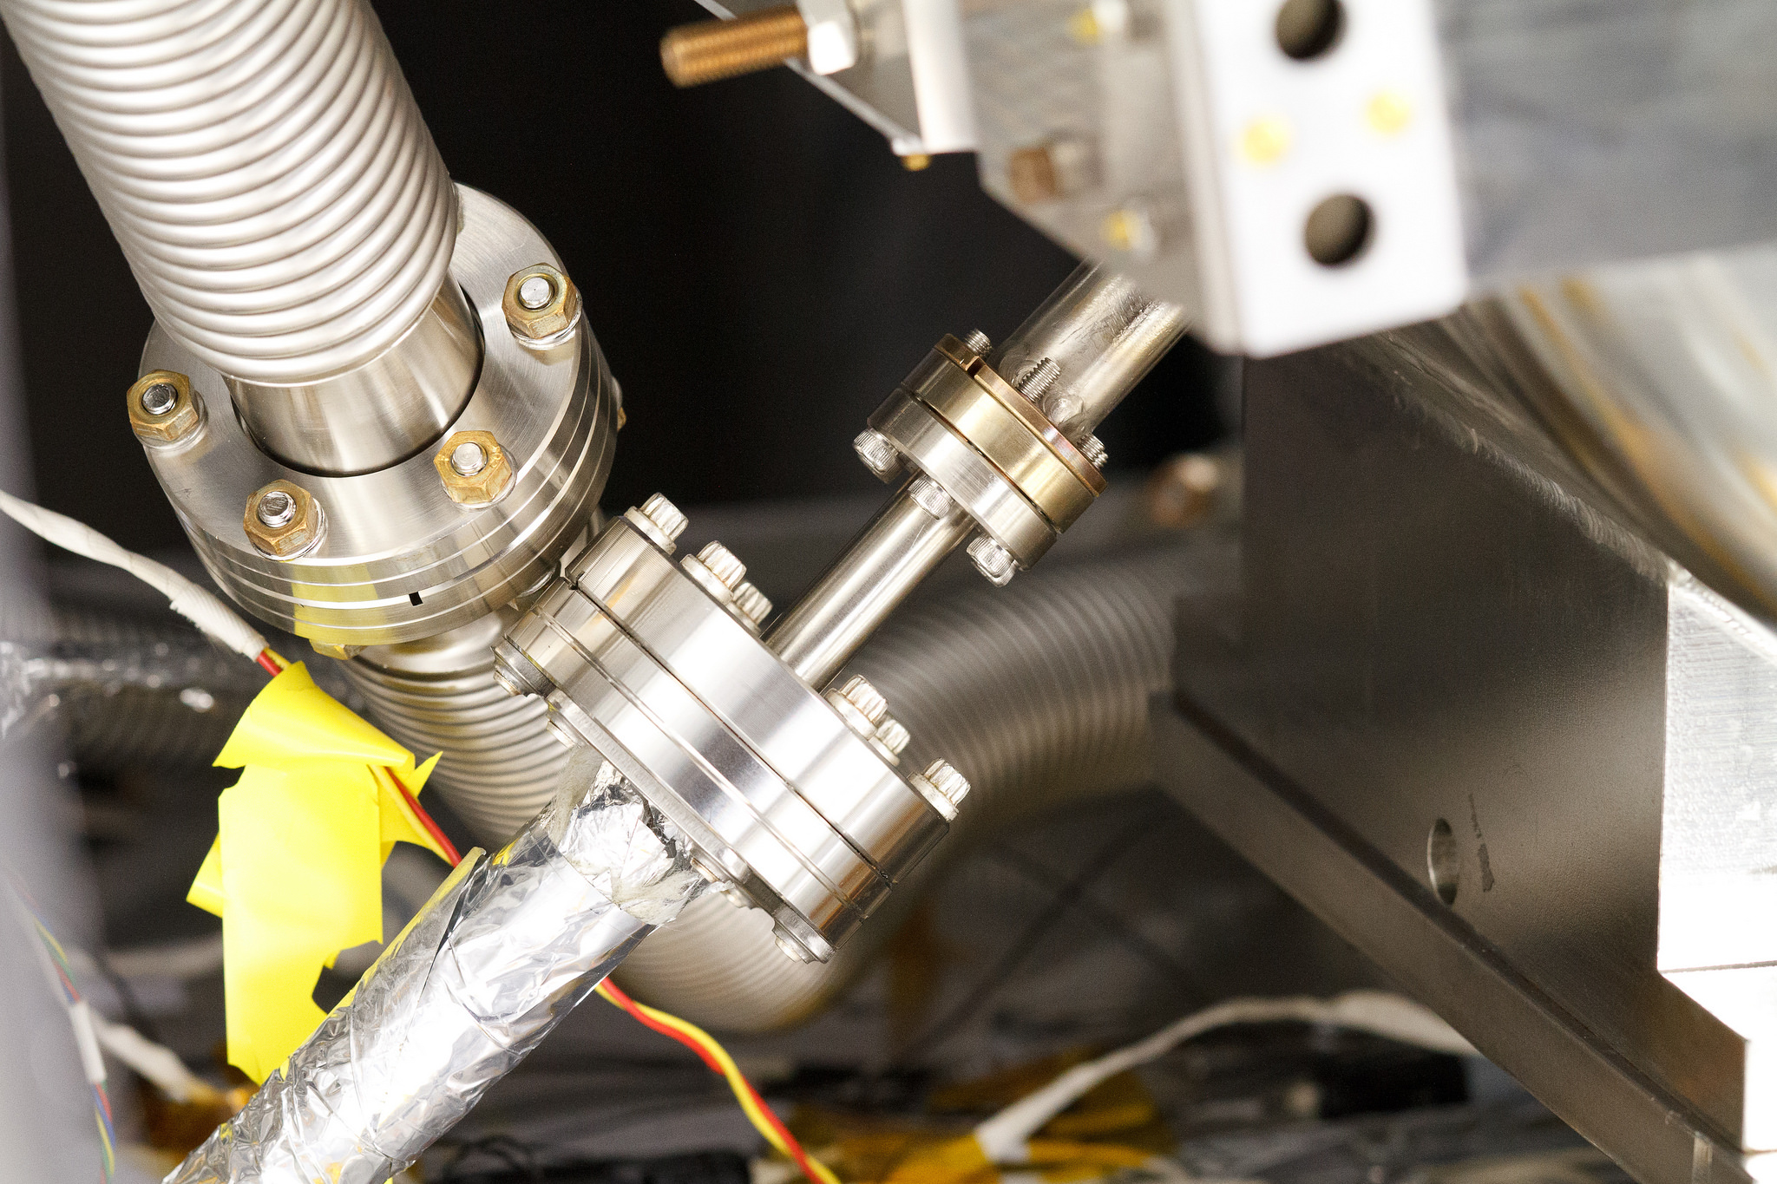
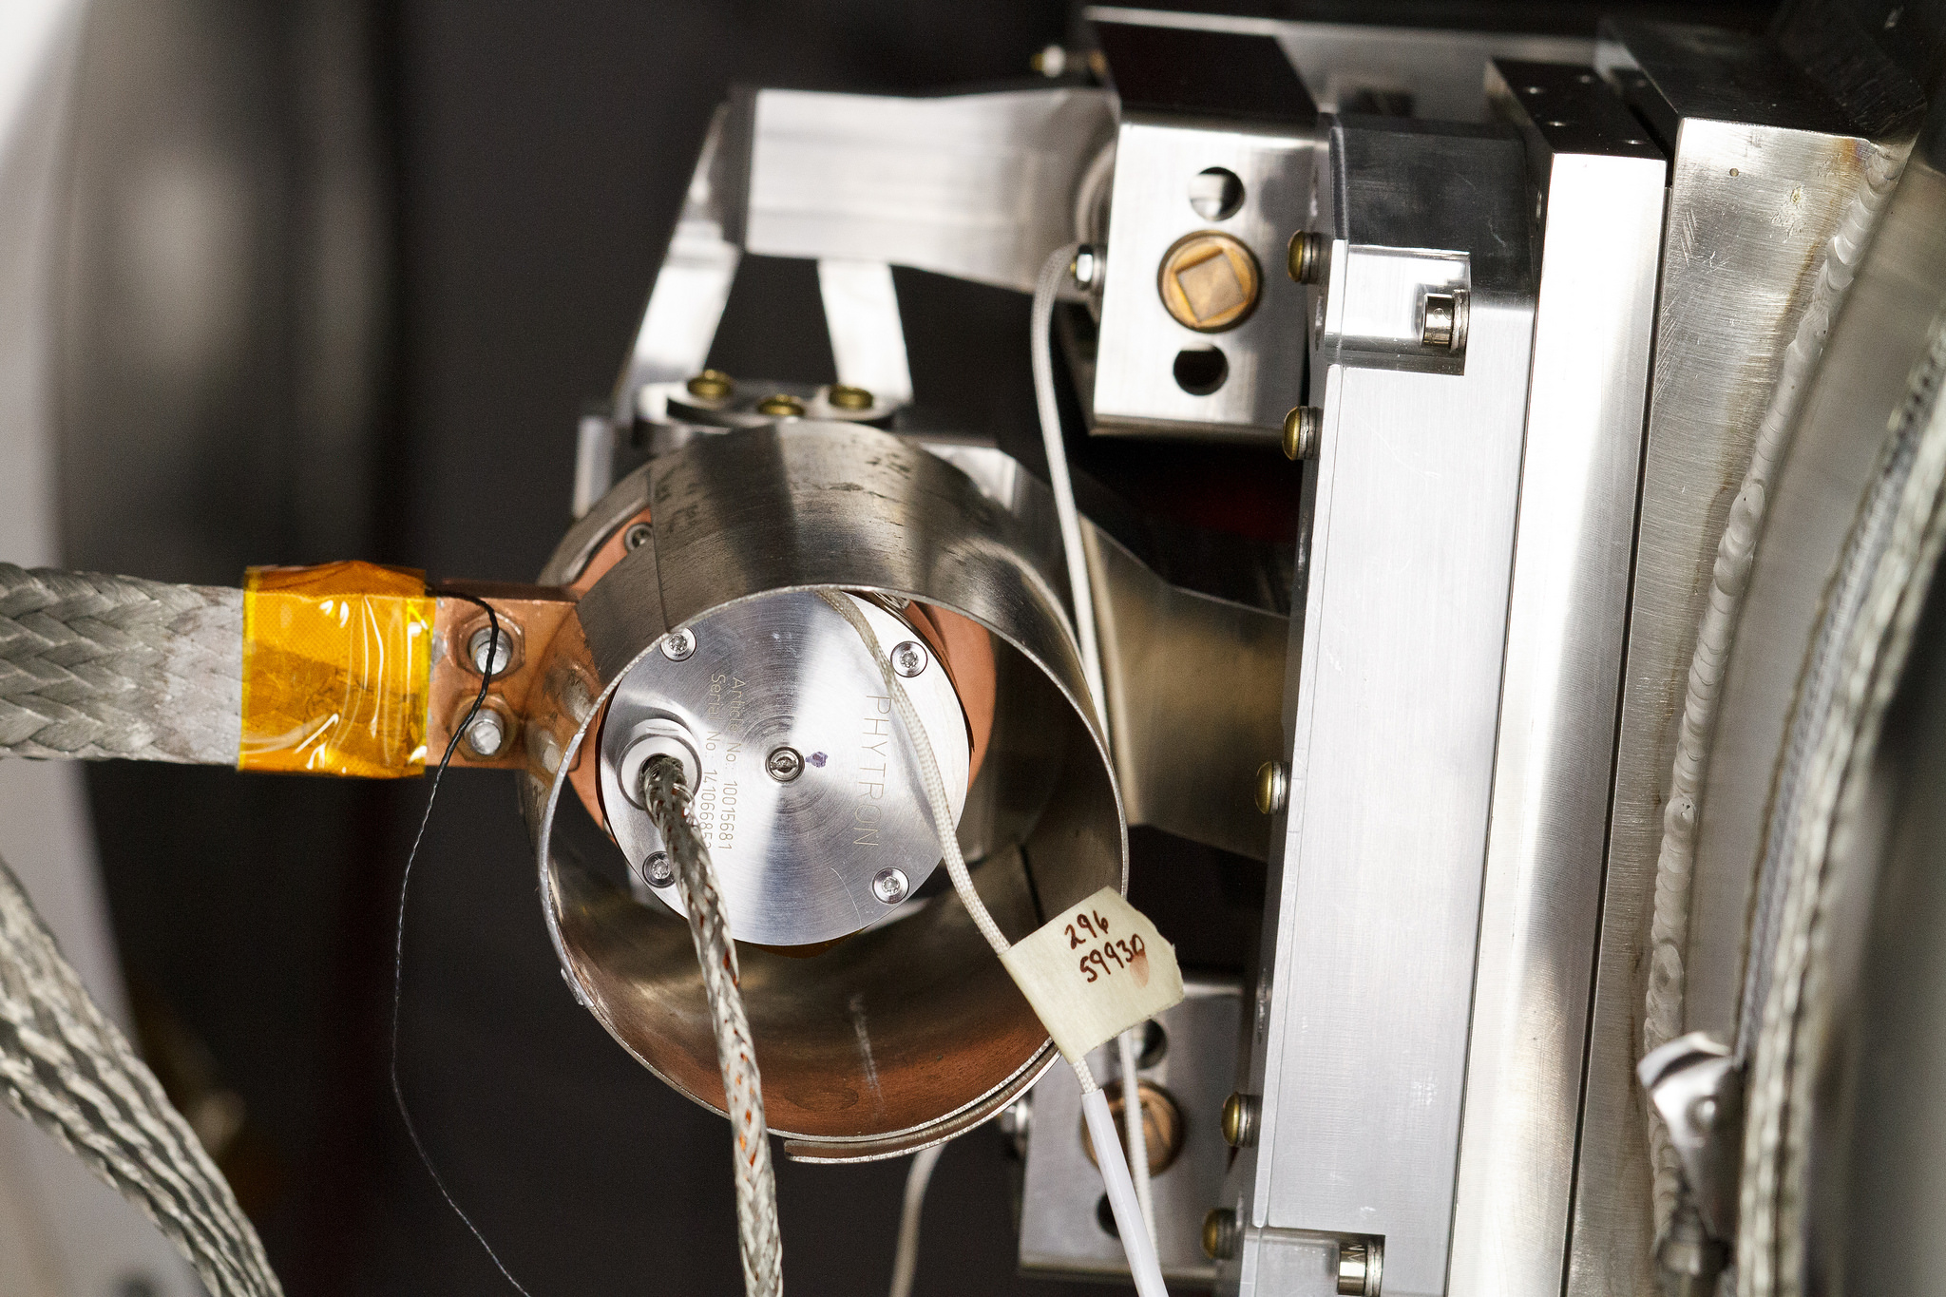
Tuner Assembly and Installation to STC
Beam vacuum and 2ph He connections
Coupler instrumentation and thermal intercepts
Beam vacuum and LHe fill line connections
Tuner motor connections and instrumentation

Slide 17
STC Test Sequence
Cavity installation
  HPC assembly (if present) and tuner assembly (if present)
  Leak check of beam line vacuum circuit (RGA scan of beam line vacuum)
  Instrumentation installation (RTD, flux gates, coupler window heater)
  Tuner checkout at room temperature
  Evacuation of the cryostat insulating vacuum, leak check
  LLRF system cable calibration
Cooldown
Test
  Finalize LLRF calibration
  Cold HPC verification off resonance (5kW in pulsed mode with 2%, 4%, 8%, 16% DF, CW mode)
  Tuning to resonance frequency
  Multipactor conditioning
  Q0, FE radiation (if present), LFD, df/dp measurements
  Tuner qualification
  Resonance control, LLRF studies
  Misc. studies (thermal, magnetic)
Warmup

Slide 18
STC: Multipactor Conditioning
3 strong MP barriers in the range 4.5-7.5 MV/m
Average MP conditioning time: 17 hours/cavity
MP distribution agrees well with model (see Paolo/Timergali talk)
16
STC
Radiation
12
Ploss
Eacc
8
4
0

Slide 19
Characterization of MP in SSR1 Cavities
Total time required to condition MP
  In 35 STC tests average time of MP conditioning is 17 hours (ranging from 4 hours to 40 hours)
  May depend on random factors, changing from cavity to cavity and from test to test (for example: how fast forward power to cavity is increased)
  No easy way to correlate with underlying cavity surface physics and MP dynamics
In STC we performed 15 tests with cavities assembled with small (matched/unity) couplers
  Allows for direct RF measurements of Ploss = Pf - Pr - Pcav (Pr << Pf)
  Data logging of all relevant parameters at 1 Hz rate
Time integral of Ploss (corrected for RF losses in cavity walls), or total energy consumption, can be used as more adequate parameters for MP characterization
We observed two distinct types of MP conditioning behavior is SSR1 cavities:
  When a cavity had little or no field emission, only 1 hard MP barrier was present
  When a cavity had field emission, then 3 hard MP barriers were present, requiring more time/energy to condition
A.Sukhanov PIP-II Technical Workshop

Slide 20
Characterization of MP in SSR1 Cavities
Type 1 MP conditioning – little or no field emission
A.Sukhanov PIP-II Technical Workshop

Slide 21
Characterization of MP in SSR1 Cavities
Type 1 MP conditioning – little or no field emission
A.Sukhanov PIP-II Technical Workshop

Slide 22
Characterization of MP in SSR1 Cavities
Another observation: correlation between partial water pressure before/after 120 C bake (measured by RGA) and MP energy consumption during conditioning
A.Sukhanov PIP-II Technical Workshop

Slide 23
Comparison of MP in SSR1 Cavities with Simulation
CST simulation (P.Berrutti/G.Romanov) of MP growth rate
Higher growth rate corresponds to stronger/harder MP
Peaks in growth rate at 5 MV/m, 6.5 MV/m and 7 MV/m
Data is represented by histogram of cavity field weighted by MP power loss
  Histograms for both Type 1 and Type 2 are shown
Reasonable agreement between MP simulation and data
A.Sukhanov PIP-II Technical Workshop

Slide 24
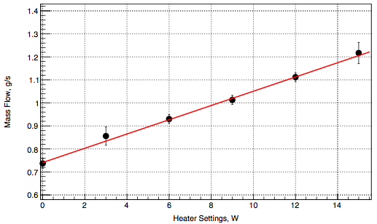
STC: Q0 Measurements
With (nearly) matched low power coupler use RF measurements and cross-check with calorimetric measurements
With high power coupler can only use calorimetric measurements
Heater calibration, S1H-NR-112
30 mg/s/W

Slide 25
STC: Q0 Measurements
Prototype SSR1 cavities qualified for pCM assembly

Slide 26
STC: Q0 Measurements
Prototype SSR1 cavities qualified for pCM assembly
Summary of DHL measurements
 | Location in CM | 1 | 2 | 3 | 4 | 5 | 6 | 7 | 8
Eacc, MV/m | Serial # | S1H-NR-106 | S1H-NR-110 | S1H-NR-112 | S1H-NR-109 | S1H-NR-114 | S1F-IU-104 | S1H-NR-113 | S1H-NR-111 | Total CM, W | Average, W
10 | Q0, 1e8 | 81 | 133 | 83 | 64 | 120 | 110 | 122 | 90
 | Ploss, W | 2.1 | 1.3 | 2.1 | 2.7 | 1.4 | 1.6 | 1.4 | 1.9 | 15 | 2
12 | Q0, 1e8 | 67.2 | 102 | 70 | 58 | 106 | 99 | 86 | 83
 | Ploss, W | 3.7 | 2.5 | 3.6 | 4.3 | 2.4 | 2.5 | 2.9 | 3 | 25 | 3
14.4 | Q0, 1e8 | 52 | 57 | 58 | n/a | 90 | 67 | 81 | 66
 | Ploss, W | 6.9 | 6.3 | 6.2 | n/a | 4 | 5.4 | 4.4 | 5.5 | 39 | 6

Slide 27
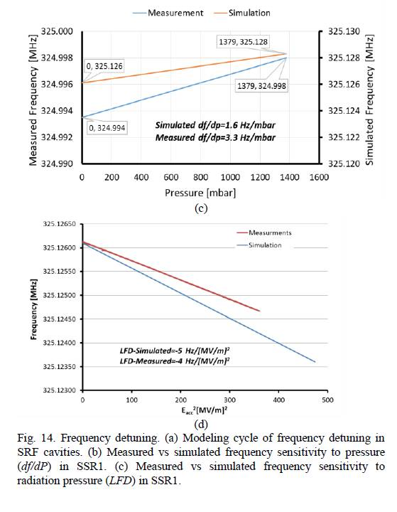
STC: df/dp and Lorentz Force Detuning Measurements
Simulation shows good agreement with measurements (see Mattia talk)
8 qualified cavities: 1.1 – 9.9 Hz/Torr
Mean value: 6.4 Hz/Torr

Slide 28
STC: df/dp and Lorentz Force Detuning Measurements
Simulation shows good agreement with measurements (see Mattia talk)
Mean value for 8 qualified cavities: -5.7 Hz/(MV/m)**2

Slide 29
Summary
Prototype SSR1 cavities went through a comprehensive test program
  Vertical tests (bare cavity)
  Horizontal tests (jacketed cavity, integrated with high power coupler and tuner)
  Prototype cryo-module (ultimate test: acceleration of H- beam with PIP-II parameters)
Prototype SSR1 cavities were demonstrated to perform up to (or exceeded) project specifications
Based on test results we decided not to change RF volume of SSR1
  MP is well understood and once conditioned is not an issue in CM operation
SS Helium vessel will be replaced with Ti vessel in production SSR1 cavity
  Help to mitigate Q0 reduction due to magnetization of SS vessel

Slide 30
Prototype SSR1 Cryomodule Testing

Slide 31
Prototype SSR1: Goal of testing at PIP2IT
Show that pCM can provide acceleration of H- beam with parameters required PIP-II physics program
Demonstrate achievement of critical parameters:
  Eacc and Q0 correspond to project requirements
  Magnets provide required parameters
  Cavities and magnets are aligned according to specifications
  RF coupler can sustain full power
  Tuners provide required range, resolution; cavities are tunable to 325.000 MHz
  pCM do not exceed designed static and dynamic heat loads
  Microphonics level within specifications
Phased approach for cavity qualification: for 1st and 2nd CM slot in PIP-II Linac

Slide 32
Phase 1 & 2 requirements: Accelerating Field and Q0
Phase 1 (CM1) |  |  |  |  | Phase 2 (CM2)
Cavity ID | Operating condition |  | Acceptance Criteria |  | Cavity ID | Operating condition |  | Acceptance Criteria
 | E_{acc}, MV/m | Q₀, x10⁹ | E_{acc}, MV/m | Q₀, x10⁹ |  | E_{acc}, MV/m | Q₀, x10⁹ | E_{acc}, MV/m | Q₀, x10⁹
SSR1_1_1 | 4.88 | 8.2 | 5.61 | 8.2 | SSR1_2_1 | 10.00 | 8.2 | 11.50 | 8.2
SSR1_1_2 | 4.63 | 8.2 | 5.32 | 8.2 | SSR1_2_2 | 8.78 | 8.2 | 10.10 | 8.2
SSR1_1_3 | 4.78 | 8.2 | 5.50 | 8.2 | SSR1_2_3 | 8.05 | 8.2 | 9.26 | 8.2
SSR1_1_4 | 7.32 | 8.2 | 8.42 | 8.2 | SSR1_2_4 | 10.00 | 8.2 | 11.50 | 8.2
SSR1_1_5 | 7.80 | 8.2 | 8.97 | 8.2 | SSR1_2_5 | 9.76 | 8.2 | 11.22 | 8.2
SSR1_1_6 | 7.56 | 8.2 | 8.69 | 8.2 | SSR1_2_6 | 10.00 | 8.2 | 11.50 | 8.2
SSR1_1_7 | 7.32 | 8.2 | 8.42 | 8.2 | SSR1_2_7 | 8.54 | 8.2 | 9.82 | 8.2
SSR1_1_8 | 10.00 | 8.2 | 11.50 | 8.2 | SSR1_2_8 | 10.00 | 8.2 | 11.50 | 8.2

Slide 33
Prototype SSR1: Test Plan Outline
Warm Pre-Test Checkout
  Instrumentation, signal integrity, vacuums, cavity & tuner “health”, alignment
Cooldown to 4K
  Thermal shield (dT < 50K) and strongback (T > 283K, dT < 5K)
  Coupler warm window (T > 275K)
Cooldown to 2K
  Achieve stable cryo operation, control loops, LL control
Individual Cavity RF Testing @ 2K
  Gradient, FE/MP, cavity frequency, coupler Q_{ext}, tuner range
Magnet Testing at 2K
  Full field operation of solenoids and X/Y correctors
Ensemble Cavity Testing @ 2K
  Total 2K heat loads, average Q₀ (individual cavity 2K heat loads were too small to measure)
LLRF Control @ 2K, Microphonics
  Simultaneously operate cavities in GDR (Generator Driven Resonator) mode (as needed for beam operation), demonstrate control with microphonics

Slide 34
Prototype SSR1: RF Performance of Cavities
Resonance frequency and Q_{L} measurements at RT, 4K, 2K. Results are within the expected ranges.

Slide 35
Prototype SSR1: individual cavity testing
Coupler conditioning off resonance at pulsed 2-16% DF, then CW
LLRF calibration
Cavity Multipactor conditioning
  3 MP barriers 4-7.5 MV/m
  Average time to condition: 16 hours
Increase cavity field to full gradient, check field emission
Misc. measurements (Lorentz force detuning, LLRF detuning calibration, microphonics etc)

Slide 36
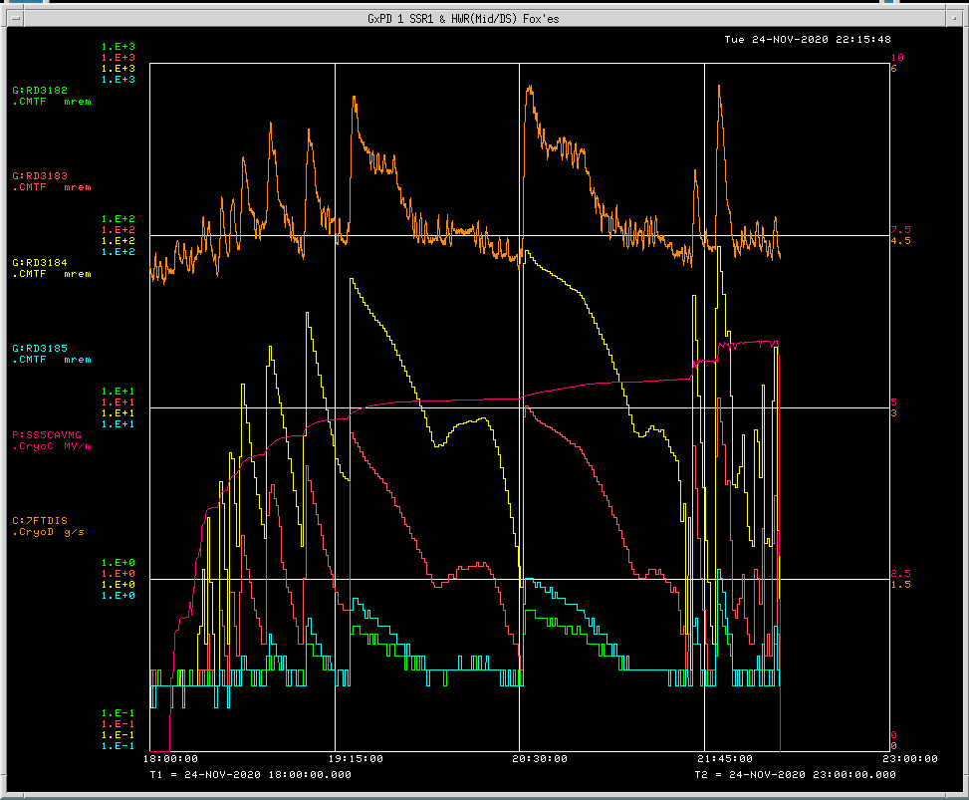
Prototype SSR1 : Multipactor Conditioning
pCM
LHe mass flow
Radiation
3 strong MP barriers in the range 4.5-7.5 MV/m
Average MP conditioning time: 16 hours/cavity
After warmup/cooldown cycle conditioning time reduced to less than 1 hour (average)
Eacc

Slide 37
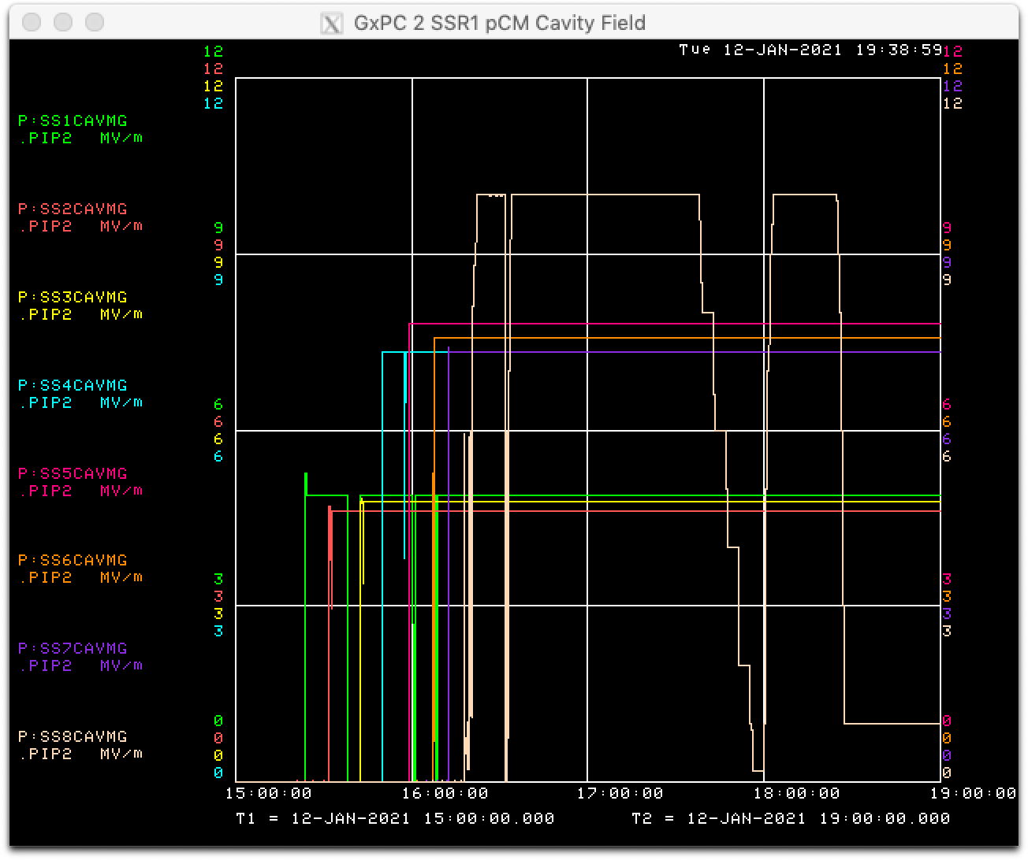
Prototype SSR1: Phase I - RF performance
All 8 cavities achieved nominal Phase I gradient (+15%)
  16.6-17.5 MeV acceleration (cavity 8 at 8-10 MV/m)
Only one cavity (#4) has mild (2-3 mR/h) FE radiation
Microphonics are better than 10 Hz (LLRF group)
1
2
3
SSR1 pCM during PIP2IT Beam Operation
Turning and phasing cavities
TOF energy measurements
Other beam studies

Slide 38
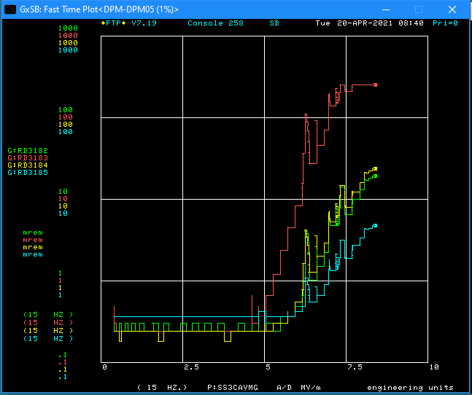
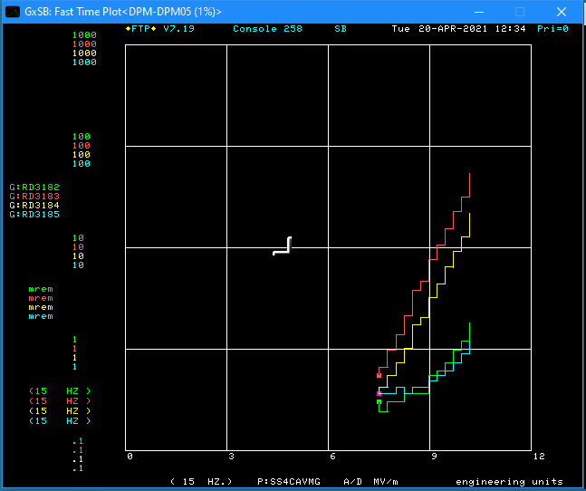
Prototype SSR1: Phase II - RF performance
6 out 8 Cavities (1,2,5,6,7 and 8) reached Phase II administrative limit, with very mild radiation (0.6-0.9 mR/h) in cavities 1,2,7,8 and no radiation in cavities 5,6. At operating gradient radiation is at background level for all these cavities.
Cavities 3 and 4 have strong FE radiation (>200 mR/h) at Phase II operating fields.
Cavity 3 has soft quench above 8 MV/m at rate 1/15 minutes, no quenches just below 8 MV/m.
Cavity 3
Cavity 4
FE onset 5 MV/m
FE onset 7.5 MV/m

Slide 39
Prototype SSR1: DHL Measurements, Heater Calibration
4 heater calibration runs taken between June 30 and July 6:
  LL can heater 9-18 W
  Cav heaters 9-18 W
  LL can + Cav heaters 18-36 W
  Cav heaters extended range 18-27 W
Applied heater corrections:
  Within correction measurement range (5-18W) use spline interpolation with 1% relative uncertainty
  Outside of the correction measurement range (>18W) use Mean correction value with R.M.S. as correction uncertainty
Calibration constant: 20.42 +- 0.09 W/(g/s)

Slide 40
Prototype SSR1: DHL Phase I
DHL measurements were made with all 8 cavities running at Phase I operating gradients:
  4.88, 4.63, 4.78, 7.32, 7.80, 7.56, 7.32, 10.00 MV/m (cavities from 1 to 8)
Cavity Configuration | MF Static, g/s |  | MF Total, g/s |  | MF Dynamic, g/s |  | Ploss, W |  | Q0, 1e9
 | Mean | Error | Mean | Error | Mean | Error | Mean | Error | Mean | Error
1,2,3,4,5,6,7,8 | 2.888 | 0.02 | 3.518 | 0.02 | 0.63 | 0.028 | 12.81 | 0.66 | 5.33 | 0.50
Total DHL for all cavities running at Phase I gradient is 12.8 ±0.7 W
  Estimated DHL for proto SSR1 CM at Phase I (based on individual cavity testing at STC) is 9 W
Only cavity 4 showed some very mild field emission radiation 2-3 mR/h
Cavities 1 and 4 had high residual magnetic fields: respectively ~150 and ~250 mG
  Cavities with high residual magnetic field (1,4) may contribute to a higher dynamic heat load than expected from estimation
The material of the Helium vessel of future SSR1 (and SSR2) cavities will be made of Titanium (and not SS316L).

Slide 41
Prototype SSR1: DHL Phase II
DHL data in the following configurations:
  Cavities 2,5,6,7,8 at Phase II gradient
  Cavity 1 only at Phase II gradient
  Cavity 4 only at Phase II gradient
  Cavity 3 only at Phase II (8.05 MV/m), at 7.7 MV/m, at 7.4 MV/m at 7.1 MV/m
  Cavities 1,2,5,6,7,8 at Phase II gradient
  Cavities 1,2,4,5,6,7,8 at Phase II and 3 at 7.5 MVm
Cavity Configuration | MF Static, g/s |  | MF Total, g/s |  | MF Dynamic, g/s |  | DHL, W |  | Q0, 1e9
 | Mean | Error | Mean | Error | Mean | Error | Mean | Error | Mean | Error
2,5,6,7,8 | 1.856 | 0.015 | 2.367 | 0.001 | 0.511 | 0.015 | 10.43 | 0.31 | 7.41 | 0.70
1 | 1.818 | 0.001 | 2.048 | 0.009 | 0.23 | 0.009 | 4.70 | 0.19 | 3.70 | 0.75
4 | 1.818 | 0.001 | 2.199 | 0.021 | 0.381 | 0.021 | 7.78 | 0.43 | 2.23 | 0.46
1,2,5,6,7,8 | 1.818 | 0.001 | 2.573 | 0.033 | 0.755 | 0.033 | 15.42 | 0.68 | 6.14 | 1.26
1,2,4,5,6,7,8 |  |  |  |  |  |  | 23.20 | 0.80 | 4.83 | 0.98
1,2,3(7.5),4,5,6,7,8 | 1.825 | 0.007 | 3.564 | 0.013 | 1.739 | 0.015 | 35.51 | 0.34 | 3.43 | 0.69
DHL for “good” cavities w/o radiation and low residual magnetic field (cavities 2,5,6,7,8) is 2.09 ± 0.06 W/cavity
  This result is within ± 10% the estimated DHL of 1.9 W/cavity for proto SSR1 CM at phase II gradients
Cavities with high residual magnetic field (1,4) and high field emission (3) have higher heat load

Slide 42
Summary
Prototype SSR1 cavities went through a comprehensive test program
  Vertical tests (bare cavity)
  Horizontal tests (jacketed cavity, integrated with high power coupler and tuner)
  Prototype cryo-module (ultimate test: acceleration of H- beam with PIP-II parameters)
Prototype SSR1 cavities were demonstrated to perform up to (or exceeded) project specifications
Based on test results we decided not to change RF volume of SSR1
  MP is well understood and once conditioned is not an issue in CM operation
SS Helium vessel will be replaced with Ti vessel in production SSR1 cavity
  Help to mitigate Q0 reduction due to magnetization of SS vessel

Slide 43
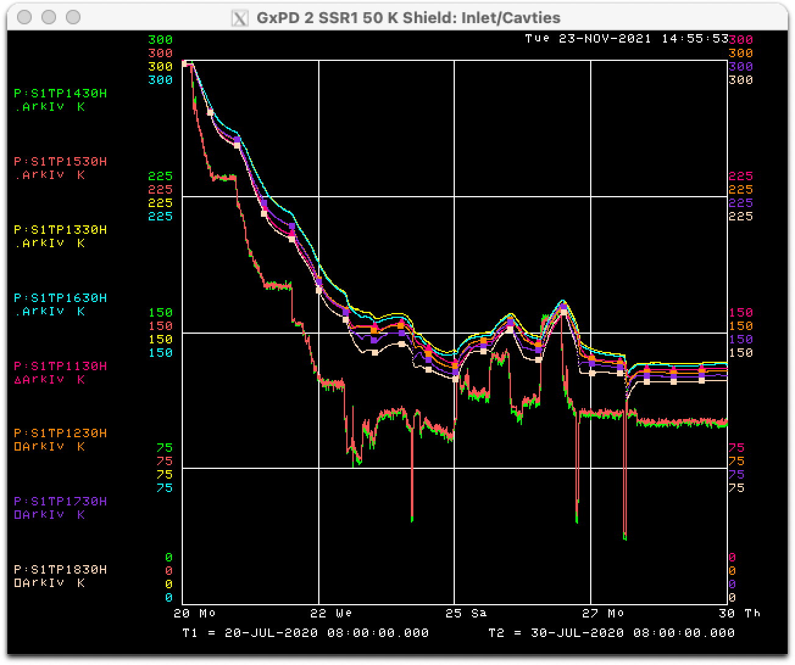
Prototype SSR1: Cooldown – Run I
Installation to PIP2IT beam line completed and ready for cooldown early July 2020
Cooldown of 50K shield on 7/20/2020
  slow (shield dT < 50K) – 6 working days
  leak developed in the insulating volume at T < 100K
    interference between shield and current leads
  stable operation at average shield T = 130K
  estimated additional heat load to 2K circuit 15-25W
Cooldown of 5K circuit on 7/28/2020
Stable 2K operation established on 7/30/2020
Strongback: thermal gradient < 1K, temperature 268-270K (< 283K requirement)
Couplers thermal intercepts (5k, 50K, 293K) were in the expected temperature ranges
We started the CM warmup on 4/29/2021

Slide 44
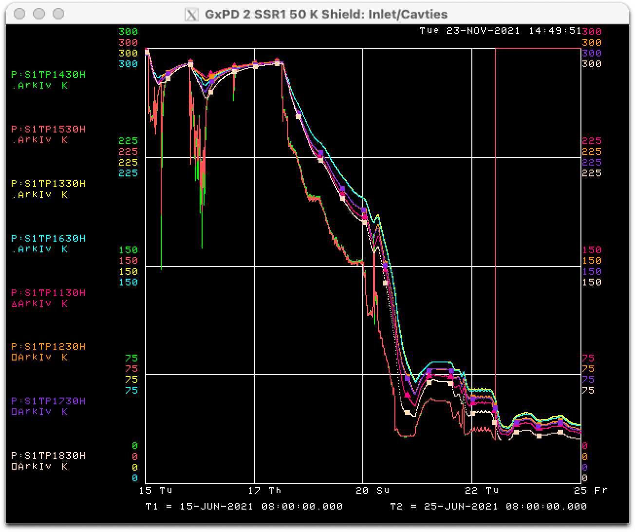
Prototype SSR1: Cooldown – Run II
Work was needed to resolve leak in the insulating volume and strongback temperature
Cooldown of 50K shield on 6/18/2021
  slow (shield dT < 50K) – 5 days
  stable operation at average shield T = 40K
Cooldown of 5K circuit (T_{min} = 5.5K; T_{max} = 6.2K) – 1 day
Stable 2K operation – 2 day
Strongback: thermal gradient < 1K, temperature 281-283K
Couplers thermal intercepts (5k, 50K, 293K) were in the expected temperature ranges
We started warming pCM up on 7/27/2021

Slide 45
Prototype SSR1: tuners performance
Successfully tuned and controlled cavities frequency to 325.000 MHz.
Piezo voltage 0-100V
Average: 16.7 Hz/V
Average: 4.4 Hz/step

