Slide 1
Single Spoke Resonators (SSR) Main Couplers Design.
S. Kazakov
03/01/2023.

Slide 2
PIP-II includes:
Room temperature cavities: RFQ, Bunching cavity x 4.
5 types of SC cavities: HWR x 8, SSR1 x 16, SSR2 x 35, LB 650 x 33, HB 650 x 24
Each cavity requires a coupler. Total number of couplers: 122 (RFQ uses 2 couplers) + spares
FNAL responsibility to design, build pre-production series and test all types of couplers except HWR type (ANL responsibility)
Main requirements to 325 MHz and 650 MHz couplers:
Parameter | 325 MHz coupler | 650 MHz coupler
Frequency, MHz | 325 | 650
RF window | Single, RT | Single, RT
Maximum nominal operating power, kW (CW, @20% reflection) | 11 | 43
Acceptance testing power, kW (CW, full reflection, any phase) | 12 | 50
2K heat load, W | < 1 | <1.1
5K heat load, W | < 3.5 | <2.5
50K heat load, W | <15 | <9
Cooling media | air | air
Maximum HV bias, kV | ± 5 | ± 5

Slide 3
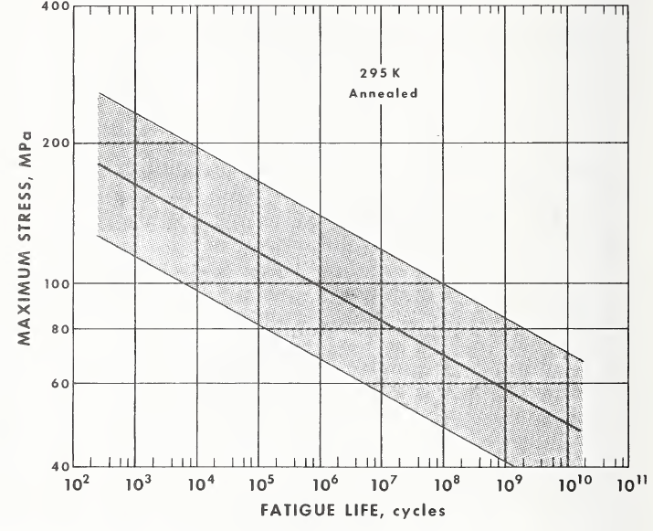
Principles of design:
Simplicity of vacuum part of coupler:
no moving parts, no bellows.
simple configuration – more reliable, easy to clean, less expansive.
Air cooling of antennas (no water) – Not so severe consequences in case of leak.
Ability to apply high voltage bias to suppress a multipactor.
Designs of 325MHz and 650 MHz coupler should be similar as much as possible
to utilize the same technology and reduce cost.
Lifetime of couplers should be ~ 20 ~ 30 years.
Thermal stresses of copper-ceramic should not exceed ~100 MPa

Slide 4
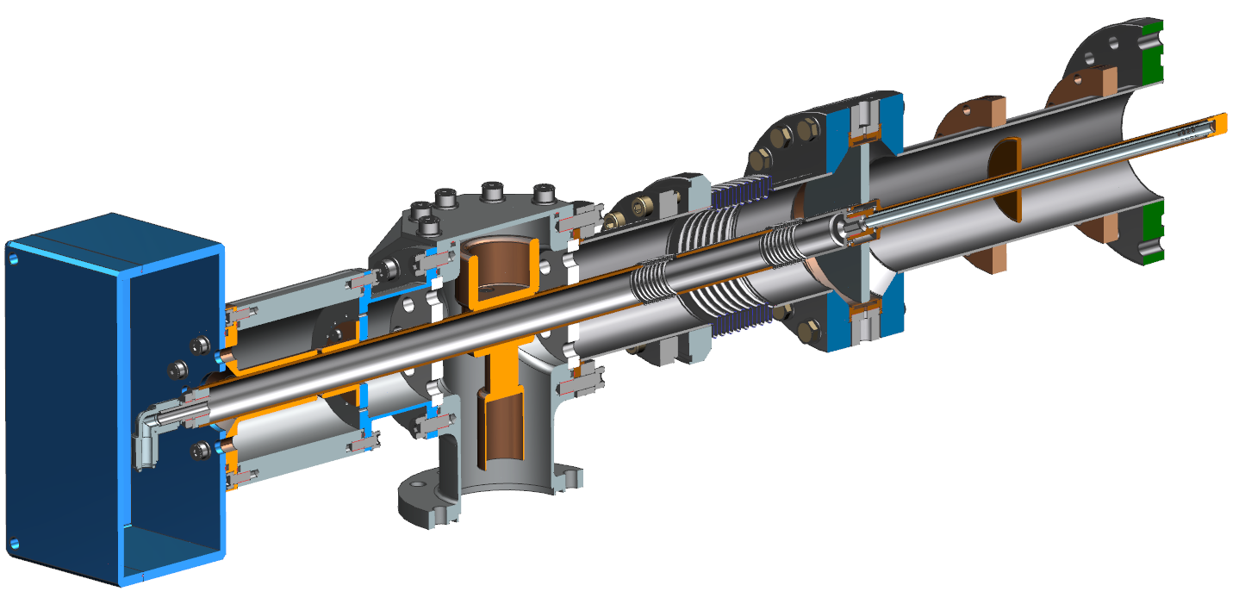
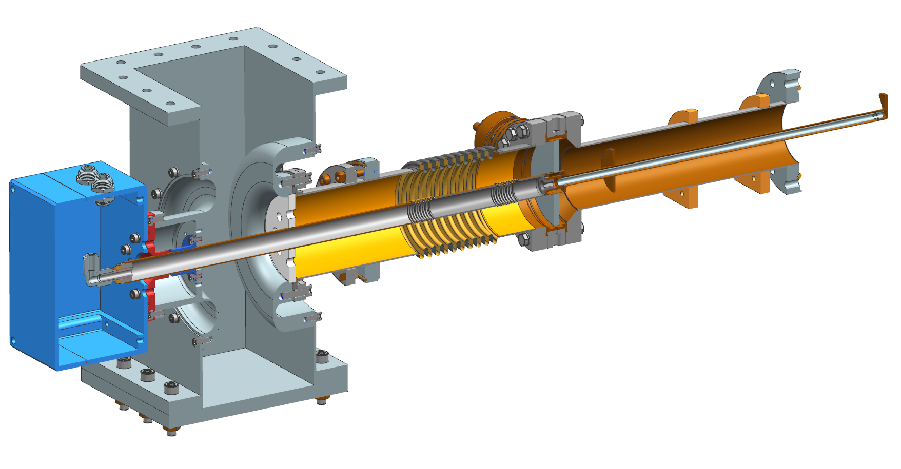
Based on this principle, 325 MHz and 650 MHz couplers were designed and built.
325 MHz coupler:
650 MHz coupler:
Similar instrument parts
Couplers utilize the same ceramic windows.
Antennas have the same diameters
Vacuum outer conductor have the same diameter
same copper coating and
Air inner conductor have the same diameter
Etc.

Slide 5
Some futures of 325 MHz and 650 MHz couplers.
Ceramic window sizes OD 100 mm, thickness 7 mm
Vacuum outer conductor diameter 3 inch (76.2 mm)
Antenna diameter 0.5 inch (12.7 mm)
Two thermal intercepts: “5K” and “50K”
Output impedance 105 Ohm.
Reasons: to reduce dynamic cryogenic losses ( ~ 1/Z) and increase multiapactror power threshold.
Matching copper polished disk at the vacuum part of antenna.
It reduces thermal radiation form room temperature ceramics and protects ceramics from possible charged particles coming from cavity.
Multipactor is suppressed by HV bias (up to 5 kV).
Ceramic window is not coated with TiN (current situation).
Couplers are cooled by air.

Slide 6
RF design:
Coupler pass band (S11 < 20 dB) ~ 40 MHz (~ 12%)
Maximum strength of E-filed in air is less then ~19 kV/cm for 20 kW (full reflection) and 5 kV bias. (Operating mode ~ 12 kW and ~3.5 kV bias).
3.5 kV bias suppressed multipactor in all parts of coupler for 20 kW RF power.

Slide 7
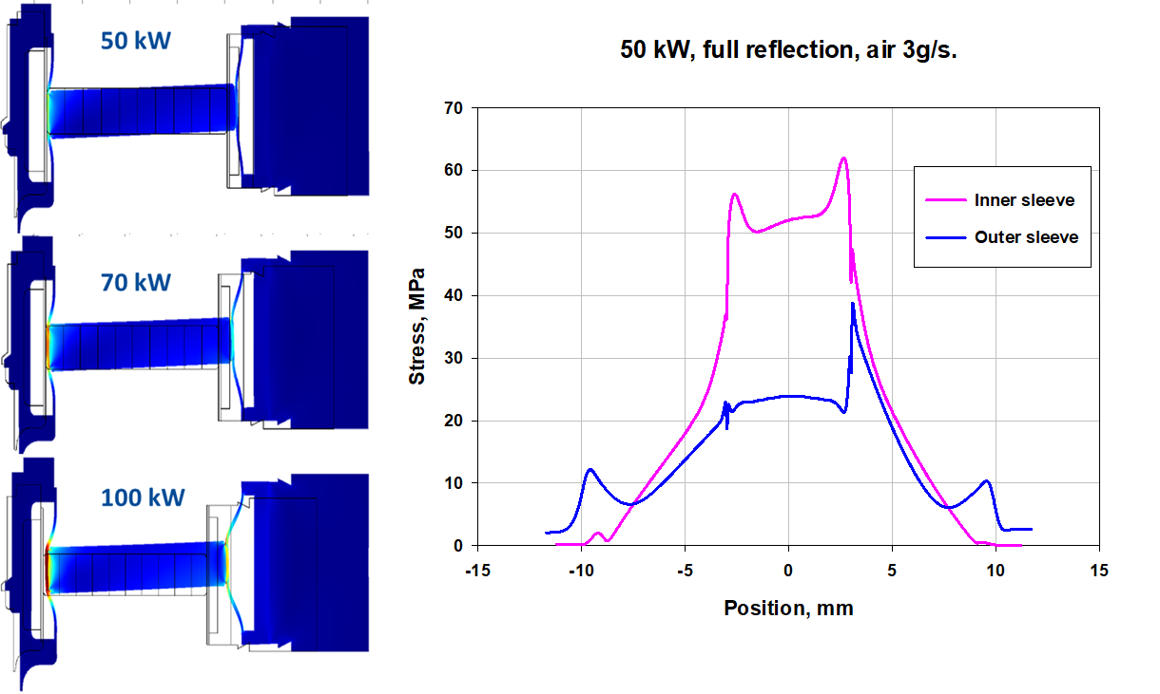
Thermal design.
Simulated cryogenic properties of 325 MHz coupler,
11 kW, 20 % reflection (including thermal radiation):
Example of simulation of thermal stresses in ceramic RF window:
Temp. of T-sink. | 2K | 5K | 50K | 293K
Static load, W | 0.8 | 2.2 | 12.3 | -9.1
Total load , W | 0.9 | 2.5 | 13.5 | -4.1
Thermal stresses.
Thermal stresses ~ 80 MPa for 70 kW(!) full reflection
and 3 g/s cooling air rate.
Coupler has a big power margin !

Slide 8
Mechanical design of 325 MHz SSR coupler
Air Side Assembly
Vacuum End Assembly
We divide the coupler into “vacuum” and “air” assemblies

Slide 9
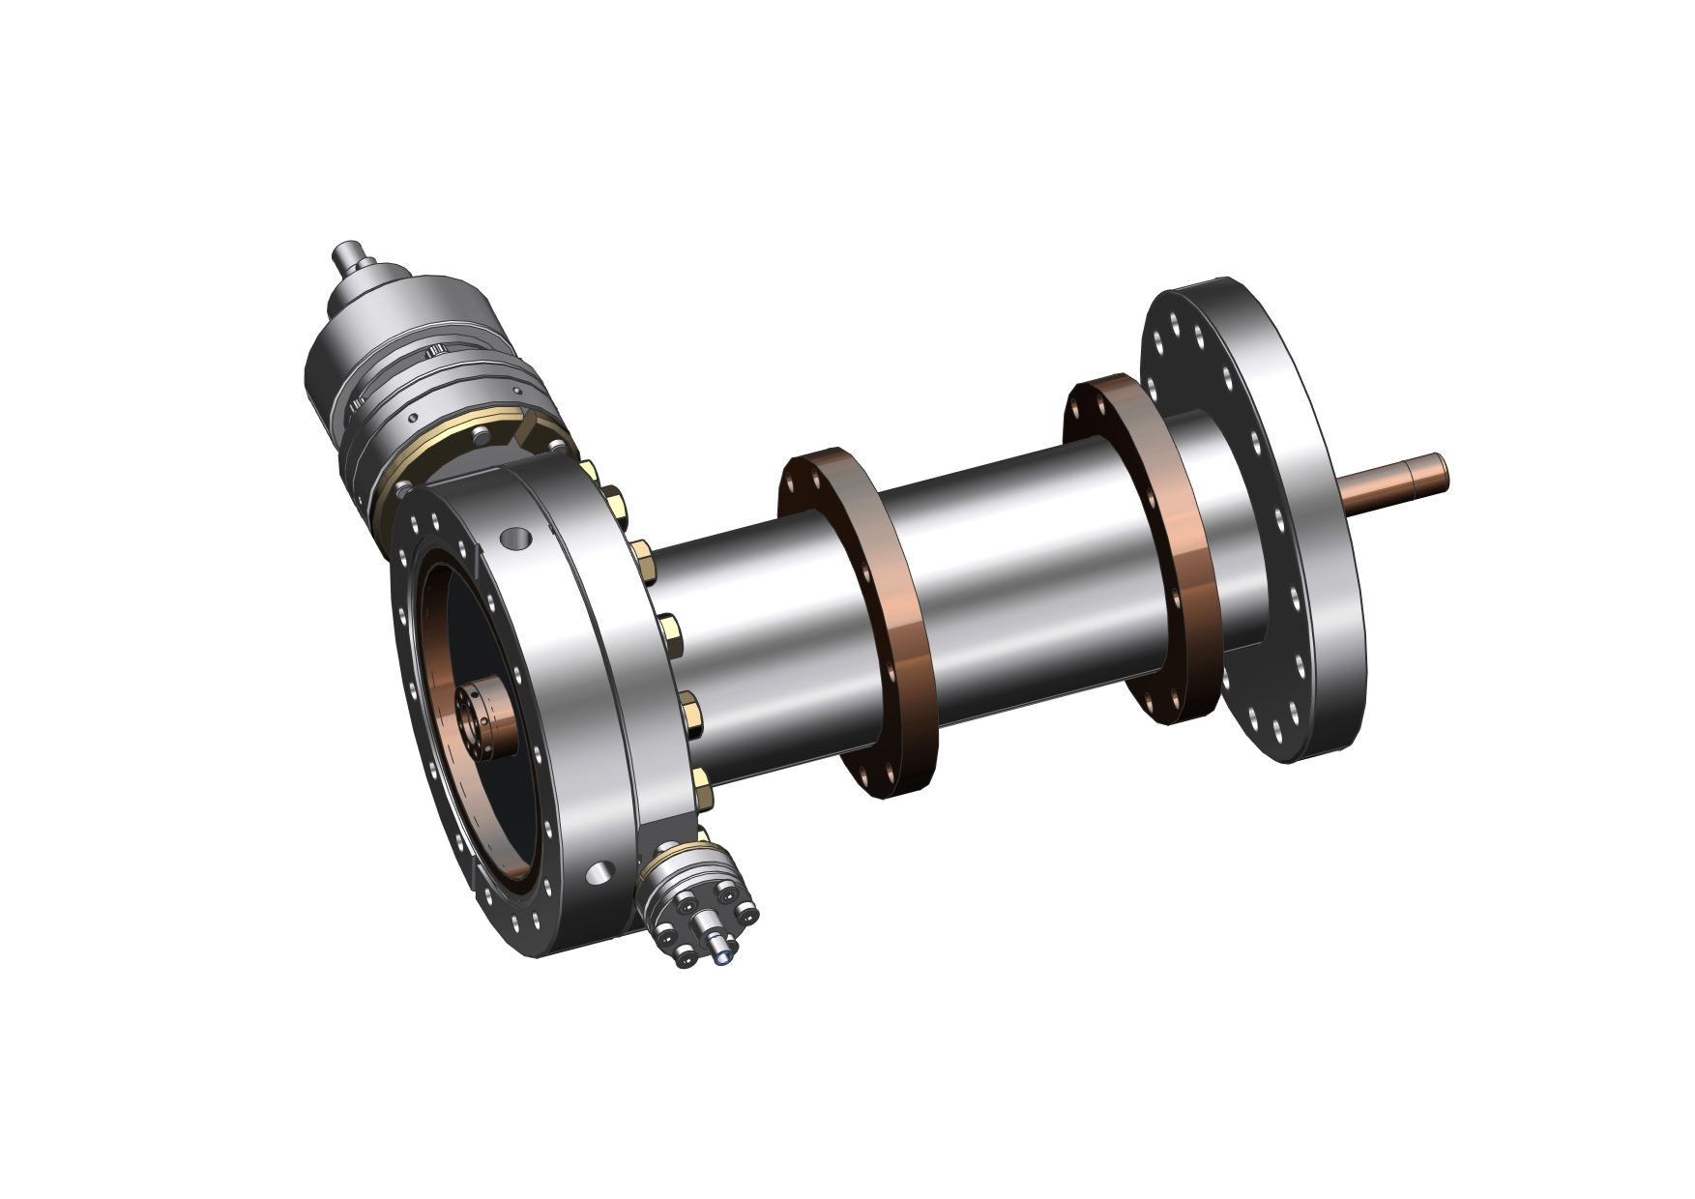
Vacuum assemble of 325 MHz SSR coupler
Vacuum
gauge
matching, protecting
copper disk
3”OD SS copper coated
outer conductor
0.5”OD
antenna
ceramic
window
5K Intercept
70K Intercept
air cooling tube
E-pickup

Slide 10
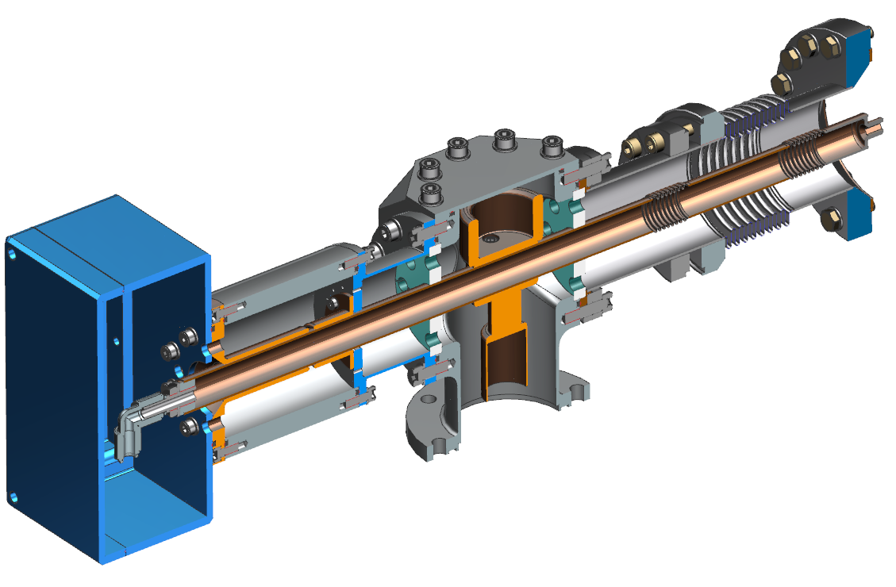
Air Side Assembly
Matching
element
Teflon
supports
Capacitor
assembly
Instrumentation box
Copper coated outer
conductor with bellows
Copper coated inner
conductor with bellows
T-junction
Standard 3’’ coaxial
waveguide
Kapton film
Air inlet

Slide 11
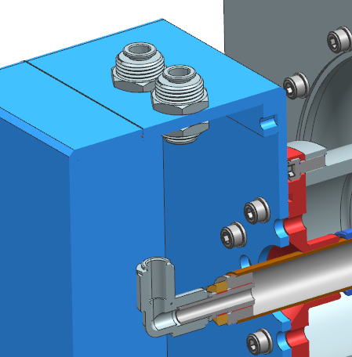
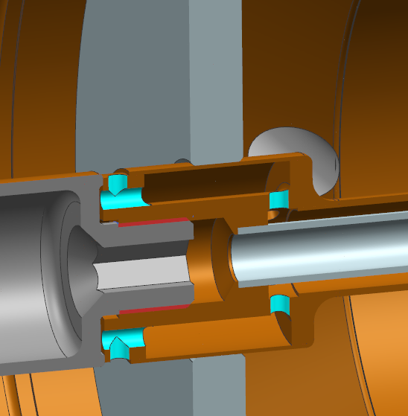
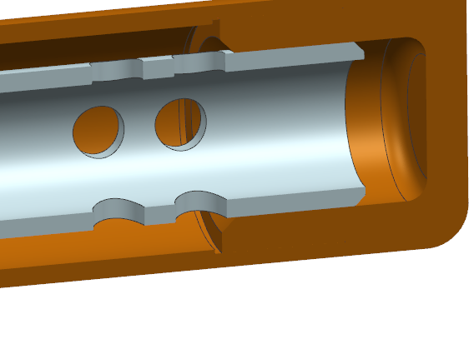
325 MHz coupler, air flow scheme:
Operating air flow rate ~ 3.5 g/s

Slide 12
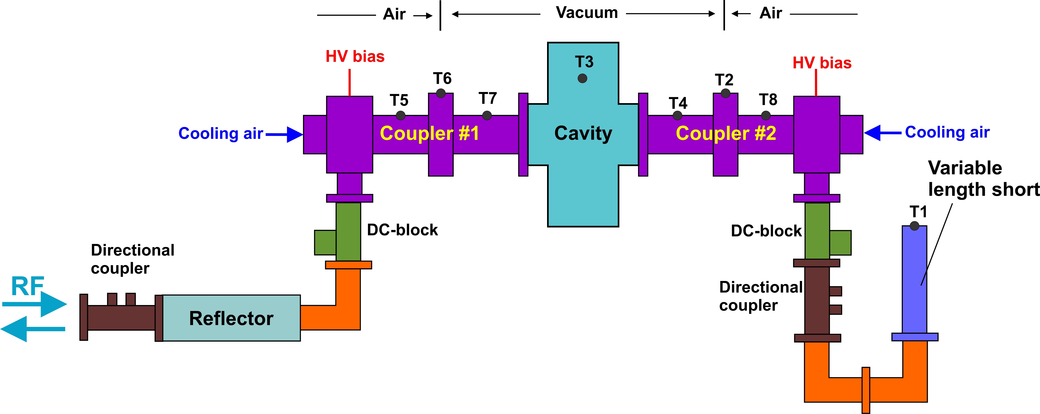
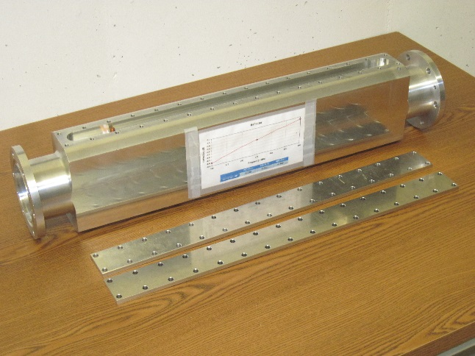
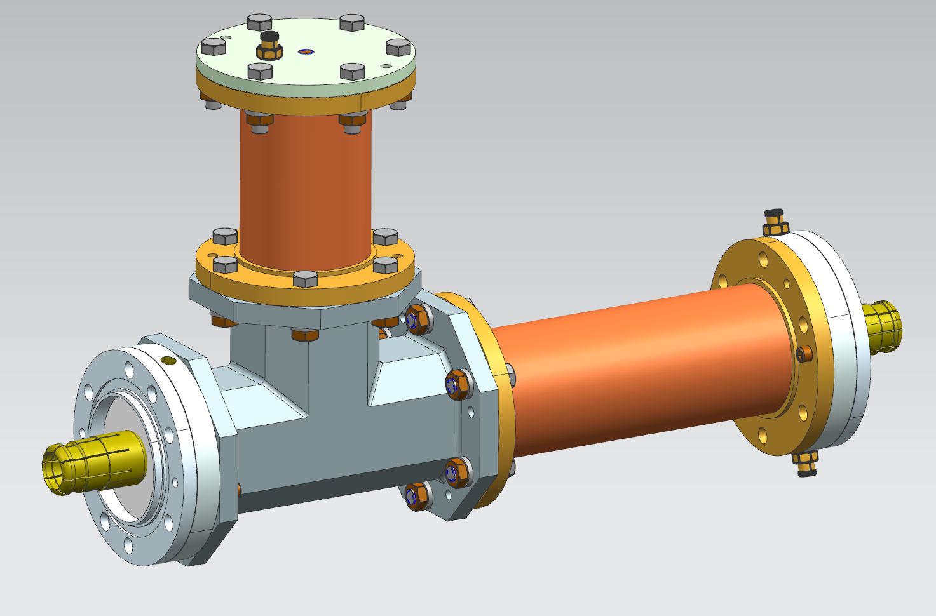
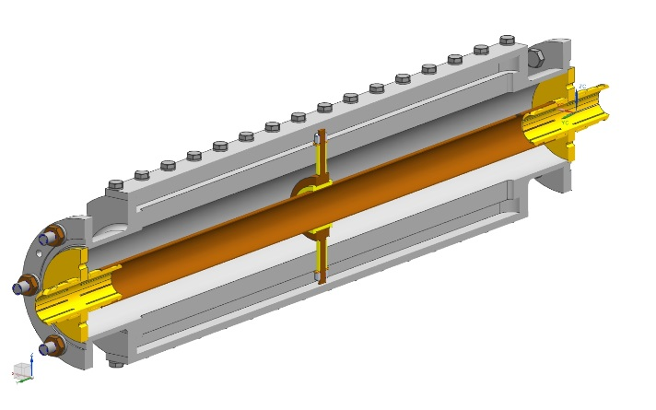
Coupler testing.
Because of limited power of 325 MHz RF amplifier (≤ 10kW), couplers are tested in Standing Wave (SW) mode with power amplification:
SW power amplification scheme:
Diagram of 325 MHz coupler test stand:
Power amplification ~ 5 times.
Reflector:
DC block – device which isolates RF amplifier from HV bias (~ 5kV)

Slide 13
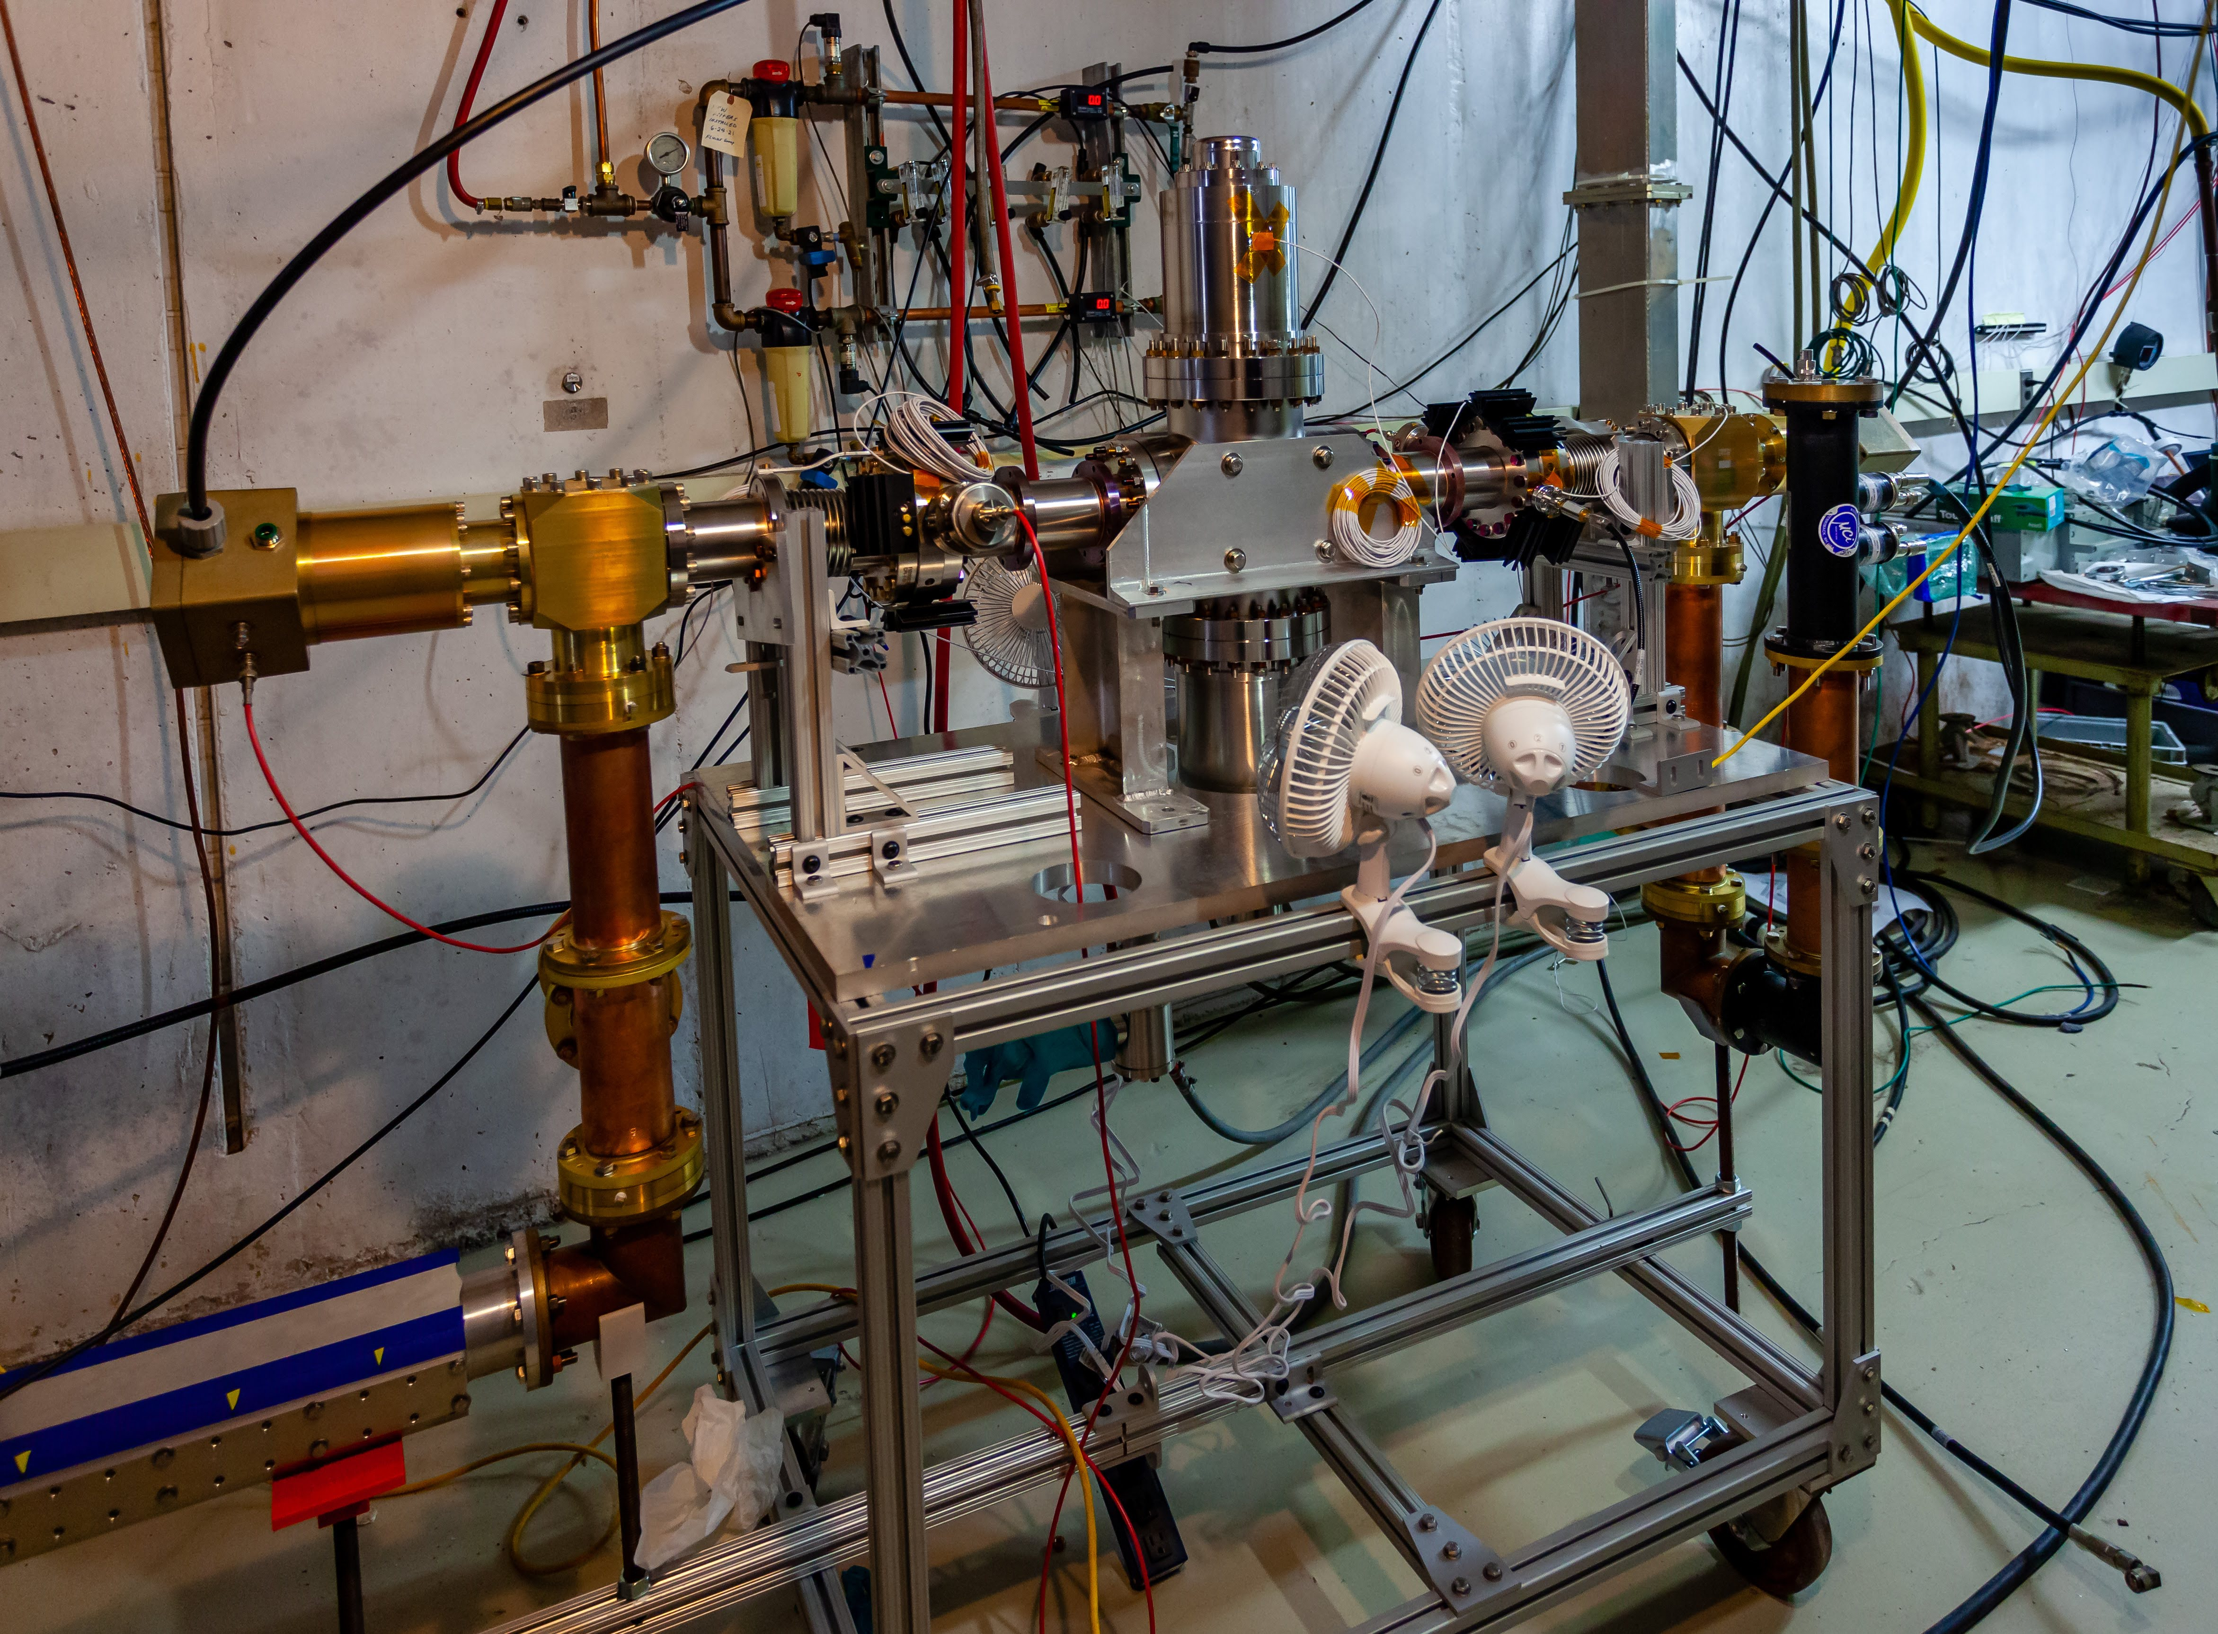
325 MHz coupler test stand in test cave.
Coupling
cavity
Coupler #1
Coupler #1
Movable
short
DC block
Reflector

Slide 14
Test preparation:
Couplers and coupling cavity are assembled/disassembled in clean room, class 10.
Couplers with coupling cavity is baked at temperature 120C x 48 hours.
Test results:
Four couplers of second generations were tested at test stand.
Couplers were tested up to specified powers:
Pulse mode: 20 kW, full reflection, 4 phase (90 dgr step), average power < 12 kW.
CW mode: 12 kW, full reflection, 4 phase (90 dgr step).
Couplers satisfy specified power requirements.
Operation with HV bias:
Couplers practically do not require conditioning if operation with HV bias.
No multipactoring were observed with HV bias.
Window temperature rise were small. Couplers have a rather big power margin.
Operation without HV bias:
At some reflection phases the multipactor exist even after significant time of conditioning.
It is true for coated with TiN ceramic window and for uncoated window.
Experiments with coated/uncoated cermics will be continued.

Slide 15
Thank you!

