Slide 1
PIP-II SSR Cryomodules
Vincent Roger
2nd March 2023
FNAL-IBS Workshop

Slide 2
Outline
Introduction
Description of the SSR2 cryomodule
Assembly process
Summary

Slide 3
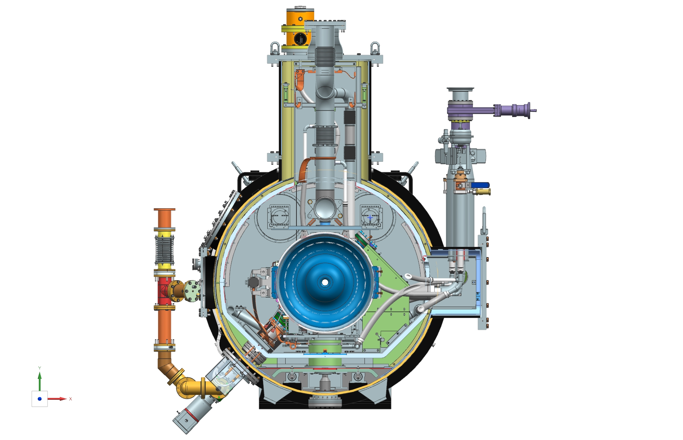
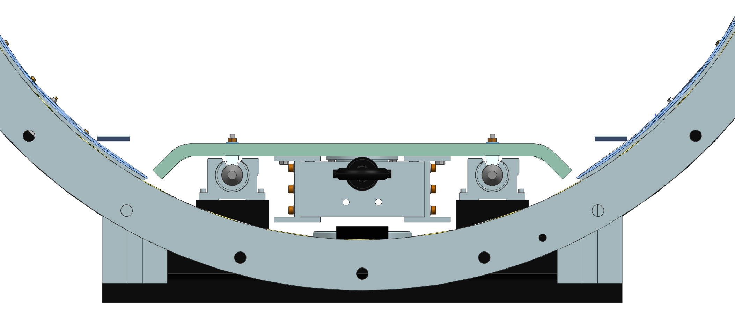
1. Introduction
For PIP II, a new style of cryomodule has been developed using a strongback at room temperature. This design is compatible for SSR and 650 cavities.
The main advantage of this Fermilab style cryomodule is to ease the assembly process.
SSR Strongback configuration

Slide 4
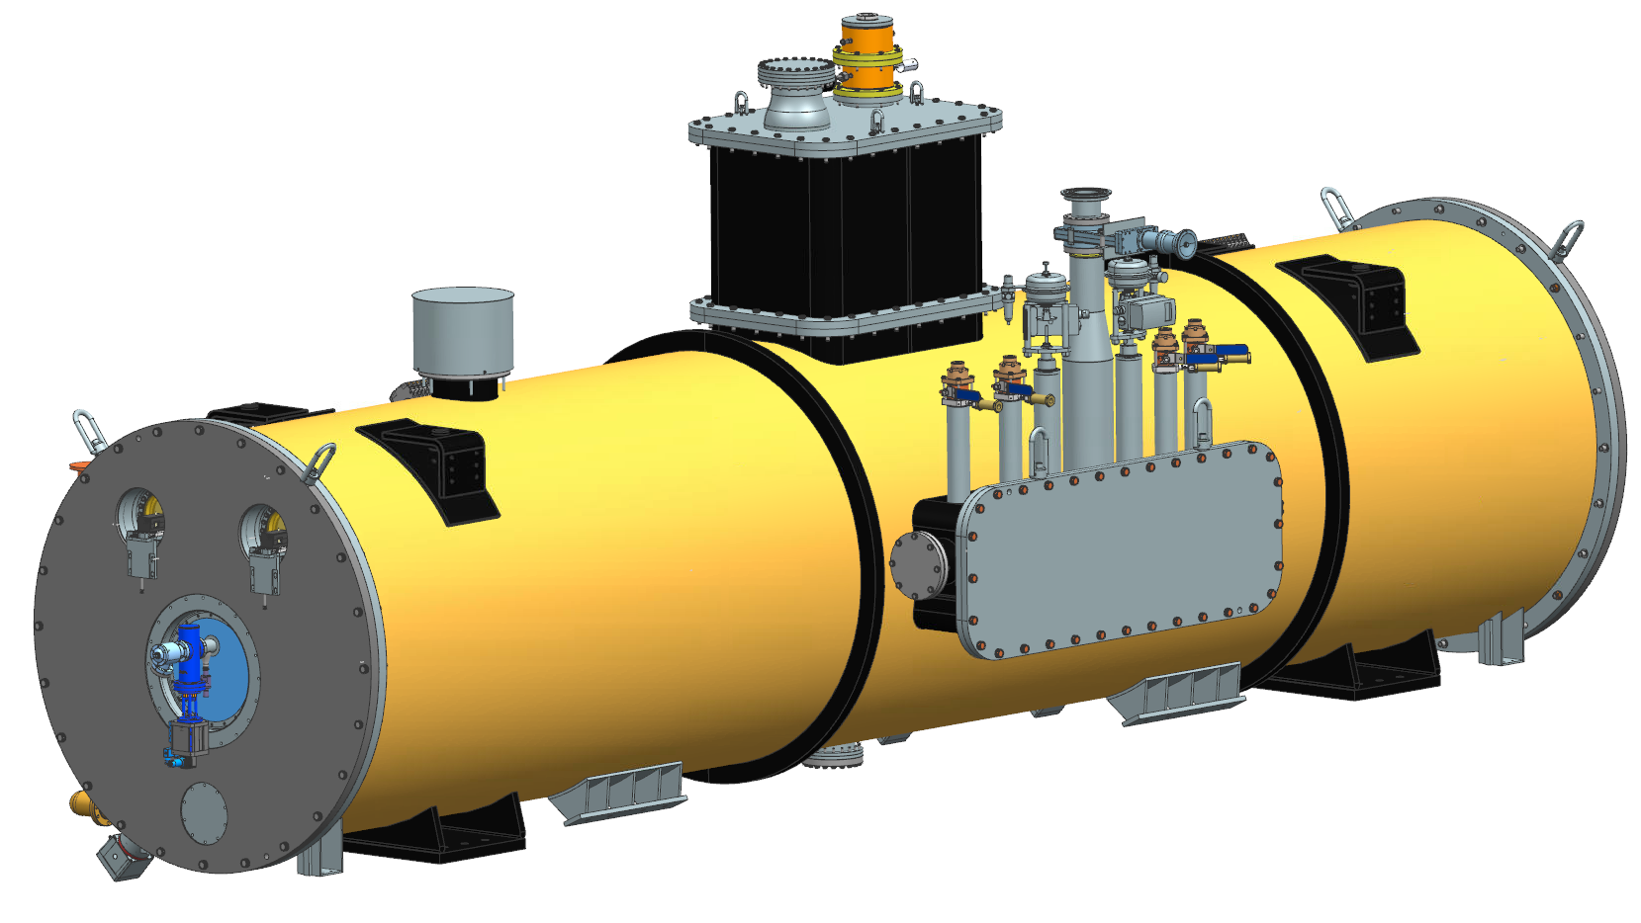
2. Description of the cryomodule
Vacuum vessel: 6.1 m long
Total length from the outer flange of the gate valve 6327 mm.
Beam pipe aperture 40 +/- 1mm
HTTS around 55 K
LTTS around 5 K
5 Bayonets, 2 cryogenic valves and 1 heat exchanger
One warm magnetic shield on the inner surface of the vacuum vessel
5 Cavities, tuners and couplers
3 Solenoids and current leads
3 BPMs
1 Relief valve
1 Vacuum port
Total weight: 9 600 kg
ISD: ED0010943

Slide 5
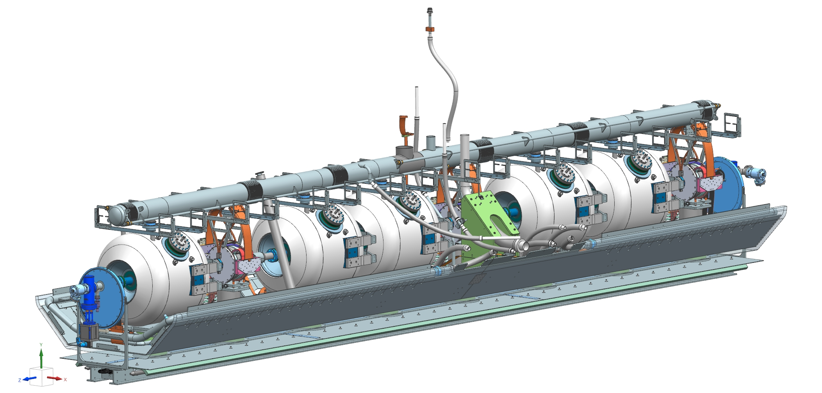
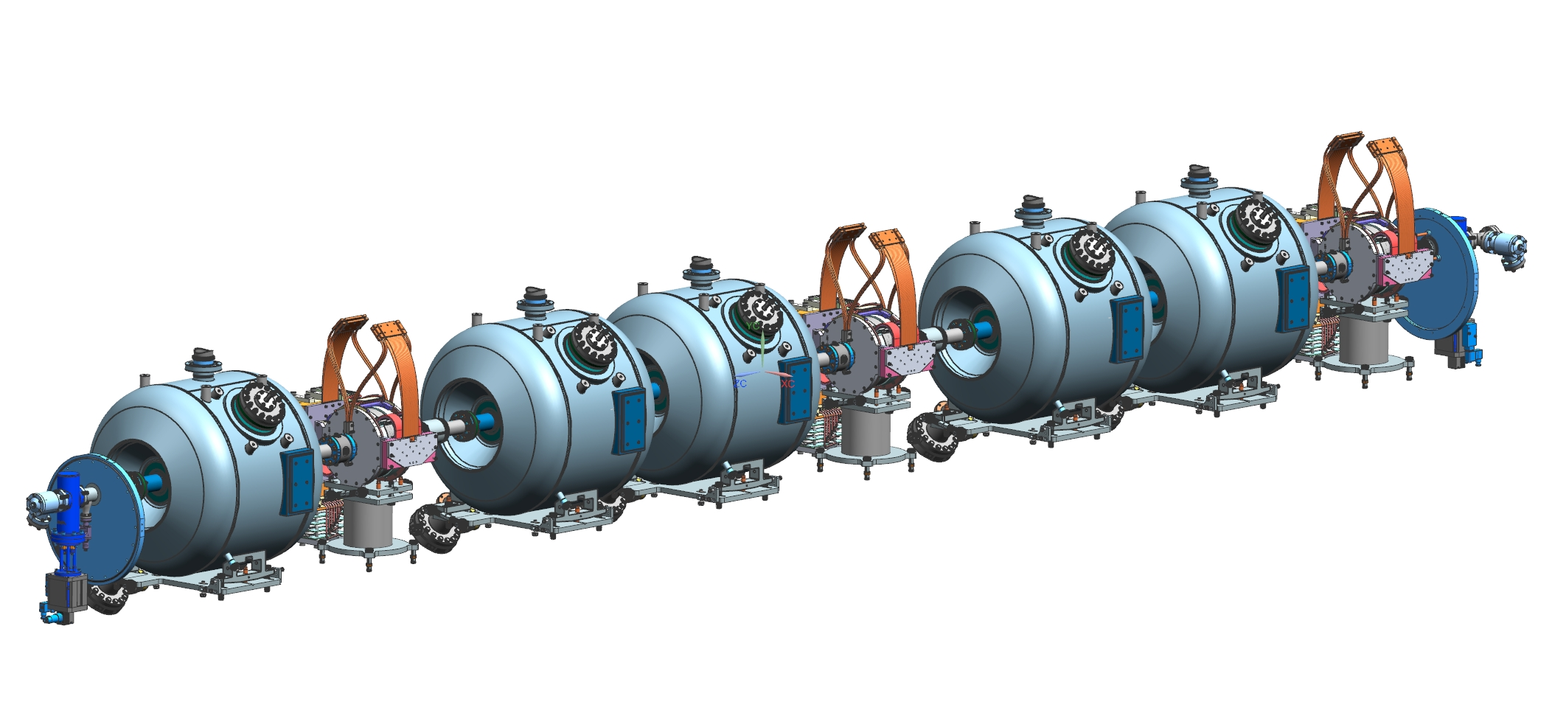
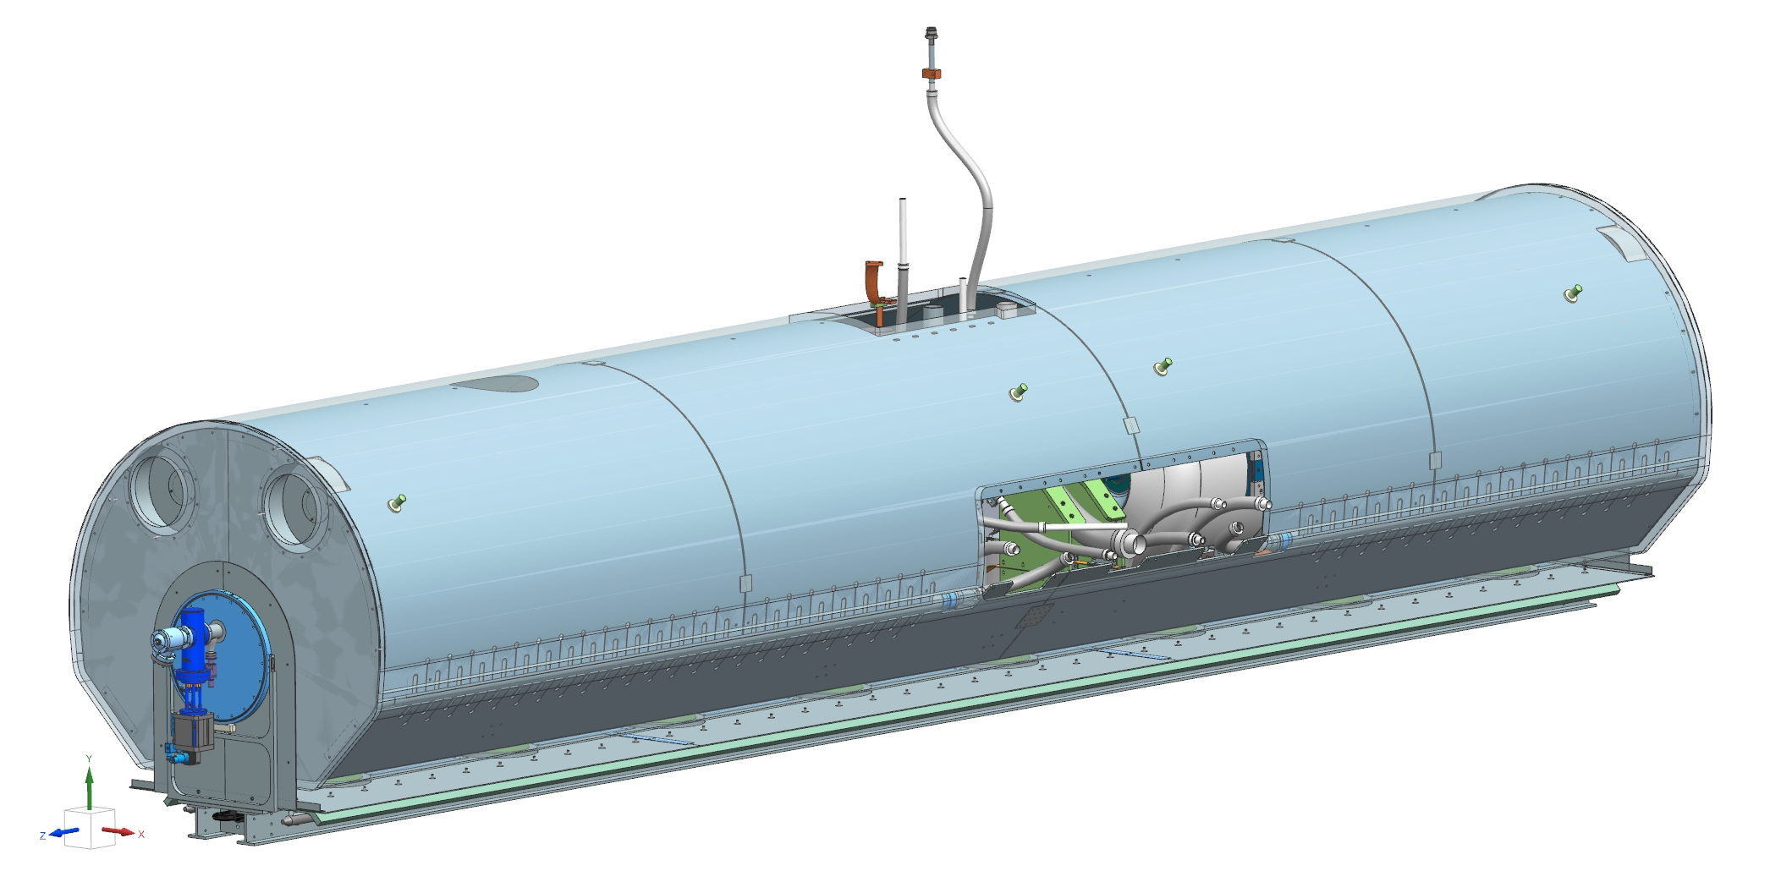
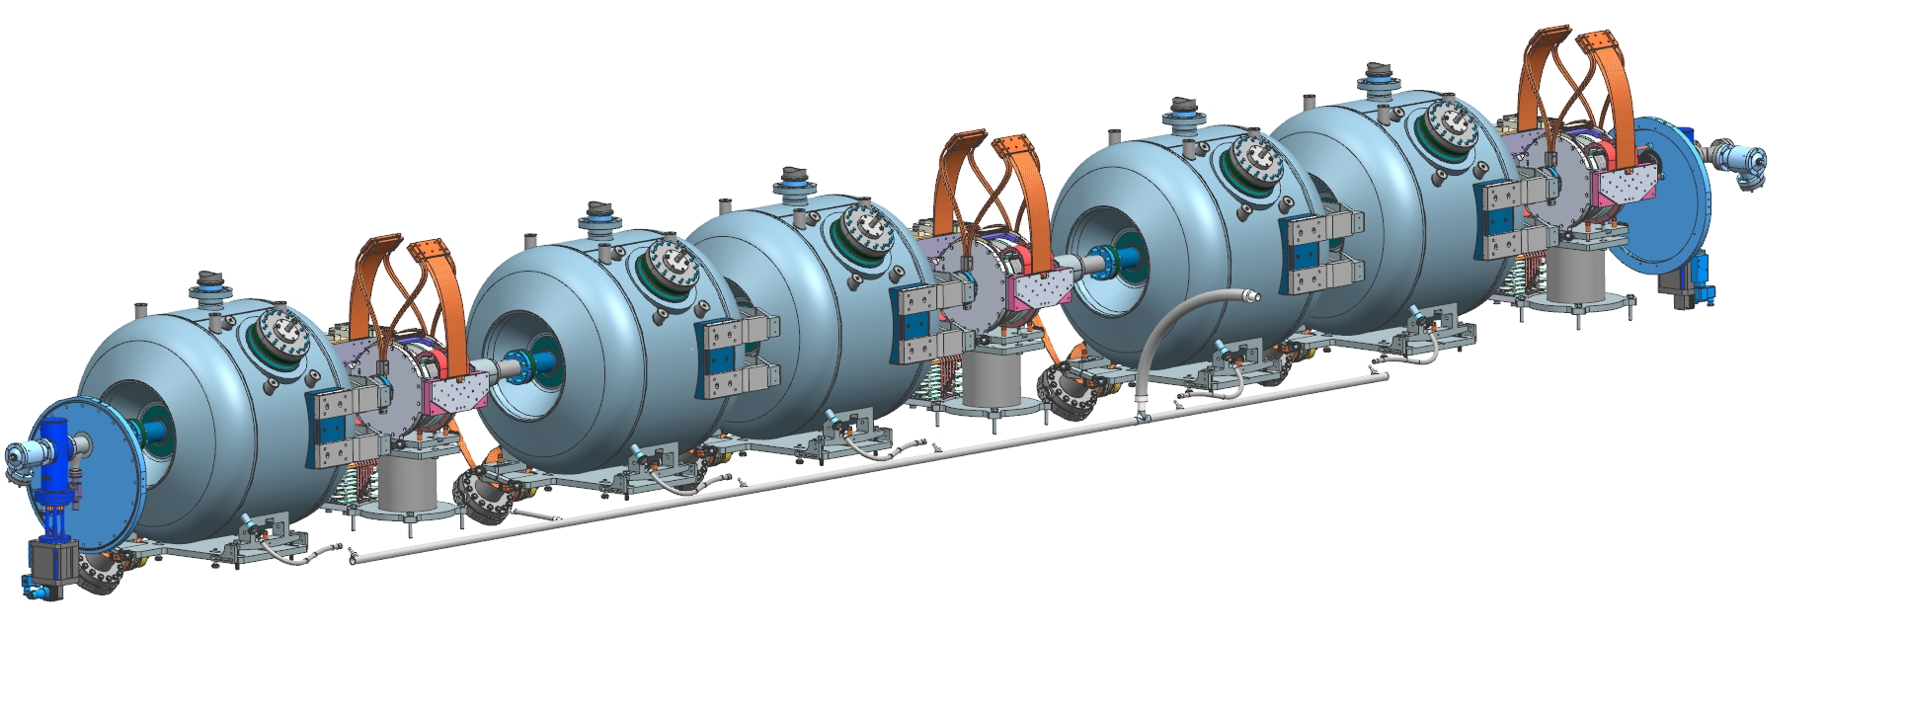
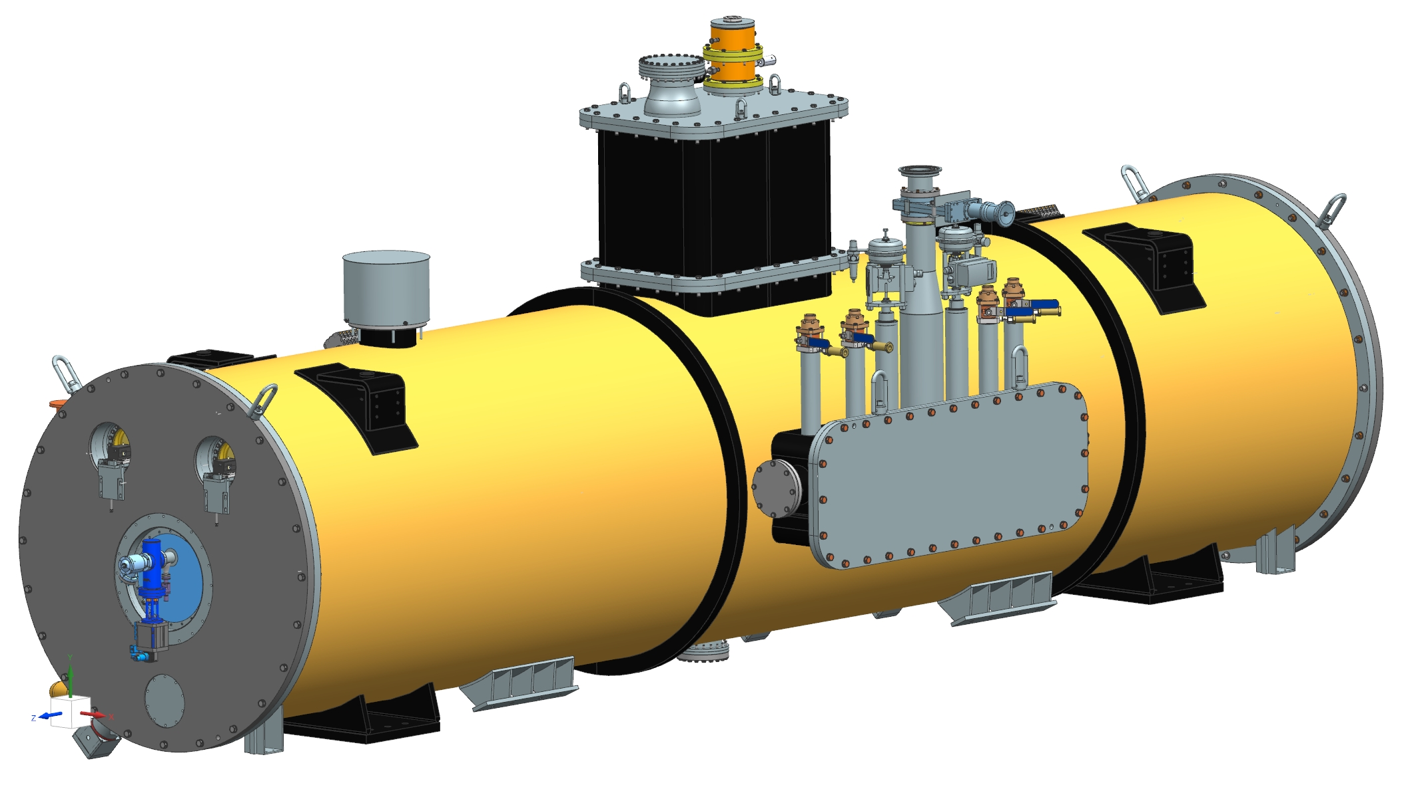
2. Description of the cryomodule
Beam line & Strong-back assembly F10138704
2.1 Main assemblies
Beam line assembly in the clean room F10127014
Coldmass assembly F10138832
Beam line assembly under the lifting tooling F10138833
Top CM assembly F10138829
Strong-back assembly F10138852

Slide 6
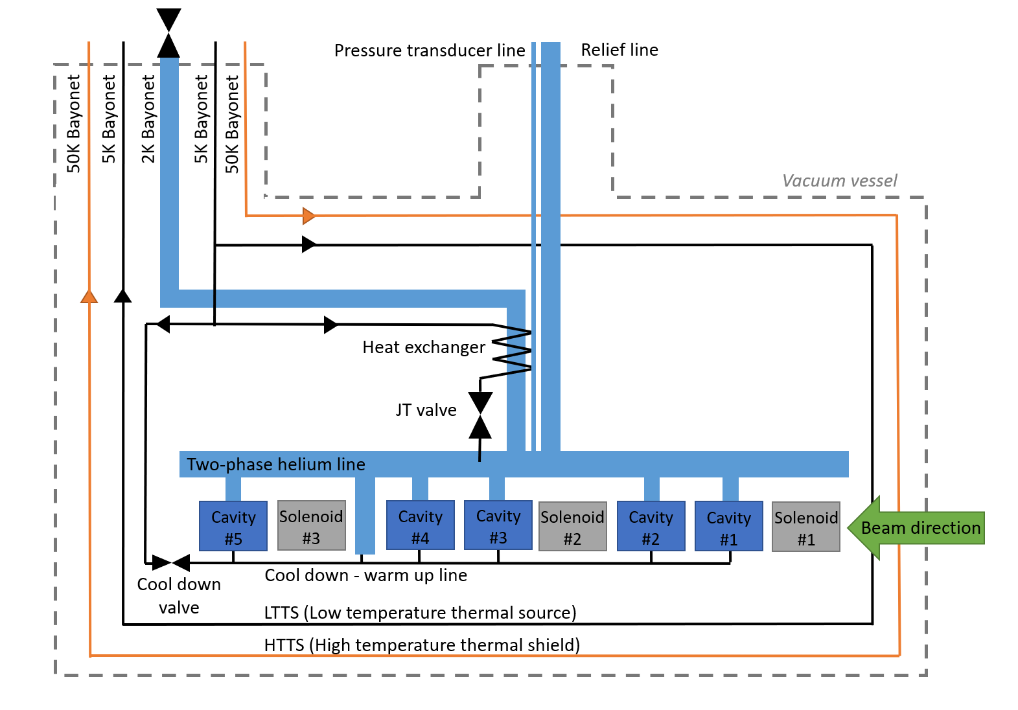
2. Description of the cryomodule
2.2 Layout of the cryomodule

Slide 7
2. Description of the cryomodule
2.2 Layout of the cryomodule
Pressure transducer
Vacuum vessel
Heat exchanger
(behind the relief line)
Global magnetic shield
HTTS
Cavity
Cavity & solenoid support
Bayonets and valves
Targets for HBCAM
Coupler
G11 support post
Strongback
Rail & bushing
Interface with the cryomodule stand

Slide 8
2. Description of the cryomodule
2.2 Layout of the cryomodule
Pipe B - Pumping line
MAWP: 2.05 bar / 4.1 bar
Pipe G - 2phase He pipe & Relief line
MAWP: 2.05 bar / 4.1 bar
Pipe A - 2 K supply
MAWP: 20 bar
Beam line
MAWP: 2.05 bar
Cavity
MAWP: 2.05 bar / 4.1 bar
Pipe E & F - HTTS
MAWP: 24 bar
Pipe H - Cool down /
warm up line
MAWP: 20 bar
Pipe C & D - LTTS
MAWP: 20 bar

Slide 9
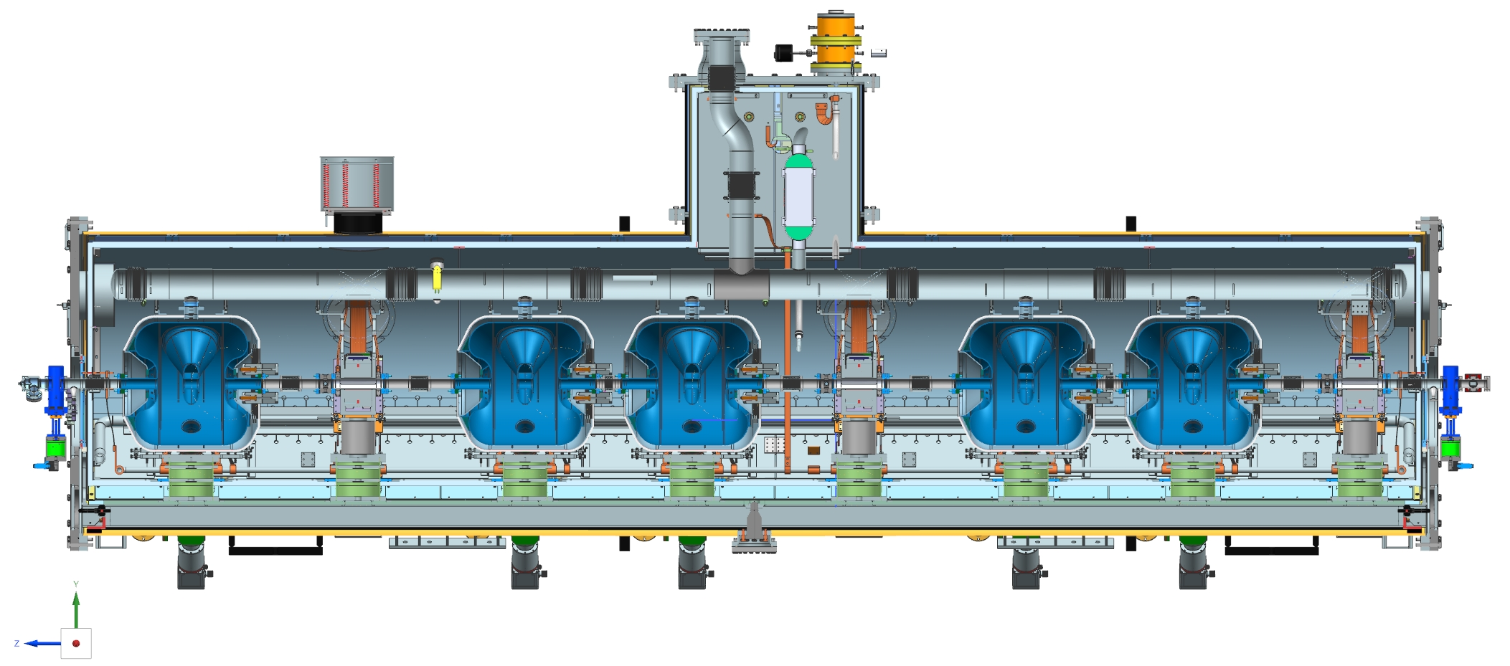
2. Description of the cryomodule
2.2 Layout of the cryomodule
Each cavity and solenoid are supported with one G11 support post. Since the helium vessel of the cavity is made of Titanium, the cavity & solenoid supports and the target frames are made also of Titanium.

Slide 10
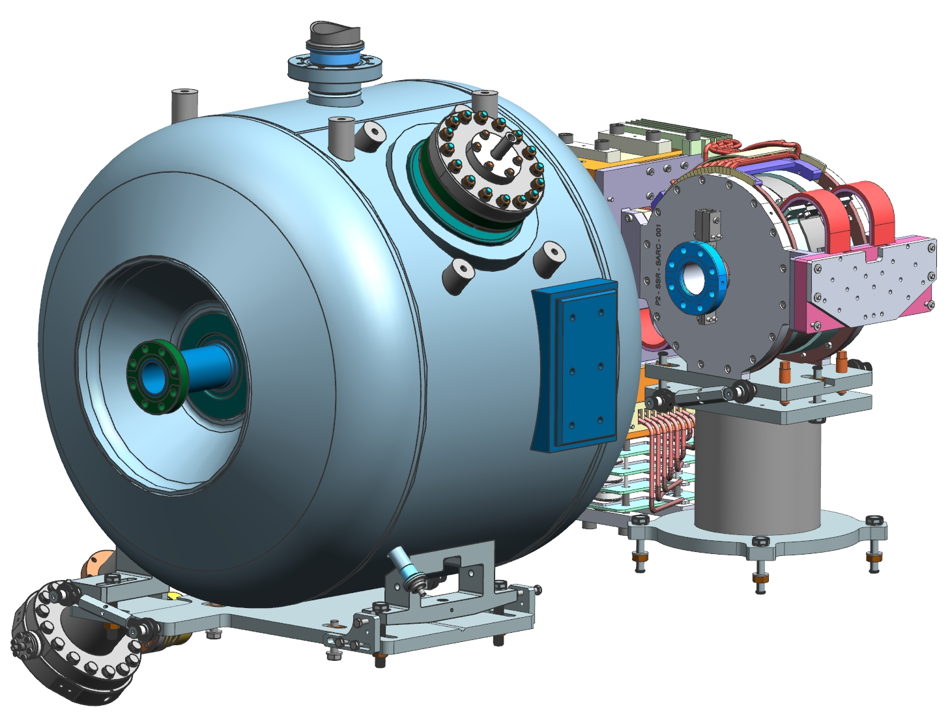
2. Description of the cryomodule
2.2 Layout of the cryomodule
The cavity and solenoid can be aligned using different set of screws. Compared to SSR1 pCM, this system has been improved allowing more flexibility and also making the alignment easier. Moreover, once the cavity and solenoid are aligned, their position can be locked easily.

Slide 11
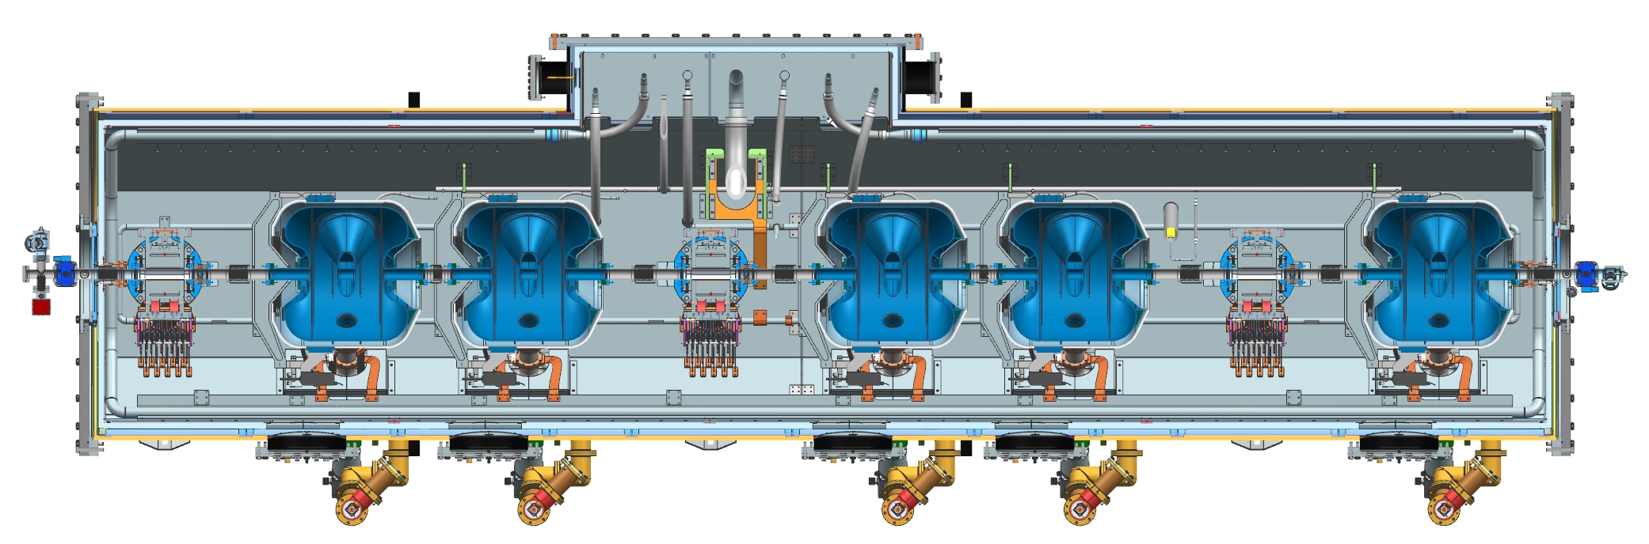
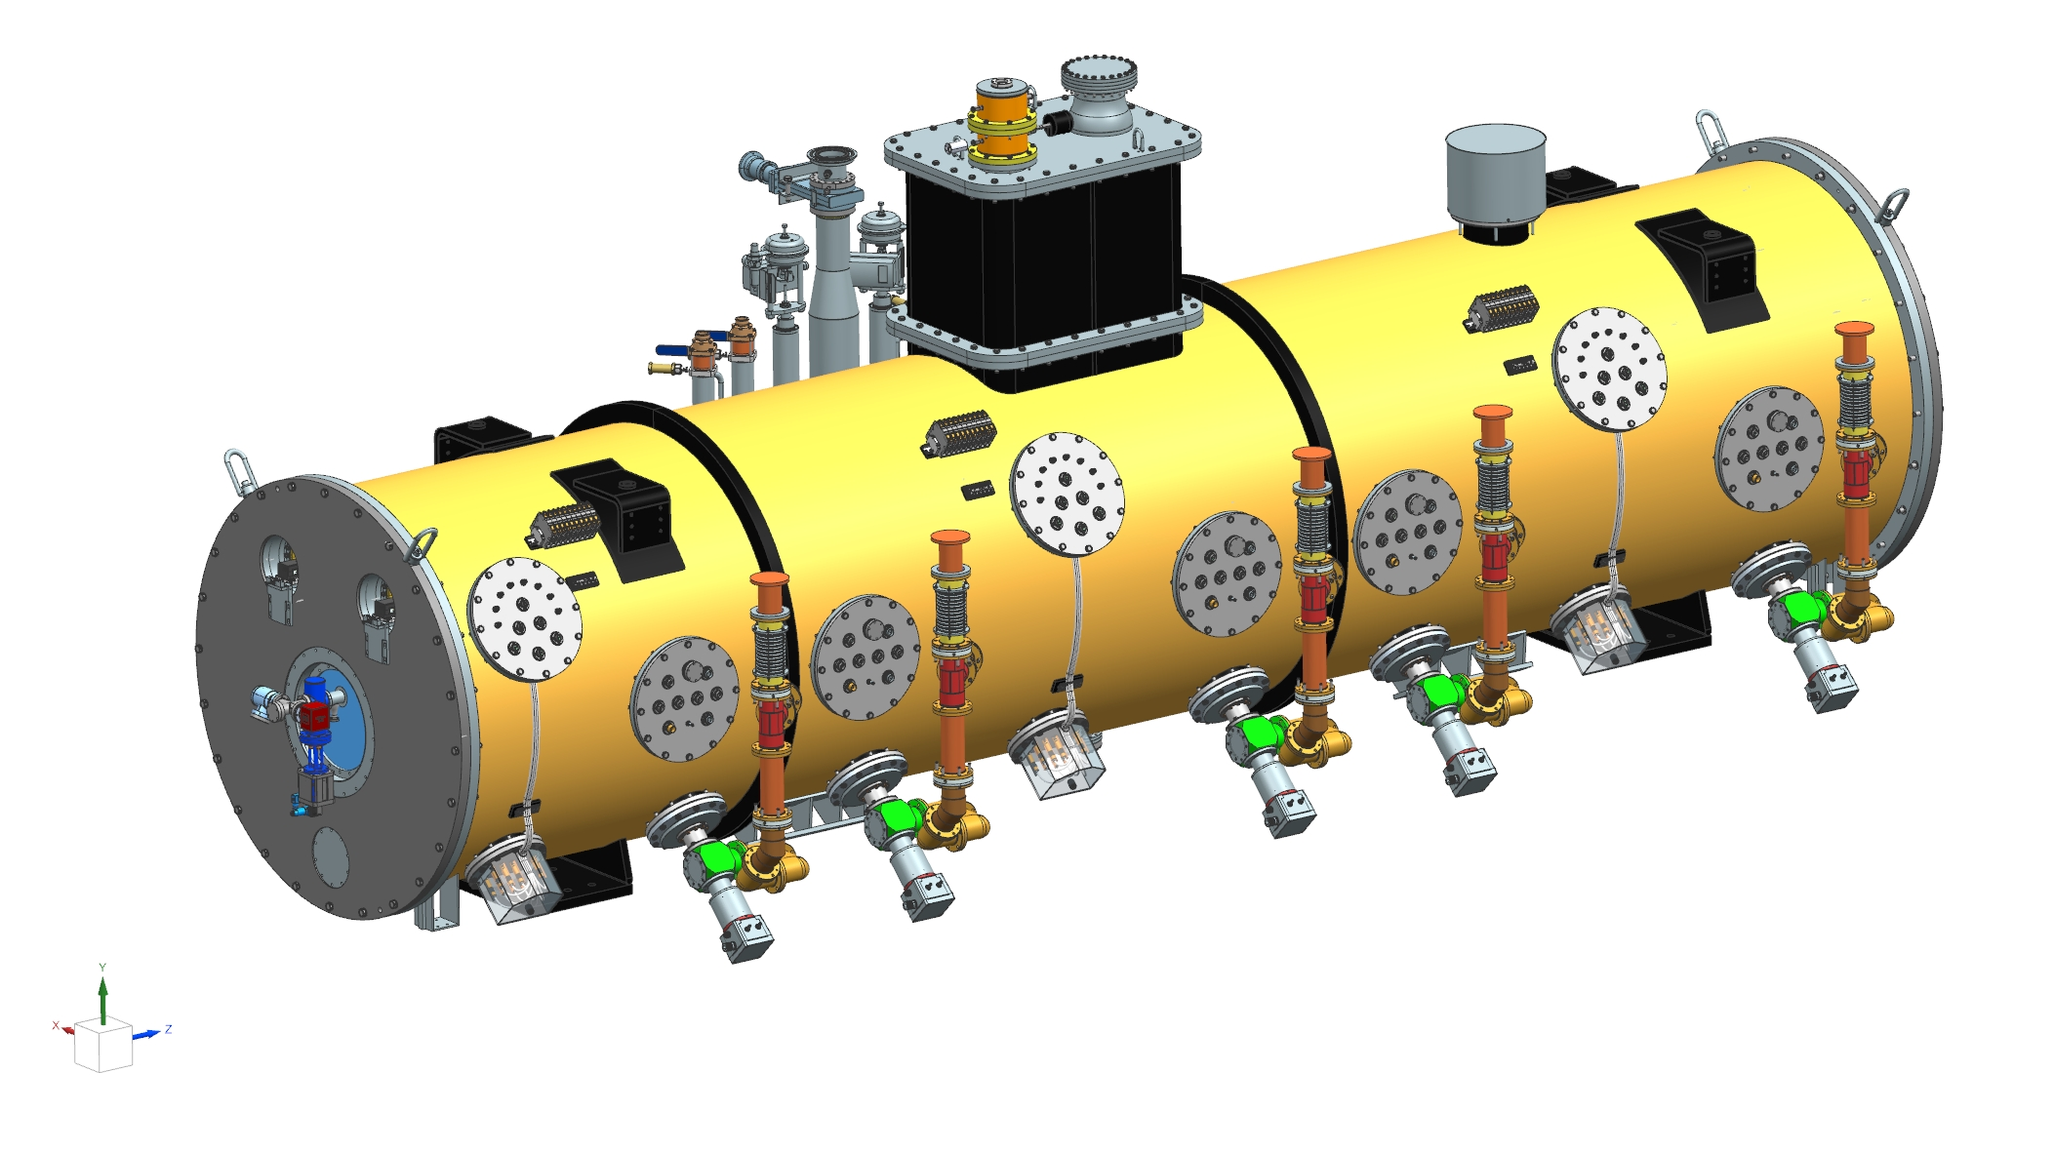
2. Description of the cryomodule
2.2 Layout of the cryomodule
Instrumentation ports are located in a way that it will be possible to access the tuner if needed.

Slide 12
2. Description of the cryomodule
2.3 Material
All parts in the insulating vacuum have been designed using approved materials listed in the TRS. In addition to vacuum, this material choice is also linked to the radiation damage expected during the 40 years of operation.
All cryogenic lines inside the magnetic shield are in SS316L and are annealed to reach magnetic permeability of 1.02.
Magnetic hygiene will be performed for all stainless-steel hardware.

Slide 13
3. Assembly process
The assembly process of the SSR2 pre-production cryomodule is similar to the one used for SSR1 & HB650 prototype cryomodules, but many improvements have been done to ease the assembly process & alignment. We are planning to perform the string assembly, the coldmass assembly and the insertion of the coldmass assembly in MP9.
Cryomodule assembly
Strongback & coldmass assembly
Lifting tooling
String assembly
Clean room

Slide 14
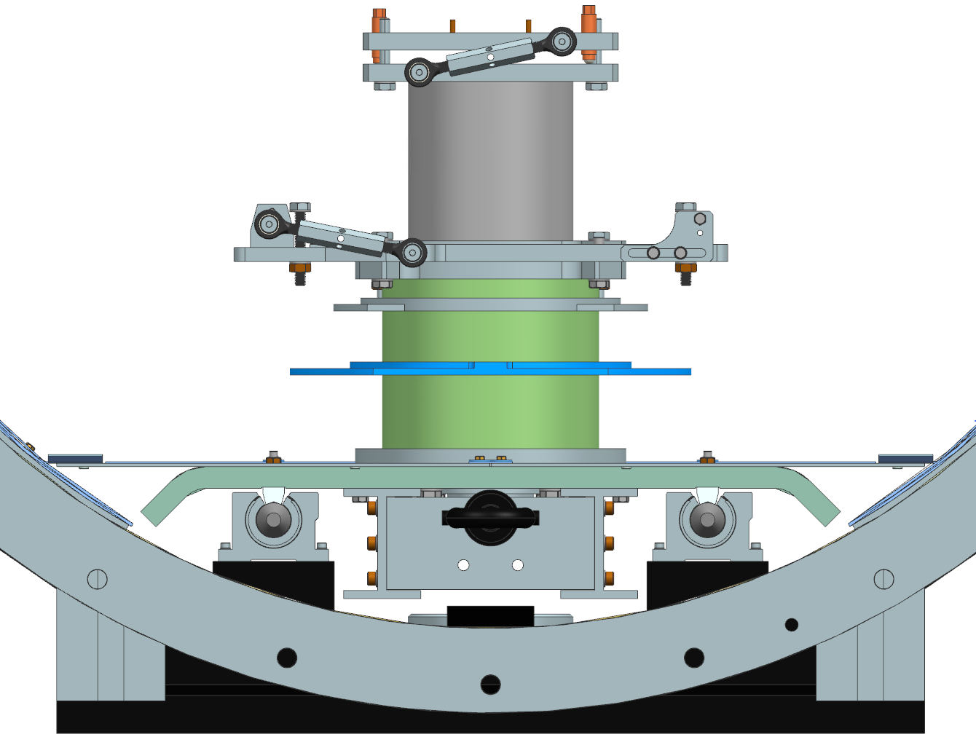
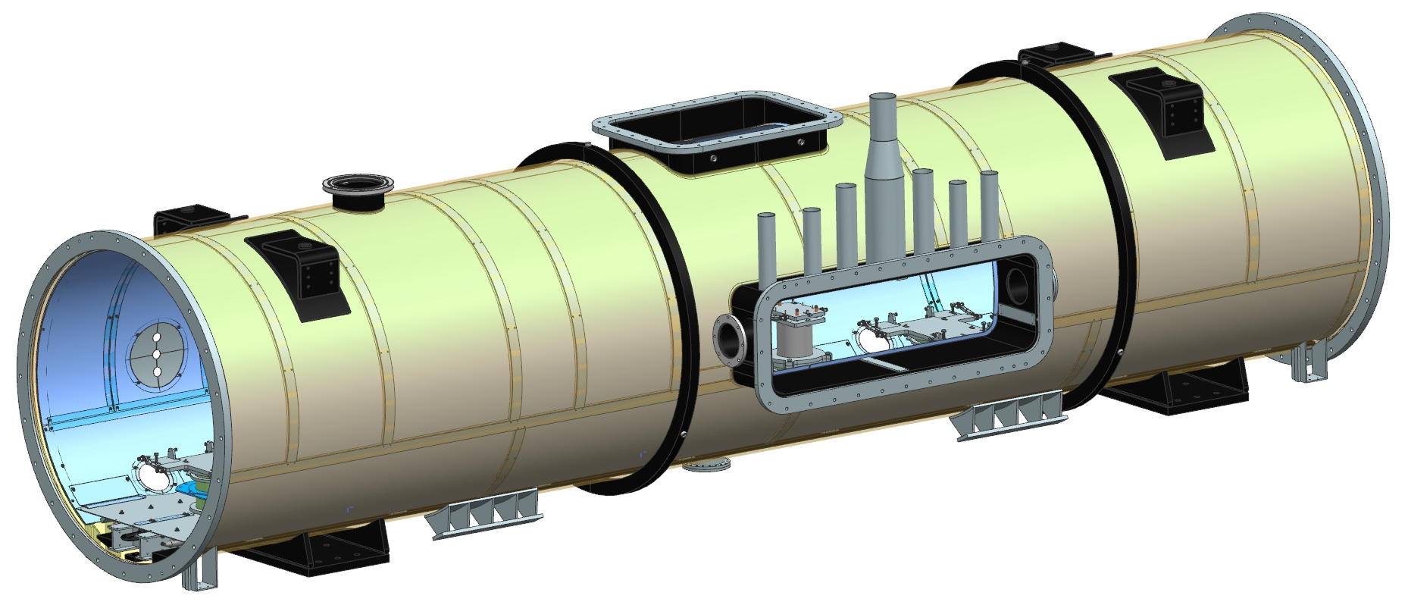
3. Assembly process
Phase 1 - Strongback fitment
On the rail assemble the strongback tray with cavity and solenoid posts.
Position the vacuum vessel in order to insert the strongback tray inside.
Insert the strongback tray with cavity and solenoid posts.
Lock the strongback to the vacuum vessel using the central pin.
Check & adjust clearance of the magnetic shield
Survey the vacuum vessel with laser tracker, calculate vacuum vessel center line.
Survey the position of the cavity and solenoid posts with the vacuum vessel as reference. Calculate the cavity and solenoid posts position compared to the center line, compared to the end flanges and compared to the coupler ports.

Slide 15
3. Assembly process
Phase 2 - Beam line assembly
Survey the rail.
Outside the clean room:
Align each cavity and solenoid on their supports with the phase 1 as reference + 1.34 mm due to the vertical shrinkage during the cool down.
Align the beam pipe end assembly with the phase 1 as reference.
In the clean room make sure that the supports plane are all in the plane. And this plane need to be parallel to the rail plane and centered.
Assemble the beam line in the clean room, perform a leak test.

Slide 16
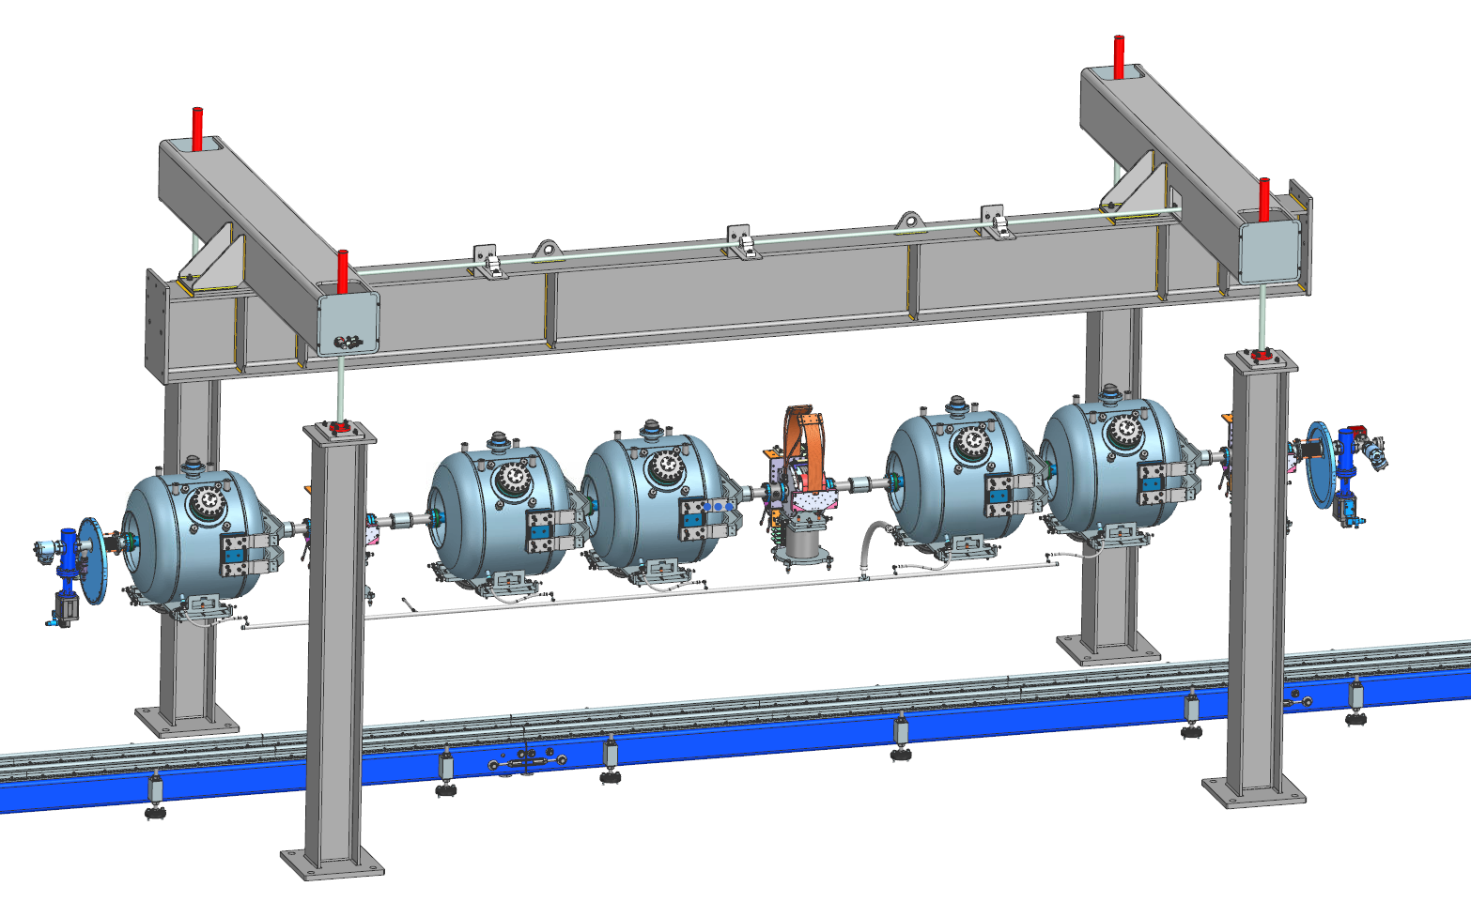
3. Assembly process
Phase 2 - Beam line assembly
Set the lifting tooling in the SSR2 configuration.
Using the winch stand, bring the beam line underneath the lifting tooling.
Check alignment using laser tracker and make modifications as needed.
Connect the beam line to the lifting tooling and lift up the beam line.
Connect the tuner
Weld the cool down warm up line to the cavities.
MAWP 20 bar except the weld making the interface with the cavities (2.05 bar warm, 4.1 bar cold)
Pressure test and leak test performed by the manufacturer
Perform a leak test if possible
Install 10 layers of MLI on the cavities and CD line.

Slide 17
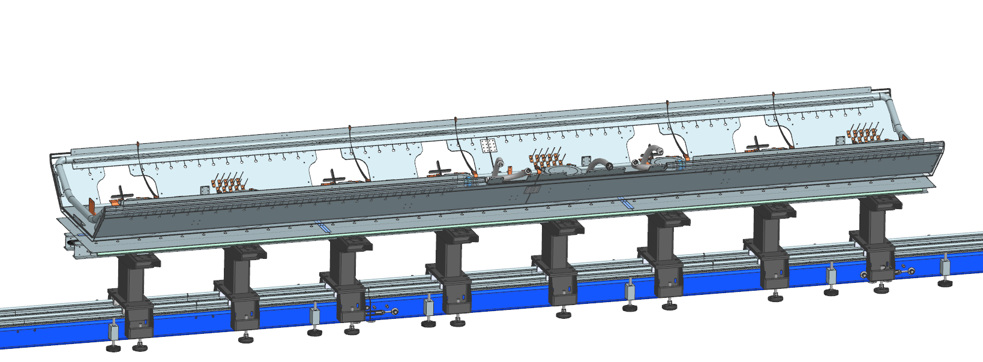
3. Assembly process
Phase 3 - Strongback assembly
Assemble the strongback on the tooling.
The strongback rails need to be located in a plane parallel to the rails. In addition, the strongback rails need to be centered compared to the rails.
Complete the strongback assembly.
Details in the assembly step by step process

Slide 18
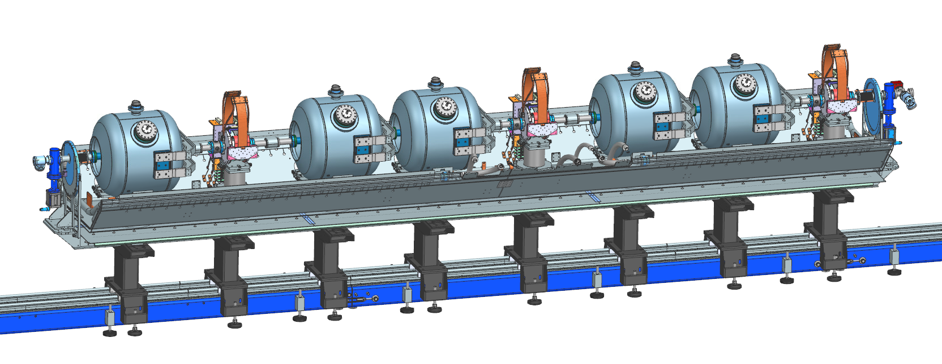
3. Assembly process
Phase 4 - Strongback and beam line merger
Position the strongback assembly underneath the lifting tooling.
Move down the beam line assembly on the strongback assembly.
Connect the cavity and solenoid posts to the G11 support post.
Final alignment using laser tracker, make modifications as needed.

Slide 19
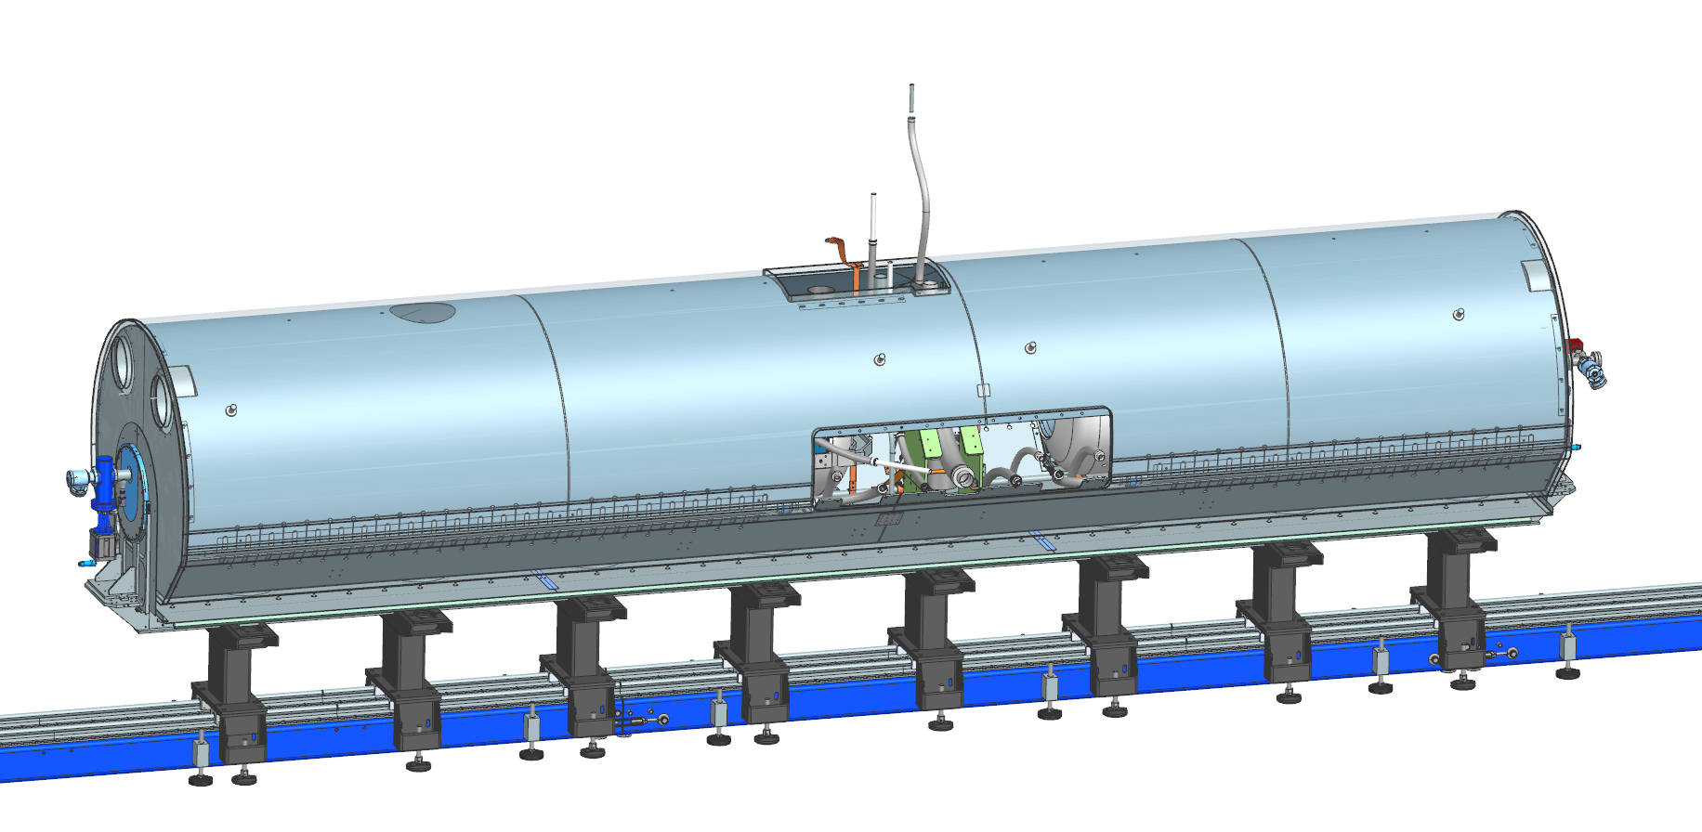
3. Assembly process
Phase 5 - Coldmass assembly
Completion of two-phase pipe, then perform a leak test.
Install cavity targets.
Install pumping line support
Install remaining cryogenic lines.
Thermal straps & instrumentation wiring.
Final check of the beamline alignment
Setup H-BCAMs.
The H-BCAMs are used to determine if the cavities and solenoids are still aligned after the coldmass insertion, after transportation and after cool down.
Install 10 layers of MLI on all cryogenic lines.
Install upper thermal shield, 30 layers of MLI, Demagnetize.

Slide 20
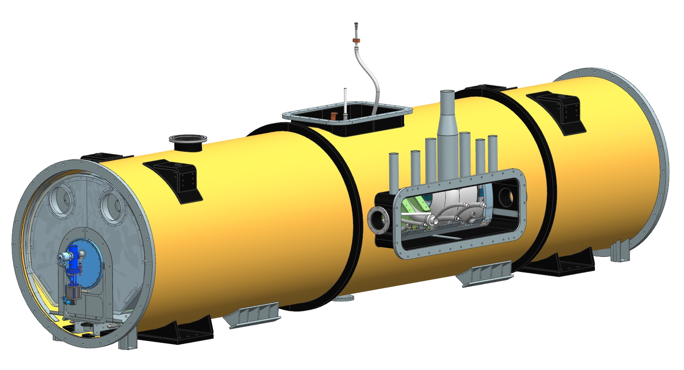
3. Assembly process
Phase 6 - Insertion of the coldmass
Prepare vacuum vessel for insertion.
Insert the coldmass.
Lock the strongback to the vacuum vessel using the central pin.
Clearance checks.
Transfer alignment of the beam line to the vacuum vessel.

Slide 21
3. Assembly process
Phase 7 - Final cryomodule assembly
Weld and pressure test of the HTTS (ASME B31.3 requirement).
Complete the assembly of top port components.
Complete the assembly of side port components.
Final tasks for completion.
Leak test of the vacuum vessel.
Pressurize LTTS circuit with 5psi helium, check for rise in insulating vacuum.
Pressurize HTTS circuit with 5psi helium, check for rise in insulating vacuum.
Pressurize 2-phase circuit with 5psi helium, check for rise in insulating vacuum.
Perform LTTS pressure test (ASME B31.3 requirement).
Perform 2-phase pipe pressure test (ASME B31.3 requirement).
Demagnetize vacuum vessel.

Slide 22
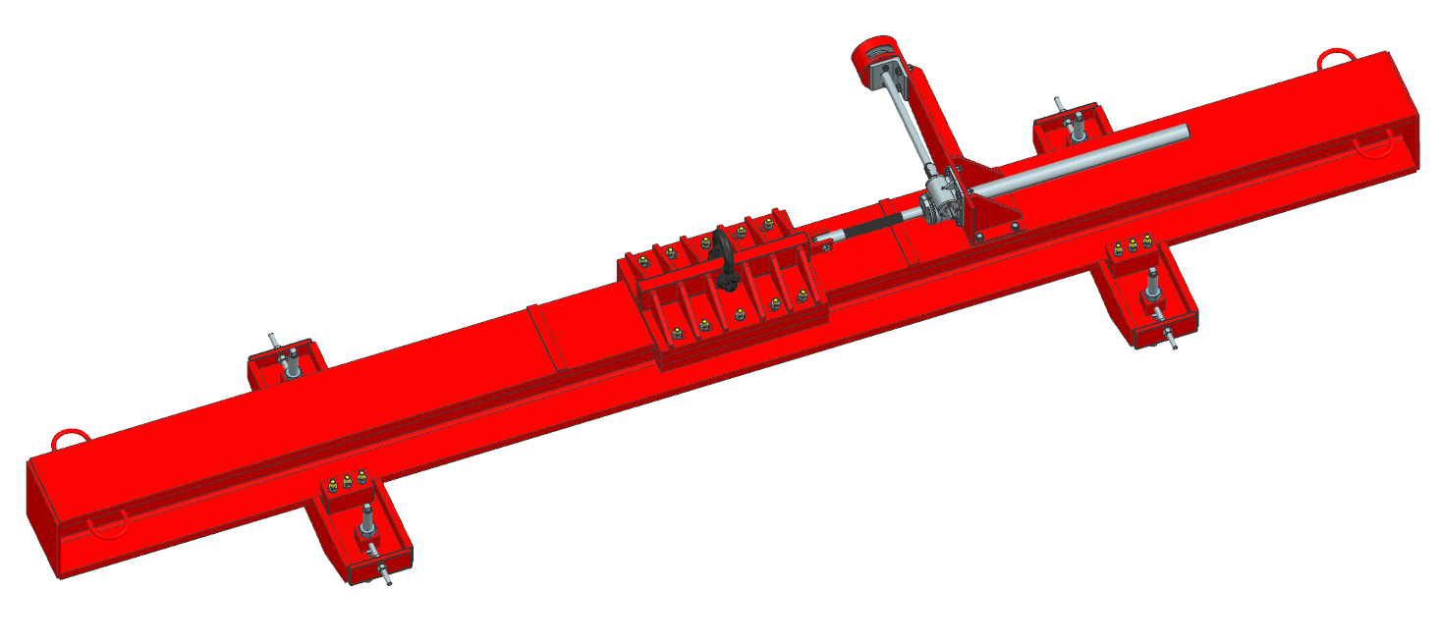
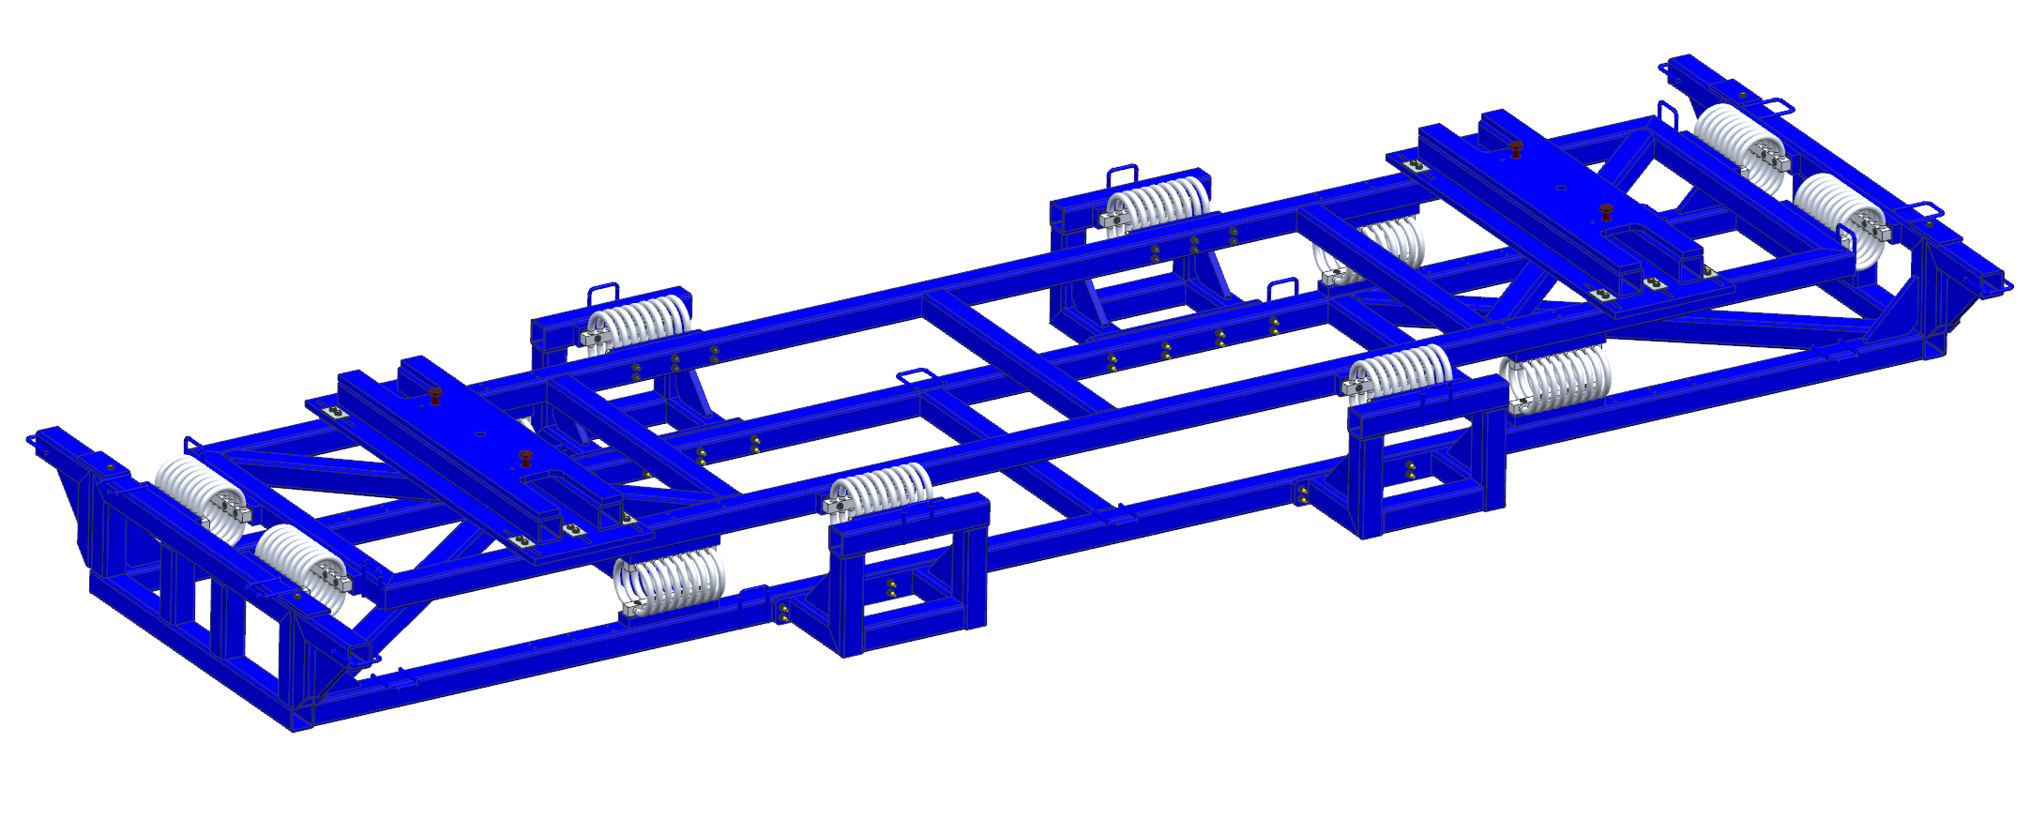
3. Assembly process
Charge 1c
Phase 8 - Lifting of the cryomodule
The cryomodule lifting tooling has been designed for SR1 prototype cryomodule. If we decide to re-use this tooling, an interface will need to be designed to match the lug position on SSR2 cryomodule.
Phase 9 - Transportation at Fermilab
This transport frame has been designed for SSR1 prototype cryomodule. Calculations will be done to determine if it can be re-used for SSR2 pre-production cryomodule.

