Slide 1
SSR1 Cryomodule Test Results
Donato Passarelli, Alexander Sukhanov
FNAL-IBS Workshop
March 1-2, 2023

Slide 2
Outline
PIP-II Injector Test facility
  Scope and cryomodules test plan
Performance and Lessons learned
  Single Spoke Resonator Cavities and Cryomodule

Slide 3
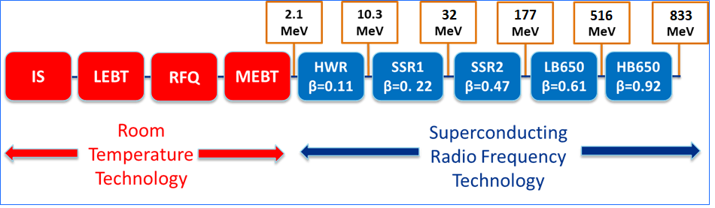
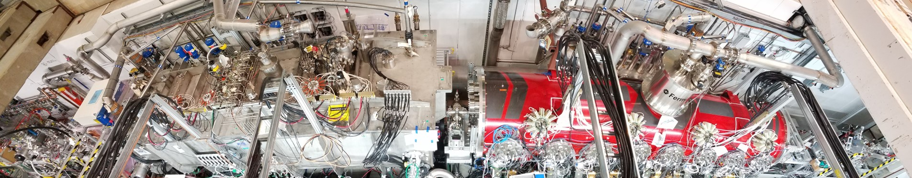
PIP-II Injector Test
Validate structural and thermal performance of the SRF cryomodules
Demonstrate performance of critical components
Show that HWR and SSR1 can provide acceleration of H- beam with parameters required PIP-II physics program
PIP2IT
10
PIP-II technology map

Slide 4
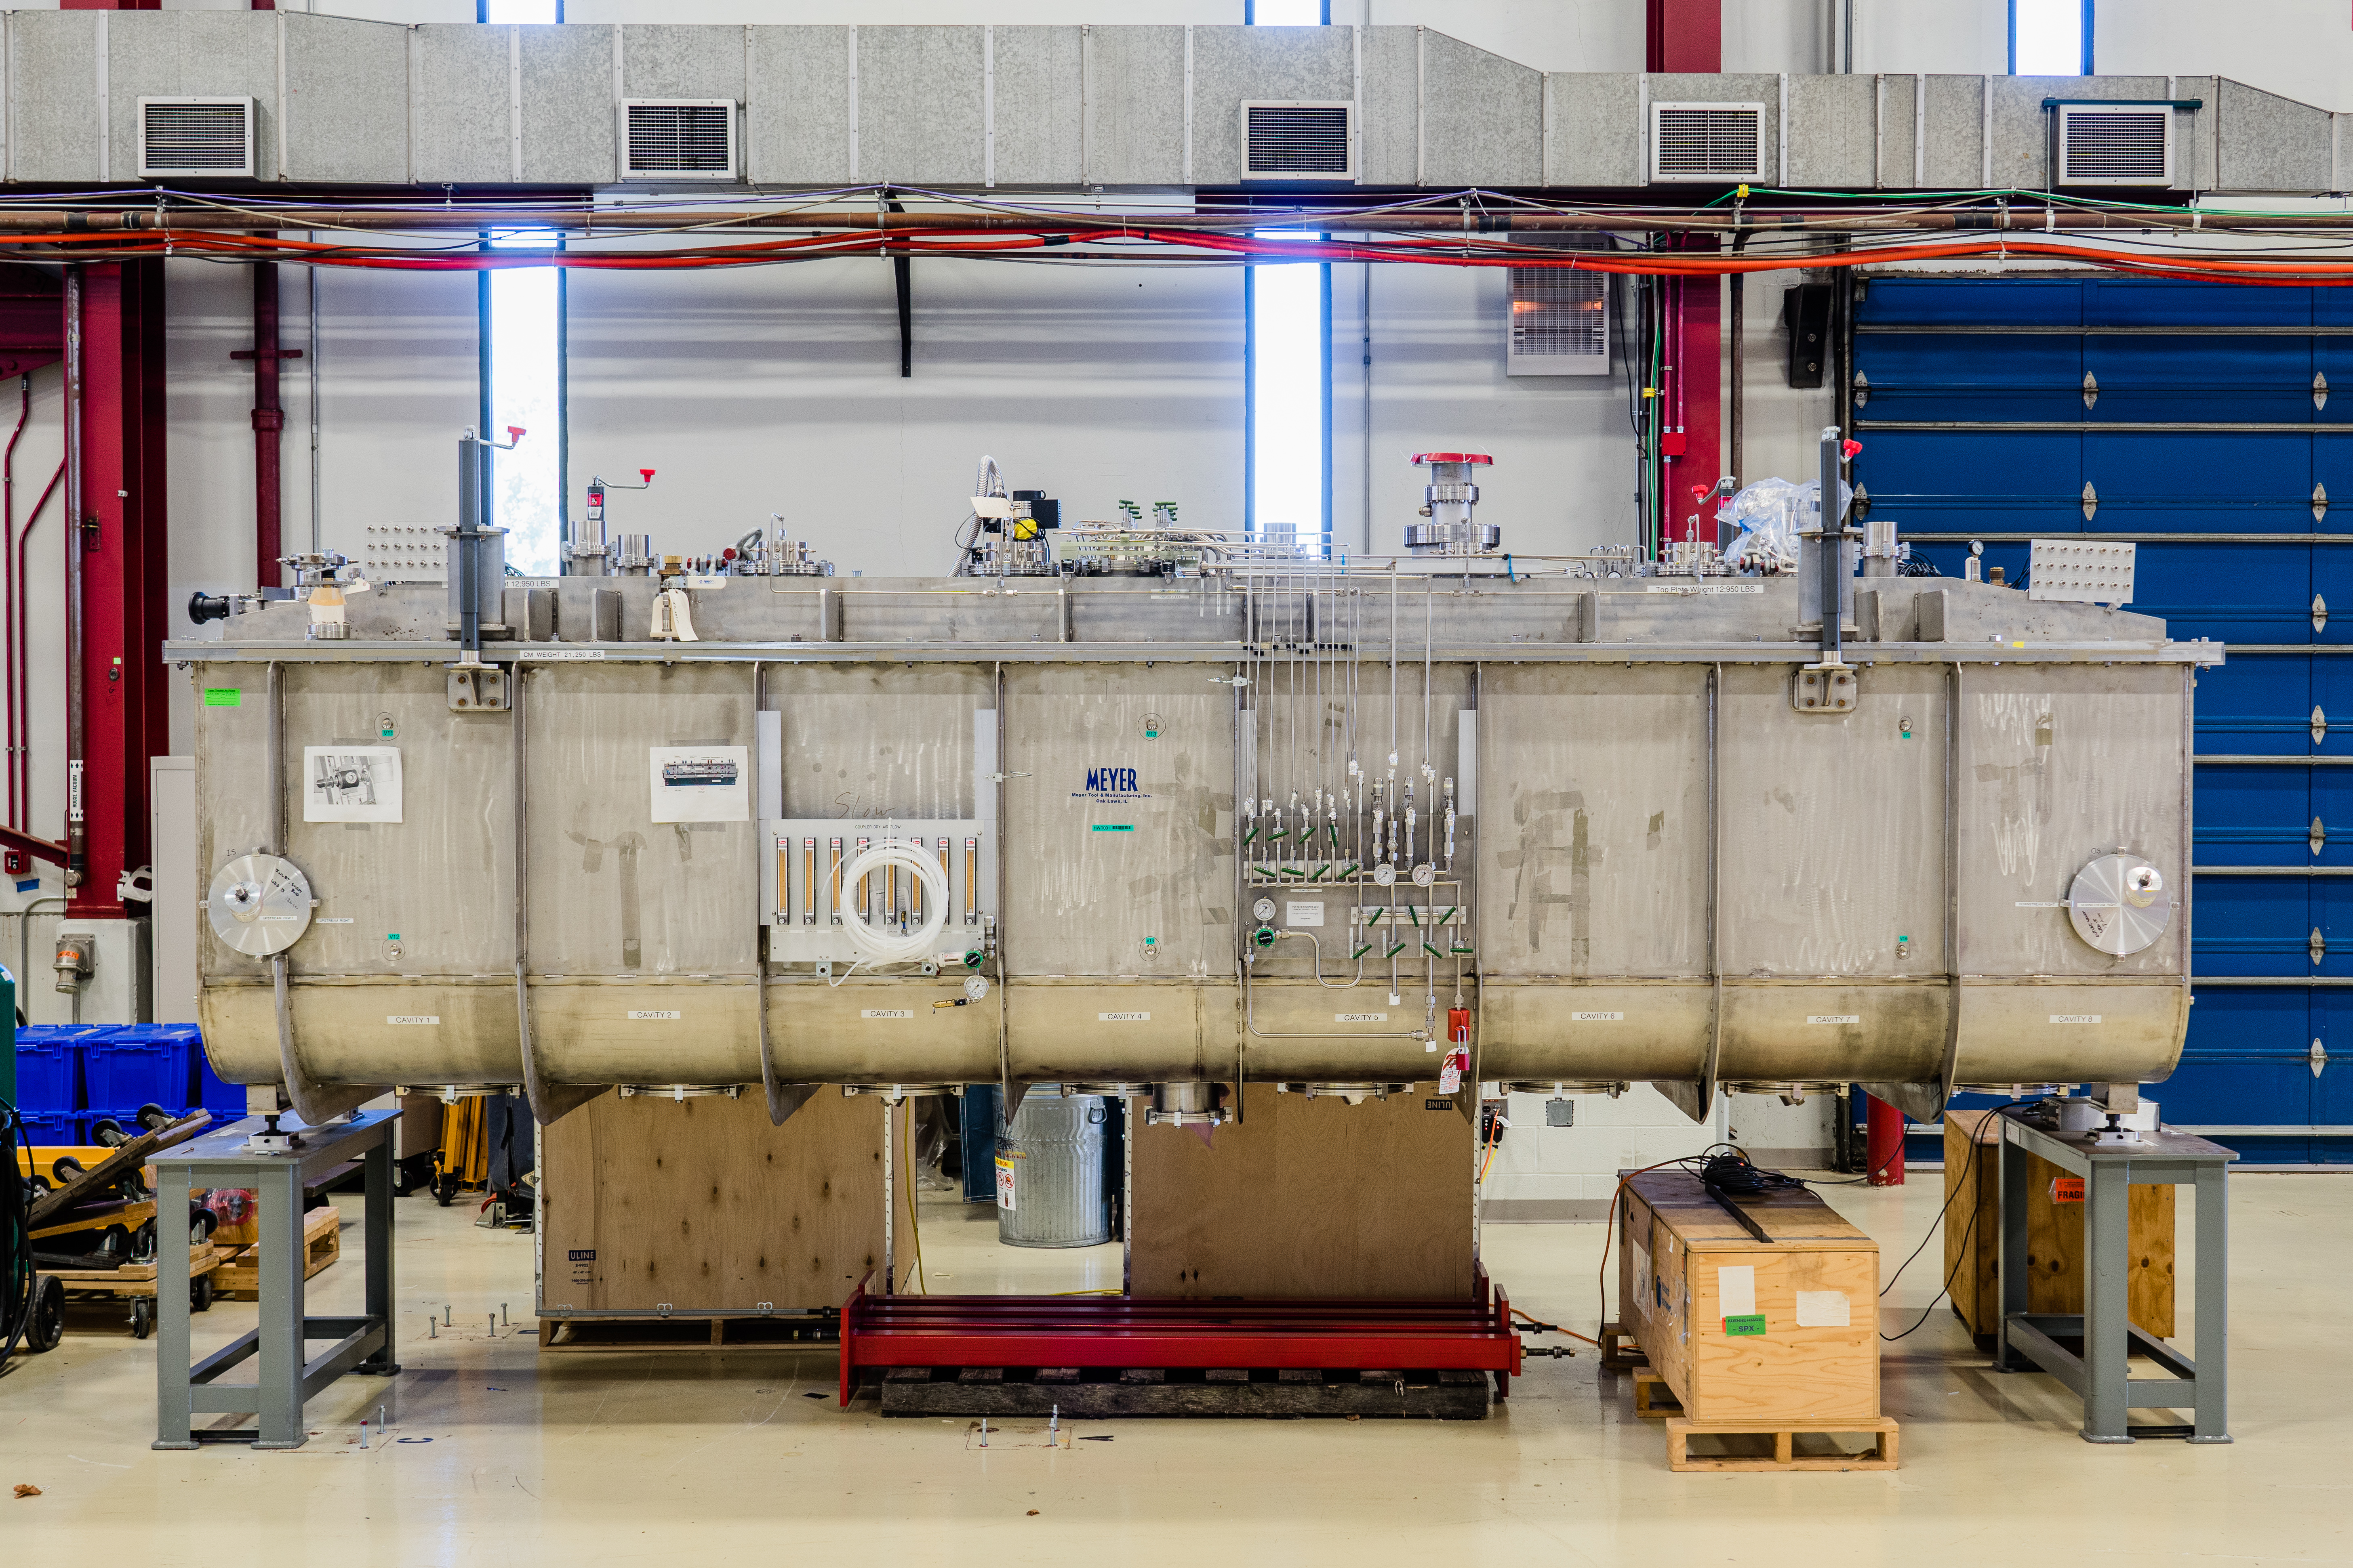
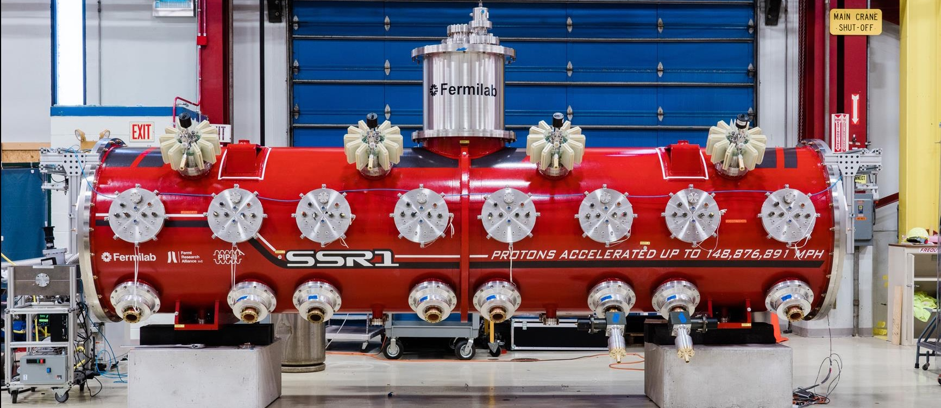
HWR and SSR1
HWR Cryomodule
Argonne National Laboratory (ANL) was responsible for design, procurement, sub-component testing, assembly of HWR CM.
Final testing was done at Fermilab.
One production HWR is required for PIP-II linac.
 | Cavity # | String Assy. | CM Length [m] | Q₀ @ 2K [x10¹⁰] | R_{s} [Ω] | Q_{L} [x10⁶]
HWR | 8 | 8 x (SC) | 5.93 | 0.85 | 5.6 | 2.3
SSR1 | 8 | 4 x (CSC) | 5.3 | 0.82 | 10.2 | 3.0
The HWR and SSR1 cryomodules operate CW with a beam current of 2 mA to accelerate H¯ beam.
SSR1 Cryomodule
The SSR1 CM was fully designed, assembled and tested at Fermilab.
Two production SSR1 CMs to follow.
The SSR1 CM is based on the “The Fermilab style cryomodule” – the concept of all future PIP-II CMs (i.e. SSR2, LB650, HB650).

Slide 5
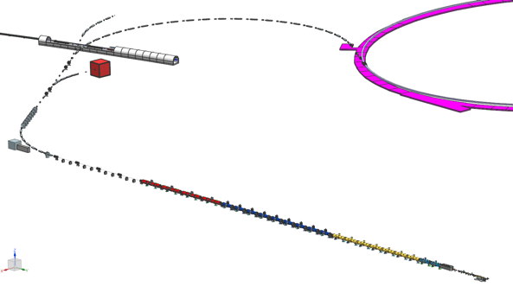
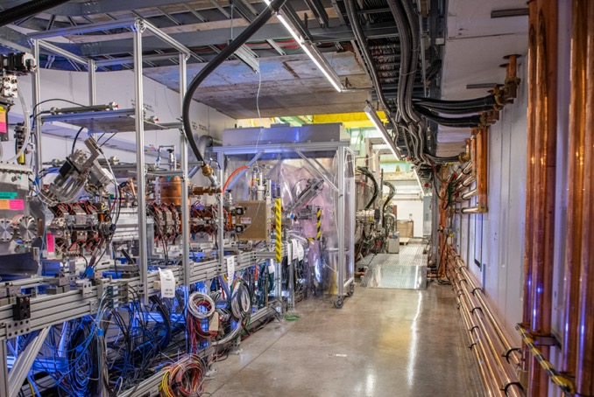
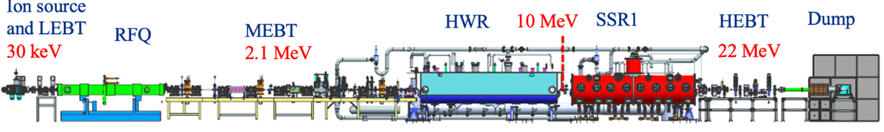
PIP-II Injector Test (PIP2IT)
PIP2IT was developed to test PIP-II critical technologies and reduce project technical risks
PIP2IT was commissioned in two phases
  Phase 1 (2015 – 2018):
    Ion source, RFQ, MEBT (2.1 MEV)
  Phase 2 (2020 – 2021):
    Ion source, RFQ, MEBT (2.1 MEV), HWR, SSR1, HEBT, Dump (22 MeV)
PIP-II

Slide 6
PIP2IT Main Goals
Reduce PIP-II technical risks
Test PIP-II technical systems to validate designs and inform design decisions
Gain commissioning experience that will be used later to shorten commissioning of PIP-II linac
Demonstrate beam with LBNF/DUNE parameters at the end of SSR1-1, including chopping pattern required for Booster injection
  Validate beam optics and quantify beam parameters. Test beam tuning procedures.
Gain experience with installation, testing, and operation of PIP2IT equipment
Integration of in-kind contributions
Collect lessons learned to improve the design of technical systems and the operational procedures.

Slide 7
HWR and SSR1 cryomodules testing at PIP2IT
Validate structural and thermal performance of the cryomodules
  Alignment, Thermal shields, Beamline and Insulating vacuum, Static Heat Loads, and Strongback (for SSR1 only)
Demonstrate performance of critical components
  Cavities: E_{acc}, Q₀ (Dynamic Heat Loads)
  Focusing lenses: Solenoids and Correctors powered up to the administrative limit
  RF couplers can sustain full power
  Tuners to provide required range and resolution
  Microphonics level within specifications, LLRF controls
Show that CMs can provide acceleration of H- beam with parameters required by the PIP-II physics program

Slide 8
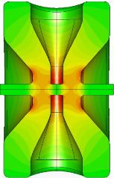
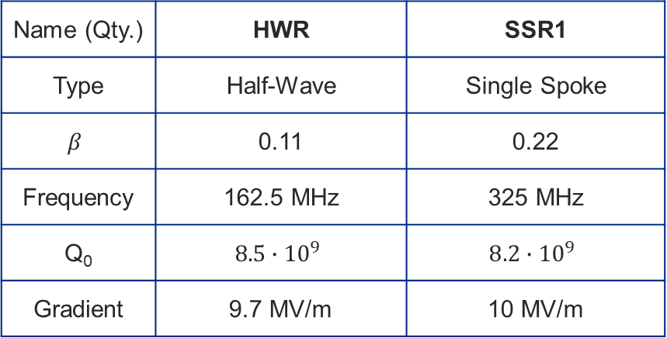
HWR and SSR1 Cavities and Cryomodules
Argonne National Laboratory (ANL) was responsible for design, procurement, sub-component testing, assembly of HWR CM and subcomponents. Final testing was done at Fermilab.
The SSR1 CM was designed based on the Fermilab style cryomodule. It was fully assembled and tested at Fermilab.
The HWR and SSR1 cryomodules operate CW with a beam current of 2 mA to accelerate the H– beam.
Name (Qty.) | HWR | SSR1
Type | Half-Wave | Single Spoke
$$β$$ | 0.11 | 0.22
Frequency | 162.5 MHz | 325 MHz
Q₀ | $$8.5∙{10}^{9}$$ | $$8.2∙{10}^{9}$$
Gradient | 9.7 MV/m | 10 MV/m
 | Cavity # | String Assy. | CM Length [m] | Q₀ @ 2K [x10¹⁰] | R_{s} [Ω] | Q_{L} [x10⁶]
HWR | 8 | 8 x (SC) | 5.93 | 0.85 | 5.6 | 2.3
SSR1 | 8 | 4 x (CSC) | 5.3 | 0.82 | 10.2 | 3.0
HWR Cryomodule
SSR1 Cryomodule

Slide 9
Test Plan Outline for the HWR and SSR1 cryomodules
Warm Pre-Test Checkout
  Instrumentation, signal integrity, vacuums, cavity & tuner checks, HBCAM for alignment monitoring
Cooldown to 4K
  SSR1 Constraints: Thermal shield (T_{max}-T_{min} < 50K); Strongback (283K < T < 315K, T_{max}-T_{min} < 5K); Coupler warm window (T > 275K)
  HWR Constraints: none
Cooldown to 2K
  Achieve stable cryo operation, control loops, LL control
Individual Cavity RF Testing @ 2K
  Gradient, FE/MP, cavity frequency, coupler Q_{ext}, tuner range
Magnet Testing at 2K
  Full field operation of solenoids and X/Y correctors
Ensemble Cavity Testing @ 2K
  Total 2K heat loads, average Q₀
LLRF Control @ 2K, Microphonics
  Simultaneously operate cavities in GDR (Generator Driven Resonator) mode (as needed for beam operation), demonstrate control with microphonics

Slide 10
SSR1 Cryomodule

Slide 11
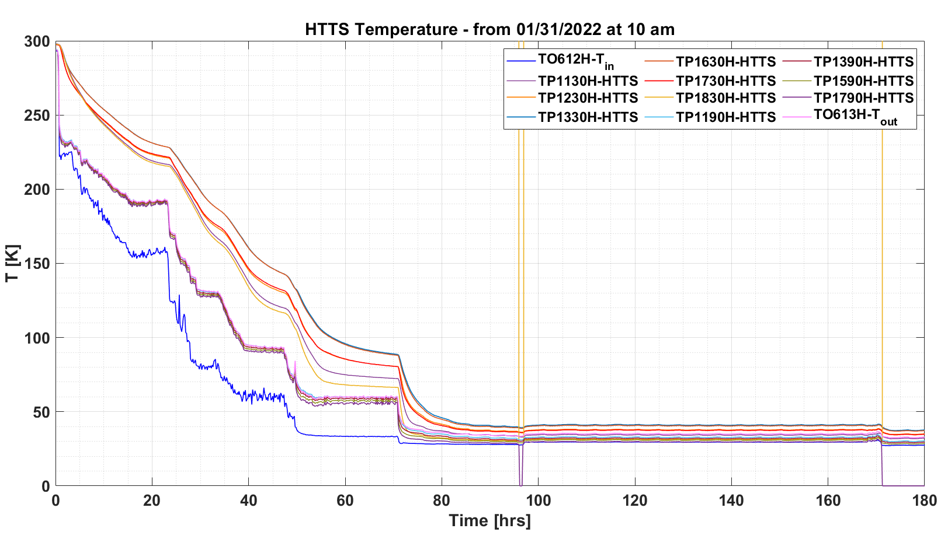
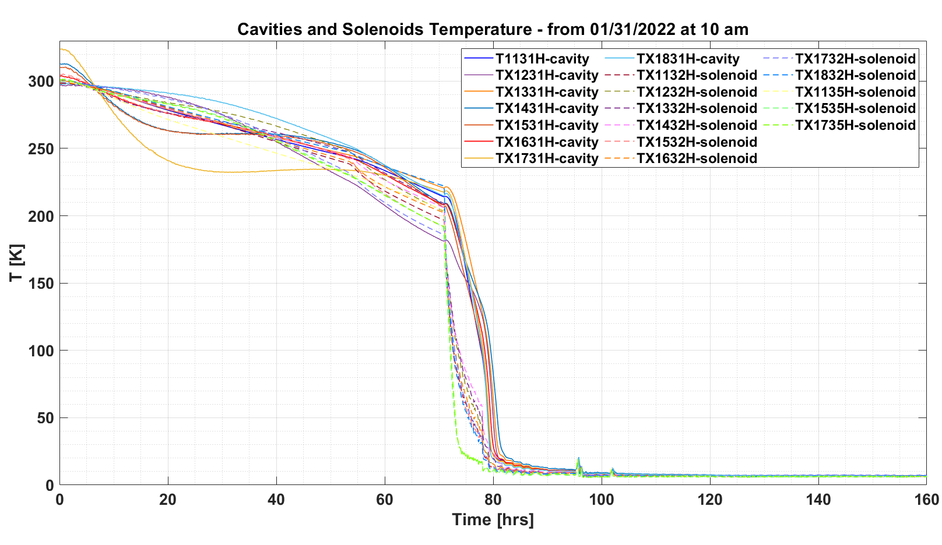
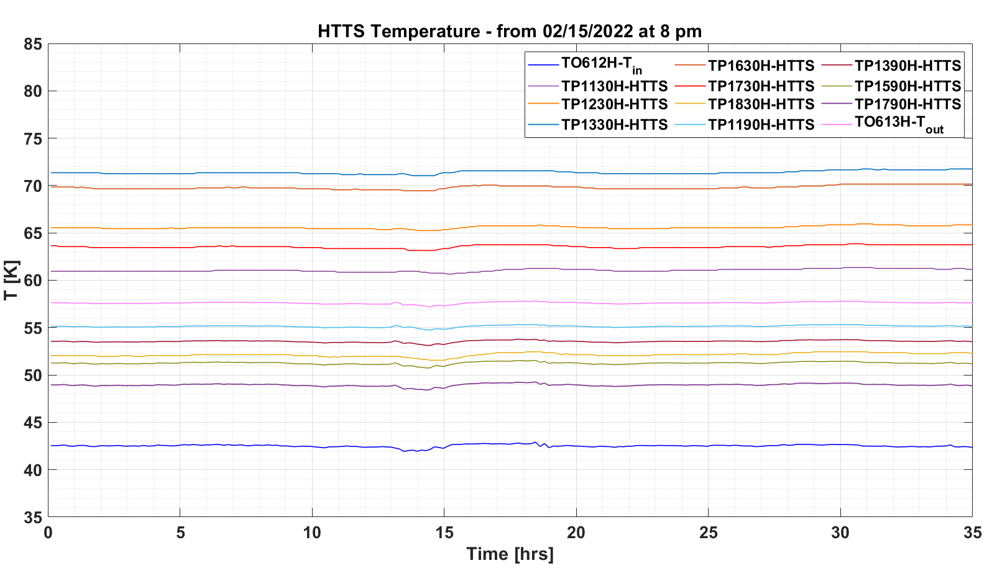
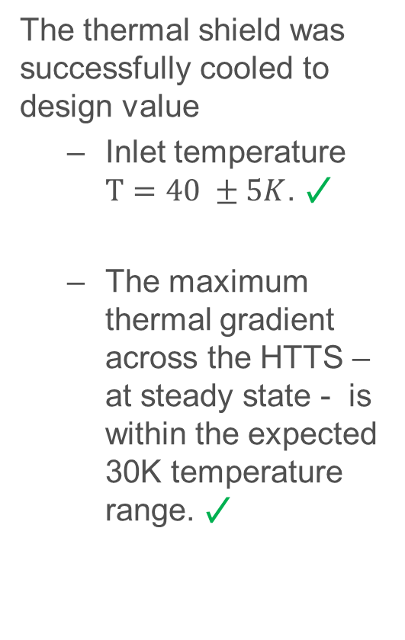
Cooldown performance
The thermal shield was successfully cooled to design value
  Inlet temperature $T=40 ±5K$. ✓
  The maximum thermal gradient across the HTTS – at steady state - is within the expected 30K temperature range. ✓
Cavities and solenoids were successfully cooled down to 2K. Stable 2K operation was maintained for several months. ✓

Slide 12
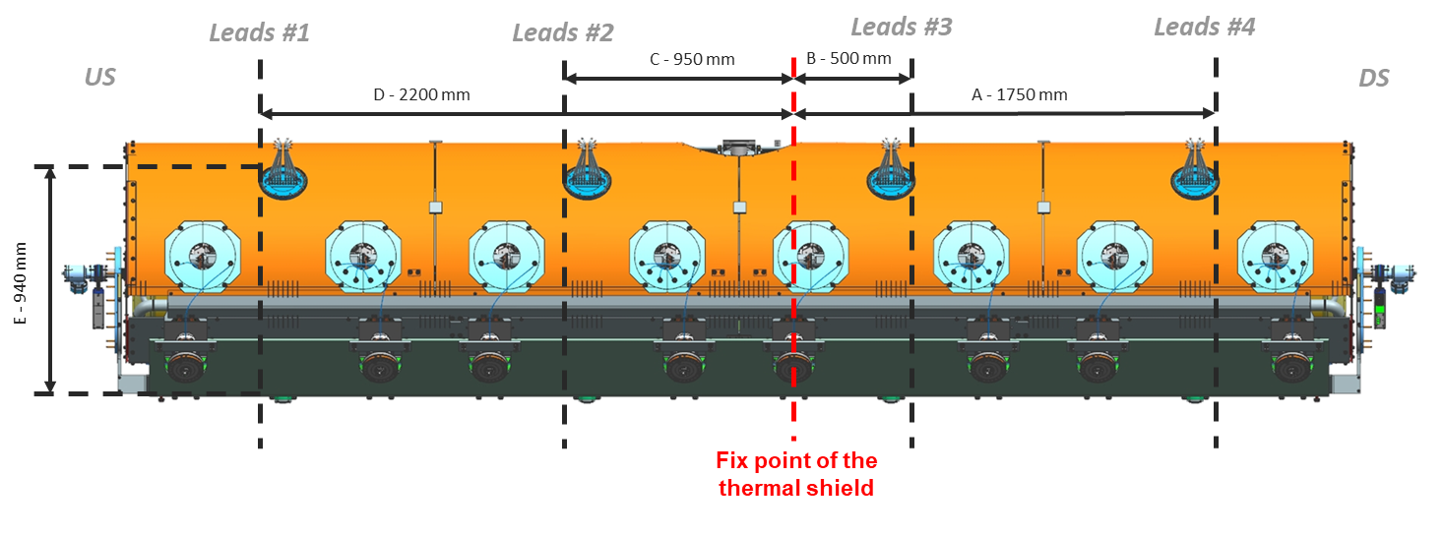
Cooldown: lesson learned
The successful cooldown was achieved at the second attempt after “correction of gaps” was made
Before
After
A final gap of about 15mm was left in the direction where the shrinkage calculated to be 7.3 – 9.1 mm
The check of the “gaps” between mobile and fixed components shall be carried out during the design and assembly phases
Before
After

Slide 13
SSR1 CM Static Heat Loads
Prototype SSR1 CM | Static Heat Loads
Proto SSR1 CM | 2K | LTTS | HTTS
Estimated values [W] | 25.4 | 44.2 | 150.3
Measured values [W] | 27.8 ±2.5 | 58.4 ±4.5 | 222.1 ±8.0
New design of the solenoid and current leads
Improved design of thermal shield/intercepts, configuration of MLI
Production SSR1 CM | Static Heat Loads
Proto SSR1 CM | 2K | LTTS | HTTS
Estimated values [W] | 13.2 | 20 | 270

Slide 14
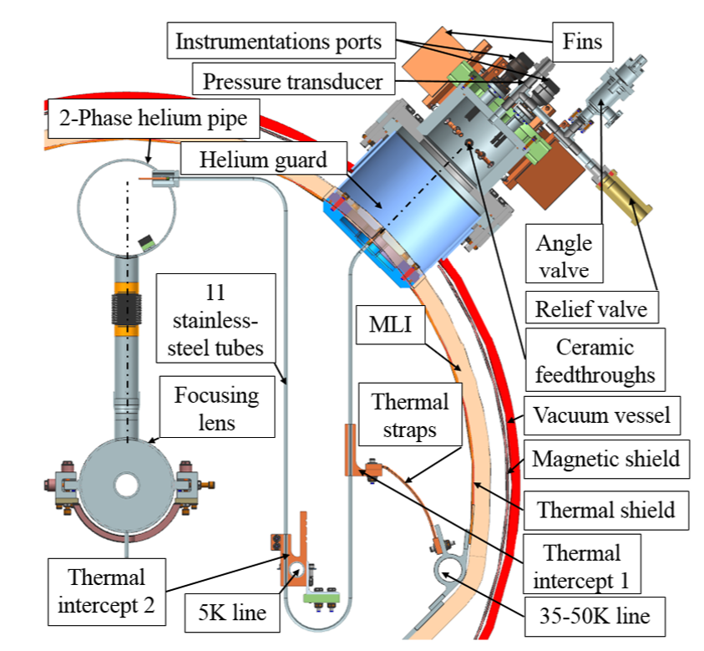
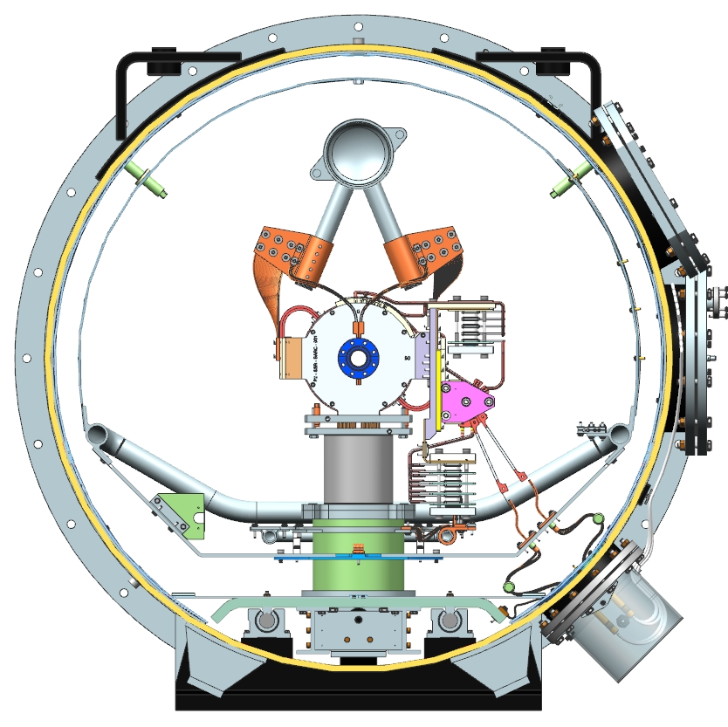
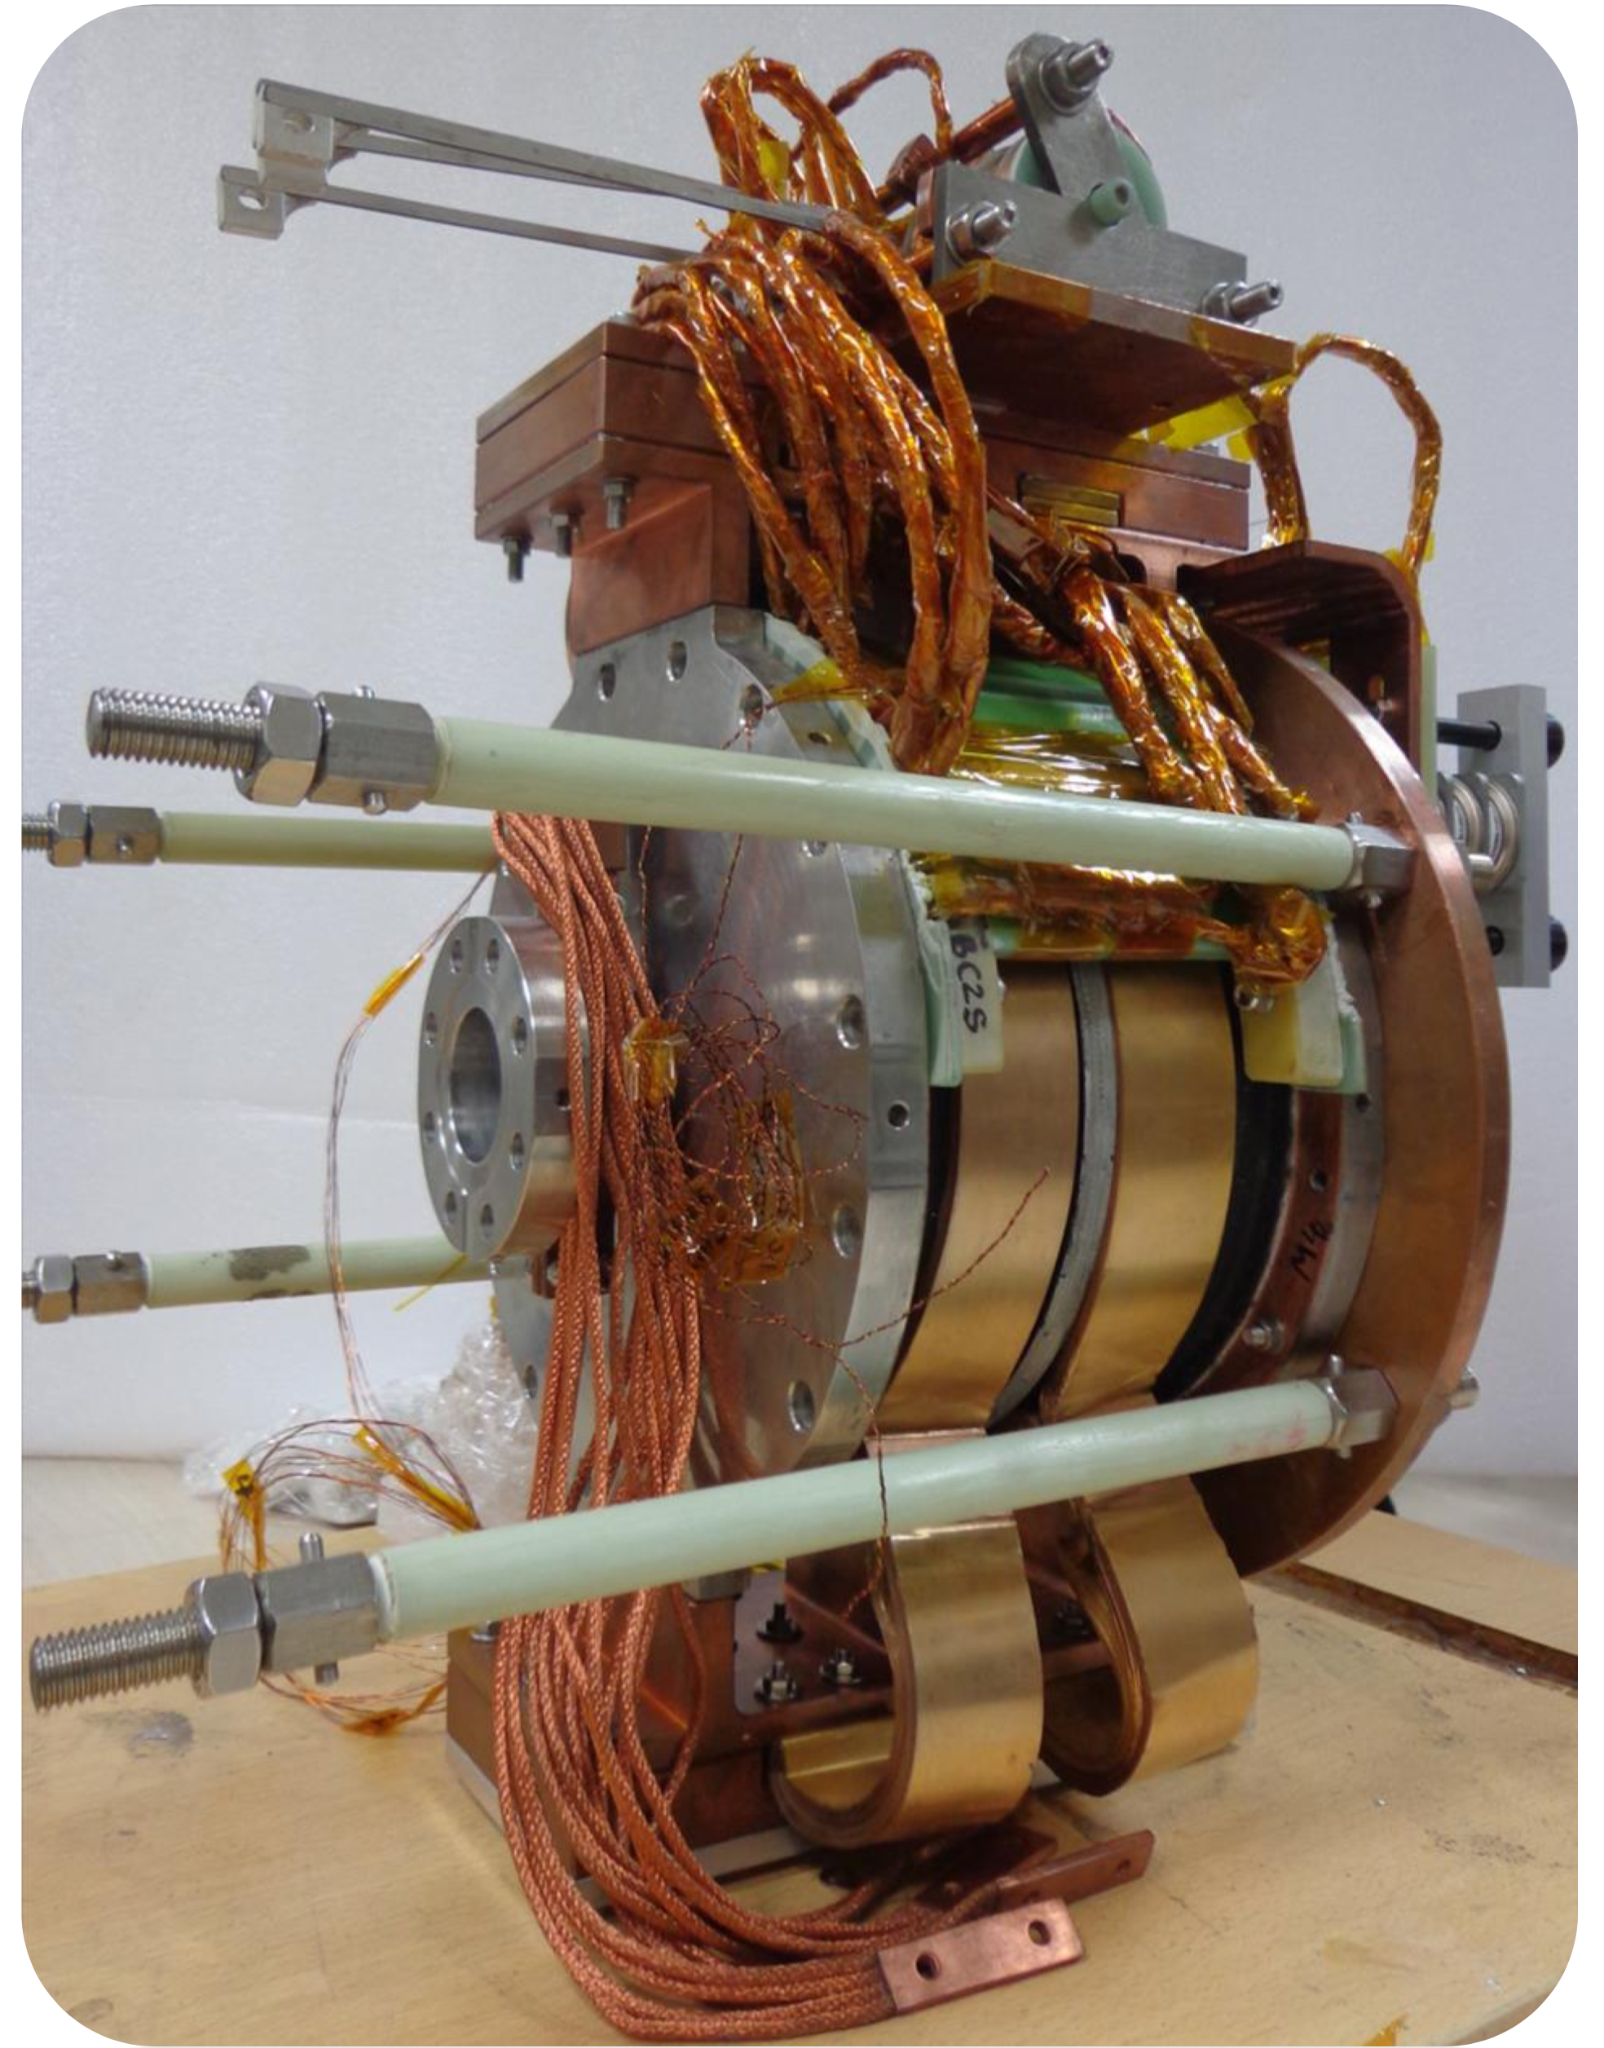
SSR1 CM Static Heat Loads Improvement
Conduction cooled type of solenoid was chosen for future SSR1 and SSR2 CMs based on the performance in terms of static heat loads (SHL) of the He-bath cooled units used for prototype SSR1 cryomodule.
  Estimated SHL at 2K of the SSR1 He-bath cooled solenoids and current leads: 14.2 W
  Estimated SHL at 2K of the new SSR conduction cooled solenoids and current leads: 1.3 W
  10x reduction of the Solenoids/Current lead SHL at 2K contributes to reduce about 2x the total CM SHL at 2K (25.4W → 13.2 W)
He-bath cooled SSR1 solenoid
Conduction cooled SSR solenoid

Slide 15
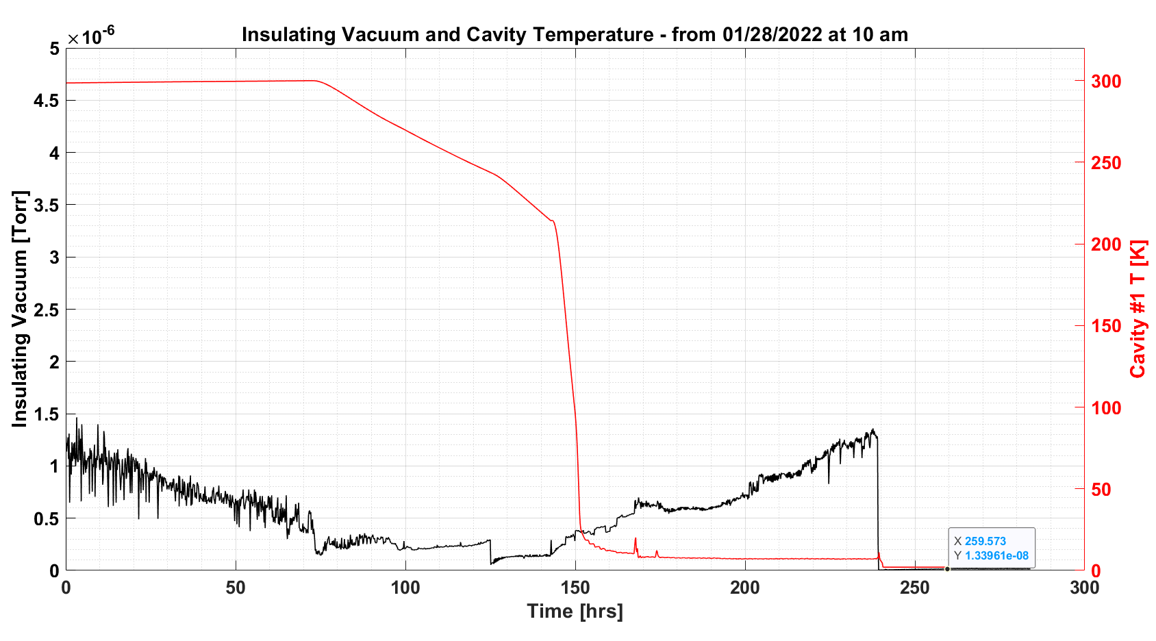
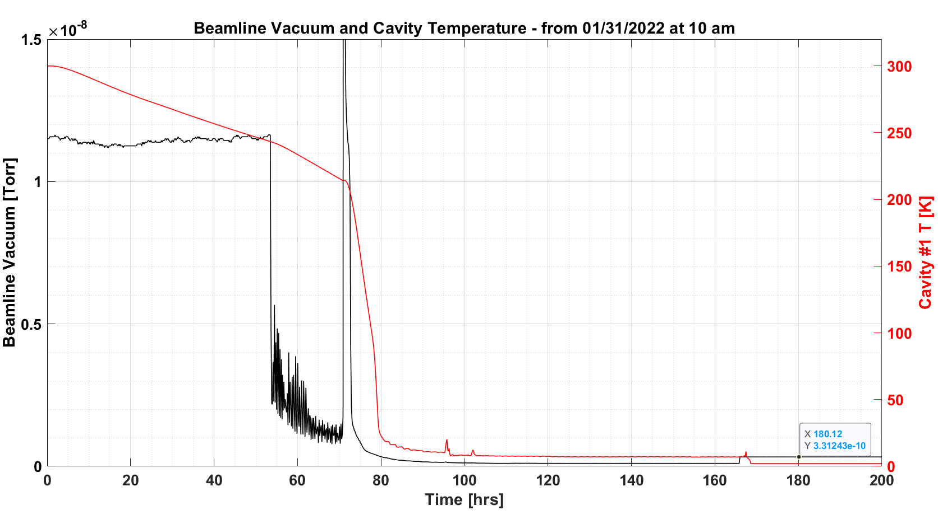
Vacuum: Insulating and Beamline
Parameter | TRS value | Measured value
Insulating vacuum at room temperature before the cooldown, mbar | ≤ 5·10⁻⁵ | 1·10⁻⁶
Insulating vacuum after the cooldown (cavities at 2K), mbar | ≤ 5·10⁻⁶ | 1.33·10⁻⁸
The insulating vacuum exceeded requirements in all operating conditions. ✓
Parameter | TRS value | Measured value
Beamline vacuum at room temperature before the cooldown, mbar | ≤ 5·10⁻⁷ | 1.18·10⁻⁸
Beamline vacuum after the cooldown (cavities at 2K), mbar | ≤ 1·10⁻⁹ | 3.3·10⁻¹⁰
The beamline vacuum exceeded requirements in all operating conditions. ✓

Slide 16
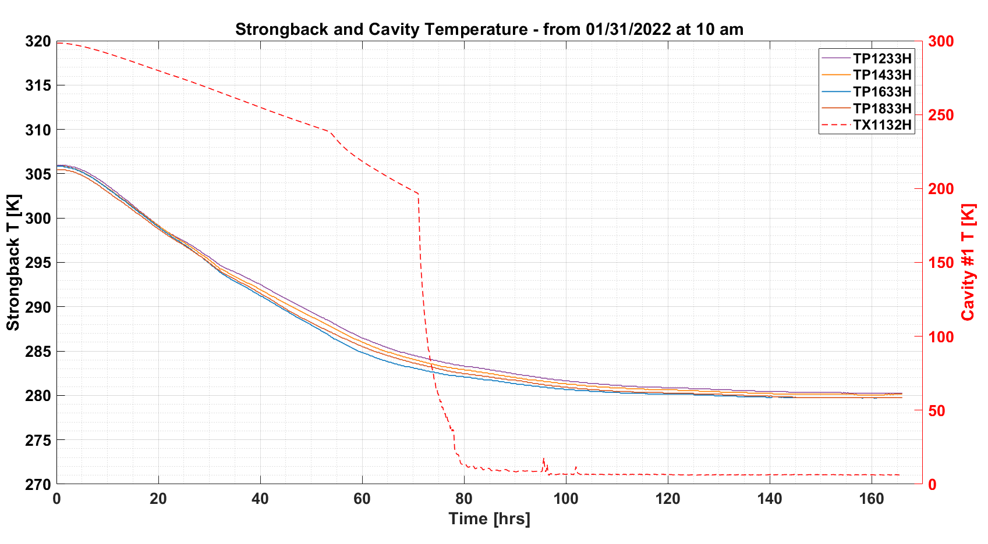
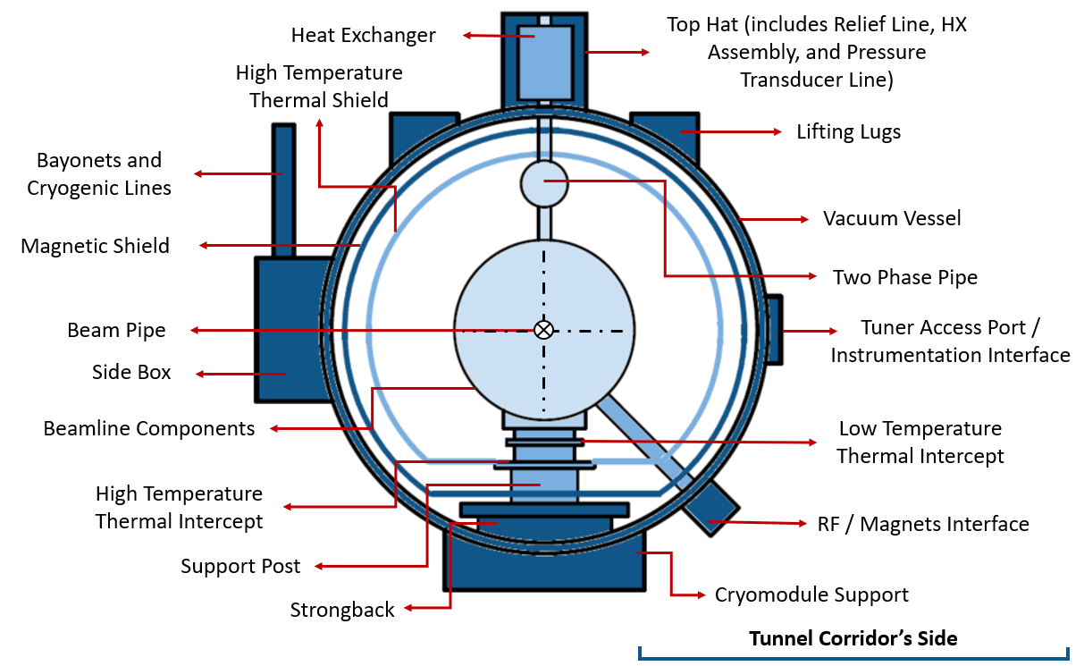
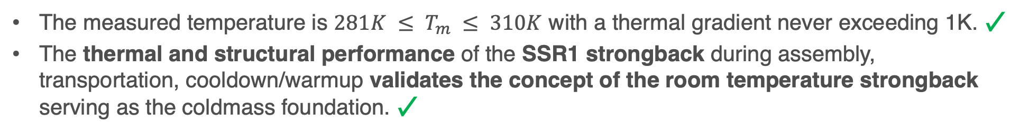
Strongback – the coldmass foundation
The measured temperature is $281K ≤ T_{m} ≤ 310K$ with a thermal gradient never exceeding 1K. ✓
The thermal and structural performance of the SSR1 strongback during assembly, transportation, cooldown/warmup validates the concept of the room temperature strongback serving as the coldmass foundation. ✓

Slide 17
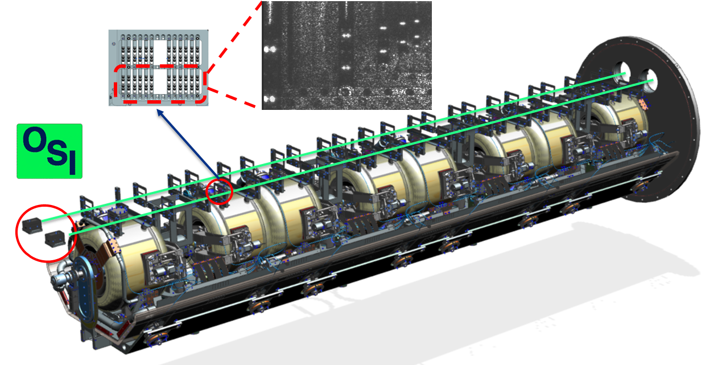
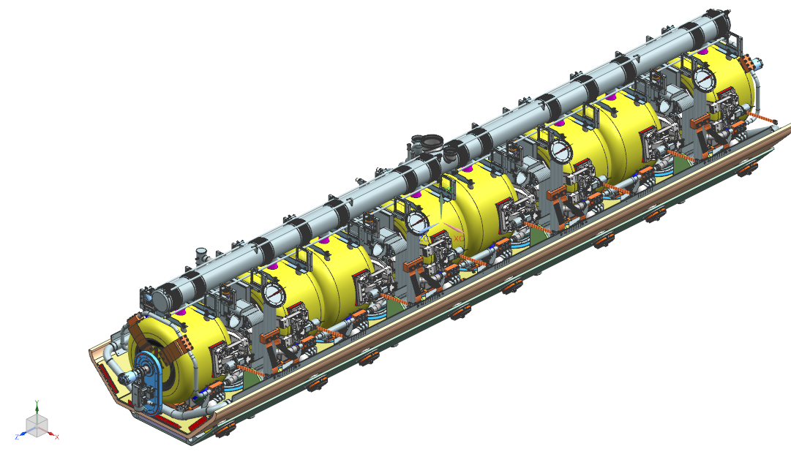
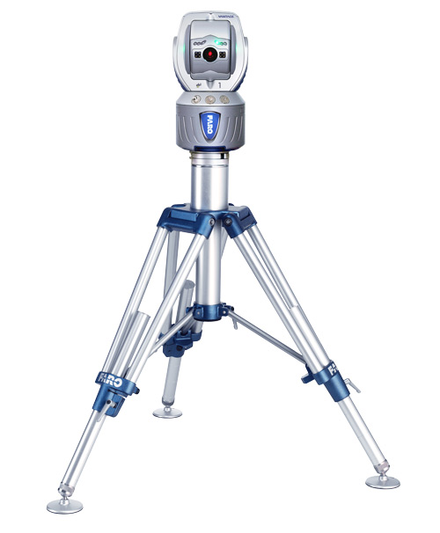
Alignment and monitoring
Alignment: laser trackers
Cavities and solenoids are aligned on strongback/support posts during the assembly process using laser trackers.
Monitoring: HBCAMs
An innovative computer vision system composed of four HBCAMs were used to monitor the positioning of cavities and solenoids after the final alignment during final assembly phases, transportation, cooldowns and warmups.
4 fiducials at each end (8 total)

Slide 18
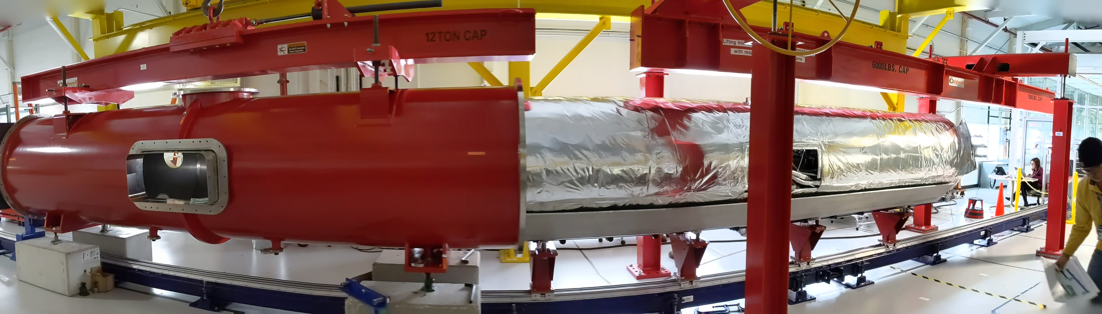
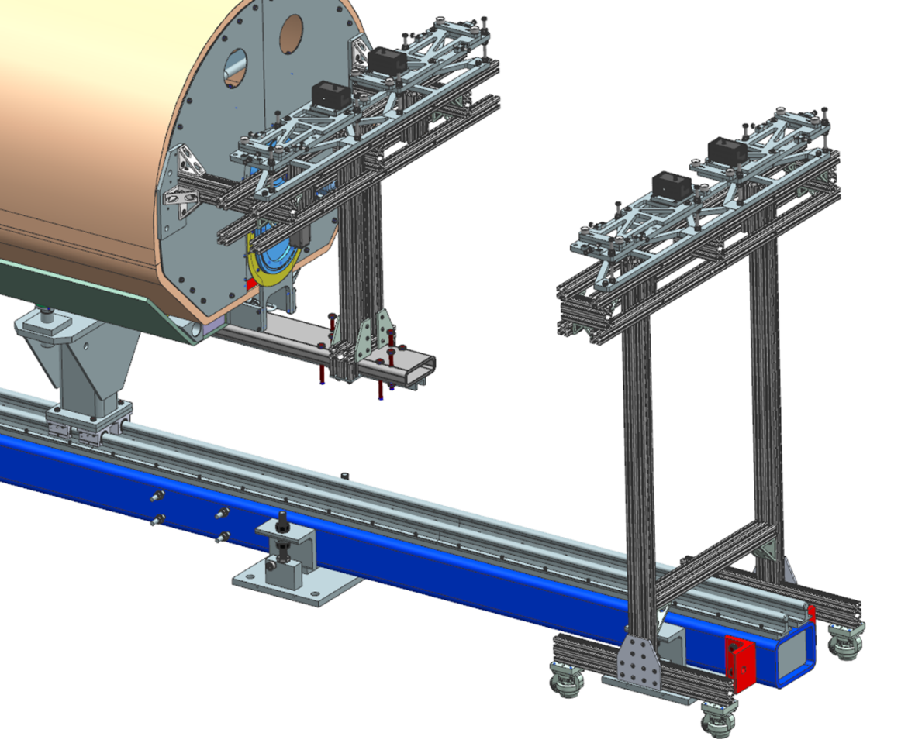
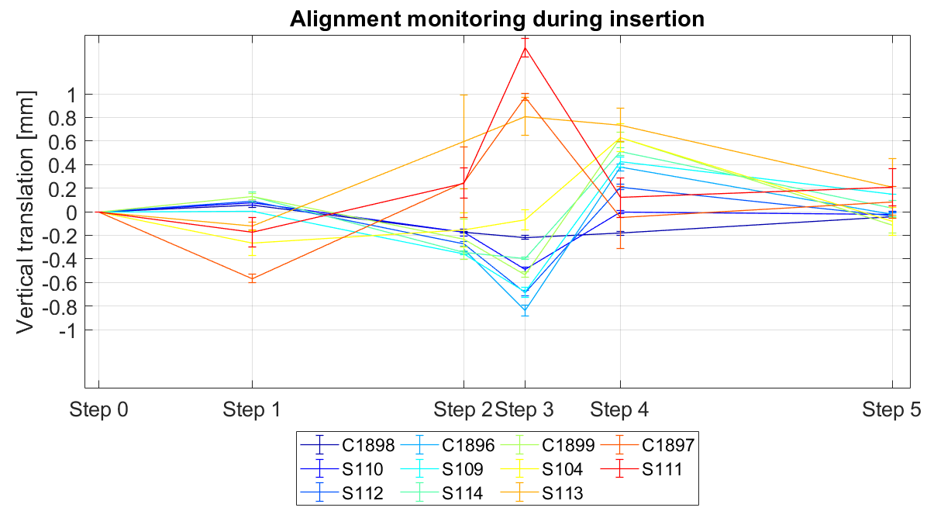
Alignment monitoring during final assembly
Monitoring the position of cavities and solenoids with HBCAM during the insertion of the coldmass into the vacuum vessel helped to validate that the alignment was retained ✓

Slide 19
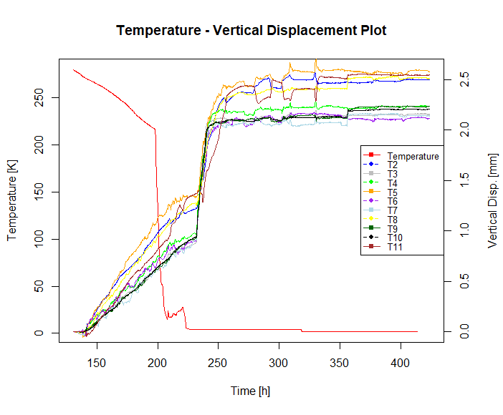
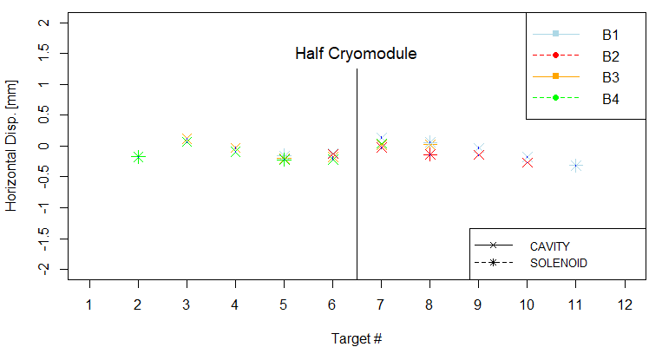
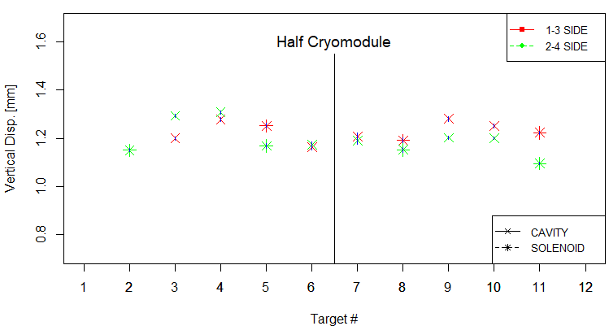
Alignment monitoring during cooldown
Total Displacement during cooldown RT -> 2K
Horizontal:
+- 0.3 mm
Vertical:
1.2 +- 0.1 mm
Note that during assembly cryostring was pre-aligned vertically at -1.2 mm
The measured displacements due to cooldown shrinkage of cavities and solenoids meet the calculated value (vertical 1.2mm) by finite element analysis ✓

Slide 20
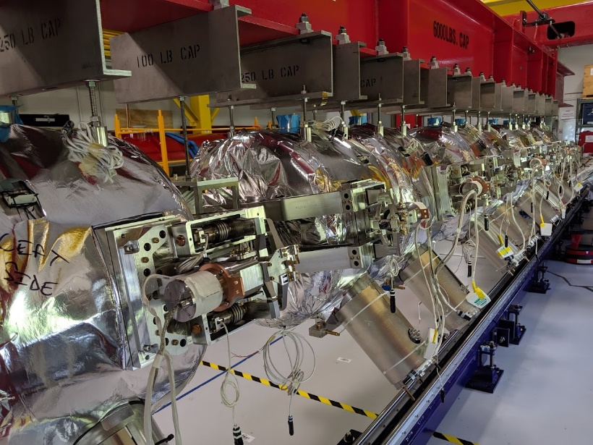
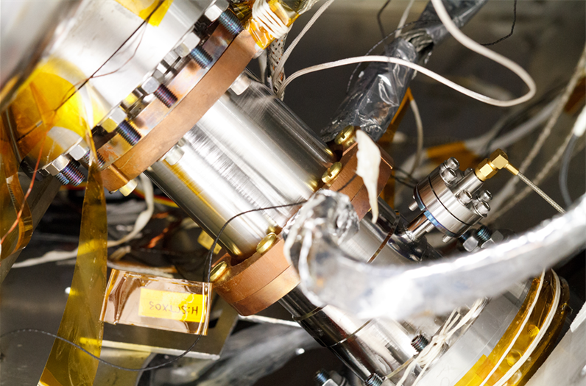
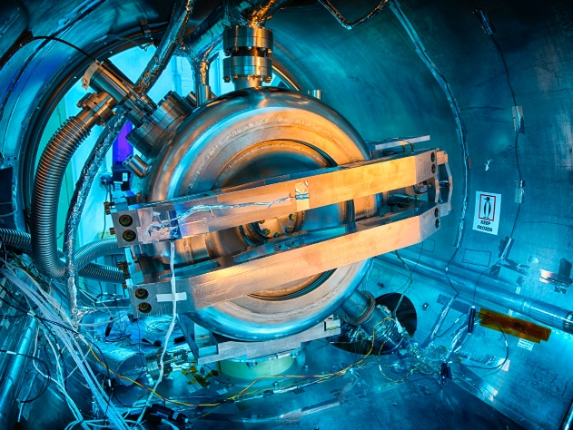
RF frequency of Cavities, Couplers and Tuners Performance
Resonance frequency and Q_{L} measurements of cavities at RT, 4K, 2K.
  Results are within the expected ranges. ✓
All eight tuners fully met acceptance criteria, confirming also measurements previously done in the Spoke Test Cryostat. ✓
  All cavities were successfully tuned to 325.000 MHz at 2K.
  Microphonics are better than 10 Hz (LLRF group)
All eight couplers reliably worked to process multipacting barriers, and to increase cavities fields and accelerate beam (Maximum power: 5kW) ✓
  Couplers successfully conditioned off resonance at pulsed 2-16% DF, then CW
Couplers thermal performances were monitored during cooldown. ✓
  The temperature of single ceramic window was maintained into the range
  283𝐾 ≤ 𝑇 ≤ 310𝐾 using heaters with an average power of 8W/coupler
  HTTS and LLTS intercepts were used to minimize HL to 2K

Slide 21
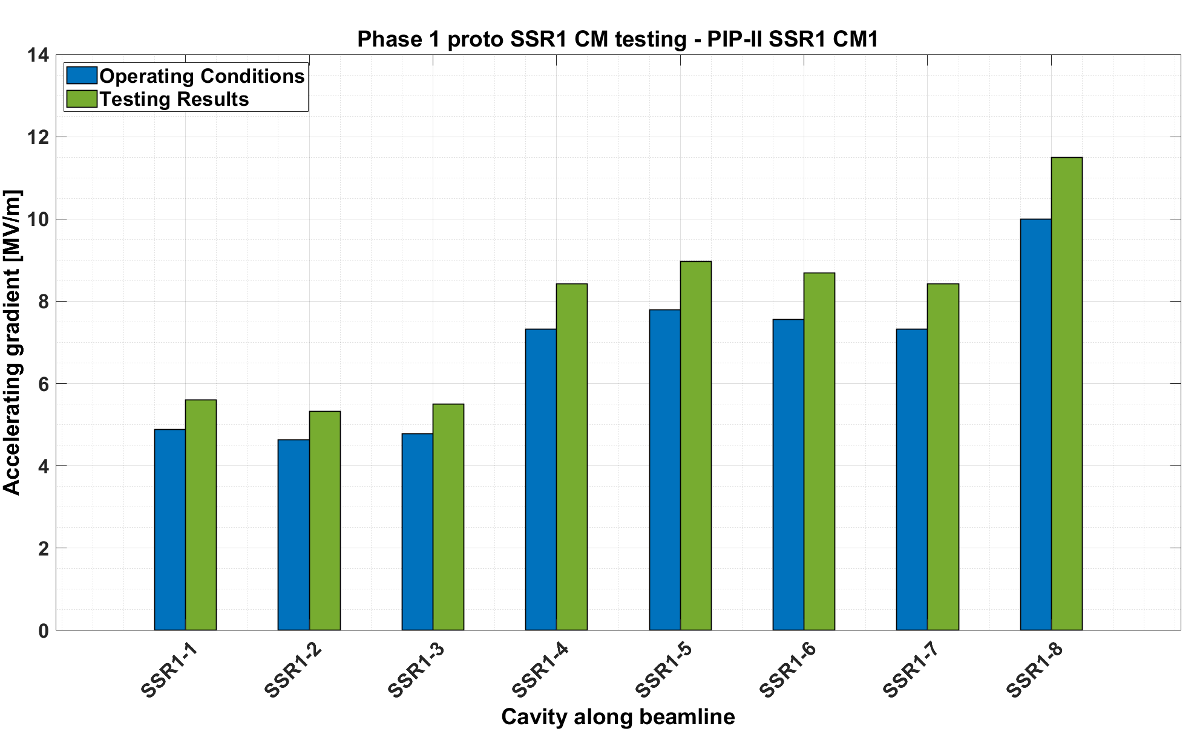
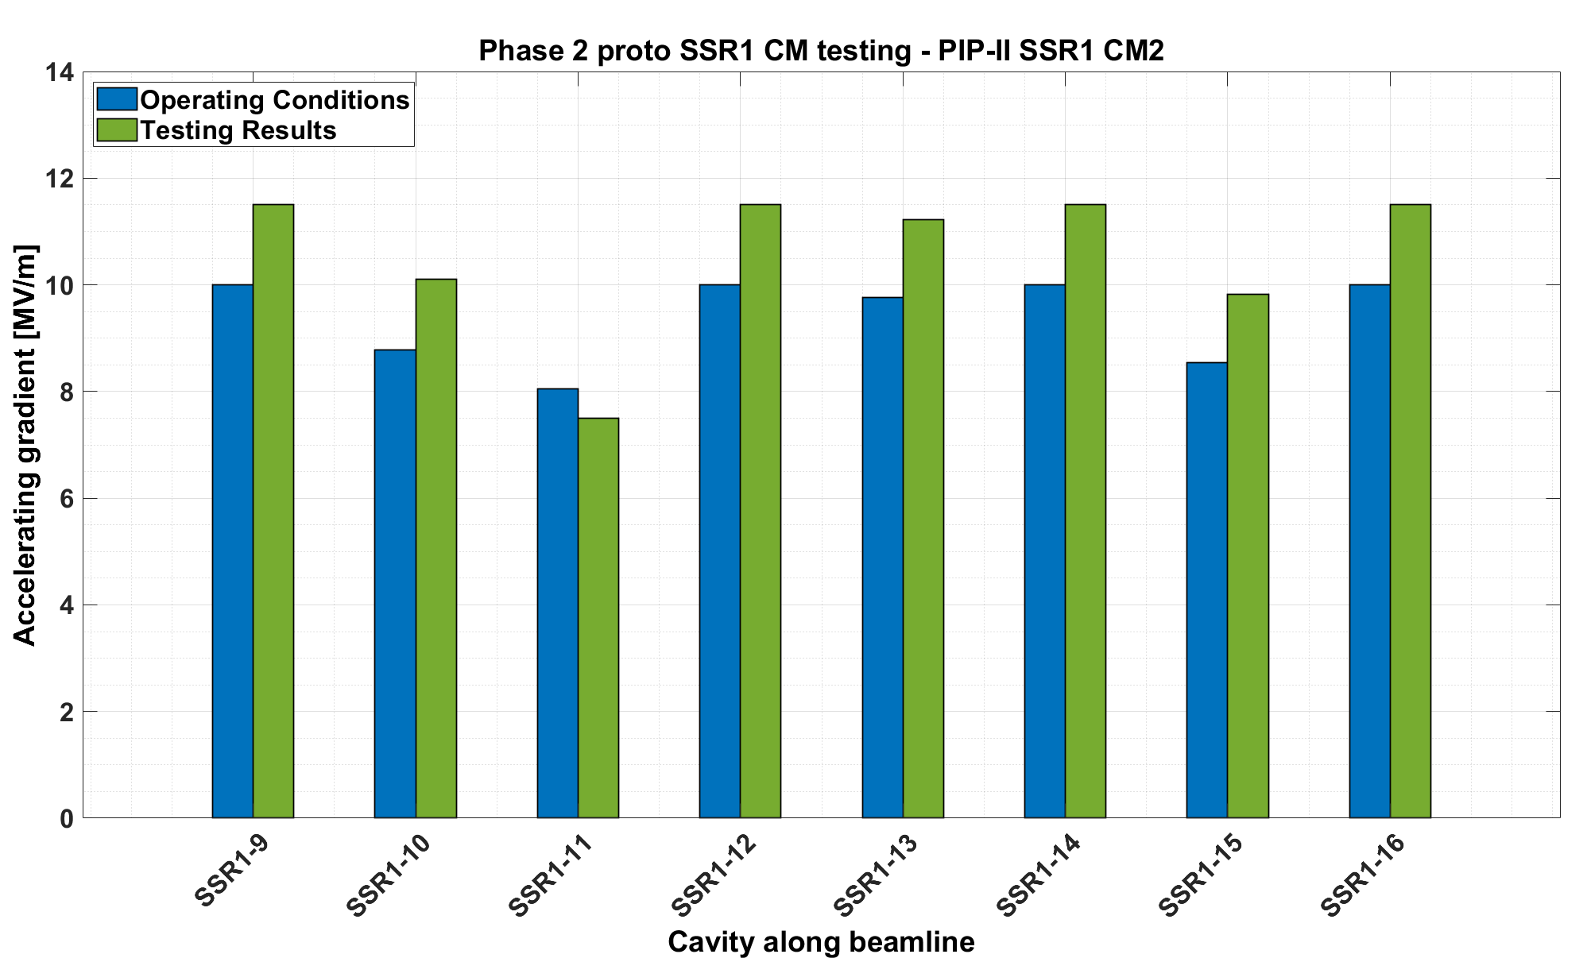
SSR1 cavities performance
Phase 1: All cavities successfully reached the gradient set as acceptance criteria (= 1.15 · operating E_{acc}) and no FE detected (<3 mR/h).
3 MP barriers 4-7.5 MV/m. Avg. time to condition: 16 hours
Phase 2: 7 out of 8 cavities successfully reached the gradient set as acceptance criteria.
Cavities 3 & 4 have FE (>250 mR/h) at operating gradients.
Cavity 3 has soft quench above 8 MV/m at rate 1/15 minutes due to high FE. Operable at 7.5 MV/m.
Dynamic Heat Load: 12.8 W (Req. DHL_{SSR1 CM1} <8.2W)
Q₀ = 5.33 ±0.50·10⁹ (Req. Q₀ > 8.2 ·10⁹)
Dynamic Heat Loads: 35.5 W (Req. DHL_{SSR1 CM2} <14.7 W)
Q₀ = 3.43 ±0.69·10⁹ (Req. Q₀ > 8.2 ·10⁹)

Slide 22
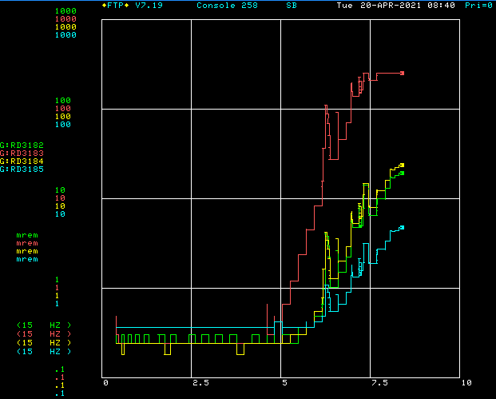
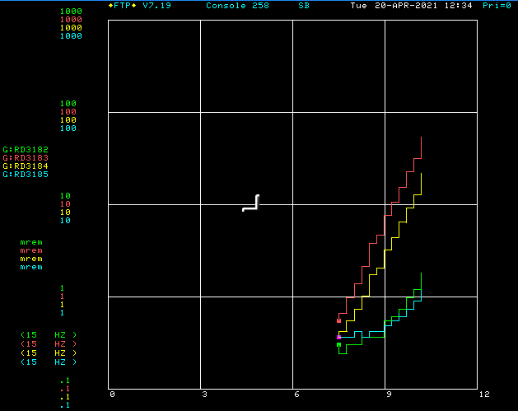
SSR1 cavities performance: field emission
FE increases/changes after thermal cycle (between Phase 1 and Phase 2 testing)
  As already described earlier for the HWR, during a cryoplant shutdown/thermal cycle, cavities reached ~90K and there was insufficient active pumping on the beamline to deal with the desorbed gas load.
  Concern about FE in cavities due to potential particulate transfer, and not to cleanroom assembly procedures.
Cavity 3 was FE free up to 5.50MV/m during Phase 1 testing (before warmup)
Cavity 4 was FE free up to 8.42MV/m during Phase 1 testing
Cavity 3
Cavity 4
FE onset 5 MV/m
FE onset 7.5 MV/m

Slide 23
SSR1 cavities performance
Operating Cavities | Measured Q₀ | Requirement | Comments
All eight cavities at Phase 1 operating accelerating fields | 5.33 ±0.50 · 10⁹ | > 8.2·10⁹ | With all cavities successfully (no field emission, no Multipacting) running at Phase 1 operating accelerating fields the measured Q₀ is 54% below requirement.
All eight cavities at Phase 2 operating accelerating field, except for cavity 3 at 0.5 MV/m below | 3.43 ±0.69 · 10⁹ | > 8.2·10⁹ | With 7 out of 8 cavities running at Phase 2 operating accelerating fields, and cavity #3, the measured Q₀ is 1.4x below requirement.
Cavities 2,5,6,7,8 at Phase 2 operating accelerating field | 7.41 ±0.70 · 10⁹ | > 8.2·10⁹ | Excluding cavities #1, 3, 4 at Phase 2, the measured Q0 is (only) 10% below the requirement.
Cavity 1 at Phase 2 operating accelerating field | 3.70 ±0.75 · 10⁹ | > 8.2·10⁹ | Cavity 1 had Q₀= 8.1·10⁹ at STC at the same Phase 2 E_{acc} (10MV/m).
Cavity 4 at Phase 2 operating accelerating field | 2.23 ±0.46 · 10⁹ | > 8.2·10⁹ | Cavity 4 had Q₀= 6.4·10⁹ at STC at the same Phase 2 E_{acc} (10MV/m). 3x Q₀ drop.
The high residual magnetic fields surrounding cavities 1 & 4 (>150mG), causing significant increase in cavity residual resistance, and FE (>250 mR/h) are the main sources of Q₀ degradation and below expectations.
FE in cavities is due to potential particulate transfer during partial warmup of the CMs.
High residual magnetic field is due to components surrounding the cavities made of ferromagnetic material that are prone (high magnetic permeability) to magnetize when solenoids are powered up.

Slide 24
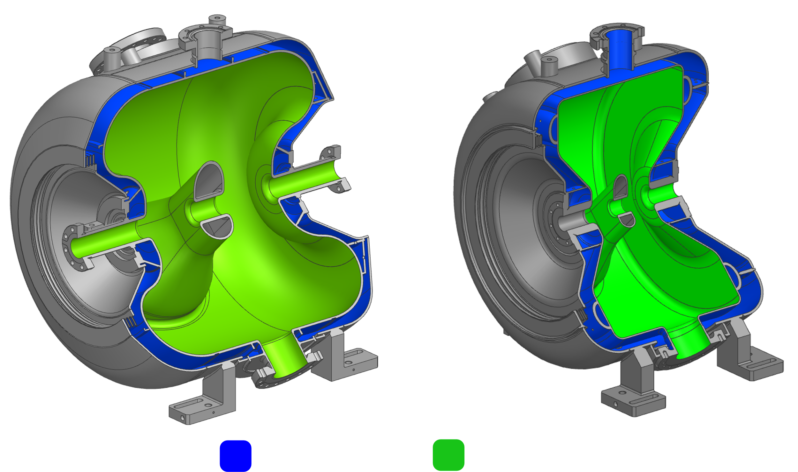
Q₀ degradation: residual magnetic field
More stringent requirements to limit remnant magnetic field at the SRF cavity surface to avoid Q₀ degradation are specified, and multiple actions are currently being taken:
  Design phase:
    Use non-ferromagnetic material whenever possible in the CM
    Helium vessel of all future PIP-II SSRs cavities will be made of Titanium
    Local shielding of cavities and/or solenoids are currently being explored.
  Quality Controls
    Check magnetic permeability and residual magnetic field of all parts and welded joints made of ferromagnetic material (i.e. SS316L) within the volume of the global magnetic shield.
      Annealing process (to lower magnetic permeability) and magnetic hygiene (to lower residual magnetic field) will be applied as needed.
  Testing
    Demagnetization procedures of solenoids shall be developed.
    Cold testing of one SSR2 cavity with a conduction cooled solenoid is being planned to validate performance before their final integration into string assembly.
Helium vessel is made of titanium
SSR1 Cavity
SSR2 Cavity

Slide 25
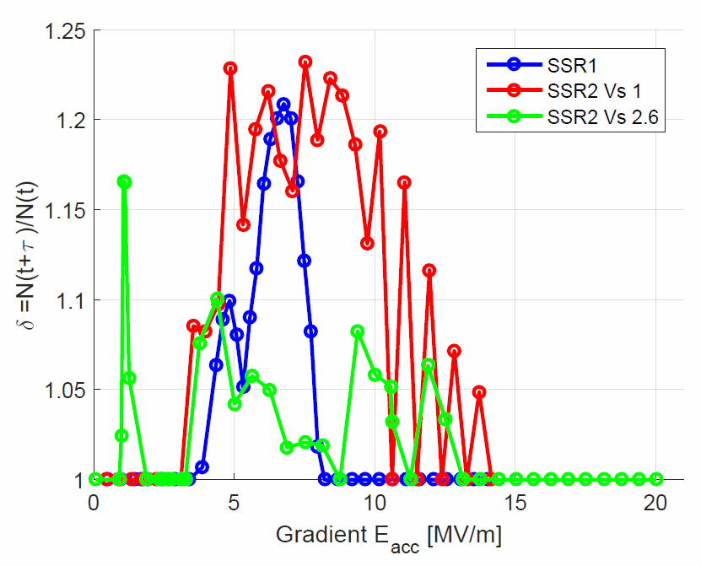
Multipacting mitigation
SSR1 cavities were kept under vacuum and N purged during the string assembly, but still the MP barriers that were previously processed during the cold testing of each individual cavity had to be processed again during cryomodule testing with an avg. of 16 hrs/cavity.
  SSR2 cavities were (re)designed to include features of Balloon Spoke Cavities to reduce MP
    Comparison with SSR1 cavity demonstrates that multipacting in the modified SSR2 cavity version 2.6 can be processed way easier than in SSR1 cavity (cold testing of the first SSR2 cavity is currently ongoing)
SSR2 Cavity v 2.6
  The RF volume of production SSR1 cavities for PIP-II won’t be changed and techniques such as plasma processing will be studied.
SSR1 Cavity

Slide 26
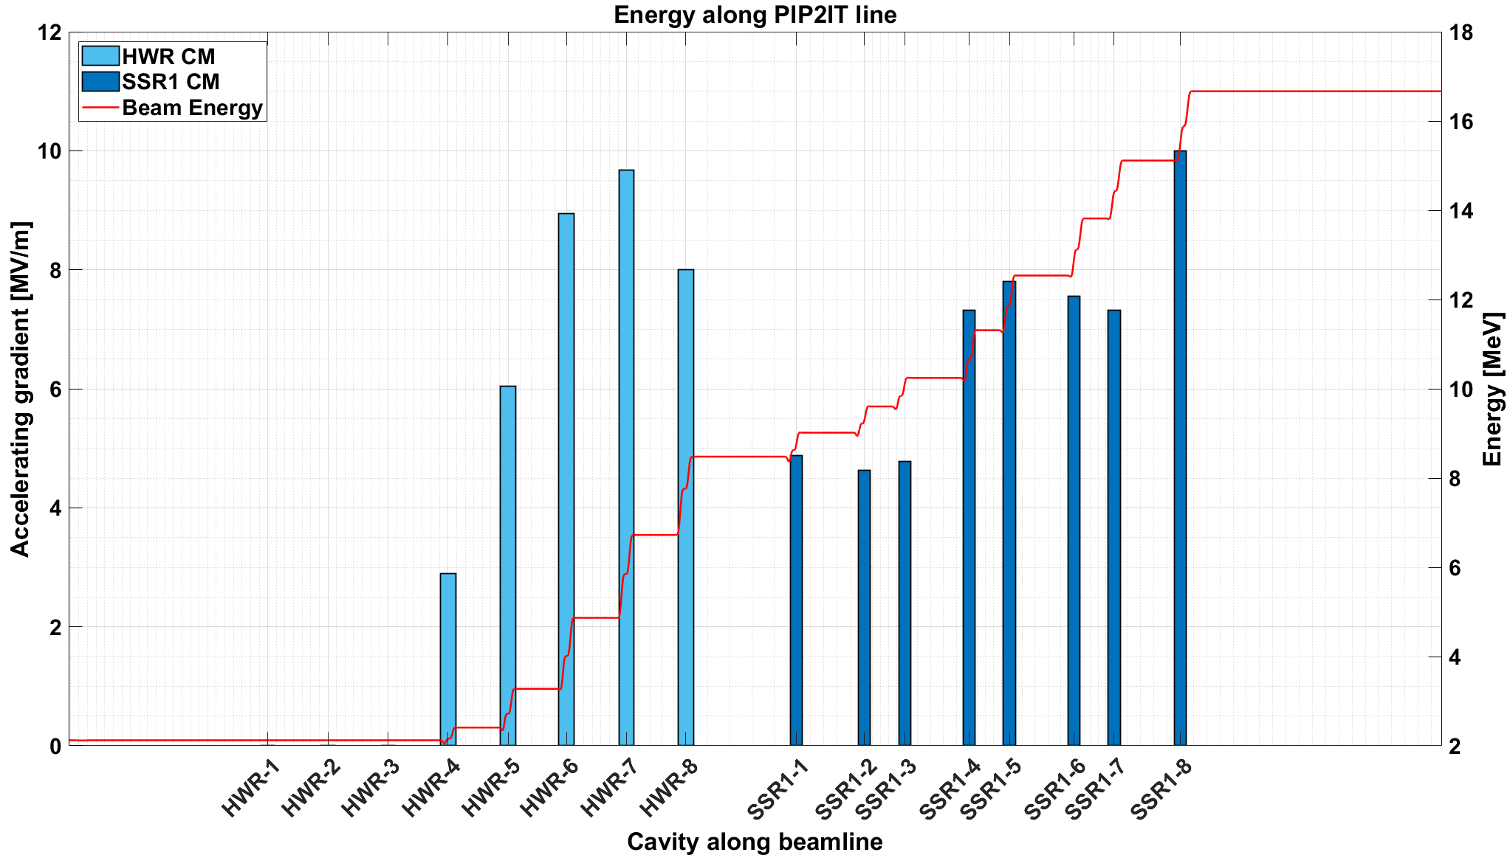
HWR and SSR1 Commissioned with Beam
Beam accelerated to 17.1 MeV ✓
HWR and SSR1 Prototype cryomodules performance validated with beam ✓
HWR cavities 1,2&3 not used for acceleration, otherwise final beam energy would have been 22 MeV
17.1
HWR Cryomodule
SSR1 Cryomodule

Slide 27
Summary of SSR1 CM test results
SSR1 Cryomodule
  Successfully cooled down to 2K, tested, and operated in PIP2IT with beam.
  Cavities, couplers, tuners passed all the checkouts and met RF requirements at 2K. Improvements and lessons learned were implemented in the design of production units.
  The proto SSR1 CM qualifies to be operable as SSR1-CM1 in the PIP-II linac with a measured total 2K heat loads of 40.4W.
  The proto SSR1 CM qualifies to be operable as SSR1-CM2 for PIP-II linac with a measured total 2K heat loads of 63.3W and cavity #3 running slightly (0.5 MV/m) below the required operating gradient.
The qualification of several structural components (i.e. strongback) of the prototype SSR1 CM validated the CM layout - “The Fermilab style cryomodule” - that was the choice for all future SRF CMs for PIP-II project at Fermilab.

Slide 28
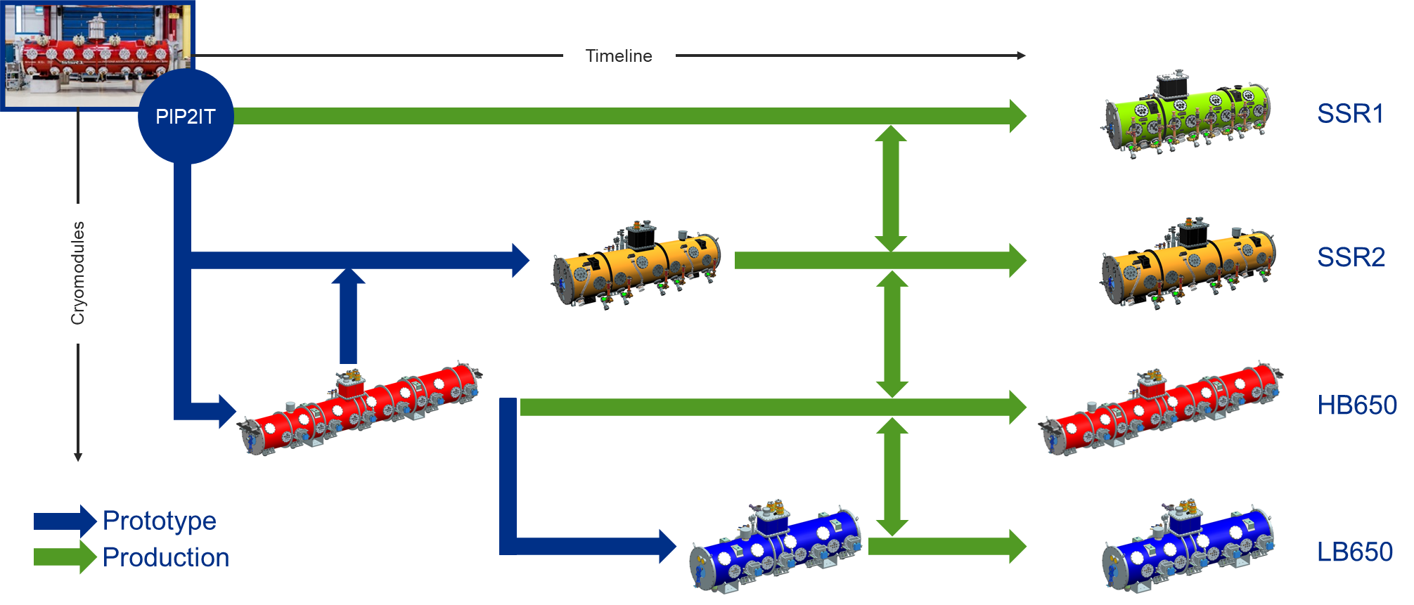
Prototype SSR1 Cryomodule: key-element of the technology path
The results and lessons learned during the assembly and testing of the proto SSR1 cryomodule allowed to overall validate the “design CM layout” used for all future PIP-II cryomodules. ✓

Slide 29
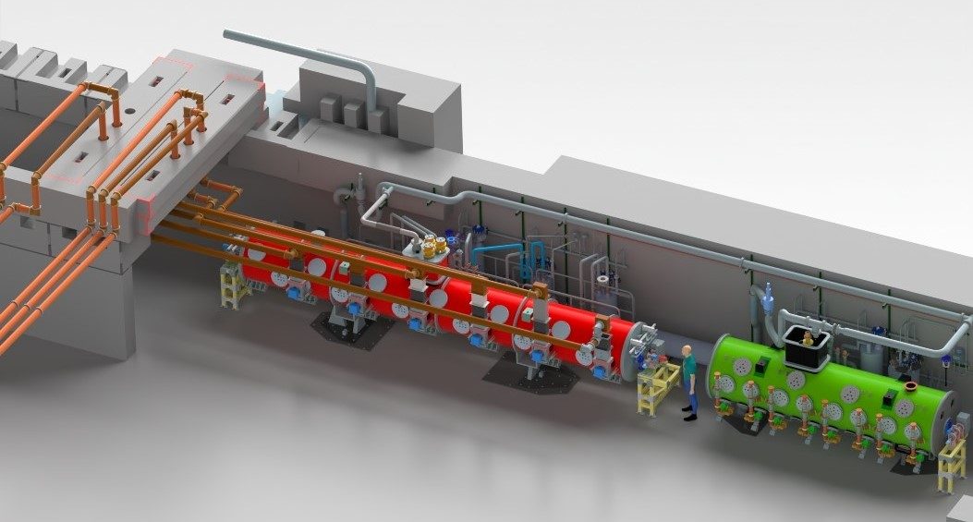
Thanks for your attention!
Next:
PIP2IT is being converted to
PIP-II Cryomodule Test Stand
650 MHz CM Test Stand
SSR CM Test Stand

Slide 30
PIP-II SRF CMs - Static Heat Loads
Static Heat Loads | Prototype SSR1 CM |  | Production SSR1 CM |  | Pre-prod SSR2 CM |  | Production SSR2 CM
Proto SSR1 CM | Design values [W] | Measured values [W] | Design values [W] | Measured values [W] | Design values [W] | Measured values [W] | Design values [W] | Measured values [W]
2K | 25.4 | 27.8 ±2.5 | 14.0 |  | 10.6 |  | 10.6
LTTS | 44.2 | 58.4 ±4.5 | 19.7 |  | 12.8 |  | 12.8
HTTS | 150.3 | 222.1 ±8.0 | 273.2 |  | 213.3 |  | 213.3
Static Heat Loads | Prototype LB650 CM |  | Production LB650 CM |  | Prototype HB650 CM |  | Production HB650 CM
Proto SSR1 CM | Design values [W] | Measured values [W] | Design values [W] | Measured values [W] | Design values [W] | Measured values [W] | Design values [W] | Measured values [W]
2K | 6.8 |  | 6.8 |  | 9.4 |  | 9.4
LTTS | 9.8 |  | 9.8 |  | 13.8 |  | 13.8
HTTS | 70.9 |  | 70.9 |  | 106.8 |  | 106.8
LTTS: Low Temperature Thermal Source (10-15K)
HTTS: High Temperature Thermal Source (40-60K)

