Slide 1
Nonlinear Integrable Optics in IOTA Run-4
A.Valishev, J.Jarvis, A.Romanov, G.Stancari, N.Kuklev, S.Nagaitsev, S.Szustkowski, J.Wieland
IOTA/FAST Meeting
24 February 2023

Slide 2
Overall goal – experimental demonstration of NIO lattice in a practical accelerator
Phase I – research concentrates on the academic aspect of single-particle motion stability using electron beams
Demonstrate large amplitude-dependent detuning with conservation of dynamic aperture
Demonstrate practical machine tuning and limits of integrable optics stability in terms of imperfections, other nonlinearities, impact of longitudinal dynamics
Phase II – intense-beam studies with protons
Interplay between NIO and space-charge
Effect of NIO on halo formation, emittance growth and losses

Slide 3
IOTA NIO Variants
System with one invariant, aka Quasi-Integrable or Henon-Heiles Type
Implemented with Octupole string in BL straight
System with two invariants, aka Danilov-Nagaitsev or Elliptic potential
Implemented with special magnet (RadiaBeam) in BR straight
The experiments with both systems rely on common machine configurations, methods of measurement and data acquisition and can be executed concurrently - combined in a single proposal.

Slide 4
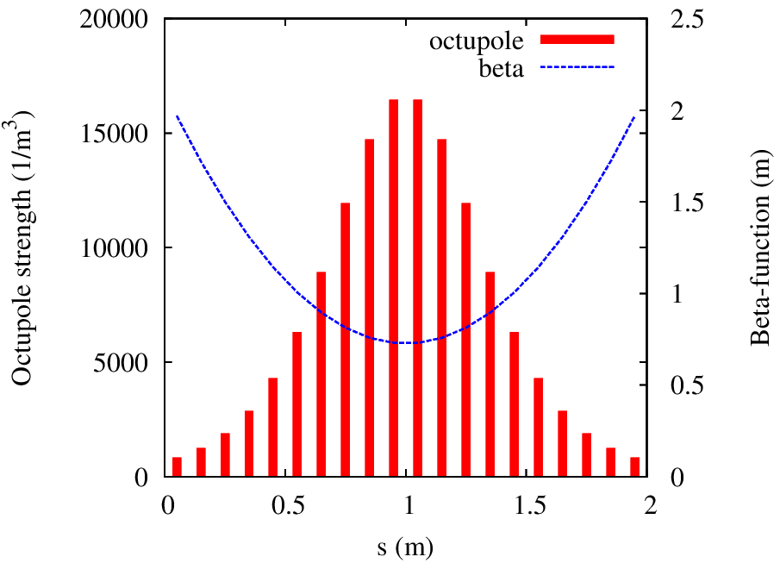
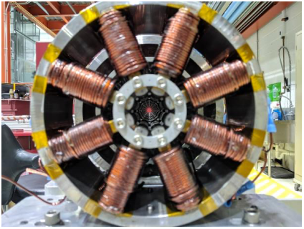
Henon-Heiles Type System with Octupoles
For example, build V with Octupoles
Only one integral of motion – H
Tune spread limited to ~12% of Q₀

Slide 5
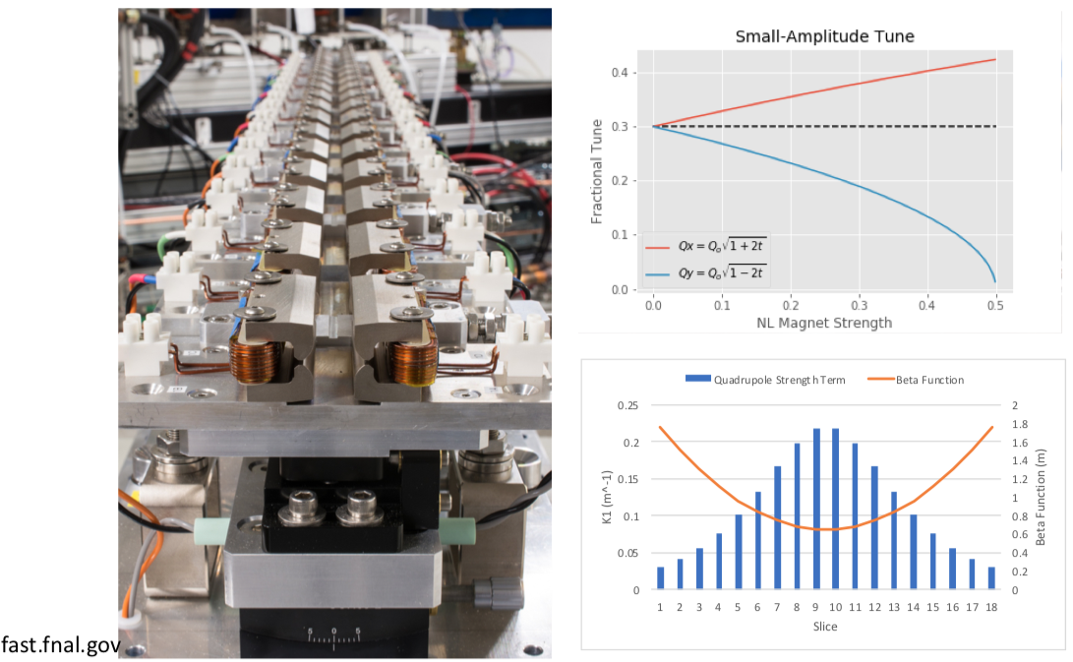
NIO with 2 Invariants of Motion – Special Magnet

Slide 6
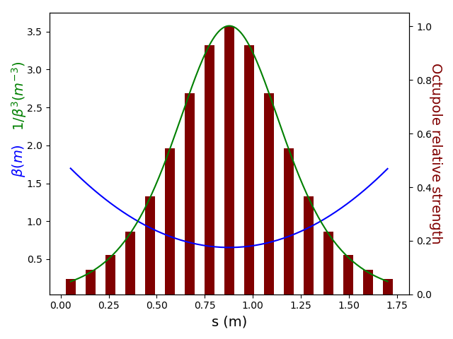
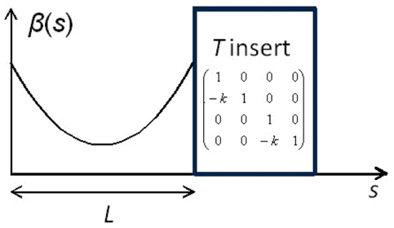
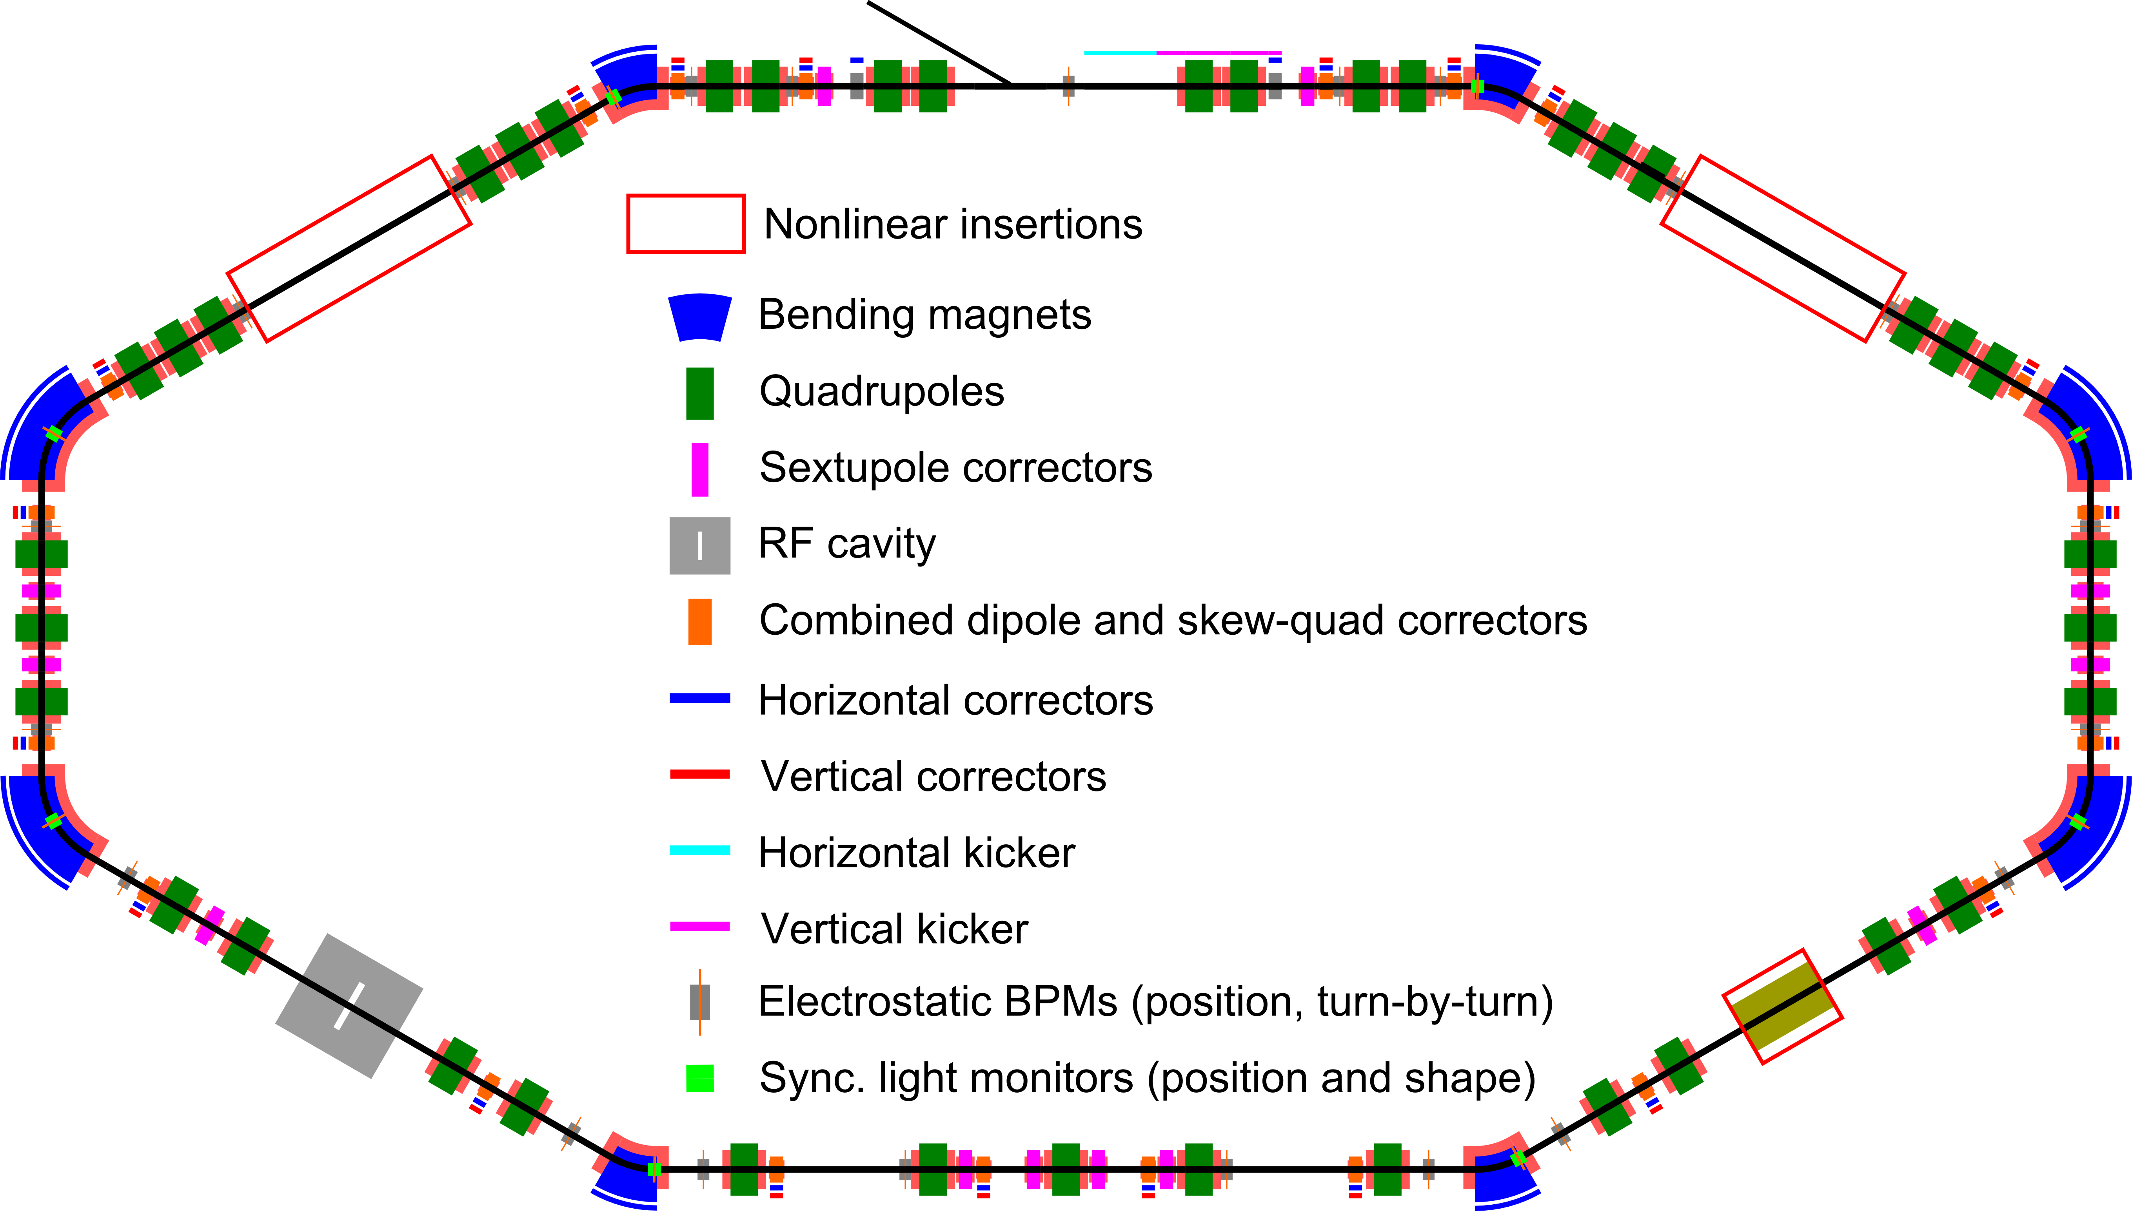
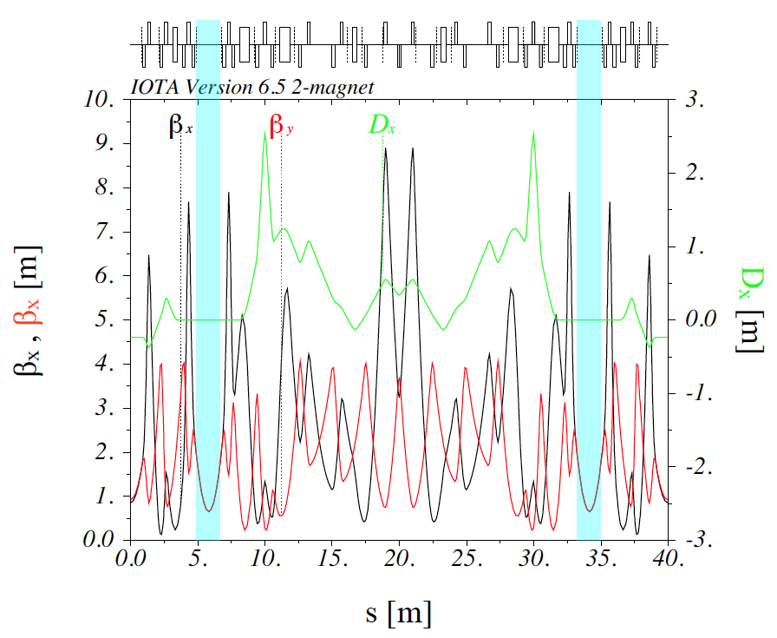
Implementation in IOTA
Practical requirements:
Round axially-symmetric linear lattice (FOFO)
2π x n phase advance
Drift with β_{x}=β_{y}, no dispersion

Slide 7
Objectives in run 4 (remain unchanged from run 2) seek to demonstrate
Large (as predicted by modeling) nonlinear amplitude-dependent tune shift without reduction of dynamical aperture
For QI system as a function of Q₀ and strength = t
For DN system as a function of strength = t
Theoretically predicted invariants of motion, estimated from measured turn-by-turn (TBT) bunch coordinates, are conserved over the course of the observations.
The NIO systems are robust against perturbations and imperfections of the implementation.
T-insert mismatch
Intrinsic resonances
Effect of sextupoles
Q₀=¼ with octupoles
Effect of integer resonance for DN system at high t
The observed transverse profiles and split beamlets observed near integer tunes agree with the predicted phase-space topology of the nonlinear potential.

Slide 8
Changes from 2019/20 run and key requirements
Reconfigured the Octupole string with new layout (9 magnets vs. 17 previously)
Full complement of sextupole magnets
Beam energy of 150 MeV
Smaller momentum spread $→$ long decoherence time
Weaker IBS $→$ smaller transverse emittance, higher beam current for better BPM resolution
Key requirements:
Lattice tuning and stability
Kicker control (H/V)
Instrumentation
Turn-by-turn BPM operation
Closed orbit BPM operation
All synclight cameras
Streak camera for longitudinal measurement (optional)

Slide 9
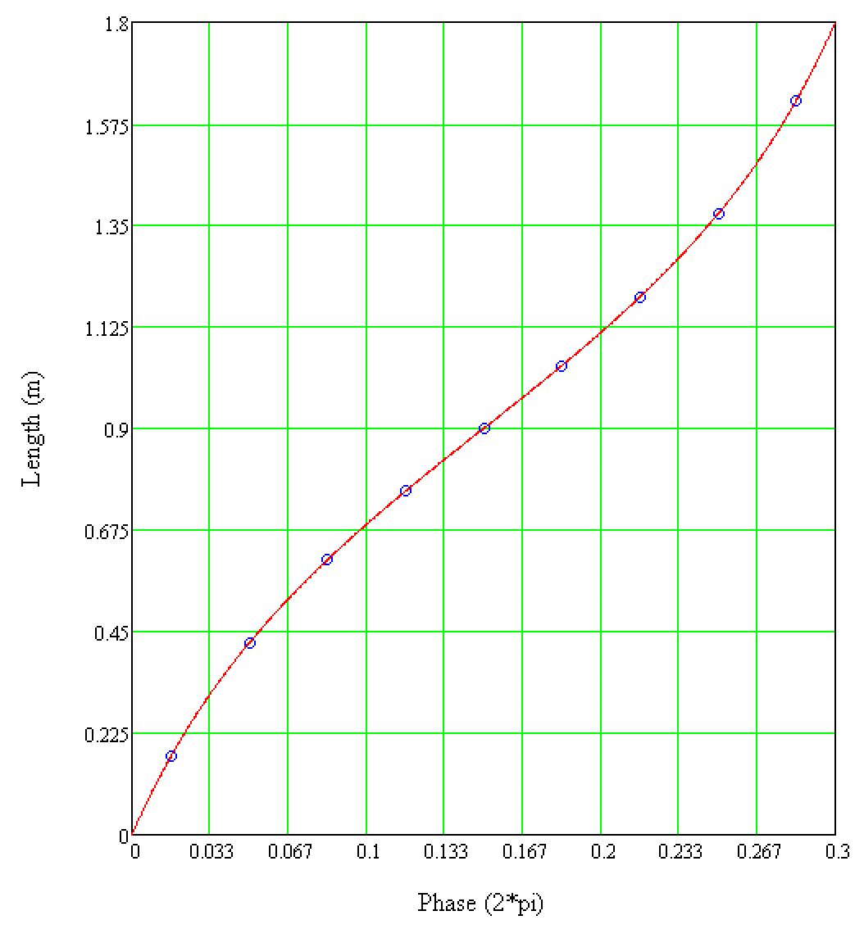
Reconfiguration of the octupole string

Slide 10
Data collection, storage, and processing
Raw data collected in ACNET datalogger and shared iota-fast.bd drive
Also copied to a FNAL linux machine
Processed data and processing software stored on the shared drive and Redmine project page
TBT data to be analyzed to extract the beam dynamics evolution and to compute the metrics of interest
Beam image data to be analyzed to extract the phase space topology features

Slide 11
Beam Time Requirements – 22 × 8 hour shifts
Commissioning of the insertions: 4×8h. Verify alignment, center the orbit through insertions, verify calibrations, and test manual knobs for fine orbit alignment.
Instrumentation and software commissioning: 4×4h. Verify performance of instrumentation and debug and update control scripts and the pyIOTA software package.
Goal 1: 4×8h. Two shifts to demonstrate the nonlinear detuning. Two shifts to acquire turn-by-turn BPM data for various amplitudes of H/V kicks and t values.
Goal 2: 4×8h to demonstrate invariant conservation. Two shifts to optimize the configuration of the inserts. Two shifts to collect TBT data for different machine configurations.
Goal 3: 6×8h for systematic studies of the interplay between integrability conservation and chromaticity compensation schemes based on sextupoles: variation of sextupole configurations; changes of Q0 for the QI option, with particular interest towards values near 1/4 and 1/3 resonances; study of the effect of the integer resonance on the dynamics of the DN system.
Goal 4: 2×8h. Study the dynamics of the DN system for values of the strength t above 0.5, using synchrotron-light diagnostics to record images of the split beamlets as a function of t.

Slide 12
Personnel
Alexander Valishev: (Principal Investigator, Scientist) conceptualization, experiment design and modeling, machine tuning, data acquisition, data analysis, supervision, funding acquisition, writing
Jonathan Jarvis: (Scientist) experiment design and preparation, accelerator operations, data acquisition and analysis, beam instrumentation and diagnostics
Nikita Kuklev: (Research Associate) experiment modeling, data acquisition, online experiment control, software for lattice tuning, data analysis, writing
Sergei Nagaitsev: (Scientist) conceptualization, experiment design and modeling, supervision, funding acquisition
Aleksandr Romanov: (Scientist) experiment design, lattice modeling, machine commissioning and tuning, data acquisition, data analysis, beam instrumentation and diagnostics
Giulio Stancari: (Scientist) experiment design, beam instrumentation and diagnostics, data acquisition, data analysis, writing
Sebastian Szustkowski: (Research Associate) experiment modeling, data acquisition, data analysis, software for lattice tuning, writing
John Wieland: (Graduate Student) experiment modeling, machine commissioning, data acquisition, data analys

