Slide 1
Welcome & Introduction
Michael Allitt
STS Accelerator Systems Manager
25D50 Pulsed Dipole Preliminary Design Review
March 6, 2023

Slide 2
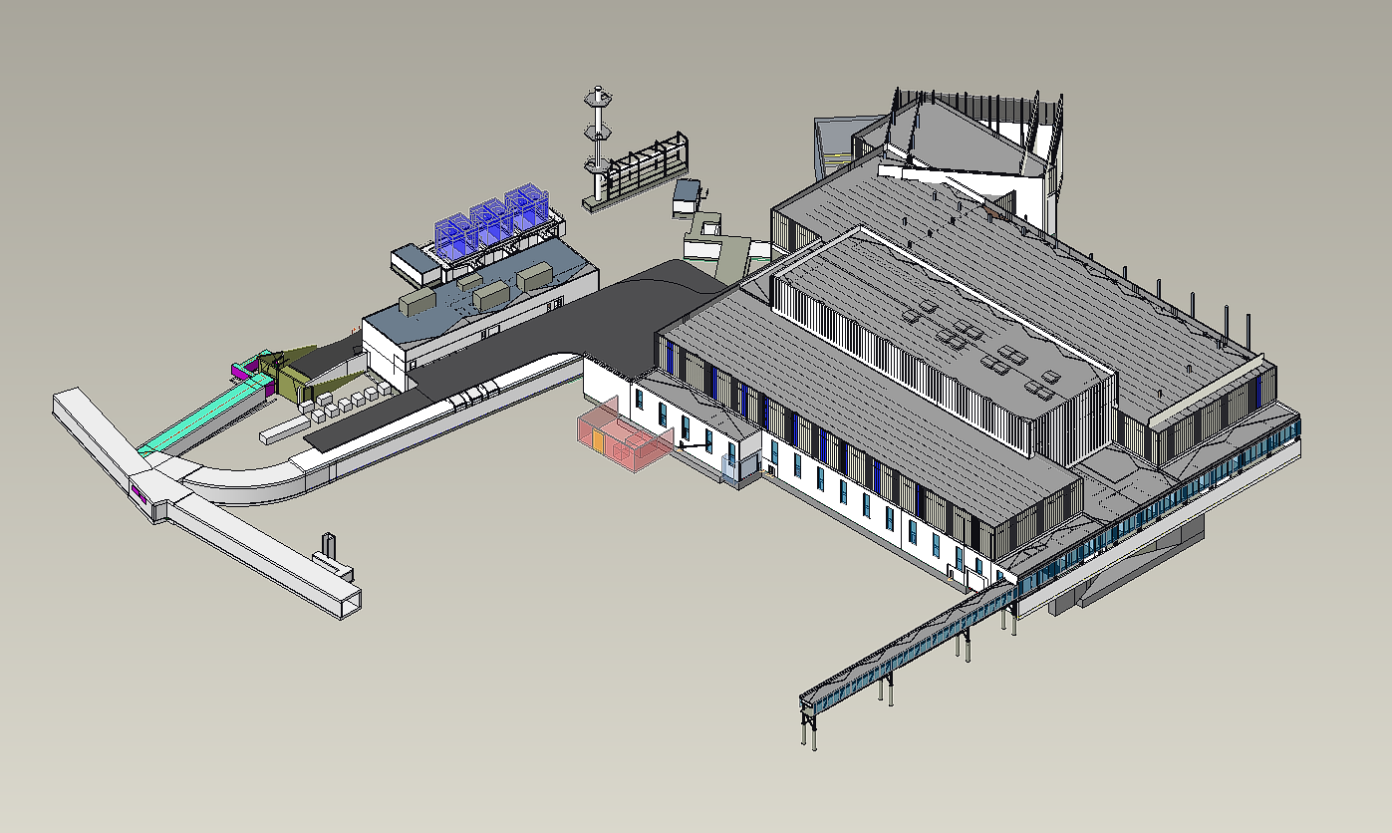
Outline
Second Target Station (STS) Project
Relevant STS Accelerator Systems scope
RTST design overview
Review objectives

Slide 3
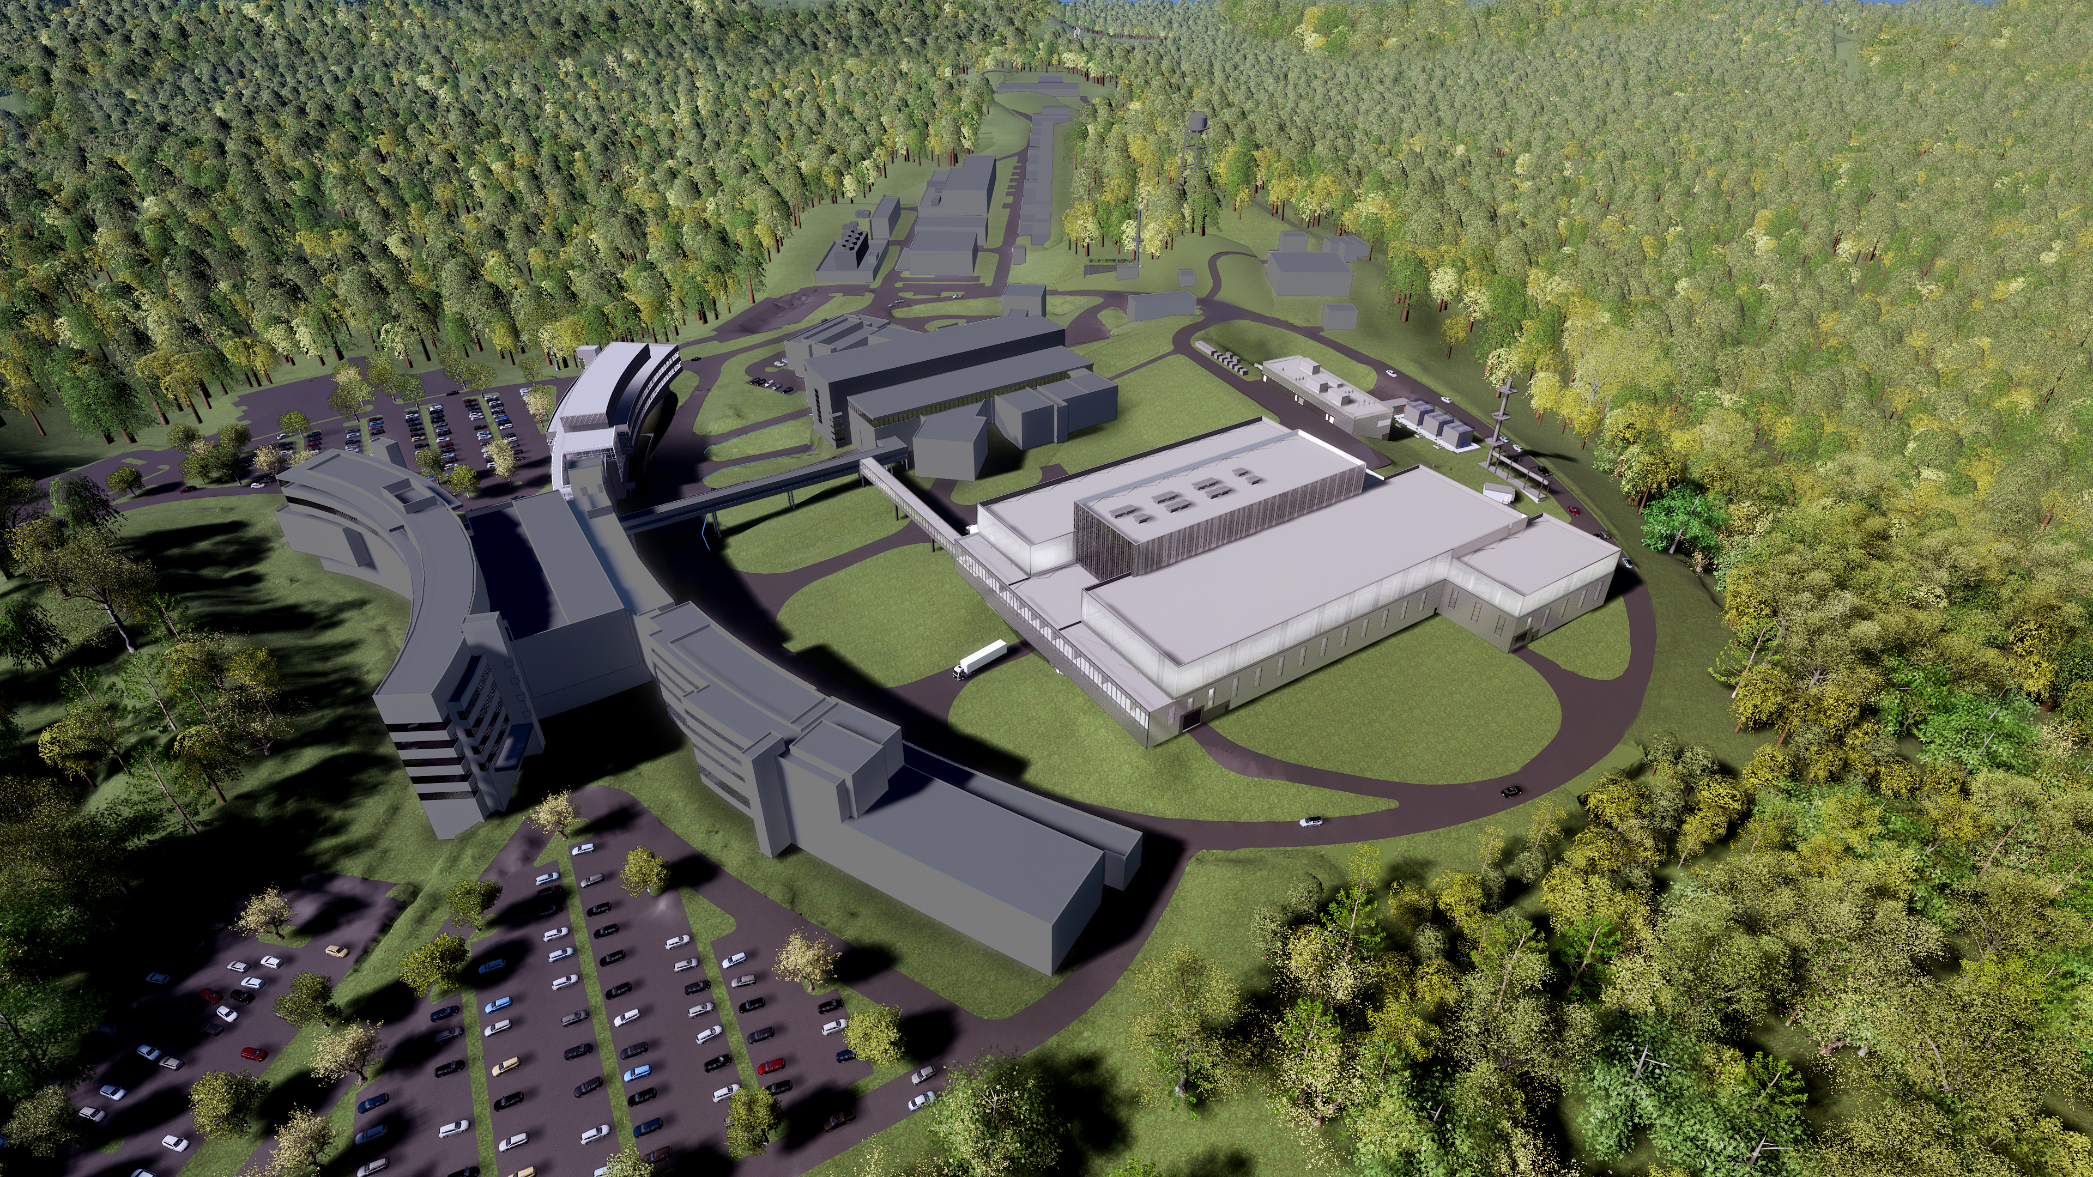
Second Target Station Project
λ = 5 Å
short-pulse
SNS-STS
ESS (5 MW)
J-PARC
USA
SNS-FTS (2 MW)
ESS (2 MW)
Asia
SNS-FTS
Europe
ISIS TS2
CSNS
long-pulse
Planned
HFIR
Existing
ISIS TS1
LUJAN
FRM-II
ILL
NIST
Optimized for cold neutrons
World-leading peak brightness
Provide new science capabilities for measurements across broader ranges of time and length scales, real-time, and smaller samples
SONATE (est.)
PSI
steady-state
ORPHEE

Slide 4
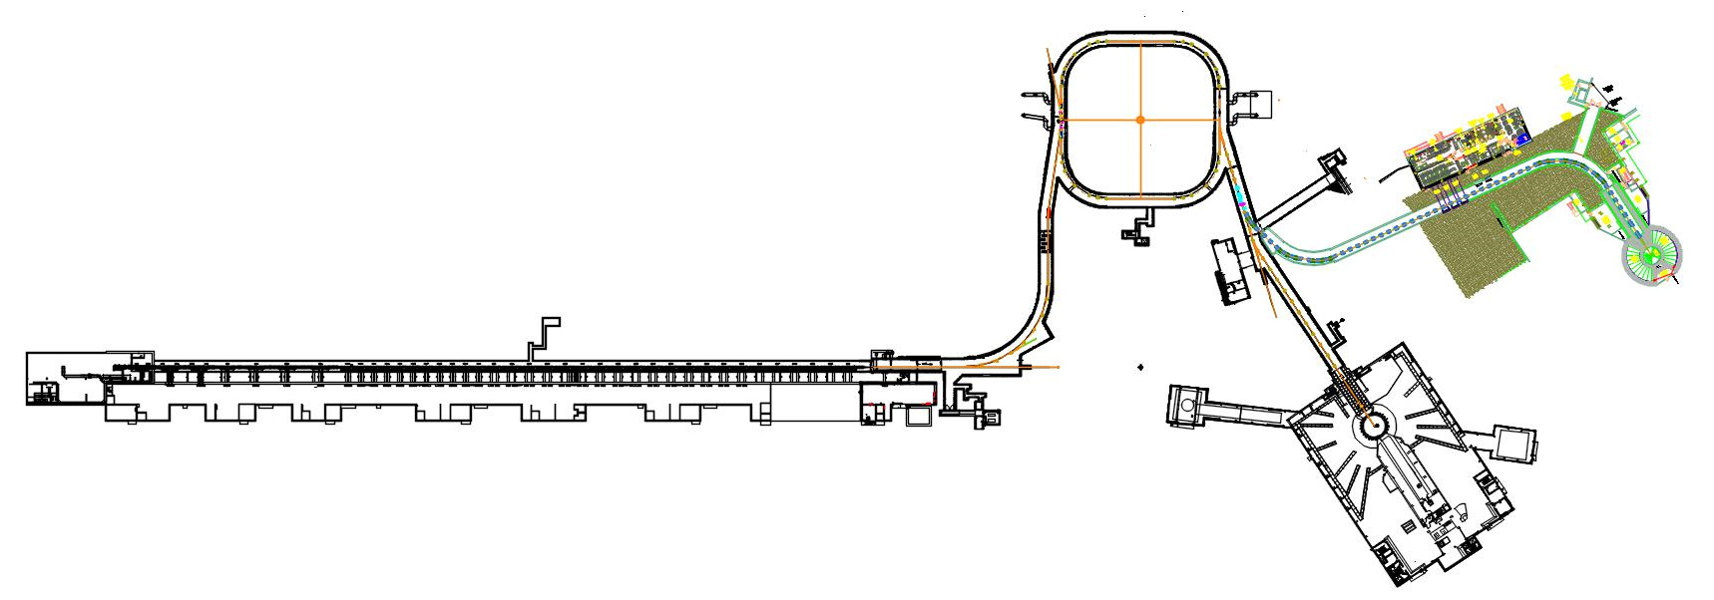
SNS Accelerator Systems – Future State
Second Target Station
700kW average power
15 pulses/sec
Rotating tungsten target
Optimized for cold neutrons
Accumulator ring
Strip electrons from H⁻ ions to create protons
Stack mini-pulses to shorten pulse and increase intensity
Length of extracted pulse < 1 µs
Extraction @ 60 Hz
Linac
H⁻ ions
1 msec macro-pulses @ 60Hz
1 GeV max energy(today)
1.4 MW max power (today)
1.3 GeV max energy (post-PPU)
2.8 MW max power (post-PPU)
Macro-pulse train
16.67 ms
300 ns
700 ns
First Target Station
2 MW average power
45 pulses/sec
Liquid Hg target
Optimized for thermal neutrons
……..
1 ms
Mini-pulse structure

Slide 5
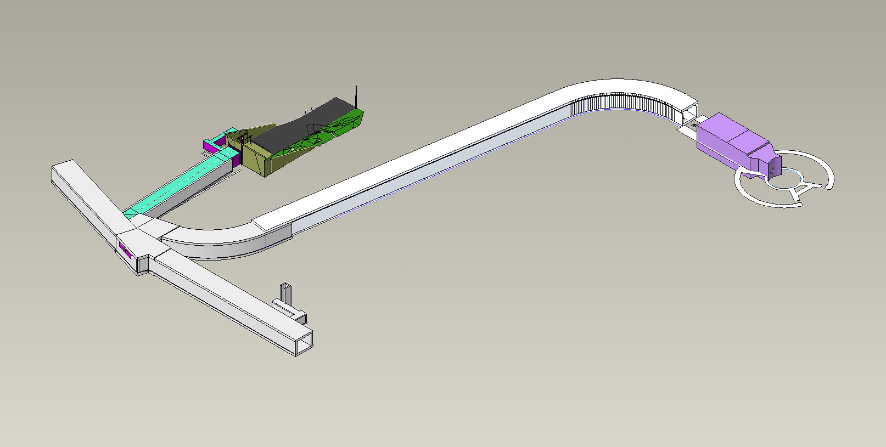
Relevant STS Accelerator Systems (AS) Scope
Ring To Second Target (RTST) beamline to transport protons from an extraction point in existing Ring to Target Beam Transport (RTBT) line to the Second Target
RTST requirements:
Beam loss < 1 W/m
Meet Target Systems requirements for proton distribution
No impact on first target beam

Slide 6
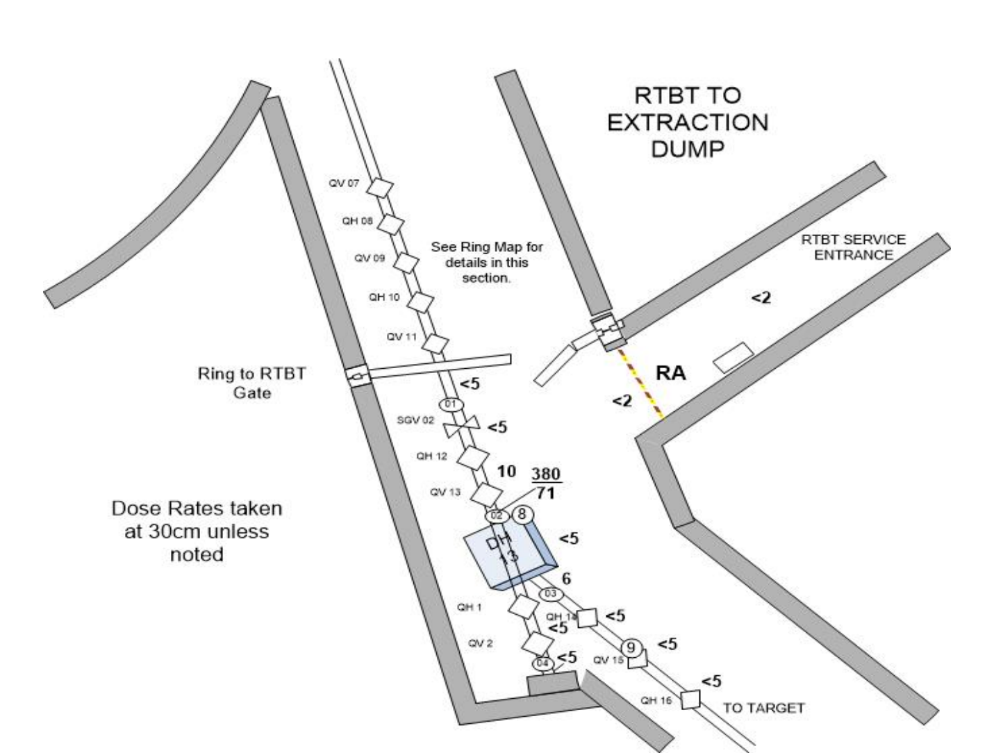
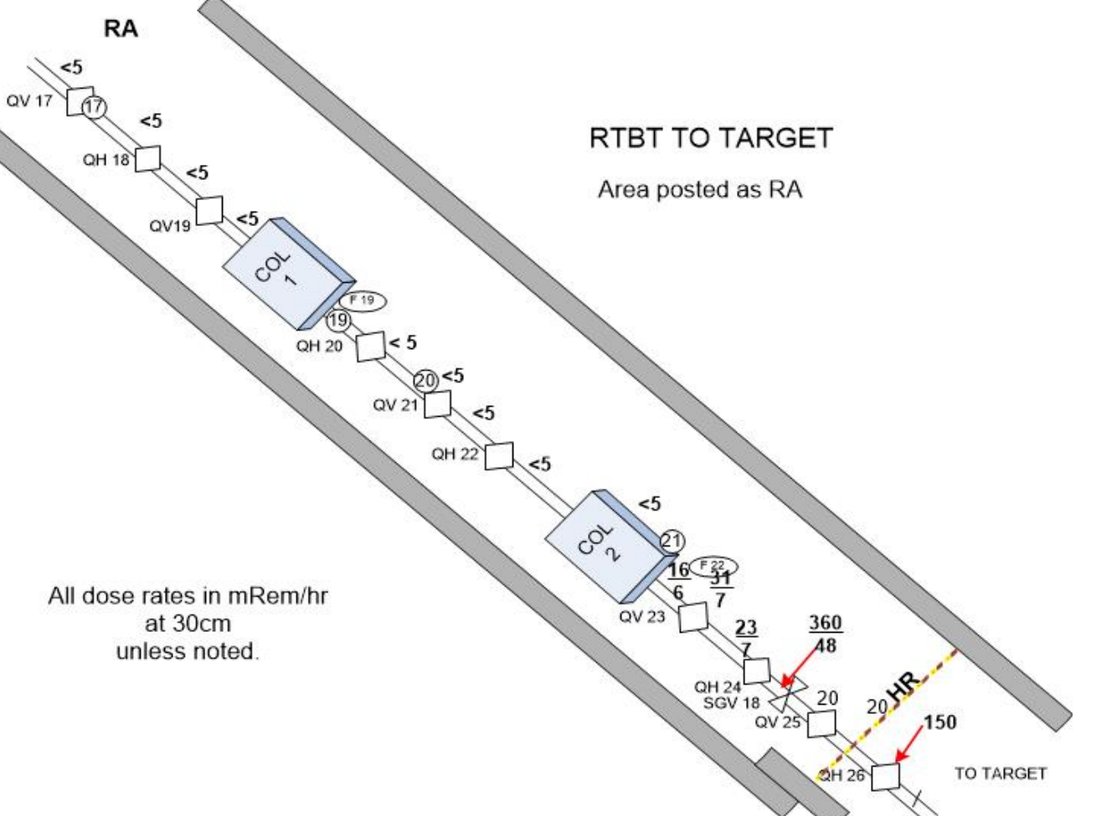
RTST Design Approach
RTBT beamline has good reliability and tunnel has low activation (beam loss well below 1 W/m), so re-use the design
Similar FODO lattice
Large (21cm) aperture
Where possible, use existing magnet & diagnostic designs, base vacuum and cooling designs on existing systems
Maintain compatibility with existing systems
Incorporate lessons learned where applicable
RTBT Activation Levels

Slide 7
RTST design based on RTBT
STS Magnet Type | Quantity
Pulsed Dipole 25D50 | 4
Large Quadrupole 40Q70 | 1
Dipole 17D120 | 15
Quadrupole 21Q40 | 56
Dipole Corrector 27CD30 | 24
From ring
Extraction region
RTBT
Second Target Station
RTST
To First Target Station
RTST length 231.9m

Slide 8
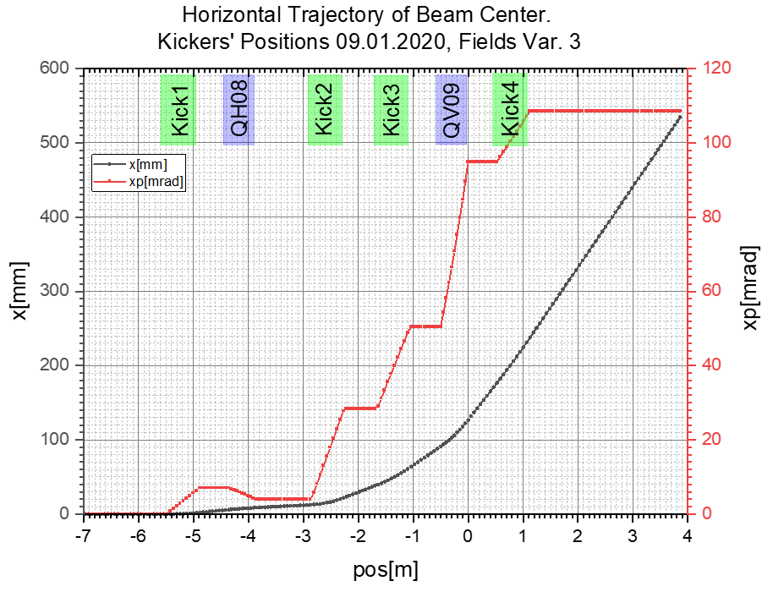
Extraction region
RTBT
QH08
PD01
PD02
PD01
QH08
PD02
PD03
QV09
PD04
QV09
PD03
QH10
PD4
QV11
Beam Deflection
RTST
One design of pulsed dipole used for all 4 positions
RTBT

Slide 9
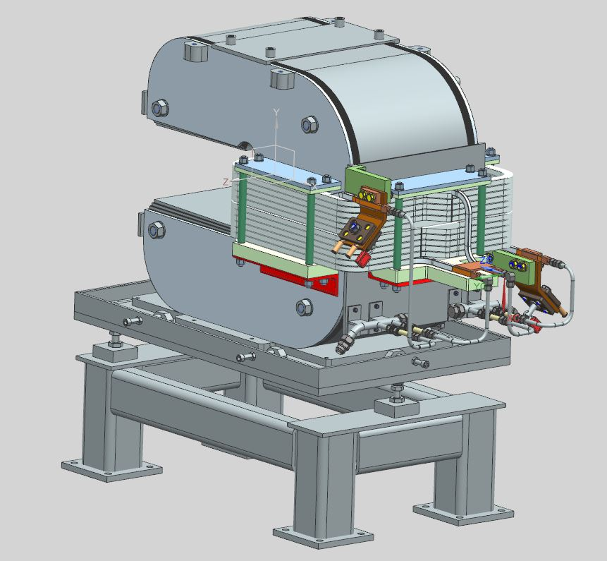
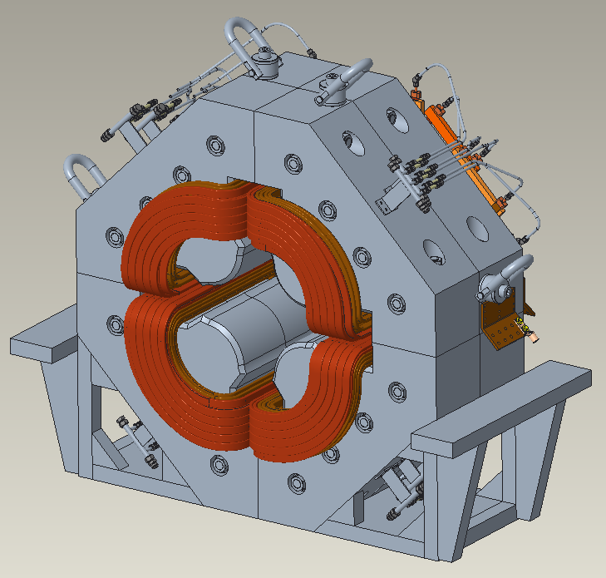
Extraction Magnet Acquisition Strategy
FNAL are designing 25D50 pulsed dipole & 40Q70 large aperture quadrupole
FNAL have also generated a magnetic design for 21Q40N narrow quadrupole
Designs are on schedule; Final Design completion for 25D50 and 40Q70 expected March 2024
25D50 proof-of-principle unit expected to be available in 2025
Remaining 3 x 25D50 units will be ordered after CD-3A approved (expected September 2024)
40Q70 proof-of-principle unit expected to be available 2026
STS will outsource completion of the 21Q40N design to a commercial vendor, including fabrication & test of a proof-of-principle unit
25D50 pulsed dipole
40Q70 quadrupole

Slide 10
Review Objectives
Evaluate preliminary design:
Does it meet the requirements?
What is the risk (if any) of proceeding with detailed engineering design?
Any opportunities for improvement / cost reduction?
Presentations & approved meeting minutes will form the preliminary design report

Slide 11
Questions?

