Slide 1
Pulsed Dipole (25D50) Requirements
Moira Wedekind Accelerator Systems Lead Engineer
PULSED DIPOLE PRELIMINARY DESIGN REVIEW
March 6, 2023

Slide 2
Outline
Definitions
Quality Level Determination
Pulsed Dipole magnet requirements
Requirements common to extraction magnets
Verification Plan

Slide 3
Definitions

Slide 4
Quality Level Determination
Health and Safety risk is rated Level 1 Serious because the lifting required to install the magnet could have fatal consequences in an accident.
Actions to be taken:
Determine what standards apply to the lifting features & verify that the standards are met (ASME BTH-1, Category B?).
Determine overhead crane hook height in RTBT tunnel and consider using swivel hoist rings.
Consider risks inherent in lifting magnet with off-center CG.

Slide 5
Quality Level Determination
Functional risk is rated Level 1 Serious because the pulsed dipole function is crucial to achieving one of the KPPs:
Actions to be taken:
Review magnetic design to verify integrated field, good field area, field uniformity and estimated residual field.
Verify that the lamination thickness will support the ramp rate.

Slide 6
Quality Level Determination
Availability risk is rated Level 2 Important because of the potential for a coil failure to impact all the STS users and for coil replacement to potentially impact all FTS users as well.
Coil failure is deemed to be more likely for this magnet than DC magnets because of the vibration induced by ramping.
Actions to be taken:
Review the coil support design for adequate vibration mitigation and consider potential need for periodic maintenance to maintain its integrity.
Reliability of water connections

Slide 7
Quality Level Determination
Material/Supplier availability risk is rated Level 2 Important because of the potential for long lead times.
Actions to be taken:
Review the acquisition plan & procurement schedule for adequate contingency.

Slide 8
Summary – Quality Level Review Actions
Determine what standards apply to the lifting features & verify that the standards are met (ASME BTH-1, Category B?).
Determine overhead crane hook height in RTBT tunnel and consider using swivel hoist rings.
Consider risks inherent in lifting magnet with off-center CG.
Review magnetic design to verify integrated field, good field area, field uniformity and estimated residual field.
Verify that the lamination thickness will support the ramp rate.
Review the coil support design for adequate vibration mitigation and consider potential need for periodic maintenance to maintain its integrity.
Review reliability of water connections

Slide 9
Pulsed Dipole Requirements
ID | Requirement – Pulsed Dipole Magnet System | Magnet Design Feature(s)
S02.02.03-R030 | The Pulsed Dipole System shall produce an integrated field ≥ 0.1839 T-m for ≥ 2 ms, cycling at 15 Hz. Discussion: This is based on RTBT lattice v5 as described in STS Beam Line Optics Design [7] with a 10% margin. The strongest magnet (RTBT:HKick09:1) uses field of 0.190 T over effective length of 0.88 m for a bend angle of 1.412 degrees. Note that FNL 3D field map is used in optics calculations. | Integrated field Lamination thickness
S02.02.03-R031 | The Pulsed Dipole System shall have a good field area ≥ ± 4.5 cm (1.8 in) horizontal and ≥ ± 5.7 cm (2.2 in) vertical. Discussion: This is based on RTBT lattice v5 as described in STS Beam Line Optics Design [7]. Note that FNL 3D field map is used in optics calculations. | Good field area

Slide 10
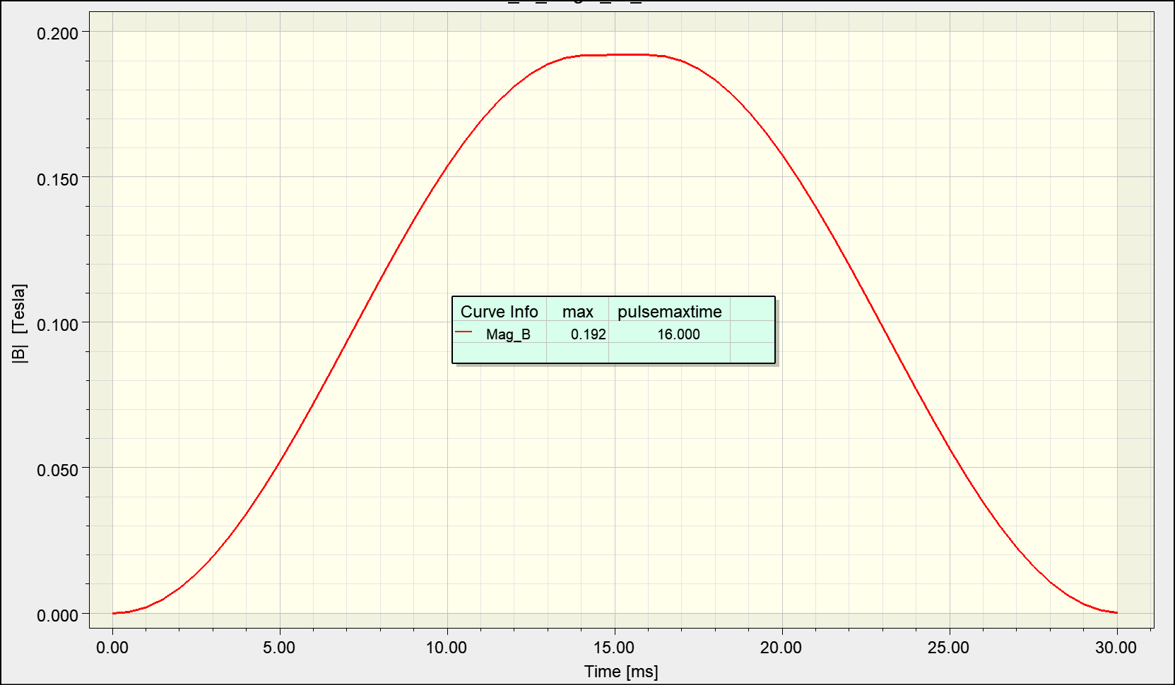
Pulsed Dipole Requirements
ID | Requirement – Pulsed Dipole Magnet System | Magnet Design Feature(s)
S02.02.03-R032 | The Pulsed Dipole System magnetic field shall transition from < 5 Gauss to the desired operating field, then back to < 5 Gauss within < 33 ms. Discussion:14ms – 2 ms – 14 ms waveform proposed to allow time to evaluate dipole operation prior to injecting the pulse, and to minimize eddy current heating in vacuum chamber. Timing System jitter is < 200 ps, delay resolution < 1 ns. See STS Beam Line Optics Design [7] for evaluation of impact of 5 G field. | Remanent field Integrated field Lamination thickness

Slide 11
Pulsed Dipole Requirements
ID | Requirement – Pulsed Dipole Magnet System | Magnet Design feature
S02.02.03-R034 | The Pulsed Dipole System integral field shall be within ± 0.1% of the design value throughout the good field region. | Field uniformity in good field area
S02.02.03-R041 | The Pulsed Dipole magnet assembly shall fit into a volume such that X ≤ 1.20, Y ≤ 1.00, Z ≤ 0.70 meters Discussion: To avoid having to move any magnets in the RTBT. X is width, Y is height, and Z is along beam axis. | Overall magnet dimensions

Slide 12
Pulsed Dipole Requirements
ID | Requirement – Pulsed Dipole Magnet Assembly | Magnet Design Feature(s)
S02.02.03-R042 | The Pulsed Dipole magnet core shall have a vertical aperture ≥ 24.73 cm (9.74 in) and a horizontal aperture ≥ 42.5 cm (16.7 in) and ≤ 50 cm (19.7 in). Discussion: The vertical aperture must accommodate a vacuum chamber with a max OD of 241.3 + 3 mm of clearance on the radius = 247.3 mm. The preferred method of installing the vacuum chamber is sliding it in from the side. The horizontal aperture must accommodate that same chamber offset by 28 mm toward the coil. Each coil, with insulation, will be 30mm x 118mm. The gap between the core and the surface of the insulation will be 30mm. | Aperture dimensions
S02.02.03-R043 | The Pulsed Dipole magnet coil shall be restrained to prevent coil motion during ramping. Discussion: Intent is to minimize opportunity for coils to develop a short. | Coil restraint

Slide 13
Pulsed Dipole Requirements
ID | Requirement – Pulsed Dipole Magnet Assembly | Magnet Design Feature(s)
S02.02.03-R044 | The Pulsed Dipole shall require ≤ 1750 A to reach an integrated field of ≥ 0.166 T-m. Discussion: This requirement ensures compatibility with commercially available power supplies. | Peak current required to generate 0.166 T-m integrated field.
S02.02.03-R045 | The Pulsed Dipole shall have an inductance ≤ 3.5 mH. Discussion: This requirement ensures compatibility with commercially available power supplies. | Magnet coil inductance
S02.02.03-R046 | The Pulsed Dipole shall have a resistance ≤ 7.0 mOhm. | Magnet coil resistance

Slide 14
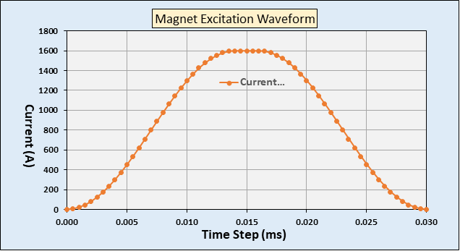
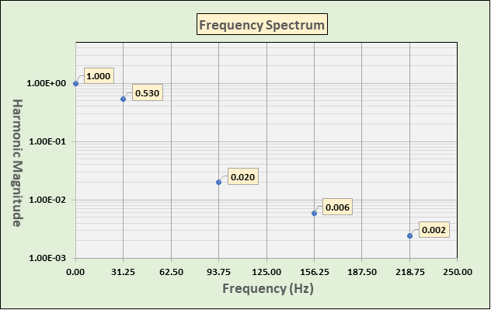
Pulsed Dipole Requirements
ID | Requirement – Pulsed Dipole Magnet Assembly | Magnet Design Feature(s)
S02.02.03-R047 | Pulsed Dipole core construction shall accommodate the frequency spectrum shown in the figures below. Discussion: This entry is intended to give traceability to the selection of lamination thickness | Lamination thickness

Slide 15
Pulsed Dipole Requirements
ID | Requirement – Pulsed Dipole Magnet Assembly | Magnet Design Feature(s)
S02.02.03-R048 | The Pulsed Dipole magnet assembly shall provide a Radiation Safety Hold (RS Hold) interface. Discussion: Details TBD. The RS hold will impact the bussing connection to the magnet. This requirement addresses an interface defined in Interface Sheet for ICS PPS and Accelerator Pulsed Dipole Magnets [8]. | RS Hold mechanical interface.

Slide 16
Requirements Common to All Extraction Magnets
ID | Requirement – Magnet System | Magnet Design Feature(s)
S02.02.03-R002 | Water-cooled extraction magnet coils should be designed for a current density < 450 Amps/cm². The current density shall not exceed 1000 Amps/cm². Discussion: Design Criteria Ring Magnet Systems [2] recommends a current density < 450 amps/cm² to reduce the resistive energy loss in the coils and keep the voltage drop across the magnets as low as possible. This will reduce the possibility of turn-to-turn shorts occurring in the coil should the insulation be damaged by radiation. The low current density will also reduce the resistive heat loss in the magnet system. | Coil current density at peak current.

Slide 17
Requirements Common to All Extraction Magnets
ID | Requirement – Magnet System | Magnet Design Features
S02.02.03-R004 | Water-cooled extraction magnet coils shall be designed to have a temperature rise < 20° C (36° F) at the maximum power supply current with an inlet water temperature between 29.4° C (85° F) and 35.0° C (95° F). Discussion: Desired maximum temperature rise is 11-14° C (20-25° F) | Temperature rise at peak current and design pressure drop with magnet operating at 15 Hz.
S02.02.03-R005 | Water-cooled extraction magnet coils should be designed for a water flow velocity < 2 m/s (6.56 ft/s). The water flow velocity shall not exceed 2.4 m/s (8 ft/s). Discussion: From Review of Cooling Water Chemistry at ORNL/SNS [3], “High local water velocities (> 2m/s) … would cause accelerated dissolution of the oxide layer, possibly causing local material loss and increased copper transport. Also need to ensure that the water flow is moderately turbulent (2000 ≤ R_{e} ≤ 100000).” | Water flow velocity in coils @ design pressure drop.

Slide 18
Requirements Common to All Extraction Magnets
ID | Requirement – Magnet System | Magnet Design Feature(s)
S02.02.03-R006 | The cooling water pressure differential across the extraction magnets shall not exceed 60 psi (414 kPa) to meet requirement S02.02.03-R004. Discussion: This is to support a Cooling Water System design pressure ≤ 150 psi. The desired pressure differential is between 30 and 50 psi. | Design pressure drop ≤ 60 psi
S02.02.03-R007 | Each extraction magnet temperature switch shall be hardwired to the magnet power supply to turn off the supply if the temperature limit is exceeded. Discussion: There needs to be an indication of what caused the power supply to shut off. See AS1-2 in PHA [1]. | Terminal block for temperature switch wires.

Slide 19
Requirements Common to All Extraction Magnets
ID | Requirement – Magnet Assembly | Magnet Design Feature(s)
S02.02.03-R008 | Water-cooled extraction magnet coils shall have at least one temperature switch per water flow path. The switch shall be mounted directly on the coil conductor near the cooling water outlet end of the coil. Discussion: The purpose of the switch is to detect coil heating that could result in a fire. See AS1-2 in PHA [1]. | Temperature switch location on coil.
S02.02.03-R009 | The temperature switch required in S02.02.03-R008 shall have a specified 170° ± 5° F (76.7° ± 2.8° C) trip point. The switch contacts shall be electrically isolated from the coil. The reset temperature shall be specified to be 150 ± 5° F (65.6° ± 2.8° C). Discussion: The preferred switch is Sensata 4344. | Temperature switch specification
S02.02.03-R010 | All extraction magnet water manifold components shall be electrically grounded to the magnet core. | Evaluate ground path for water manifolds

Slide 20
Requirements Common to All Extraction Magnets
ID | Requirement – Magnet Assembly | Magnet Design Feature(s)
S02.02.03-R011 | For extraction magnets located in the RTBT tunnel, any piece that will be lifted with the RTBT tunnel overhead crane for installation or maintenance should weigh no more than 12.5 tons (11,340 kg) but shall weigh no more than 25 tons (22,680 kg). Discussion: There are two 12.5 ton cranes on a single rail in the RTBT that can be used together if necessary. | Magnet weight
S02.02.03-R013 | The extraction magnet core assembly shall be pinned such that it will meet the dimensional requirements after it has been disassembled and reassembled, without special jigs or fixtures. | Pole tips pinned

Slide 21
Requirements Common to All Extraction Magnets
ID | Requirement – Magnet Assembly | Magnet Design Feature(s)
S02.02.03-R014 | The extraction magnet shall have external fiducials capable of supporting magnet alignment to 100-micron in x/y and 1-mrad yaw, pitch, and roll. Discussion: This requirement is relative to the SNS Coordinate System where the Z axis is along the beam line. The location of fiducials on the magnet is important – details TBD. The positioning along the beam axis is not as critical – within ~ 1 cm.. | Number and location of features for attaching fiducials.
S02.02.03-R015 | For water-cooled extraction magnets, the assembled magnet shall withstand 300 psig (2068 kPa) hydrostatic (water) test pressure for one hour without evidence of external leakage or internal pressure drop other than that resulting from a change in water temperature. Discussion: 300 psi is 2 x the max targeted water pressure in the SNS water system. | Water connections rated for 300 psi.

Slide 22
Requirements Common to All Extraction Magnets
ID | Requirement – Magnet Assembly | Magnet Design Feature(s)
S02.02.03-R016 | Unless otherwise stated, the assembled extraction magnet shall withstand 1000 V DC for one minute between the coil leads and the magnet core without evidence of insulation damage or breakdown, or leakage current > 5 µA. | Coil insulation design
S02.02.03-R017 | The roll of the extraction magnet, the difference between the vertical field of the magnet measured magnetically and the level position of the magnet determined mechanically, shall be less than 2 mrad. The pitch and yaw of the magnet shall be less than 1 mrad. Roll, pitch, and yaw measurements shall be given with respect to the fiducials on the magnet. | Dimensional tolerances
S02.02.03-R018 | The extraction magnet shall be designed with terminal blocks or flags to mate with cable termination lugs. Discussion: Intent is to conform to SNS standard connections. | Appropriate cable termination features

Slide 23
Requirements Common to All Extraction Magnets
ID | Requirement – Magnet Assembly | Magnet Design Feature(s)
S02.02.03-R019 | The exposed conductors on the extraction magnet coils shall not be covered. Discussion: From SNS Final Safety Assessment Document for Proton Facilities [4]. The purpose is to reduce radiation exposure to workers by minimizing the amount of time they are near the beam line. | Coil leads are not covered.

Slide 24
Requirements Common to All Extraction Magnets
ID | Requirement – Magnet Assembly | Magnet Design Feature(s)
S02.02.03-R020 | The extraction magnet assembly shall be designed such that the magnet (mechanical) central axis can be placed coincident with the beam path (at a 1.045 m nominal beam height) mounted on a support that meets requirements S02.02.06-R001 and S02.02.06-R002. Discussion: This is intended to ensure that there is enough clearance between the magnet and the floor for a support stand with some vertical adjustment. The nominal beam height was derived from the elevations on the Burns and McDonnell RTST Stub drawings. Floor elevation 1076’, Beam line elevation 1079.43’. The RTBT beam height is listed in [4] as “approximately 41 inches above the floor”. | Distance between magnet and floor is sufficient space for a stand with ± 1” of vertical adjustment.

Slide 25
Requirements Common to All Extraction Magnets
ID | Requirement – Magnet Assembly | Magnet Design Feature(s)
S02.02.03-R021 | The extraction magnet core shall be grounded to the tunnel ground system. | Magnet has appropriate ground wire attachment.
S02.02.03-R024 | Each extraction magnet coil shall be made from a single length of conductor. Discussion: This is to avoid splices inside the coil. | Coil length appropriate to meet this requirement.

Slide 26
Requirements Common to All Extraction Magnets
ID | Requirement – Magnet Assembly | Magnet Design Feature(s)
S02.02.03-R025 | The water-cooled extraction magnet coils shall meet the requirements of Specification for Radiation Resistant Fiberglass/Epoxy Insulated Magnet Coils [5]. Discussion: This includes silver plating, hydrostatic test to 300 psi, turn-to-turn insulation test. | Coil design includes sufficient insulation and resin impregnation.
S02.02.03-R026 | Extraction magnet electrical mating surfaces shall be plated with 0.0003” (7.6 µm) silver in accordance with ASTM B700-20. Discussion: To provide a corrosion-resistant joint. Barrel plating appears to be the most cost-effective method, so that should be considered in the design and procurement strategy. | Will be included in engineering design

Slide 27
Requirements Common to All Extraction Magnets
ID | Requirement – Magnet Assembly | Magnet Design Feature(s)
S02.02.03-R027 | The extraction magnet wetted parts shall be OFHC copper, stainless steel, ceramic, or approved hose material. Discussion: No aluminum or brass is allowed. OFHC copper and stainless steel are preferred. See Characterization of Particulate Material from Two Filters Associated with the SNS Cooling System [6], and Review of Cooling Water Chemistry at ORNL/SNS [3] for water quality discussions. | Confirm appropriate materials used
S02.02.03-R028 | Extraction magnet water connection ports shall be compatible with female 37° flair JIC (SAE J514/ISO 8434-2) hose fittings, 1 – 1/16 - 12 thread size. Discussion: Intent is to be compatible with Parker p/n 10656-12-12C hose fitting. | Confirm compatibility

Slide 28
Requirements Common to All Extraction Magnets
ID | Requirement – Magnet Assembly | Magnet Design Feature(s)
S02.02.03-R029 | Extraction magnet water hoses shall be routed a minimum of 6” (15.2 cm) away from the magnet aperture. Discussion: Intent is to minimize radiation damage to hoses. | Confirm that design supports this
S02.02.03-R063 | Extraction magnet packaging shall be designed to protect the magnet from damage due to transport loads. Discussion: | Final design scope
S02.02.03-R064 | Extraction magnet assemblies shall be transportable in a WB-40 truck. Discussion: The STS access road design basis is a WB-40 truck. | Truck is ~ 8’ x 8’, will carry ~ 44,000

Slide 29
Verification Plan
Design inspection for all relevant requirements
Review magnet & coil manufacturing process and identify interim inspection hold points
Tests called out in Coil Manufacturing Spec (water flow path obstruction, hydrostatic and turn-to-turn insulation)
Dimensional verification & reproducibility of magnet assembly
Field Map – integrated field, good field area, field uniformity, remnant field, magnetic field orientation with respect to fiducials (need to decide which of these, if any, require ramping)
Verify expected water flow and temp rise at 20 psi pressure differential, max current, 15 Hz
Magnet pressure test
Magnet hipot test

Slide 30
Discussion

Slide 31
Extraction Magnet Requirements from S02020300-SRD10000 R01 not applicable to Pulsed Dipole Magnet Assy

Slide 32
Pulsed Dipole Requirements
ID | Requirement – Pulsed Dipole Magnet System | Magnet Design feature
S02.02.03-R033 | The Pulsed Dipole System shall maintain its desired magnetic field within ± 0.1% over a period of ≥ 1µs. Discussion: This allows us to slow down the ramp as much as possible. See STS Beam Line Optics Design [7] for beam loss analysis due to noise. | N/A
S02.02.03-R035 | The Pulsed Dipole System peak field shall have pulse-to-pulse repeatability within ± 0.1% of the desired operating magnetic field. Discussion: The RTST error analysis performed in May 2022 uses ± 0.1% as the noise limit for the Pulsed Dipoles. Need to incorporate settling time for each pulse. See STS Beam Line Optics Design [7] for beam loss analysis due to noise. | N/A

Slide 33
Pulsed Dipole Requirements
ID | Requirement – Pulsed Dipole Magnet System | Magnet Design Feature(s)
S02.02.03-R036 | The Pulsed Dipole System shall provide sufficient operating information to determine if the Pulsed Dipole waveform is within specifications for any given pulse. Discussion: Assumption is that the system will provide waveform feedback for the purpose of evaluating the actual magnet waveform on a pulse-by-pulse basis. Where the waveform is generated (amplifier or magnet?) will be determined by the severity of the consequences of magnet failure and the potential failure modes in the power supply (likelihood that current output ≠ current through magnet). | N/A

Slide 34
Pulsed Dipole Requirements
ID | Requirement – Pulsed Dipole Magnet System | Magnet Design Feature(s)
S02.02.03-R037 | The Pulsed Dipole System shall evaluate the actual Pulsed Dipole waveform against the specified waveform and signal MPS to prevent the next pulse from being injected into the ring if the evaluation fails. Discussion: Need to develop P/F criteria. This test can potentially be used prior to the STS pulse to ensure the magnet is on and prior to every FTS pulse to make sure the magnet is off. Note that this requirement extends the required flattop time for the pulse to accommodate a) settling time, b) waveform evaluation & fault generation, c) MPS reaction time (~ 10 us). | N/A

Slide 35
Pulsed Dipole Requirements
ID | Requirement – Pulsed Dipole Magnet System | Magnet Design Feature
S02.02.03-R038 | The Pulsed Dipole System shall support the PPS design for preventing beam extraction into the RTST beam line. Discussion: To prevent beam into RTST if the beam line or target is not ready for beam. See AS4-16, TS4-1 in PHA [1]. This requirement addresses an interface defined in Interface Sheet for ICS PPS and Accelerator Pulsed Dipole Magnets [8]. | RS Hold mechanical interface.
S02.02.03-R039 | The Pulsed Dipole System shall provide an automated method for disconnecting the power cables between the magnet and the power supply. Discussion: This is an interface to PPS in accordance with Interface Sheet for ICS PPS and Accelerator Pulsed Dipole Magnets [8]. | N/A

Slide 36
Requirements Common to All Extraction Magnets
ID | Requirement – Magnet System | Magnet Design Feature(s)
S02.02.03-R040 | Upon shutdown, the Pulsed Dipole System shall dissipate its stored electrical energy within 5 minutes. Discussion: This requirement addresses an interface defined in Interface Sheet for ICS PPS and Accelerator Pulsed Dipole Magnets [8]. | N/A
S02.02.03-R001 | The RTST extraction magnets shall extract a proton beam with a pulse length of 661 ns at 15 Hz from the RTBT beam line. | N/A
S02.02.03-R003 | Air-cooled extraction magnet coils shall be designed for a current density < 150 amps/cm². | N/A

Slide 37
Requirements Common to All Extraction Magnets
ID | Requirement – Magnet Assembly | Magnet Design Feature(s)
S02.02.03-R012 | The extraction magnet assembly design should consist of subassemblies if required for: Installation or replacement of magnet coils Installation or replacement of magnet vacuum chamber Discussion: This requirement has two objectives: to facilitate initial installation and alignment of the magnet, and to allow for in situ repair/replacement of the magnet coils or vacuum chamber while minimizing the need for realignment of the magnet. | N/A

Slide 38
Requirements Common to All Extraction Magnets
ID | Requirement – Magnet Assembly | Magnet Design Feature(s)
S02.02.03-R022 | Each extraction quadrupole magnet assembly shall provide an interface for mounting a Beam Loss Monitor. | N/A
S02.02.03-R023 | Each extraction magnet assembly shall provide an interface for supporting the vacuum chamber, if required. | N/A

