Slide 1
Results From Particle Tracking Studies
Andrei Shishlo
Accelerator Physicist, AS Group
25D50 Pulsed Dipole Preliminary Design Review
March 6th, 2022

Slide 2
Outline
RTST Beam Line
Extraction Region RTBT-to-RTST
3D Fields in PyORBIT Code
Tracking Results
Conclusions

Slide 3
RTST Beam Line
RTBT-to-RTST Extraction Region
RTST beam line includes mostly the same magnets as the existing RTBT line to FTS
RTBT-to-RTST extraction magnet system is a part that is most different from existing RTBT line

Slide 4
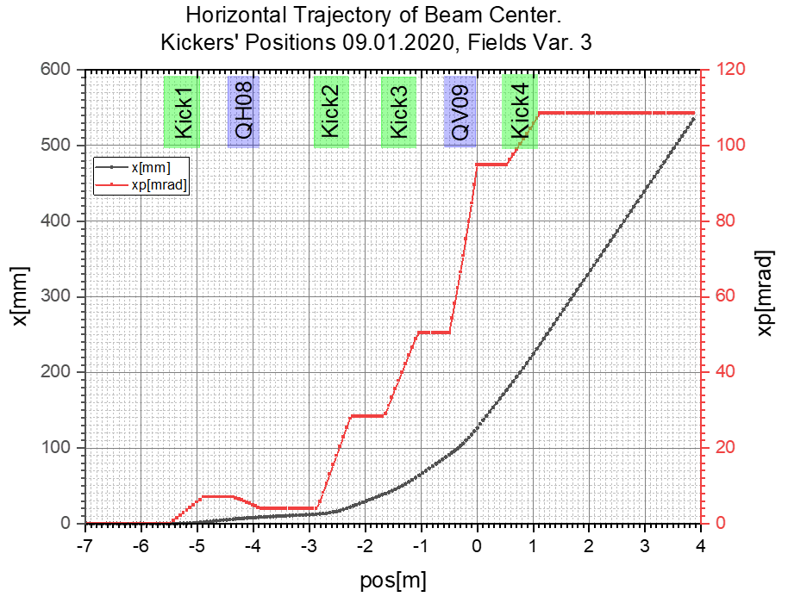
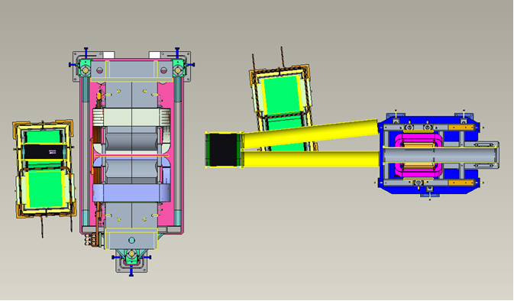
Roles of Pulsed Dipoles in RTBT-to-RTST Beam Extraction
QV09
PD4
PD3
QH10
Pulsed dipoles have the major role in the beam extraction to RTST
1.473 m

Slide 5
Injection Scheme: 3D Tracking Region
3D Direct Tracking Region
Beam to 2nd Target
Kicker#3
Kicker#1
Kicker#2
Kicker#4
RTBT:QV07
RTBT:QH08
Beam to 1st Target
RTBT:QH10
RTBT:QV09
Initial particle tracking were performed by using idealized quad and pulsed dipoles in PyORBIT code
To test the beam optics with realistic magnetic field distribution we need 3D tracking.
The start point of tracking is the beginning of QV07, and the last point is the end of QH10 magnet in RTBT line
The real magnetic fields of dipole kickers are overlapping with quads, so we cannot use any conventional particle tracking codes

Slide 6
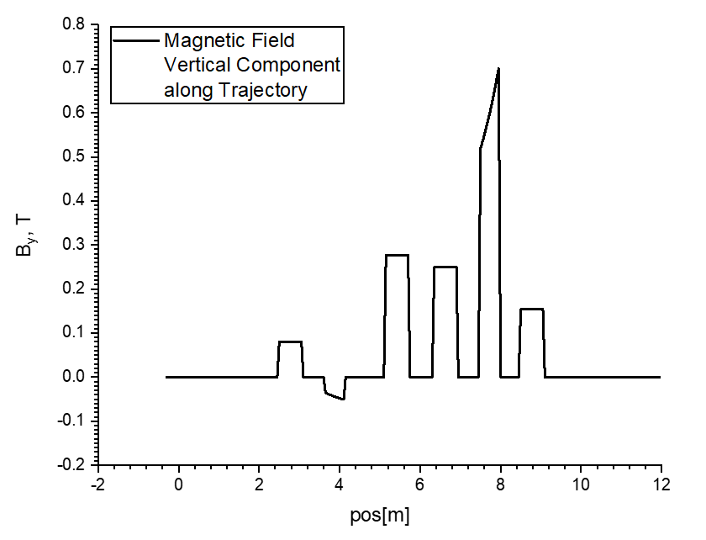

Magnetic Field along Center Trajectory
Hard edge (ideal) models for quads and dipole kickers
FNAL 3D map fields for dipole kickers and RTBT:QV09
FNAL 3D map field for dipole kickers
Quads and kickers fields are overlapping

Slide 7
Tracking Results for Trajectory of Beam Center
Difference in traditional and RK4 tracking was .3 mm on top of 534 mm deviation
FNAL 3D map fields for dipole kickers and a big aperture quad (RTBT:QV09)

Slide 8
RMS Sizes in RTBT Extraction Region
We have difference in the vertical beam sizes – about 1.1 mm on top of 7.5 mm RMS
Reason for that could be a bigger vertical size inside RTBT:QV09 (vertically focusing quad)
The effect on downstream tracking should be estimated

Slide 9
RTST Tracking the Bunch after 3D Extraction Tracking
Vertical
RMS Sizes:
Good agreement
About 1 mm diff. for Vertical RMS size on ST
Horizontal
Horizontal Dispersion:
Not so good agreement
As a result, we see losses: 3*10⁻⁴
This could be improved by slight retuning of RTST optics
Horizontal
Vertical

Slide 10
RTST Tracking the Bunch after 3D Extraction Tracking
2021.03.28 Quad Power Supplies Redistributed
Horizontal
Vertical
The quads at the 1st arc were provided with separate power supplies
The horizontal dispersion was tuned to less than 4 mm
2,000,000 macro-particles no beam loss
Horizontal
Vertical

Slide 11
3D Fields Comparisons – Separate and Combined
(for Q+3Kickers)
Kickers’ field should be increased by
RTBT_Mag:HKick08:1 -> +2.5%
RTBT_Mag:HKick08:2 -> +2.0%
The final trajectory is 22 mm to the right (on top of 534 mm), and angle is103 mrad instead of 108.3 mrad.

Slide 12
RTBT to RTST Sizes
Sizes are as before.
It is possible to correct all angles in distribution and use particles as injected to RTST.

Slide 13
RMS Beam Sizes in RTBT 1-2
Vertical
Horizontal
Usage of 3D map introduces some deviations in the vertical beam sizes after RTBT:QV09
We can use several quads after QV09 to restore the design sizes in RTBT
Theory says that it could be done with only 4 quads, but we have limitations on a maximal quad fields, so we used 6 quads.

Slide 14
RTBT Quad Fields Change and Final Sizes after Fitting
RTBT_Mag:QH10 fields (initial,fitted) G[T/m] = ( +5.8755 , +5.8740) change [%] = +0.03
RTBT_Mag:QV11 fields (initial,fitted) G[T/m] = ( -5.6131 , -5.4325) change [%] = +3.22
RTBT_Mag:QH12 fields (initial,fitted) G[T/m] = ( +4.2686 , +4.3039) change [%] = -0.83
RTBT_Mag:QV13 fields (initial,fitted) G[T/m] = ( -3.7275 , -3.8297) change [%] = -2.74
RTBT_Mag:QH14 fields (initial,fitted) G[T/m] = ( +2.8732 , +2.9125) change [%] = -1.37
RTBT_Mag:QV15 fields (initial,fitted) G[T/m] = ( -2.7618 , -2.7675) change [%] = -0.21
After small tweaking of fields for 6 quads we restored beam sizes in the rest of RTBT.
No beam loss was seen for 2,000,000 macro-particles tracking.

Slide 15
Conclusions
Particles tracking with FNAL 3D maps for Dipole Kickers and the big aperture quad (RTBT:QV09) did not created any surprises
With minimal correction to field integrals for the dipole kickers we reproduced the extraction trajectories and RMS beam sizes
Using realistic 3D magnetic fields with magnet interaction effects can give small losses caused by increased dispersion which is correctable with RTST quads
Changes in RTBT optics to the First Target Station are minimal and correctable
Now PyORBIT has a Particle Tracking Module for 3D Fields

Slide 16
Backup

Slide 17
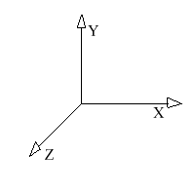
Software Class Structure for Magnetic Field Sources
PyORBIT Code
BaseFieldSource Class
(E,B) = F(r,t)
Field Source
#1
Shifted FieldSource Class
Has coordinate transformation
4x4 matrix
FieldSourceContainer Class
Container for set of BaseFiledSorces
DipoleFieldSource Class
B = const
Field Source
#1
Field Source
#3
QuadFieldSource Class
Bx = G*y
By = G*x
3D FieldSource Class
3D Map of B(x,y,z)
Container
System
Field Source
#2
Each field source has its own internal coordinate system

Slide 18
Tracker: Runge-Kutta 4th Order Differential Equation Solver
Lorentz Equation
Tracker solves Lorentz equation of motion for a relativistic particle using the field source container
User must specify
  a desired accuracy and initial number of integration steps
  The entrance and exit planes as equation
Slow. About 100 times slower than our usual matrix like Hamiltonian tracker

Slide 19
FNAL Design: Pulsed Dipole + Large Aperture Quad

Slide 20
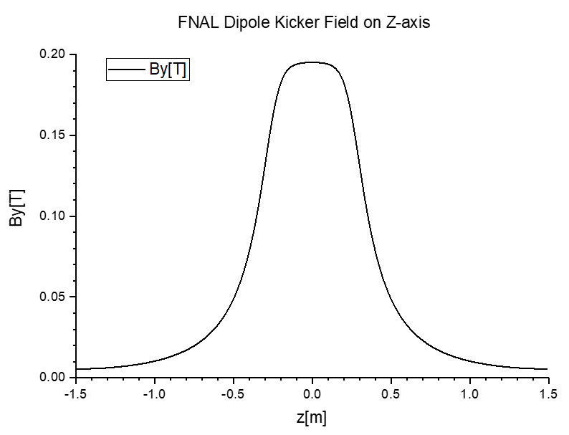
Used Field Sources – Dipole Kicker
Ideal quads and 3D Map from FNAL for large aperture quad
Ideal dipole and 3D map dipole with a field map from FNAL
FNAL Dipole Map was defined only for y > 0 and z >0 region of space. The symmetric considerations were used for other regions
z > 0
z < 0
x < 0
y > 0
x > 0
y > 0
x < 0
y > 0
x > 0
y > 0
x < 0
y < 0
x > 0
y < 0
x < 0
y < 0
x > 0
y < 0
8 regions – for 6 we used symmetric transformations

Slide 21
Symmetric Transformation Verifications
Fields in all quadrants demonstrated the correct symmetry (as expected).

Slide 22
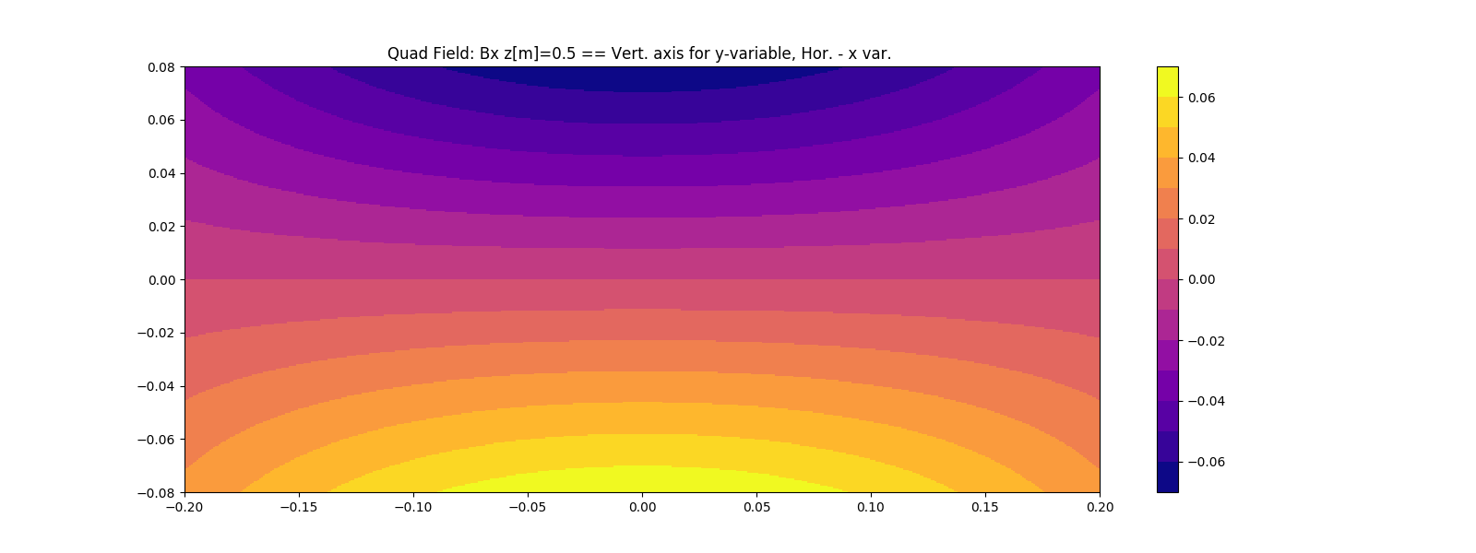
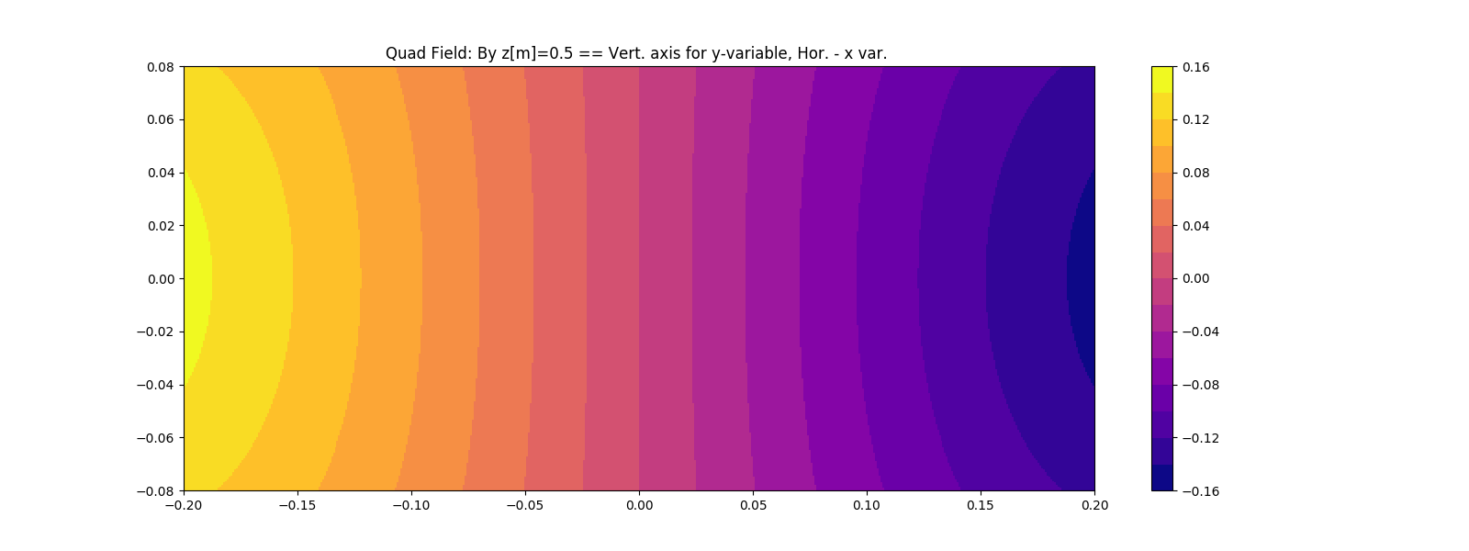
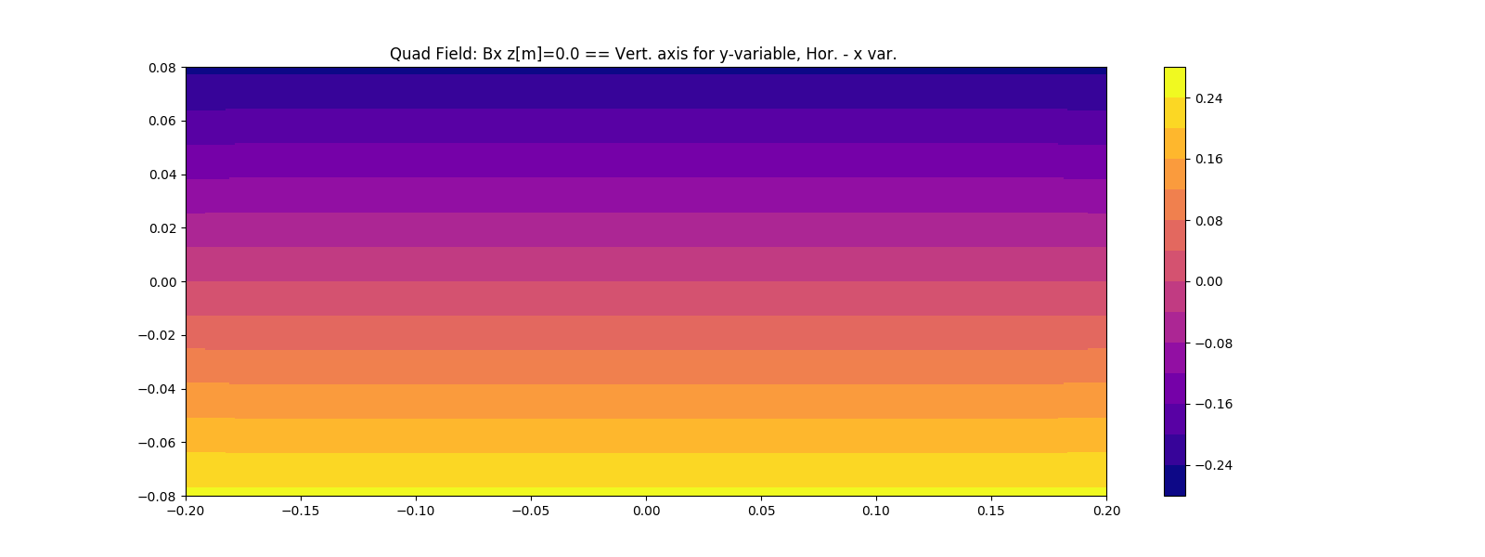



3D Field Map and Symmetry for Quad
B_{x}
B_{y}
B_{z}
Z = 0.5 m
Z = 0. m
Z = -0.5 m

