Slide 1
Pulsed Dipole (25D50) Mechanical Interfaces
Austin Chaires Accelerator Systems Mechanical Engineer
PULSED DIPOLE PRELIMINARY DESIGN REVIEW
March 6, 2023

Slide 2
Outline
Magnet – stand interface
Metrology interfaces
Handling
Cooling system interface
Electrical interfaces

Slide 3
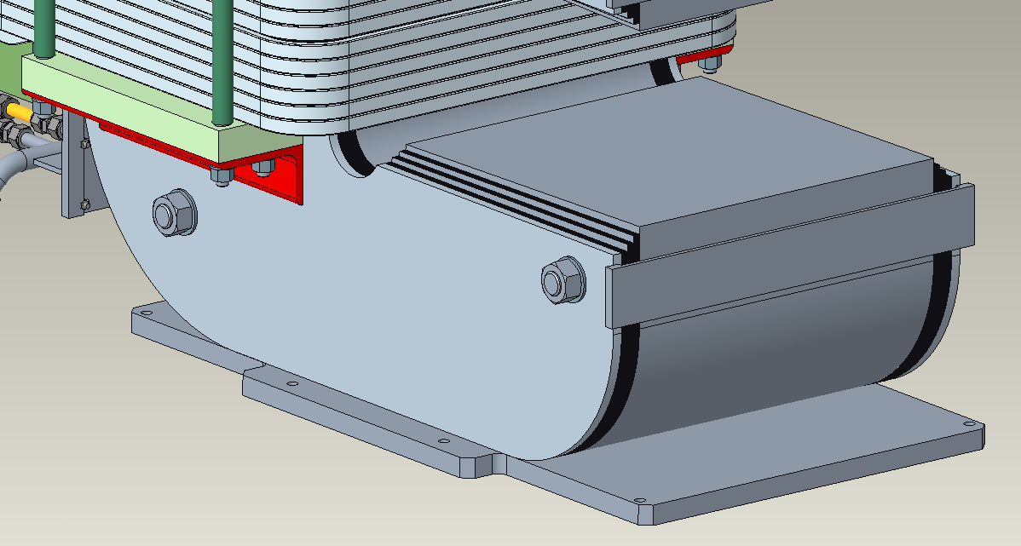
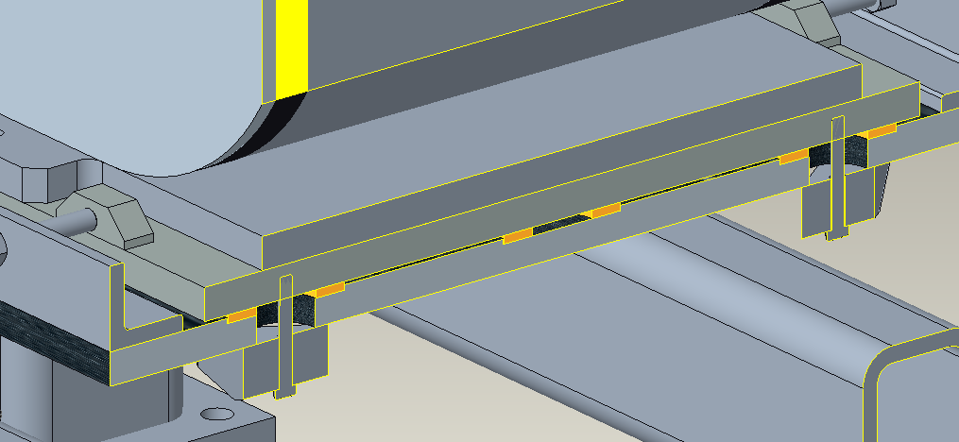
Magnet to Stand Interface
The magnet has a stability plate on the bottom welded to the two vertical stainless-steel side plates. For interfacing to the stand, it is placed on top of the stand’s top sliding plate and attached via fasteners.
Fillet Welds
A Concept Stand design for reference
Top Sliding Plate
Holes for Mounting
Stability Plate

Slide 4
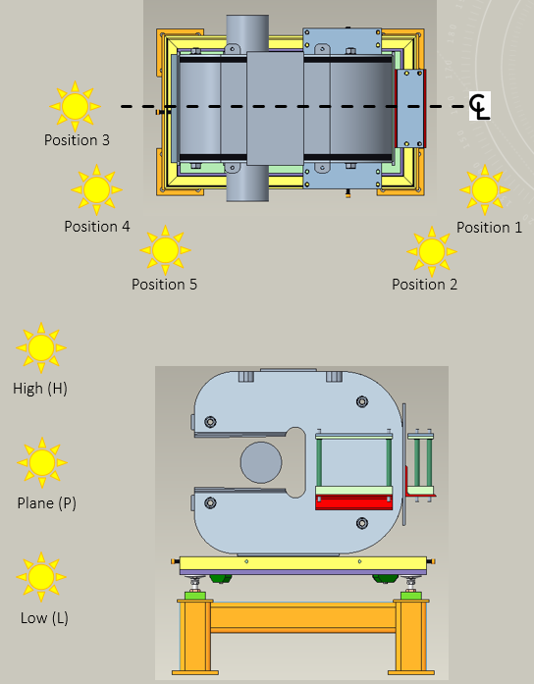
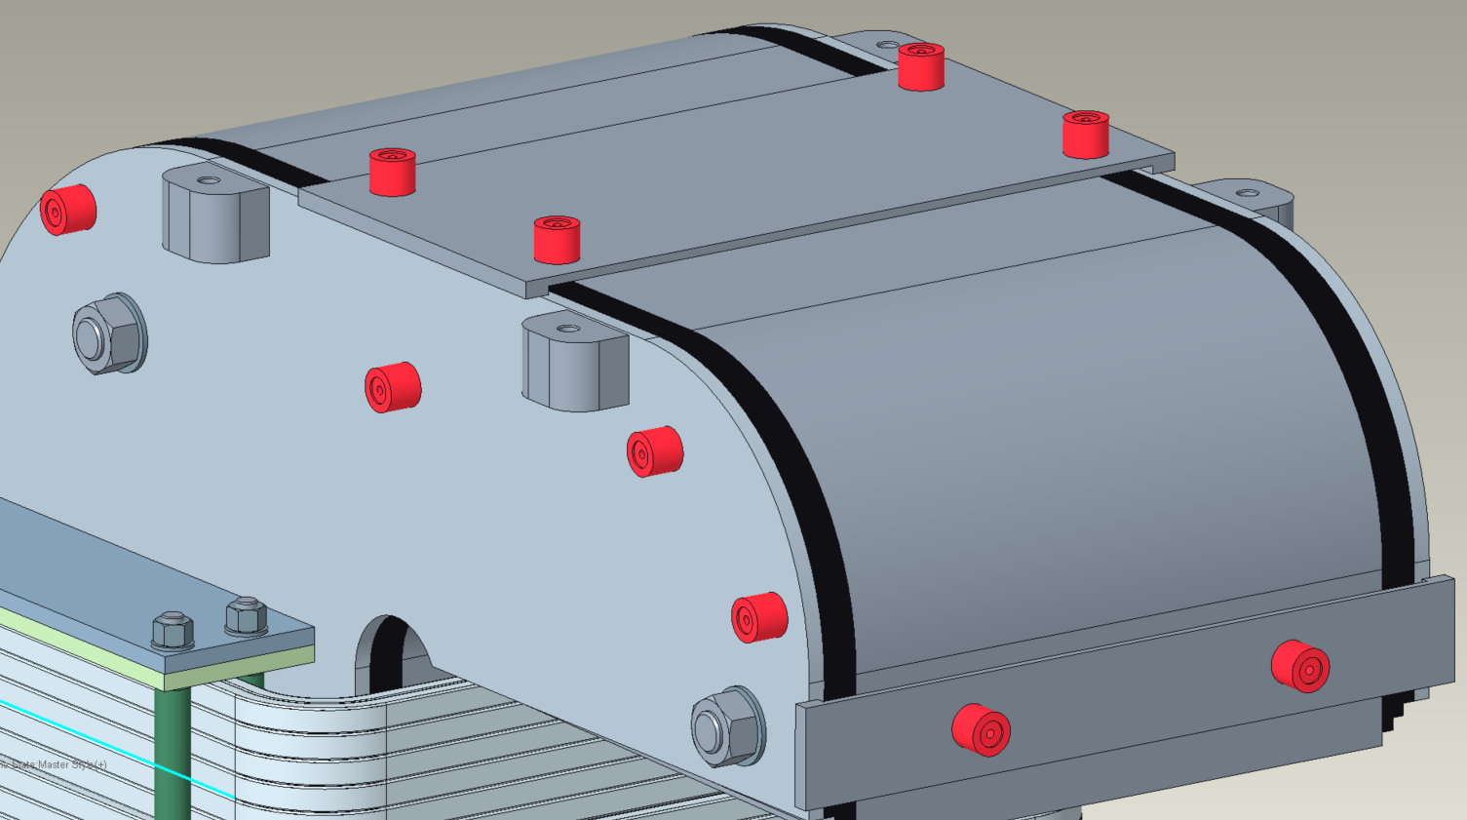
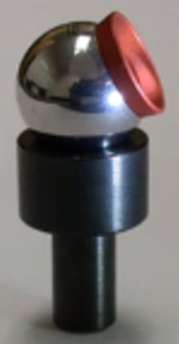
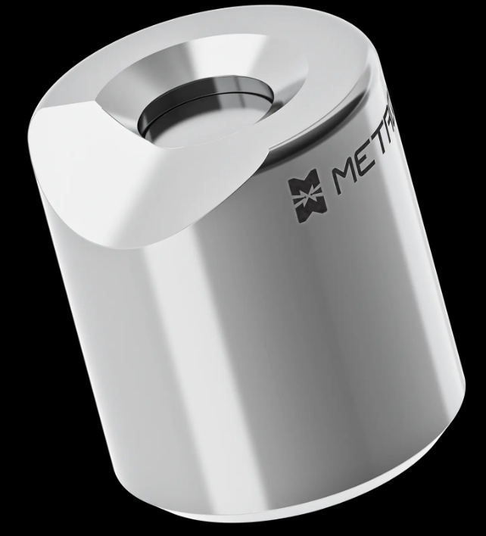
Metrology Interfaces
Magnet mapping and installation require the using of metrology equipment to precisely align the magnetic field (or other designated origin feature) relative to the expected beam trajectory.
Custom spherical mount reflectors (SMRs) nests welded on four sides of the magnet allowing for 4 or more location points to be recorded at one laser location.
This nest arrangement meets the requirements of the SNS metrology group.
Relative positions for laser tracker
Left: 0.5” SMR and Nest commonly used SNS Equipment. Right: Potential COTS option for SMR nest
Example Position 4H
Laser Locations

Slide 5
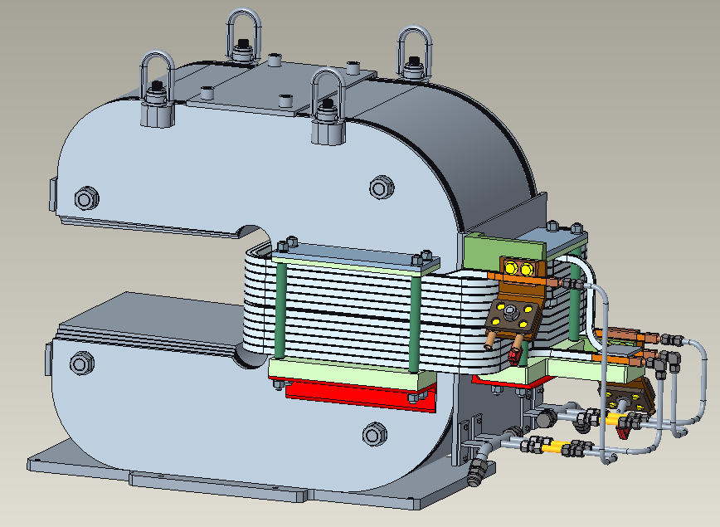
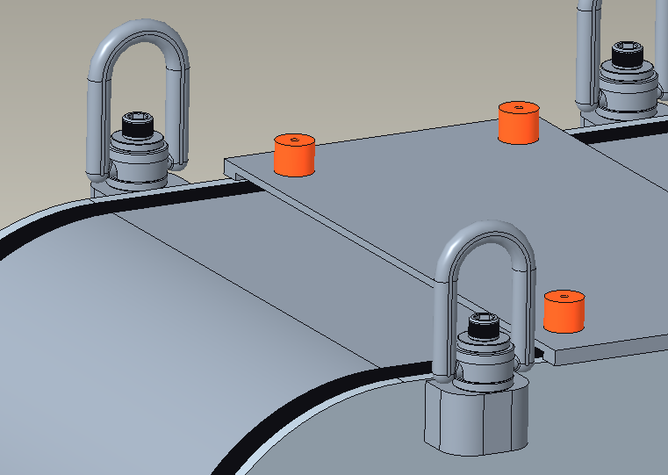
Handling
Lifting the magnet and the stand individually are requirements. The magnet has 4 lifting points at the top, boss features with M16 threaded holes. One lifting option could be swiveling hoist rings with a 1900 kg working load limit to lift the 3.5E3 kg (7700 lbs) magnet.
Hoist Rings

Slide 6
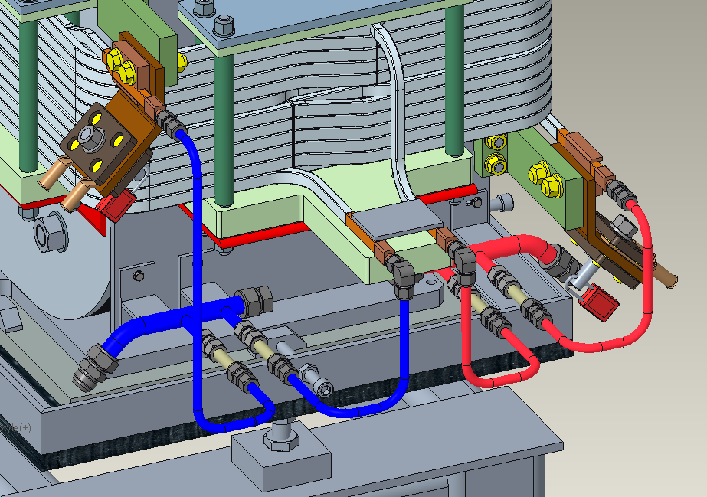
Cooling System Interface
Combined power dissipation of both coils under normal operating conditions is approximately 3.4 kW. This heat will be extracted via the existing beamline deionized water system. Cooling water supply and return connections are made to 2-way manifolds which then supply each coil independently. Maximum inlet pressure and temperature are 150 PSI and 95° F (35° C). At pressure drop of 20 PSI (0.14 MPa), total predicted flow rate is 2.2 GPM. Expected temperature rise will be 10.8° F (6° C).
Upper Coil
Inlet
Lower Coil
Outlet
2-way
Manifold
3/4” AN Fitting
DI Water Return
3/4” AN Fitting
DI Water Supply
Lower Coil
Inlet
Upper Coil Outlet

Slide 7
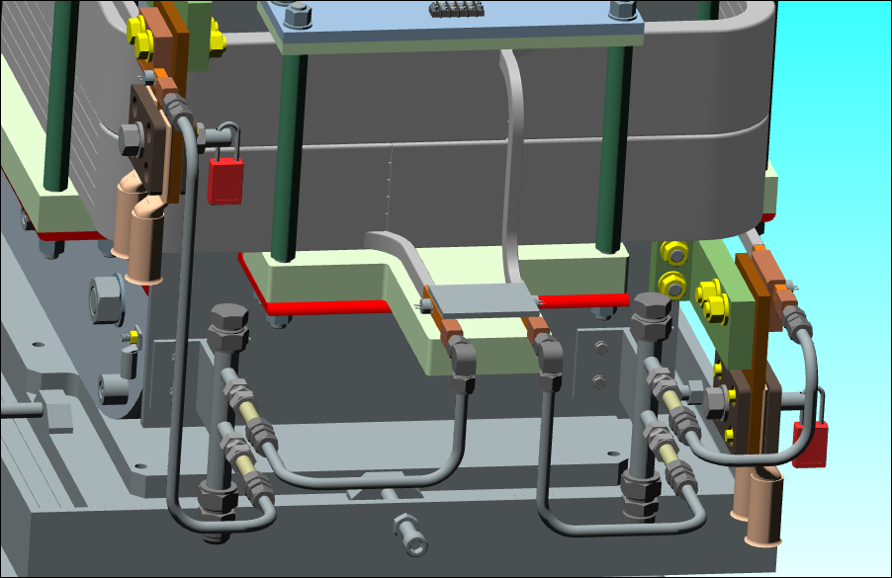
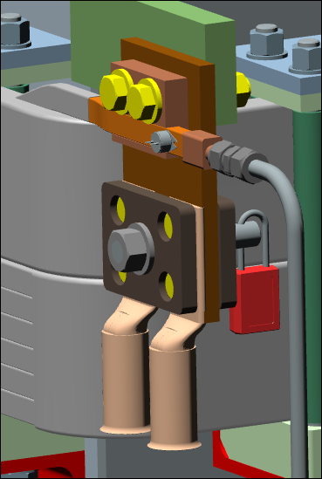
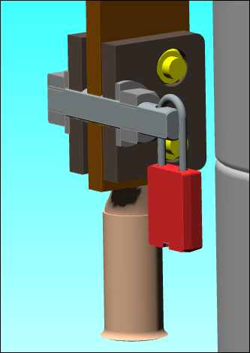
Electrical Interface – Power Connections
To meet National Electrical Code ampacity requirements, power for the magnet will be carried via two 535 kcmil conductors in parallel. Cables will be terminated with two-hole style copper compression lugs and fastened to the magnet connection flags.
Pulsed dipoles are considered a personnel protection radiation safety device. Therefore, connections are guarded by shrouds and secured by locks that are under control of the SNS radiation safety officer.
Safety Plate
G10 Bracket
Positive Terminal
Negative Terminal
Coil Lead
Hole & Lock
Electrical Bridge Between coils in series
Compression Lugs

Slide 8
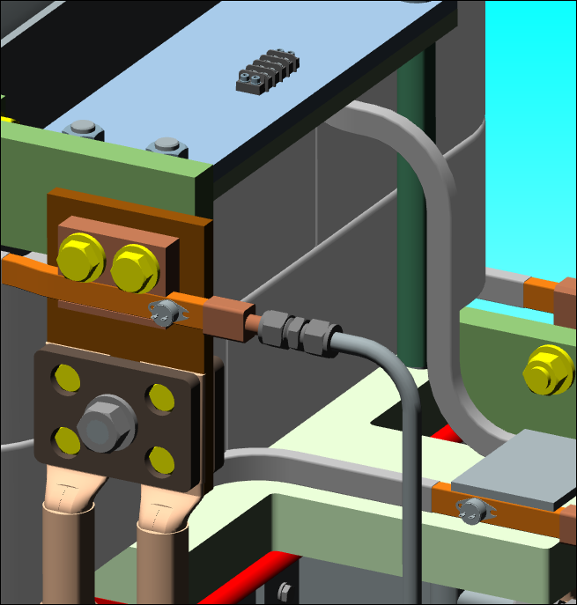
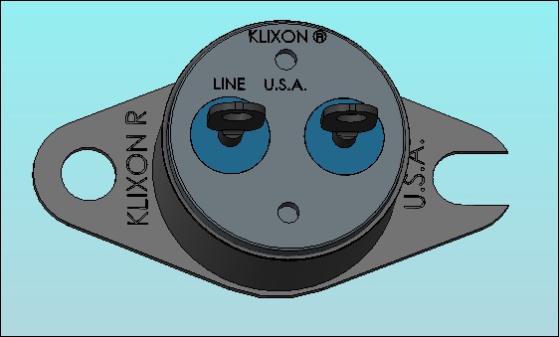
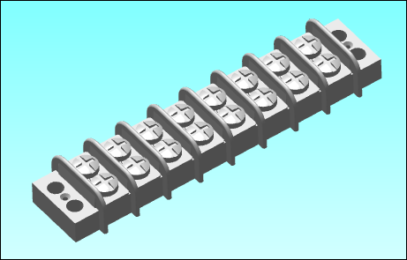
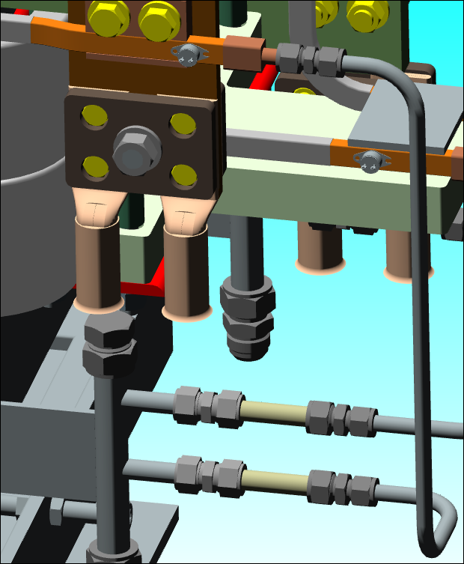
Electrical Interface – Temp Interlock, Voltage Break
Thermostat switches are mounted at each coil lead. If temperature exceeds 170° F, the switch opens and disables the power supply
Thermostat wiring leads are collected at a terminal strip
Thermostat Terminal Block
Peek insulators
Peek tube insulators provide electrical isolation between coil leads and the grounded water manifolds

Slide 9
Questions

