Slide 1
Pulsed Dipole System Functional Description
Larry Boyd
Accelerator Systems Electrical Lead
PULSED DIPOLE PRELIMINARY DESIGN REVIEW
March 6, 2023

Slide 2
Outline
Pulsed Dipole System Overview
SNS Timing System
≤ 15 Hz Validation System
Pulsed Power Supply / Amplifier
Power Supply Output Requirements
DCCT Hardware
Power Supply to Magnet Interconnection
Vacuum Chamber
Vacuum Chamber Heating

Slide 3
Pulsed Dipole System Overview
Timing system issues the ramp-up command to waveform generator prior to second-target protons loading into ring
The waveform generator outputs a low-level drive signal to be amplified for the magnet
The drive signal is intercepted by a physically and electrically autonomous in-line system that prevents excitation in excess of 15 Hz from reaching the current amplifiers
Waveform
Generator / Monitor
Amplifier
Magnet
SNS
Timing System
2
3
DCCT
1
Independent ≤15 Hz
Validation Circuit
Machine Protection
Magnet Current Readback

Slide 4
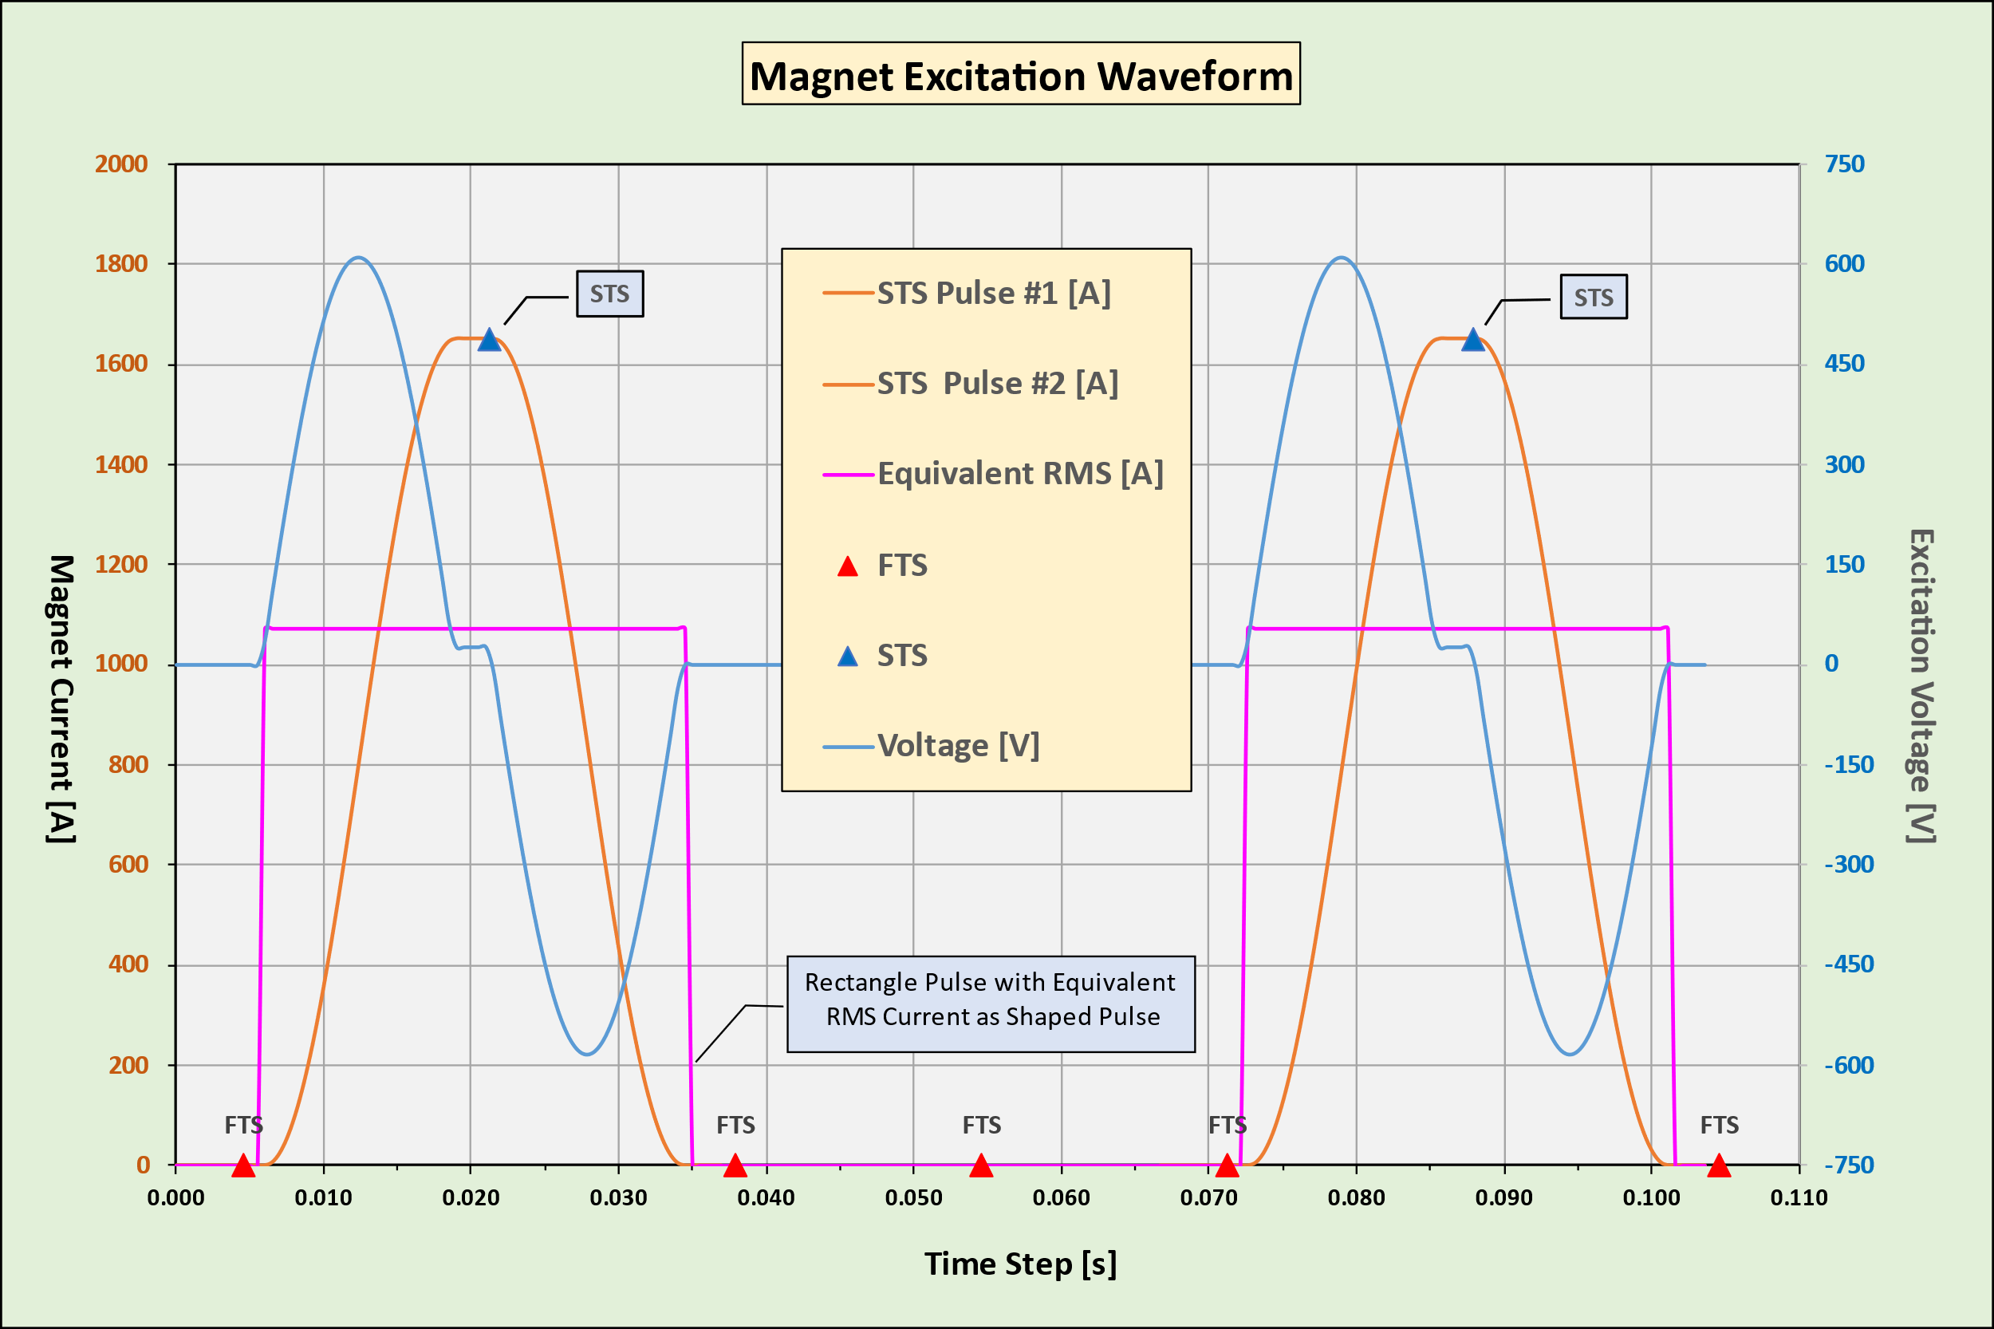
SNS Timing System
After the end of a first-target pulse…
Timing system informs the waveform generator the up-coming pulse is intended for second target
Generator starts excitation ramp-up for the second target pulse
Returns excitation to zero before next first target pulse

Slide 5
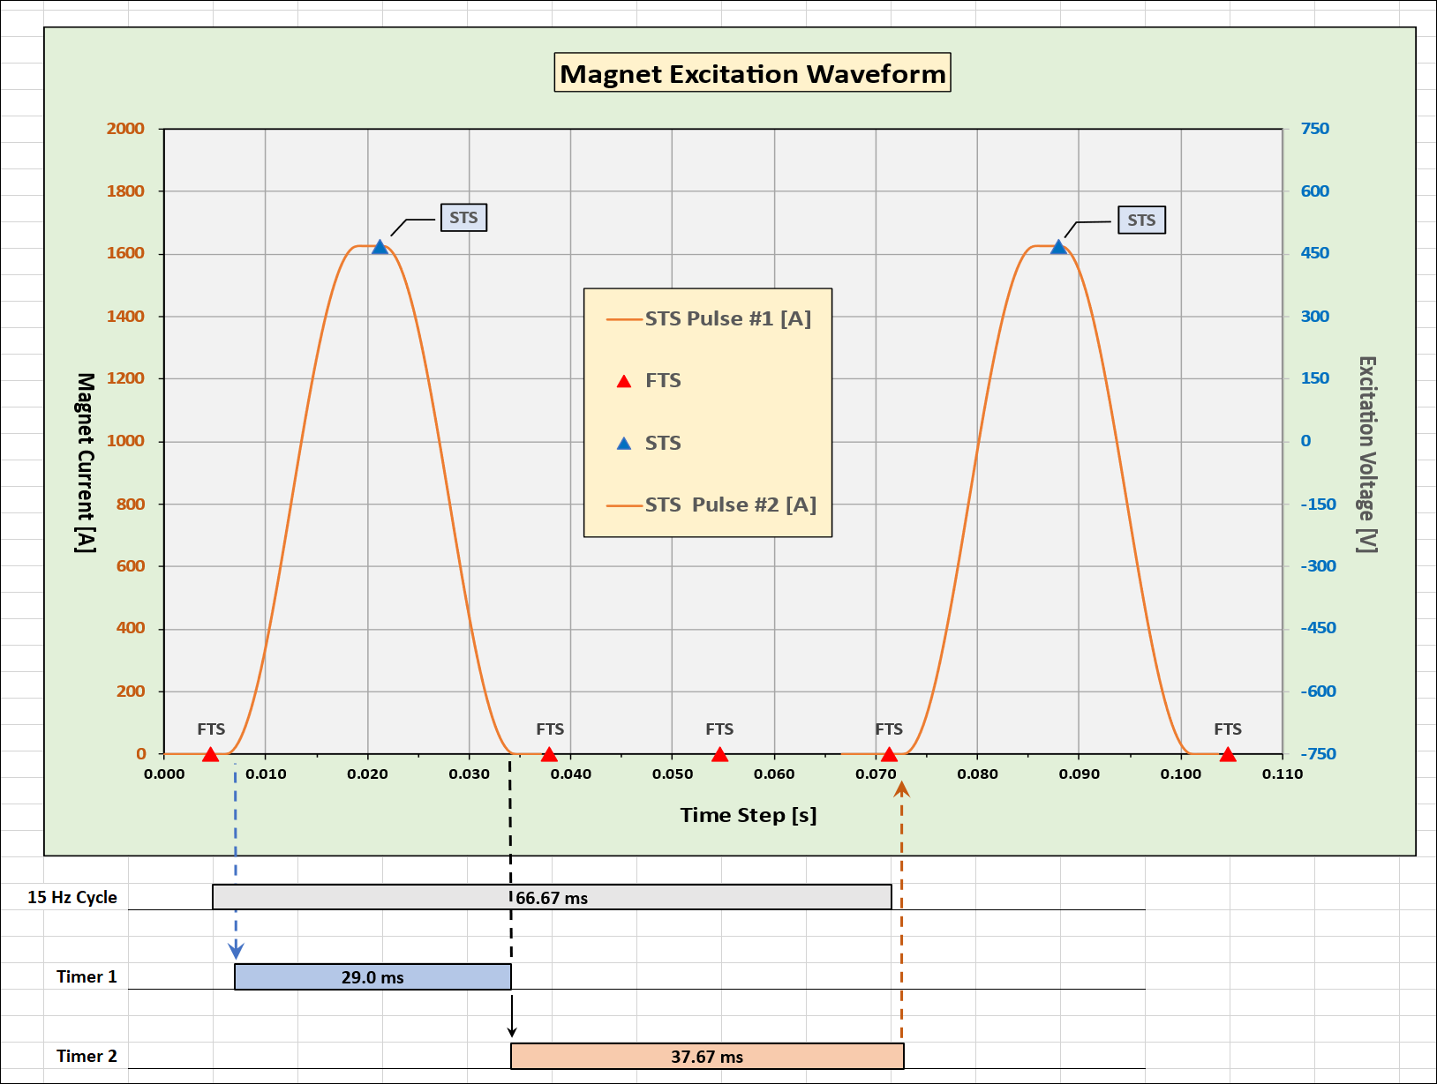
≤ 15 Hz Validation System
Incorporates two timers
  Timer 1 is triggered by onset of first excitation
  Timer 1 enables the signal path for maximum of 29 ms, only long enough for one pulse
  Timer 2 is trigged by expiration of Timer 1
  Timer 2 disables the signal path for the next three first-target proton pulses

Slide 6
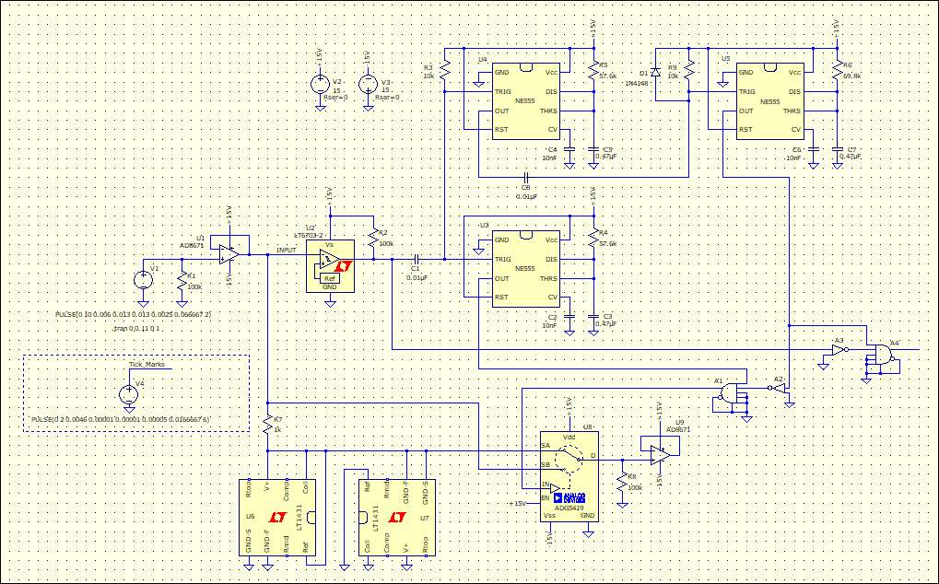
< 15 Hz Validation Circuit Simulation
Spice Circuit Simulation
  Signal Input Buffer
  Input Comparator
  Timer 1 triggered by input
  Timer 1 enables signal path for STS through analog switch
  Timer 2a and 2b generate a dead-zone that disables signal path during FTS
1
2
5
3
4

Slide 7
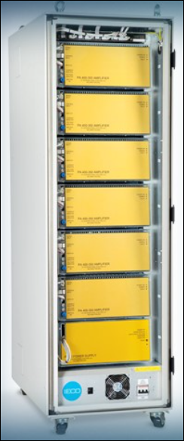
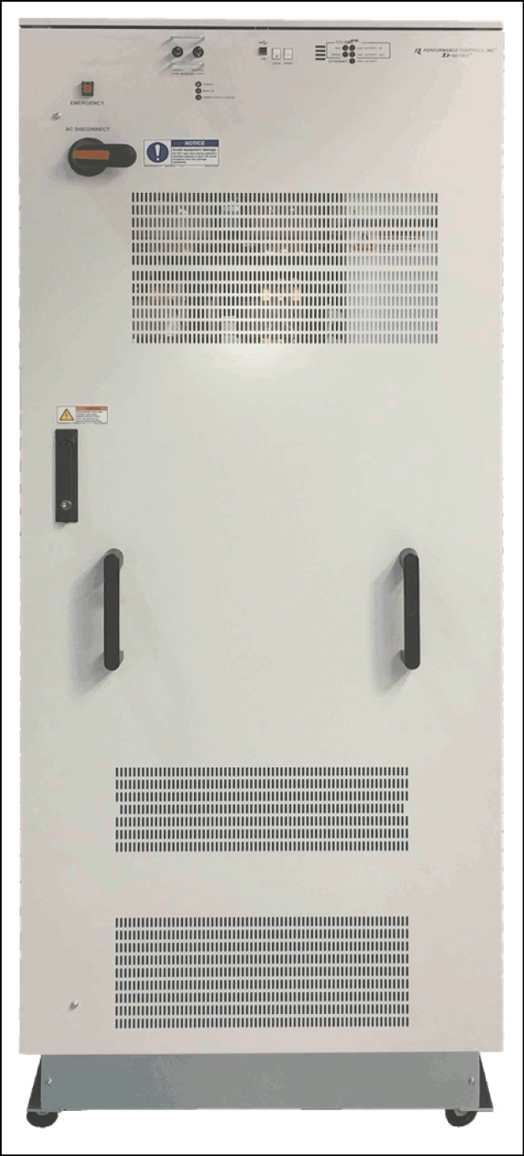
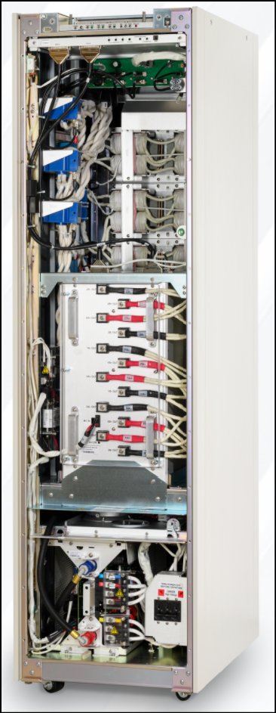
Pulsed Power Supply / Amplifier
Several potential vendors
MRI gradient amplifiers modified to have a single high current output
IECO – Finland
Performance Controls Pennsylvania
Analogic - Boston

Slide 8
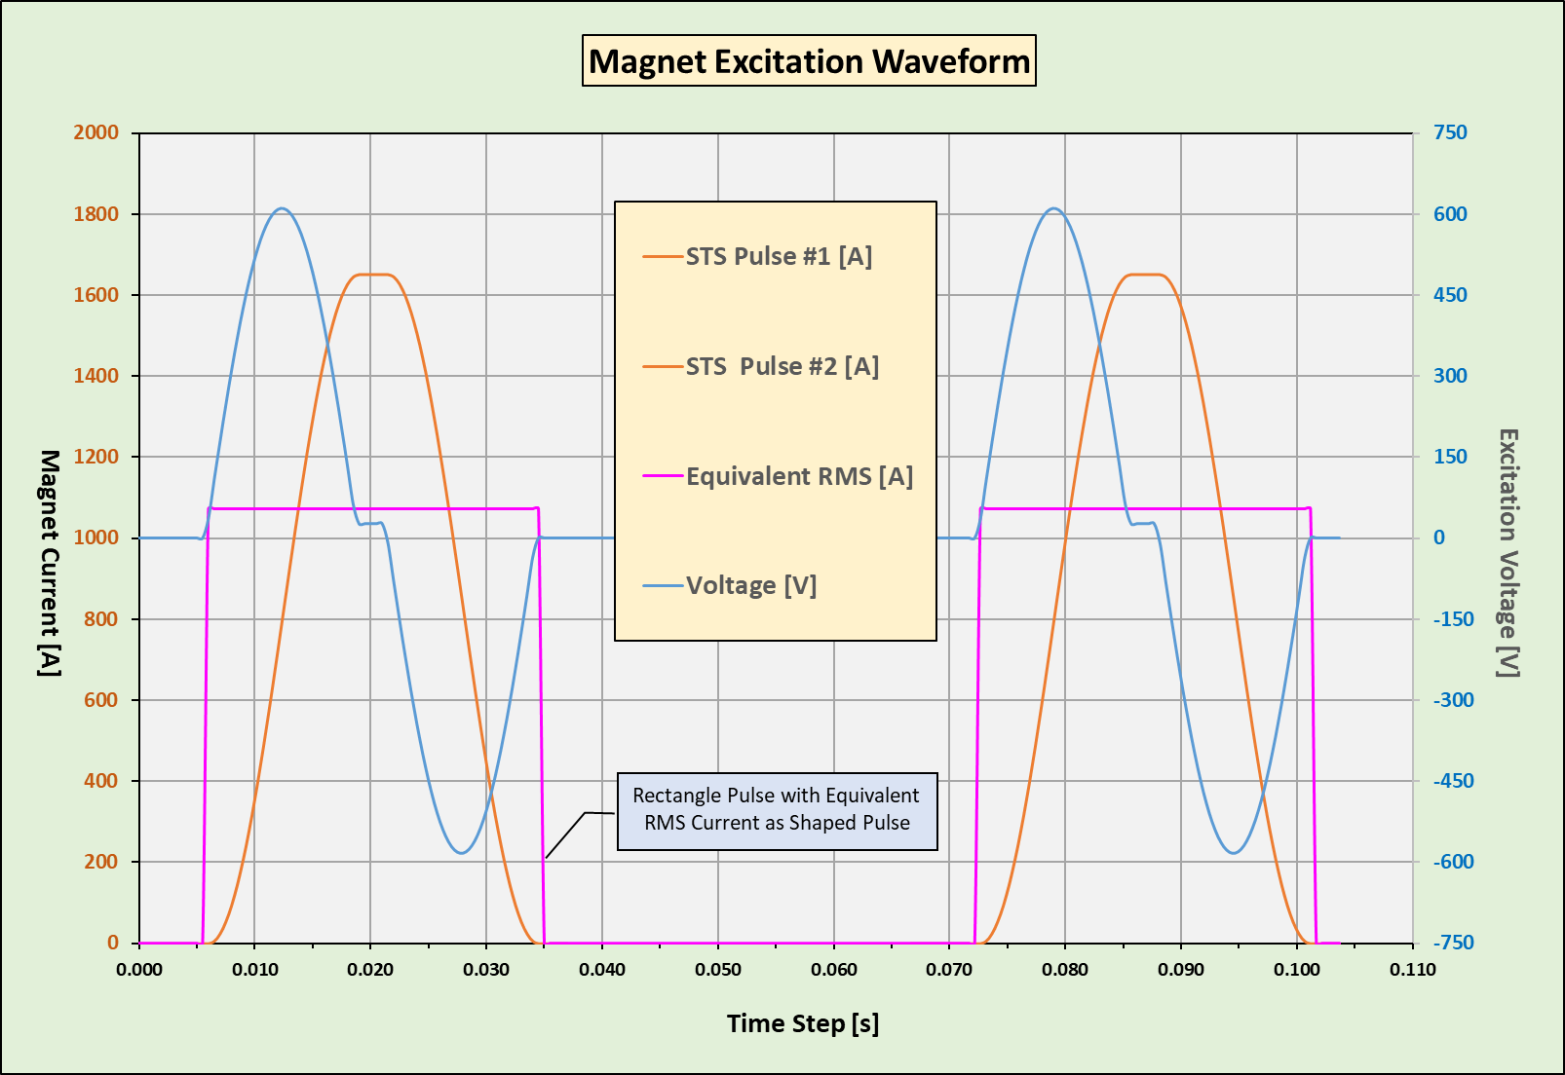
Power Supply Output Requirements
High peak current ≥ 1650 amps
Equivalent pulse rms current of 1100 amps
Duty cycle of 28.5 ms / 66.67 ms
Long term rms current is 65% of pulse rms = 700 amps

Slide 9
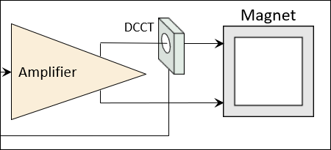
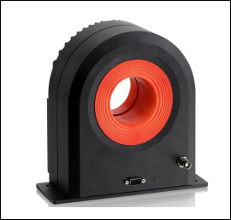
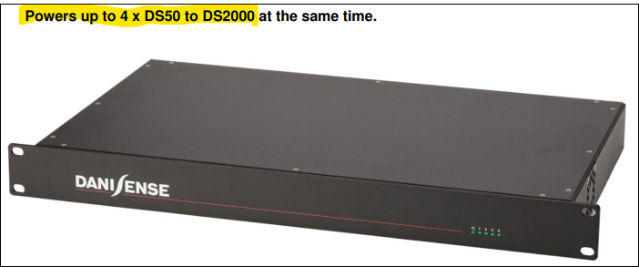
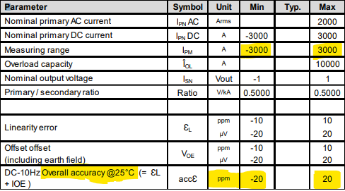
DCCT Solution
Provides independent feedback to waveform monitor
Need four transducers, one for each pulsed dipole
Extremely accurate

Slide 10
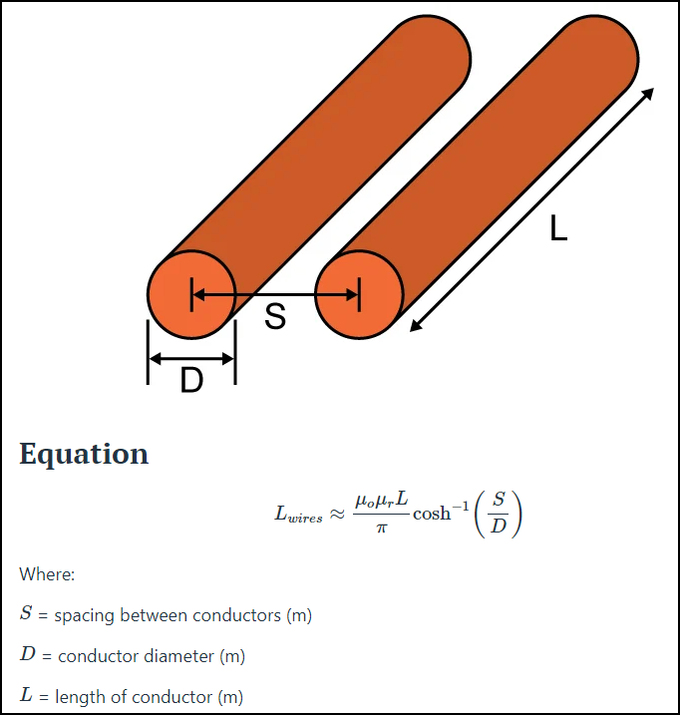
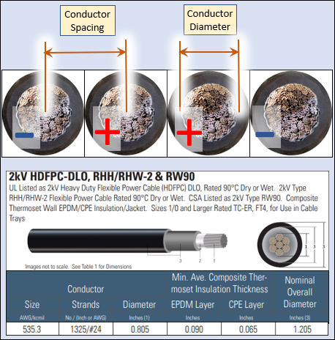
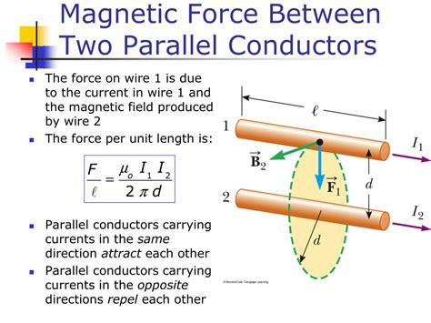
Power Supply Interconnection
Required ampacity ≥ 700 amps
https://www.allaboutcircuits.com/tools/parallel-wire-inductance-calculator/

Slide 11
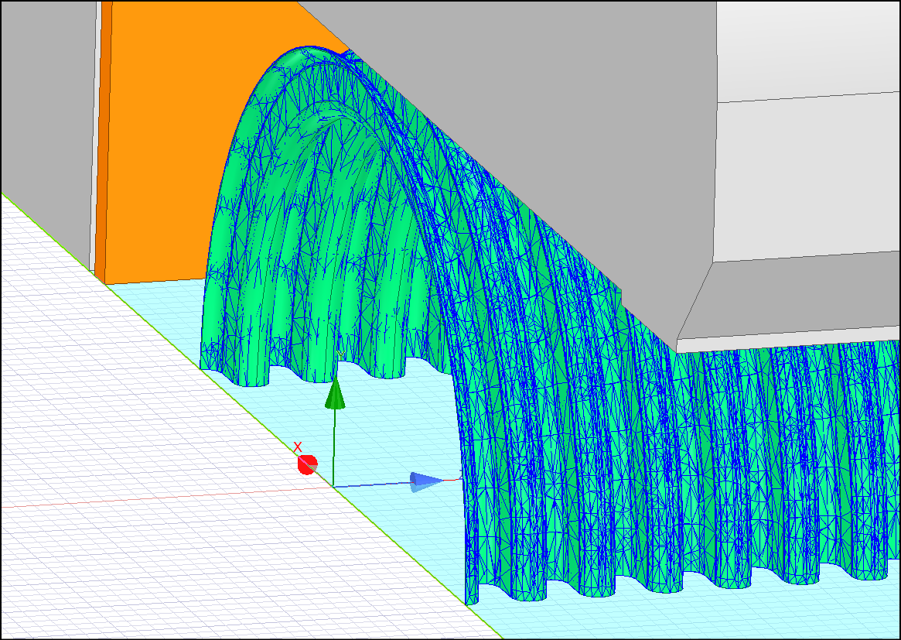
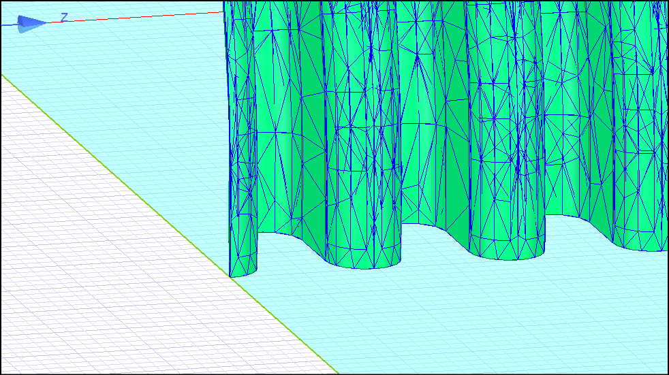
Pulsed Dipole Vacuum Chamber
Approach to vacuum chamber must account for ramping dipole field
Ramping field will induce Eddy current in metallic chambers
Circulating currents create resistive heating
Ceramic chambers were considered but not desirable
Proposing to use thin wall Inconel bellows
  0.3 mm (0.012”) wall

Slide 12
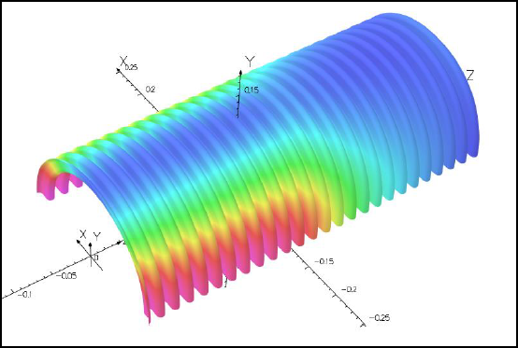
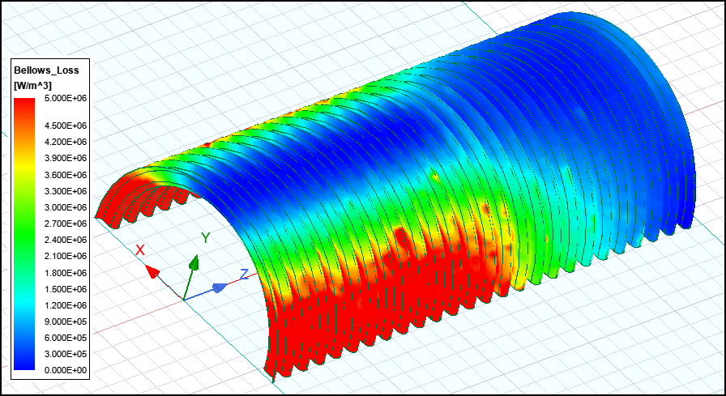
Vacuum Chamber Heating
Heat loss analyzed in both OPERA and Ansys
Very similar results
Eddy current disturbance of field quality decays rapidly
  Has no effect when protons arrive
V. Kashikhin, FNAL
Parameter | OPERA | Ansys
Inductance | 2.92 mH | 2.31 mH
Peak Voltage | 1877 V | 1400 V
Peak Field | 0.195 T | 0.195 T
Bellows Loss | 81 Watts | 84 Watts
L. Boyd, ORNL

Slide 13
Questions

