Slide 1
25D50 Proposed Magnetic Measurements
David Harding for Joe DiMarco
25D50 Preliminary Design Review
6 March 2023

Slide 2
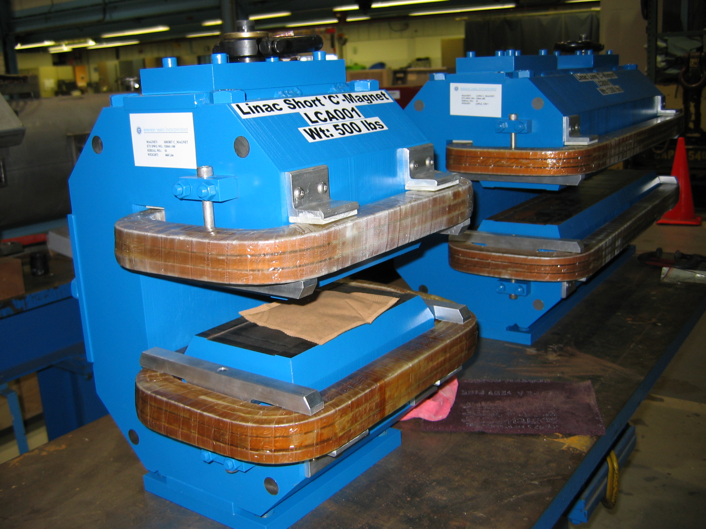
Measurements similar previous pulsed magnets
The proposed AC system would be similar to the one used on measurements of C-magnet measurements for the Fermilab MuCool Project (2005). This had:
  peak field of 0.65 T
  8.33 ms half-sine pulse
  15 Hz repetition rate.
For comparison, the STS will have:
  ~30ms pulse and 20ms flattop at center of pulse.
  15Hz repetition rate (every fourth cycle of 60Hz).
➔Fairly similar measurement parameters.
DiMarco, Joseph, et al. “A Fast-sampling, Planar Array for Measuring the AC Field of Fermilab Pulsed Extraction Magnets”, 2008.

Slide 3
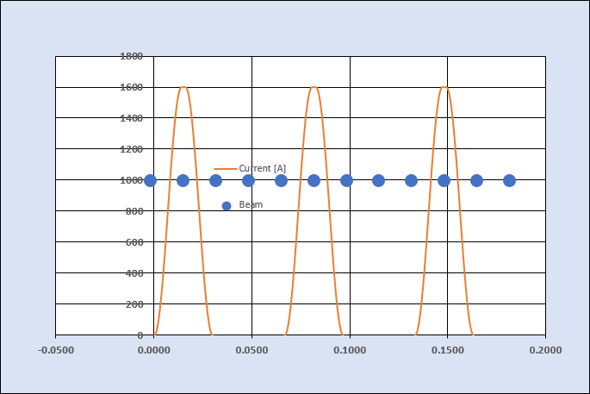
Current pulse for STS dipole measurements

Slide 4
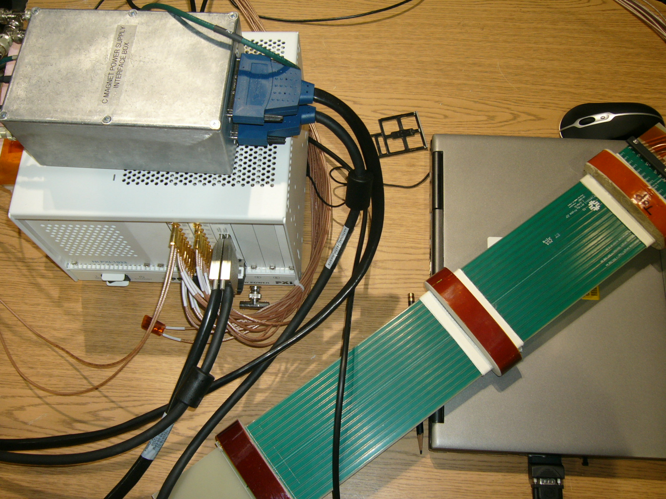
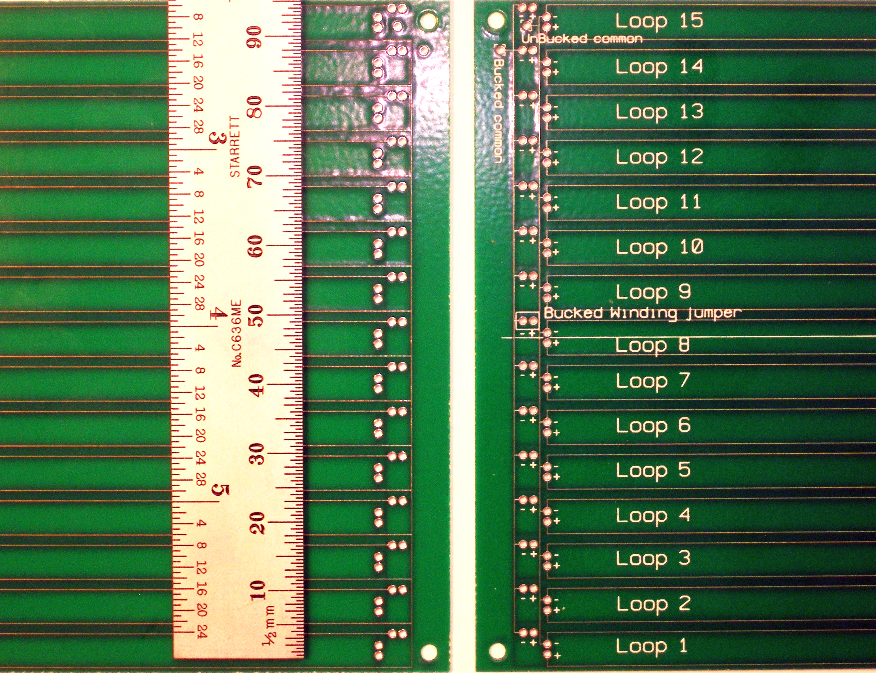
The C-magnet measurements used a single, 2-layer printed circuit board with 15 identical loops.
The array of coils was simultaneously sampled at data rates of up to 100 kHz with 10 kHz bandwidth using 24-bit ADC’s.
The PCBs were 550mm long by 97.5 mm wide,
We propose building a new, curved probe to cover the full magnet integral.
A similar probe is currently in the works for measurement of Fermilab Booster gradient magnets measurements slated for later this year (15 Hz and 20 Hz sine waves).

Slide 5
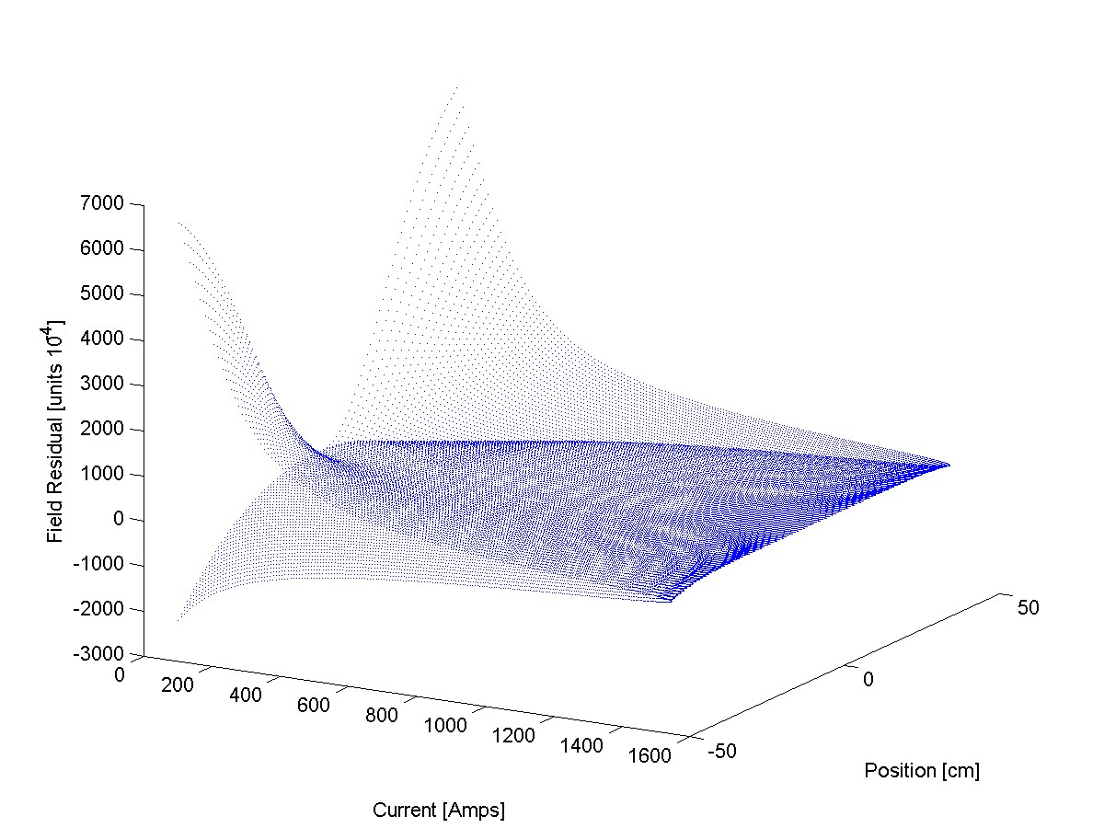
Measurements at 100kHz data acquisition sampling rate

Slide 6
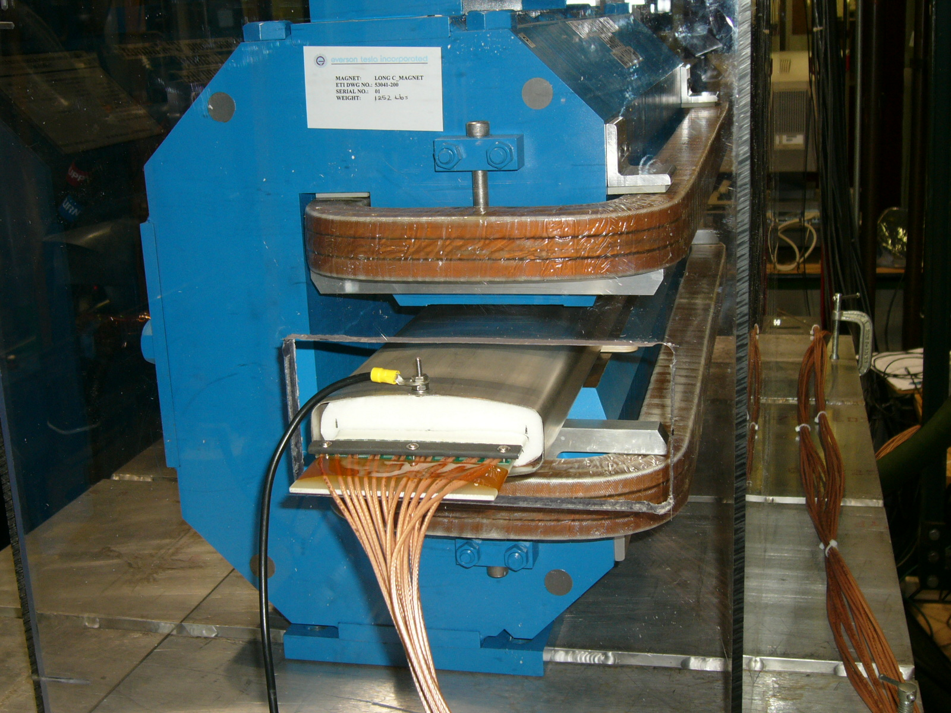
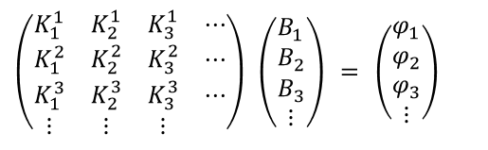

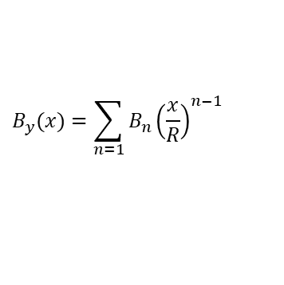
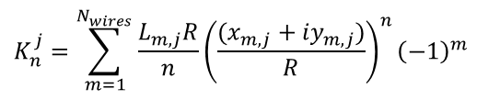
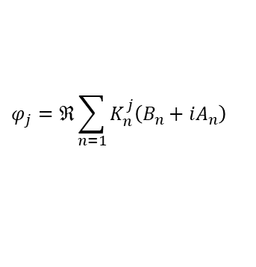
Harmonic field coefficients across the aperture can be determined
$$C_{n}=B_{n}+iA_{n}$$
$$φ_{j}=ℜ\sum_{n=1}{K_{n}^{j}\left(B_{n}+iA_{n}\right)}$$
$$K_{n}^{j}=\sum_{m=1}^{N_{wires}}{\frac{L_{m,j}R}{n}{\left(\frac{(x_{m,j}+iy_{m,j})}{R}\right)}^{n}{\left(−1\right)}^{m}}$$
$$\left(\begin{matrix}K_{1}^{1} & K_{2}^{1} & K_{3}^{1} & ⋯ \\ K_{1}^{2} & K_{2}^{2} & K_{3}^{2} & ⋯ \\ K_{1}^{3} & K_{2}^{3} & K_{3}^{3} & ⋯ \\ ⋮ & ⋮ & ⋮ & \end{matrix}\right) \left(\begin{matrix}B_{1} \\ B_{2} \\ B_{3} \\ ⋮\end{matrix}\right) = \left(\begin{matrix}φ_{1} \\ φ_{2} \\ φ_{3} \\ ⋮\end{matrix}\right)$$
$$B_{y}(x)=\sum_{n=1}{B_{n}{\left(\frac{x}{R}\right)}^{n−1}}$$

Slide 7
Harmonic Fields vs Current
Slices of field shape at currents of interest

