Slide 1
Single crystal update April 6, 2023
Yuxiang Guo, Dan Levin

Slide 2
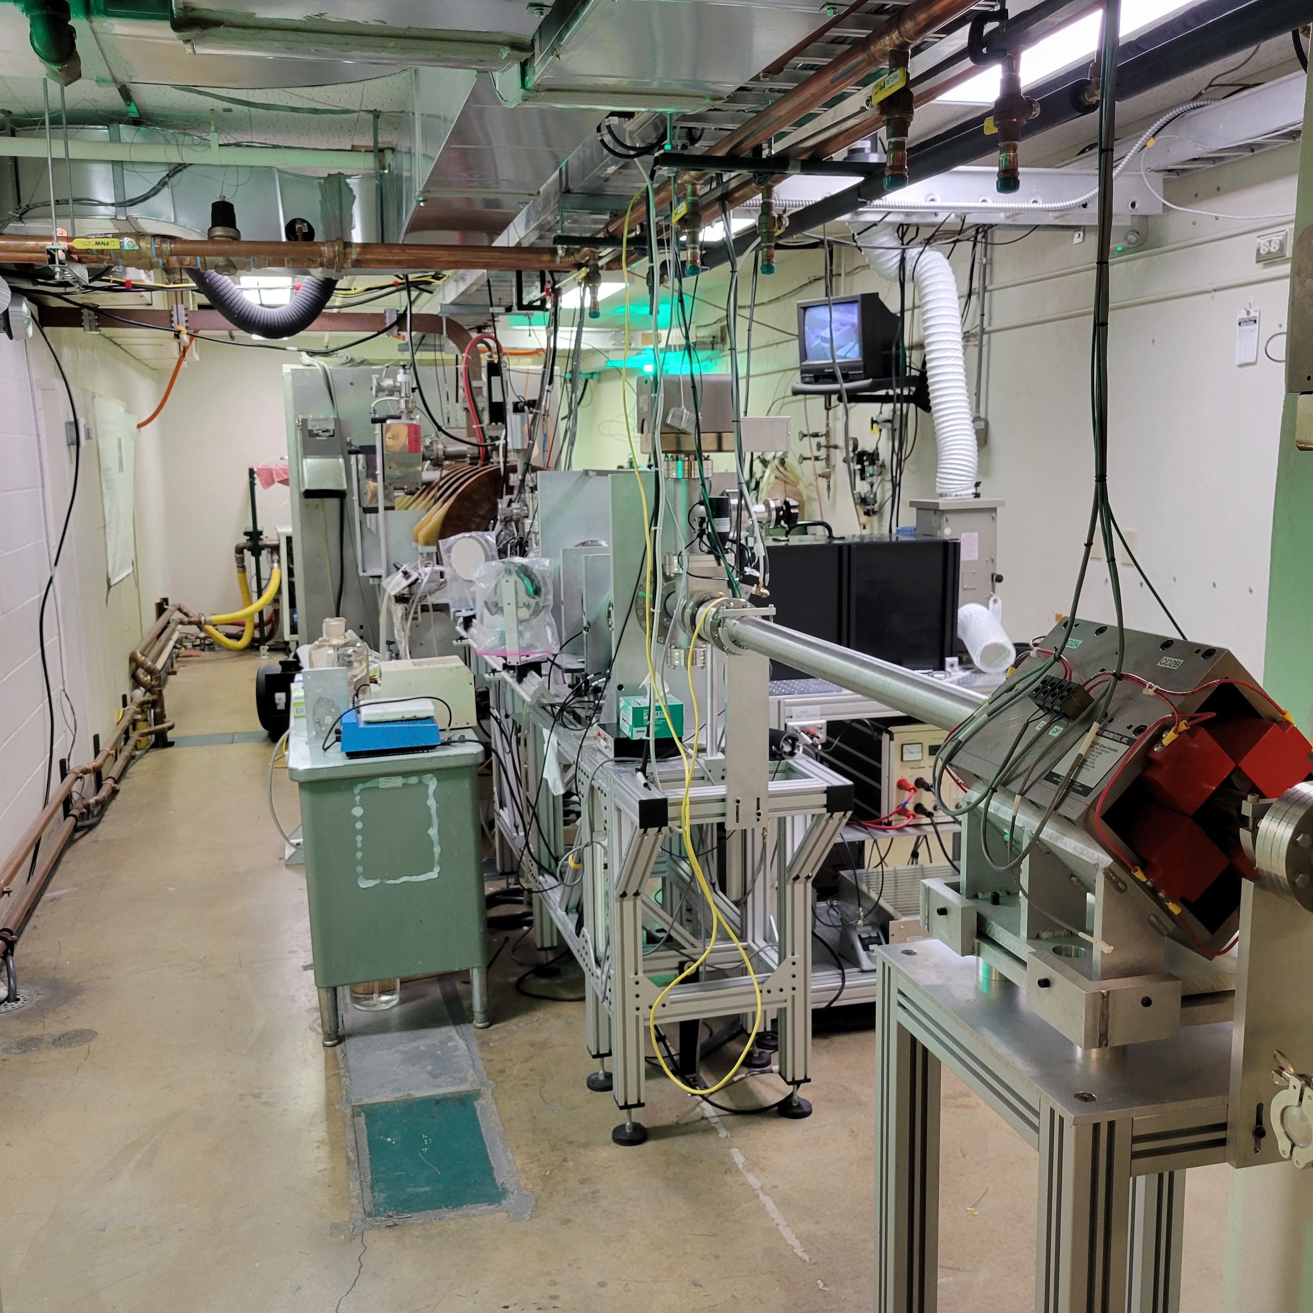
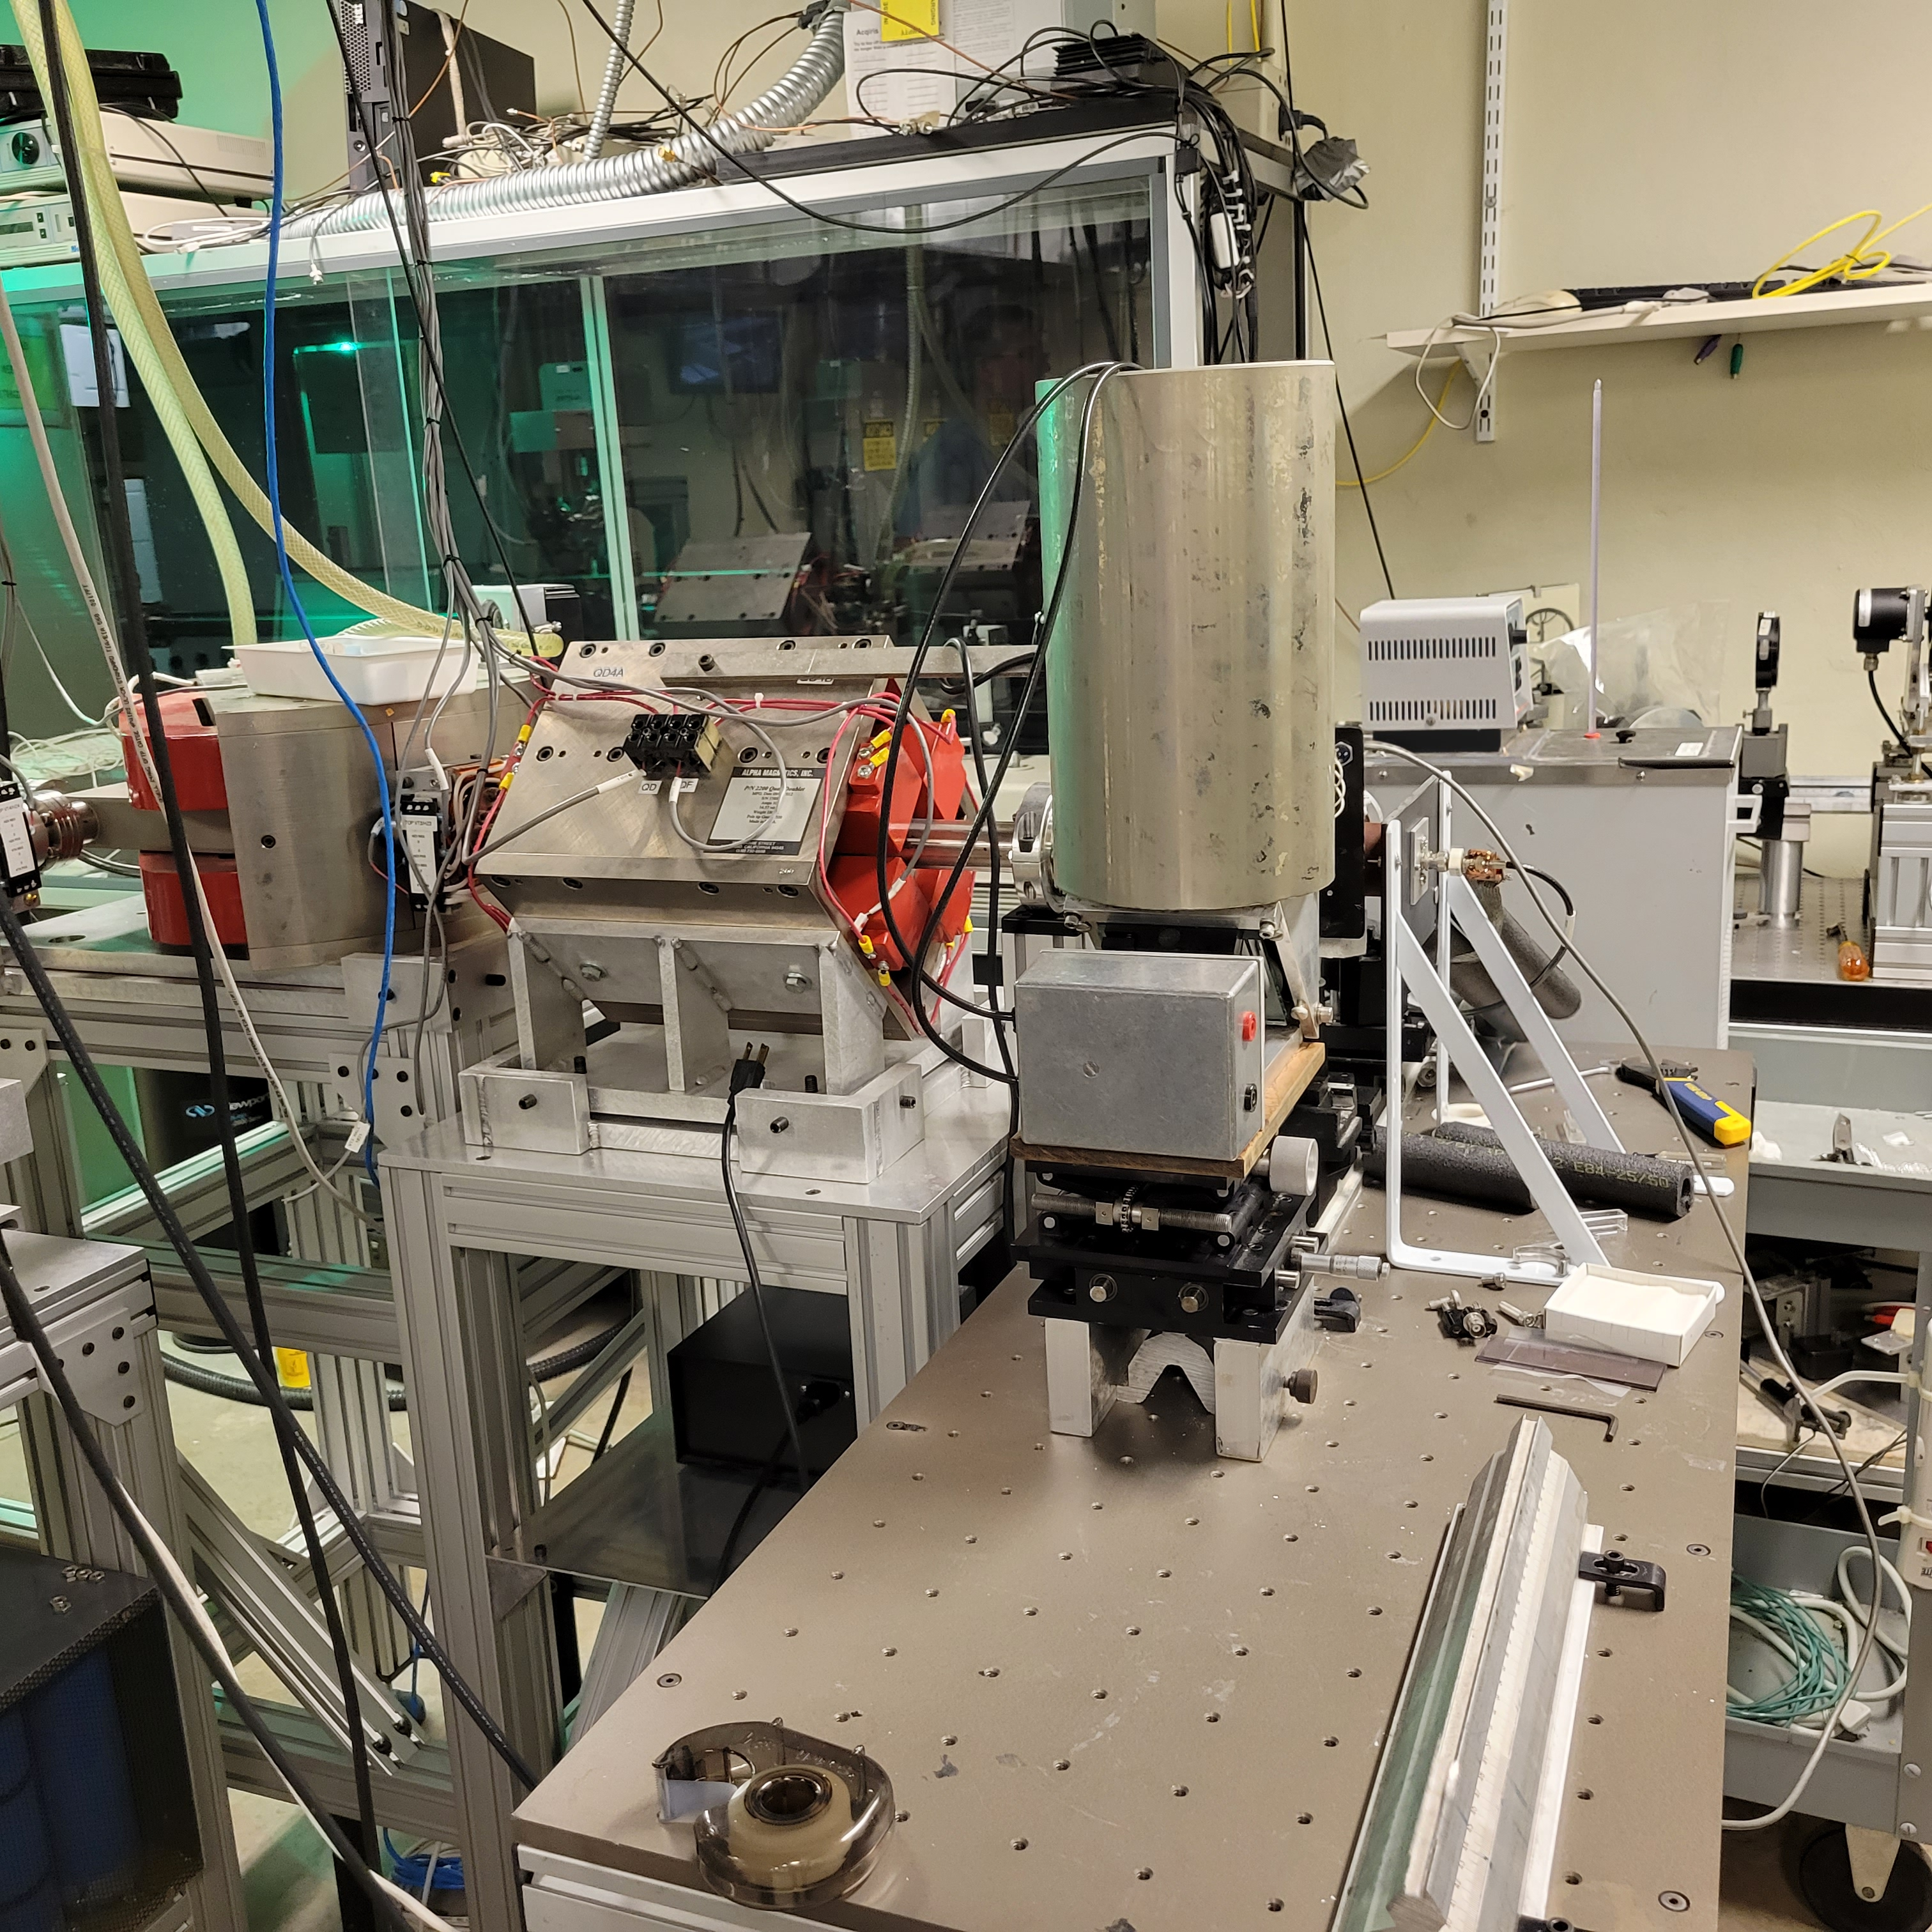
Proposal for a test beam at Notre Dame Radiation Lab
Beam line
Staging area

Slide 3
Test beam at Notre Dame Radiation Lab
NDRL has linac generating 8 MeV electrons
pulsed beam with injector: width = 1 ns to 1.6 us
Pulsed beam without injector ➔ width = 3 us → can get single particles- but will be difficult to calibrate
Can use small scintillator hodoscope to register single hits- but might be time consuming.
Will employ short ~ 1 ns pulse of many particles.
max current > 1 amp; minimum measurable charge per pulse
➔ 0.09 nC using in-line inductive pickup
➔ 0.007 nC for focused beam using Faraday cup = 3x10⁵ particles/pulse
defocus to achieve arbitrarily low rates
Gauge pulse intensity using the small hodoscope calibrated for MIPs
rep rate = 60 Hz
1 ns

Slide 4
Proposal for a test beam at Notre Dame Radiation Lab
3 mm bore
low particle count per pulse
rep rate = 60 Hz
1 –1600 ns

Slide 5
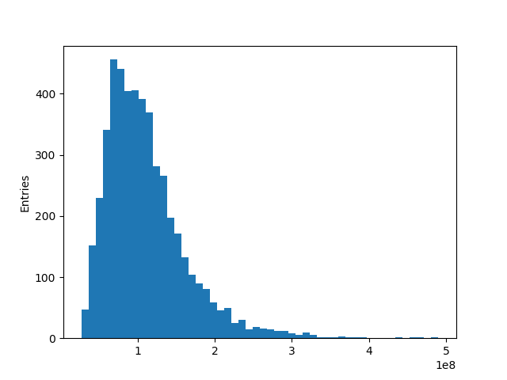
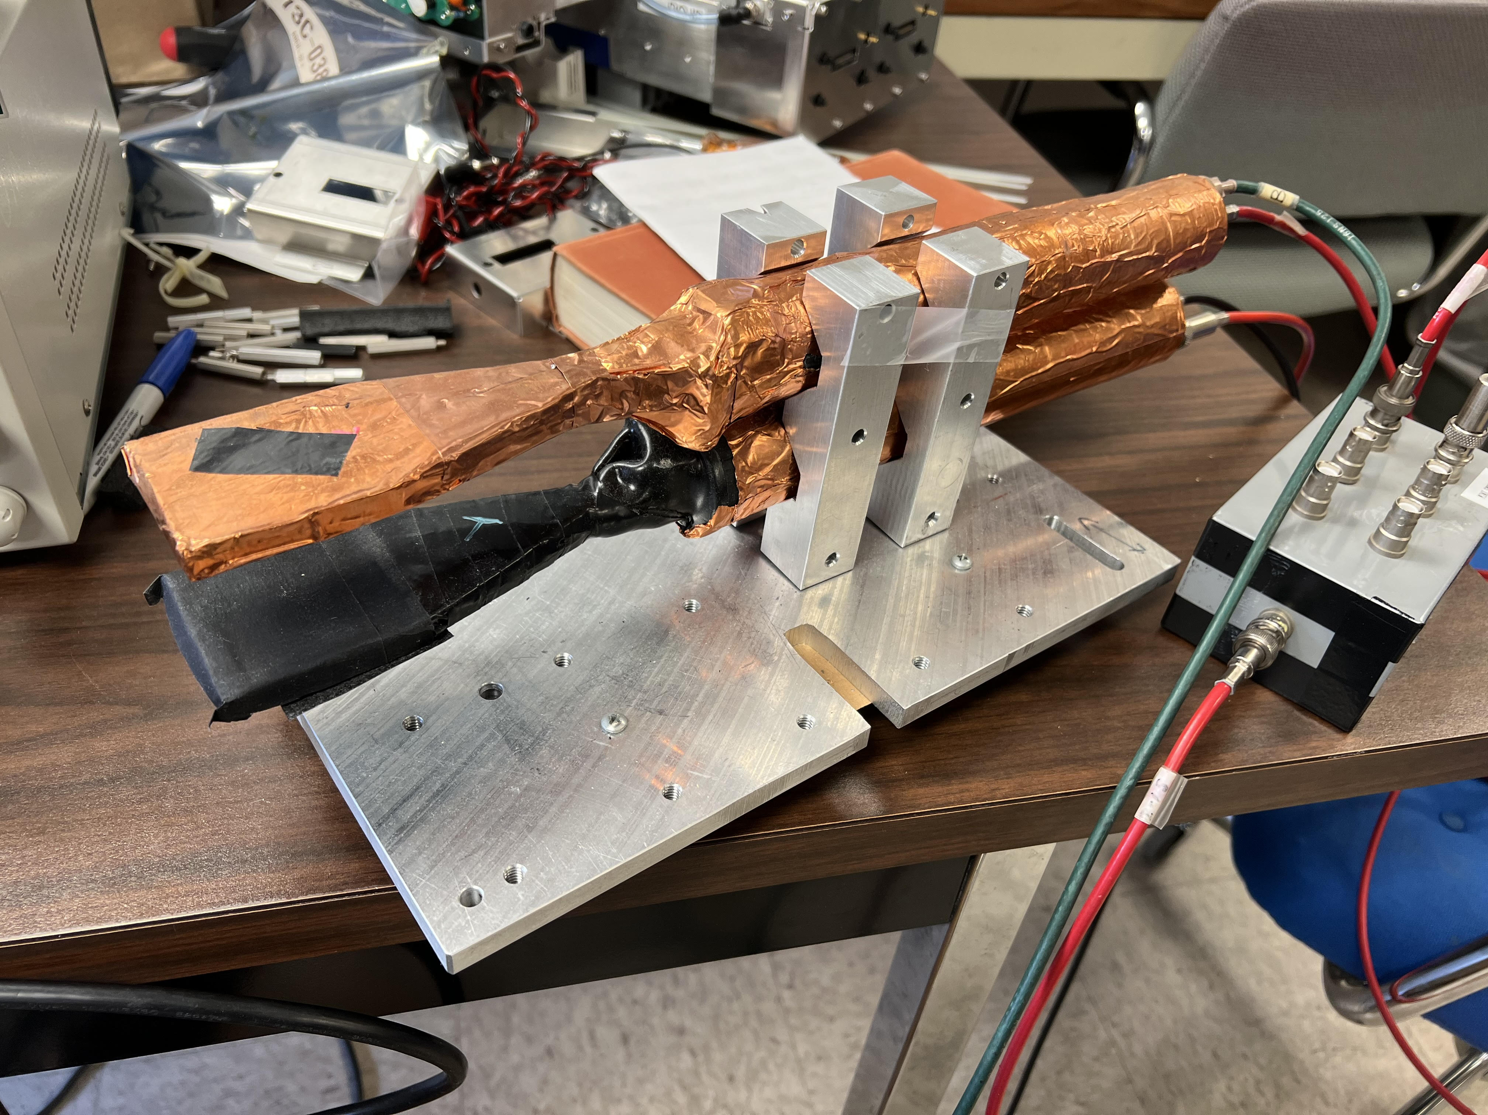
Estimate the charge /pulse using scintillator hodoscope
Hodoscope charge (unit: p.e.) measurement of cosmic muon
Coincidence rate: 7.7 s/event

Slide 6
Proposal for a test beam at Notre Dame Radiation Lab
4 SiPMs
area of each = 6mm x6 mm
PMT
4 SiPMs
area of each = 6mm x6 mm
𝜃
Beam angles: -90 < 𝜃 < 60
Beam radius ~ 5 mm

Slide 7
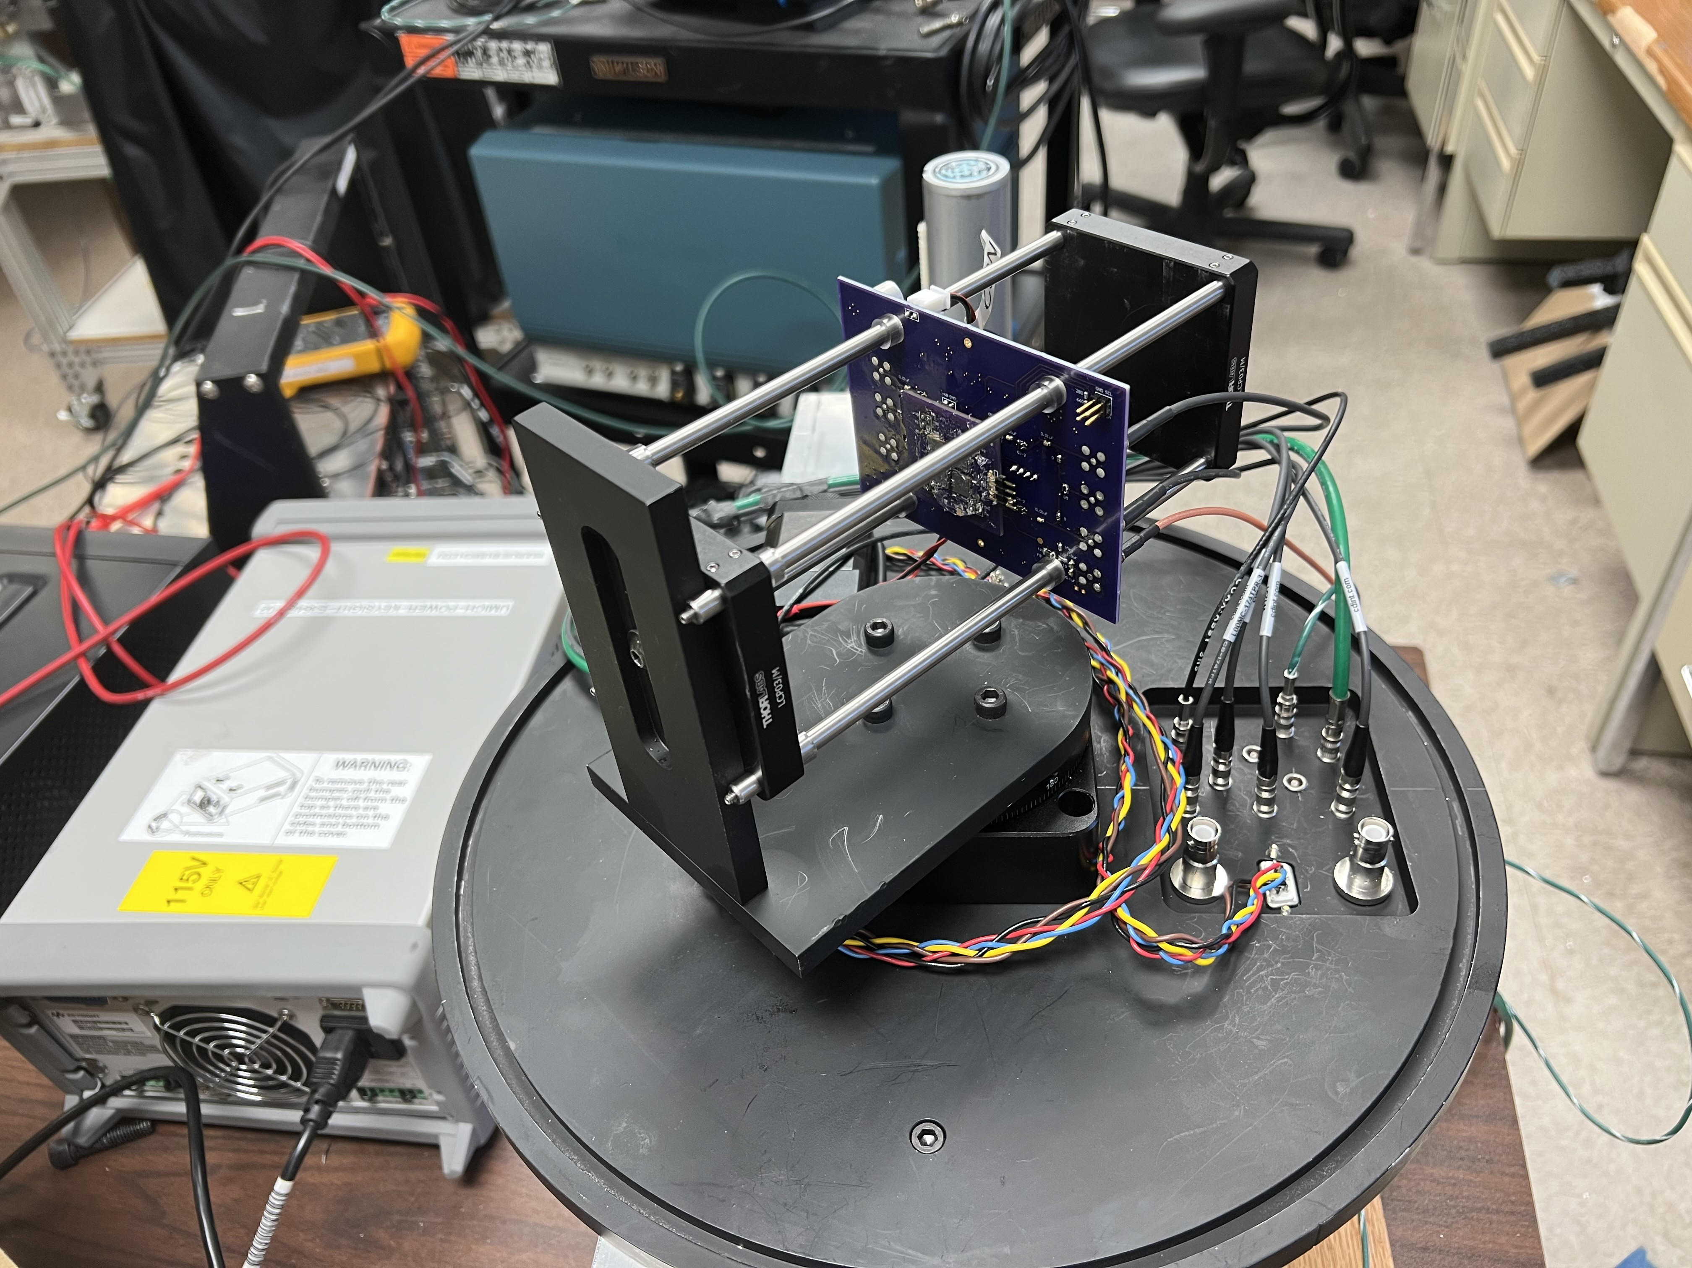
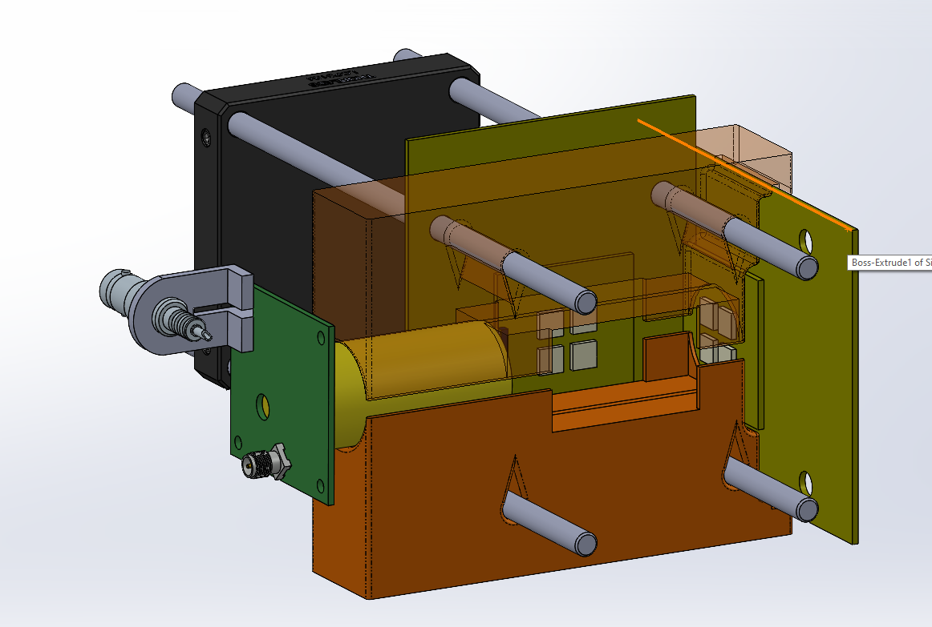
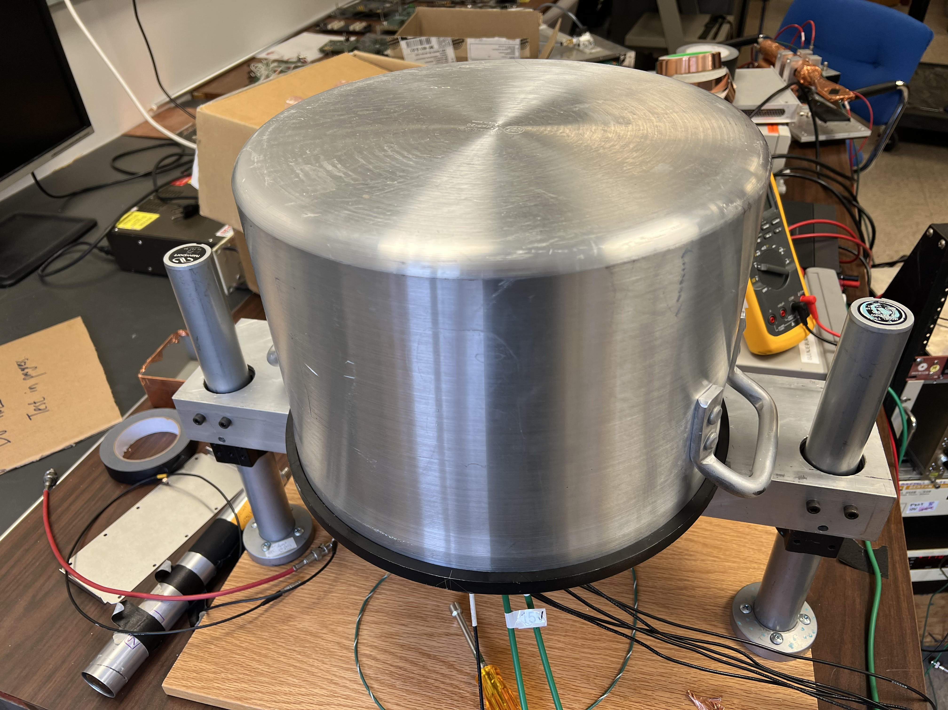
Setup
Rotating base
Crystal/SiPM holder
Lift base and cap

Slide 8
Test samples
Chemical | Density g/cm³ | Index refraction | Cerenkov |  | Scintillation
 |  |  | Threshold [MeV] | Yield ph/MeV | Peak 𝜆 | Yield ph/MeV | Decay time [ns]
PbWO₄ (PWO) | 8.28 | 2.16 | 0.066 | tbd | 420 | 200 | 6-20
Bi₄Ge₃O₁₂ (BGO) | 7.13 | 2.15 | 0.066 | 20 | 480 | 8K-10K | 300
PBF₂ | 7.8 | 1.8 | 0.103 |  |  | ~500
Optical glass Silica (59%) + PbO or BaO +ZnO | 2.2 | 1.46 | 0.190 | tbd | -- | -- | --

Slide 9
Experimental considerations
Look for Cerenkov signal features:
in optical glass block as reference without scintillation
evaluate with SiPMs = with/without long wavelength pass filter
evaluate light yield vs angle of incidence.
For Scintillation no angular effect expected.
(is there a systematic effect ?)
For Cerenkov expect some possible effect forward vs backward
Evaluate for BGO, PWO, Optical glass
Evaluate usefulness of NDRL for future experiments

Slide 10
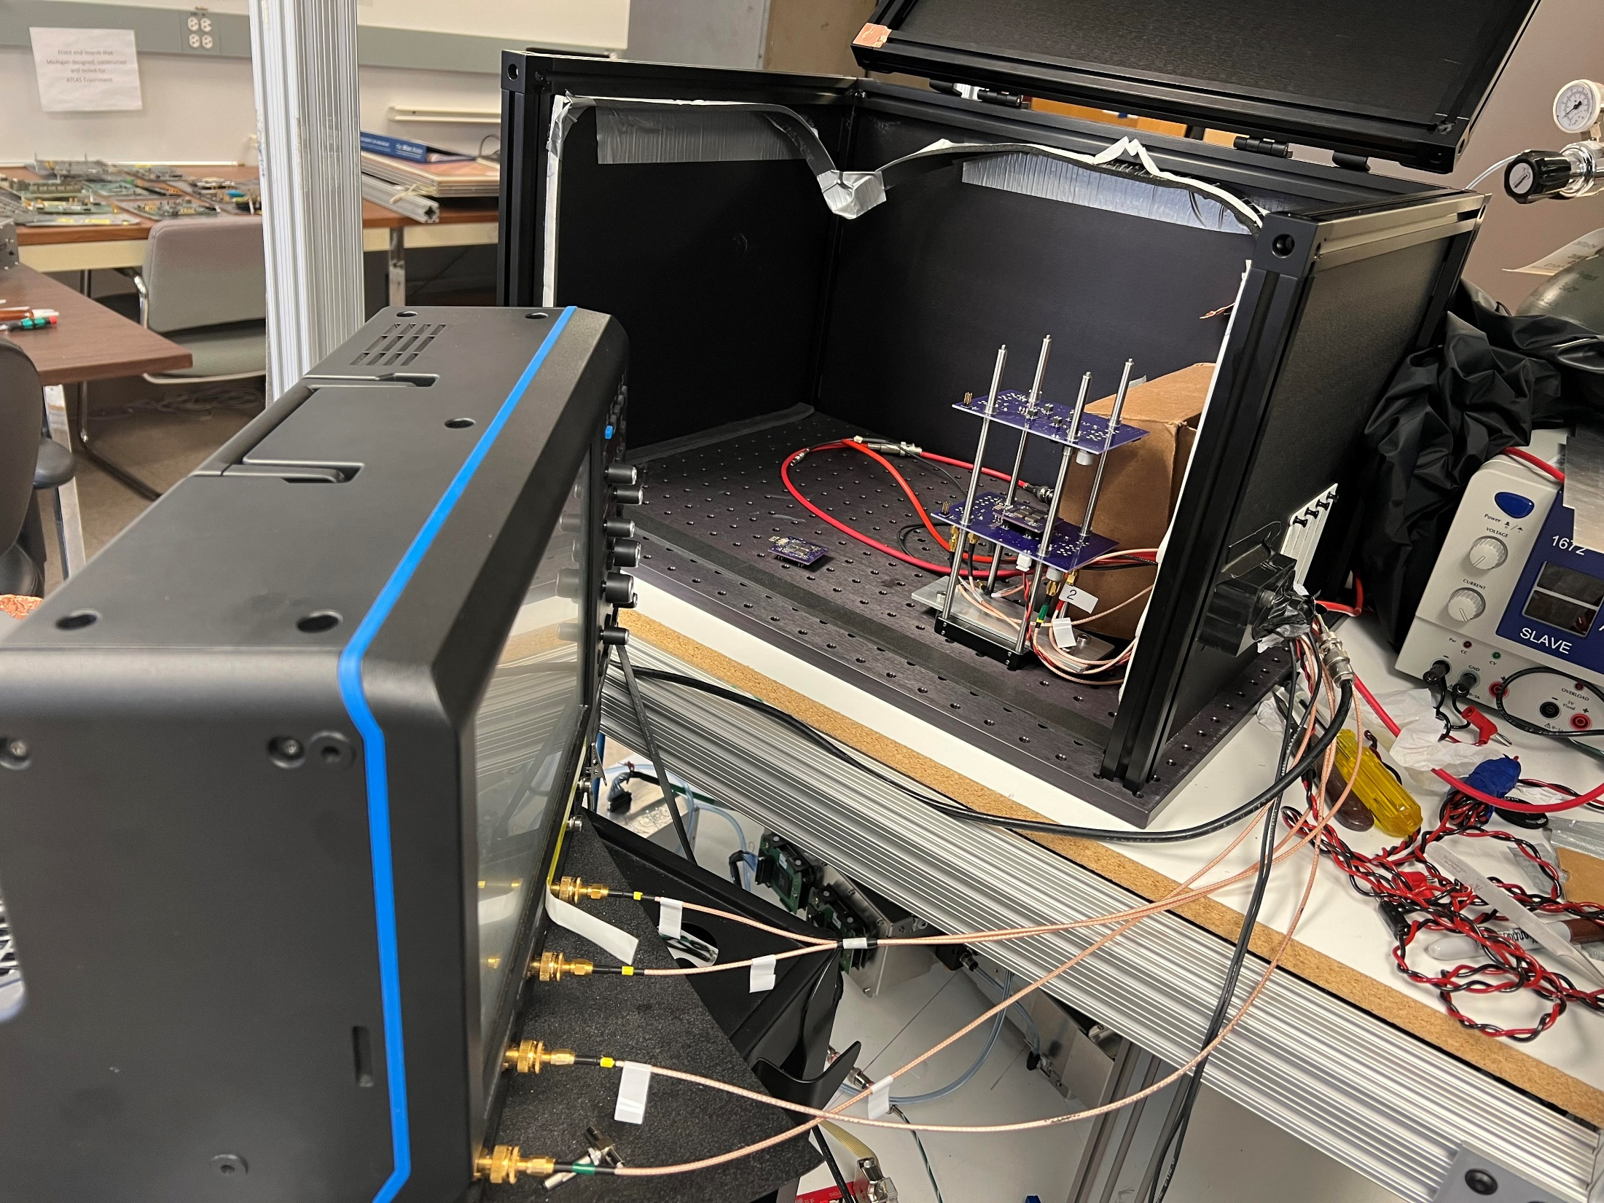
Noise test
Amp board and SiPM board received last year are referred to as “old”, boards received this year are referred to as “new”.
All tests performed with no HV to the SiPMs.
4 output channels are measured with a 8-bit oscilloscope, at 1 mV/div.
new board
new SiPM
LV PSU
old SiPM
8-bit oscilloscope
old board

Slide 11
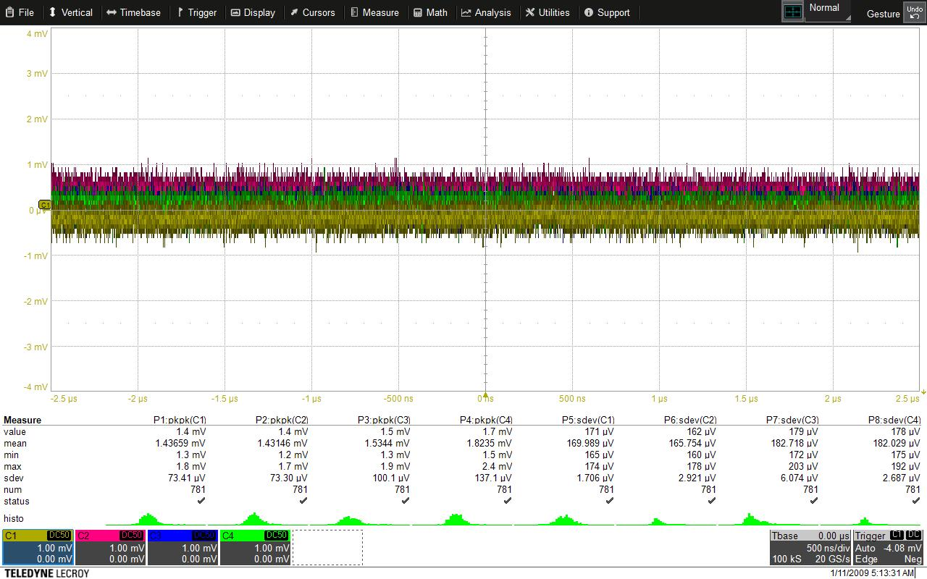
Noise test
Data RMS and peak-to-peak values are measured for each channel.
Peak-to-peak value, and RMS value are recorded in table

Slide 12
Old amp board
 | no SiPM |  |  | old SiPM, no HV |  |  | new SiPM, no HV
 | Cable off | amp_off | amp_on | amp_off | amp_on
 |  |  |  | darkbox open | darkbox open | darkbox closed | darkbox open | darkbox closed
ch1_RMS (uV) | 172 | 170 | 247 | 169 | 420 | 278 | 1332 | 347
ch2_RMS (uV) | 163 | 164 | 248 | 163 | 379 | 255 | 1379 | 338
ch3_RMS (uV) | 174 | 184 | 254 | 182 | 476 | 322 | 1631 | 403
ch4_RMS (uV) | 176 | 179 | 247 | 180 | 390 | 285 | 1021 | 291
ch1_pktopk (mV) | 1.31 | 1.29 | 1.88 | 1.29 | 3.48 | 2.32 | 11.44 | 2.83
ch2_pktopk (mV) | 1.27 | 1.29 | 1.92 | 1.29 | 3.2 | 2.2 | 10.37 | 2.84
ch3_pktopk (mV) | 1.31 | 1.39 | 1.93 | 1.37 | 3.95 | 2.67 | 11.99 | 3.28
ch4_pktopk (mV) | 1.45 | 1.49 | 1.94 | 1.49 | 3.3 | 2.47 | 8.74 | 2.5
scope noise: ~170 mV
Cable: little to no noise introduced
Amplifier noise: ~180 mV
SiPM rf noise: ~340 mV
SiPM rf noise: ~130 mV

Slide 13
Noise test with the rotating platform
 | amp_off | amp_on | With SiPM
ch1_RMS (uV) | 190 | 214 | 203
ch2_RMS (uV) | 176 | 194 | 225
ch3_RMS (uV) | 188 | 221 | 219
ch4_RMS (uV) | 176 | 200 | 210
ch1_pktopk (mV) | 1.18 | 1.42 | 1.41
ch2_pktopk (mV) | 1.15 | 1.44 | 1.47
ch3_pktopk (mV) | 1.15 | 1.44 | 1.47
ch4_pktopk (mV) | 1.13 | 1.37 | 1.46
Board in metal closure

