Slide 1
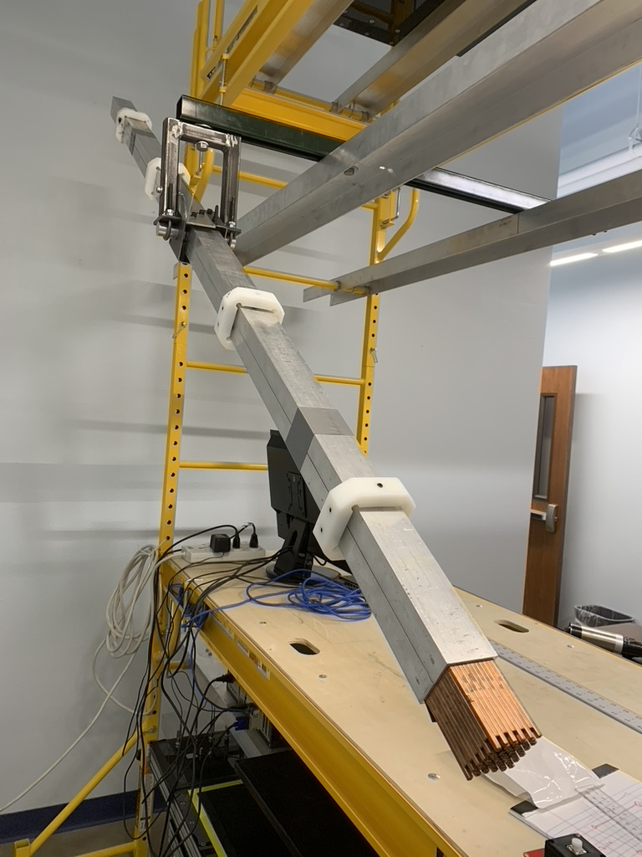
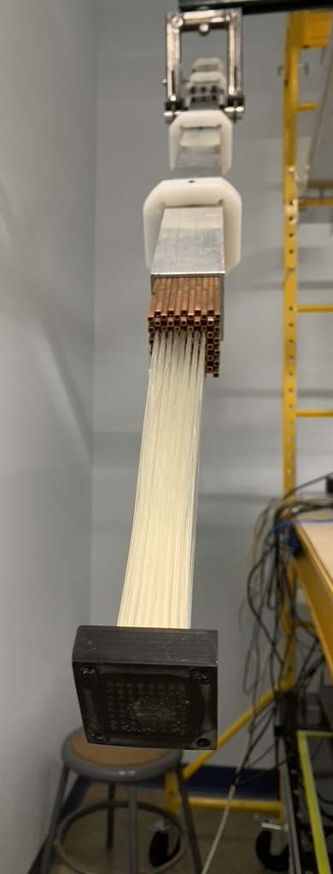
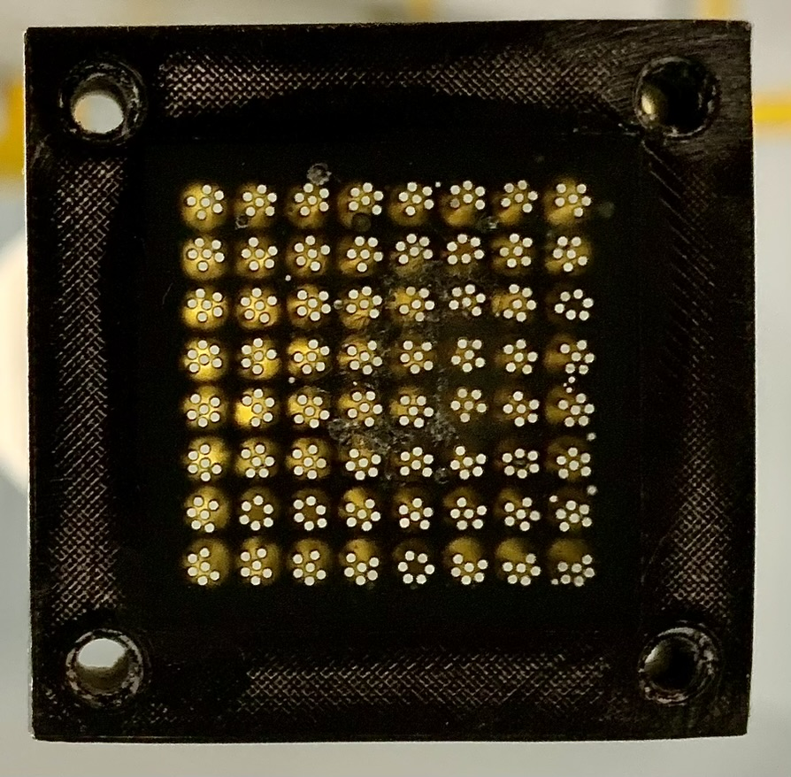
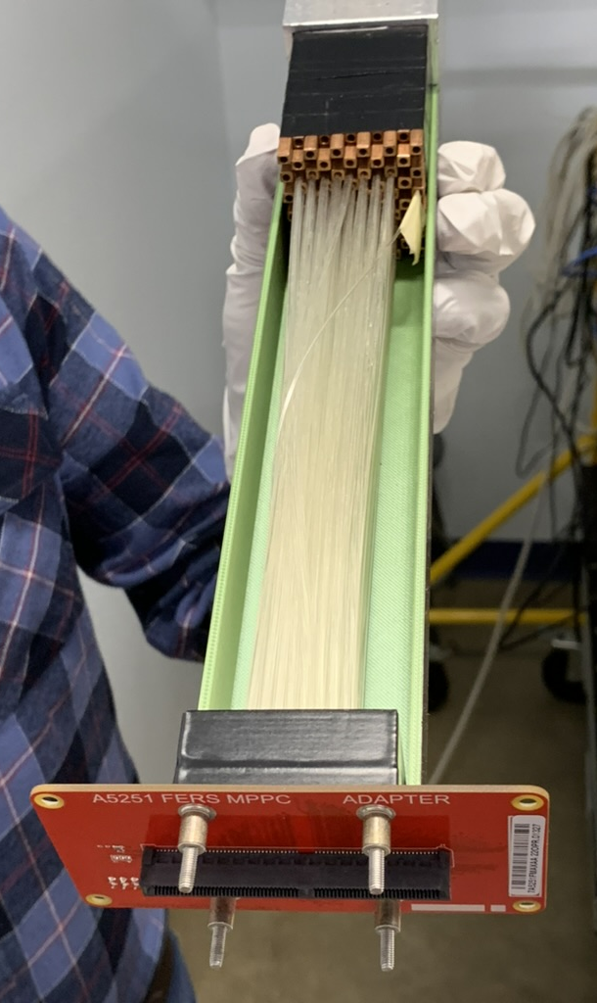
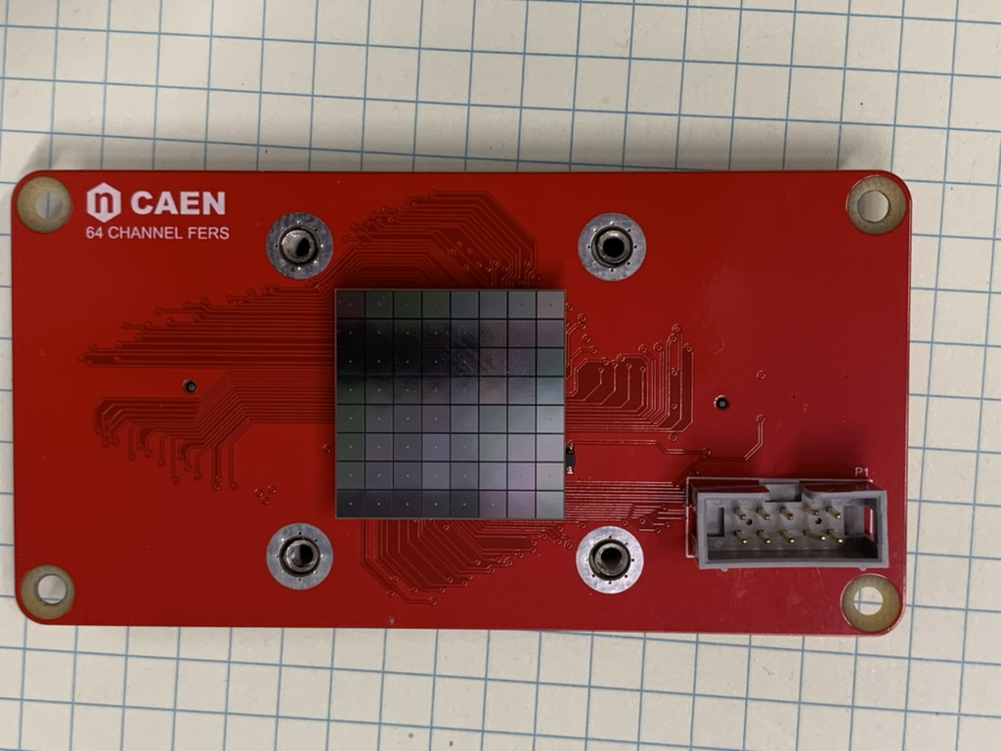
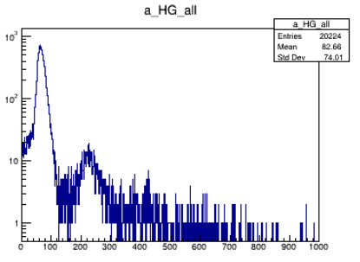
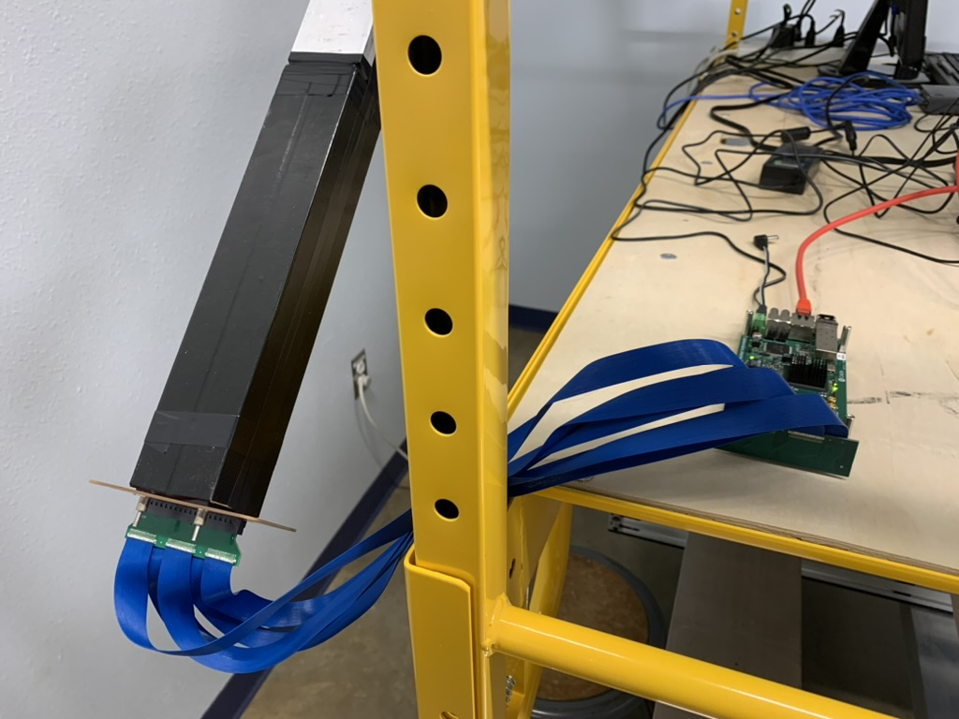
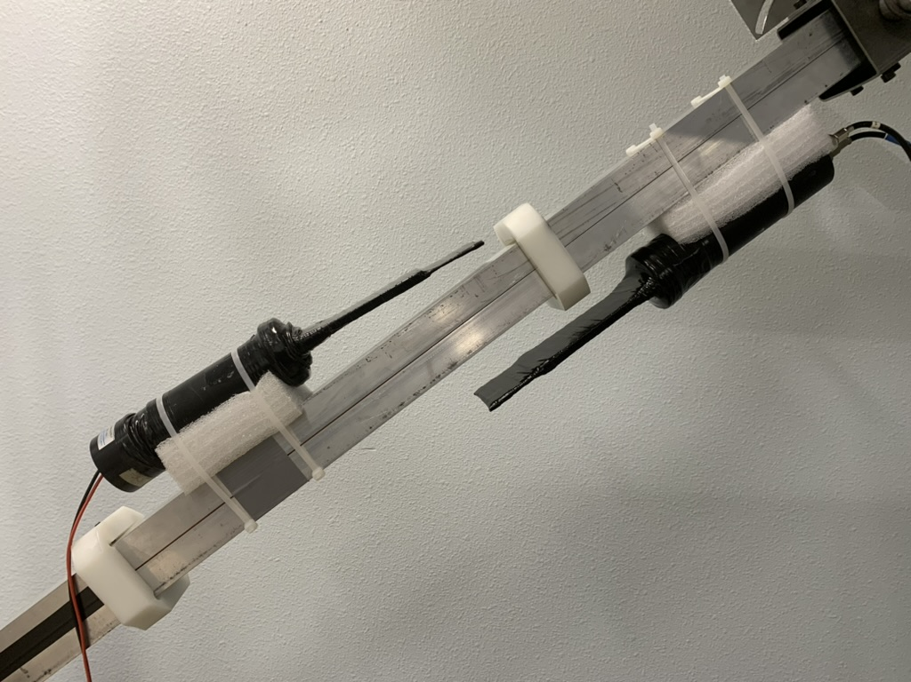
Status of Cu Module – April 2023

Slide 2
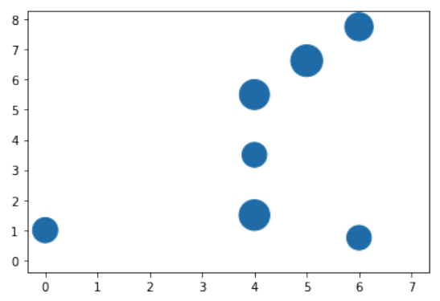
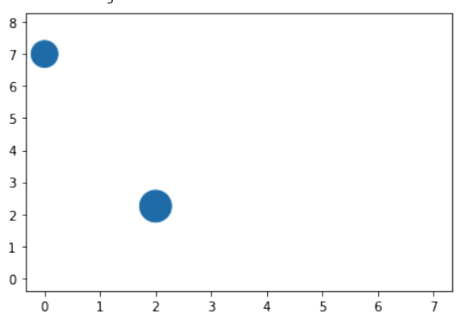
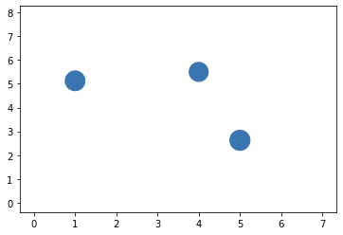
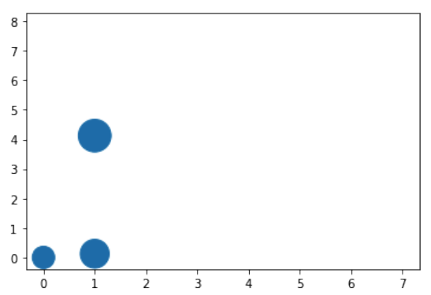
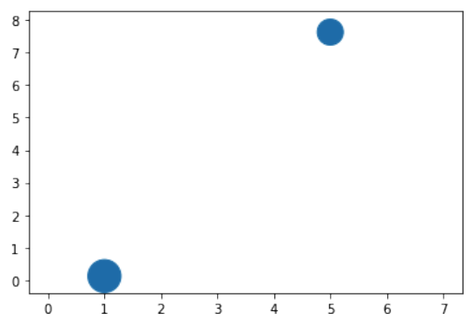
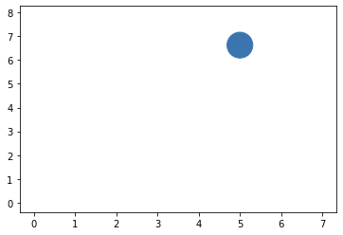
Some Preliminary Data (316 cosmic muons)
We are working with cosmic muon setup, collecting data, and performing cross-checks. Above, signals are shown if the signal is greater than 1 photon. The size of circle is proportional to signal

Slide 3
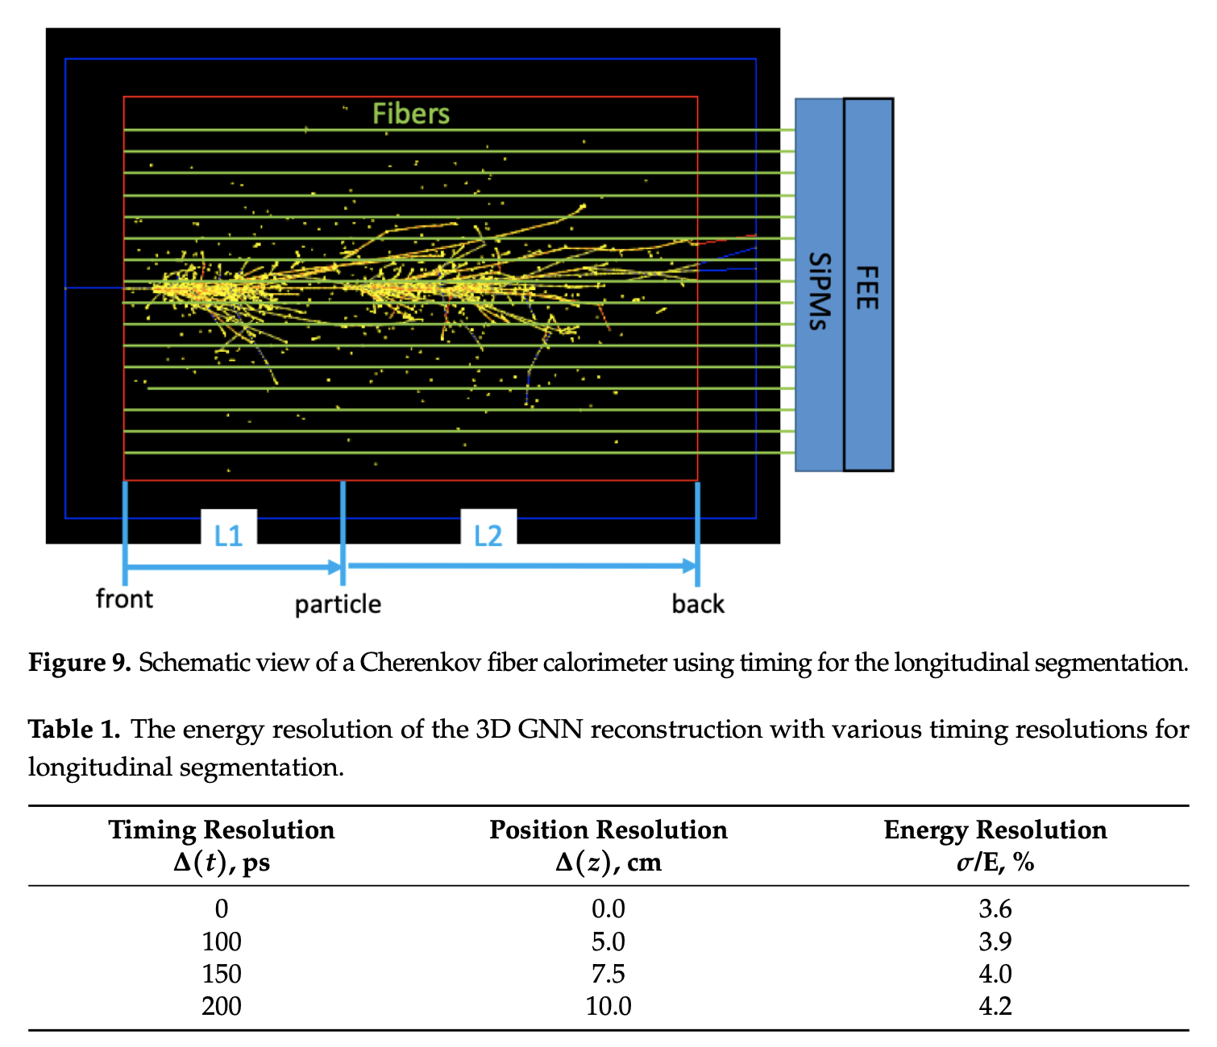
Longitudinal Segmentation with Timing

Slide 4
Simulations/Estimates with DREAM Module
0.05 ns
0.2 ns
1 ns

Slide 5
Summary and Plans
CAEN FERS readout system with a 64-ch Hamamatsu SiPM array is under study. We integrated the readout system with the 2-m copper module with embedded quartz fibers. We take cosmic data, analyze, and assess (and do it again)
If the cosmic tests go well in the next few weeks, we plan to ship the detector to CERN for beam tests in June-July
We plan to investigate OnSemi SiPM arrays for its faster pulse shape compared to Hamamatsu SiPMs
Simulation of the original DREAM module is nearly finished. We plan to refurbish the DREAM module by replacing PMTs with SiPMs later this year

