Slide 1
9am Meeting
Jeff Eldred
Friday, March 3, 2023
OneWest

Slide 2
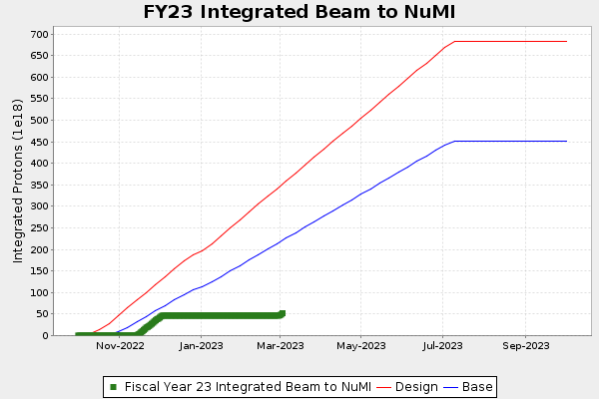
NuMI
I drew a line
and got ~400e18
on July 9th.

Slide 3
Current Plan for This Week, Next Week
NuMI / MI
- About 675kW yesterday.
- Keep NuMI flux below 800kW until approved (when spot size changes).
Muon Campus
- Muon g-2 and mu2e milestones this week, I’ll let them present.
- Quad power supply down Wed 2pm – Thur 2pm.
Linac (& Booster?) Access Wed 3/8
- Linac has request a half-shift access on Wed 3/8, for vacuum pump on DTL Tank 5.
- Linac will make a source change at that time.
- Likely a good time to tie-off BRF2.
Linac DTL Tank 5
-- DTL Tank 5 is a significant concern going forward,
-- Looking to schedule a 5-7 day downtime when repair plan is in place.
FAST/IOTA
- Supervised access on 8am Monday.

