Slide 1
9 O’Clock Meeting
Nathan Ruffatti
MCR Crew Chief
Friday, March 3rd, 2023

Slide 2
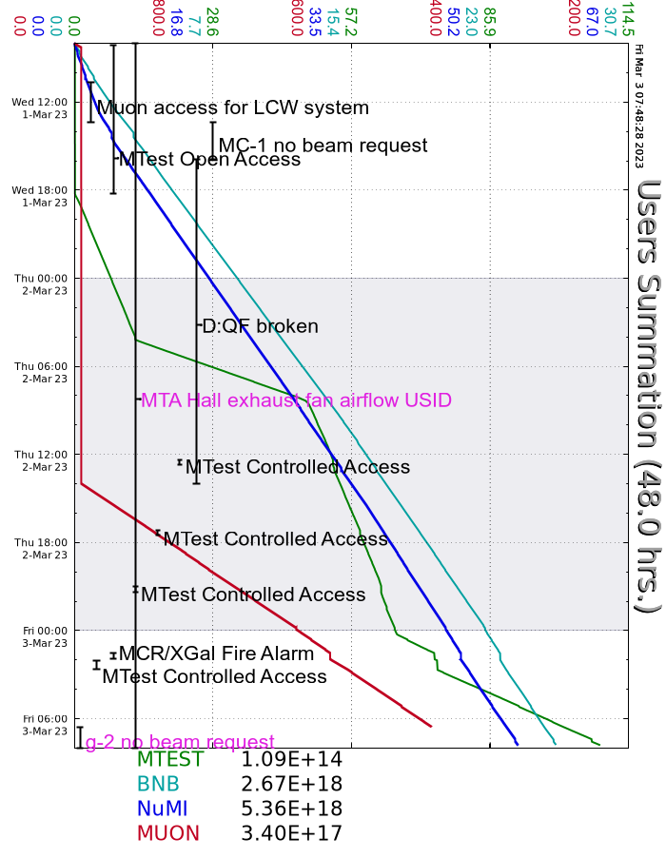
Since Wednesday…
Wednesday
Extraction, DR, M4 prepared for access for LCW leak investigation/repair
D:QF not outputting, down overnight
Thursday
Recycler Damper node not responding (RRXDMP)
EE support repaired D:QF, beam established beam to g-2
Friday
Footprint fire alarm, issue with a flow switch. Fire techs will address it later today
L:GR5MID took a small step down, no response from LO/HI and no effect on beam

