Slide 1
Muon Campus Report - 03/03/2023
Steve Boi

Slide 2
Overview and Issues
Beam to g-2 between periods of Mu2e studies and downtime.
Saturday/Sunday: beam to g-2.
Monday:
x21 BNLs at g-2 achieved!
Tuesday:
Mu2e studies – BPM commissioning continued.
Switched to g-2 at 16:00.
Breaker trip on D:V907 overnight, Ops reset ok.
Wednesday:
Downtime for LCW leak investigation. Patched D6SF17 sextupole – reduced to dripping leak. Magnet was previously patched and requires brazing for proper repair.
D:QF supply DCCT amp failed during DR ramp-up.

Slide 3
Overview and Issues
Wednesday (cont):
ESS ORC signed off and ESS powered for the first time! (D:ESS2)
Thursday:
D:QF supply repaired – Matt Kufer & EE Support.
AP-0 Target Blower maintenance was performed.
Beam to g-2 for studies.
Today:
Mode switch to Mu2e for continued BPM commissioning in DR until 16:00.
Beam to g-2 after 16:00.

Slide 4
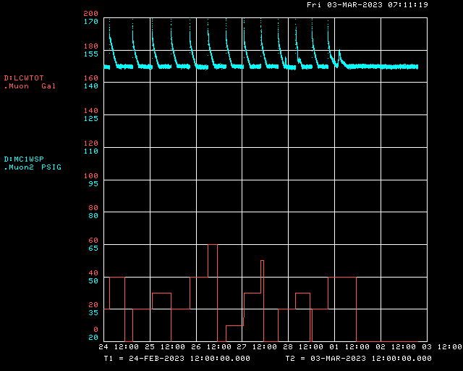
LCW Leak Repair
No significant water makeup after repair.

Slide 5
Beam to g-2
Protons to AP0 Target
g-2 Calorimeter-Tagged Muon Decays ($Σ_{24 calos}n_{i}$)
g-2 T0 Detector
Delivery Ring Abort
Low CTAGs due to g-2 studies
LCW Leak Repair
D:QF Repair

Slide 6
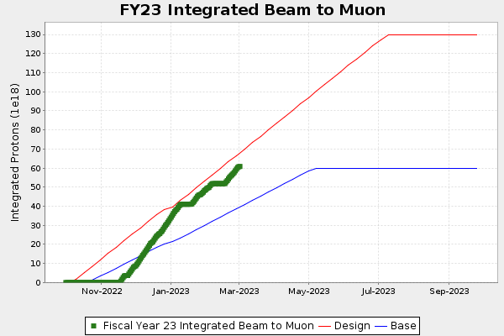
g-2 Protons on Target

Slide 7
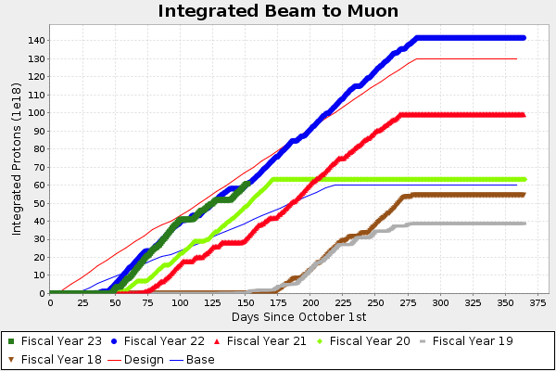
g-2 Protons on Target

Slide 8
g-2 Performance

Slide 9
g-2 Performance
2.10 BNL

Slide 10
Future Prospects
Mu2e studies
Prepare DR for resonant extraction with ESS2 only.
BPM commissioning
ESS conditioning.
g-2 running between Mu2e study time.

