Slide 1
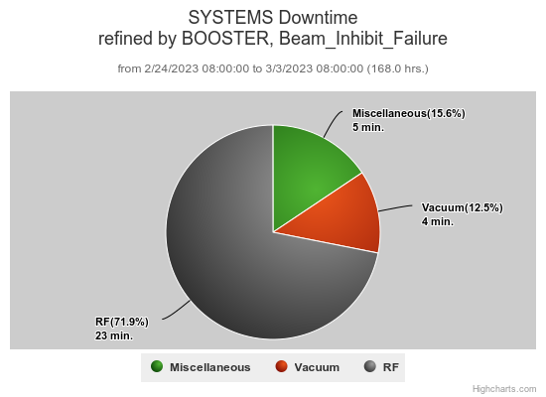
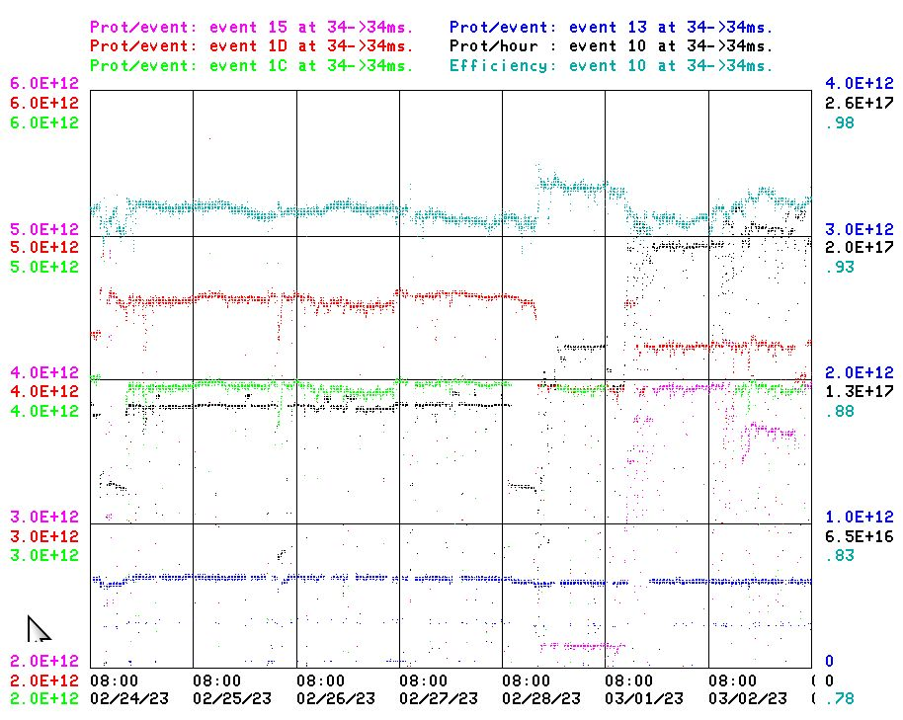
Booster Operations 02/24/23 – 03/3/23
Booster Studies
Downtime this week: ~32 minutes
23 min: A few minor RF related trips, BRF4 Bias supply control unit failure
4 min: Vacuum trip (IPQ16)
5 min: Misc, BLM trips
Also this week:
This week:
Beam to NuMI currently ~4.3 E12 per pulse
This week to BNB ~4.0-4.6 E12 per pulse, up to 5Hz , ~ 5-8E16 pph
Beam to Muon this week, ~ 4E12 per pulse, ~ 1E12 pot
Beam to SY as requested 2T, ~ 5E11 per pulse
Startup of ($15) NuMI cycles, running beam to RR/MI, Booster tuning for higher Booster throughput now that NUMI is running.
General tuning and orbit tuning to reduce losses and improve efficiency.
Looking for 1.5 to 2hrs to look at BRF2 modulator
BRF4 Bias control unit replaced.
20Hz upgrade effort at E4R continues.
Monitoring 400 MeV Chopper stability. Last weekend Linac 400 MeV losses suspected chopper. No issues since last Sunday.
Thanks to Ops for maintaining good Booster performance over week.

