Slide 1
48 Hour Summary
Patrick Dowdle
MCR Crew Chief
March 8, 2023

Slide 2
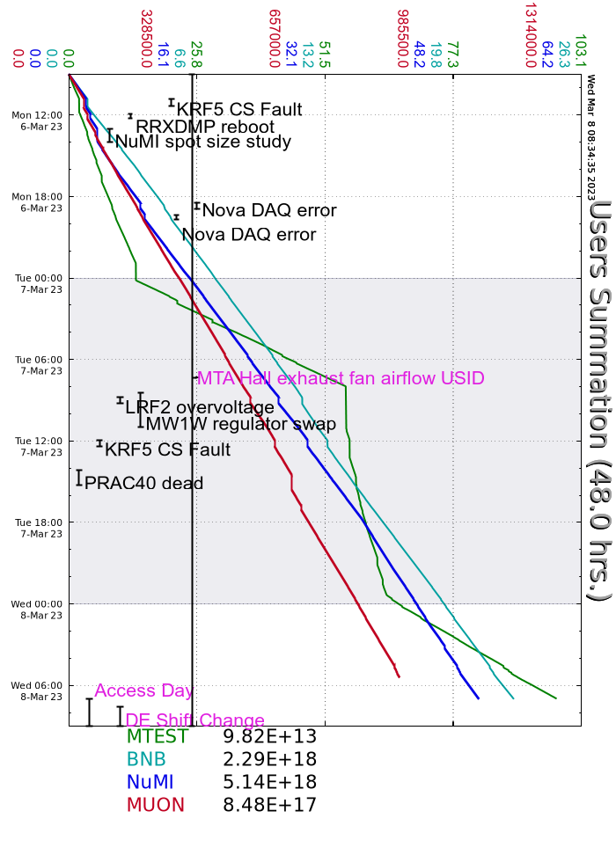
Summary
In general:
Tuning up with the return on NuMI beam
Tuesday:
F:MW1W tripped off on DC overload
RR losses suddenly jumped up, no cause identified yet
Today:
Prepared Linac for controlled access
MI-10 and MI20-62 currently being prepared for controlled access

