Slide 1
Brief update of Muon Collider Higgs Physics studies
1
Higgs & 4th Family Physics Studies 3/21/2012 https://indico.fnal.gov/conferenceDisplay.py?confId=5398
Higgs Studies 8/1/2012 https://indico.fnal.gov/conferenceDisplay.py?confId=5760
This update
G P Yeh 9/2012

Slide 2
2
Project X : Multi mA
Intensity Frontier

Slide 3
Higgs MC Parameters -Upgrade
3
Proton Linac 8 GeV
Reduce transverse emittance to 0.0002m
More Protons/pulse
Accumulator,
Buncher
Parameter | Symbol | Value
Proton Beam Power | P_{p} | 4 MW
Bunch frequency | F_{p} | 15 Hz
Protons per bunch | N_{p} | 4×5×10¹³
Proton beam energy | E_{p} | 8 GeV
Number of muon bunches | n_{B} | 1
μ^{+/-}/ bunch | N_{μ} | 5×10¹²
Transverse emittance | ε_{t,N} | 0.0002m
Collision β* | β* | 0.05m
Collision β_{max} | β* | 1000m
Beam size at collision | σ_{x,y} | 0.02cm
Beam size (arcs) | σ_{x,y} | 0.3cm
Beam size IR quad | σ_{max} | 4cm
Collision Beam Energy | E_{μ+},E_{μ_} | 62.5(125geV total)
Storage turns | N_{t} | 1000
Luminosity | L₀ | 10³²
+4→1 bunch combiner
Hg target
Drift, Bunch, Cool
Linac
RLAs
Collider Ring
δν_{BB} =0.027

Slide 4
Neuffer 8/8/2012

Slide 5
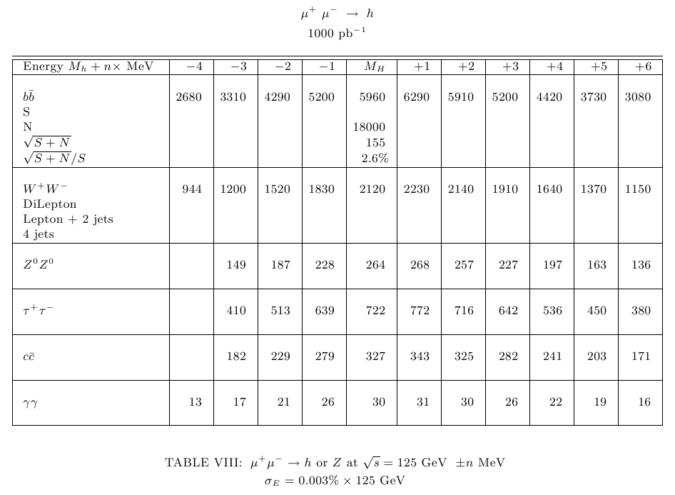
5

Slide 6
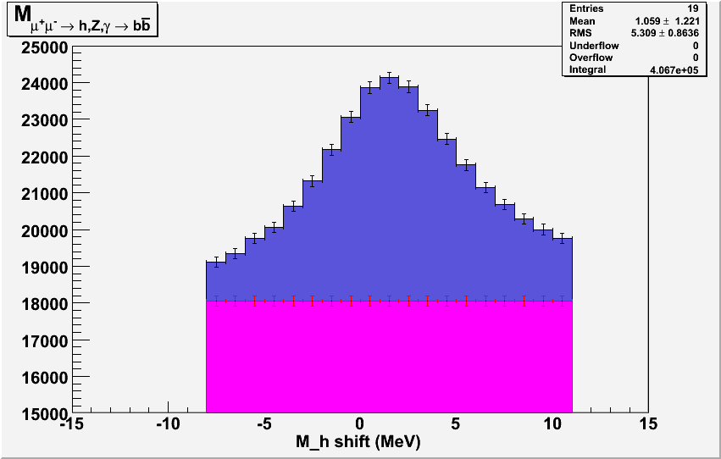
6

Slide 7
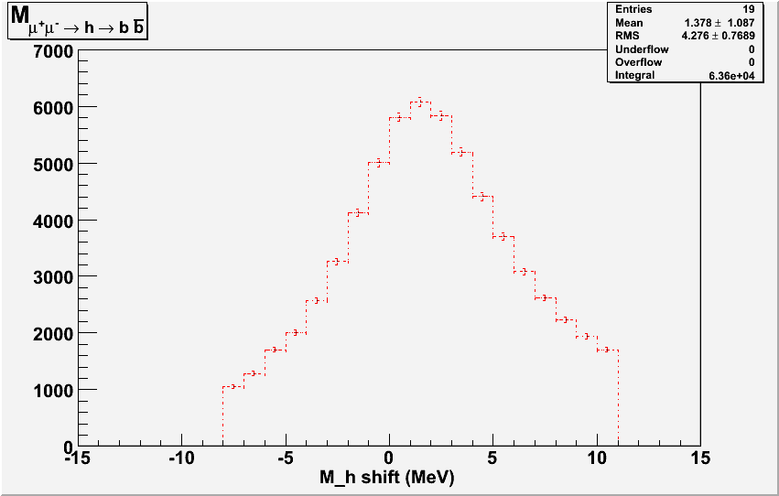
7

Slide 8
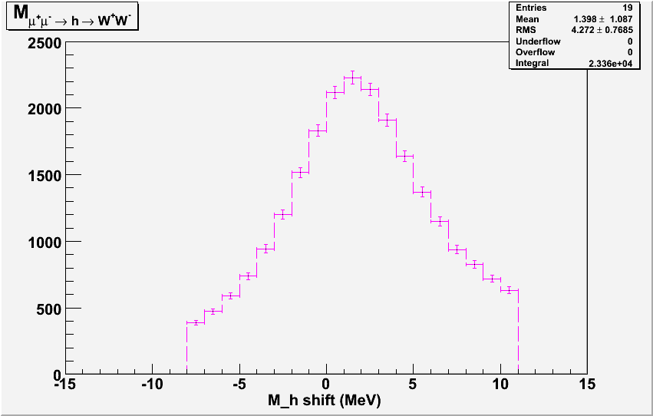
8

Slide 9
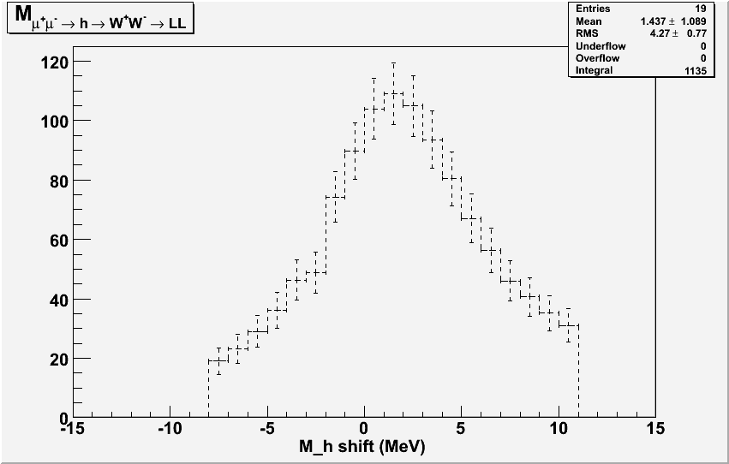
9

Slide 10
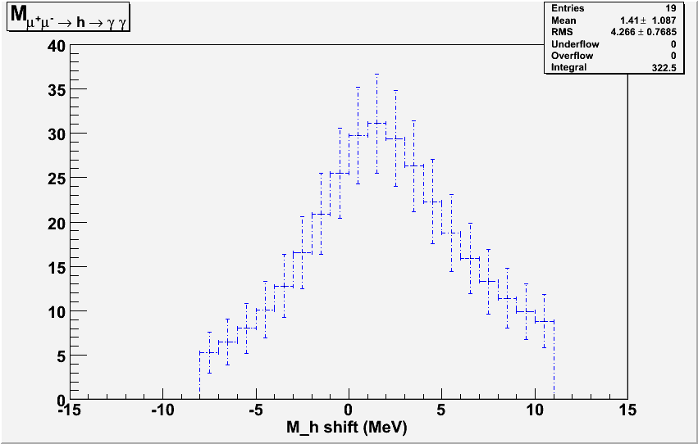
10

Slide 11
Summary
11
LHC has discovered Higgs
μ+ μ− Η ΖΗ ννΗ μμΗ ννΗΗ h A H H H ?
Muon Collider Higgs Factory μ+ μ− Η measure H mass & width to MeV level measure H coupling to b W to few %
0
0
0
+
-
31
L ~ 10 for Mh=125
~
>

